Slide 1
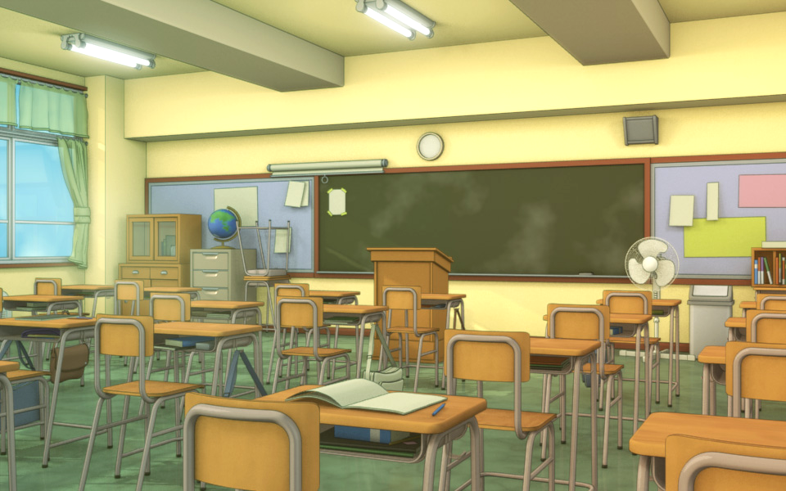
Tenafly High School
Special Education Program

Slide 2
Study Skills/Academic Support
Goals, instructional objectives and expected outcomes are structured to meet the individual needs of the students as stated in their IEPs.
Some Topics Covered Include:
Organization
Study and Test Taking Strategies
Time Management
Self- Advocacy and Transition

Slide 3
Study Skills/Academic Support Classes
Study Skills/Academic Support classes are divided into three teams:
9th Grade Team (Study Skills)
10th and 11th Grade Team (Academic Support)
12th Grade Team (Academic Support)
* Academic Support Classes for 10th – 12th graders are Pass/Fail.

Slide 4
Grading System
Class Preparation
Class Participation
Class Work
Daily Planner Checks
Notebook Checks
Class Projects/Activities
Monthly Goals
Total Points

Slide 5
In-Class Support
Certified special education teacher collaborates with the mainstream teacher.
Provided to eligible students who have been identified for support in the mainstream classroom.
Provides strategies and accommodations as indicated in the IEP.

Slide 6
Communication
Parents can contact Study Skills teachers by calling the High School Special Education Office directly by phone at 201-816-6612 or by email:
Ann-Marie Desplat (supervisor) adesplat@tenafly.k12.nj.us
Michelle Zanoria mzanoria@tenafly.k12.nj.us
Megan Catanzariti mcatanzariti@tenafly.k12.nj.us
Caitlin Cranwell ccranwell@tenafly.k12.nj.us
Chris DeVries devries@tenafly.k12.nj.us
Tara Haggerty thaggerty@tenafly.k12.nj.us
Dinah Huh dhuh@tenafly.k12.nj.us
Amanda Saudino asaudino@tenafly.k12.nj.us
Rachel Lieberman rlieberman@tenafly.k12.nj.us
Jack Mullen jmullen@tenafly.k12.nj.us
Luz Reyes lreyes@tenafly.k12.nj.us
Jillian Rothstein jrothsetein@tenafly.k12.nj.us
Marissa Ruggiero mruggiero@tenafly.k12.nj.us
Ingrid Scanlon iscanlon@tenafly.k12.nj.us
Dawn Signorile dsignorile@tenafly.k12.nj.us
Alicia Sedlock asedlock@tenafly.k12.nj.us
Mimi Tang-Johnson mtangjohnson@tenafly.k12.nj.us

Slide 7
Progress Checks
Both the Parent Portal and the Student Portal are open for viewing on Genesis. Please review these periodically with your child.
Special education teachers periodically review progress with individual students, helping each student set both short and long term goals for academic success.
IEP Progress marks are sent quarterly via email.

Slide 8
Materials for Success
Special Education teachers recommend the following:
Planner
Calculator
3-Ring Binder Notebooks & Paper
Notebook Dividers
Assortment of Pens, Pencils, and White Out
Highlighters and Sticky Notes

Slide 9
Teacher Web
Assignments from supported classes are posted on the Special Education Department’s web site. These assignments are updated daily.
Study Skills Homework Website

Slide 10
FOCUS FOR FRESHMEN
The focus for freshmen is to have a successful transition to the high school.
Freshmen will become familiar with:
extra time procedures at THS
making appointments with mainstream teachers
their accommodations and modifications
resources that are available to them at THS (case managers, study skills office, guidance counselors, CSI, after school help, study groups, etc)

Slide 11
FOCUS FOR SOPHOMORES
Get involved (clubs, volunteer work, sports)
Start increasing vocab skills (PARCC/SAT/ACT)
Career inventories and questionnaires through Naviance to expose students to possible post-secondary options

Slide 12
FOCUS FOR JUNIORS
Students should keep grades up and show continued effort to teachers.
(Spring Recommendations)
Sign up for the October PSATs ASAP
(Given on Saturday 10/14)
In the new year, sign up for the SATs and/or the ACTs.
Continue to utilize and be exposed to resources through Naviance for possible career and post-secondary options

Slide 13
Thank You!

