Slide 1
Senior Registration

Slide 2
Palmer Course Registration
How did we do this last year?
When did you get your schedule?
How many of you tried to change your schedule?... and how did that go?
Bonus Question: How many class changes were made in the fall?

Slide 3
DATA: Fall 2022
1,465 student visits to counseling (4 weeks)
1,387 changes made to student schedules
= 1,465 instances of students missing class
= 1,387 disruptions to classes at the start of the year

Slide 4
2023: NEW CLASS REGISTRATION PROCESS
1. All students select classes in the Spring (February / March)
2. Schedules will be finalized earlier (Goal = May/June)
3. The classes you choose now will be the classes you will take next year
+ Create an easier transition back to school in the fall for students and staff
+ Enable to students to receive schedules earlier
+ Reduce the number of students out of class weeks 1 – 4
+ Allow teachers to begin teaching immediately at the start of the year
+ Potential to create more balanced class sizes

Slide 5
Agenda for Today:
1
4
2
3
Review Palmer graduation requirements
Think about the future: options to consider when selecting classes
Check your graduation requirements
Next steps to select your classes

Slide 6
Credits​ | Subject Areas​
8​ | English​
7​ | Social Studies (US History 1,2; Government; Economics required)​
6​ | Mathematics (Algebra 1,2, or equivalent, or higher required)​
6​ | Science (Biology 1,2 required and 1 year of Physical Science)​ PS= ESPS, Physics, Chem, Geology
3​ | Physical Education​
1​ | Health​
2​ | Humanities (World Language, Music or Art)​
1​ | Computer​
1​ | Practical Arts (Postsecondary Workforce Readiness – PWR)​
11​ | Electives​
46​ | Total Credits​

Slide 7
Graduation Requirement: College & Career Readiness / PWR
Demonstration | English | Math
SAT | 470+ | 500+
ACT | 18+ | 19+
ACCUPLACER | NexGen: 241+ (Read) or 236+ (Write) | NexGen: 255+ (AR) or 236+ (QAS)
ASVAB | 31+
Concurrent Enrollment | Passing grade per district and school policy
Industry Certificate | Individualized
ACT WorkKeys | Bronze level or higher
Standards-based performance assessment | For Students with IEP's Only

Slide 8
Things To Consider When Selecting Classes
1
2
4
5
6
3
Meet graduation requirements
Enroll in at least 6 classes each semester (12 total for the year) to be a full-time student (though you may need more…)
Take classes that move you closer to your goals after graduation
Considering college? Challenge yourself/ prepare for college work
Continue to explore interests
Consider concurrent enrollment and other options outside of Palmer
Check admissions requirements at the schools you are interested in

Slide 9
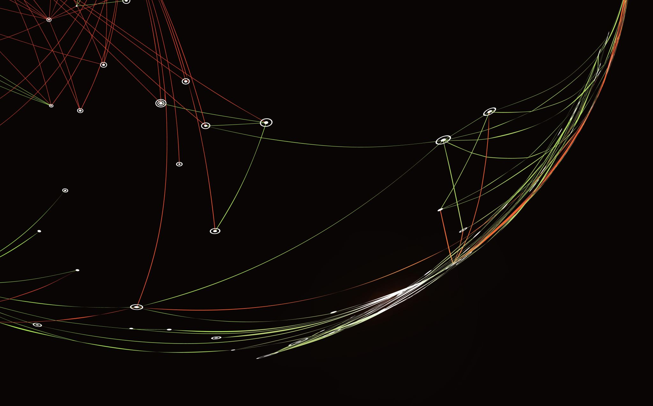
College and Career Options
IB Diploma or AP classes can grant college credit
Concurrent Enrollment:
Take classes at PPSC to get a head start on college
Primarily for general education/liberal arts core classes needed for 4-year degrees
Career Start:
Hands-on career and tech programs done at PPSC
Auto Body Work; Construction; Criminal Justice; Diesel Power; Fire Science; Health Careers; Nursing; Vet Tech; Welding; Zookeeping
Career Pathways: Hands-on career and tech programs run through Wasson campus
Auto service; Business; Cybersecurity & IT; Education; Horticulture & Landscaping; Culinary Arts; Journalism; Multimedia Graphic Design. Check your email for information!
ISSA Beauty School
Hairstyling /cosmetology at International Salon & Spa Academy. Check your email for information!

Slide 10
ASCENT
Get a year or more of college paid for!
How?
Be on track to graduate
Complete 9+ college credits prior to the end of Sr. year (Via AP, IB, Concurrent Enrollment, Career Pathways, Career Start)
GPA of at least 2.0
See your counselor for full details

Slide 11
College and Career Options – How to Get started
IB Diploma & AP classes
Request them through this class enrollment process
Career & Technical Programs (Career Start, Career Pathways, Beauty School)
Ms. Briones (College & Career Counselor) sends information for enrollment opportunities via D11 email
February/March is prime enrollment time so look for emails or tell your counselor you are interested
Traditional Concurrent Enrollment
Can be done in either or both semesters
Ms. Briones sends information for enrollment via D11 email in Sep/Oct and in Feb/Mar
Check Your D11 Email Frequently – There are Hard Deadlines for These Programs

Slide 12
Check your transcript! Are you on track?
Look at your transcript
Check credit completion
Make a plan
Step 1: Find total number of credits earned. Should have 28 or more credits.
Step 2: Look for any failed classes
Step 3: If you failed any core classes or see errors reach out to your counselor
Step 4: If you have less than 28 credits reach out to your counselor for a plan of recovery

Slide 13
Register for Senior Classes!
Next
Steps
Speak to your teachers to determine appropriate class placements/ levels.
1
Speak to your counselor about credits, credit recovery & classes to support your post-Palmer plans.
2
Meet with your counselor to register during Social Studies class Monday, Feb. 6 Tuesday Feb. 7 BRING YOUR LAPTOP.
3
You must select your classes on Feb. 6 or 7 or classes will be chosen for you.
4

Slide 15
Important News!
Palmer will be using a NEW registration process this year.
Step 1:
Pre-registration presentation – TODAY!
Step 2: Complete registration form using teacher, parent, and counselor input
Step 3:
Register for classes
Monday, Feb. 6
Tuesday, Feb. 7
NOTE:
Schedule changes will not be permitted in the fall. The classes you choose on registration day will be the classes you will take next year.
Step 4:
Final fall schedules may be available prior to summer break.

