Slide 1

DualEnroll and ACTIVATING
MYCOMPTON portal
Welcome to Compton College!
Today we will be assisting you in activating
your MyCompton Portal and share tools for success!
Please open a web browser to this page
http://www.compton.edu

Slide 2
Overview
Welcome
Activating MyCompton Portal
    Valid Compton College Email Address
    Date of Birth
DualEnroll Account
Orientation
Microsoft Office 365
CANVAS Overview
Tutoring, Cranium Cafe
Contact Information

Slide 3
What You Will Need
Valid Compton College Email Address
  @compton.edu (received after 36-48 hours of application submission)
Date of Birth (DOB)
If you do not have your Compton email address let us know in the chat and a representative can help.

Slide 4
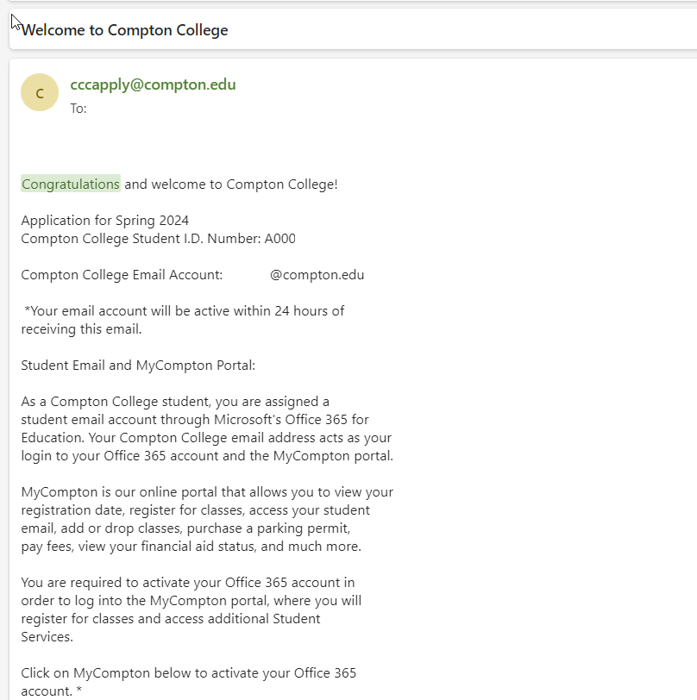
Welcome Email
Keep an eye out for this welcome email that will be sent to the email you provided in your application.

Slide 5
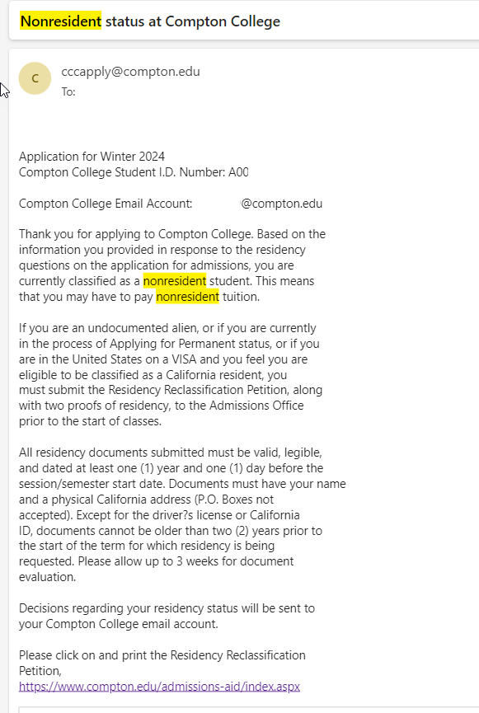
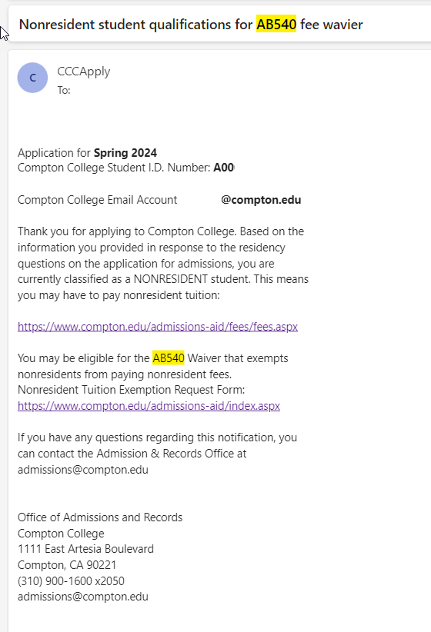
Residency and AB540 Eligibility
If you indicated in your application that you do not have established residency, please keep an eye out for one of these emails. It will provide you with information on next steps you need to complete.

Slide 6
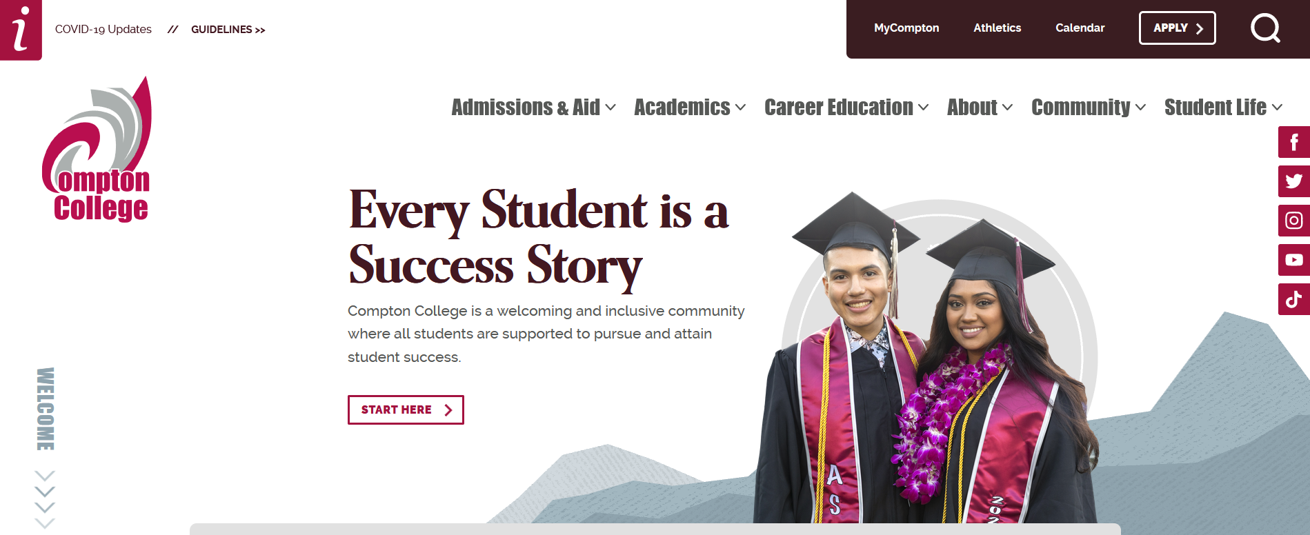
MyCompton Portal
Click on MyCompton

Slide 7
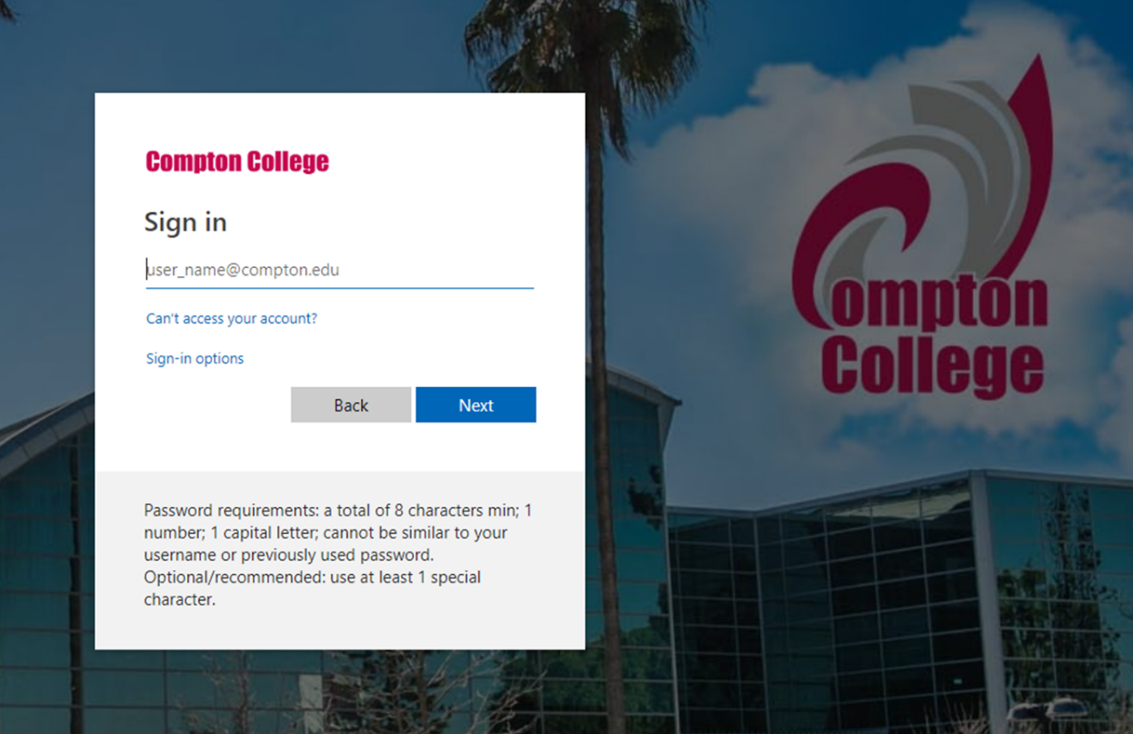
Signing In For the First Time
For the first time signing in, all students will enter a temporary password.
The temporary password is:
AaYYMMDD!
Where YYMMDD is the student’s date of birth (DOB).
YY – last two digits of birth year
MM – two digits of birth month
DD – two digits of birth day
For example, if student’s DOB is—08/31/2002, then their password would be - Aa020831!

Slide 8

Lost your Password?
Click on Can’t access your account?

Slide 9
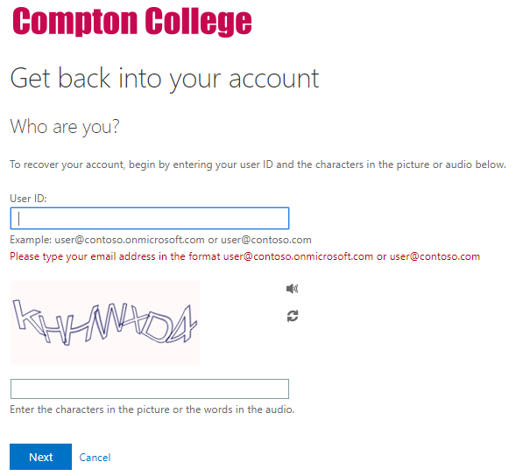
Lost your Password?
Follow on-screen prompts (security questions) to reset your password.
If you are not successful, please email helpdesk@compton.edu and they can assist you with this process.
Phone # (310) 900-1234

Slide 10
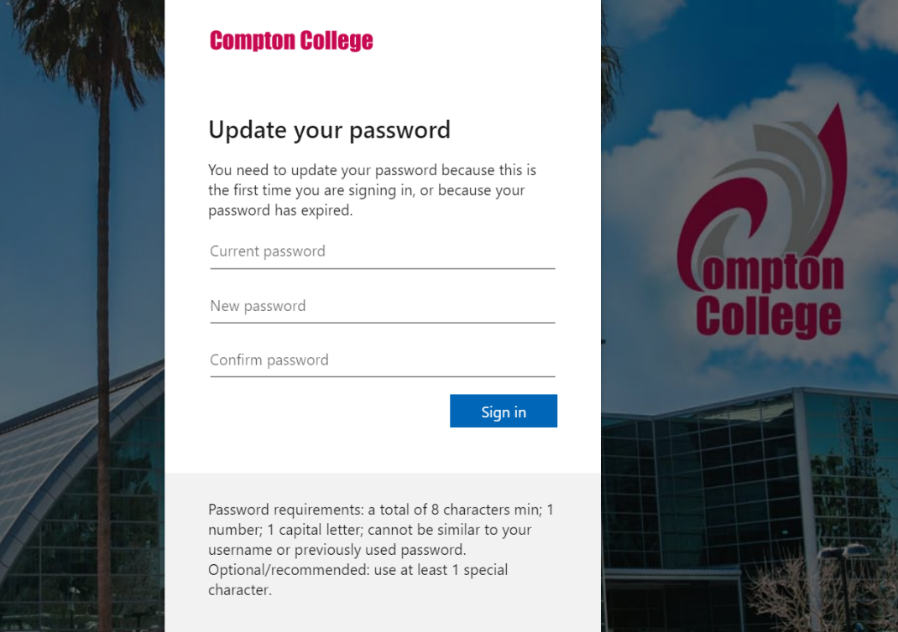
Create A New Password (If this is your first-time)
Once successfully signed in, you will need to create a new password.
On the first field, “Current password” is the temporary password.
You must then select a new password that meets the requirements as outlined on the page.
It is recommended you write down the new password and keep it somewhere safe!

Slide 11
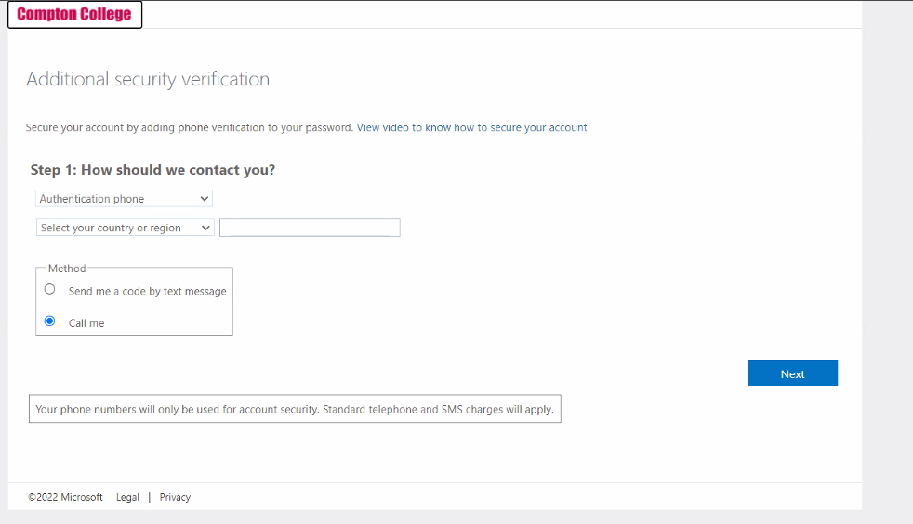
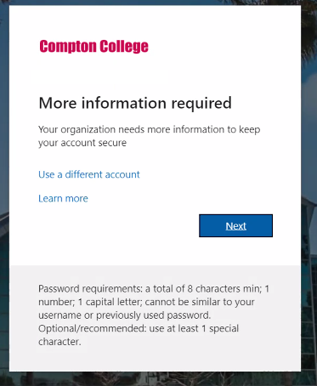
Additional Security Verification
You will need a cellphone or access to email for additional security verification.

Slide 12
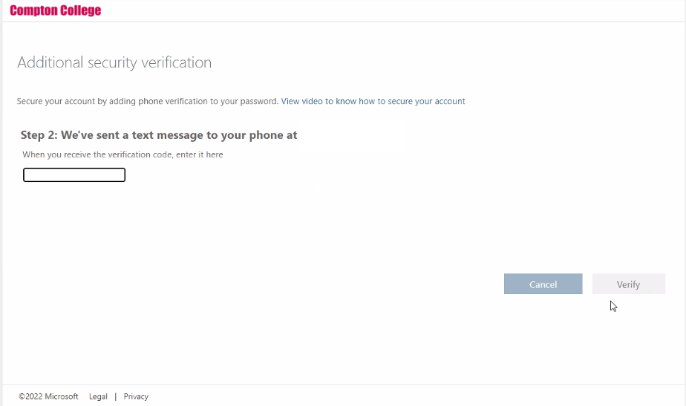
Additional Security Verification
Verify your phone number or email by the verification code sent to you.

Slide 13
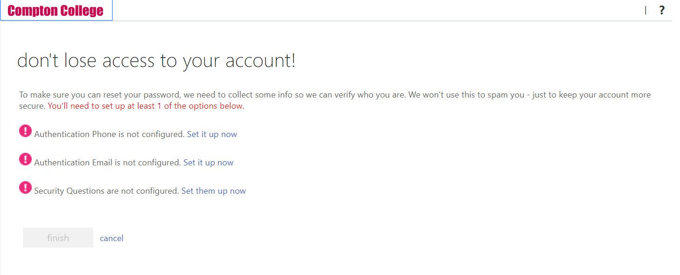
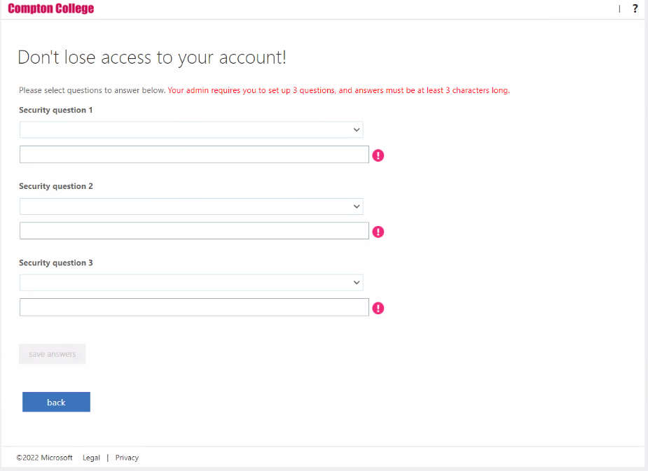
Protect Your Account
After choosing a new password, you will need to set up additional questions that will help with account retrieval in the future.
Write down security questions and answers and keep them safe place.

Slide 14
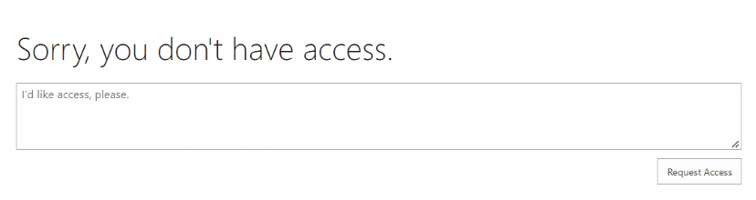
MyCompton Portal – Error?
If you get an error, just go back to our main page and log back in!

Slide 15
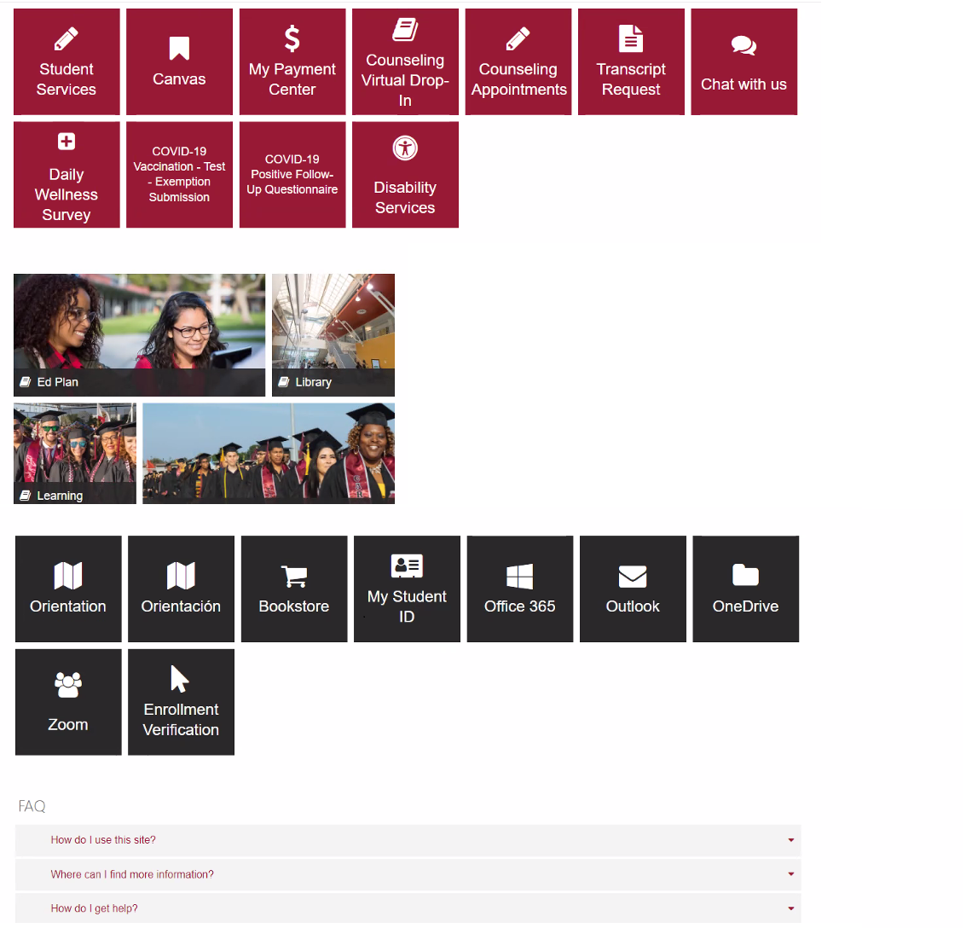
MyCompton Portal
Once at the home screen,you have access to all services related to MyCompton, including:
Student Services (Portal)
Canvas (Online Classrooms; see below)
Transcripts
Disability Services
Chat with us
Orientation
Scrolling down the page you can access Outlook (email) and Office 365 applications.

Slide 16
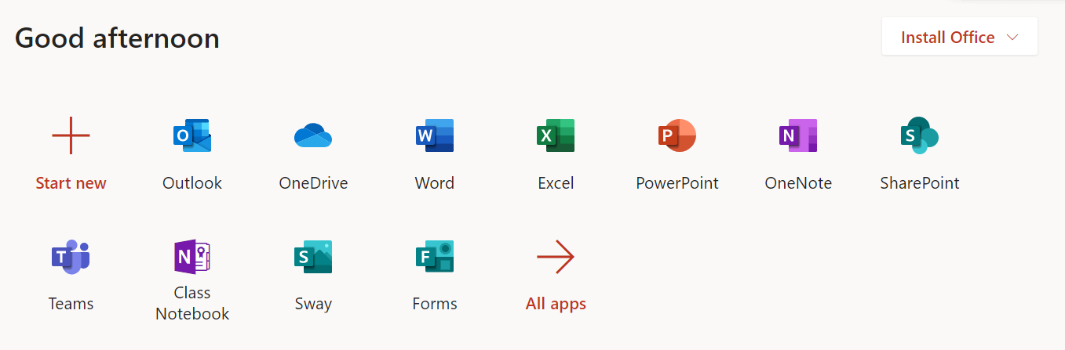
Office 365
All registered Compton College students have access to Office 365 cloud programs.
You can download these on your own computer at no cost.

Slide 17
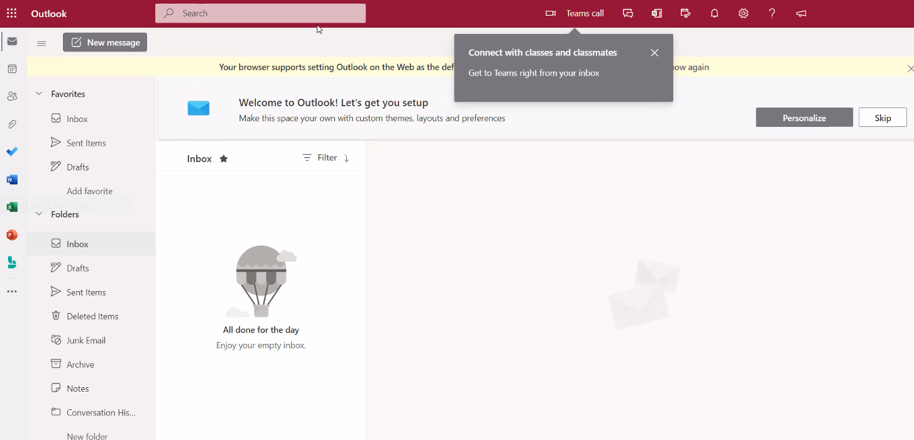
What is your Outlook Email (Compton College Email)?
Outlook is where all official Compton College email is sent and is your MyCompton username (@compton.edu)

Slide 18
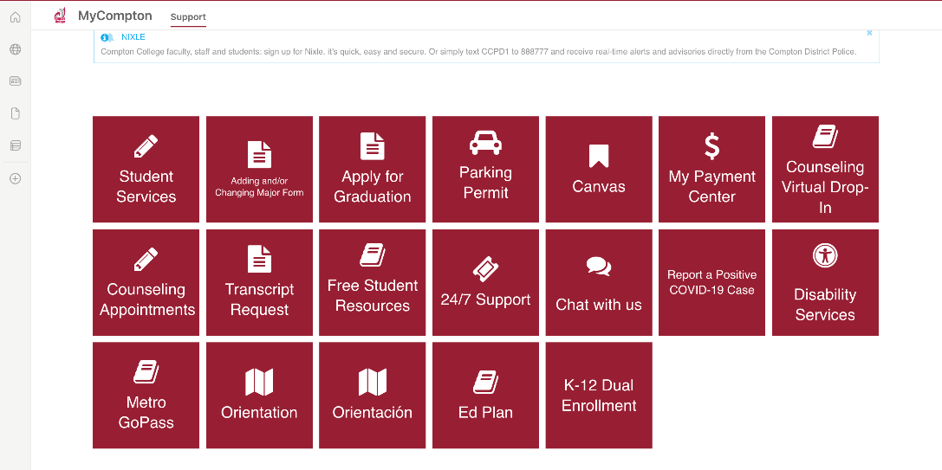
DualEnroll Tile
Log into MyCompton using your Compton email and password.
Once you’re in MyCompton, you will scroll down to the K-12 DualEnroll tile.

Slide 19
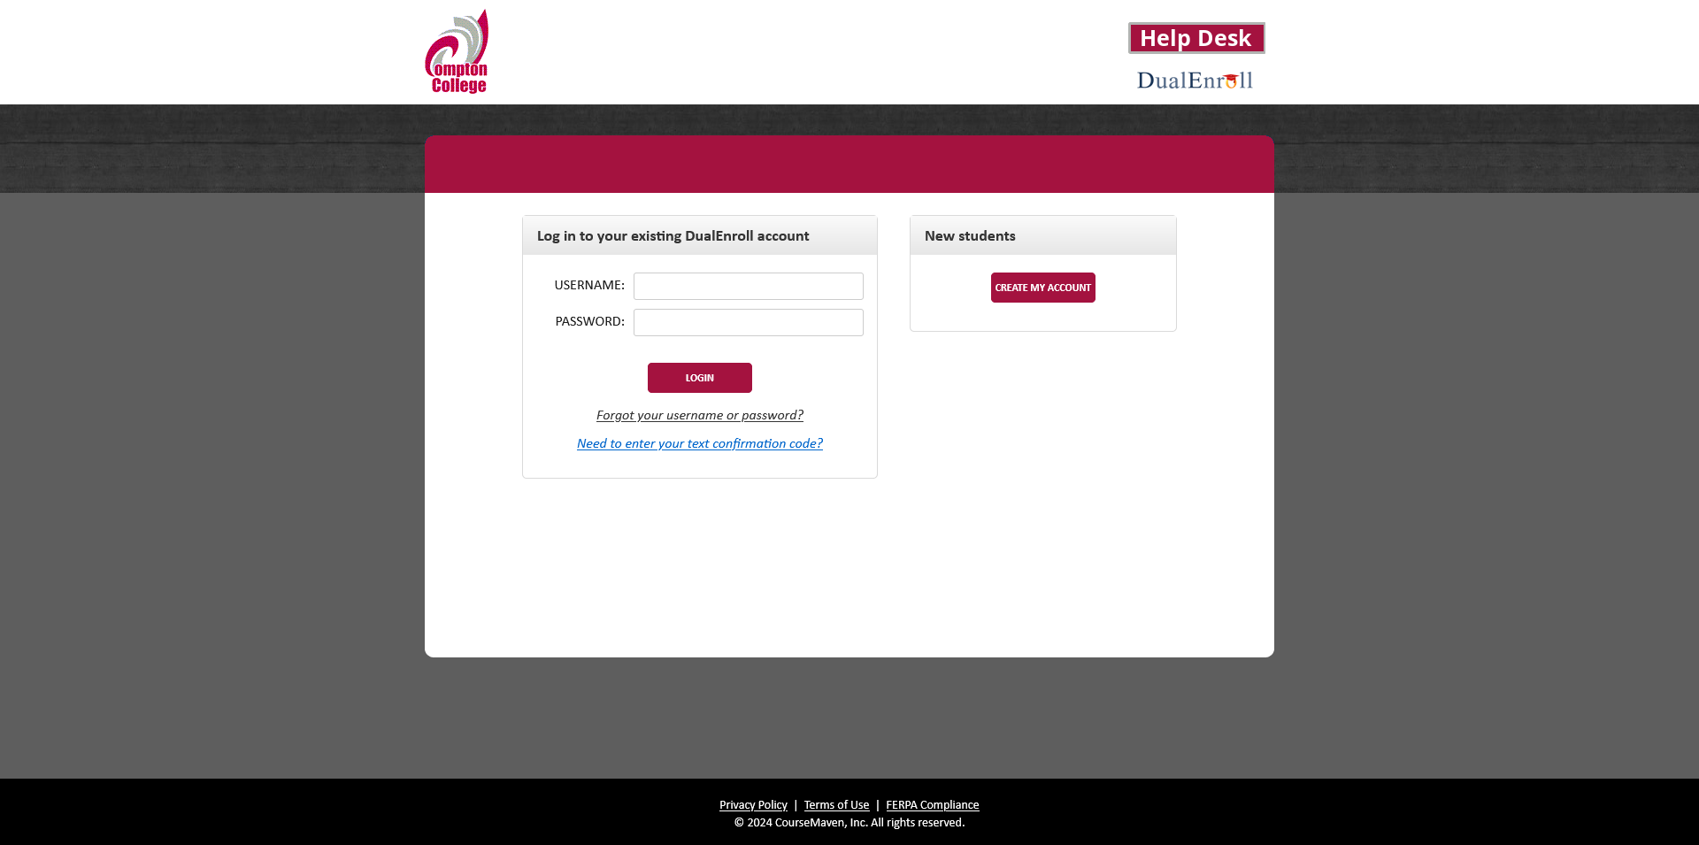
DualEnroll New Account Creation
Begin by clicking the “Create My Account” button in the “New students” section.

Slide 20
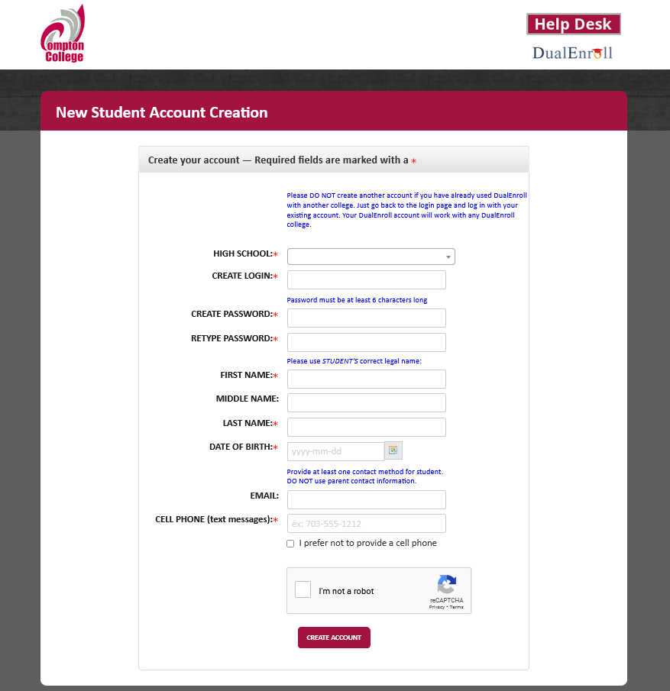
DualEnroll New Account Creation
Use your personal information to create the account. You will complete the following sections:
High School
Create Login
Password
Name
Email
Date of Birth

Slide 21
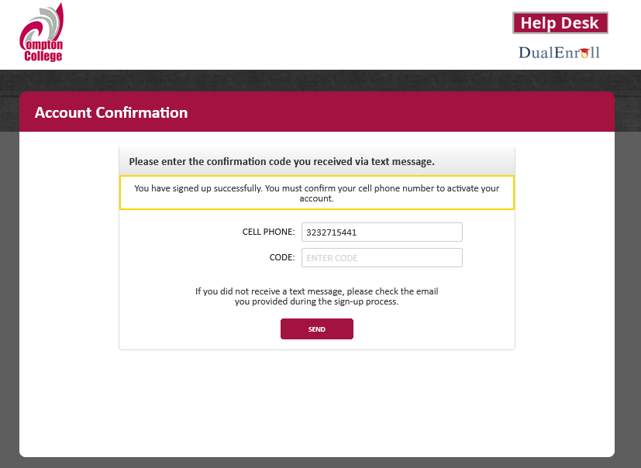
DualEnroll Account Verification
Based on the email and/or phone number you provided, you will receive an activation code.

Slide 22
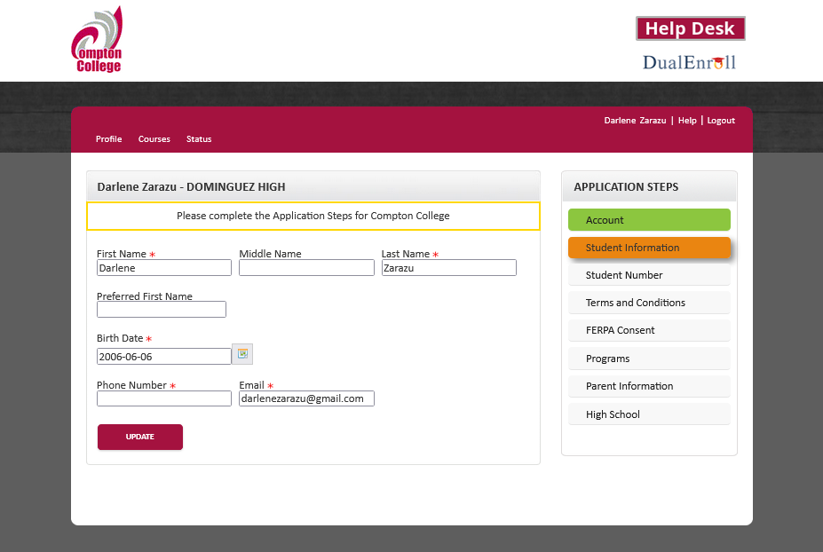
DualEnroll Personal Information
Your name will be transferred over to this screen.
You are also able to make updates here.

Slide 23
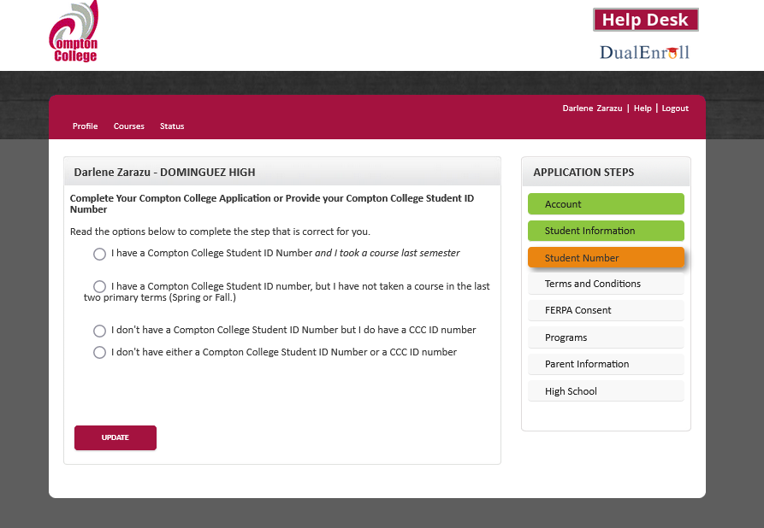
DualEnroll Compton College ID
Please have your Compton College Student ID number (A0001234) ready to provide on this screen.
Select the best option that fits.
If you have never applied to Compton College, please let one of the Compton College staff members know.

Slide 24
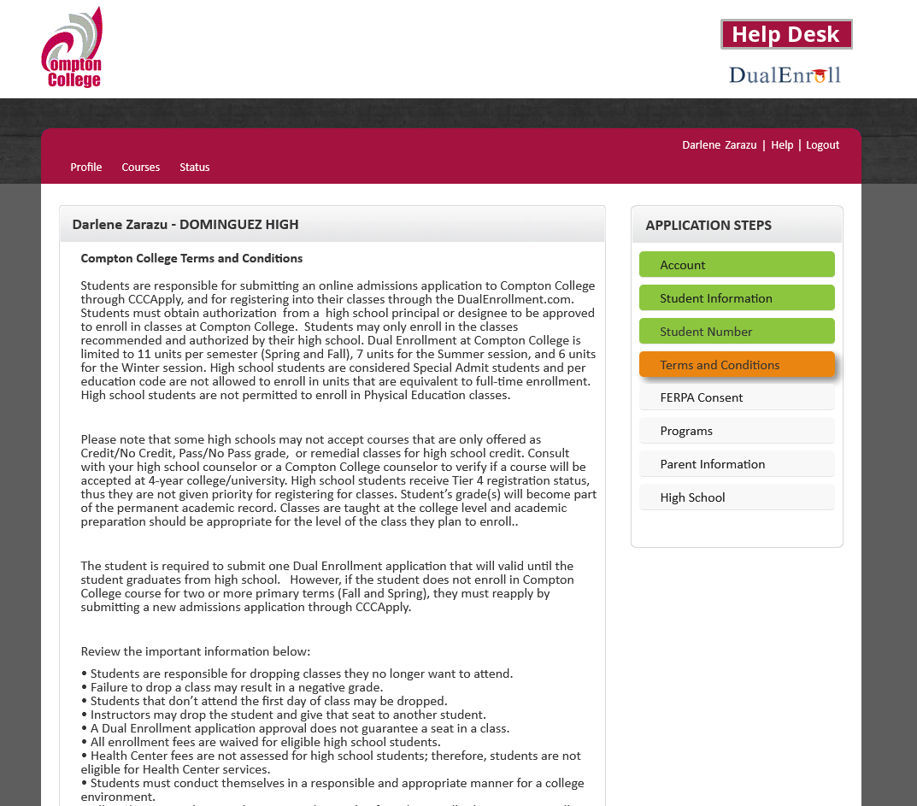
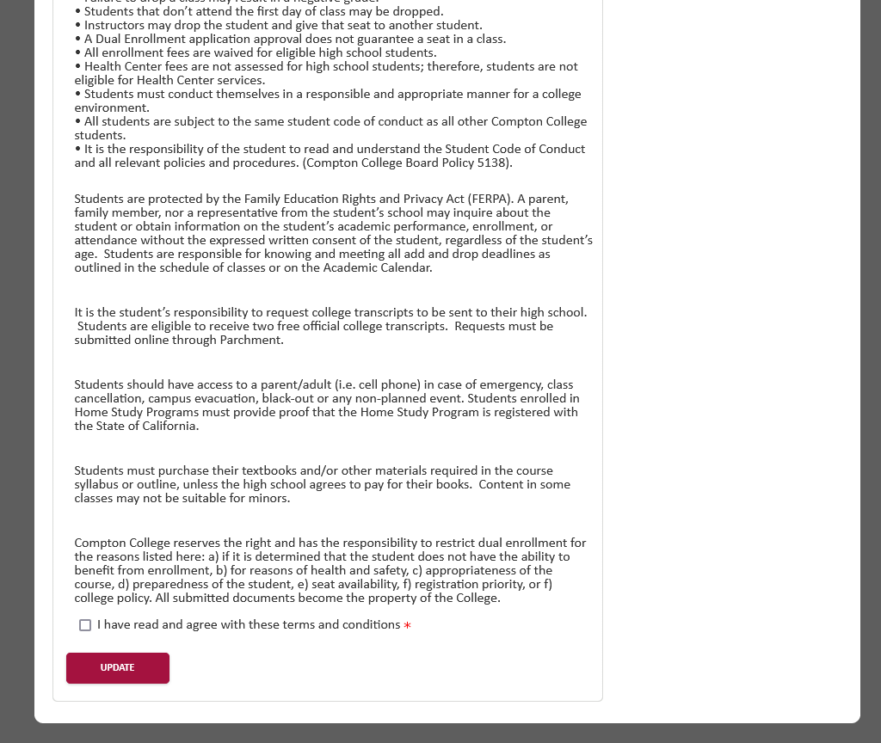
DualEnroll Terms and Conditions
Read through the consent terms and when you are ready, check the box to agree with the terms and conditions and select update.

Slide 25
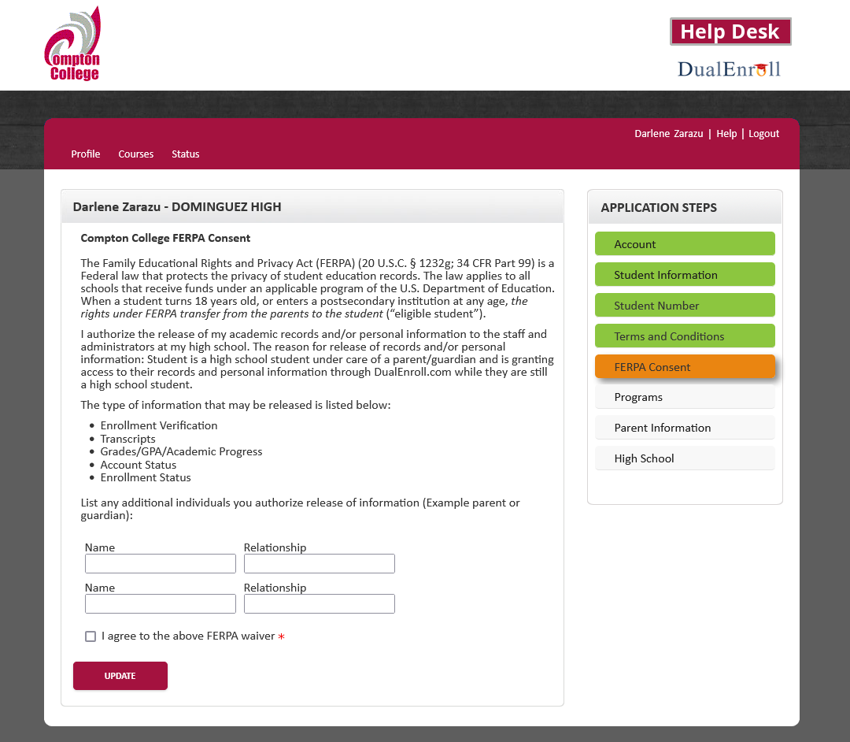
DualEnroll FERPA Consent
You must provide the information for a parent or legal guardian.
After you enter the information, select the box to agree with the FERPA waiver.

Slide 26
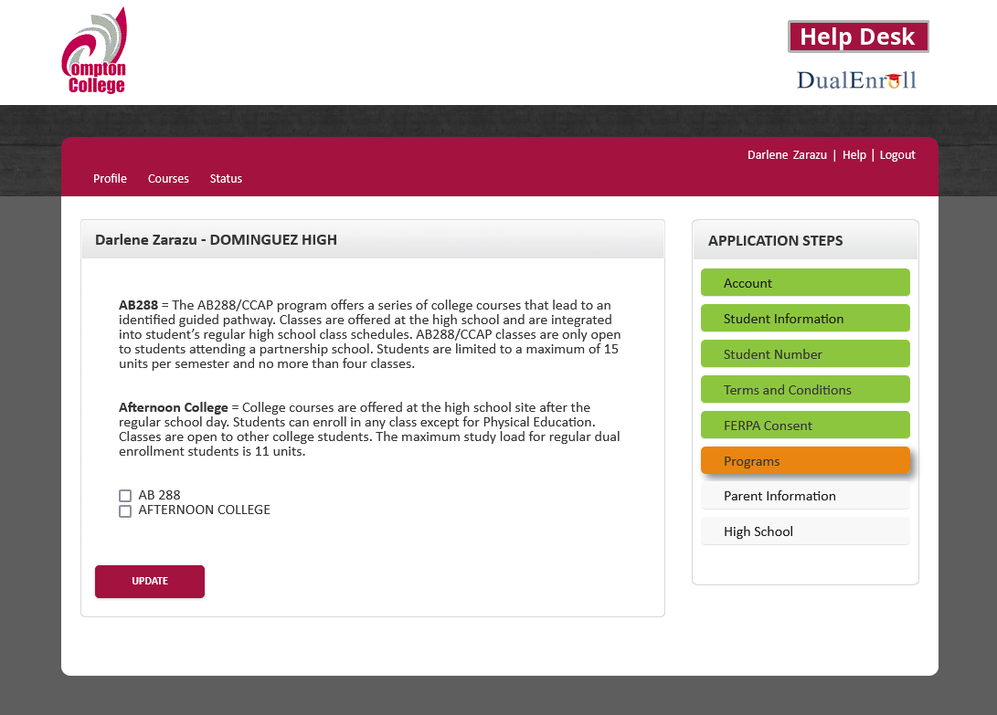
DualEnroll Program Selection
Select the Dual Enrollment program you are/will be in.
If you are in more than one, select all the options that apply.

Slide 27
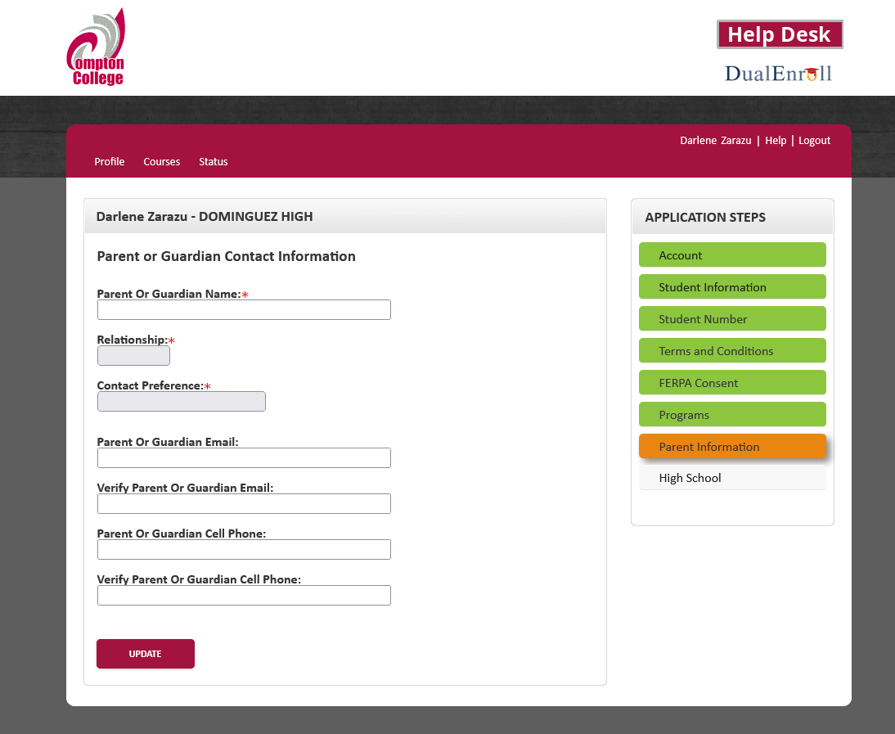
DualEnroll
Parent/Legal Guardian Information
Enter the information for your parent/legal guardian that will consent for your dual enrollment course(s).

Slide 28
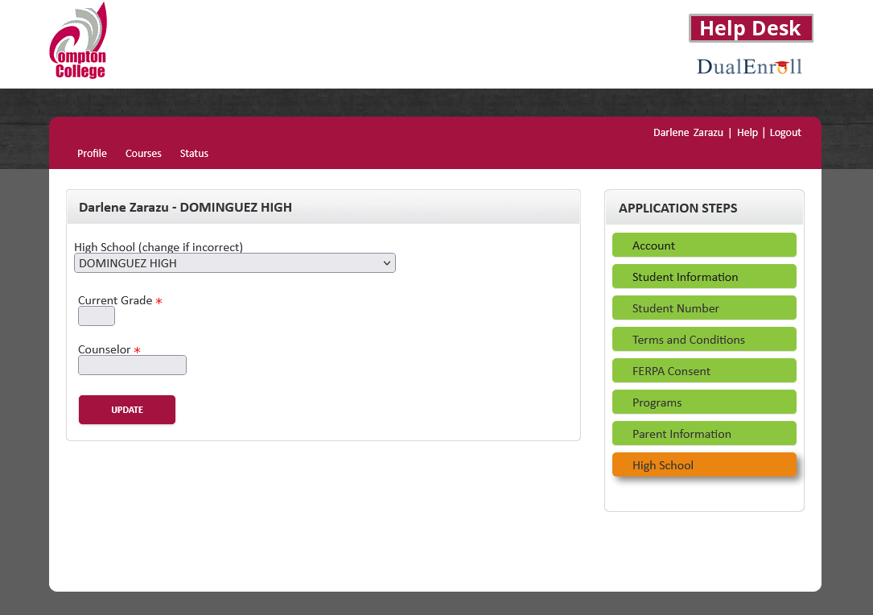
DualEnroll High School Selection
Select the high school you attend, your grade level, and high school counselor.
If you do not know who your counselor is, select the “I don’t know” option.

Slide 29

Please Check-in with your parent/legal guardian at home

Slide 30
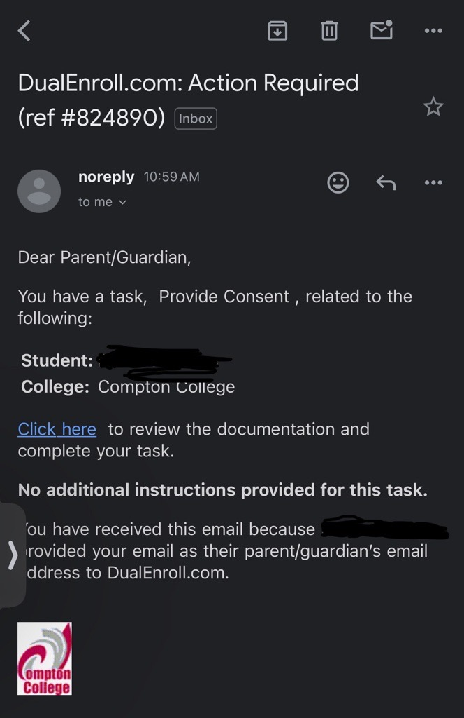
DualEnroll
Parent Consent Notification
Parental or guardian consent is required to admit a student to a community college dual enrollment course(s).
They will receive an email or phone number with instructions like the image shown on how to review the document and complete the task.

Slide 31
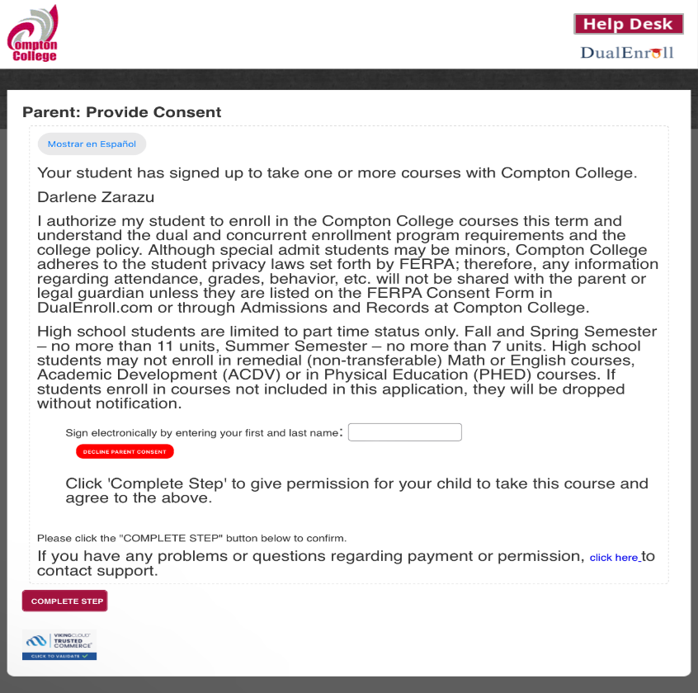
DualEnroll Parent Consent
Your parent/legal guardian will sign the consent electronically by providing their name and clicking the “complete step” button.

Slide 32

DualEnroll Class Selection Process

Slide 33
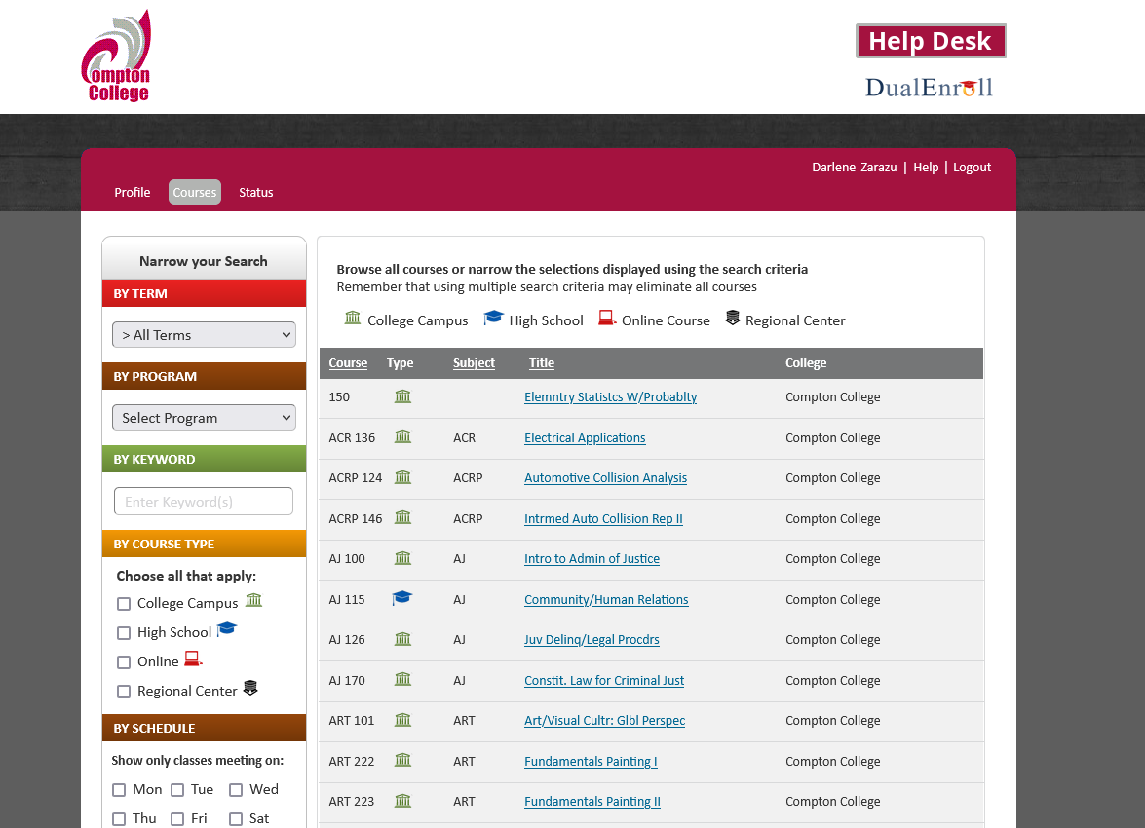
DualEnroll Class Selection Screen
Applies to SUMMER and future term registration:
Select class based on:
  Dual enrollment program type
  By schedule
  Keyword

Slide 34
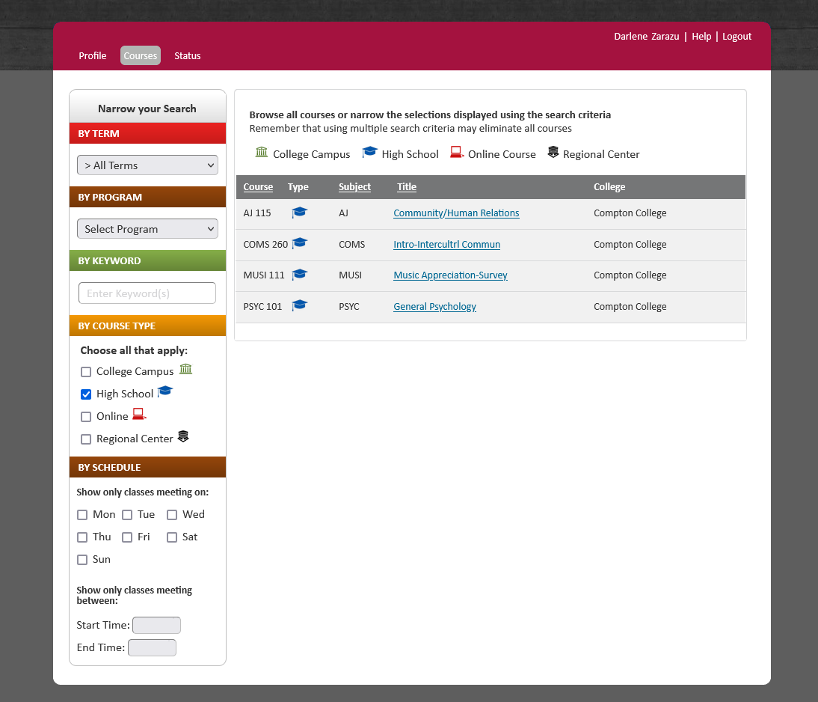
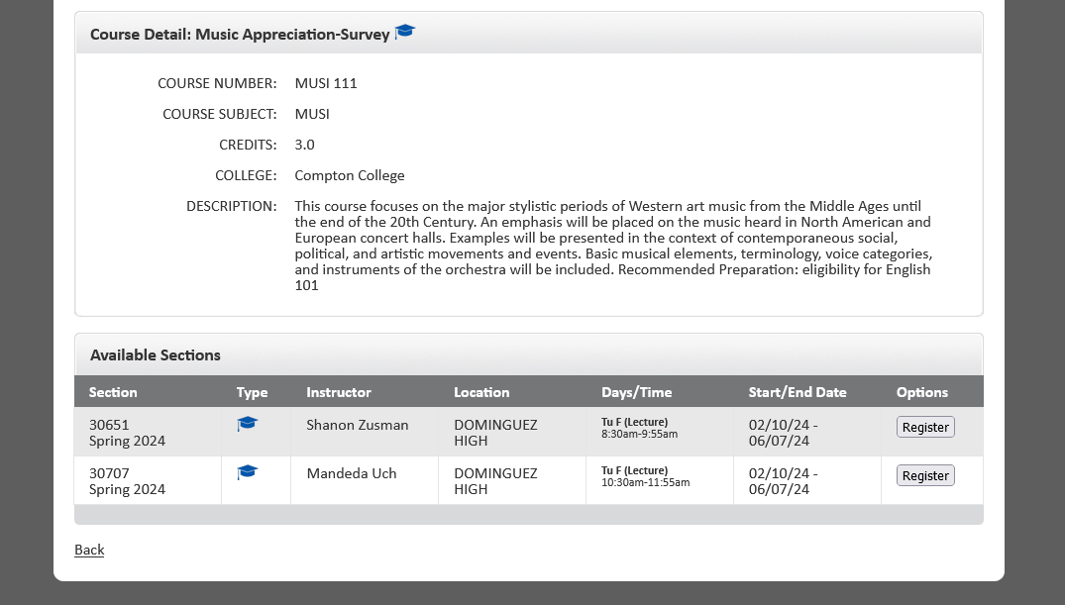
DualEnroll Course Registration
  Select the course you are interested in taking.
  In the next screen, select “Register”

Slide 35
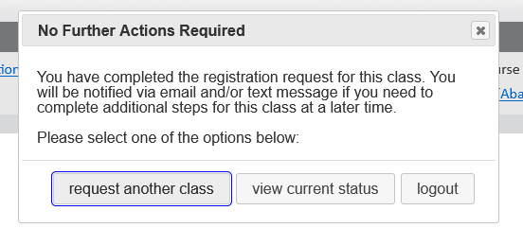
Course Registration Status
  You can view the status of your requested registration by clicking “view current status”.
  Reminders:
    Your registration will not be approved if your parent/legal guardian has not provided consent or if your high school counselor/personnel has not consented your registration.

Slide 36

You may have: Pending tasks

Slide 37
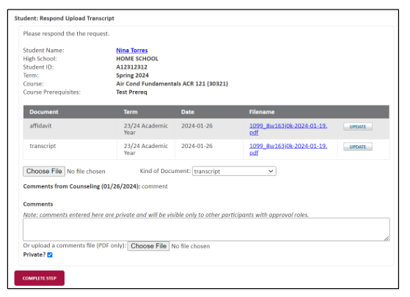
Potential Student Tasks
  You may have pending tasks to complete such as:
  Upload Transcript
  In certain situations, the college may require you to upload a high school transcript.

Slide 38
How do I complete orientation?
Click on Orientation tile (a Spanish version is also available)
Notes:
Unhide this slide if you are doing a Promise-based orientation.

Slide 39
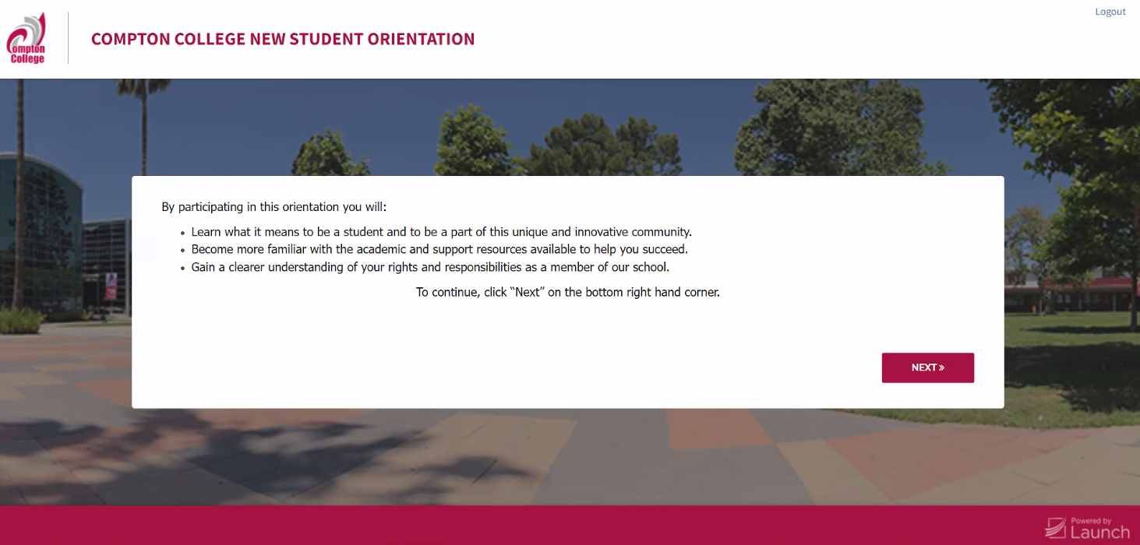
Orientation
Notes:
Unhide this slide if you are doing a Promise-based orientation.

Slide 40
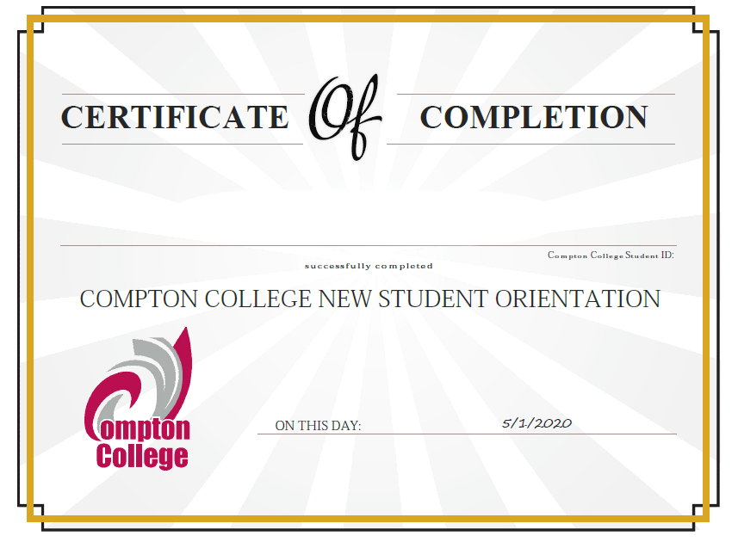
Orientation
After you are done with orientation, you will receive a certificate of completion. Take a picture or screenshot and keep for your records! You are now ready to start on an educational plan with a counselor.
Notes:
Unhide this slide if you are doing a Promise-based orientation.

Slide 41
How do I log in to Canvas?
Click on Canvas tile

Slide 42
What is Canvas?
In Canvas you can:
    access class syllabus and information
    complete and turn in assignments
    participate in discussions
    take assessments/quizzes
    contact your instructor
    and more

Slide 43
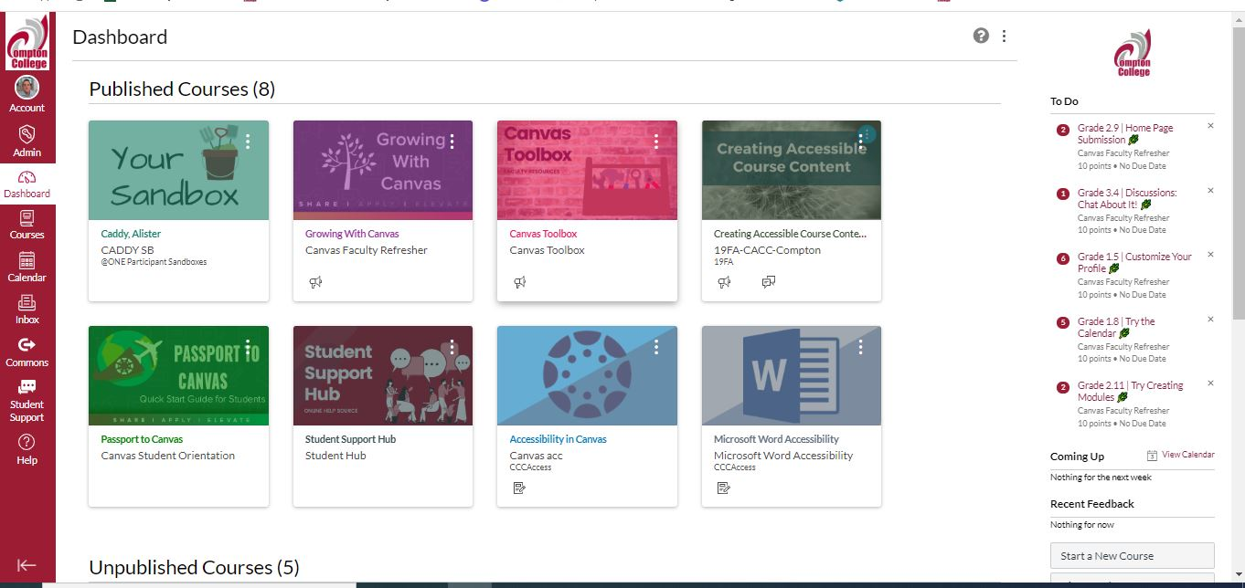
How do I navigate the dashboard in Canvas?

Slide 44
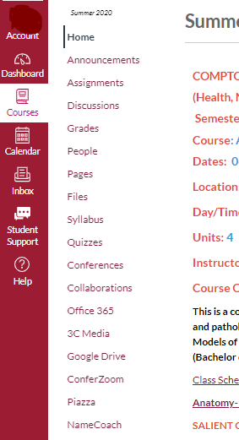
How do I navigate in my course in Canvas?
The Course Navigation will be on the left side by the Global Navigation in each course.
Instructors can modify this so it's a little different in every course.
For example, they could "hide" the discussions index. You would then access the discussion by going to the module with that discussion (or assignment, quiz etc.)
The links help you navigate inside a course.

Slide 45
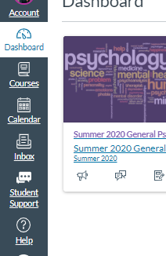
What is Global Navigation?
The Global Navigation will be on the left side of the screen (desktop) or at the bottom (mobile).
It contains:
  Account-allows you to view and edit your account details like profile picture and bio
  Dashboard-brings you back to your dashboard
  Courses-shows all your active course. You can also click "all courses" to see all your courses past and present

Slide 46
How do I view my assignments?
Accessing assignments depends on how your instructor has set up the course but usually includes:
  Calendar
  Modules
  Assignment Index in the course navigation
Different types of assignments can be:
  Submission assignments
  Quizzes
  Discussions

Slide 47
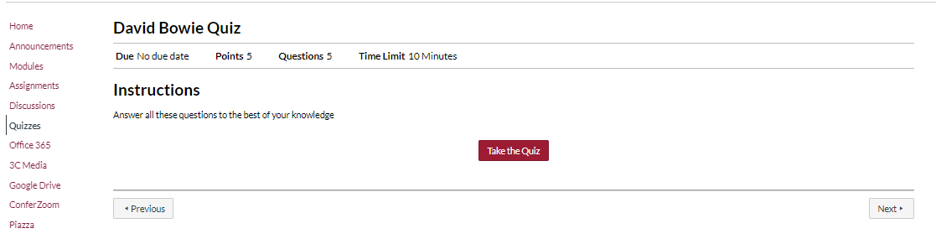
How do I take a quiz?
Find the quiz in the Assignment or Quizzes Index
Review the quiz details before you start.

Slide 48
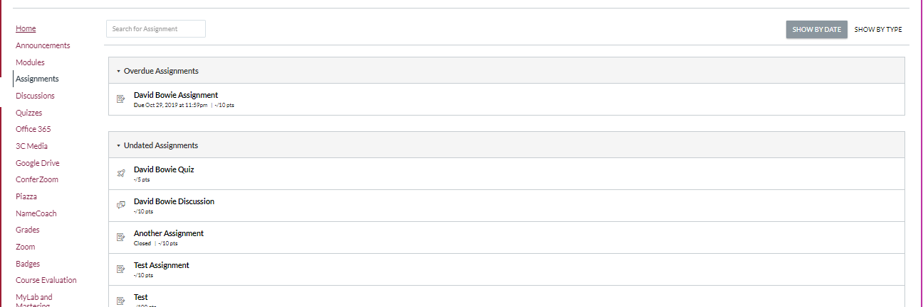
How do I turn in an assignment?
Note: if you do not see the "Assignments" in the course navigation, the instructor may have the course organized around Modules

Slide 49
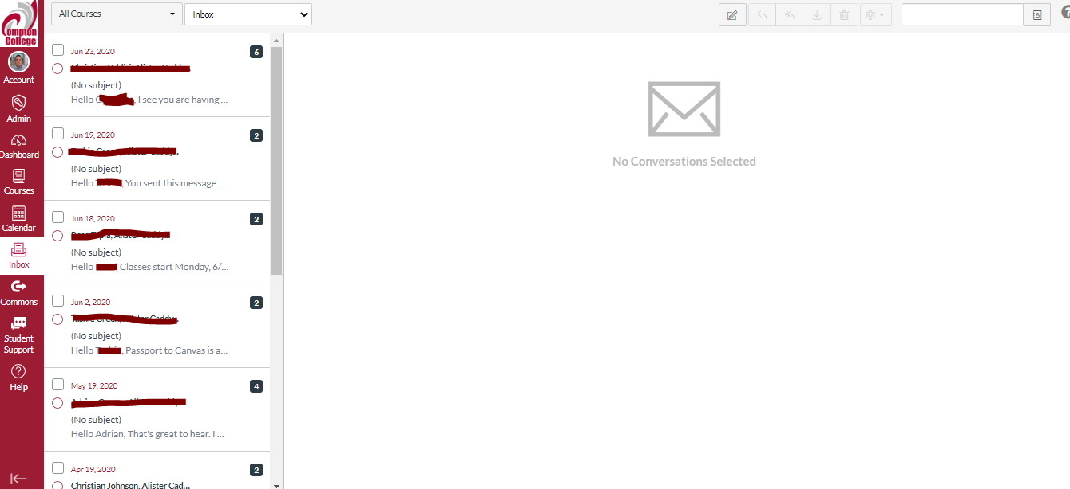
How do I use Canvas Inbox?
Click on the icon with pencil inside a square.

Slide 50
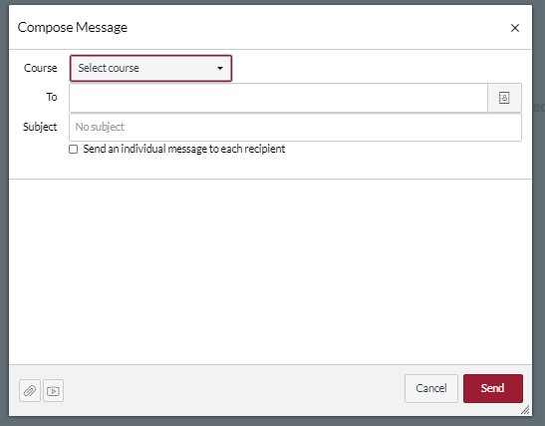
How do I send a message in Canvas?
Type in your instructor's name, add a subject and write a message.

Slide 51
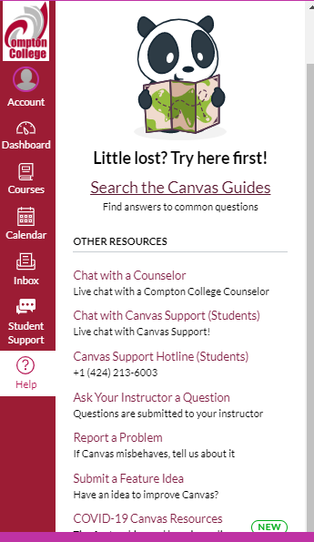
Still have questions?
Canvas 24/7 Hotline: (424) 213-6003
Canvas Help Chat located in the "Help" button on Global Navigation.
Reach out to Distance Education at distance_ed@compton.edu

Slide 52
How do I get help in Canvas?
The Student Support Hub (found in Global Navigation) has links to all online services that Compton offers like:
  Counseling
  Library
  IT Helpdesk
  And MUCH MORE
In your Dashboard, you will have access to a Canvas informational course called Passport to Canvas
  Self-paced
  Clear, animated guides
  Contains information in this presentation and MUCH MORE

Slide 53
NetTutor
NetTutor
NetTutor is an on-demand tutoring platform for available 24/7, 365 days a year.
To access free online tutoring support from NetTutor, first sign into Canvas.
Once you are logged in to Canvas, click on the Student Hub and choose Online Tutoring-Student Success Center.
Read through the Informed Consent Statement. If you agree to the terms, click the
Accept and Continue button.

Slide 54
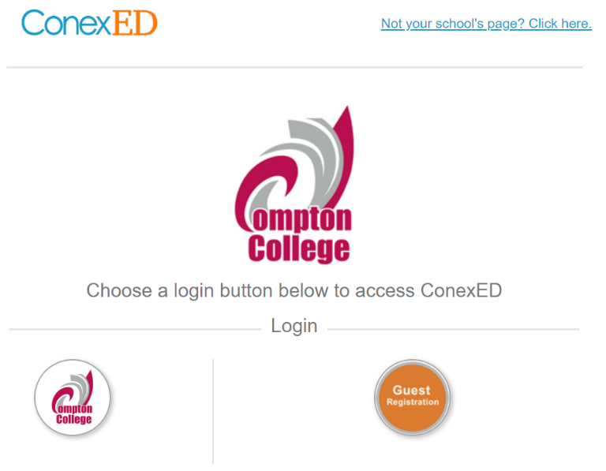
Login to ConexED
Click on Login to NetTutor Online Tutoring

Slide 55
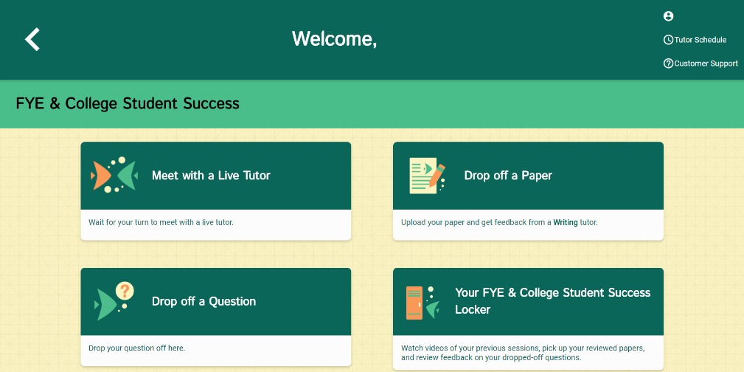
ConexED - NetTutor
Selecting the subject you need help in will lead other options that NetTutor offers:
· Meet with a Live Tutor
· Drop off a Paper
· Drop off a Question
· Your “Subject” Locker
ConexED
ConexED is the platform that houses NetTutor and Cranium Cafe. NetTutor offers live tutoring on-demand, question drop-off, and writing feedback. Tutors are subject matter experts trained in how to translate tutoring best practices and learning strategies to support students online, one student at a time.

Slide 56
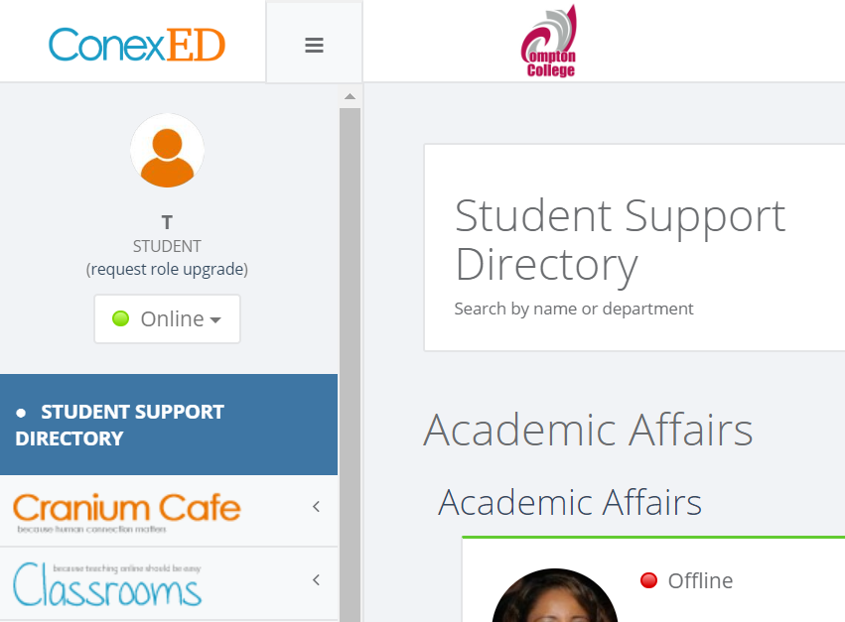
Cranium Cafe
Cranium Cafe
Cranium Cafe is a meeting and collaboration platform designed specifically for student support. Once inside the cafe, you can utilize a variety of methods to communicate in an online platform. Cranium Cafe is a good resource for students interested in one-on-one counseling and other services.
Find any Student Support Services department and chat online with Compton College staff, counselors, and administrators.

Slide 57
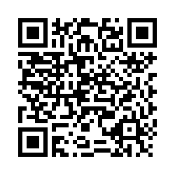
Please Scan – Exit Survey
Please complete the following Exit Survey by scanning this QR Code with a smart device camera

