Slide 1
Putnam is Open for Business! Some Available Commercial Properties
May 2024
Town of Putnam
Economic & Community Development Department
Mary Ann Chinatti, Director 860-963-6800 x200
Maryann.chinatti@putnamct.us

Slide 2
Featuring: #1 –117 Providence Pike #2 – 7 Providence Pike – Stonewall Commons #3 – 251 Park Rd. #4 – 35 Main St. #5 – 284 School St.

Slide 3
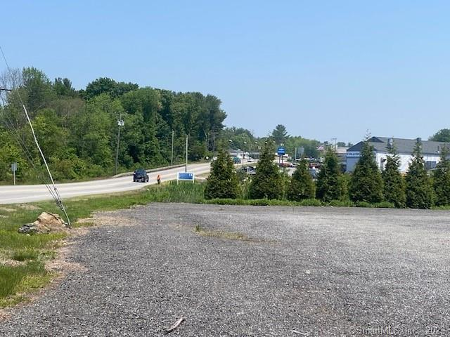
117 Providence Pike Zone: HC Listed by: RE/MAX Bell Park Realty Contact: Dick Loomis 860-428-6616
VACANT LOT
Lot Size: 2 AC
PUB. W/S AT STREET
Living space upstairs
OWNER FINAN. POSSIBLE
$1,350,000
#1

Slide 4
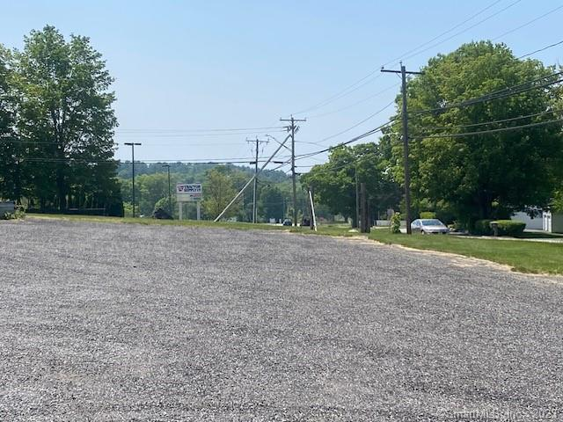
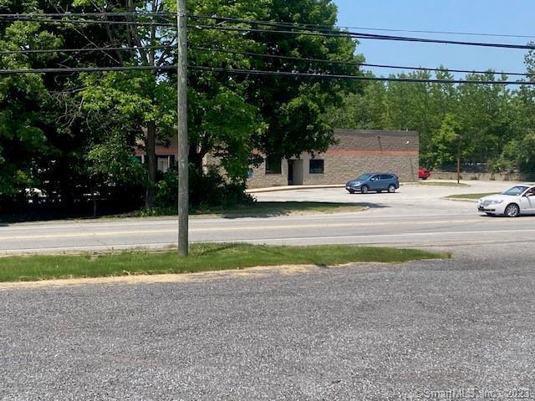
#1

Slide 5
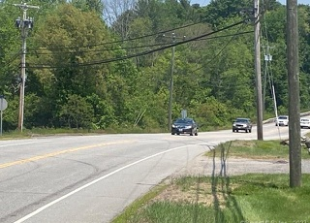
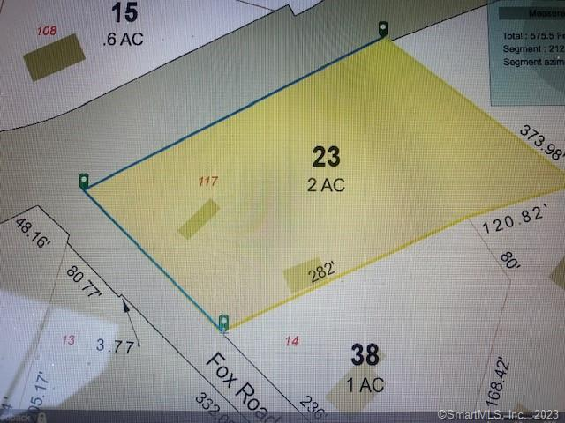
#1

Slide 6
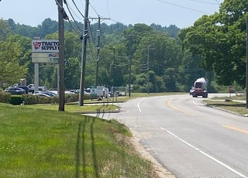
#1

Slide 7
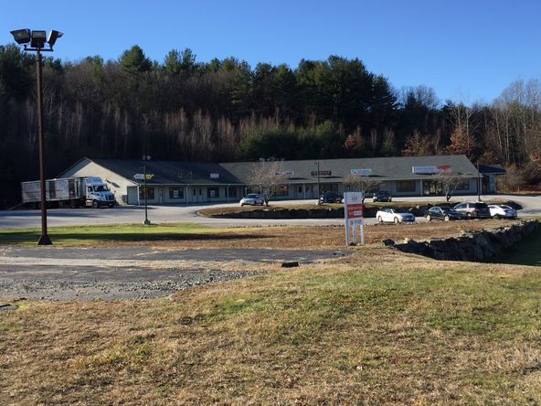
7 Providence Pike Stonewall Commons Zone: HC Listed by: Galaxy Development, LLC Contact: Kayla Cournoyer 508-619-2083 x643
MULTIPLE UNITS AVAILABLE FOR RENT
UNIT 2: 1000SF – 2000SF
$833 - $2,500/MO
UNIT 3: 1000SF – 2000SF
$833 - $2,500/MO
UNITS 4 & 5: 1,350SF – 2,850SF
$1,125 - $3,800/MO
#2

Slide 8
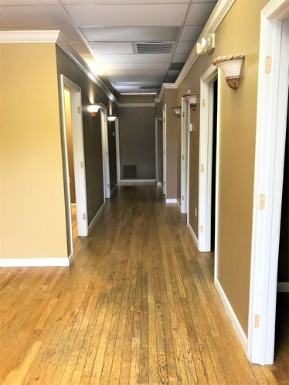
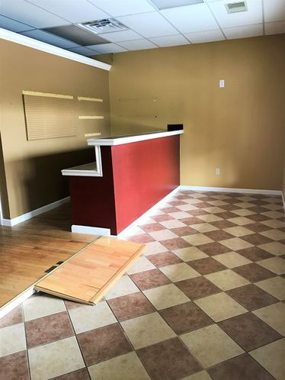
UNIT 2
#2

Slide 9
UNIT 3
#2

Slide 10
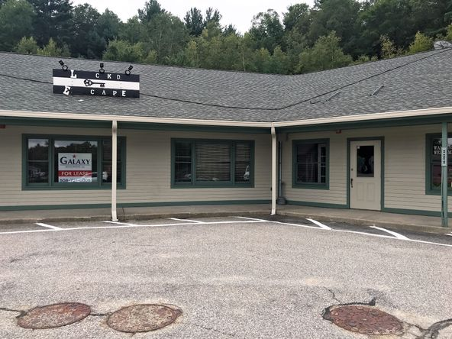
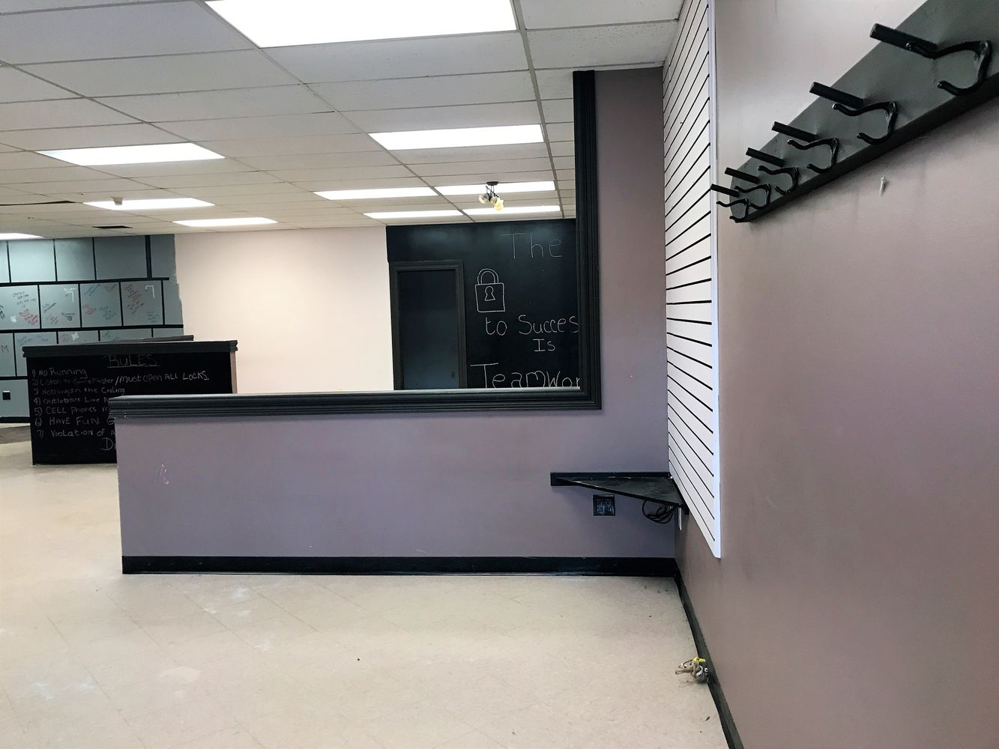
UNITS 4 & 5
#2

Slide 11
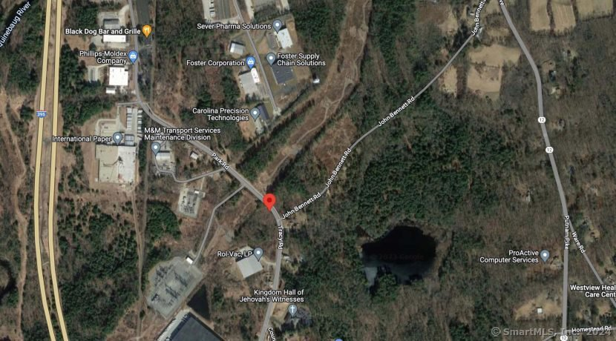
251 Park Rd. Zone: I Contact: CR Premier Properties 860-315-9070
VACANT LOT
LOT SIZE: 1 AC
OWNER FINANCING AVAILABLE
$30,000
#3

Slide 12
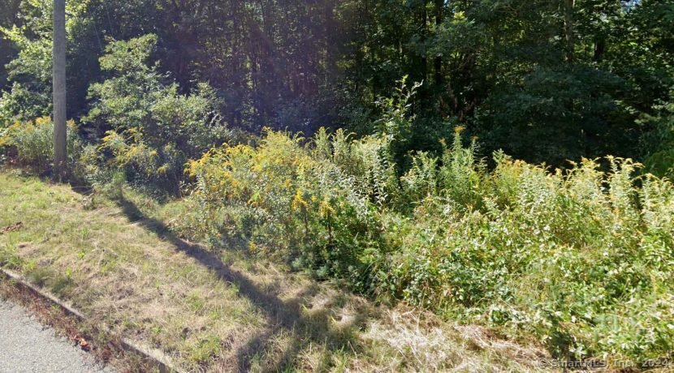
#3

Slide 13
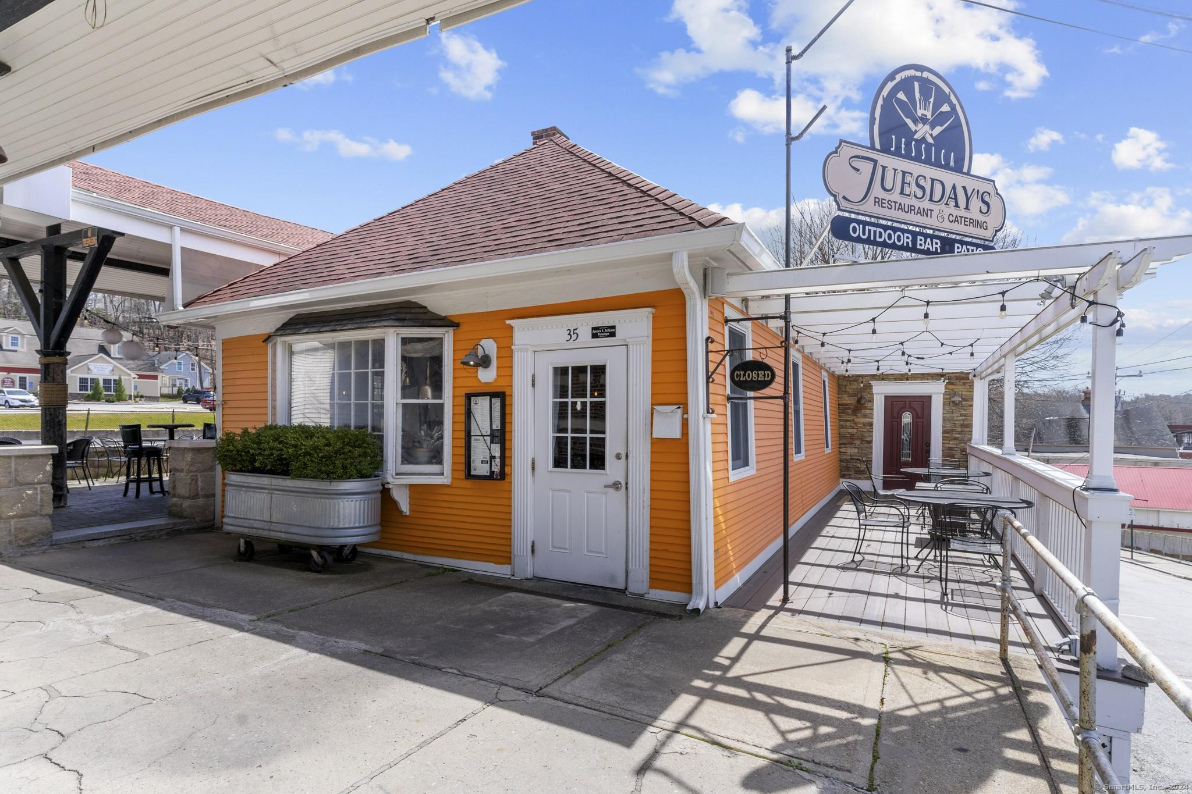
35 Main St. Zone: PD Listed by: RE/MAX Bell Park Realty Contact: Dick Loomis 860-428-6616
2,748SF BUILDING
.06 AC LOT
$1,100,000
#4

Slide 14
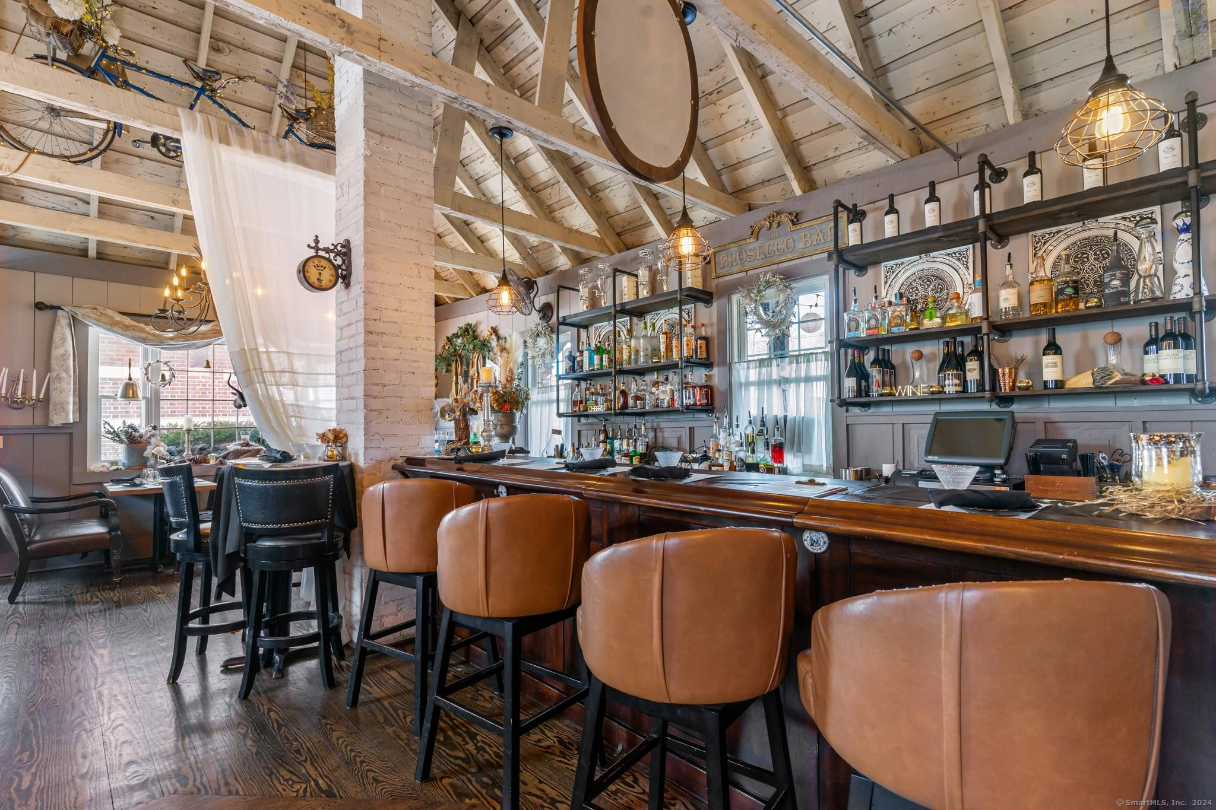
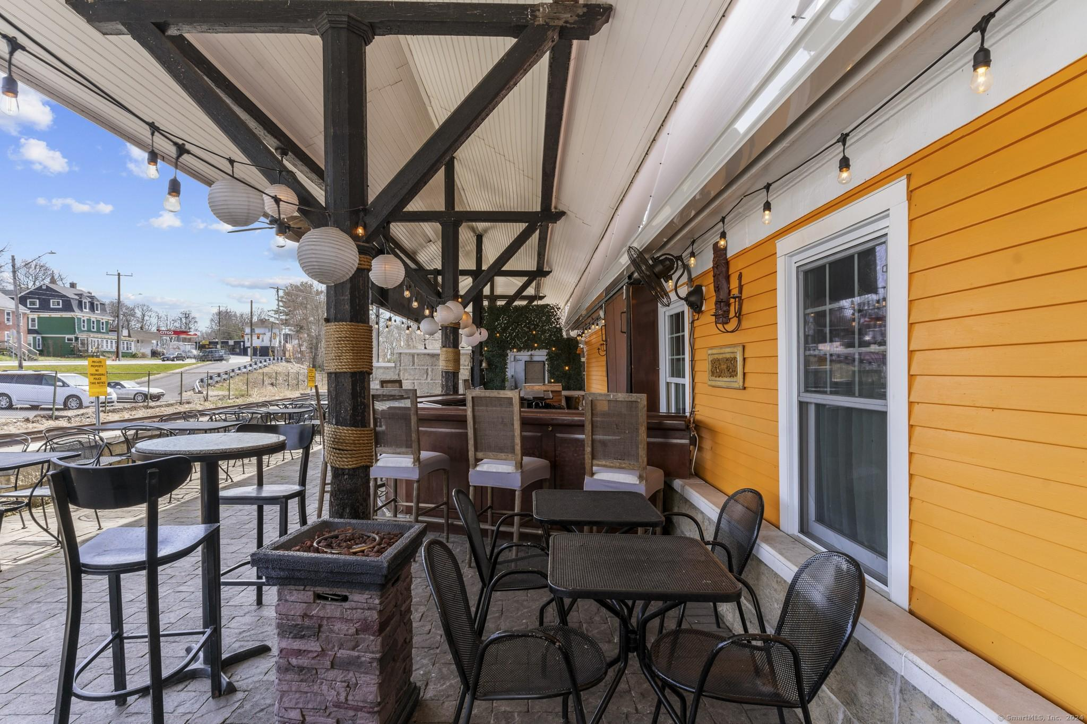
#4

Slide 15
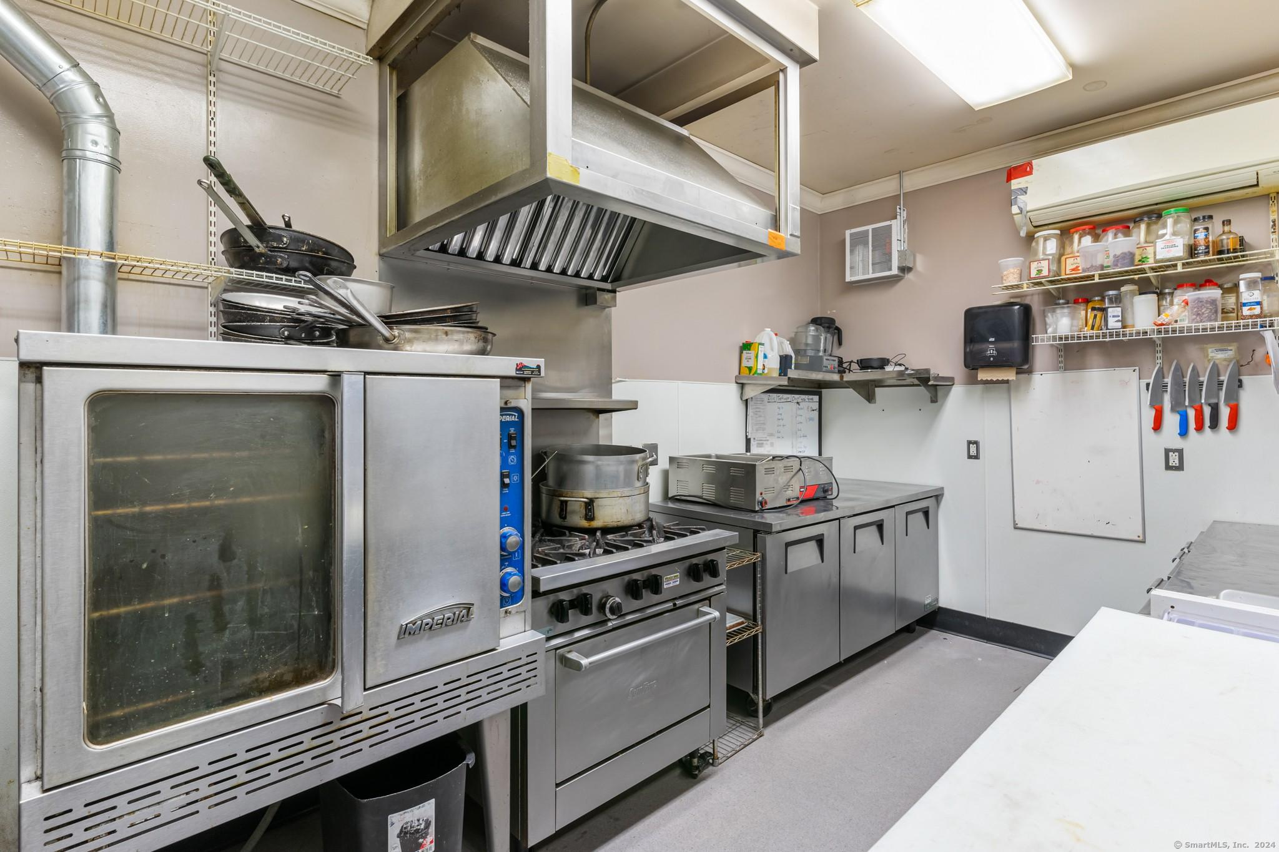
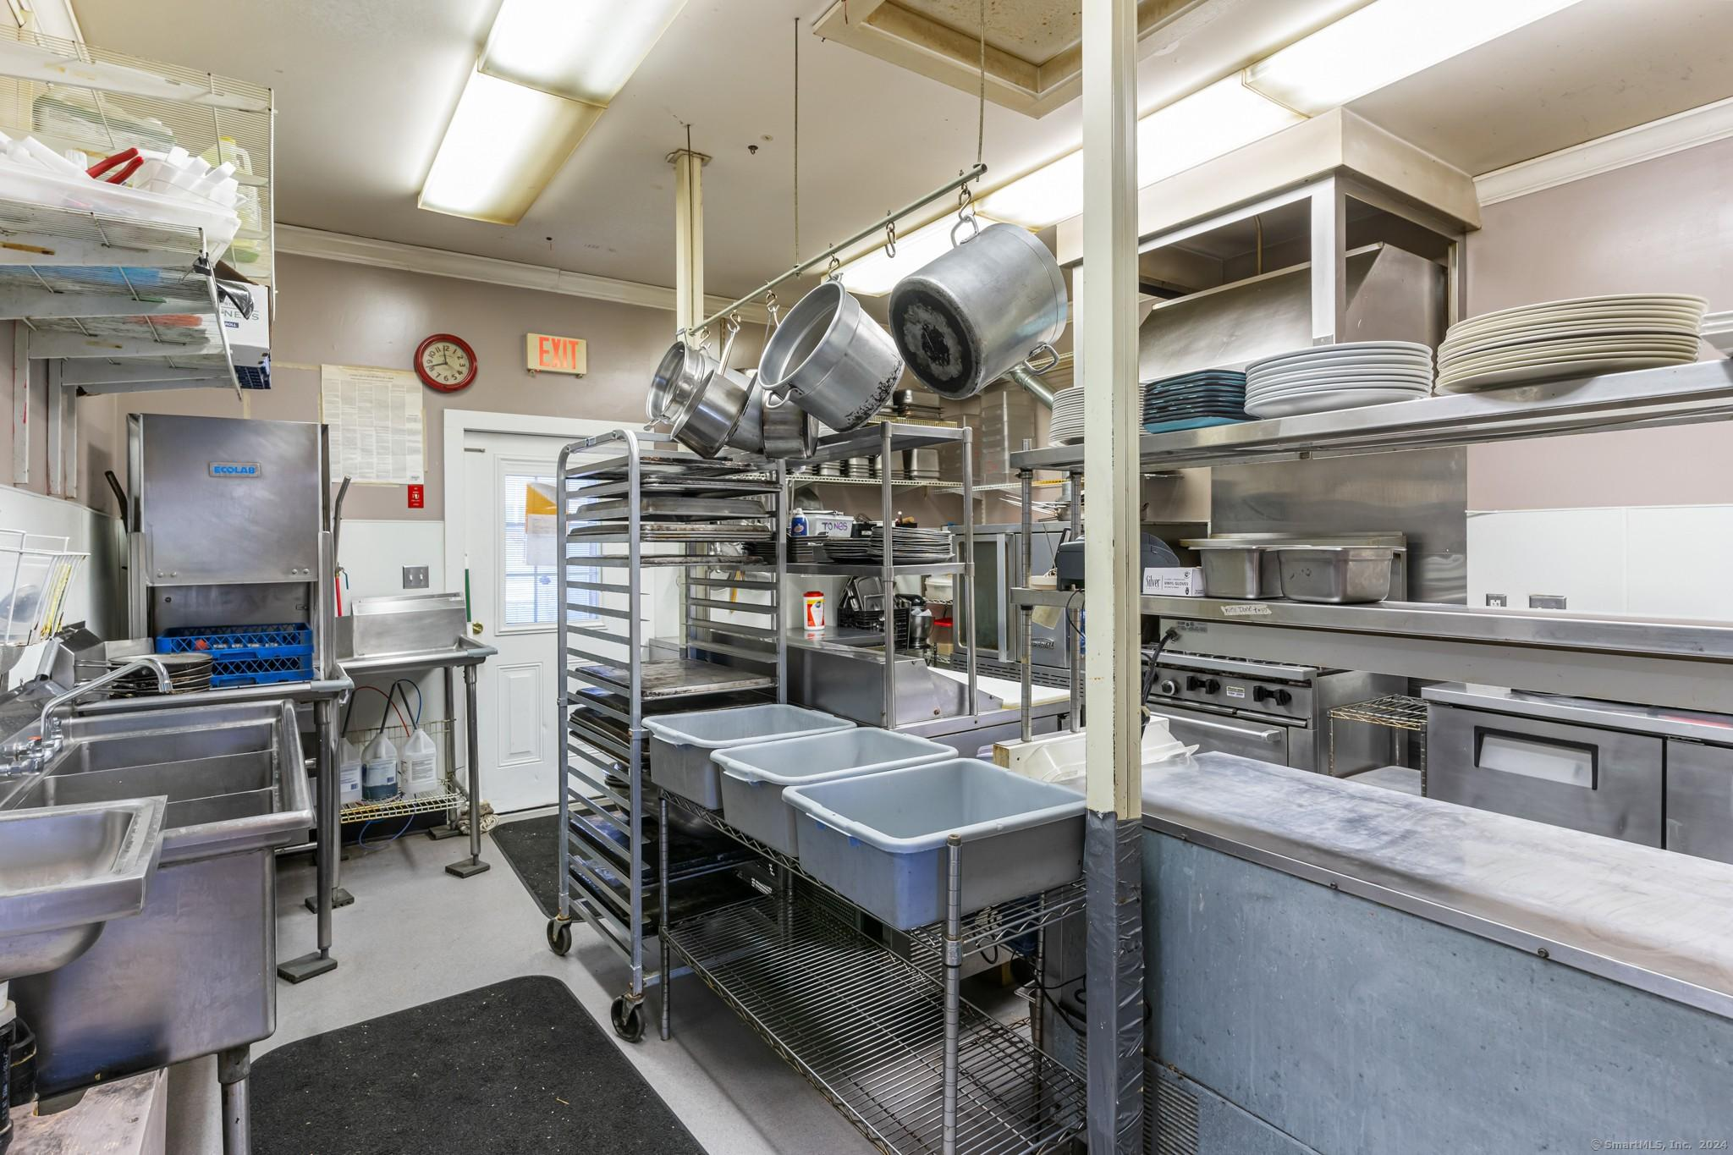
#4

Slide 16
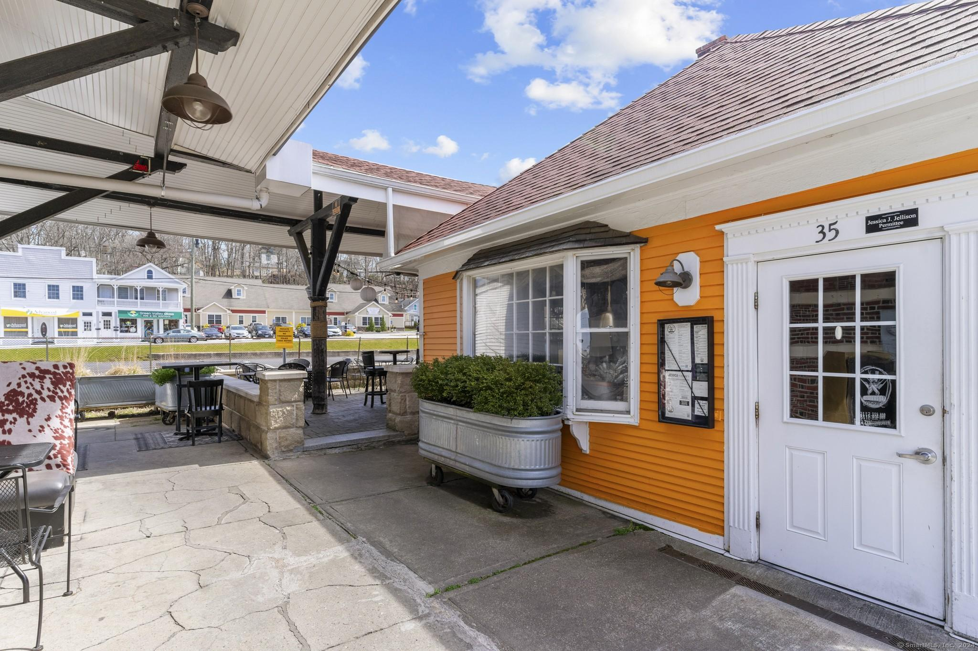
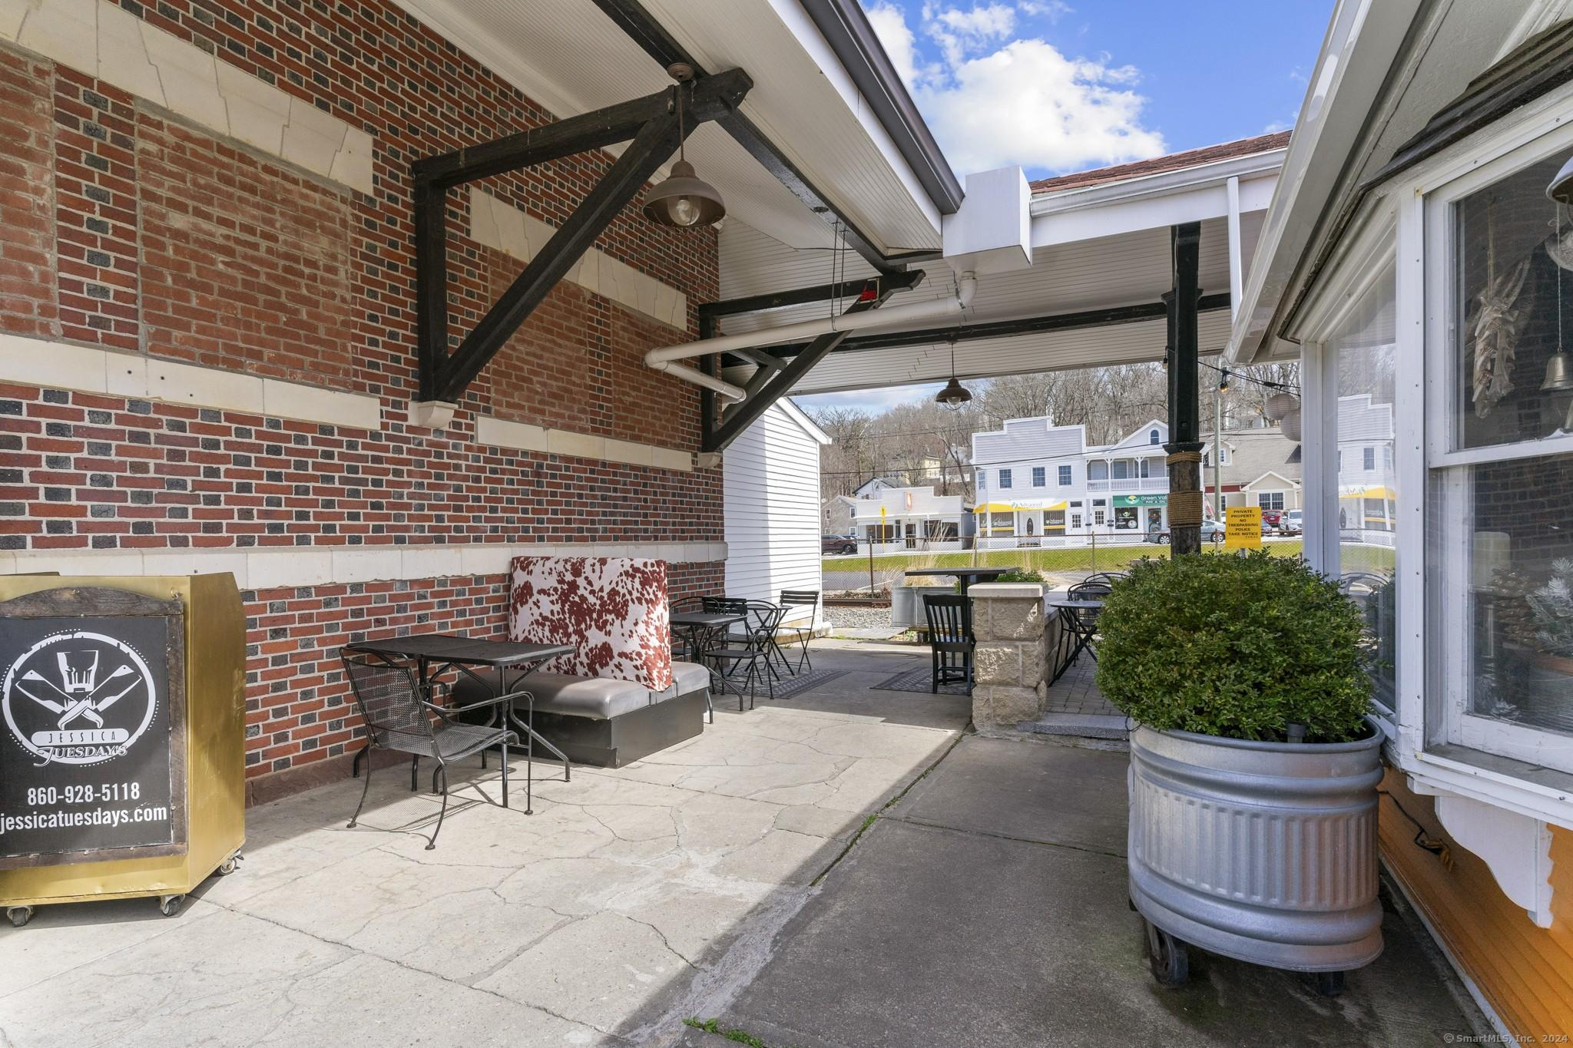
#4

Slide 17
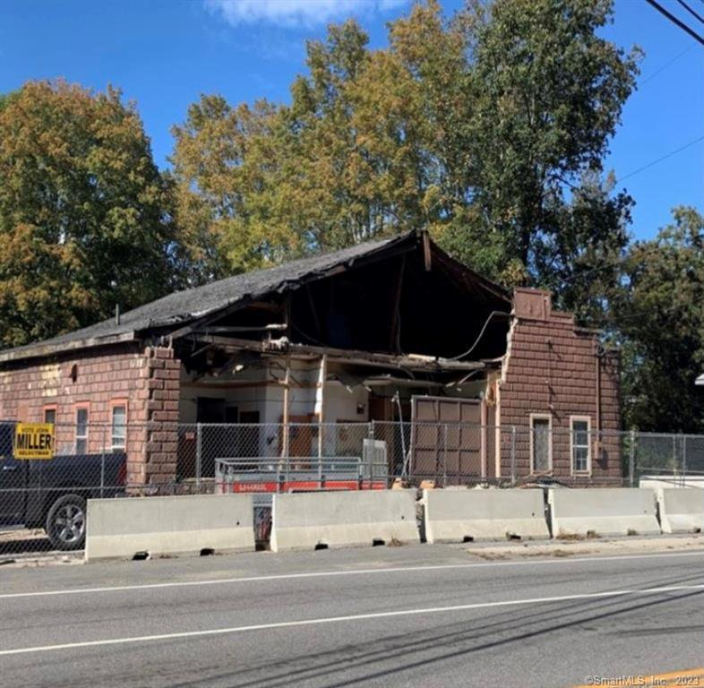
284 School St. Zone: HC Listed by: CR Premier Properties 860-315-9070
3,407SF BUILDING
FULL REPAIR OR TEAR DOWN REQUIRED
LOT SIZE .10 AC
$20,000
#5

Slide 18
If you’re interested in any of these properties, contact the agents listed, or the Putnam Economic & Community Office (contact info on the cover page of this presentation), and we’re happy to help you bring your business to town or expand your existing Putnam business.
More featured properties coming soon!

