Slide 1
What is stress?

Slide 2
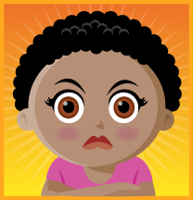

Stress is:
When you’re worried
When you’re scared
When you’re angry
When you’re frustrated
When you’re overwhelmed

Slide 3

What causes stress?
Parents – “Hurry up, do your homework, do your best, stay out of trouble. . .”
Friends – “I don’t like that, don’t wear that, try this. . .”
Yourself – “I need to do better, be different. . .”

Slide 4
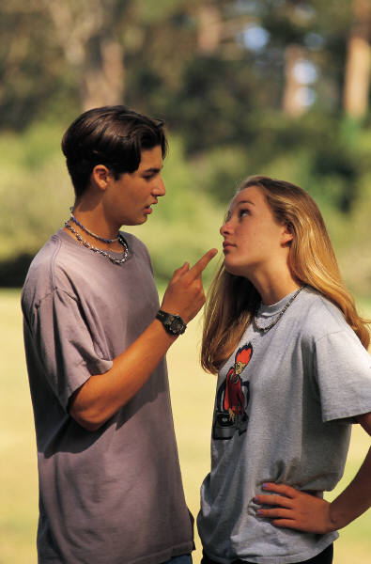
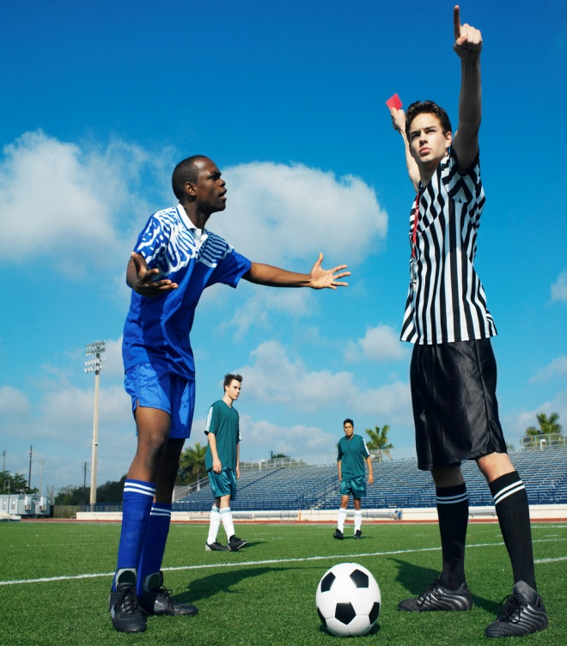
Other things that cause stress:
Watching parents argue
Being pressured to do something you know you shouldn’t
Not being/feeling good enough
Worrying about how your body is changing
Worrying about your family, friends, neighborhood
Feeling guilty

Slide 5
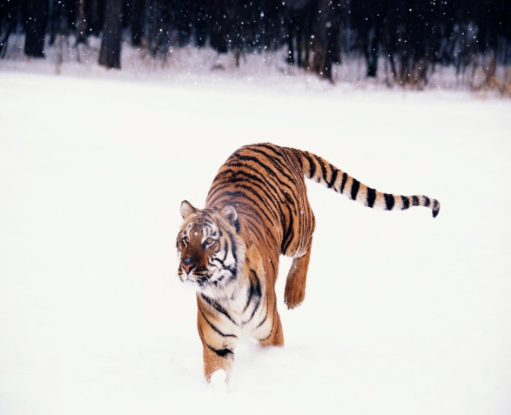
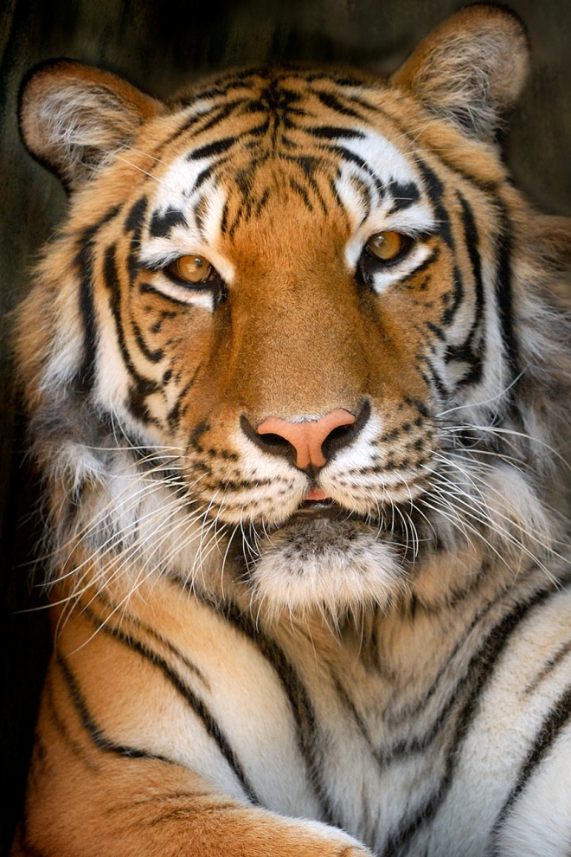
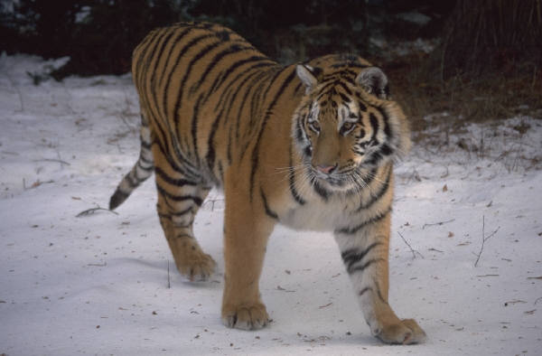
Is Stress Always Bad?
No, it’s not always a bad thing. Sometimes stress helps us deal with hard situations.
Think about a long time ago when people lived in the jungle—where a tiger might leap out at any moment.
If you saw a tiger and had to run, how does that feel in
your body?

Slide 6
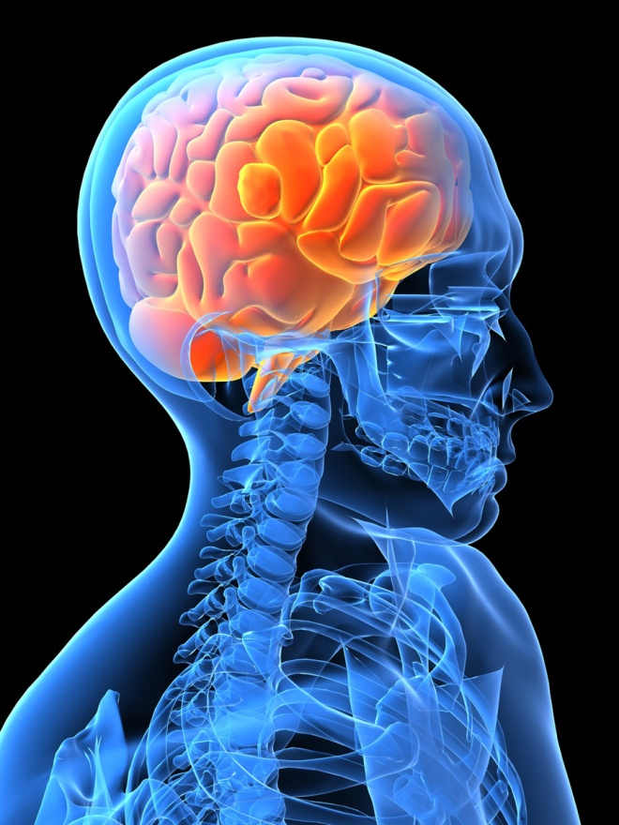
If Stress is good, why does it make us feel bad?
Today, we don’t have to run away from tigers. . .
  It’s important to use our brain to help decide what is a real emergency
  Use exercise to use up that energy
  The trick is to figure out when something is really an emergency and when your emotions are only treating it like one!

Slide 7
How do I cope with stress?

Slide 8
Some of the bad things to do:
Fighting
Bullying
Skipping school
Running away
Hurting your body
Pulling away from people who love you
Gangs

Slide 9
Some of the good things to do:
Take care of my body by:
    Exercising
    Getting good rest and relaxation
    Eating three meals a day
    Drinking plenty of water
Never get too:
    H – Hungry
    A – Angry
    L – Lonely
    T – Tired

Slide 10
More good things:
Ask for help if you need it – there is always someone who is willing to listen
Pay attention to the things that make you feel good, peaceful, calm
Journal – write about what is bothering you
Do something for someone else.

