Slide 1




Top 10 Testing Tips

Slide 2

Tip #1
PREPARE the night before!
Have backpacks and school clothes ready the night before the test to avoid rushing on test day.
Maintain a pleasant home environment and avoid unnecessary conflicts.
Make sure your child is ON TIME the day of the test!

Slide 3

Tip #2
Go to bed early!
Make sure your child gets a good night’s sleep before a test.
Put all electronic devices in another room to charge, as to not wake your child during the night.

Slide 4

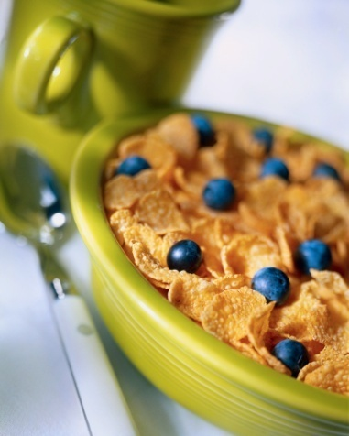
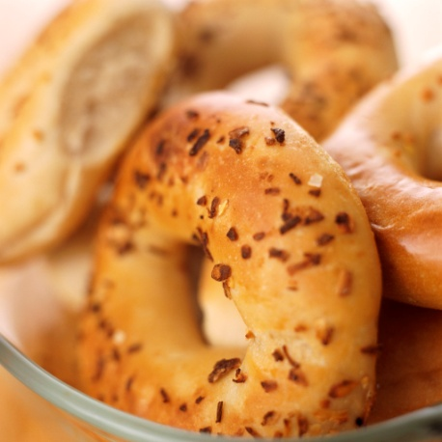

Tip #3
Eat a healthy breakfast!
Make sure your child eats a breakfast that will stick with them.
Healthy breakfast items give your child much needed fuel to do their best and sustain their energy for the duration of their test .

Slide 5


Tip #4
Wear comfortable clothes!
Wear clothing that fits. Not too tight and not too big.
Ensure your child is present during the day of testing. Children generally perform better when taking tests in their groups rather than at a make-up time.

Slide 6


Tip #5
RELAX! Take slow, deep breaths!
Wish your child good luck each morning of the test. Tell your child that you believe in them.
Remind your child the test is important. Encourage them to do his/her best.

Slide 7


Tip #6
Follow directions. Read each question.
Remind your child to listen carefully to the instructions from the teacher and to read the directions and each question carefully!

Slide 8

Tip #7
Mark neatly. Erase completely.
Tell your child to attempt to answer all of the questions and not leave any blank.

Slide 9
Tip #8
Move On
Move on if you don’t know an answer.
Explain to your child the importance of using their time wisely. If your child gets stuck on a question, encourage him or her to make the best guess and move on.

Slide 10

Tip #9
Review
Make sure all questions are answered.
Tell your child to attempt to answer all of the questions and not to leave any blank.
Encourage your child to stay focused on the test, even if other students finish early.

Slide 11
Tip #10
Plan
Plan to do something fun after the test
List some activities you would like to do to celebrate your hard work and determination!

Slide 12

Wrap It Up
If your child is disappointed after taking a test, reassure him or her that there will be plenty of opportunities to improve and succeed.
If your child is too ill to attend on the day of the test, please call the school office at 817-815-6700.

