Slide 1
I CAN DECIDE…IT’S UP TO ME
I can decide about many things. I can make choices.

Slide 2

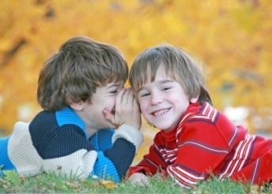
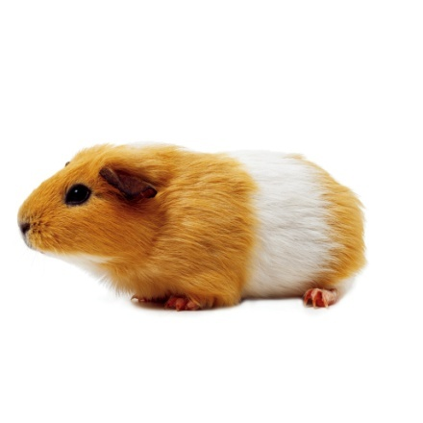

Some Choices are easy and some choices are hard!

Slide 3


Some choices are harder than others!
What will happen……
How will it make others feel…
Before I decide I think about what will happen.
I think about how it might make others feel.

Slide 4
When I choose to do the right thing I feel good about my choices!
I feel good when I stop and think.
Sometimes I don’t stop and think before I make a choice.

Slide 5
As long as I remember to…
Think about what will happen after I make each choice.
Think about how my choices will make others feel.
Think about those who believe in me.
And think about me!

Slide 6
IT’S ALL UP TO ME!
I WILL MAKE GOOD CHOICES!

