Slide 1
CONGRATULATIONS
CLASS OF 2024

Slide 2
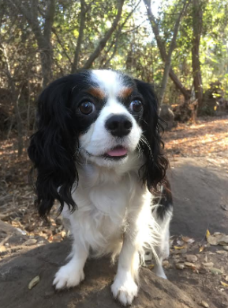
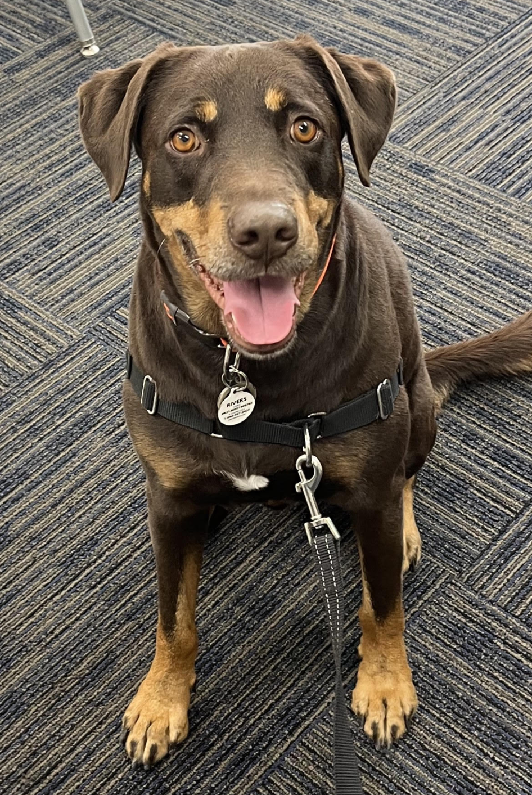
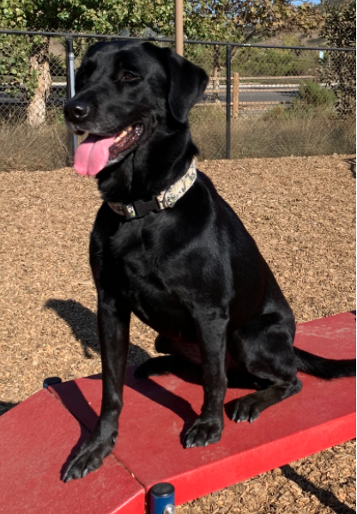
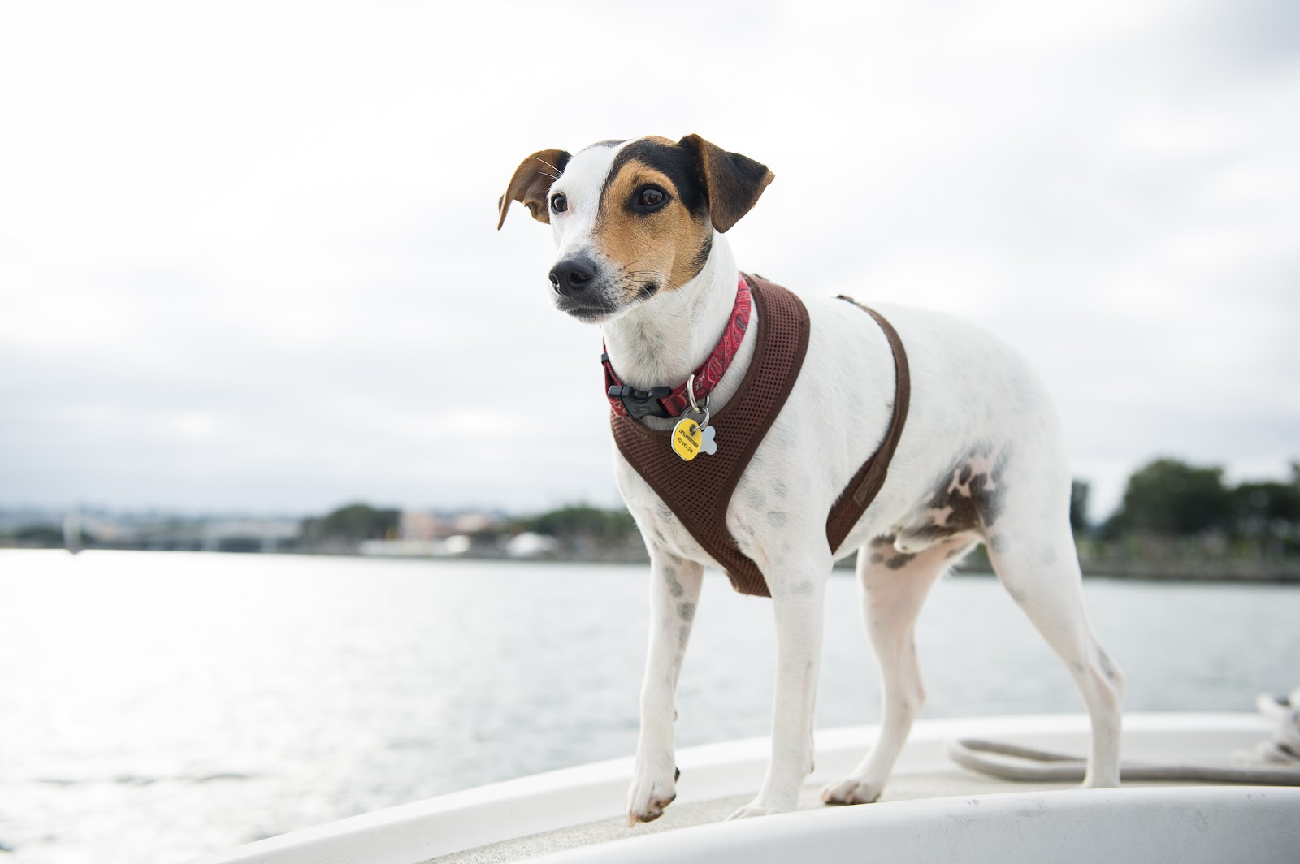
The Pacific View Charter Therapy Dogs Congratulate the 2024 Graduating Class!

Slide 3
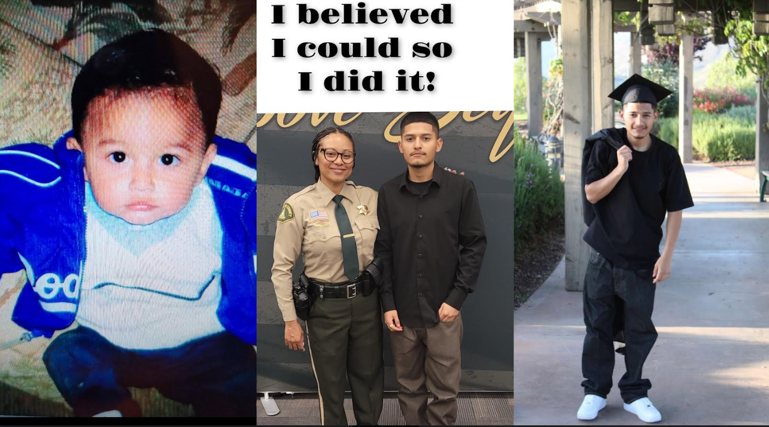
Isaac Alcala

Slide 4
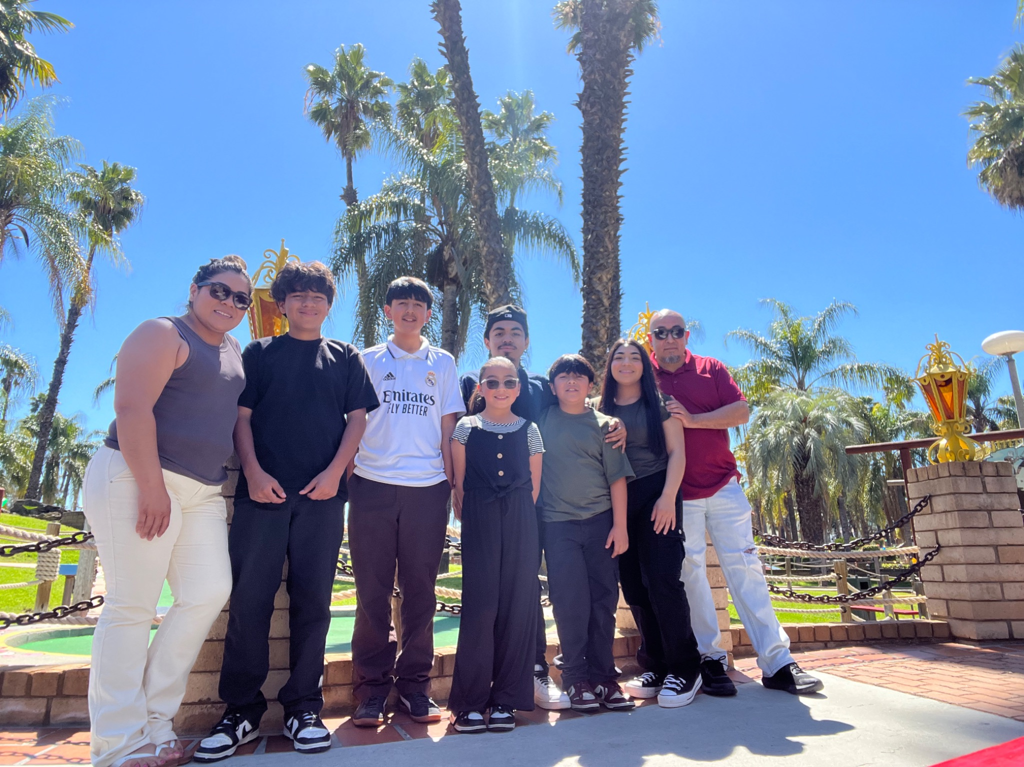
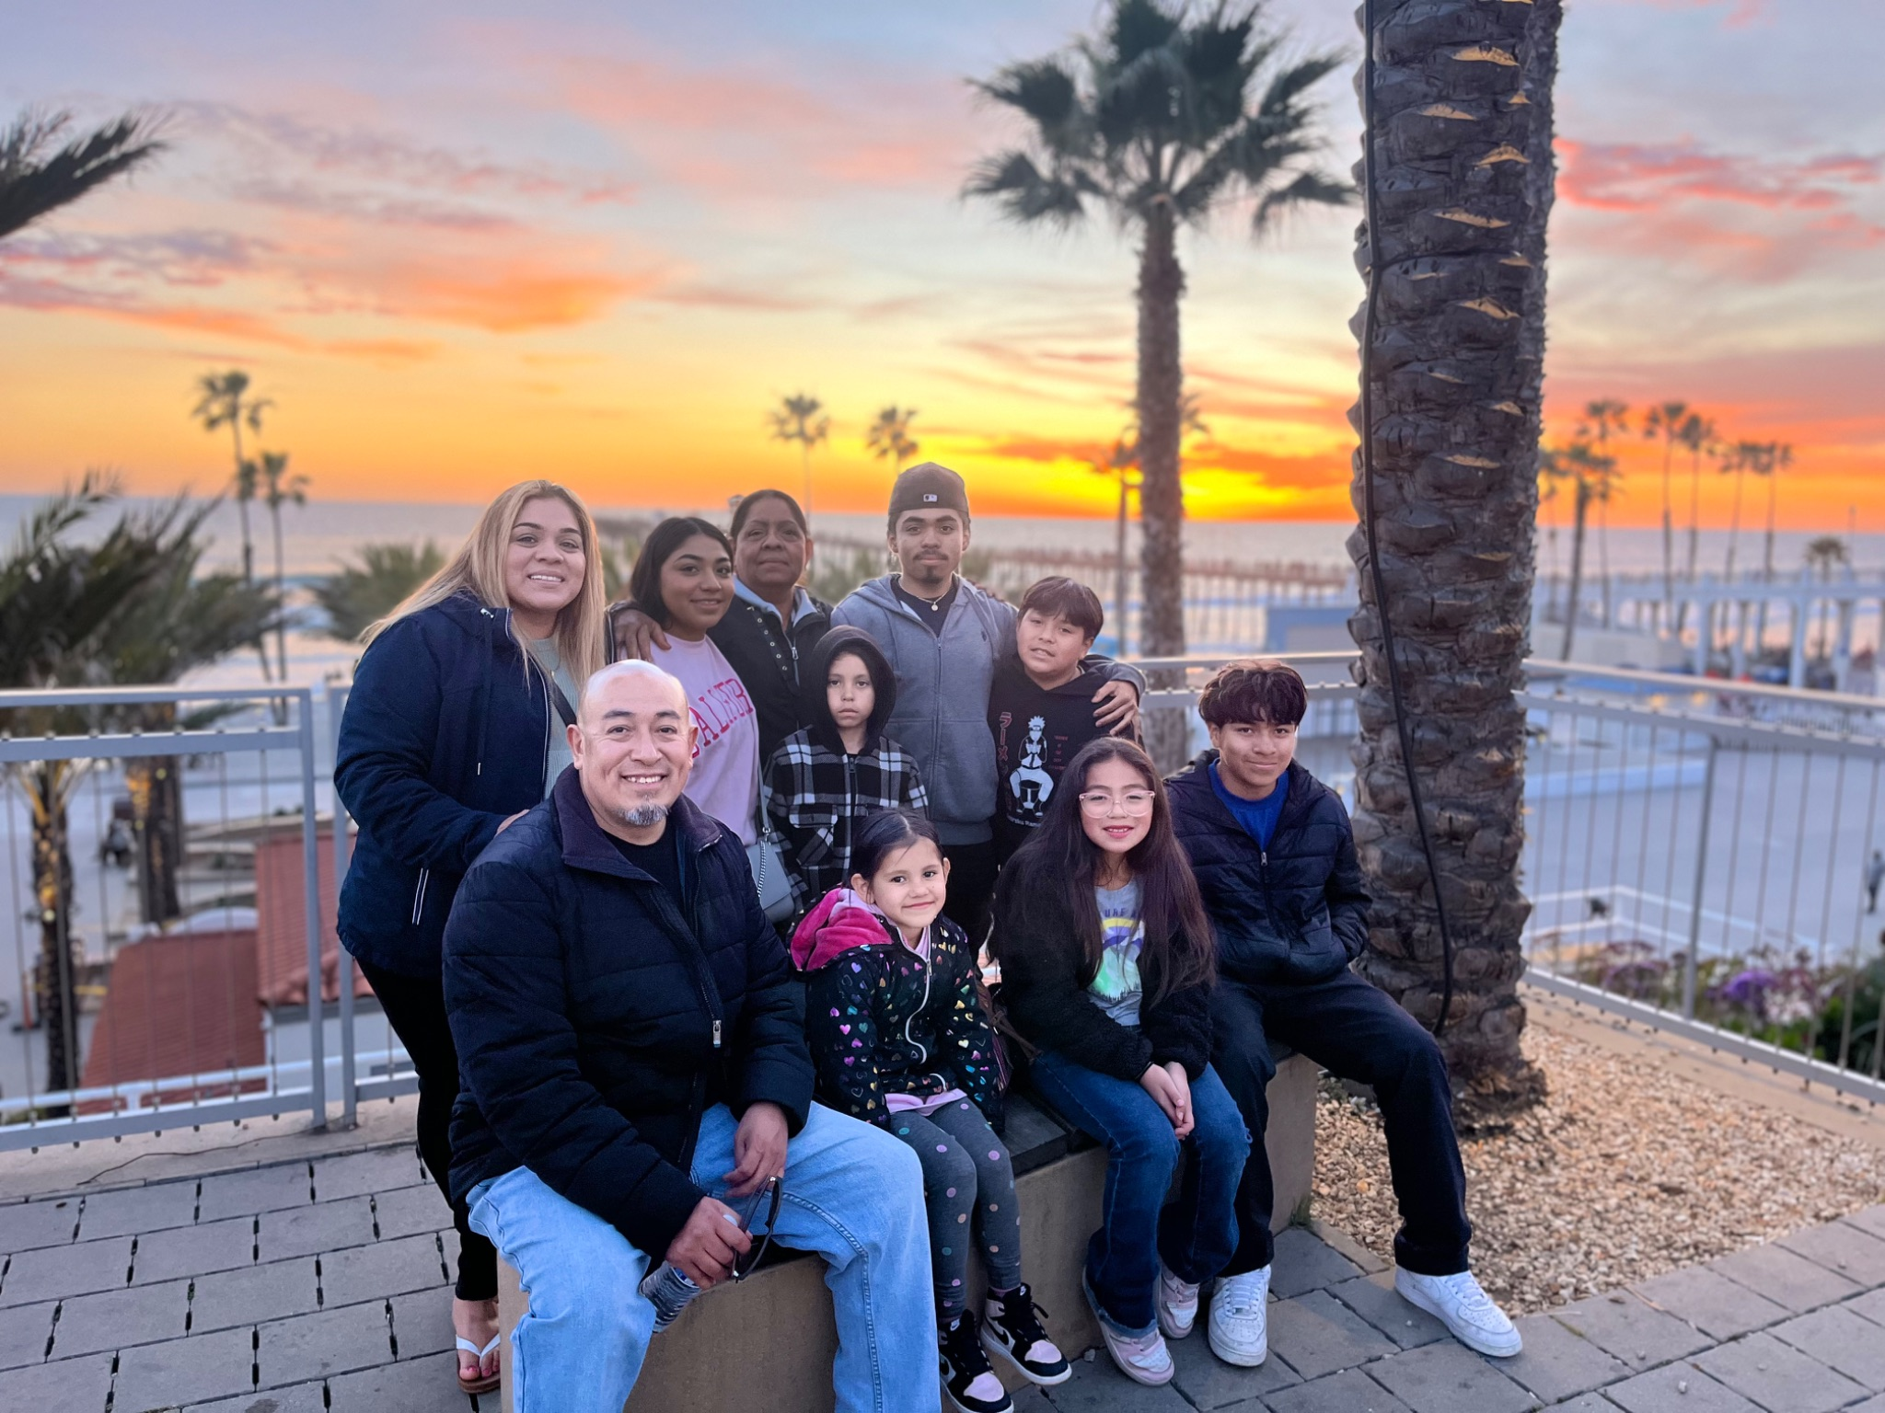
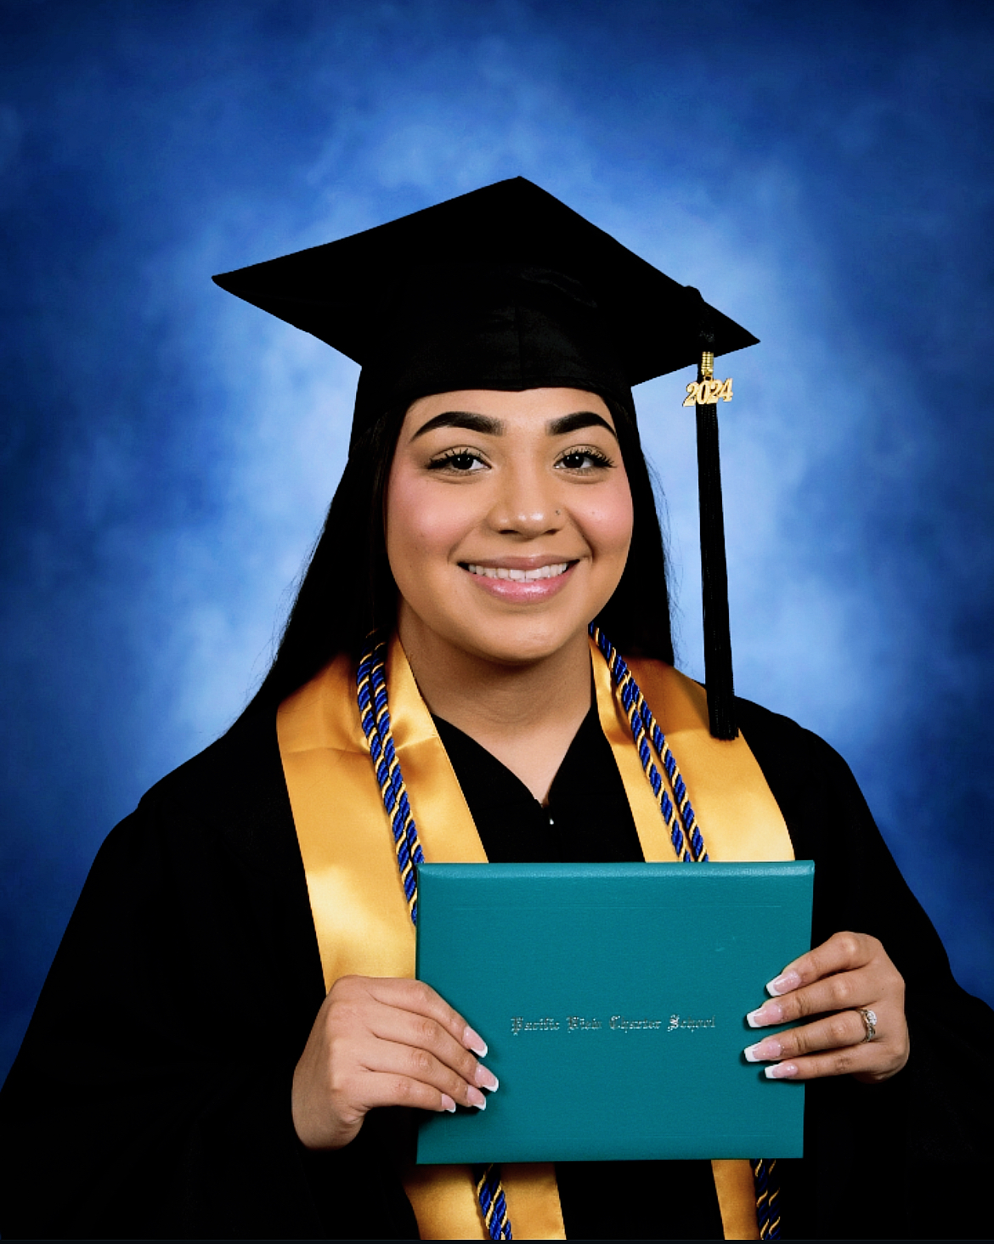
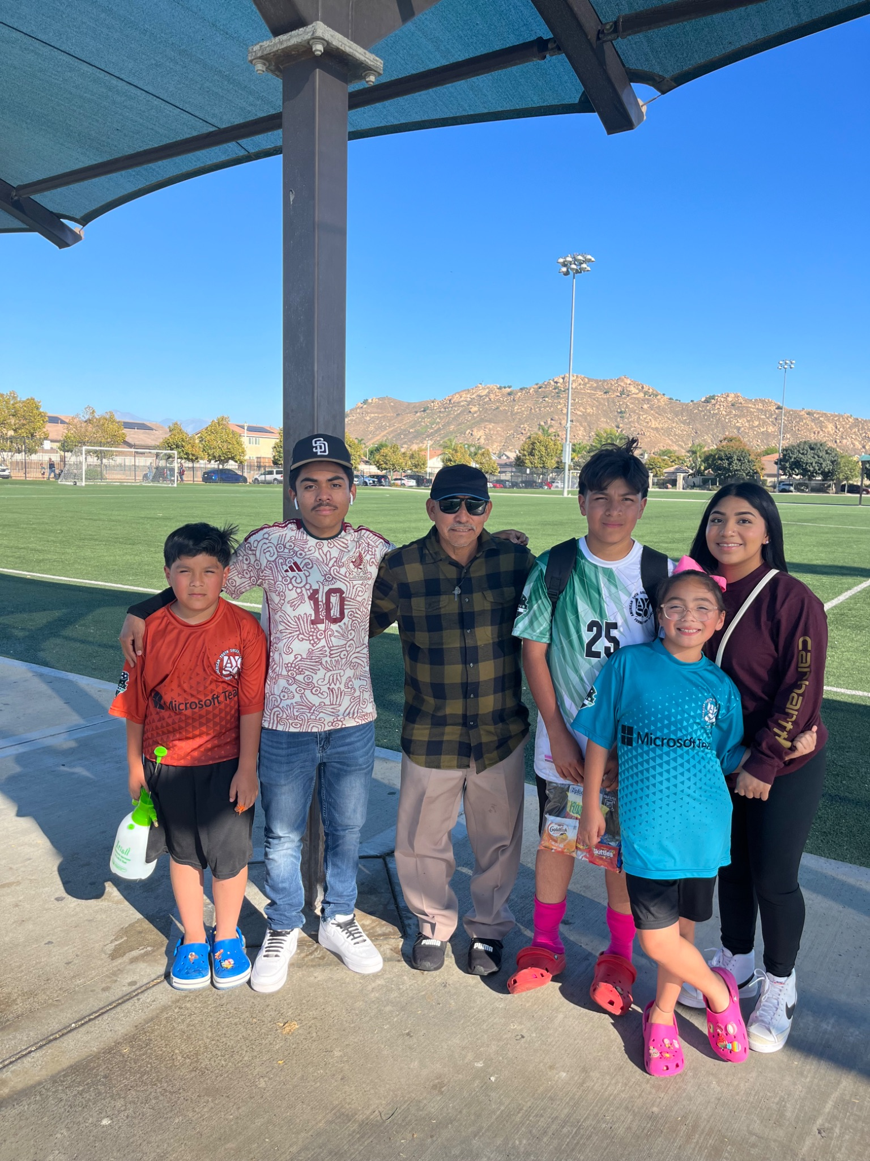
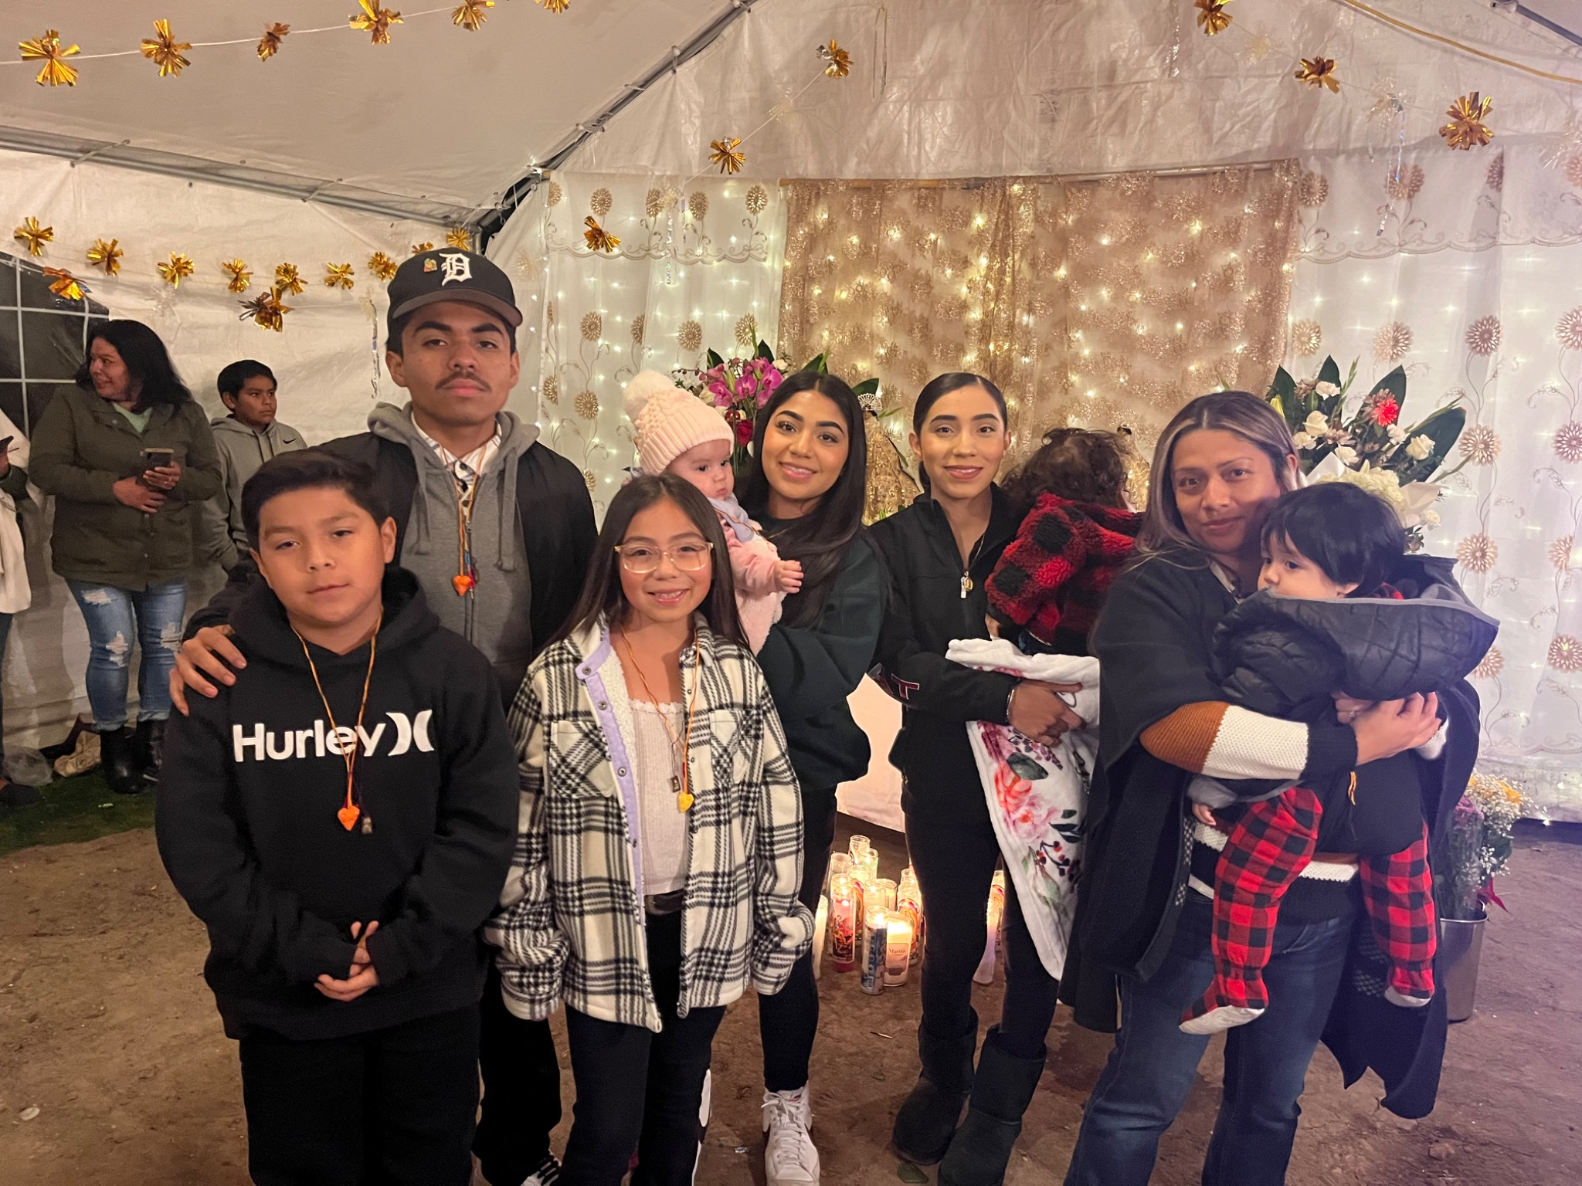
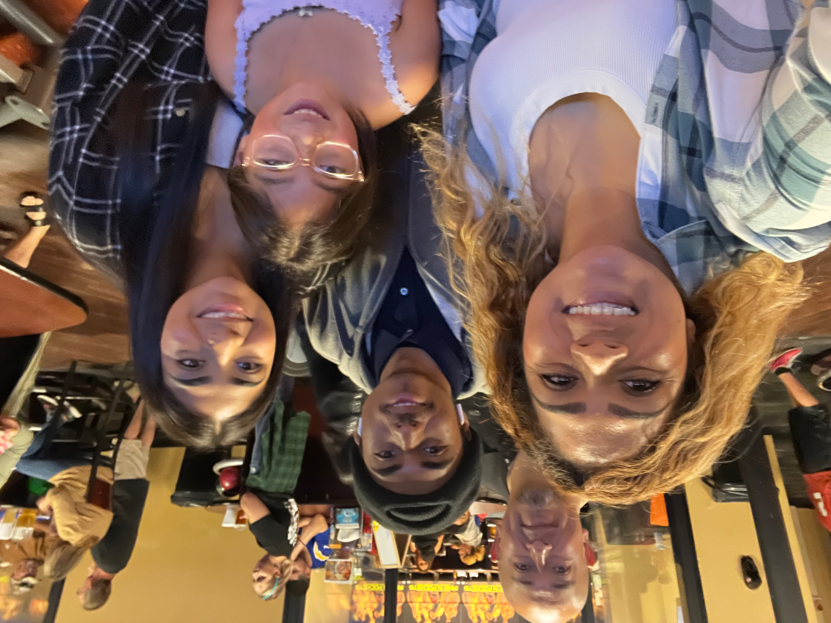
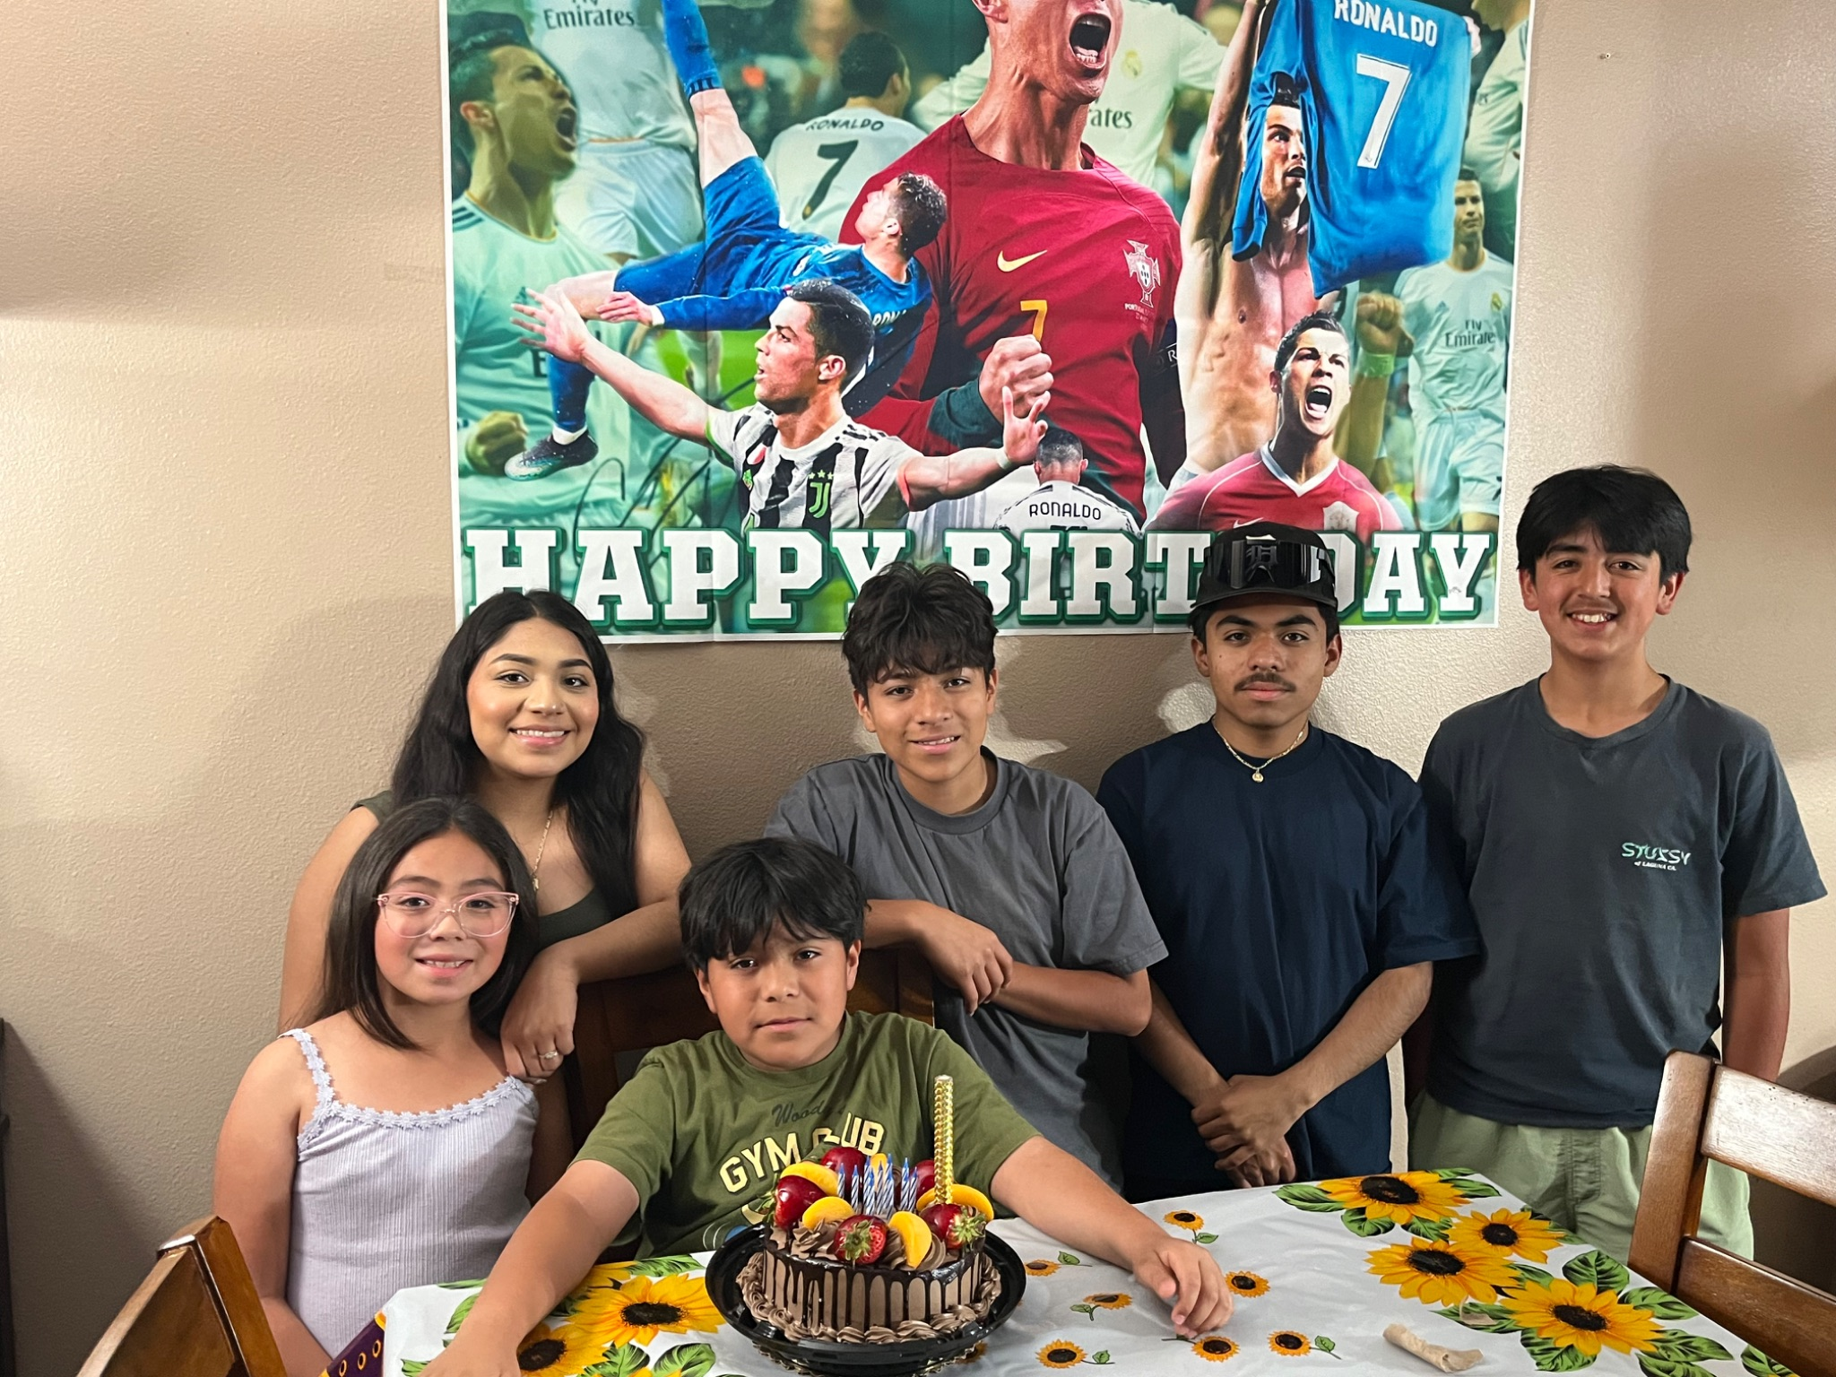
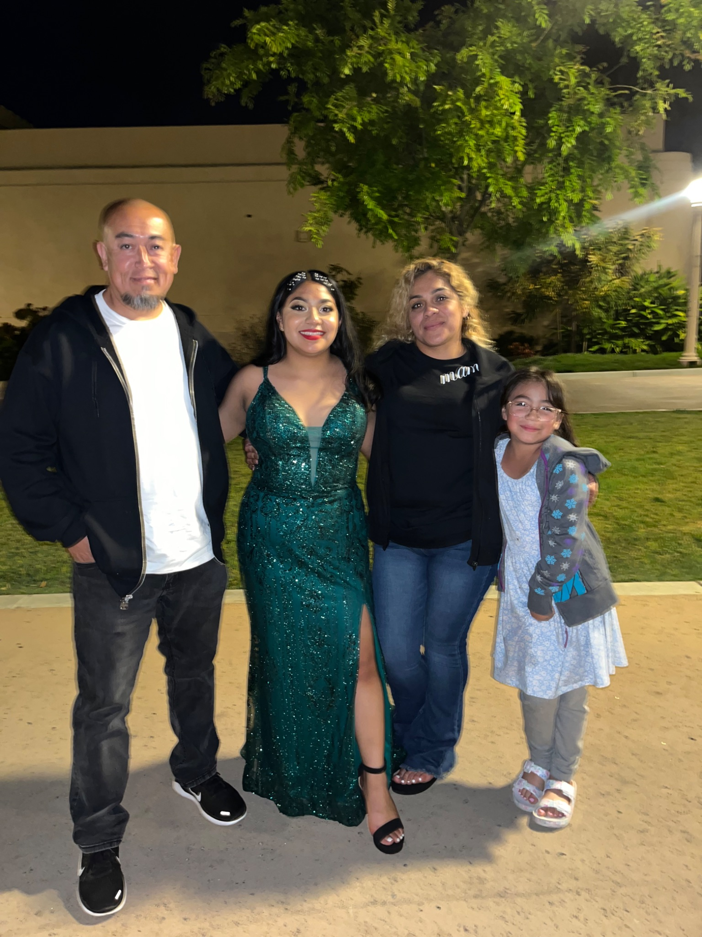
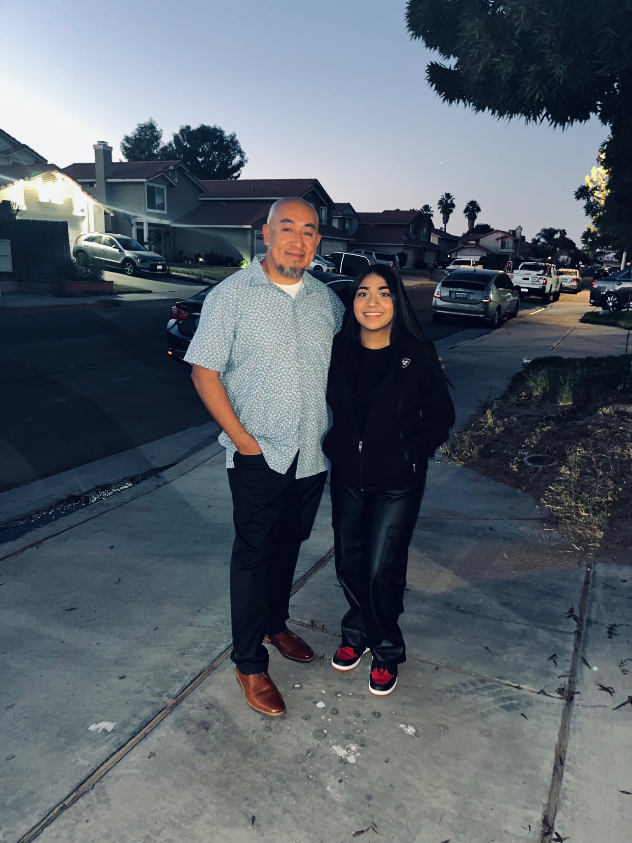
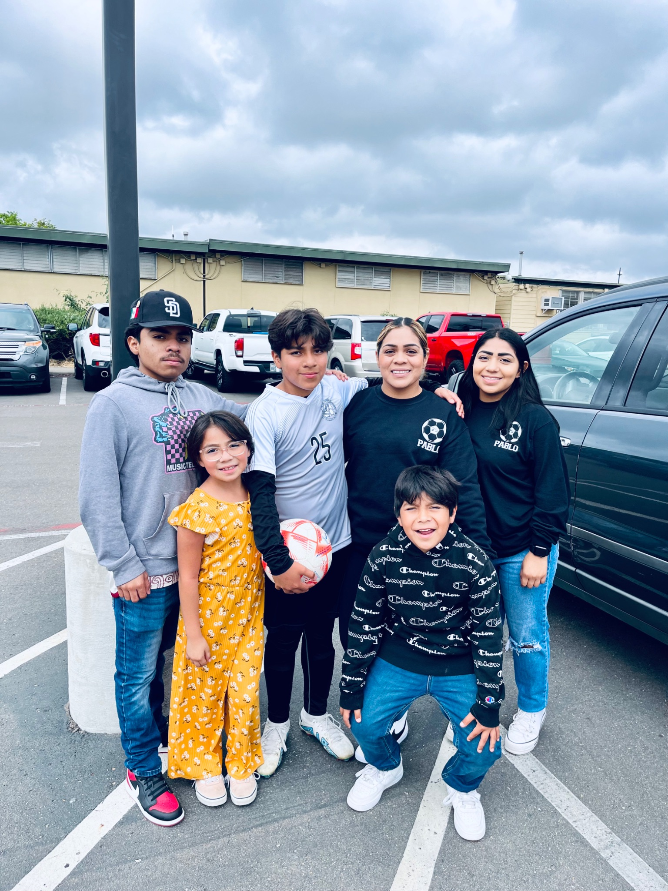
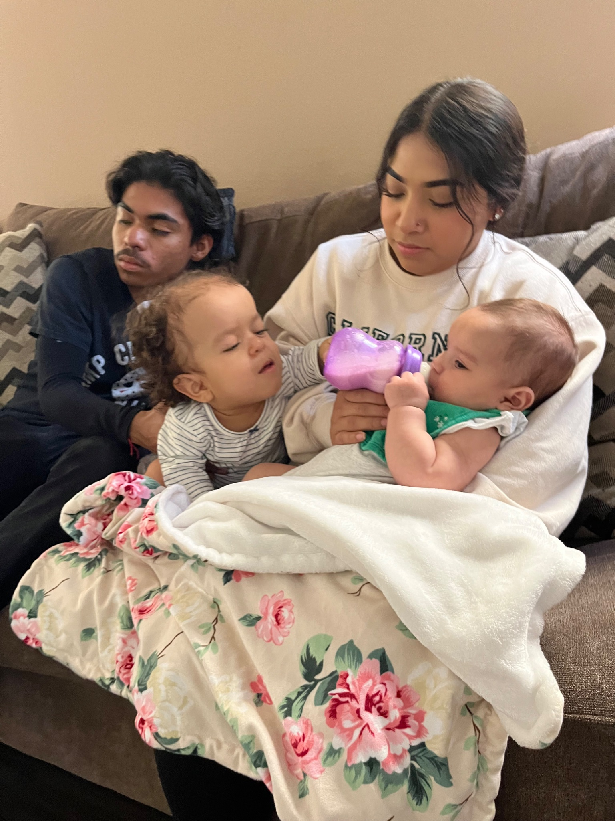
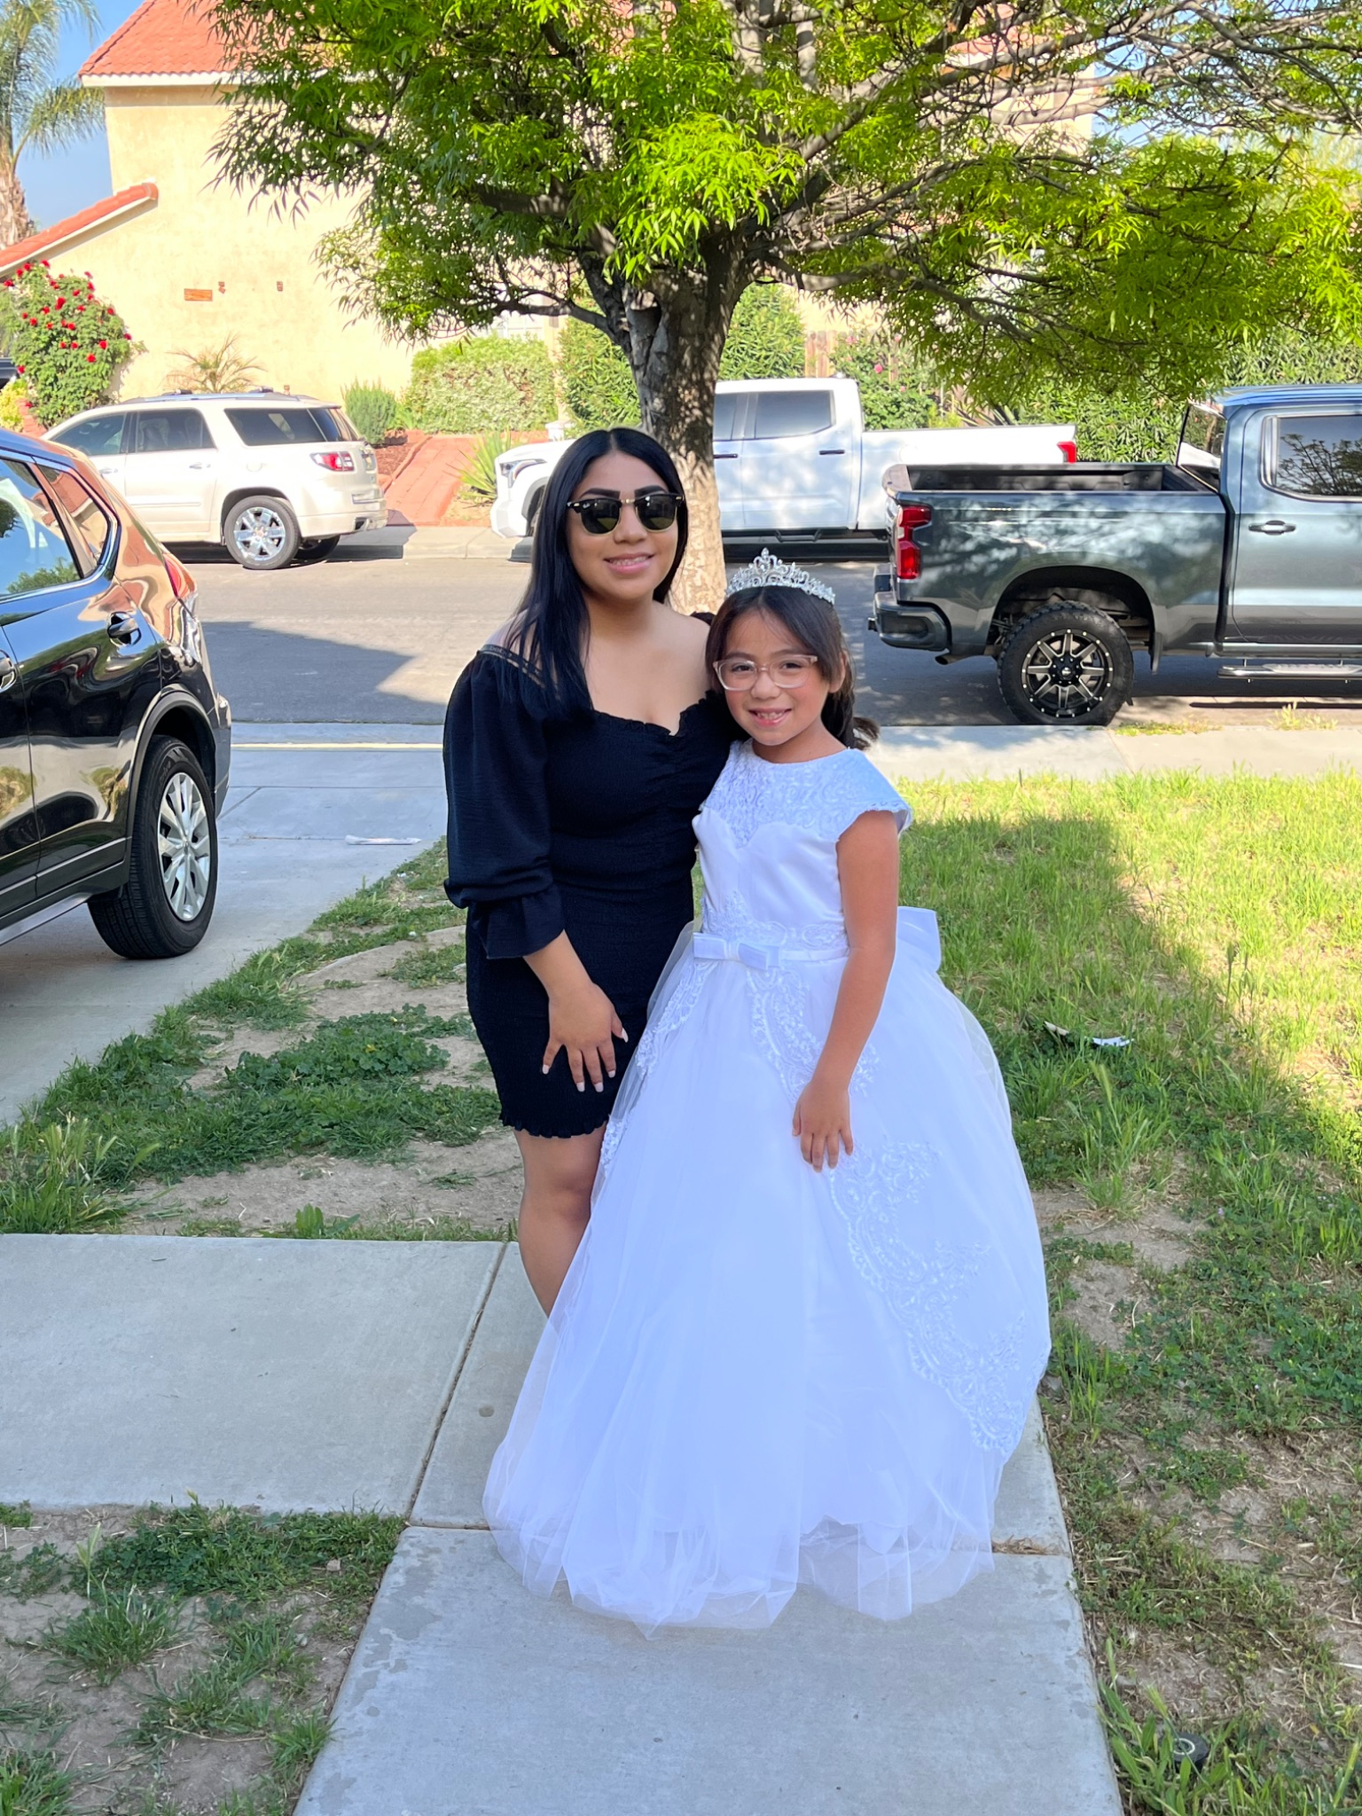
Ariana Alvarez

Slide 5
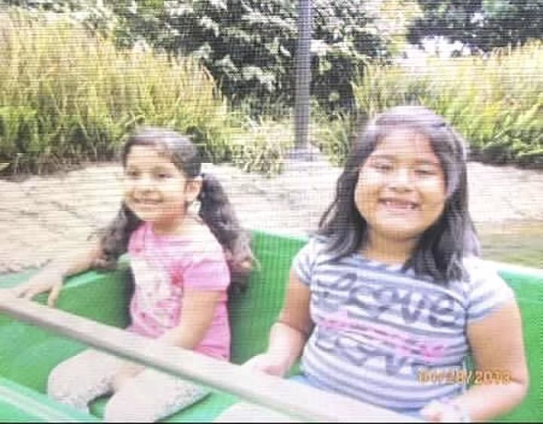
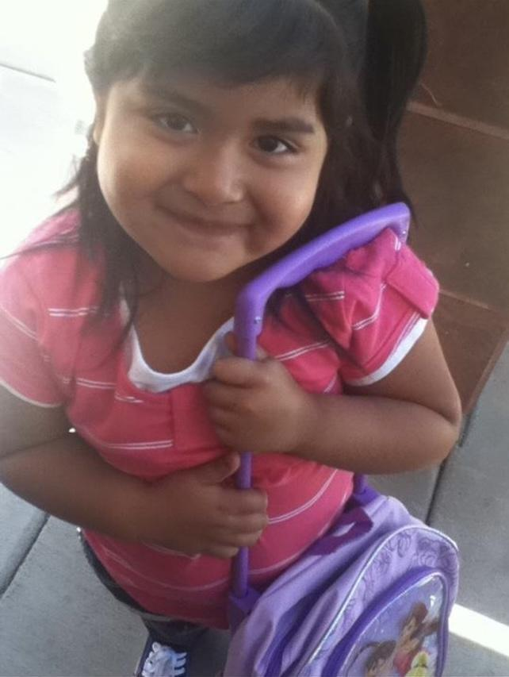
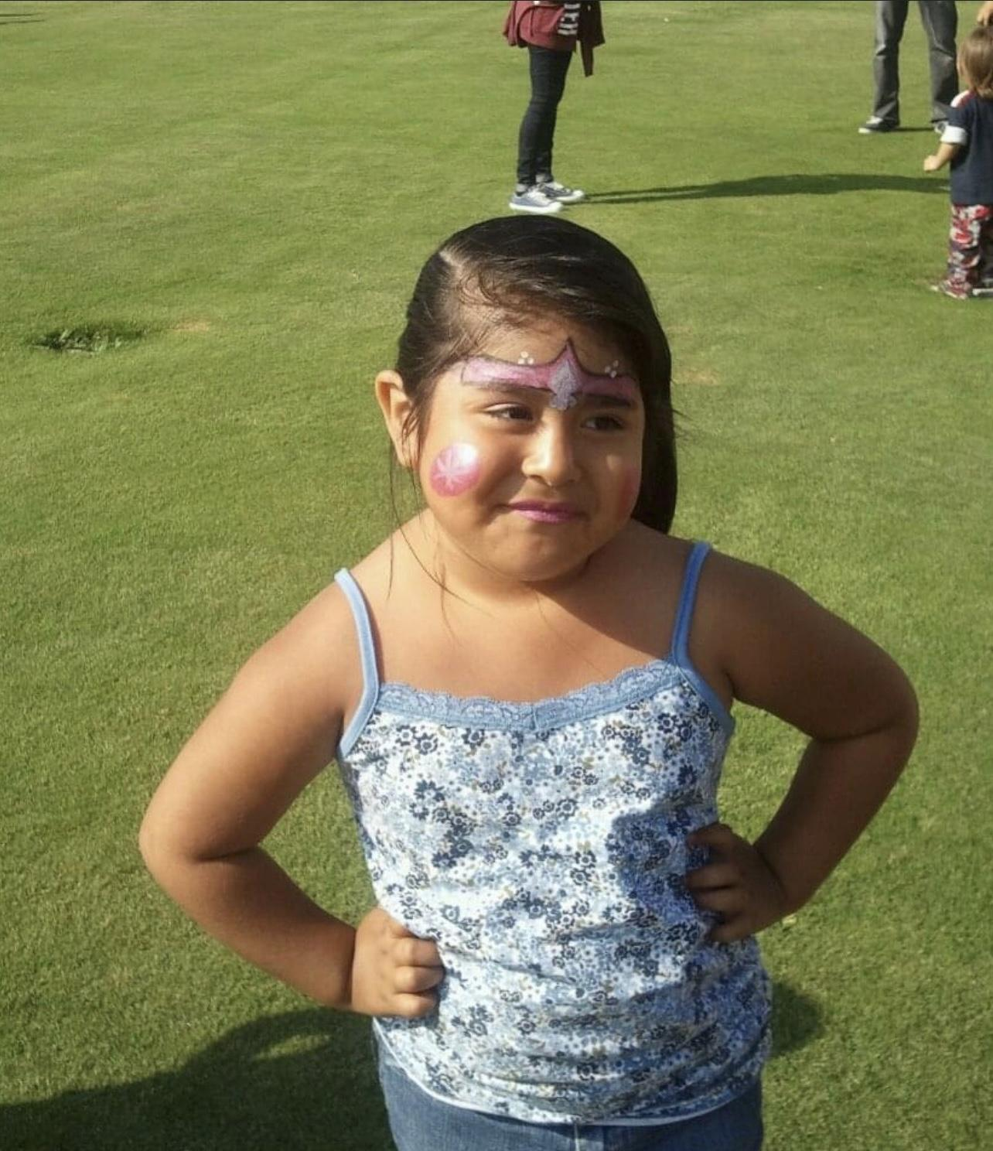
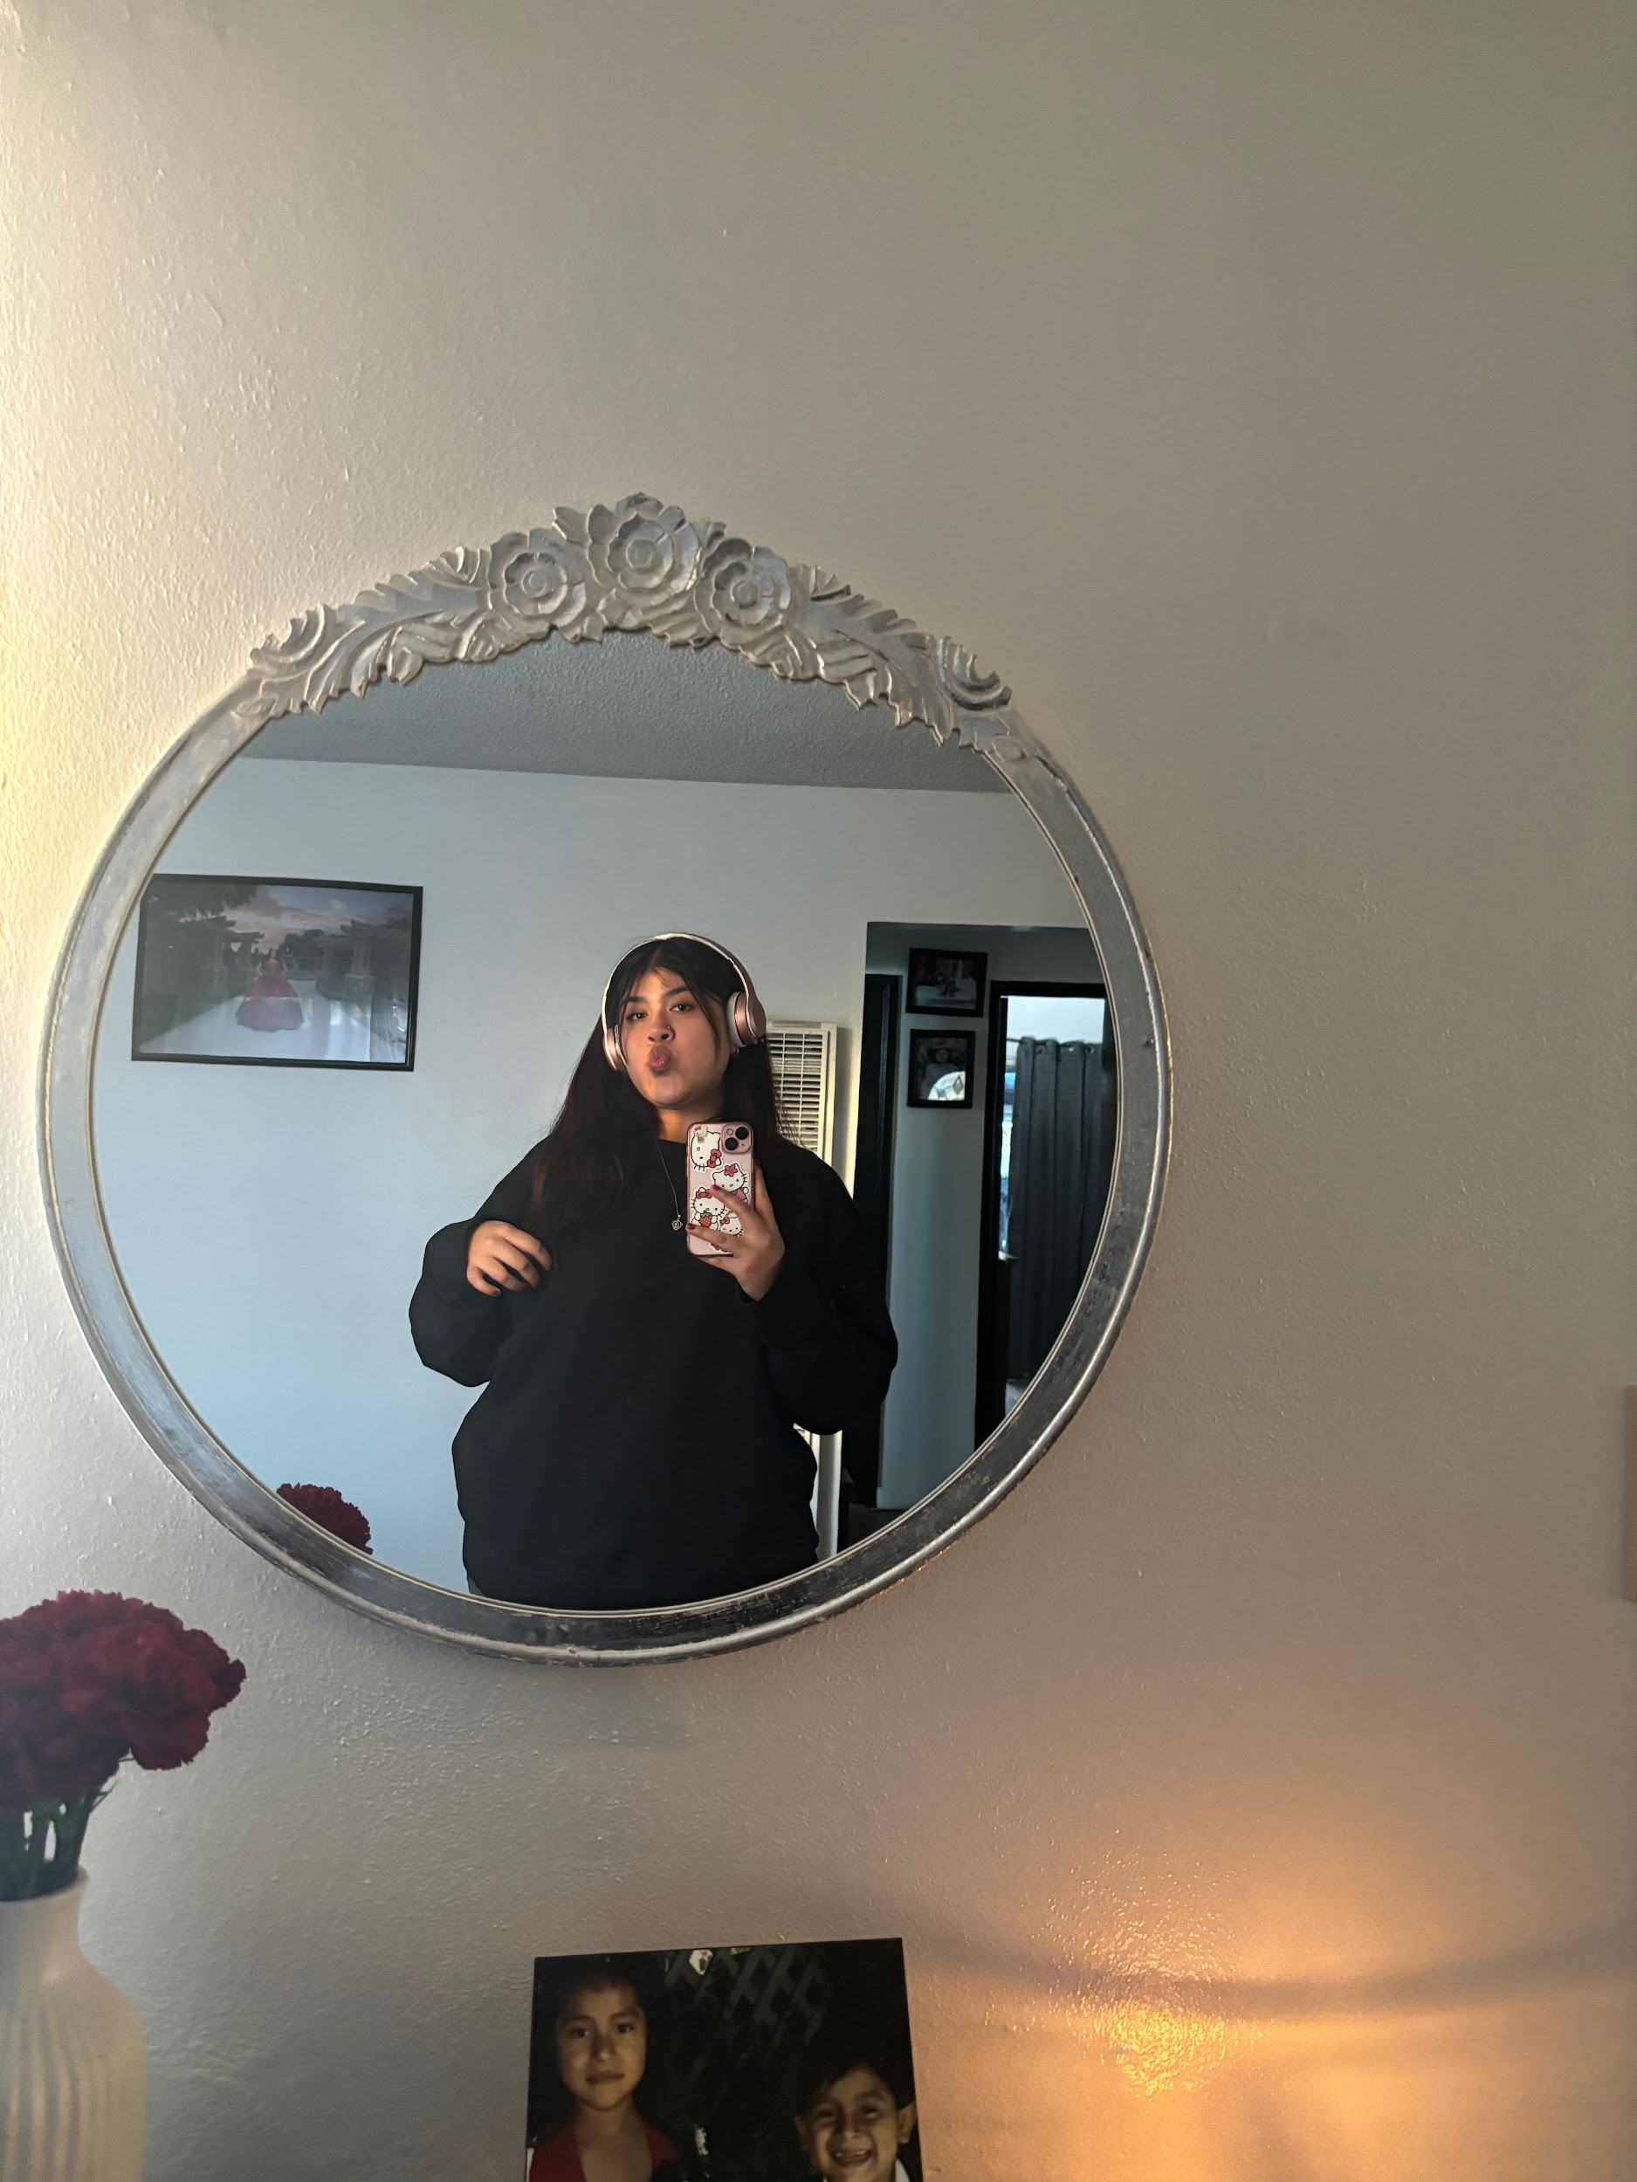
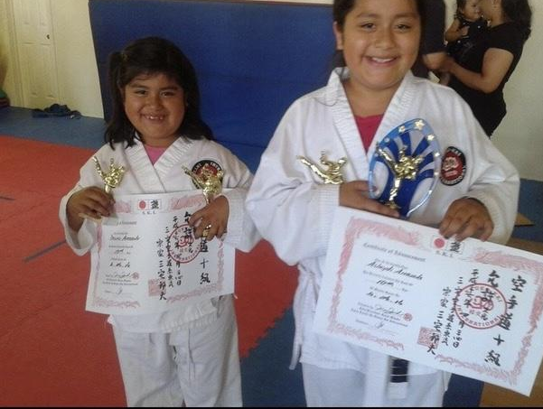
Desiree
Arrazola

Slide 7
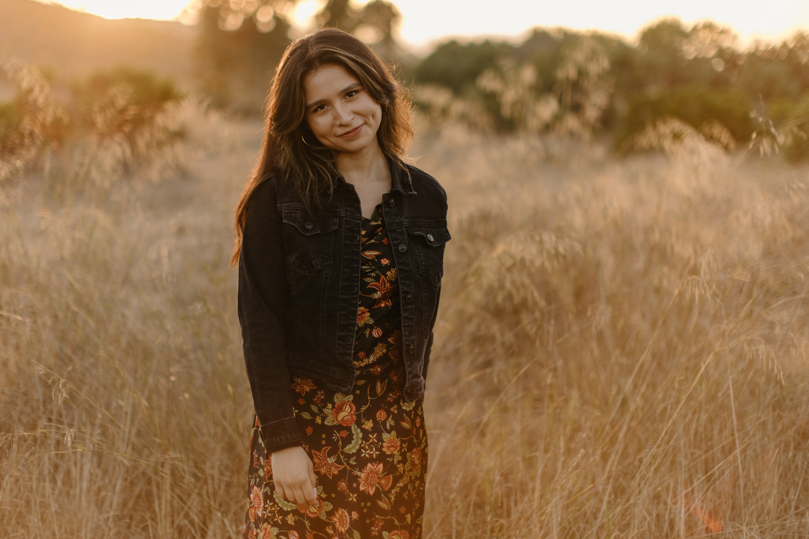
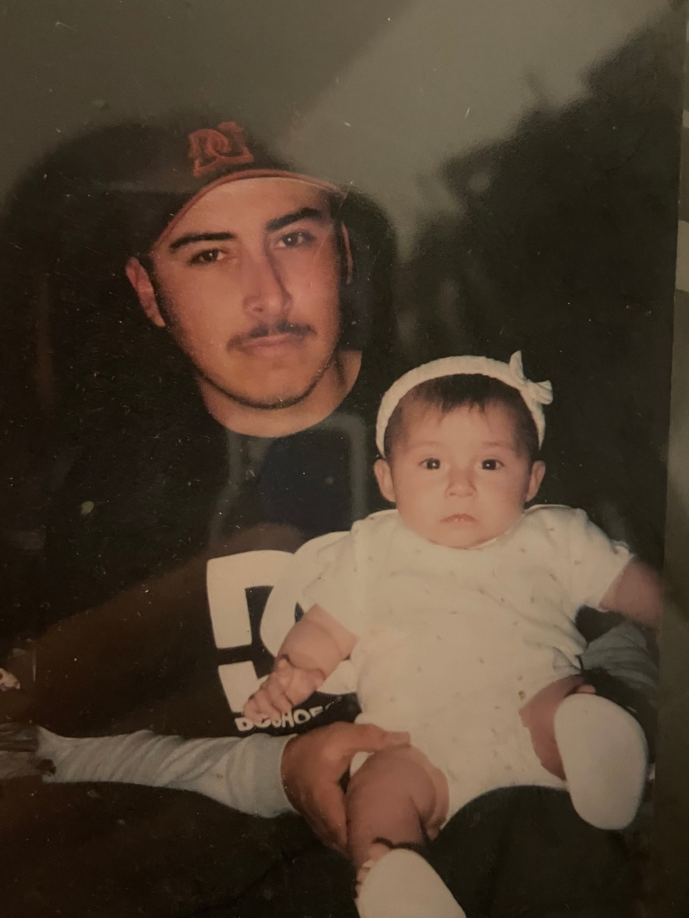
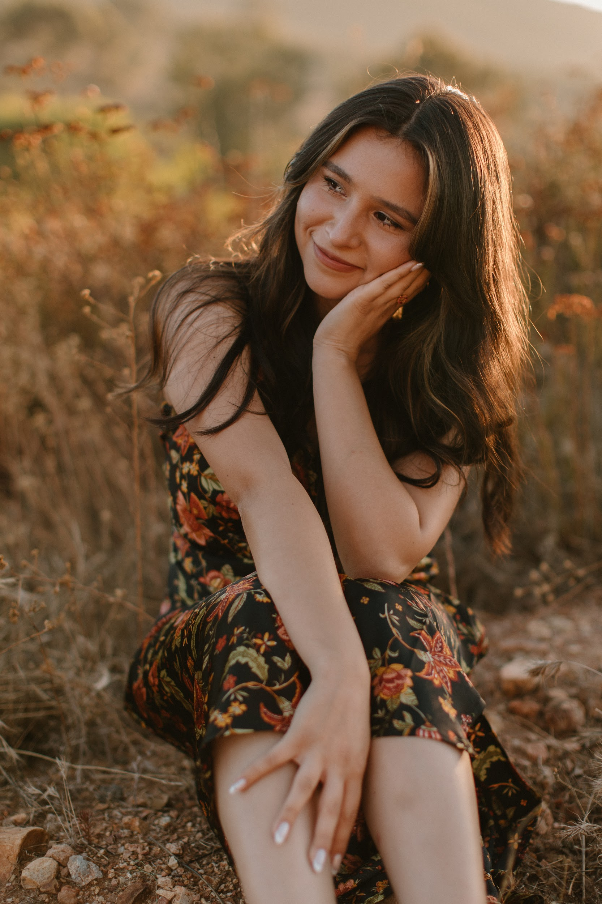
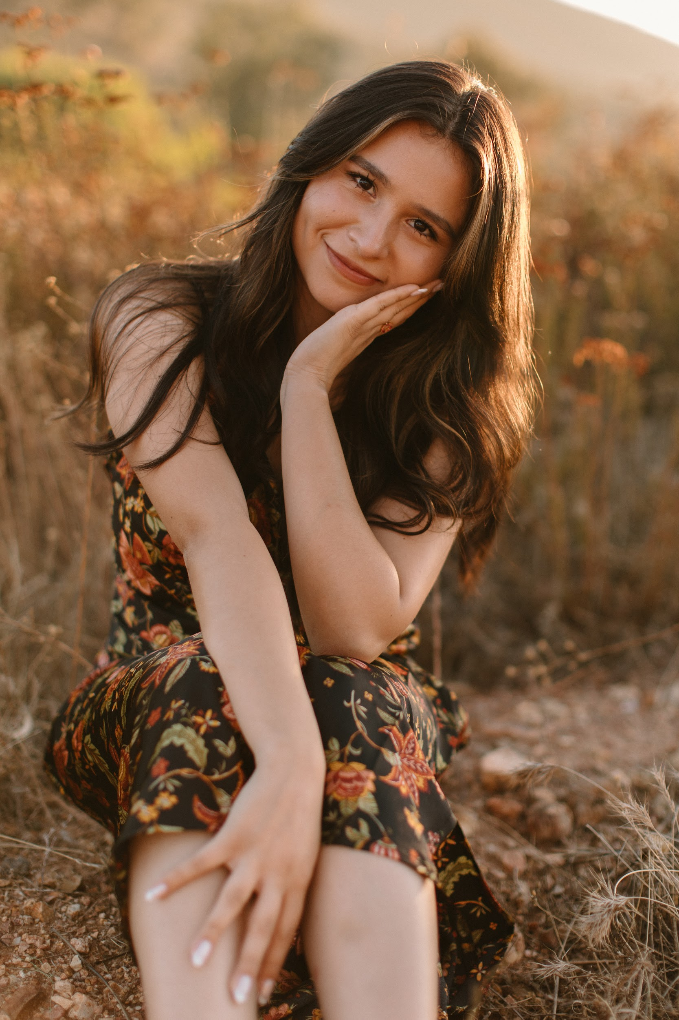
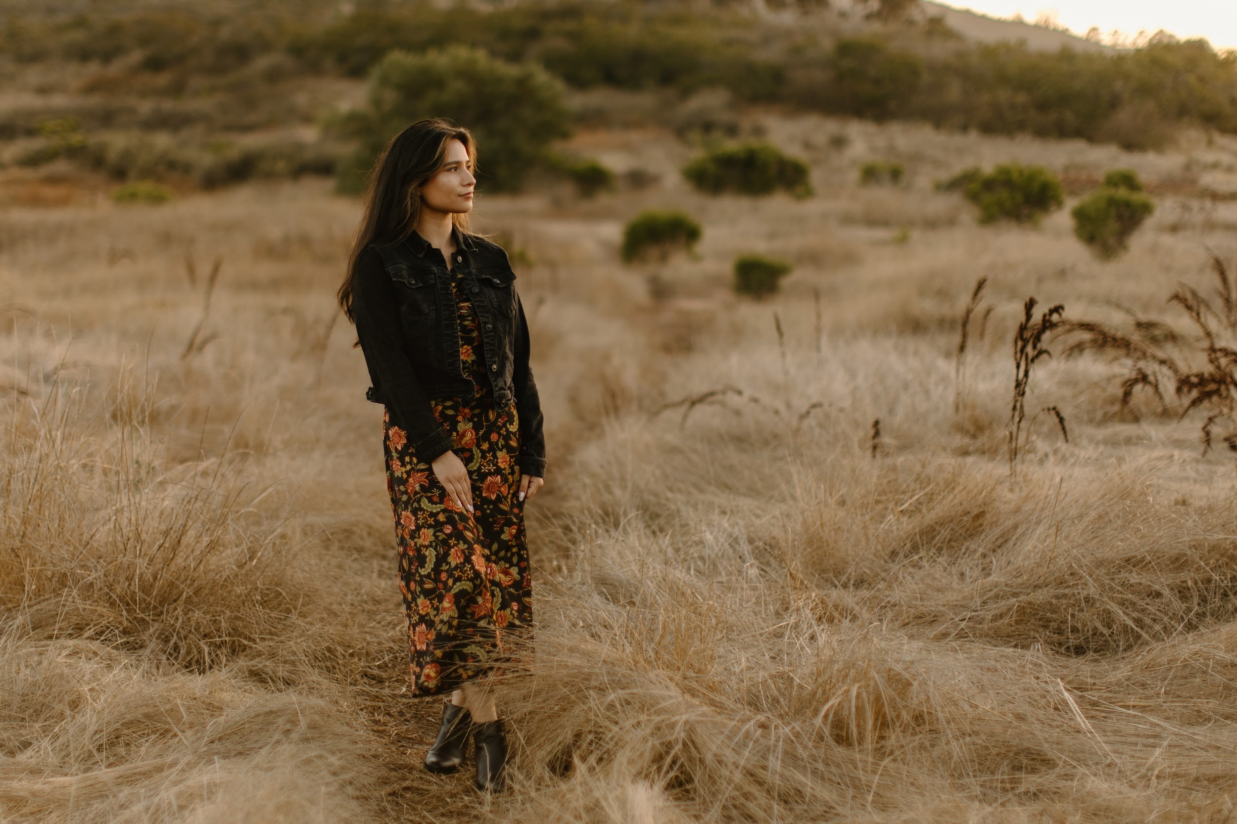
Hailey Castellanos

Slide 8
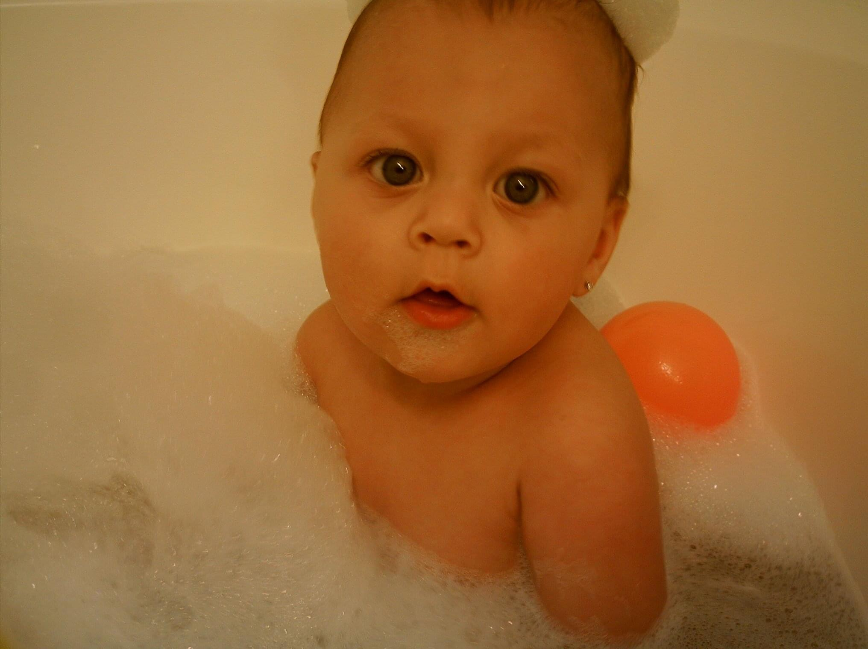
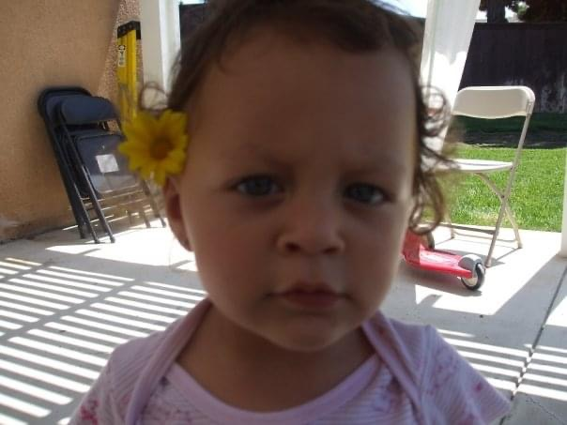
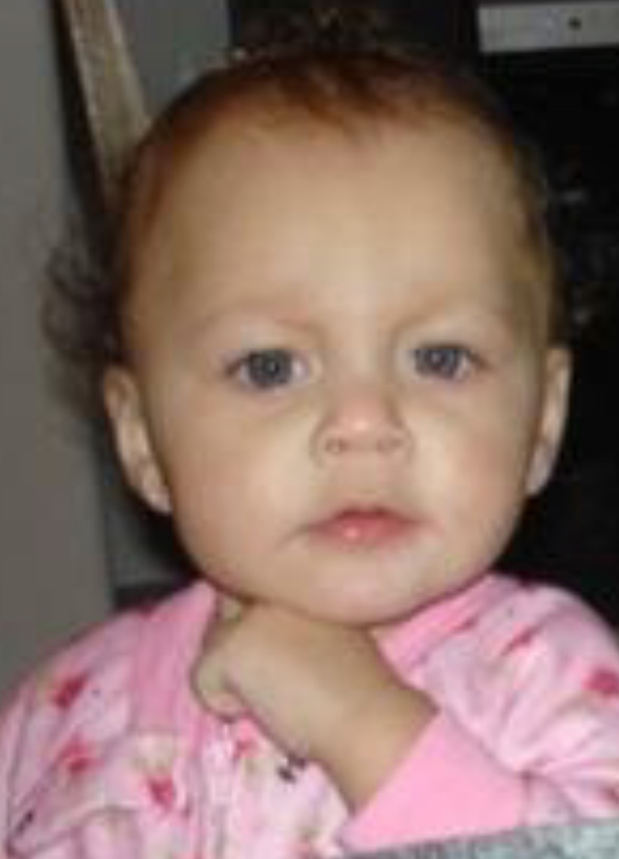
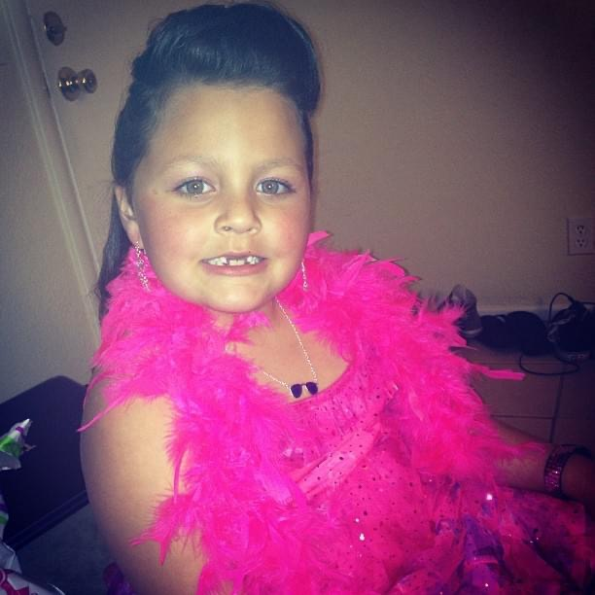
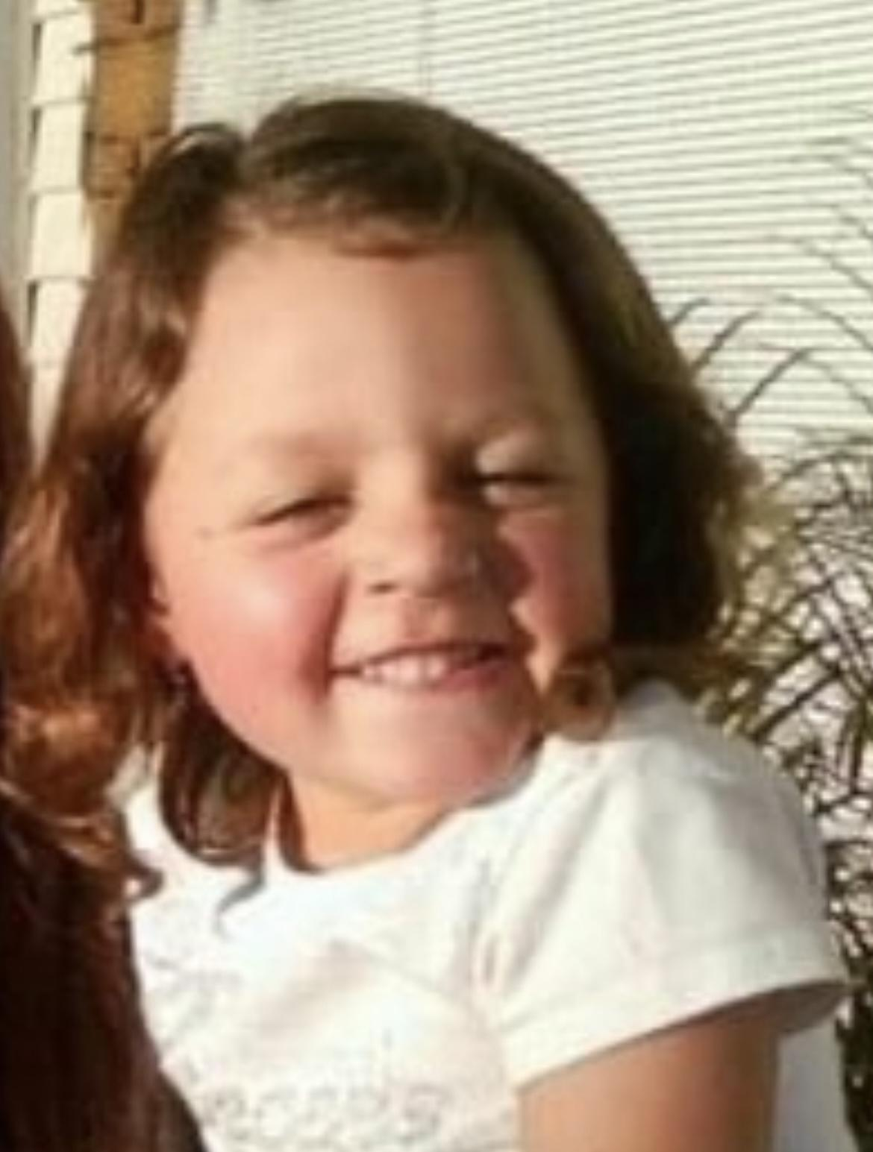
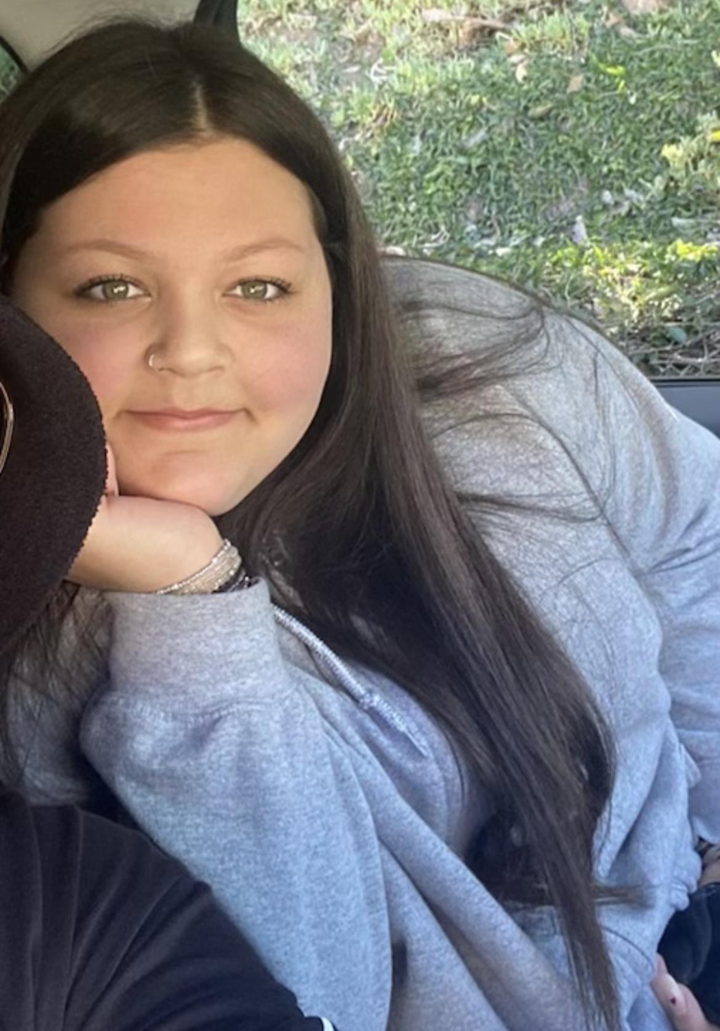
Class of 2024
J'Lynn Castro-Nixon

Slide 9
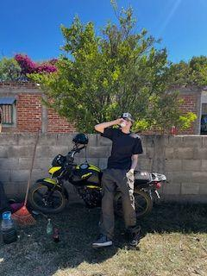
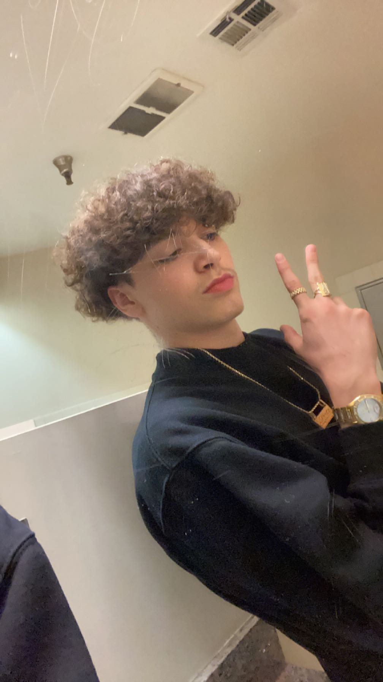
Alfredo De Luna
Career Goals:
Go to college for International Real Estate
Open up my own Investment Bank

Slide 10
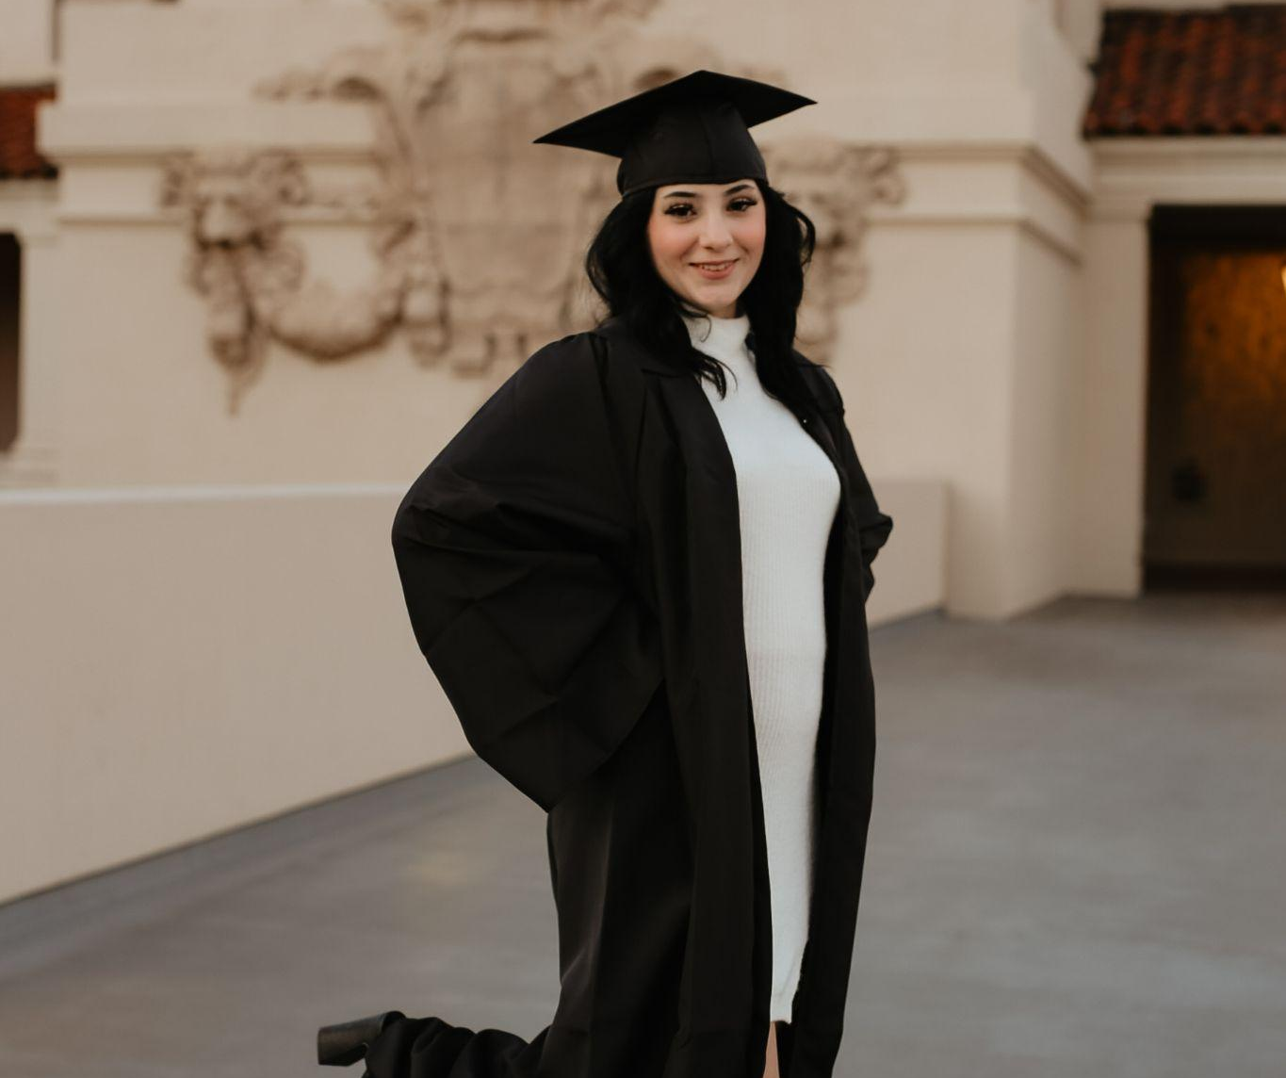
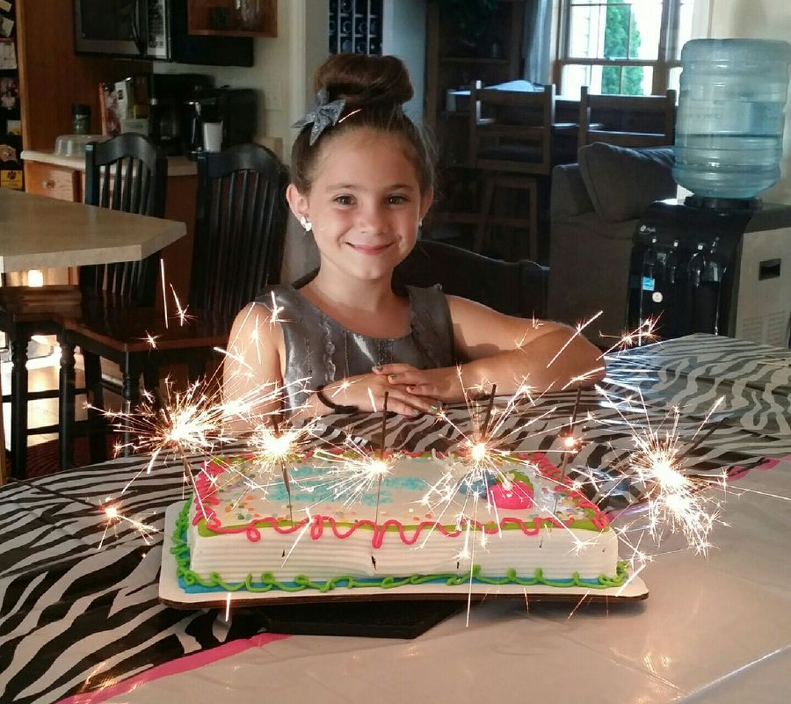
Slow down you're doing fine
You can't be everything you want to be before your time
Although it's so romantic on the borderline tonight …
Vienna waits for you…
Emma Esquivel

Slide 11
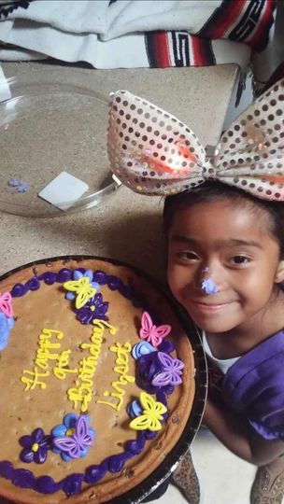
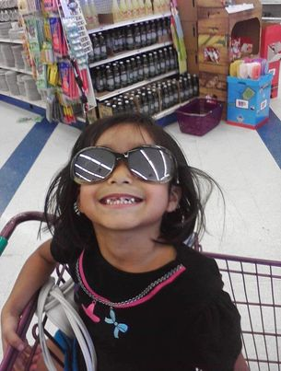
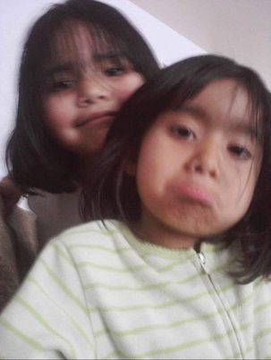
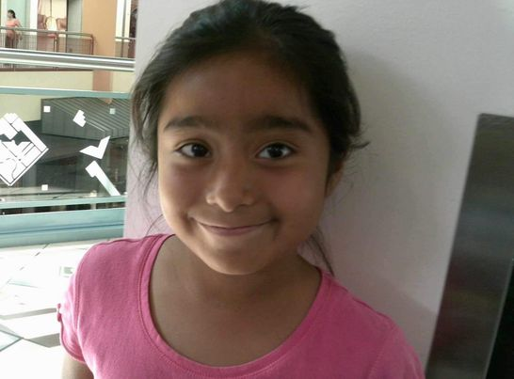
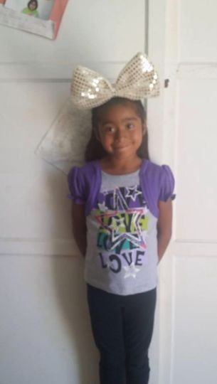
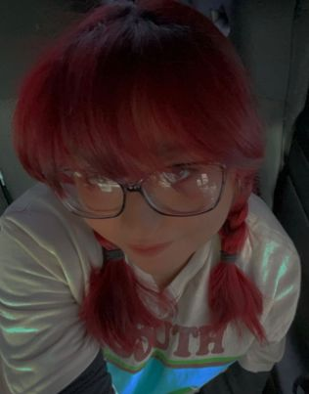
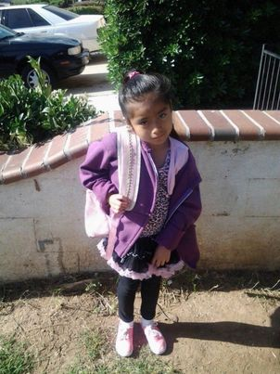
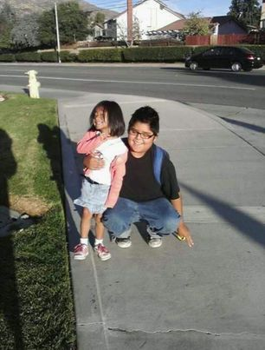
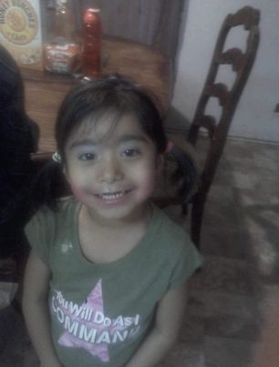
“You have brains in your head.You have feet in your shoes.You can steer yourself any direction you choose.”-
Dr.Seuss
Lizset Garcia

Slide 12
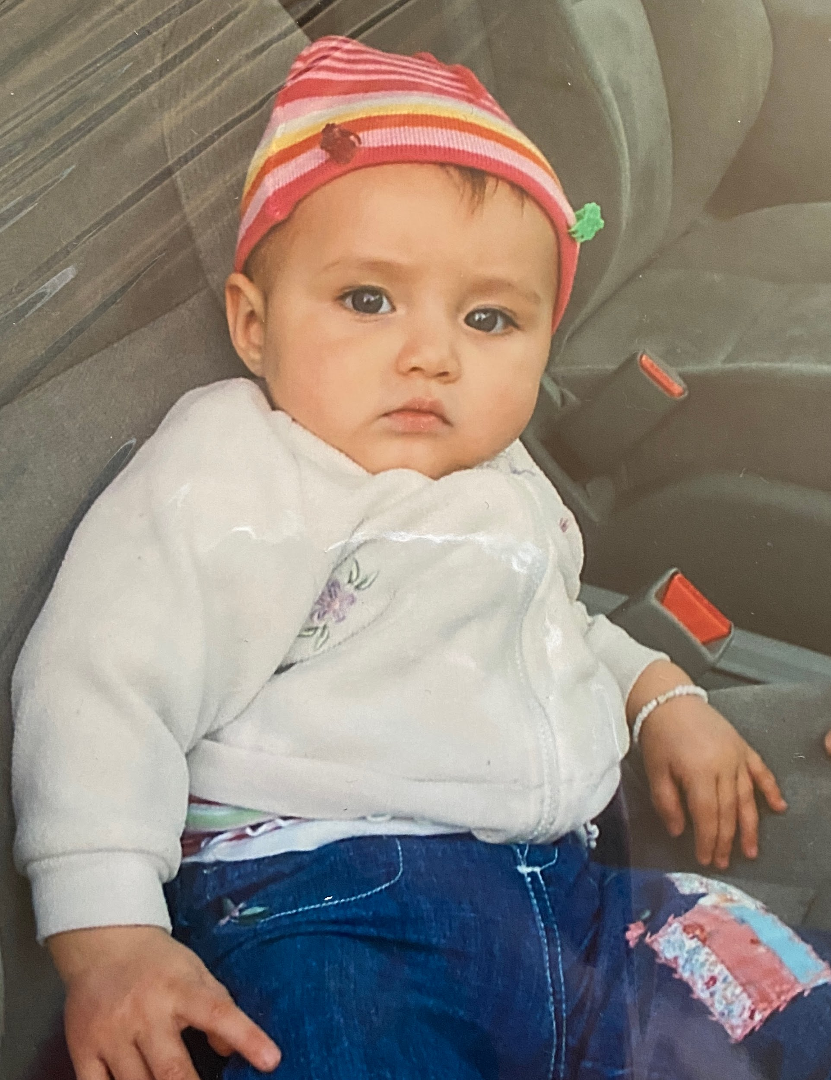
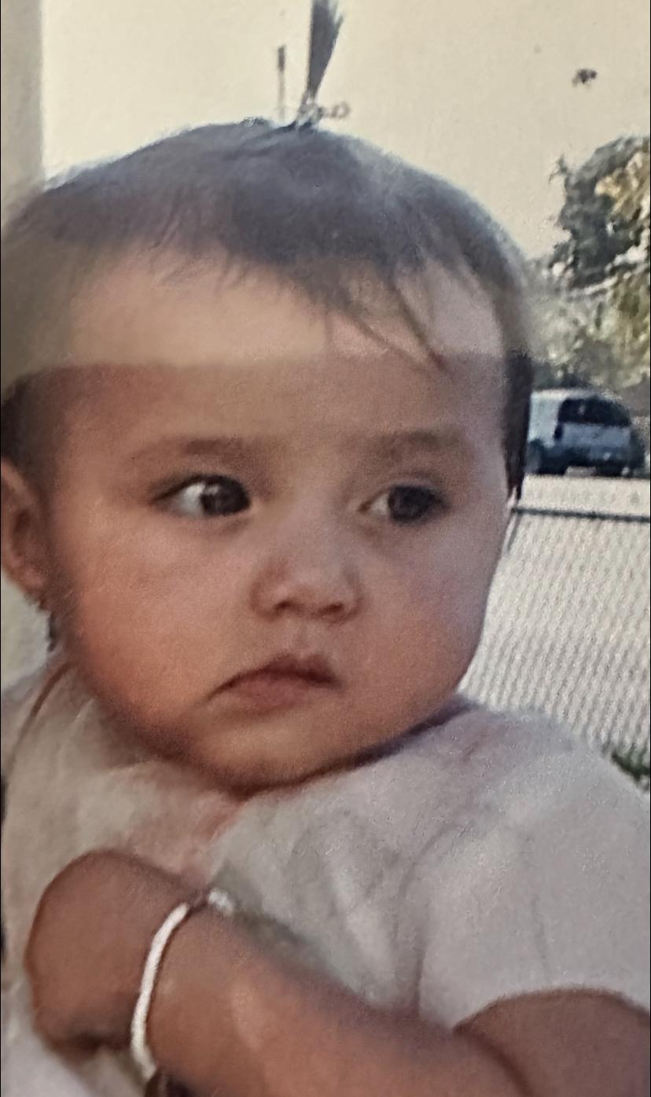
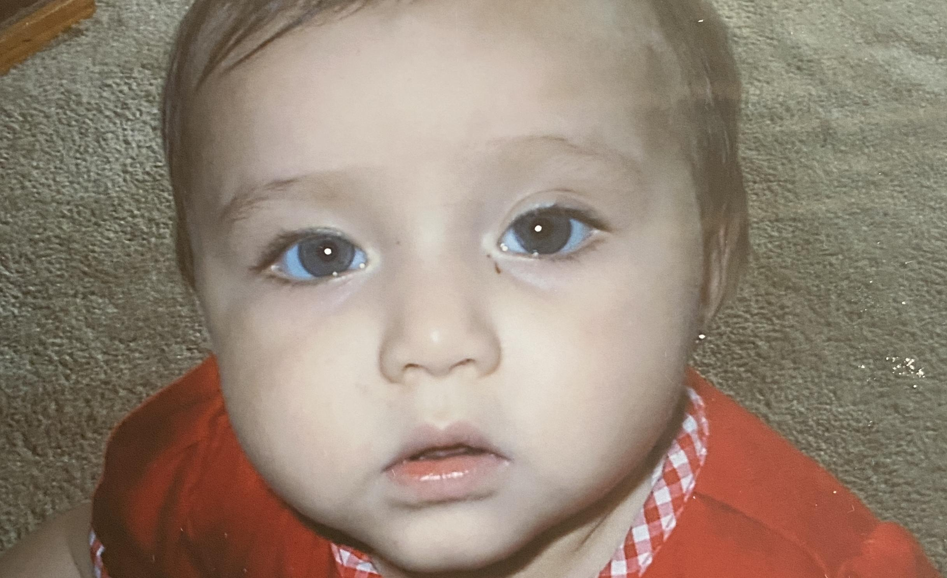
Rosa Grimaldo

Slide 13
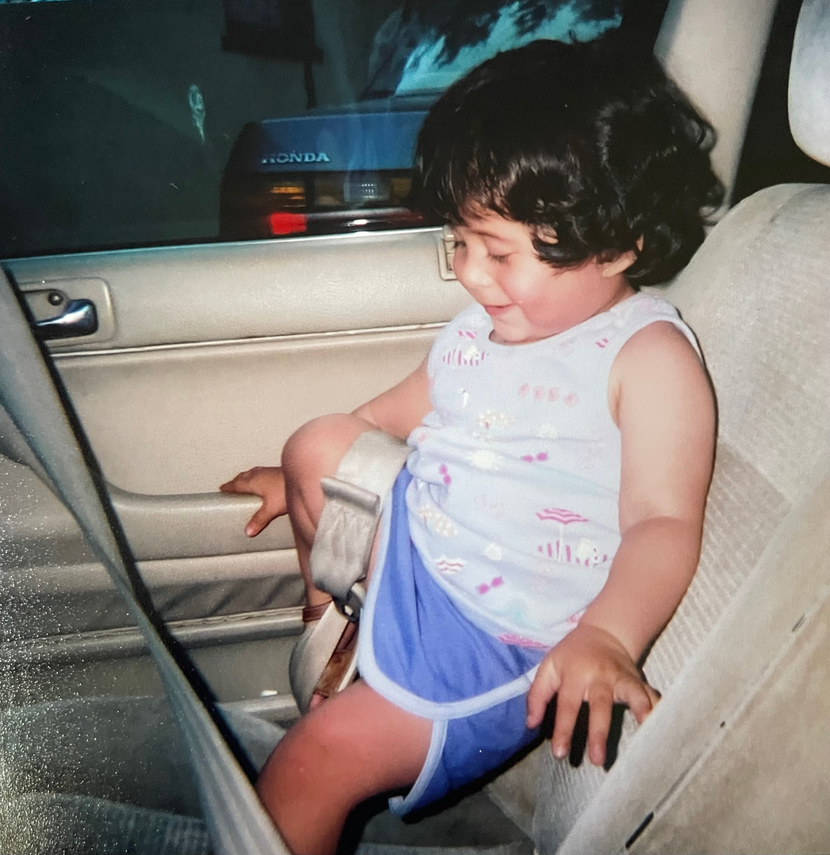
VALERIA GUZMAN

Slide 14
Valerie Heyer

Slide 15
Ethan Le
“You are not DEFEATED when you lose. You are defeated when you QUIT.
-Paulo Coelho
Do not let your disabilities or obstacles stop you in your journey to success.

Slide 16
Jesus Marin Martinez

Slide 17
Your future is bright when you reach for the stars!
We are so proud of you Brittany.
Love,
Mom, Dad, Ashley
Brittany McMorris

Slide 18
Christopher Montano II

Slide 19
Do want makes you happy,
No regrets
Analicea Nerey

Slide 21
Yasmine Marie Oliver

Slide 22
Congratulations
Dillan Ramos!
We are very proud of you!

Slide 23
Congratulations
Garrett Sandridge
Class of 2024

Slide 24
“Be yourself; everyone else is already taken.”― Oscar Wilde
Fatema Sayed

Slide 26
Now then, stand still and see this great thing the LORD is about to do before your eyes!
1 Samuel 12:16
RIYANA WEST

Slide 27
I believed I could THEN
And I did NOW
Harmony Williams
Class of 2024

