Slide 1
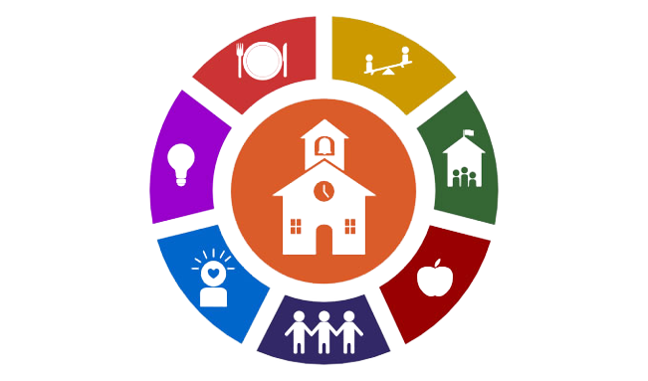
Community Schools
Clayton County public Schools

Slide 2
Community School Sections
What is a community school?
Four Pillars
Whole Child Approach
Community School Locations in CCPS
How to get involved
​Meet the Team
​
​

Slide 3
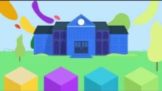
What is a Community School
Community Schools are public schools that provide services and support that fit each neighborhood’s needs, created and run by the people who know our children best—all working together.
The community schools strategy transforms a school into a place where educators, local community members, families, and students work together to strengthen conditions for student learning and healthy development. As partners, they organize in- and out-of-school resources, supports, and opportunities so that young people thrive.

Slide 4
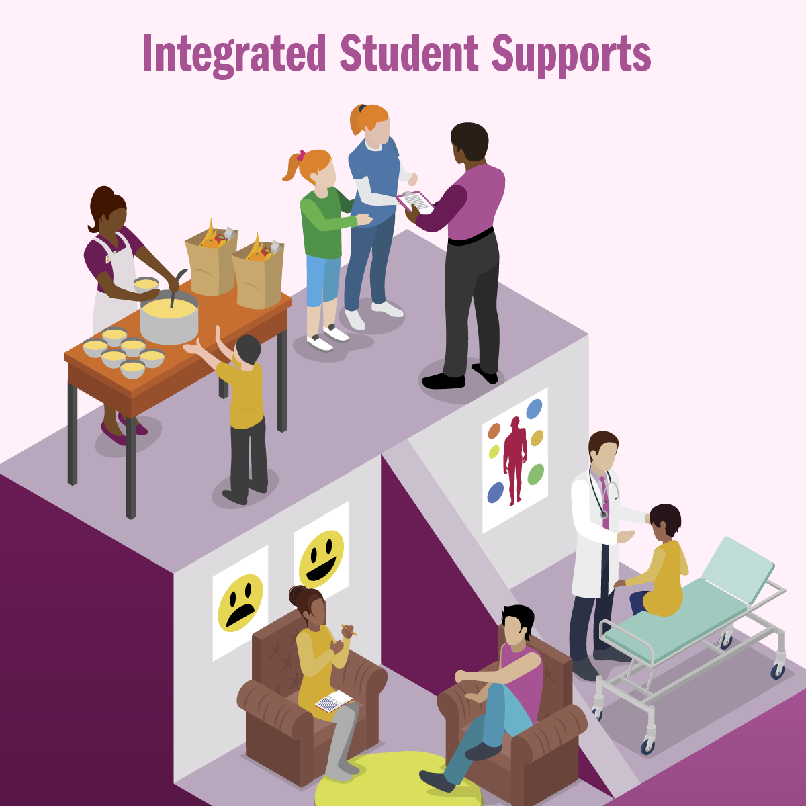
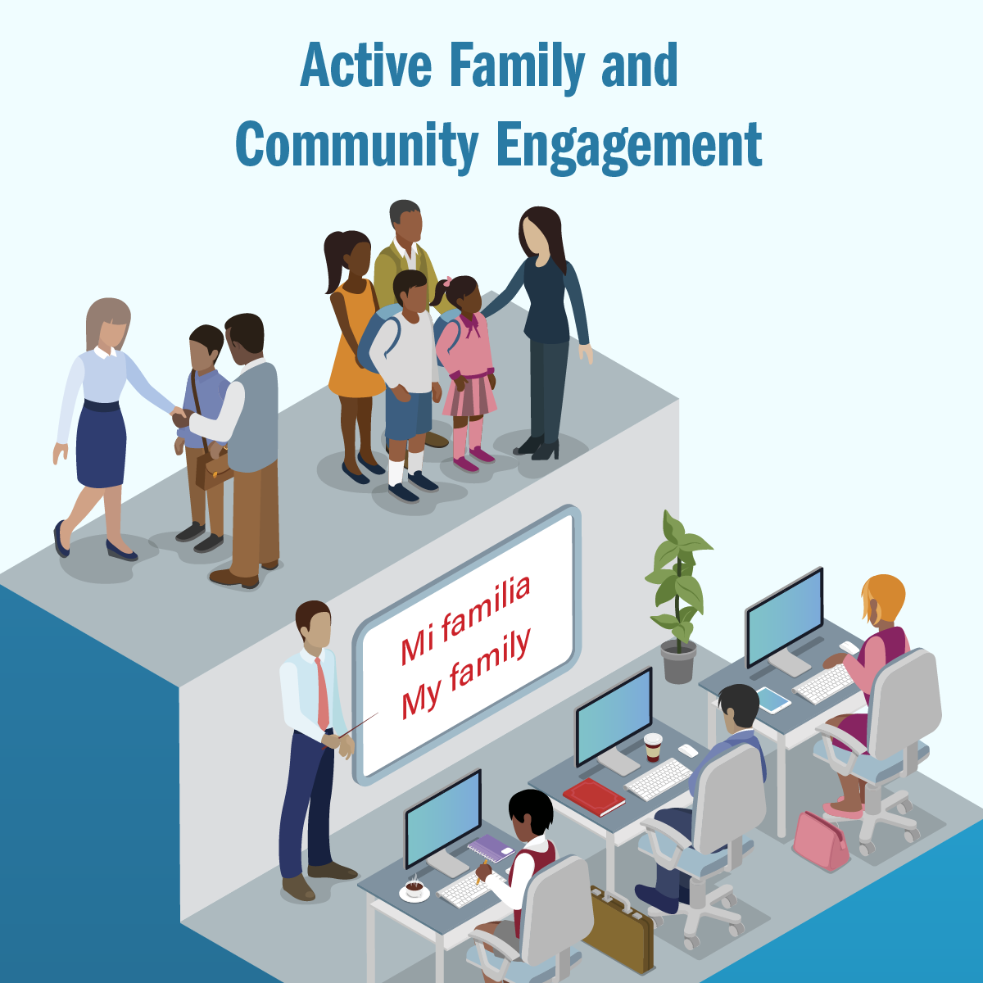

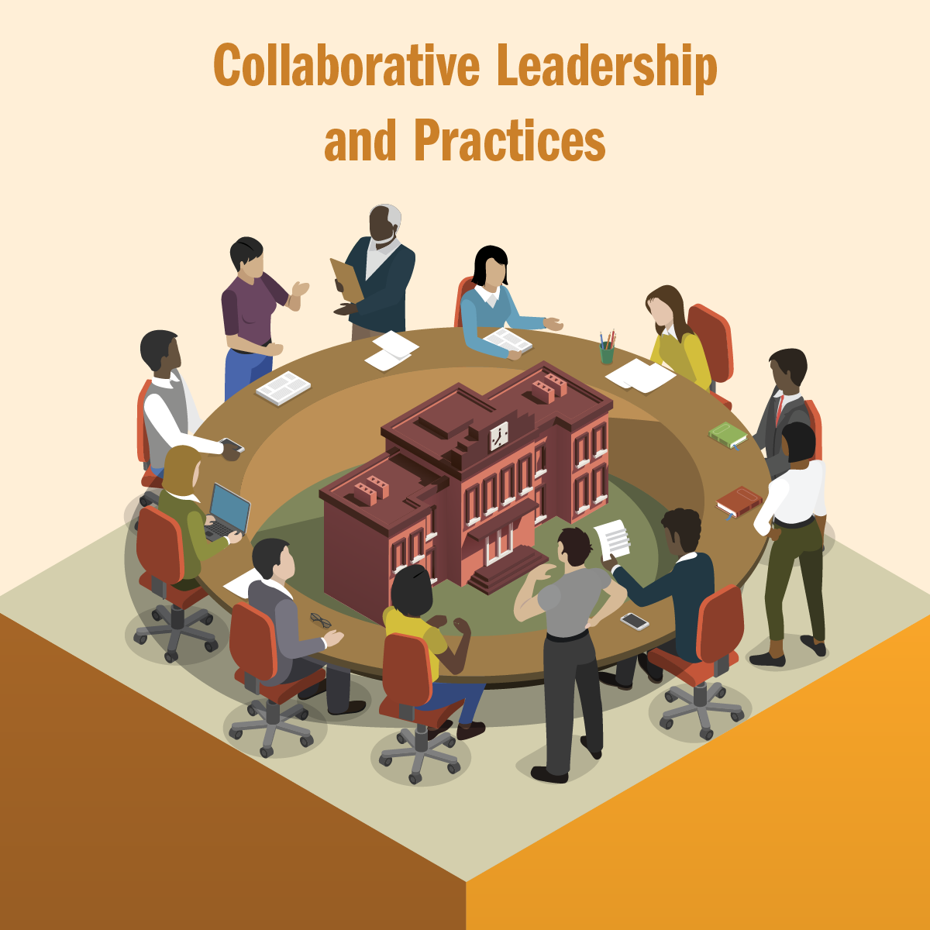
Community Schools are built on the four pillars
.
.
.
.
Schools function as neighborhood hubs. There are educational opportunities for adults, and family members can share their stories and serve as equal partners in promoting student success.
Facilitate programs to address out-of-school learning barriers for students and families. Mental and physical health programs support student success.
Parents, students, teachers, principals, and community partners build a culture of professional learning, collective trust, and shared responsibility through site-based leadership teams and teacher learning communities.
Enrichment activities emphasize real-world learning and community problem solving. After-school, weekend, and summer programs provide academic instruction and individualized support..

Slide 5
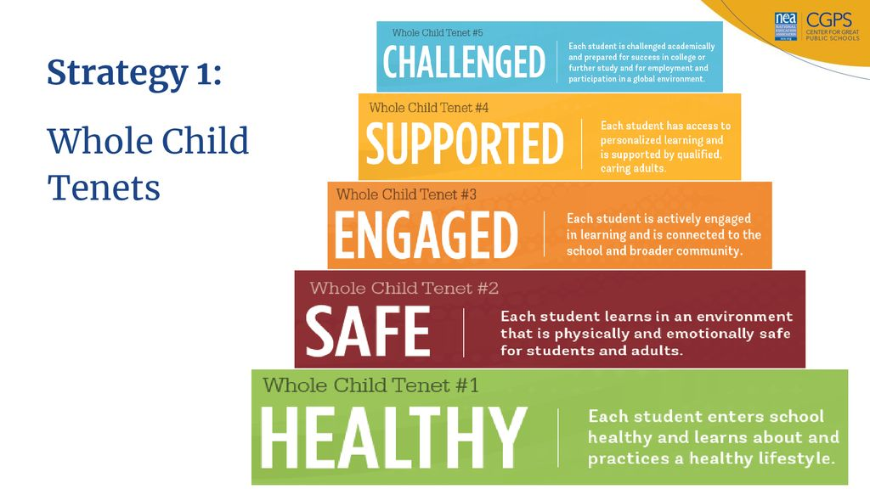
Community Schools
Uses a wHOLE CHILD Model approach
A whole child approach, which ensures that each student is healthy, safe, engaged, supported, and challenged, sets the standard for comprehensive, sustainable school improvement and provides for long-term student success.
Whole Child Tenet #1: HEALTHY
Each student enters school healthy and learns about and practices a healthy lifestyle.
Whole Child Tenet #2: SAFE
Each student learns in an environment that is physically and emotionally safe for students and adults.
Whole Child Tenet #3: ENGAGED
Each student is actively engaged in learning and is connected to the school and broader community.
Whole Child Tenet #4: SUPPORTED
Each student has access to personalized learning and is supported by qualified, caring adults.
Whole Child Tenet #5: CHALLENGED
Each student is challenged academically and prepared for success in college or further study and for employment and participation in a global environment.

Slide 6




Community School Sites
Eddie White
Middle Academy
Hampton, Georgia
Forest Park
Middle School
Forest Park, Georgia
Jonesboro
Middle School
Jonesboro, Georgia
North Clayton
High School
College Park, Georgia

Slide 7
How to get InvolveD
Become a Partner
Volunteer
Donate
Participate
Learn more
Please contact one of the
Coordinating Supervisors for further assistance.

Slide 8
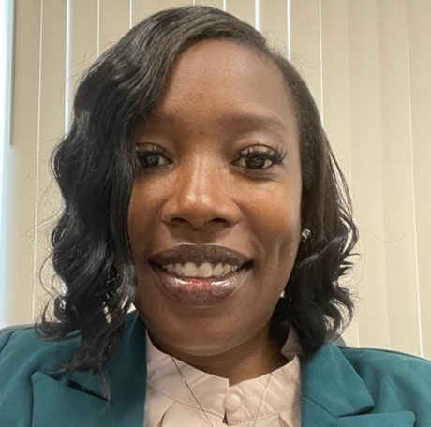
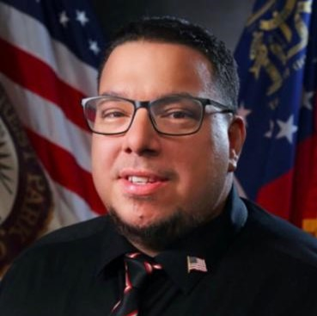
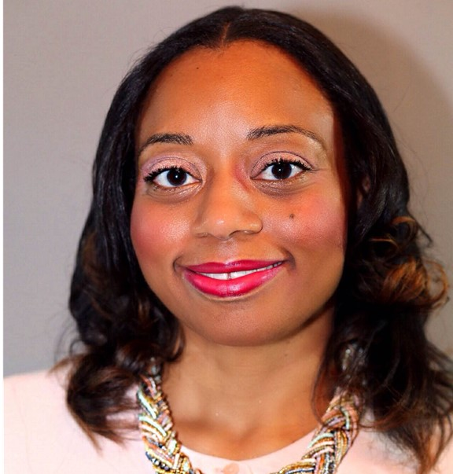
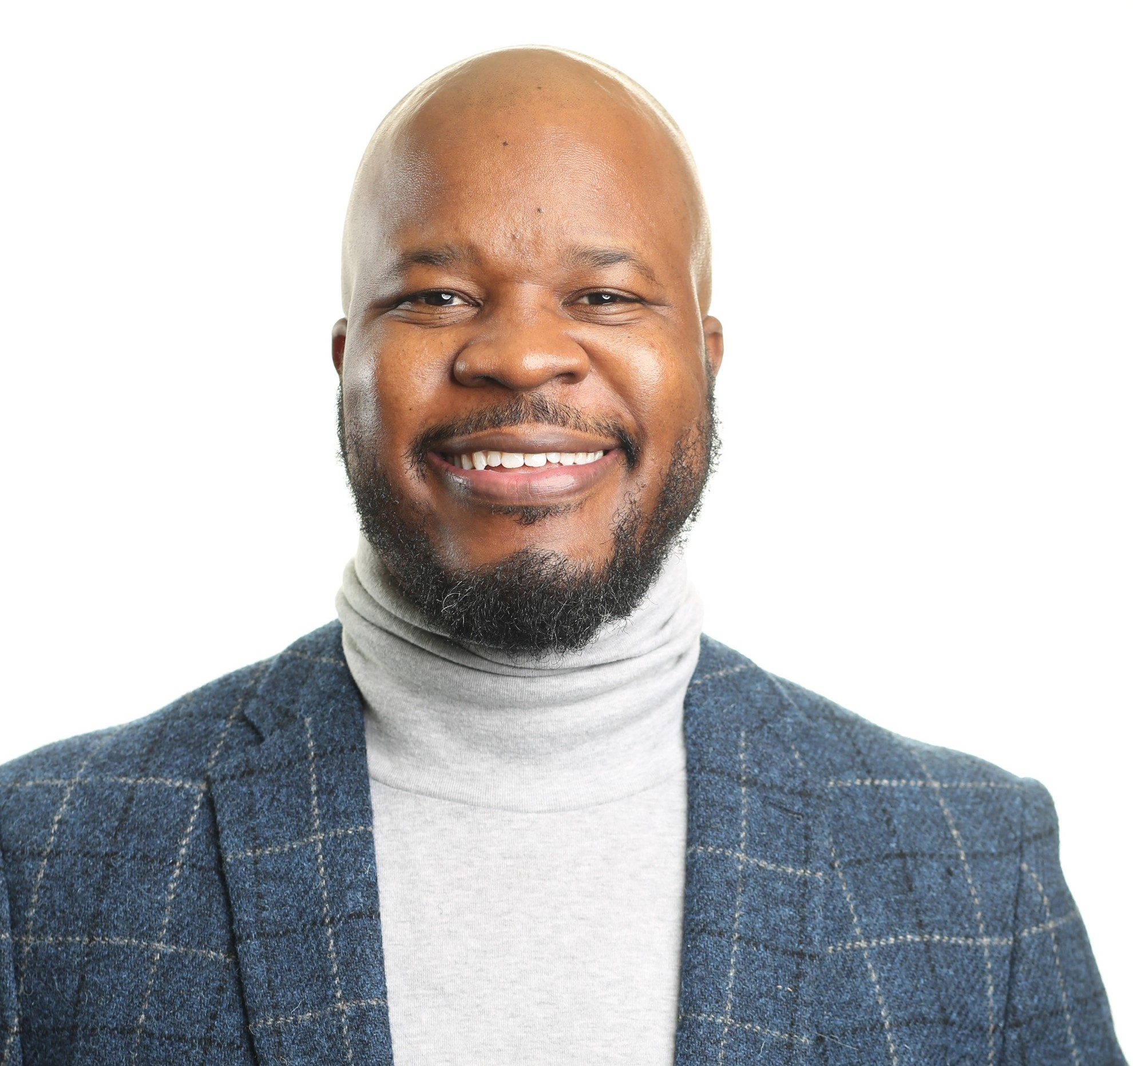
MEET OUR TEAM
Coordinating Supervisors
Dr. Shalun Matthews
Hector Gutierrez
Rasha Portis​
CalLeb Obumba
Eddie White Middle Academy
shalun.matthews@clayton.k12.ga.us
Forest Park Middle School
hector.gutierrez@clayton.k12.ga.us
Jonesboro Middle School
rasha.portis@clayton.k12.ga.us
North Clayton High School
calleb.obumba@clayton.k12.ga.us

Slide 9
Patricia Gandara
“There is no better place to create a caring community than in our schools–the heart of our future.”

