Slide 1




Morningside Middle School
Communities In Schools of the Charleston Area
“Programs don’t change kids- relationships do!”
- Bill Milliken, founder of Communities In Schools

Slide 2

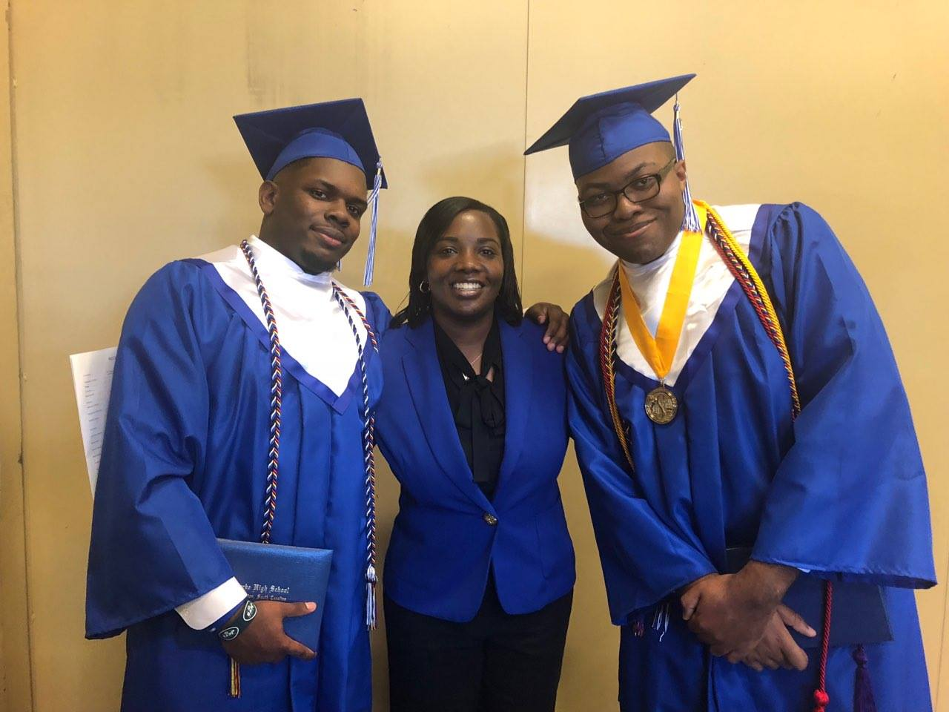
Our Mission
The mission of Communities In Schools is to surround students with a community of support, empowering them to stay in school and achieve in life.

Slide 3


CIS Program Delivery Model
TIER 1: WHOLE SCHOOL
Basic Needs Programing:
School Supply Drives
Food Drives
Clothing Drives
Coordination of Community Partners
TIER 2: SMALL GROUPS
Self Esteem
Anti-Bullying
Wise Guys
TIER 3:
One-on-One
Counseling
Mentoring
Tutoring
Highly qualified
Degree in counseling, social work or similar field
Years of Experience
Trained in evidence based program delivery models
Community Leader and Professional

Slide 4



CIS Program Delivery Model
TIER 1: WHOLE SCHOOL
Basic Needs Programing:
School Supply Drives
Food Drives
Clothing Drives
Coordination of Community Partners
Community Leader
Organized and professional
TIER 2: SMALL GROUPS
Self Esteem
Anti-Bullying
Wise Guys
Degree in education, counseling, social work or relatable experience
TIER 3:
One-on-One
Counseling
Mentoring
Tutoring
Highly qualified
Years of Experience
Trained in evidence based program delivery models

Slide 5
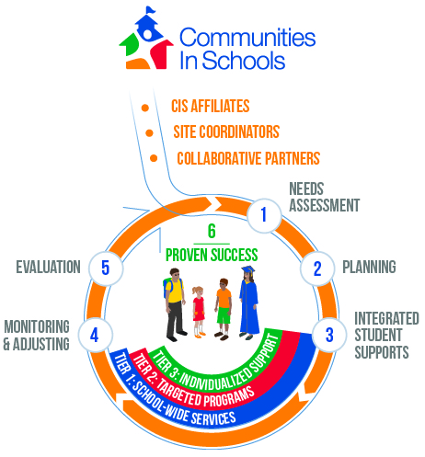
https://www.communitiesinschools.org/our-model/

Slide 6

The Five Basics of CIS
Communities In Schools believes that every child needs and deserves these “Five Basics”:
A one-on-one relationship with a caring adult
A safe place to learn and grow
A healthy start and a healthy future
A marketable skill to use upon graduation
A chance to give back to peers and community

Slide 7
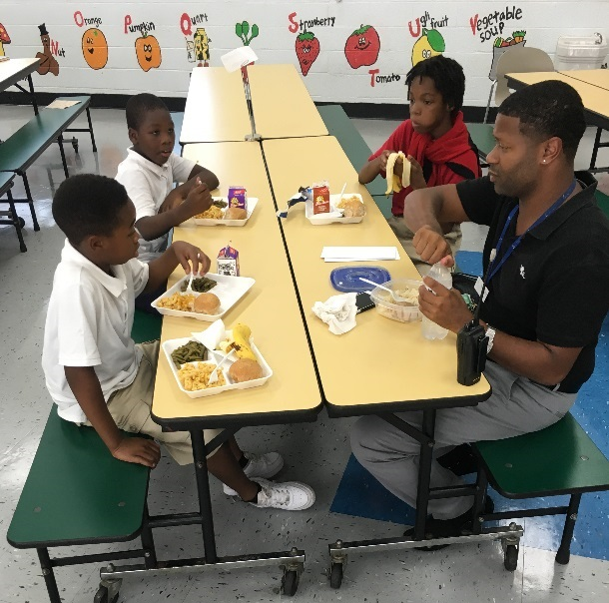
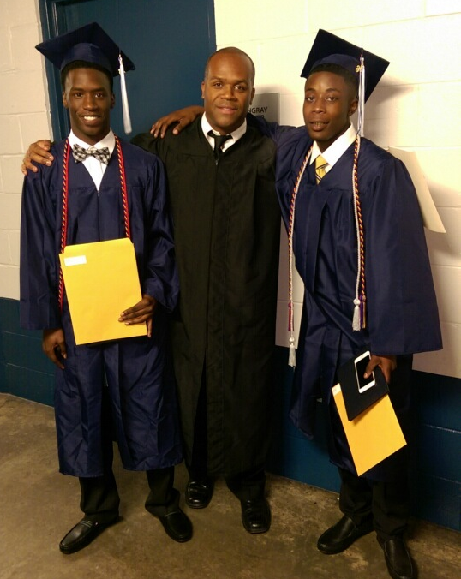
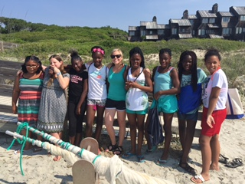
CIS Site Coordinator role
Remove non-academic barriers allowing students to focus on learning
Behavioral Interventions
College and Career Prep
Academic Assistance
Teach Life Skills
Family Engagement
Provide Basic Needs
Notes:
Risk Factors:
Low socioeconomic status
Single parent families
Low educational expectations
Bullying
Large number of siblings
Truancy
Transient/high-mobility
Aggressive behaviors
Emotional/mental health concerns
High-risk peer groups (gangs, delinquent youth, bullies)
Case Managed Services:
Behavioral Counseling
Healthy Lifestyles
Abuse Prevention
Life Skills
Goal Setting
Anger Management
Service learning opportunities

Slide 8
Ways to utilize your CIS Site Coordinator
Consult teachers, counselors, school administrators and parents about behavioral concerns
Provide case management and encourage improved school attendance
Counsel individuals, groups and families
Conduct home visits and encourage parental
involvement
Identify Resources and make referrals for services
Offer field trips and service learning opportunities
Provide support and guidance to mentors and tutors
See groups weekly – social skills, academic success, enrichment activities, behavioral intervention

Slide 9
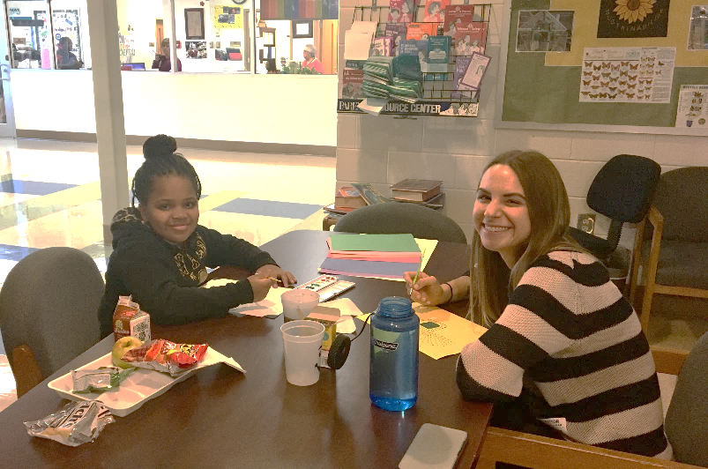
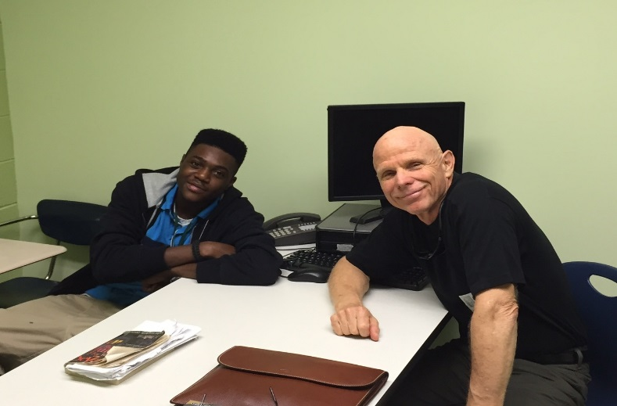
Volunteer Opportunities
Attendance
Lunch Buddy @ Elementary Schools
Just one hour, once a week
Eat lunch together, play games, arts and crafts, go outside
Check and Connect
Behavior
One-on-one Mentoring
Small group leader
Other Opportunities
School Supplies/uniforms
Teacher Appreciation Week
Day of Caring/Special Events
Coursework
Classroom Champion
Literacy Leader/Math Mentor
Notes:
One-time events - Quarterly celebrations, Schools store, etc.

Slide 10
"No significant
learning occurs
without a
significant
relationship."
–Dr. James Comer

Slide 11
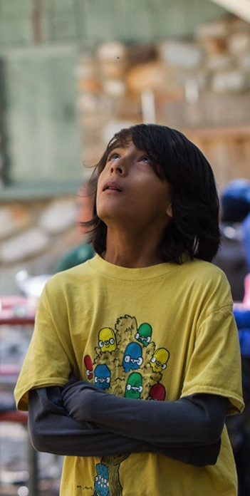
“Whether the burdens come from the hardships of poverty, the challenges of parental substance abuse or serious mental illness, the stresses of war, the threats of recurrent violence or chronic neglect, or a combination of factors, the single most common finding is that children who end up doing well have had at least one stable and committed relationship with a supportive parent, caregiver, or other adult.”
National Scientific Council
on the Developing Child, 2015
Harvard University
Notes:
Tell participants that rigorous research has also demonstrated the power of relationships that you just discussed through the lens of your own lives
First reveal and read the author of the quote and then read the quote on the slide.
You may want to stop and discuss this slide and the following slides on relationships or could move through them quickly to reinforce the general point that research demonstrates the extraordinary power of relationships in young people’s lives.

Slide 12
Developmental Relationships in Your Development
Notes:
Tell participants to keep in mind some of the ideas and emotions that they saw in the video as you as them to do an exercise focused on the role that relationships played in their development
Ask participants to complete the DR in Your Development Tool individually. Allow time for people to work alone and silently to complete the form.
Tell participants that they should also give some thought to the two questions at the bottom of the form
When most participants have completed the DR in Your Development Tool, end the time for individual quiet work and ask people to discuss the questions at the bottom of the form with a partner or a group of three people. Do not make the groups too large or people will not have sufficient time to really dialog about the role that relationships played in their own lives.
Tell participants that while it is important that everyone get a chance to share their answers on the bottom of the form, they can ask questions and have a bit of a dialog.
When all of the people in the pairs or groups have had a chance to talk, bring the conversation back to the full group and ask if anyone shared a particularly interesting memory with their partner or group. Invite a few people to share their memories with the full group to conclude the exercise.

Slide 13

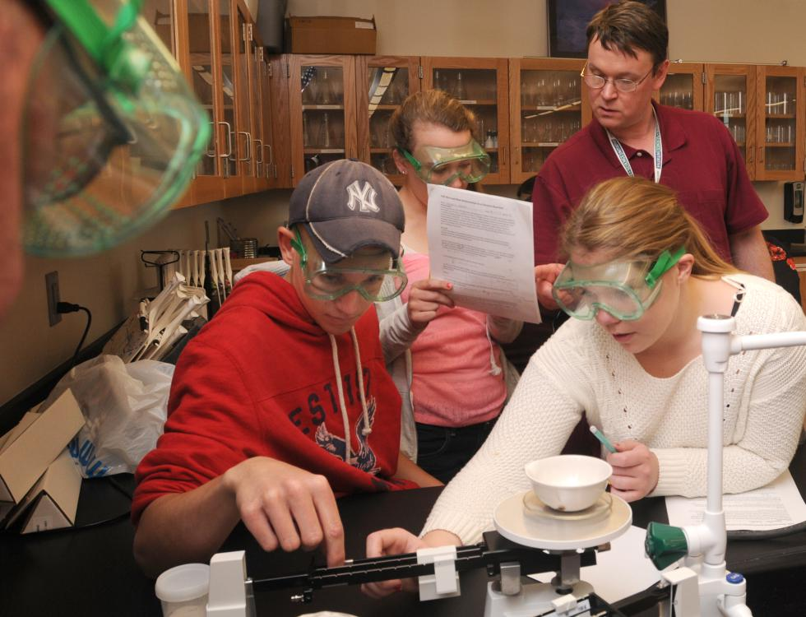



Elements of Developmental Relationships
Express Care
Challenge Growth
Provide Support
Share Power
Expand Possibilities
Notes:
Use this slide to tell participants that Search Institute’s work has identified five key elements of a developmental relationship.
Tell participants that they can find a copy of the Developmental Relationships Framework in their Developmental Relationships Handouts
Read through those five elements using this slide.
Explain that in a truly developmental relationship these actions happen bi-directionally, that is, directed from the adult to the young person and from the young person to the adult. In a developmental relationship between a young person and an adult, however, it is the adult who takes the lead in these actions and expresses them most strongly, intentionally, and consistently.
You may want to note that Search Institute’s work on developmental relationships also extends to relationships among young people. Research on peer relationships is in its early stages but is finding that the five elements of a developmental relationship also occur for young people.

Slide 14
How Two Elements Work Together
High Challenge Low Care
High Challenge High Care
Low Challenge Low Care
Low ChallengeHigh Care
CHALLENGE
CARE
Notes:
When showing this slide, pause to note that there is a particularly important connection between the first two elements of a developmental relationship: expressing care and challenging growth.
As you can see from the graphic on the slide, we want young people to be in the quadrant at the top right, where they feel a great deal of care in a relationship with an adult and also a great deal of challenge.
Too often, however, kids experience relationships that would fall in one of the other quadrants.
In particular highlight how too often we nurture young people but don’t challenge them, and also challenge them but don’t let the know we care about them.

Slide 15

SPECIAL EVENTS
Push Up & Up: Saturday, November 9th 9am
Chocolate Affair: Friday, February 21st , 2020

Slide 16

Questions??

