Slide 1
School board meeting
Dec. 12, 2023

Slide 2
Superintendent’s Report
Presented by Supt. Dr. Kim Hiel
Notes:
Good evening Chair Mosequda-Jones and school board members.
Here are a few things that have happened over the past two weeks.
Last week, two separate core planning meetings were held with various stakeholders across the district. The groups represented the Maple Grove Senior High Renovation Project and the new District school. Input will be gathered from these groups as progress is made at each site. One of the processes will be to visit different school sites in the metro area. Other facilities updates where core planning participation has and will continue to occur have been at Brooklyn Middle Steam School and North View Middle School. These sites are progressing well and selection of new furniture for all sites are being made, as mentioned by Chair Mosequda-Jones. I have to admit the preschool chair looks pretty intimidating to sit on let known the thought of ever getting up again.
A successful first trimester has ended and we are early into our second tri. As our students progress in their educational journey it will be important for us all to recognize the hard work that is being done by our scholars and to provide them with time to just be kids and young adults.
Winter break is quickly approaching which will provide our students with a well-earned break. We hope this time off will provide time for our families to spend more time together and to simply take time to relax. Sometimes the best time off is to simply to do nothing.
As always, thank you parents and guardians for choosing Osseo Area Schools to teach your children. We do recognize that this is a privilege. We will continue to work toward achievement for all of our babies and becoming One Community for All.

Slide 3
Points of Pride
Notes:
A regular part of the superintendent’s report is to share Points of Pride in our district.
By sharing our Points of Pride, we are taking time to recognize and celebrate, the scholars, staff and community members who are contributing to the accomplishment of our mission which is:
to inspire and prepare each and every scholar with the confidence, courage and competence to achieve their dreams; contribute to community; and engage in a lifetime of learning.
I have members of our District Cabinet here to assist in sharing some examples from the last few weeks.

Slide 4
Notes:
In the area of ACHIEVING DREAMS
Meme White, a student at Maple Grove Senior High School, was one of several students highlighted in Maple Grove Magazine this fall.
White talked with the magazine about her heritage and her experience as a Native American princess, representing Osseo Area Schools at powwows.

Slide 5
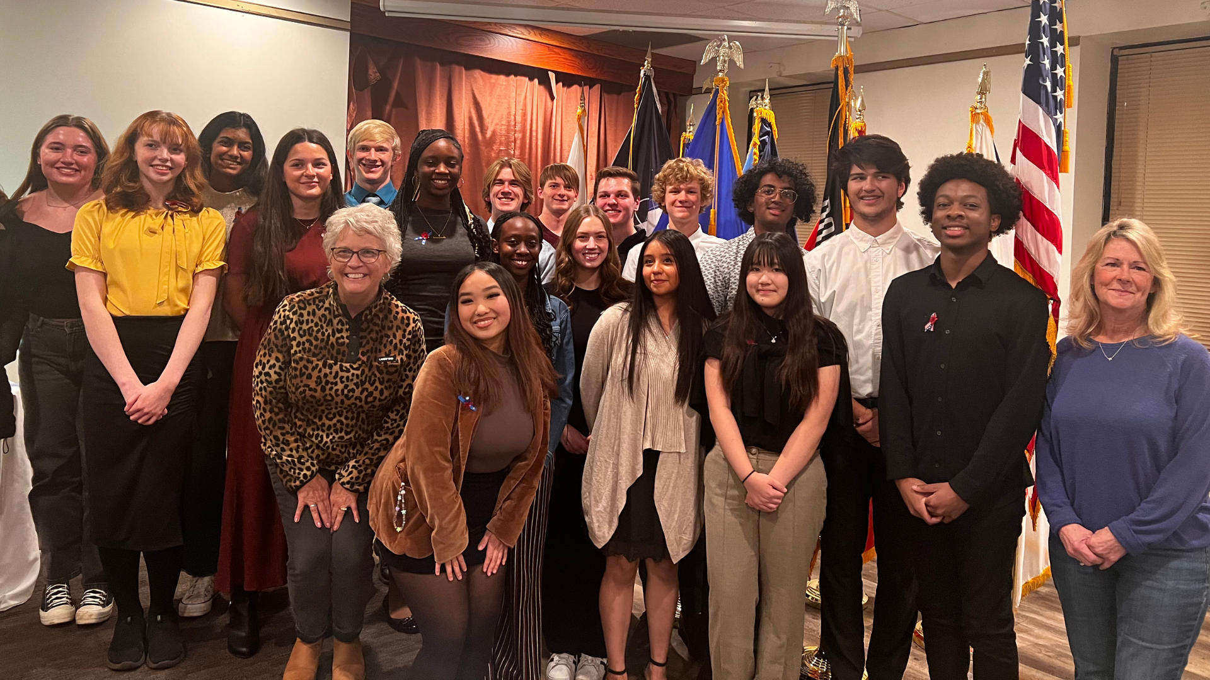
Notes:
American Legion Boys State and American Legion Auxiliary Girls State are summer leadership and citizenship programs for high school juniors, which focus on exploring the mechanics of American government and politics. Last summer, thirty students from Maple Grove, Osseo and Park Center senior high schools attended Boys and Girls State.
Boys State took place June 11-17 at St. John's University, and Girls State took place June 11-17 at Bethel University.
The students recently gathered at the Osseo-Maple Grove American Legion to reflect on their time at the program.

Slide 6
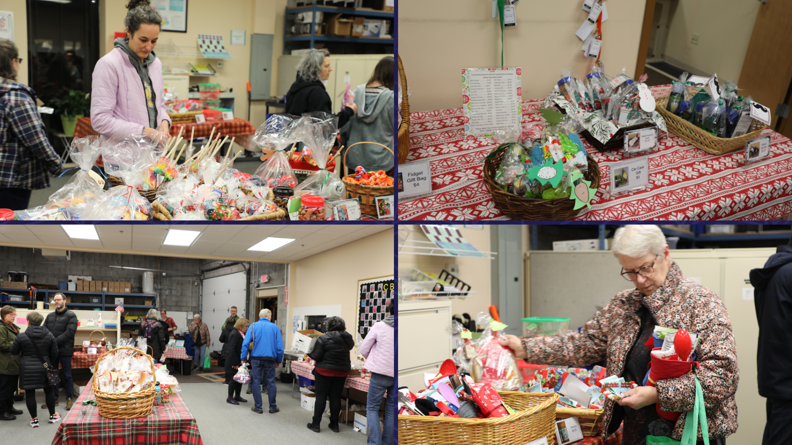
Notes:
On Nov. 29, Community-Based Vocational Assessment & Training or CBVAT students hosted district and community members at their annual winter sale and open house, the result of months of hard work. Various handcrafted items, designed and put together by CBVAT students, were for sale, including greeting cards, gift bags, movie kits, car care kits, pet sets, baking sets and more.

Slide 7
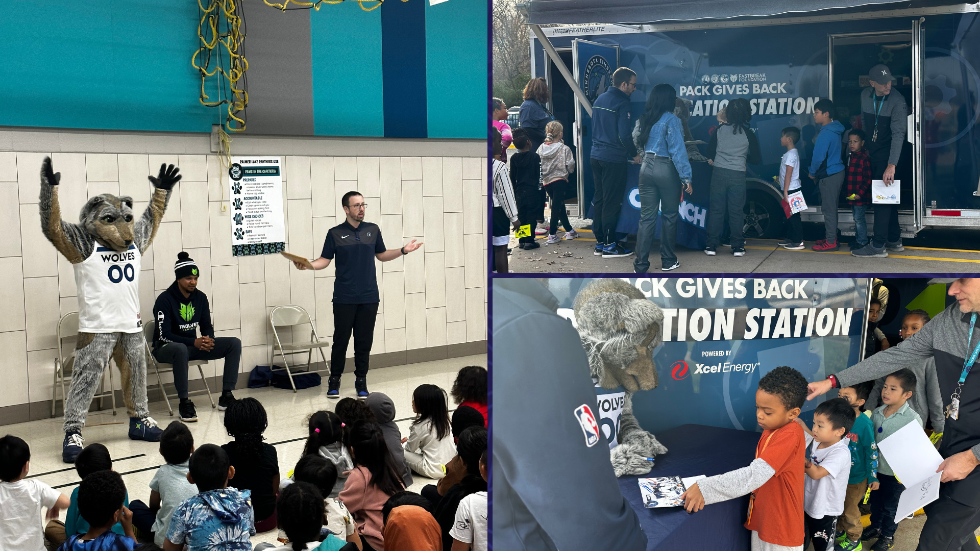
Notes:
What makes a Bookmobile more fun than adding a famous mascot to the mix? The Timberwolves' Crunch recently spent time with Palmer Lake Elementary School students, taking part in a presentation and hanging around for high-fives and hangout time with students during the Bookmobile event.

Slide 8
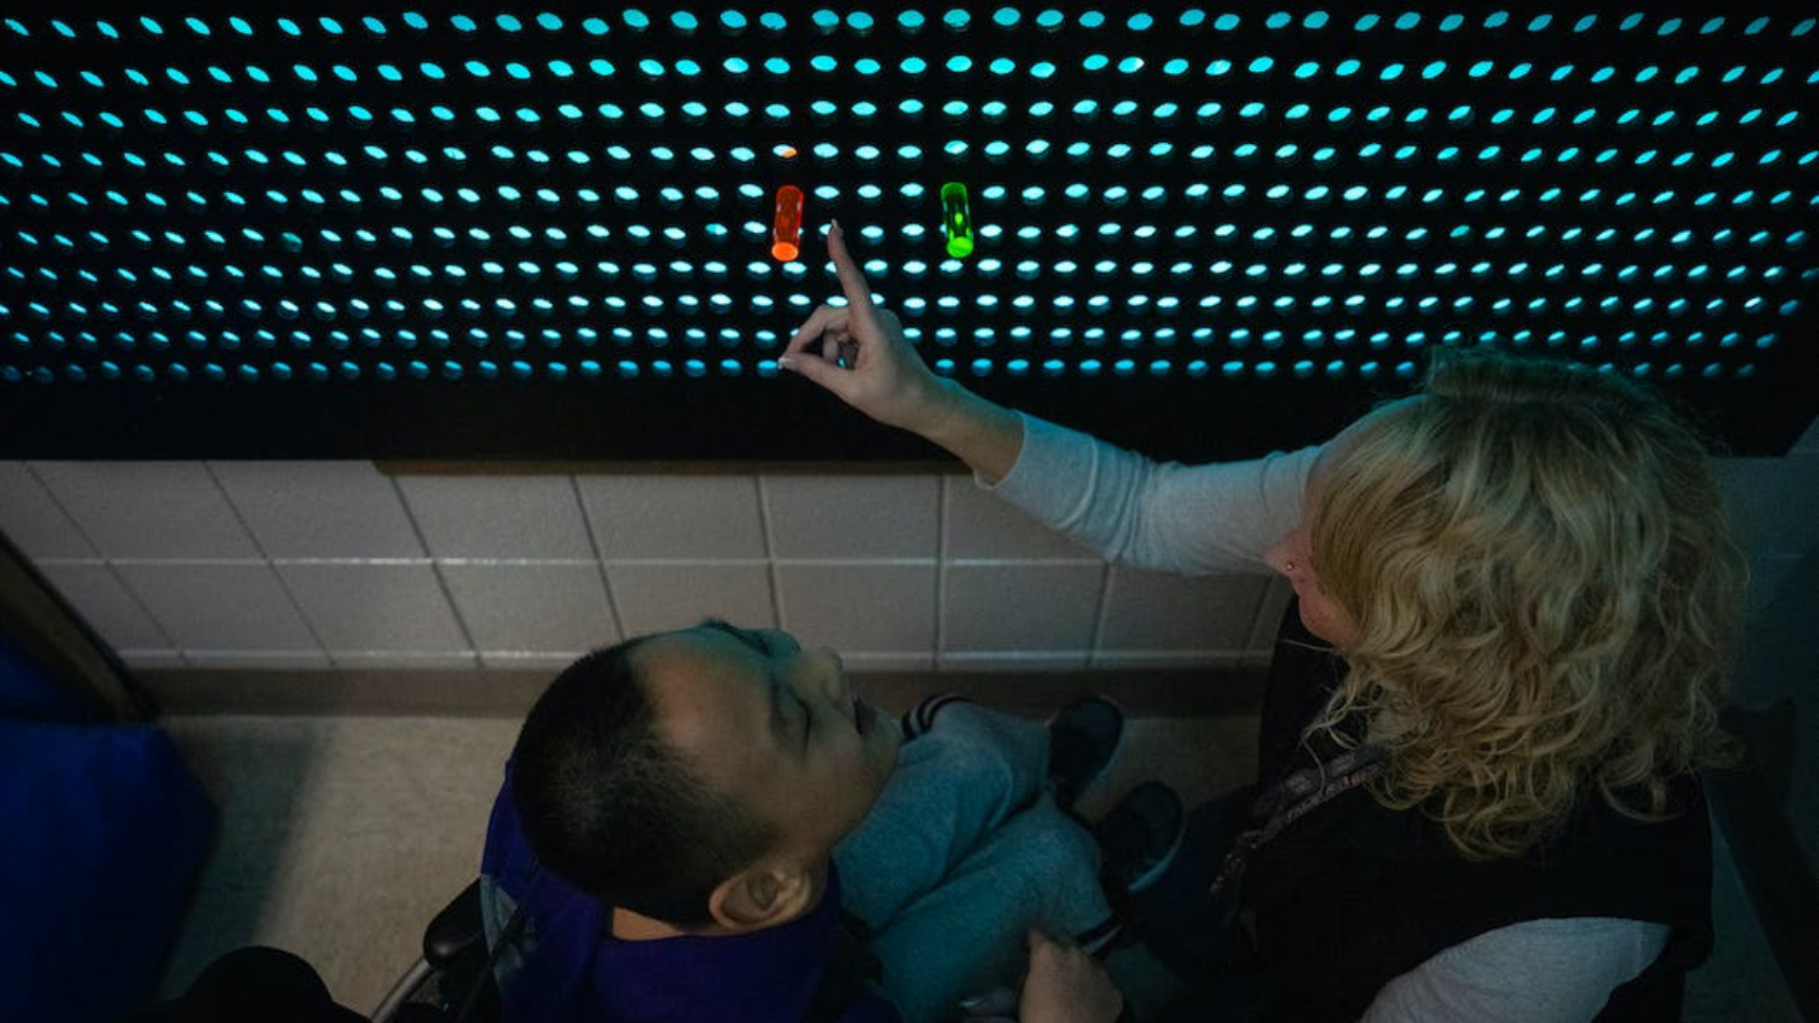
Notes:
In the area of CONTRIBUTING TO COMMUNITY:
Grants from the Maple Grove and Brooklyn Park Lions Clubs helped North View Middle School's special education department obtain a wishlist item for their students: a large Lite-Brite style wall unit that supports learning for the school's visually impaired students. The school's technical education classes helped to build the unit.
The wall was recently covered by local media outlets, including the Star Tribune and CCX Media.

Slide 9
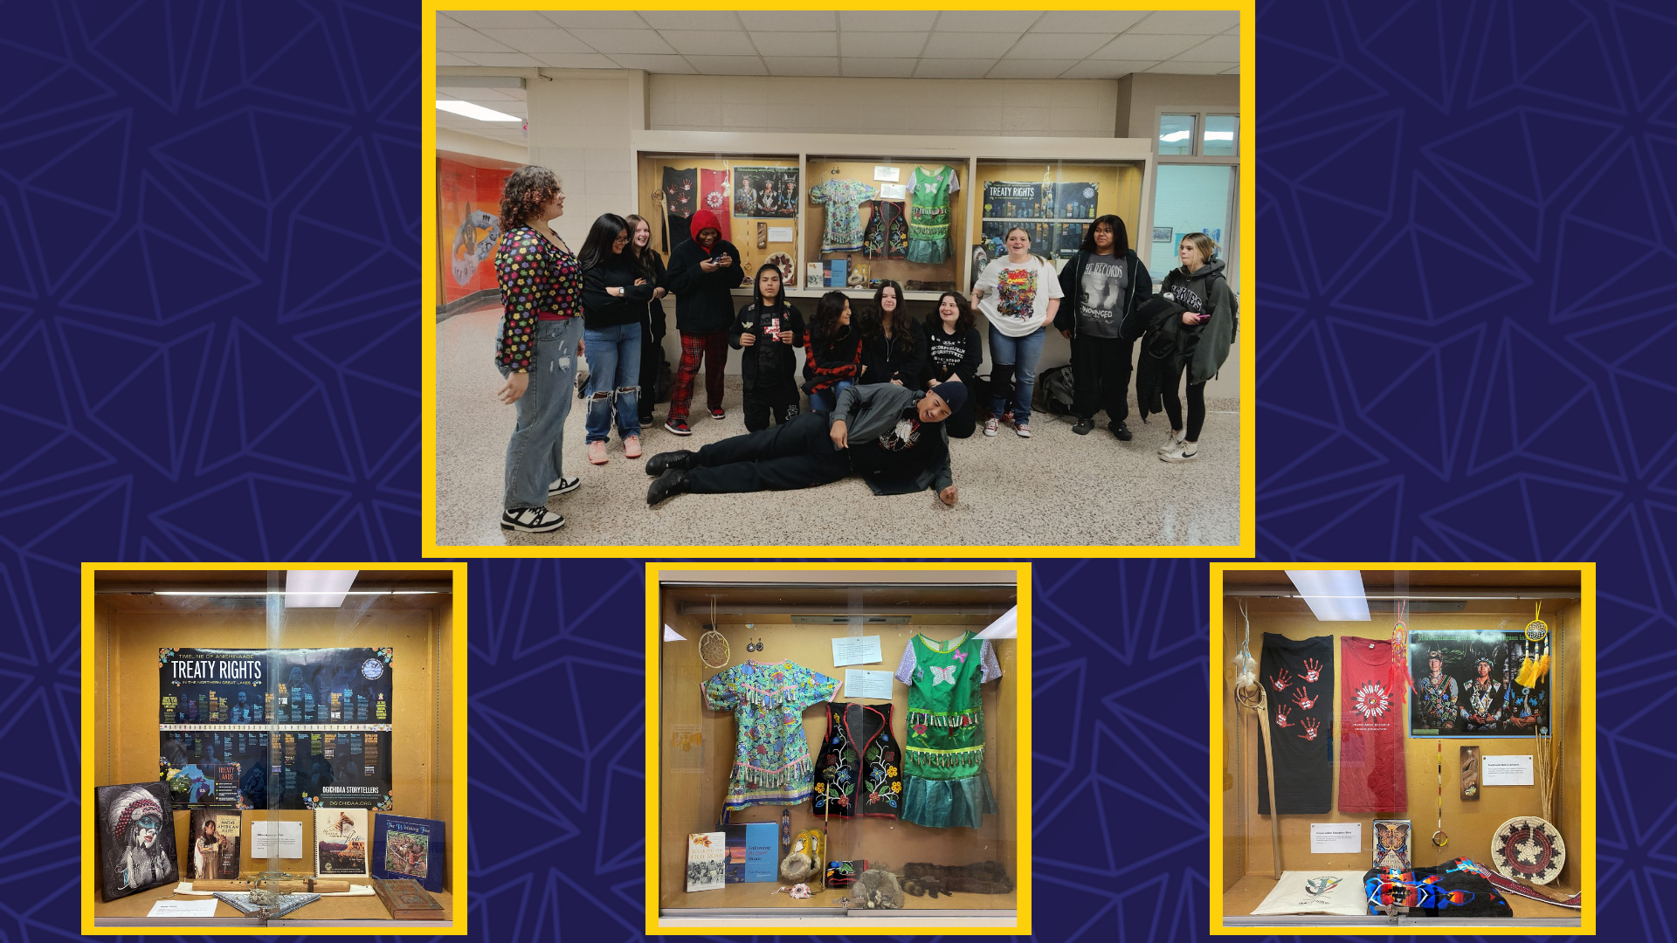
Notes:
In the area of LIFELONG LEARNING
November was Native American Heritage Month! Osseo Area Schools celebrates the rich and diverse cultures and histories, as well as the essential contributions of Native people in the over 80 tribal nations represented in Osseo Area Schools.
At Osseo Senior and Park Center Senior high schools, the American Indian Education department put together a display case for Native American Heritage Month. Students brought in some of their own items that they felt represented who they were as Indigenous people, and some items were brought in to put on display from our Indian Education Cultural Resource Center. Students wrote descriptions of some of the items in an effort to educate their peers and teachers, as well as to dispel myths and stereotypes.
At Maple Grove Senior High School, students were visited by Isabella Griffin, who works in the Minnesota Department of Education's Office of Indian Education. Griffin shared about her own educational experiences, how she came to work in the community and potential career paths in the field of Indian Education.

Slide 10
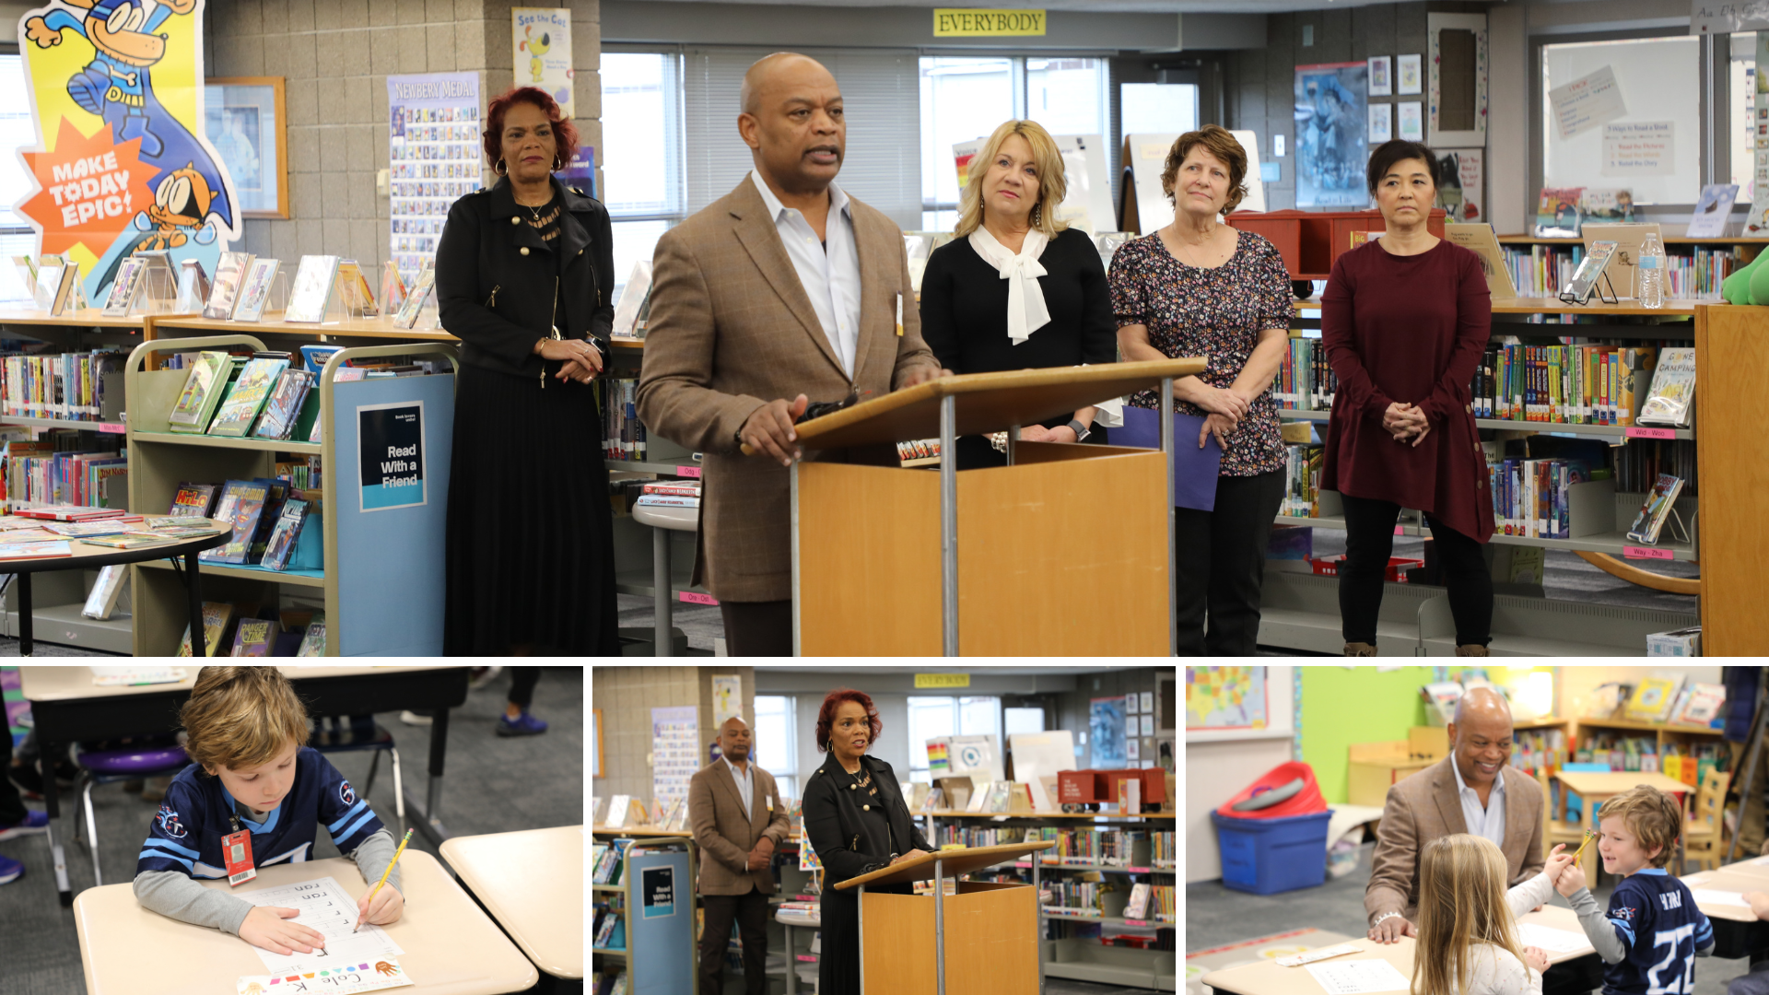
Notes:
Rush Creek Elementary School recently hosted a press conference, in partnership with the Minnesota Department of Education, to share an update about the Minnesota Reading to Ensure Academic Development, or READ, Act.
During the press conference, Superintendent Dr. Kim Hiel joined Minnesota Department of Education Commissioner Willie Jett and Literacy Director Julie Novak. Teachers Paige Daley, from Fernbrook Elementary School, and Carmy Mersereau, from Fair Oaks Elementary School, spoke about the impact of the literacy lessons they have seen on students in the classroom.
After the press conference, the visitors and media present joined Linda Schwartz’s kindergarten classroom to observe students doing a structured literacy lesson. As part of the READ Act, teachers will receive training focused on structured literacy with the goal of having every child reading at or above grade level every year.

Slide 11
Notes:
Students in the skills program at Osseo Senior High School recently went on a community outing to Cub Foods in Brooklyn Park. Students completed a BINGO coverall Scavenger Hunt to locate food items within the store related to the Thanksgiving meal they would be cooking in class on Tuesday and Wednesday.
Students also practiced their social skills, asking Cub employees where items may be located in the store.
Finally, two different groups of students were also responsible for filling a shopping cart with the ingredients for a Thanksgiving celebration at school on Wednesday. A portion of students also participated in a cost comparison activity to learn how to become smart consumers and save money.

Slide 12
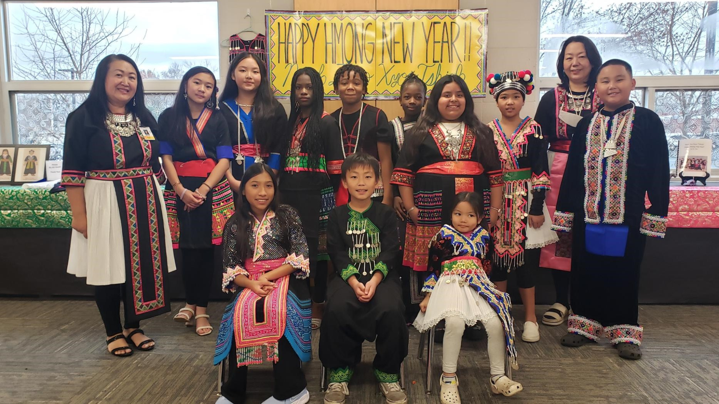
Notes:
Fair Oaks Elementary celebrated Hmong New Year, with the school's English language teacher, Mrs. Vang, sharing a presentation on Hmong culture and a group of students teaching others a traditional Hmong dance.

Slide 13
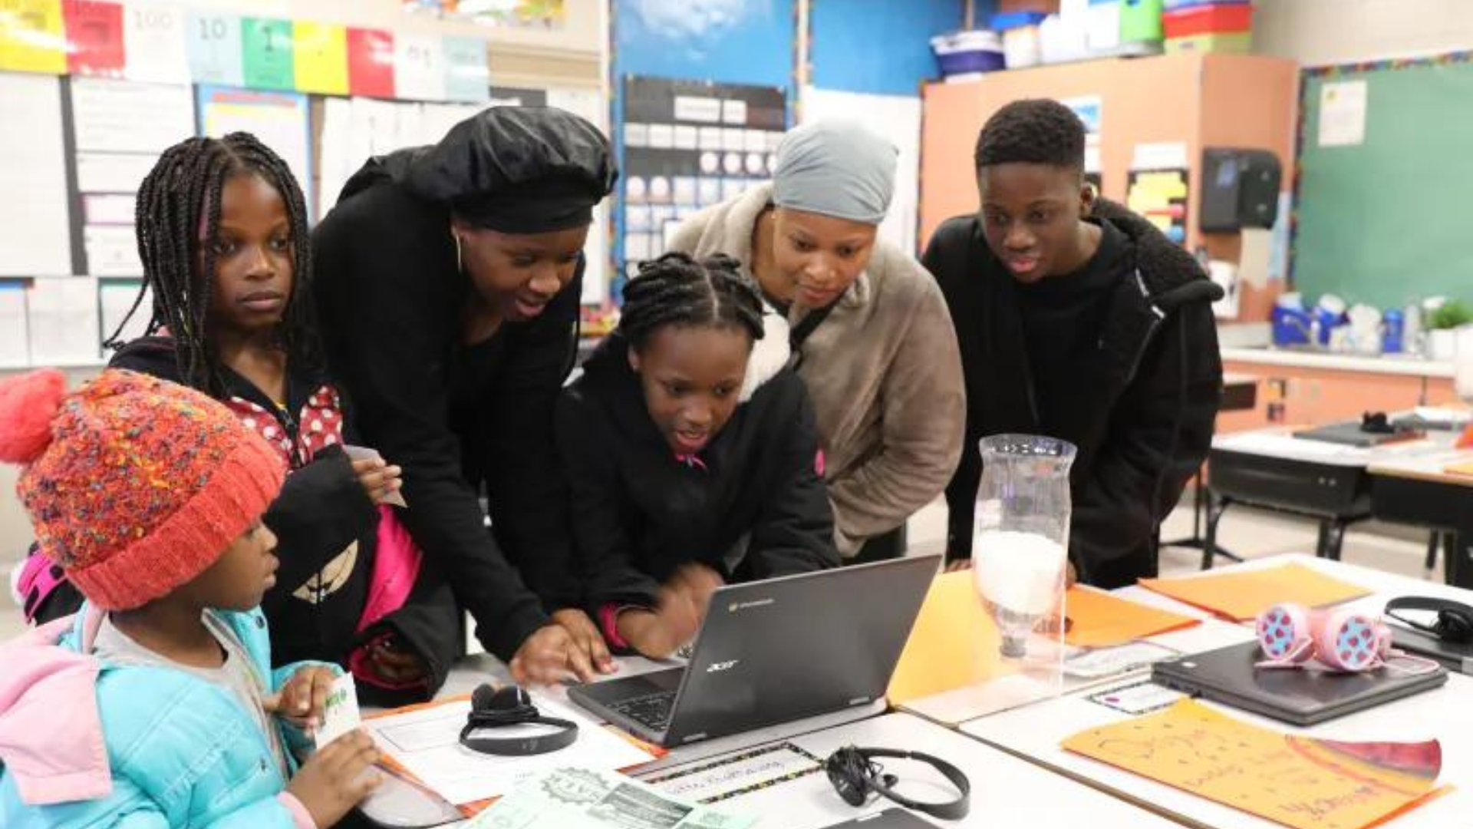
Notes:
Scholars from Weaver Lake: A Science, Math & Technology School had a chance to show off what they’ve learned in their value-added science, engineering, technology and math (STEM) curriculum so far this school year at a STEM in Action family event.
Students showed off their STEM projects on topics such as the needs of plants and animals, light and sound, plant and animal relationships, the spinning Earth, a lake study and ecosystem restoration.

Slide 14
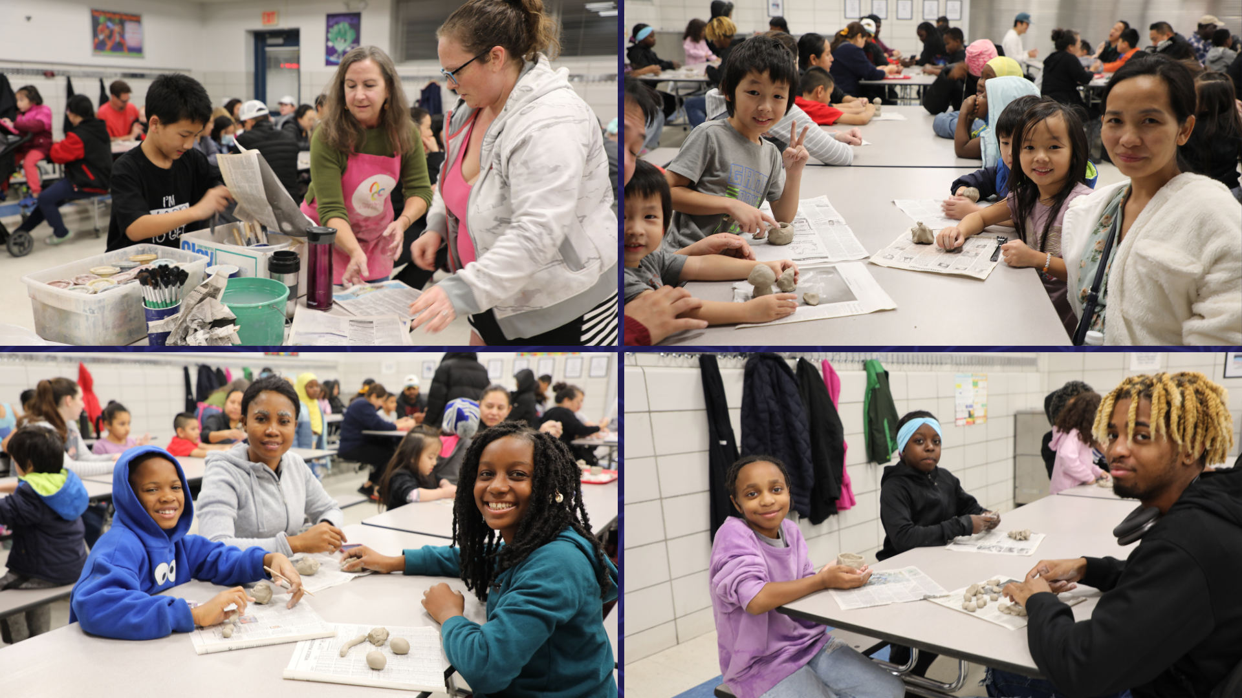
Notes:
The Northern Clay Center out of Minneapolis came to Garden City Elementary School to host a clay camp for all the school’s students and families. The cafeteria was packed with amateur sculptors from the event’s start to finish, as all ages enjoyed the challenge of turning their ball of clay into their own masterpieces.
Garden City funded the family art event through a grant from the District 279 Foundation and grant money from Northern Clay to provide an experiential learning opportunity for its students. In addition to the evening family event, Northern Clay also visited each of the school’s classrooms three different times this fall to teach the kids about the medium of clay and facilitate a different clay project for each grade level.

Slide 15
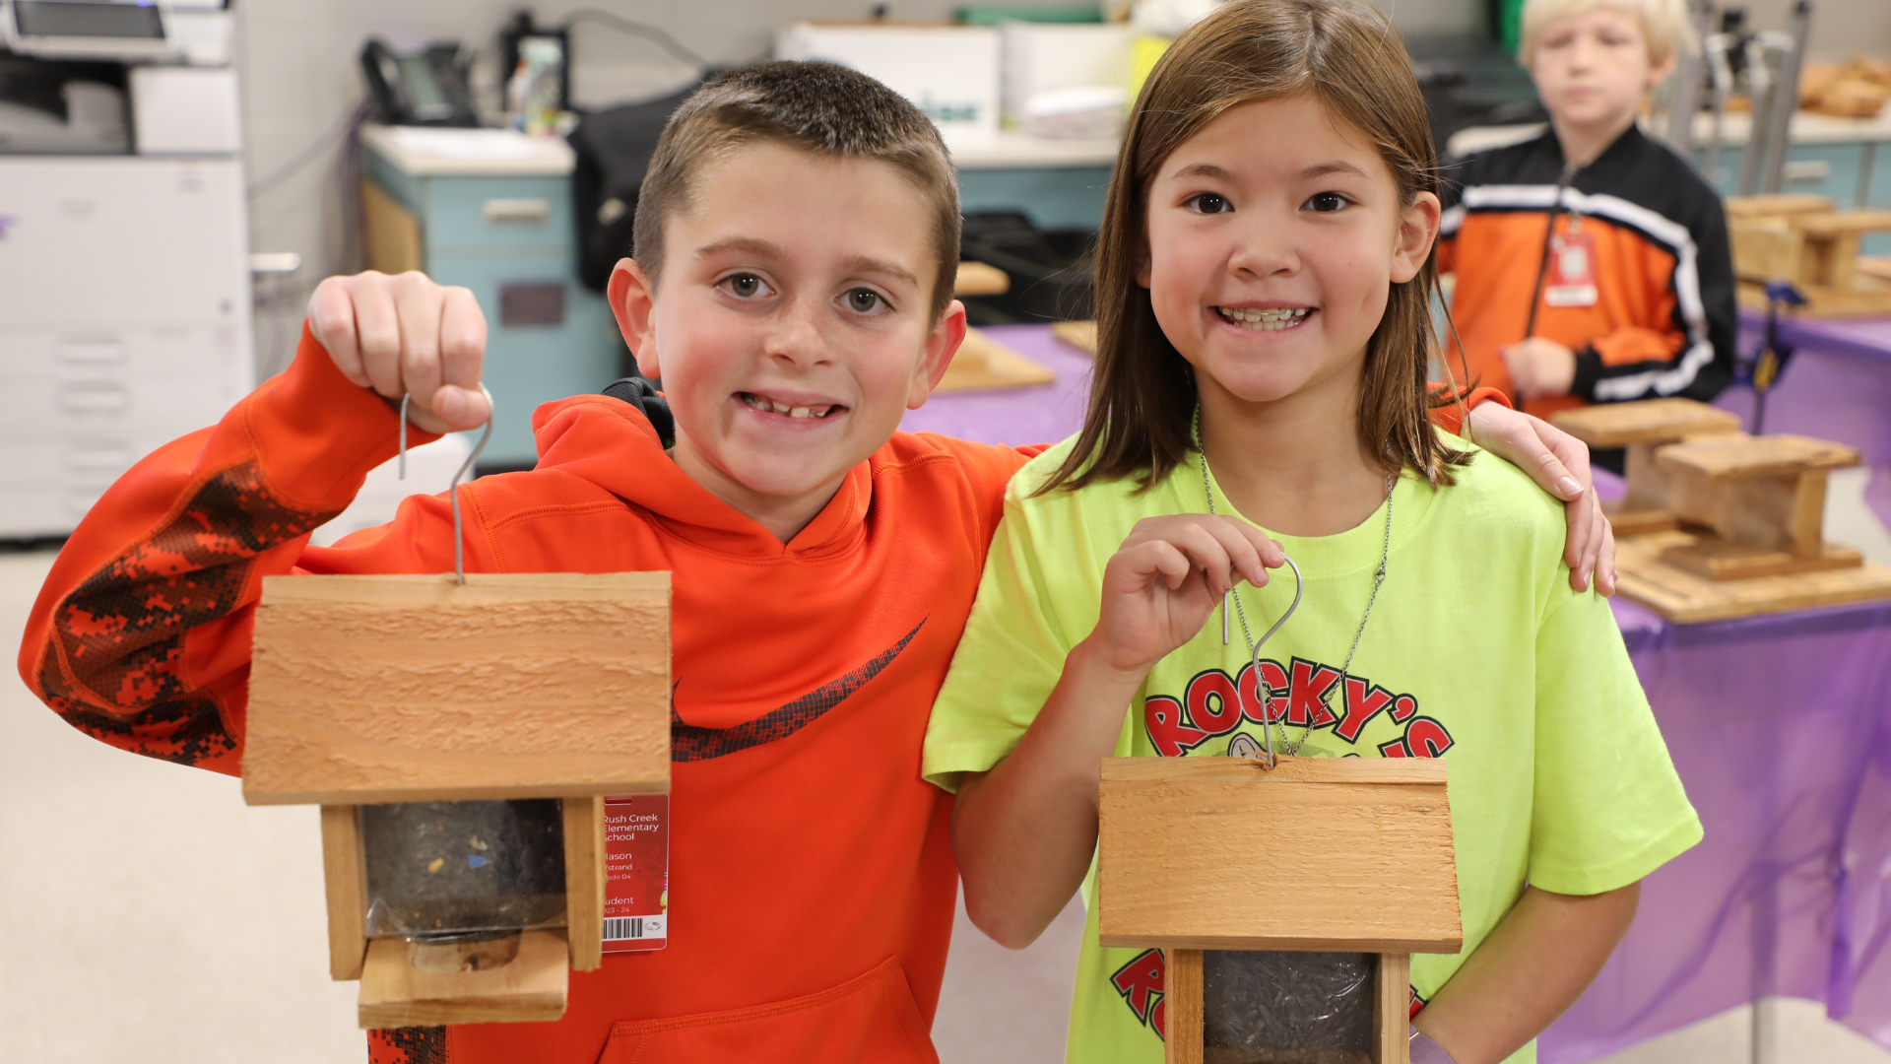
Notes:
Fourth graders across the district, including in Lois Hehn’s class at Rush Creek Elementary School, recently had the opportunity to learn about birdwatching and make their own birdhouses thanks to a project coordinated by an Osseo Area Schools graduate.
Mason, a fourth grader in Mrs. Hehn’s class, said, “This is my favorite project that we have done all year.”

Slide 16
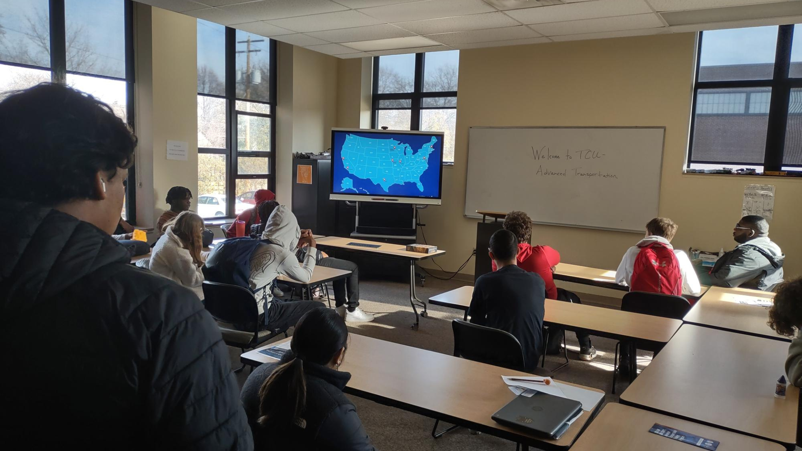
Notes:
Thirty-three district scholars who participate in the Community-Based Vocational Assessment and Training, or CBVAT, program had an opportunity to visit St. Paul’s Job Corps campus to learn about the numerous opportunities the training and education program provides.
Job Corps has over 120 locations nationwide, and it provides free career training and education in 10 industries for low-income young adults ages 16-24. District students viewed and learned more about training and apprenticeship programs, including culinary arts, office administration, signs and painting, and advanced transportation.

Slide 17
Notes:
In the area of MISSION DRIVEN EMPLOYEES
Michael Ahrendt, or Mr. Michael to the students, has worked as a custodian at Basswood Elementary School for five years, but the impact he has on students goes far beyond the traditional job requirements.
Ahrendt said, “The kids make it worthwhile coming. They say thank you and we appreciate you, and the staff does too,” Ahrendt said. “I love it. I am very content here.”
Learn more about Ahrendt in the Staff Spotlight on the district website!

Slide 18
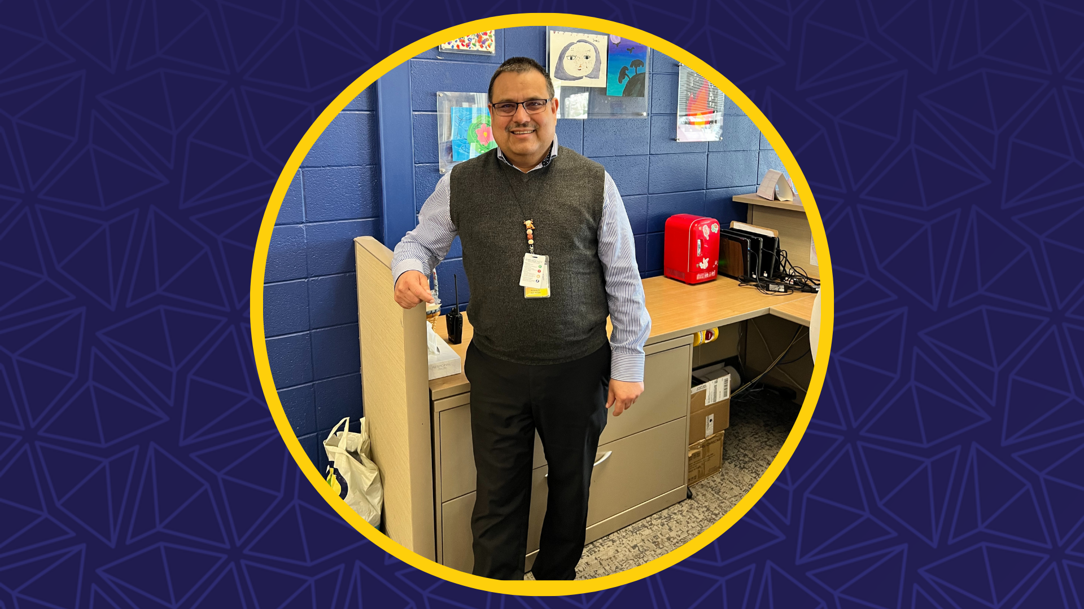
Notes:
Birch Grove School for the Arts principal, Dr. Ronald Salazar, was recently recognized with a Distinguished Alumni award by the University of Minnesota's College of Education and Human Development. The award highlighted Salazar’s impact on underrepresented communities through educational leadership that promotes student learning.
Salazar said, “Some people get awards for the work that we do, but as a leader we facilitate and support people. The work done in a school is the work that everybody does, both licensed and non-licensed staff. I received the award, but the work is being done by everybody.”

Slide 19
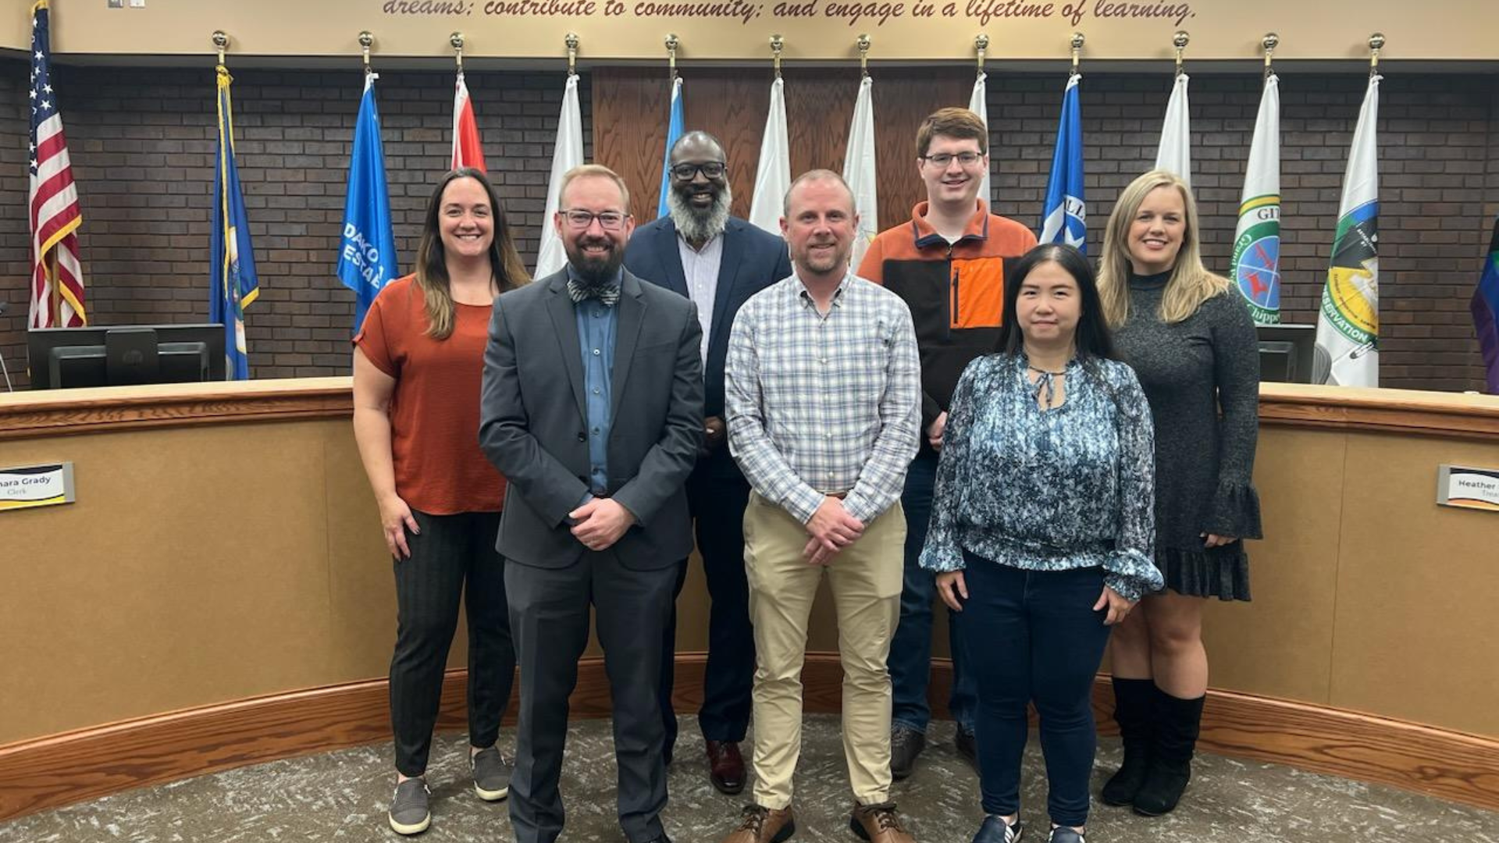
Notes:
Osseo Area Schools recently received a Synergy Achievement Award, an annual award presented to districts in recognition of their outstanding success in utilizing the Synergy student information system in an innovative way to support their organization's work.
The district was selected for this recognition because of the development completed to utilize the student information system to streamline the site-based student risk assessment process. This allows for greater collaboration from a variety of staff members to ensure at-risk students are getting the resources and support needed. Besides being recognized for the great work at the Annual EduPoint Conference, the district also received a $1,000 technology grant.
The team that worked on this project and was recognized for this award included Dave Moredock, Emily Kaehn, Katie Kimsey, Jay Lohse, Yunqi Huang, Gerald Edwards and Anthony Padrnos.

Slide 20
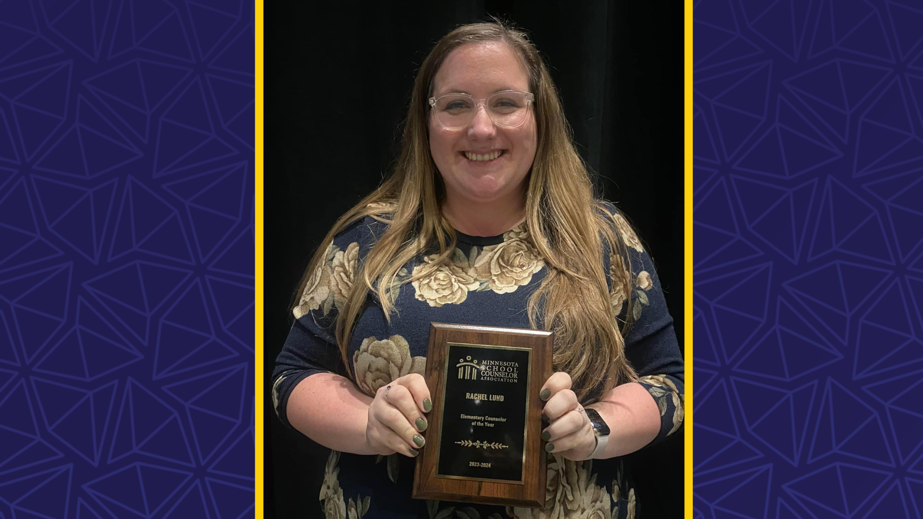
Notes:
Garden City Elementary School’s counselor, Rachel Lund, recently received the Minnesota Elementary Counselor of the Year Award from the Minnesota School Counselor Association at their annual conference.
Lund said, “Being able to listen and problem solve and support people has always been at the core of who I am.”

Slide 21
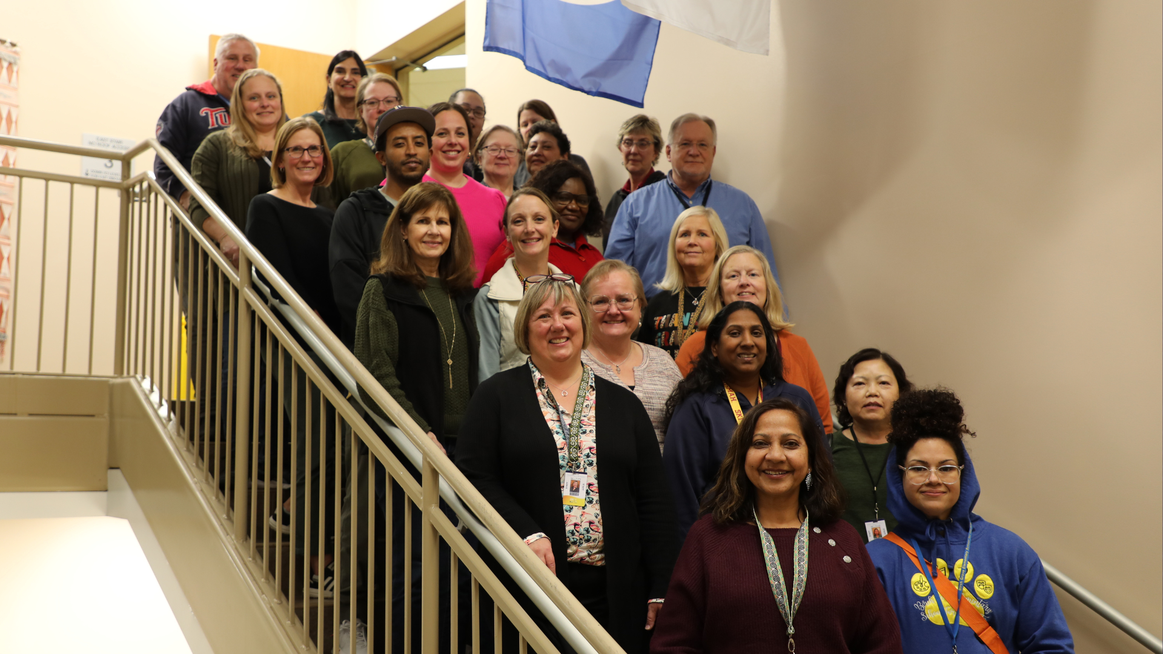
Notes:
In October, Osseo Area Schools’ Adult Basic Education (ABE) HyFlex Learning program was recognized by the Minnesota Community Education Association as the recipient of the 2023 Region 3 Community Educator of Excellence Award at the organization’s fall conference. This award is presented to outstanding projects that exemplify the concept of Community Education.
The HyFlex programming gives students flexibility to attend classes and receive instruction in-person or online synchronously through Google Meet.
Emily Watts, program coordinator for the district’s ABE program, said, “The Osseo Adult Basic Education teaching team has reimagined what instruction and learning are all about. They took their skill, talent and experience of in-person instruction, combined it with the pandemic experience of providing online instruction, and developed classroom environments that provide high-quality education experiences, whether students are attending in person or online.”

Slide 22
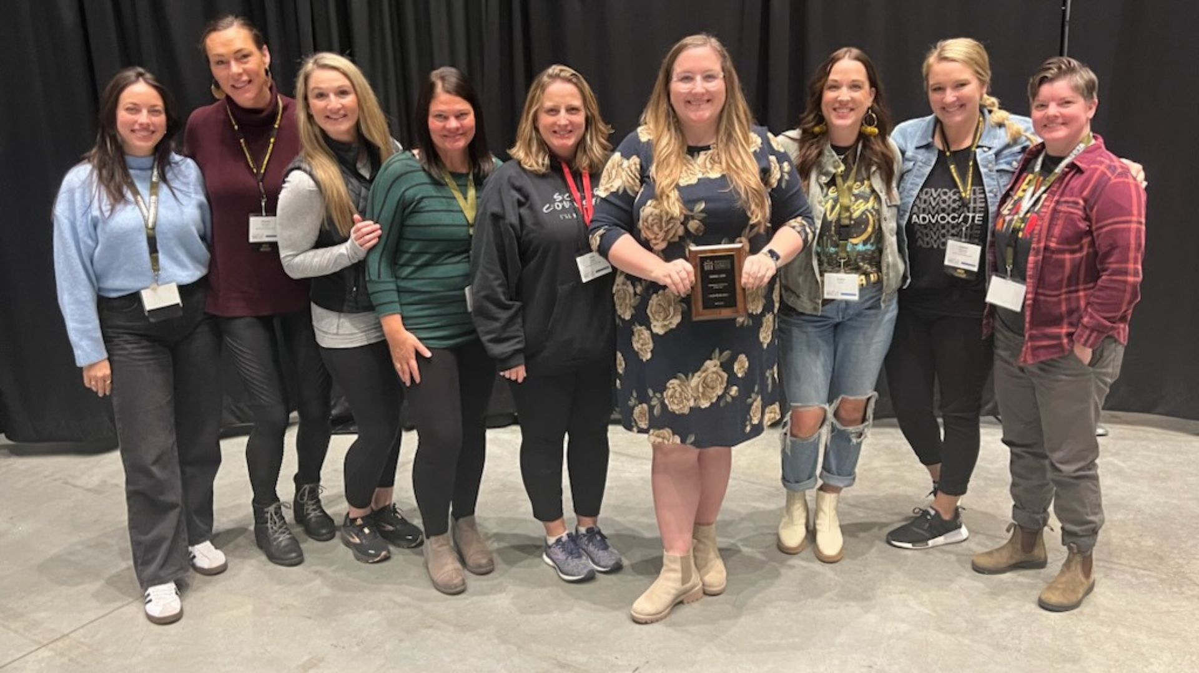
Notes:
Osseo Area Schools recently had nine of its schools honored at the Minnesota School Counselor Association Conference for being Recognized Model Program schools through the American School Counselor Association, or ASCA. To earn this recognition, schools must implement an ASCA-aligned school counseling program and submit an application, which takes over a year to complete.
The nine recognized schools included: The district’s recognized schools include Woodland, Oak View, Garden City and Basswood elementary schools, Brooklyn Middle Steam and North View Middle schools and Maple Grove, Osseo and Park Center senior high schools.
Thank you to the dedicated work of counseling teams throughout the district.

Slide 23
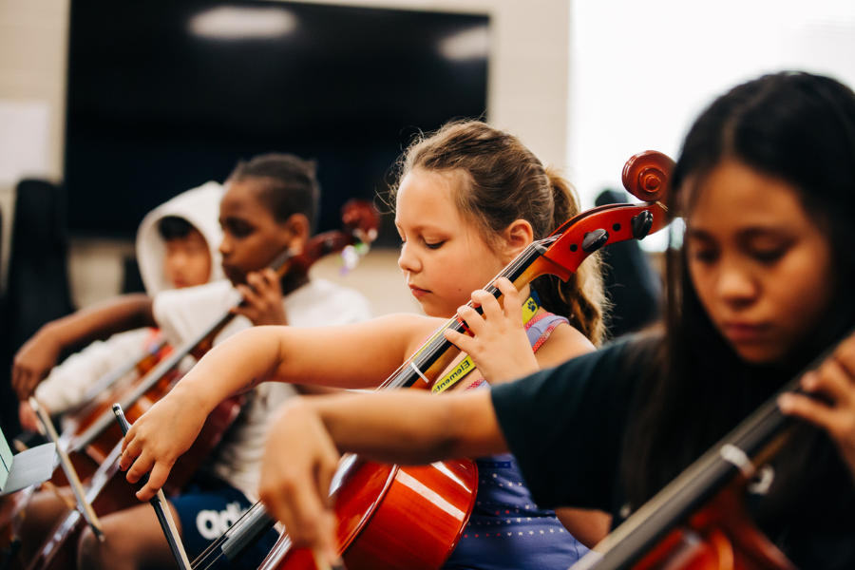
Notes and Reminders
Concerts taking place in district schools
No school for students Dec. 20-Jan. 1
Dec. 31: First magnet school lottery deadline
Notes:
Thank you team and thank you to each and every district staff person who works each day in our district. You are appreciated!
Throughout the months of December and January, various musical concerts will be held at schools across the district. Visit the district website to find out more about upcoming concerts.
There will be no school for students Dec. 20-Jan. 1 for winter break. School will resume on Jan. 2.
The first magnet school lottery deadline is Dec. 31. Learn more at district279.org/magnet.
Thank you for allowing us to teach your child. We wish everyone a wonderful break and a great new year. That concludes tonight’s Superintendent's Report.

Slide 24
School board meeting
Dec. 12, 2023

