Slide 1
HARRISBURG CITY SCHOOL DISTRICT ELEMENTARY AND SECONDARY SCHOOL EMERGENCY RELIEF SET-ASIDE FUNDS PROGRESS REPORT
Dr. Christy Thompson
ESSER Administrator
April 11, 2023

Slide 2
ACT 24 OF 2021
Act 24 of 2021, signed into law on June 30, 2021, allocated $500 million in ARP ESSER set-aside funds.
$250 million for learning loss
$50 million for summer enrichment
$50 million for afterschool activities
$135 million for other LEAs
$14 million for PDE

Slide 3
ARP SET ASIDE AFTER SCHOOL
Allocation:$558,615
How has the district spent its ARP ESSER Set Aside After School Funds?

Slide 4
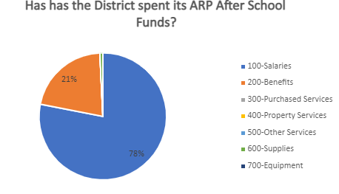
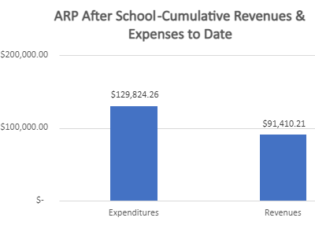
ARP SET ASIDE AFTER SCHOOL FORECAST

Slide 5
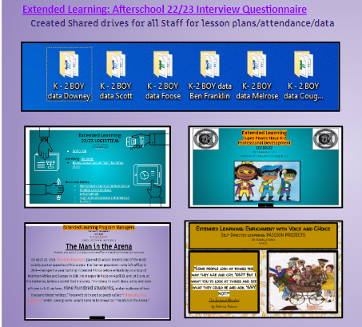
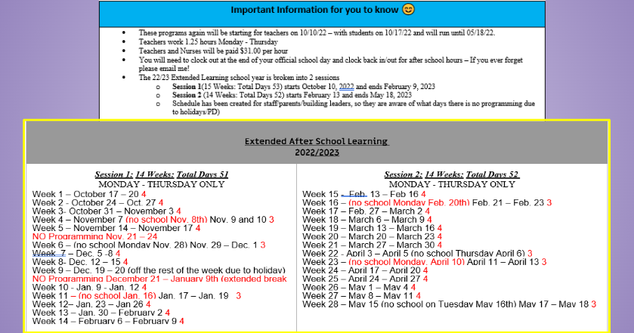
ARP SET ASIDE AFTER SCHOOL IMPLEMENTATION ACTIVITIES

Slide 6
ARP SET ASIDE SUMMER
How has the district spent its ARP ESSER Set Aside Summer Funds?
Allocation: $558,615

Slide 7
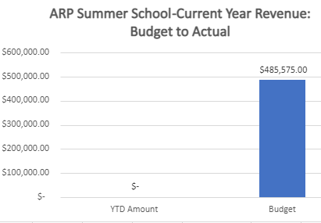
ARP SET ASIDE SUMMER FORECAST

Slide 8
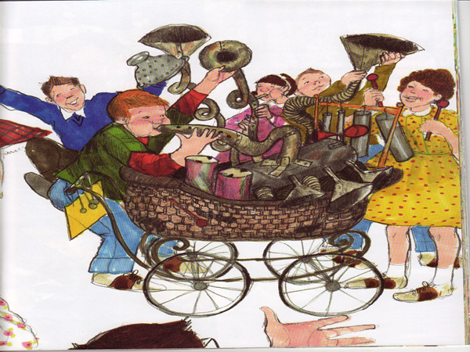
ARP SET ASIDE SUMMER IMPLEMENTATION PROJECTED ACTIVITIES
Site Administrators
Summer Learning:
Professional Development
2022-2023
Dr. Danielle Curzi
Director of Extended Learning K-12
Website for Families
Wonders Camp Staff PD
Super Reader Camp
Grades 1 - 4
Wonders Camp Grades 5 -8
Enrichment
Grades 9-12
Credit Recovery
Grades 10 -12
8

Slide 9
ARP SET ASIDE LEARNING LOSS
How has the district spent its ARP ESSER Set Aside Learning Loss Funds?
Allocation:$2,793,073

Slide 10
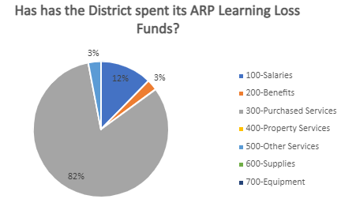
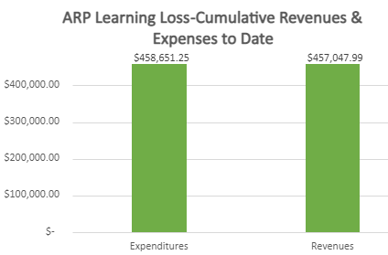
ARP SET ASIDE LEARNING LOSS FORECAST

Slide 11
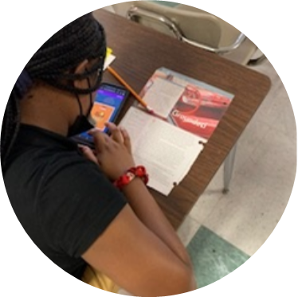
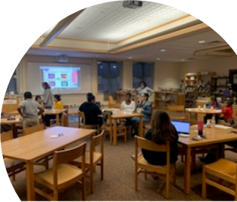
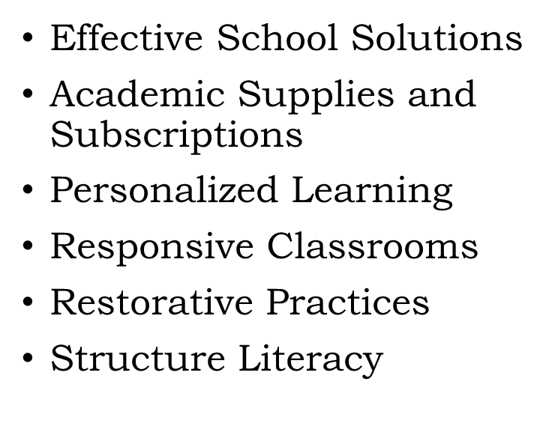
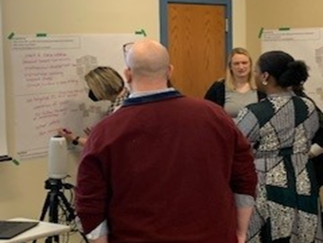
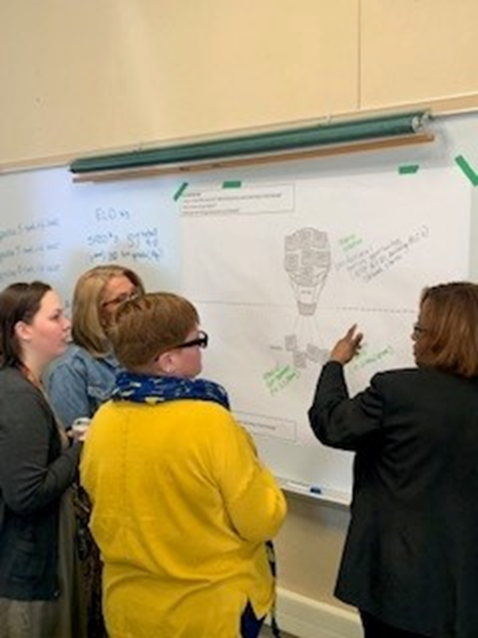
ARP SET ASIDE LEARNING LOSS IMPLEMENTATION ACTIVITIES”

Slide 12
ARP ESSER A-TSI 2.5% SET ASIDE
How has the district spent its ARP ESSER Set Aside A-TSI
2.5 % Funds?
Allocation: $143,604

Slide 13
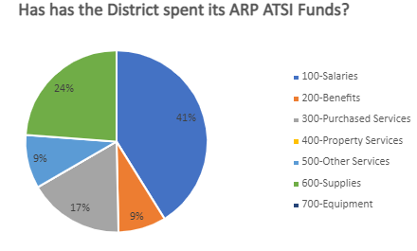
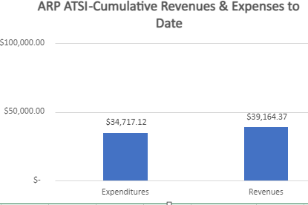
ARP ESSER A-TSI 2.5% SET ASIDE FORECAST

Slide 14
ARP ESSER A-TSI 2.5% SET ASIDE IMPLEMENTATION ACTIVITIES
Foose
Collaborative STEM activities and projects
Research based math Instruction professional development
Number Worlds KG-5th Grades
Imagine Math KG-5th Grades
Educational Student Incentives
DataWise professional development

Slide 15
ARP ESSER A-TSI 2.5% SET ASIDE IMPLEMENTATION ACTIVITIES
Scott
Research based Growth Mindset professional development
Research based math Instruction professional development
Number Worlds KG-5th Grades
Imagine Math KG-5th Grades
Educational student incentives
DataWise professional development

Slide 16
ARP SUPPLEMENTAL IDEA-PART B
How has the district spent its ARP ESSER Set Aside IDEA-Part B Funds?
Allocation: $298,419

Slide 17
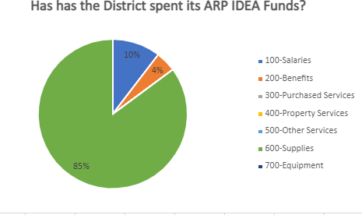
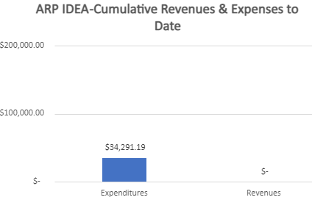
ARP SUPPLEMENTAL IDEA-PART B FORECAST

Slide 18
ARP SUPPLEMENTAL IDEA-PART B IMPLEMENTATION ACTIVITIES
An order for 100 iPads, 100 Otter box cases, and 10 micro charging stations has been placed.
Ordering for the new sensory rooms at Foose and Ben Franklin has begun.

Slide 19
ARP ESSER -HCY HOMELESS GRANT
How has the district spent its ARP ESSER –HCY Homeless Grant Funds?
Allocation: $272,709

Slide 20
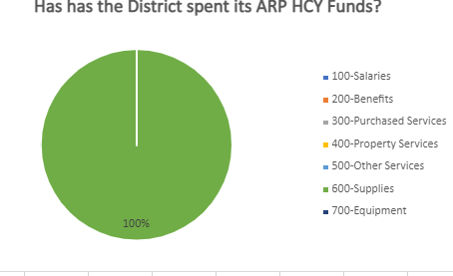
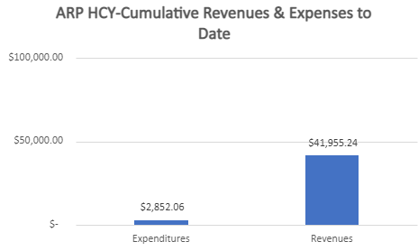
ARP ESSER -HCY HOMELESS GRANT FORECAST

Slide 21
ARP ESSER -HCY HOMELESS GRANT IMPLEMENTATION ACTIVITIES
10 schools will open Cougar Dens:
School supplies;
Uniforms, coats, sweaters;
Hygiene products; and
An area for parents to wash laundry. “Selected schools for example Ben Franklin Elementary.”

Slide 22
SPOTLIGHT SCHOOLS
Sci Tech
Camp Curtin
Rowland
Foose
Scott

Slide 23
SPOTLIGHT VIDEO

