Slide 1
Harrisburg City School District Elementary and Secondary School Emergency Relief (ESSER) Progress Report
Dr. Christy Thompson,
ESSER Administrator
January 10, 2023

Slide 2
ELEMENTARY AND SECONDARY SCHOOL EMERGENCY RELIEF FUND IMPLEMENTATION

Slide 3
ESSER I ALLOCATION $4,767,579.00
How has the district spent its
ESSER I Funds?

Slide 4
ESSER I COMPLETED PROJECTS
Personal Protective Equipment;
Salaries and Benefits (Reg. Ed/Spec. Ed.;
HVLA Contract/Montgomery County Intermediate Unit;
Non-Public School Programs; and
Technology Fees.

Slide 5
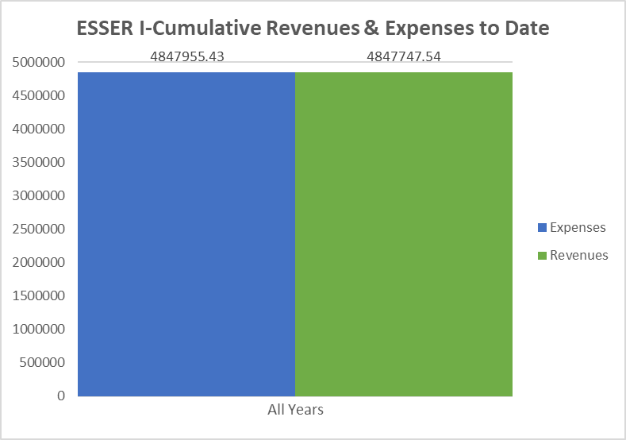
ESSER I FINANICAL FORECAST

Slide 6
ESSER II ALLOCATION $24,873,106
How has the district spent its ESSER II Funds?

Slide 7
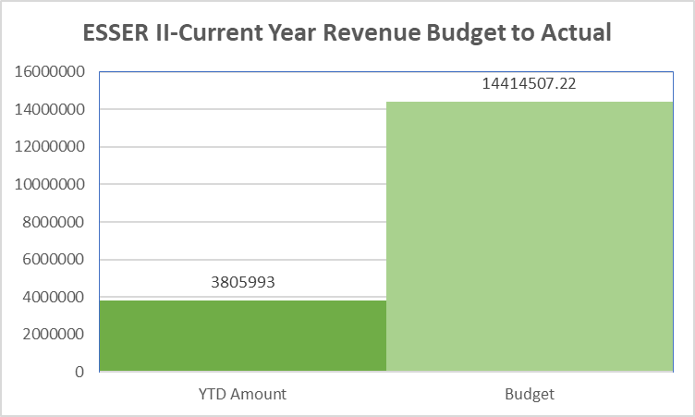
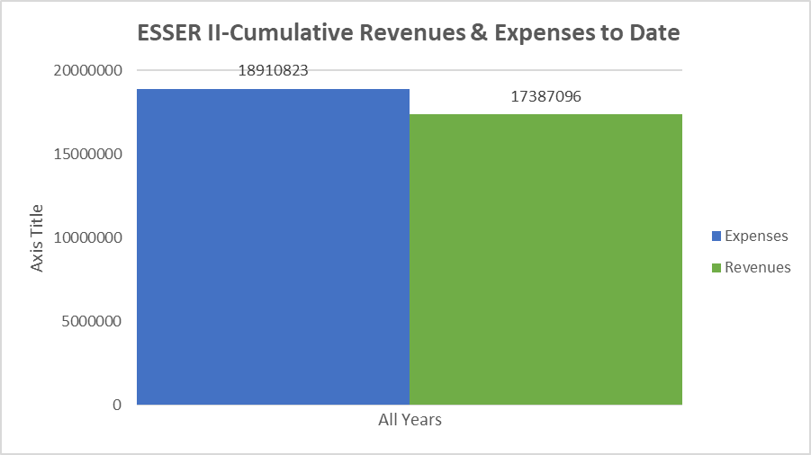
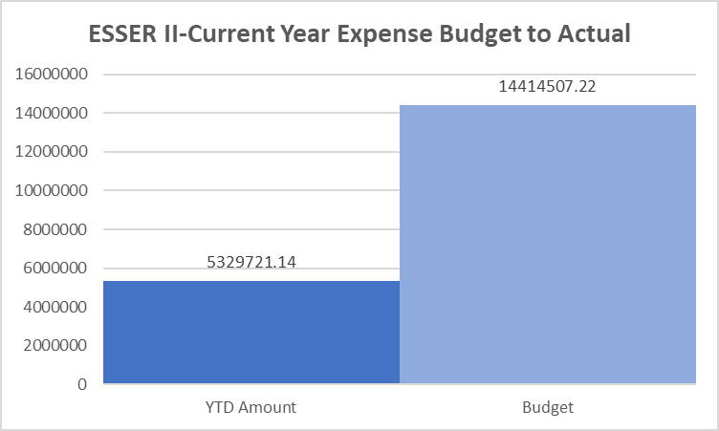
ESSER II FINANCIAL FORECAST

Slide 8
ESSER II
How has the district spent its ESSER II Funds?
Retention Bonuses for teachers and paraprofessionals;
Overtime and class coverage for teachers and paraprofessionals;
Salaries/benefits for music, art, library/media specialist;
Multi-tiered Support System (MTSS) PD;
Online Program Tuition for MCIU Program;
PA Counseling Contract;
Renzulli Learning;
Chromebooks 1:1 Learning for students;
Summer School Programming;
Academic supplies;
Classroom furniture; and
HVAC projects.

Slide 9
ESSER III ALLOCATION $50,311,096
How has the district spent its ARP ESSER III Funds?

Slide 10
ESSER III ONGOING PROJECTS
CC BY-NC-ND
HVLA Project Manager
HVLA Teachers
ESSER Administrator
LivingWell Contractor
Behavior Specialist Elementary, Middle and High
Supervisor of Extended Learning
Effective School Solutions Contractor
HVAC Replacements
Steele Renovations
Student Recognitions
Staff Recognitions
Technology
Academic Supplies/Subscriptions
Network Equipment

Slide 11
ESSER III
ARP ESSER III
DECEMBER 2022

Slide 12
ESSER III
ARP ESSER III
DECEMBER 2022

Slide 13
ESSER III
ARP ESSER III
DECEMBER 2022

Slide 14
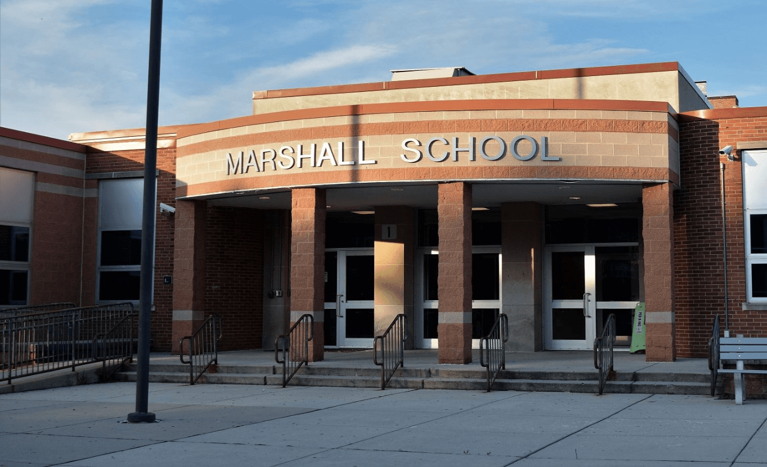
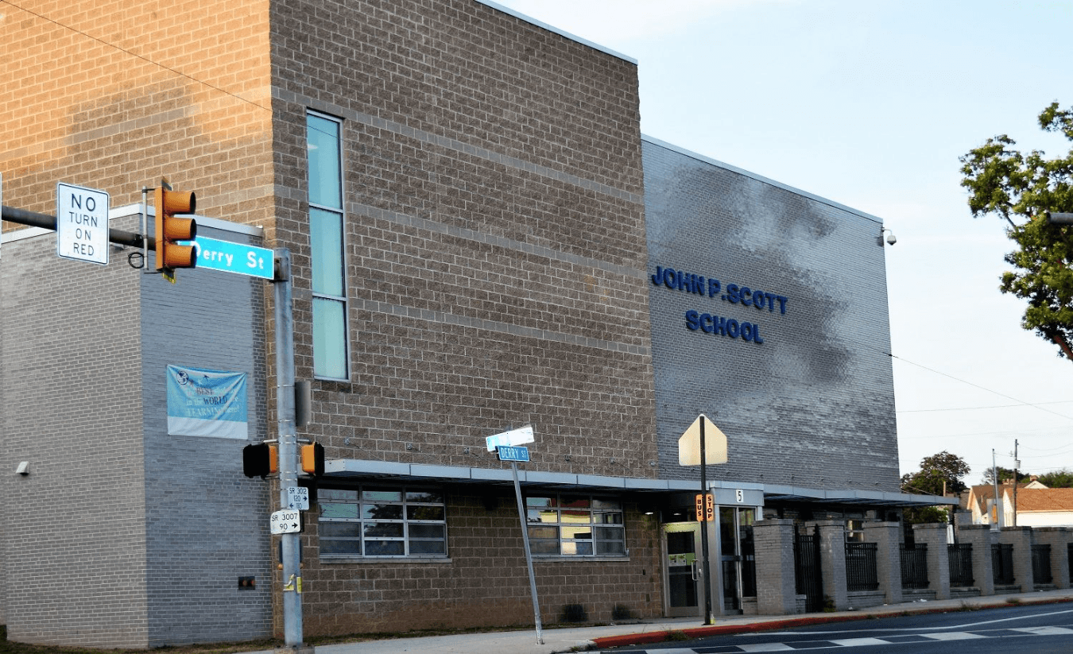
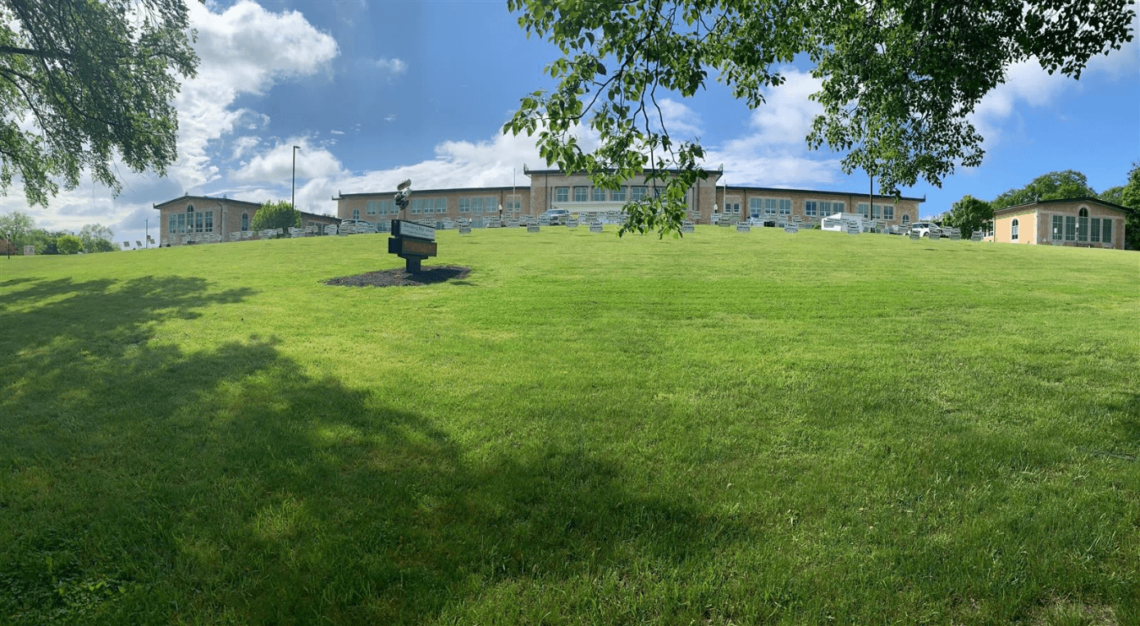
ESSER PROJECTS SPOTLIGHT SCHOOLS
Marshall Math and Science
John Scott Elementary
Ben Franklin Elementary
John Harris High School

Slide 15
ESSER PROJECTS SPOTLIGHT SCHOOLS
INSERT VIDEO

Slide 16
Thank you!
This Photo by Unknown Author is licensed under CC BY-ND

