Slide 1
DR. CHRISTY THOMPSON JANUARY 9, 2024
HARRISBURG CITY SCHOOL DISTRICT ELEMENTARY
AND SECONDARY SCHOOL EMERGENCY RELIEF FUNDS
PROGRESS REPORT

Slide 2
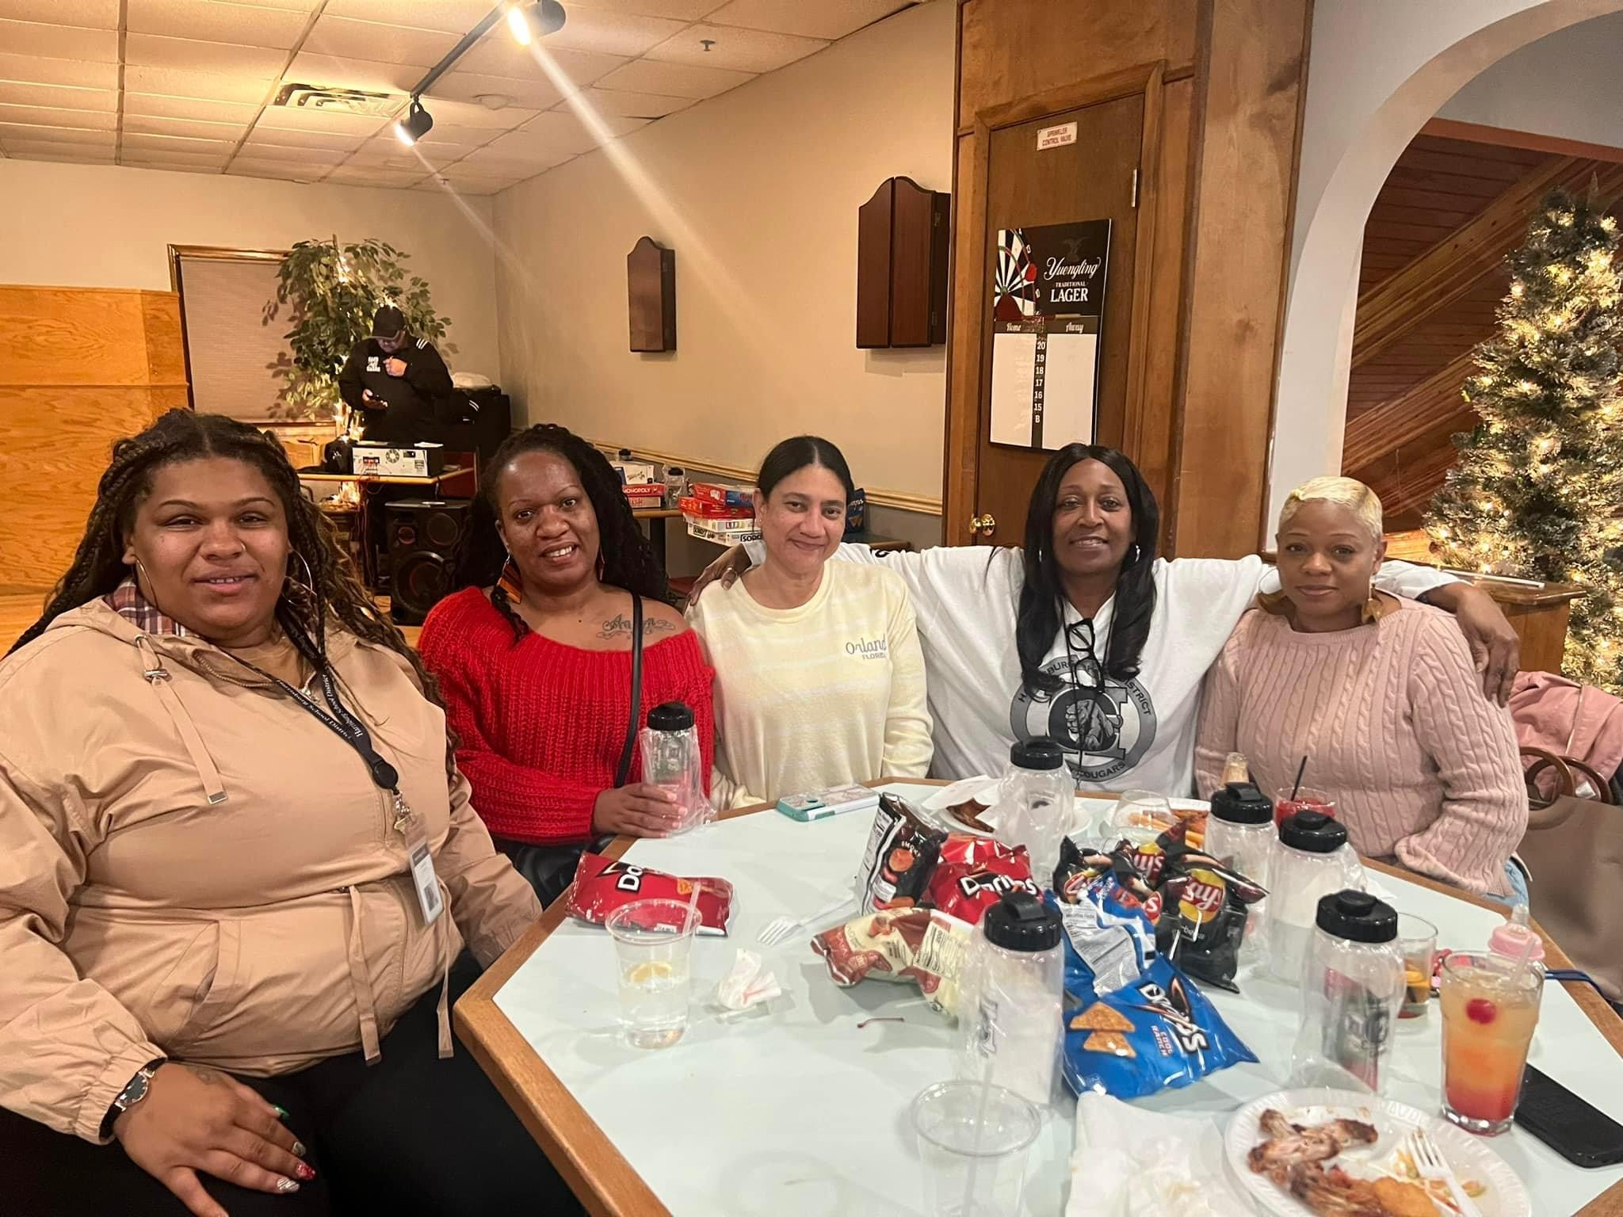
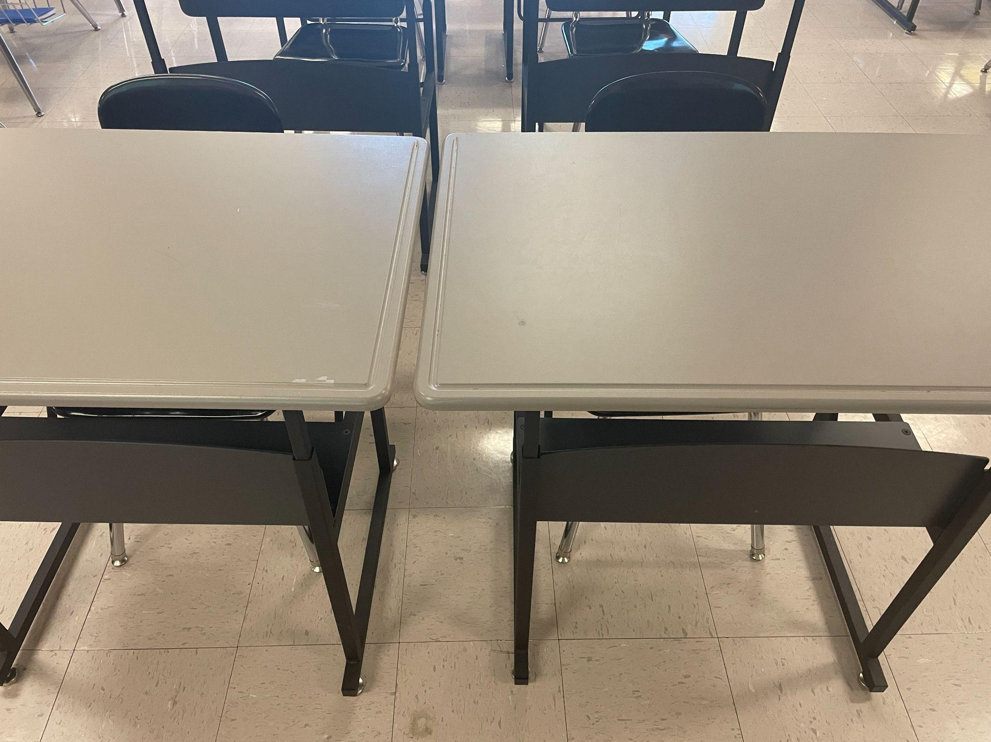
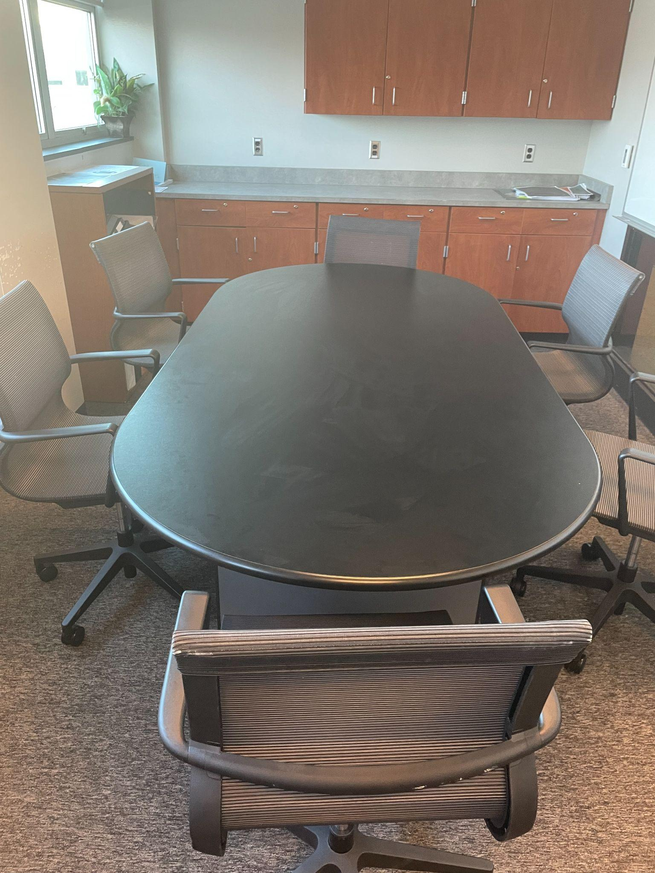
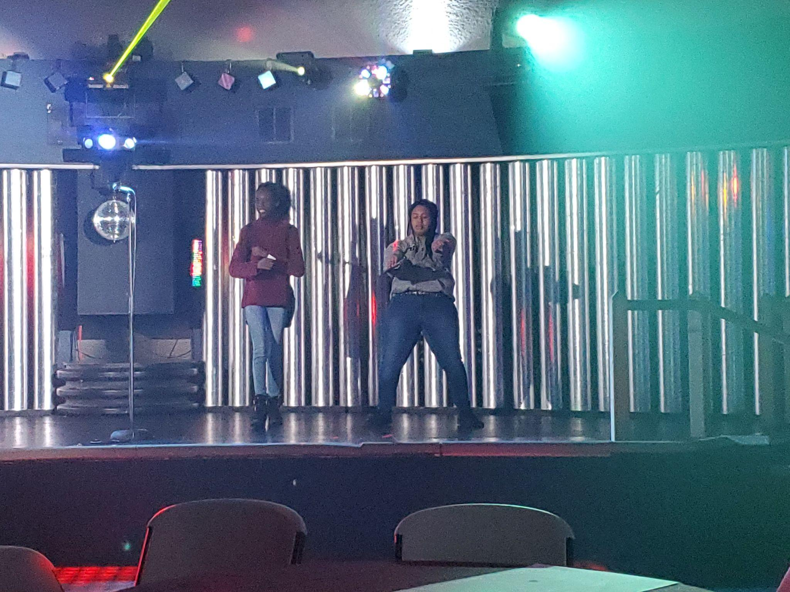
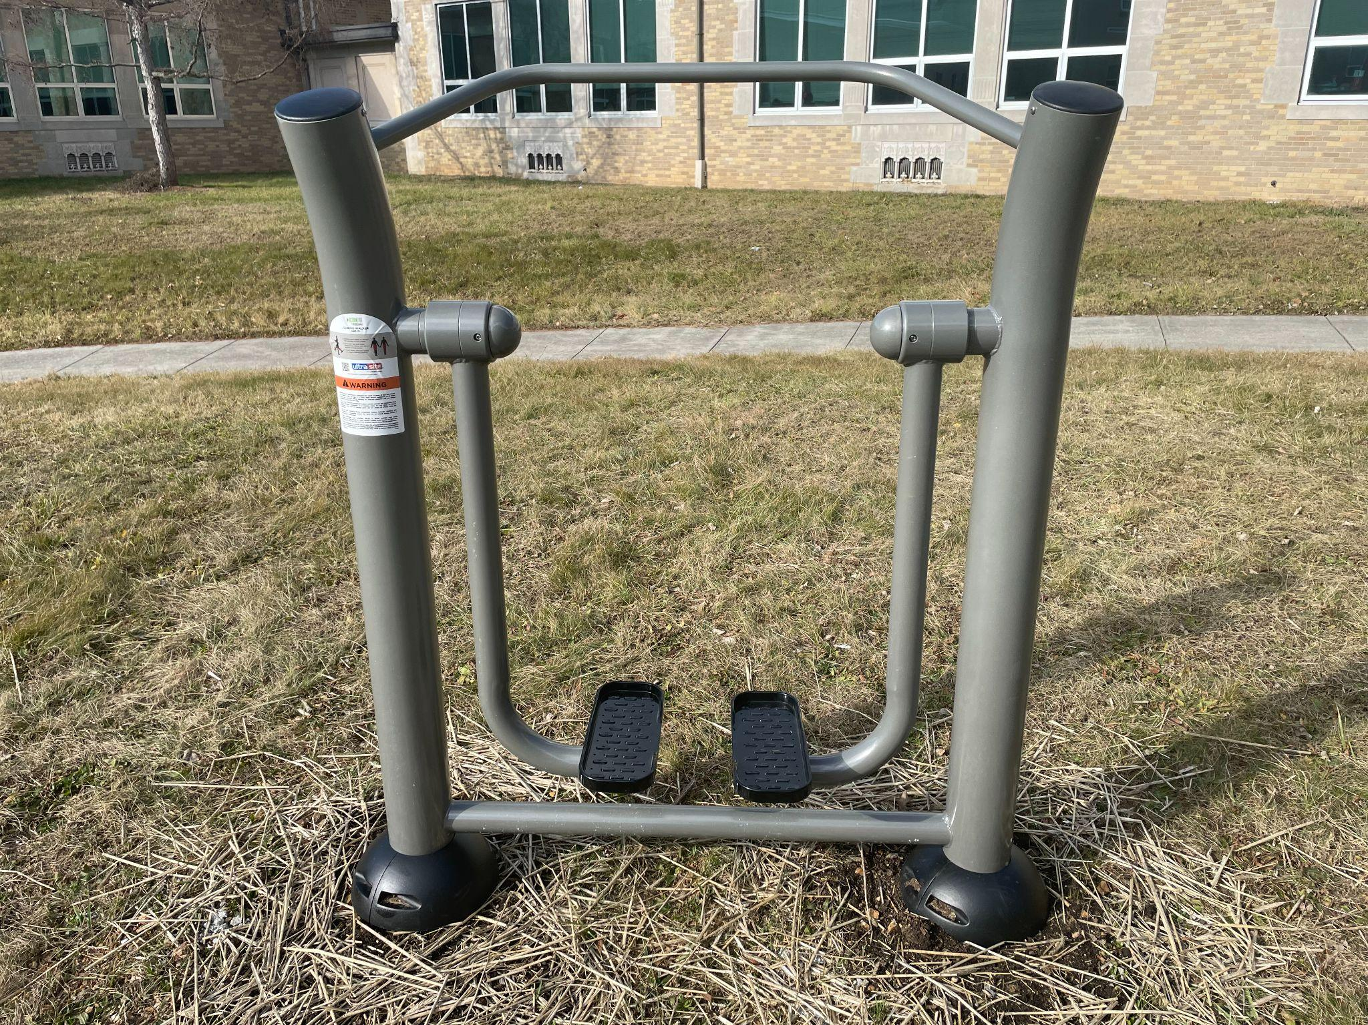
A TRIP DOWN ESSER FUNDING MEMORY LANE JOHN HARRIS Campus

Slide 3
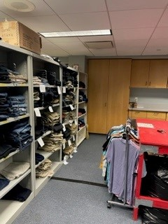
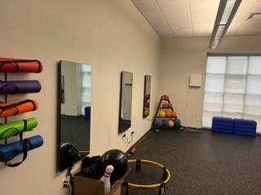
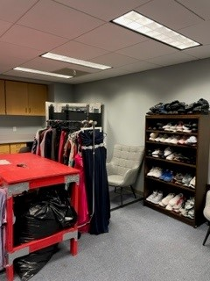
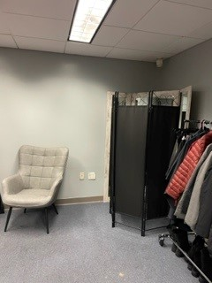
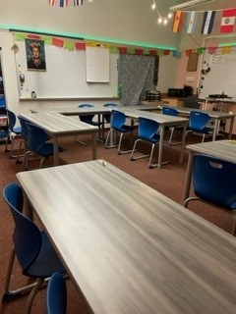
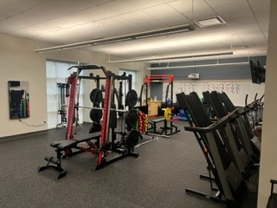
A TRIP DOWN ESSER FUNDING MEMORY LANE SCITECH Campus
“DON’T COUNT THE YEARS, COUNT THE MEMORIES.”
- UNKNOWN

Slide 4
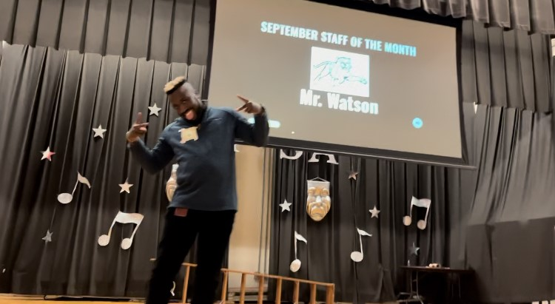
A TRIP DOWN ESSER FUNDING MEMORY LANE MARSHALL MATH AND SCIENCE
“DON’T COUNT THE YEARS, COUNT THE MEMORIES.”
- UNKNOWN

Slide 5
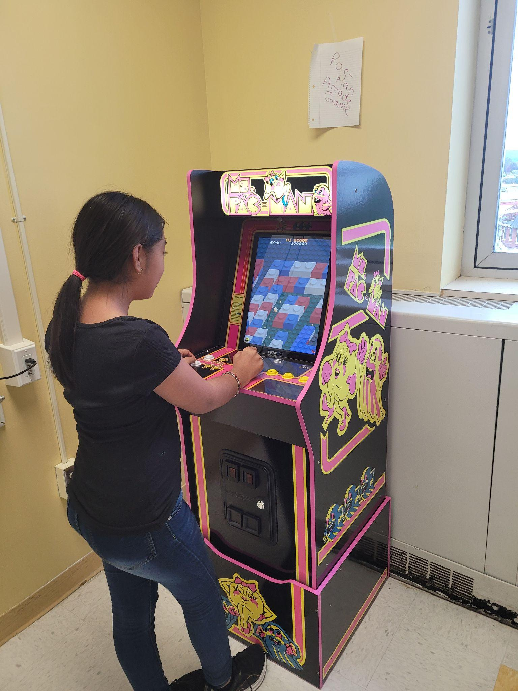
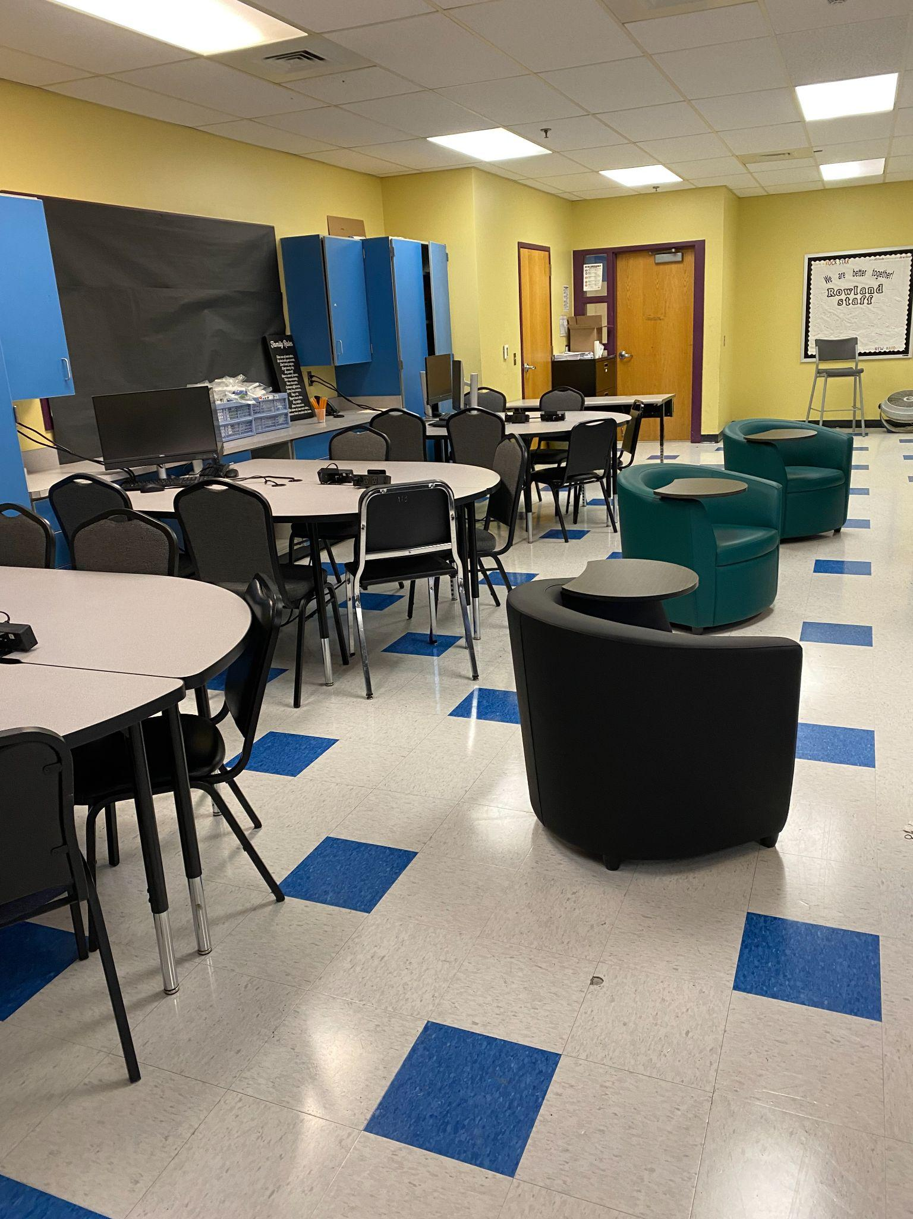
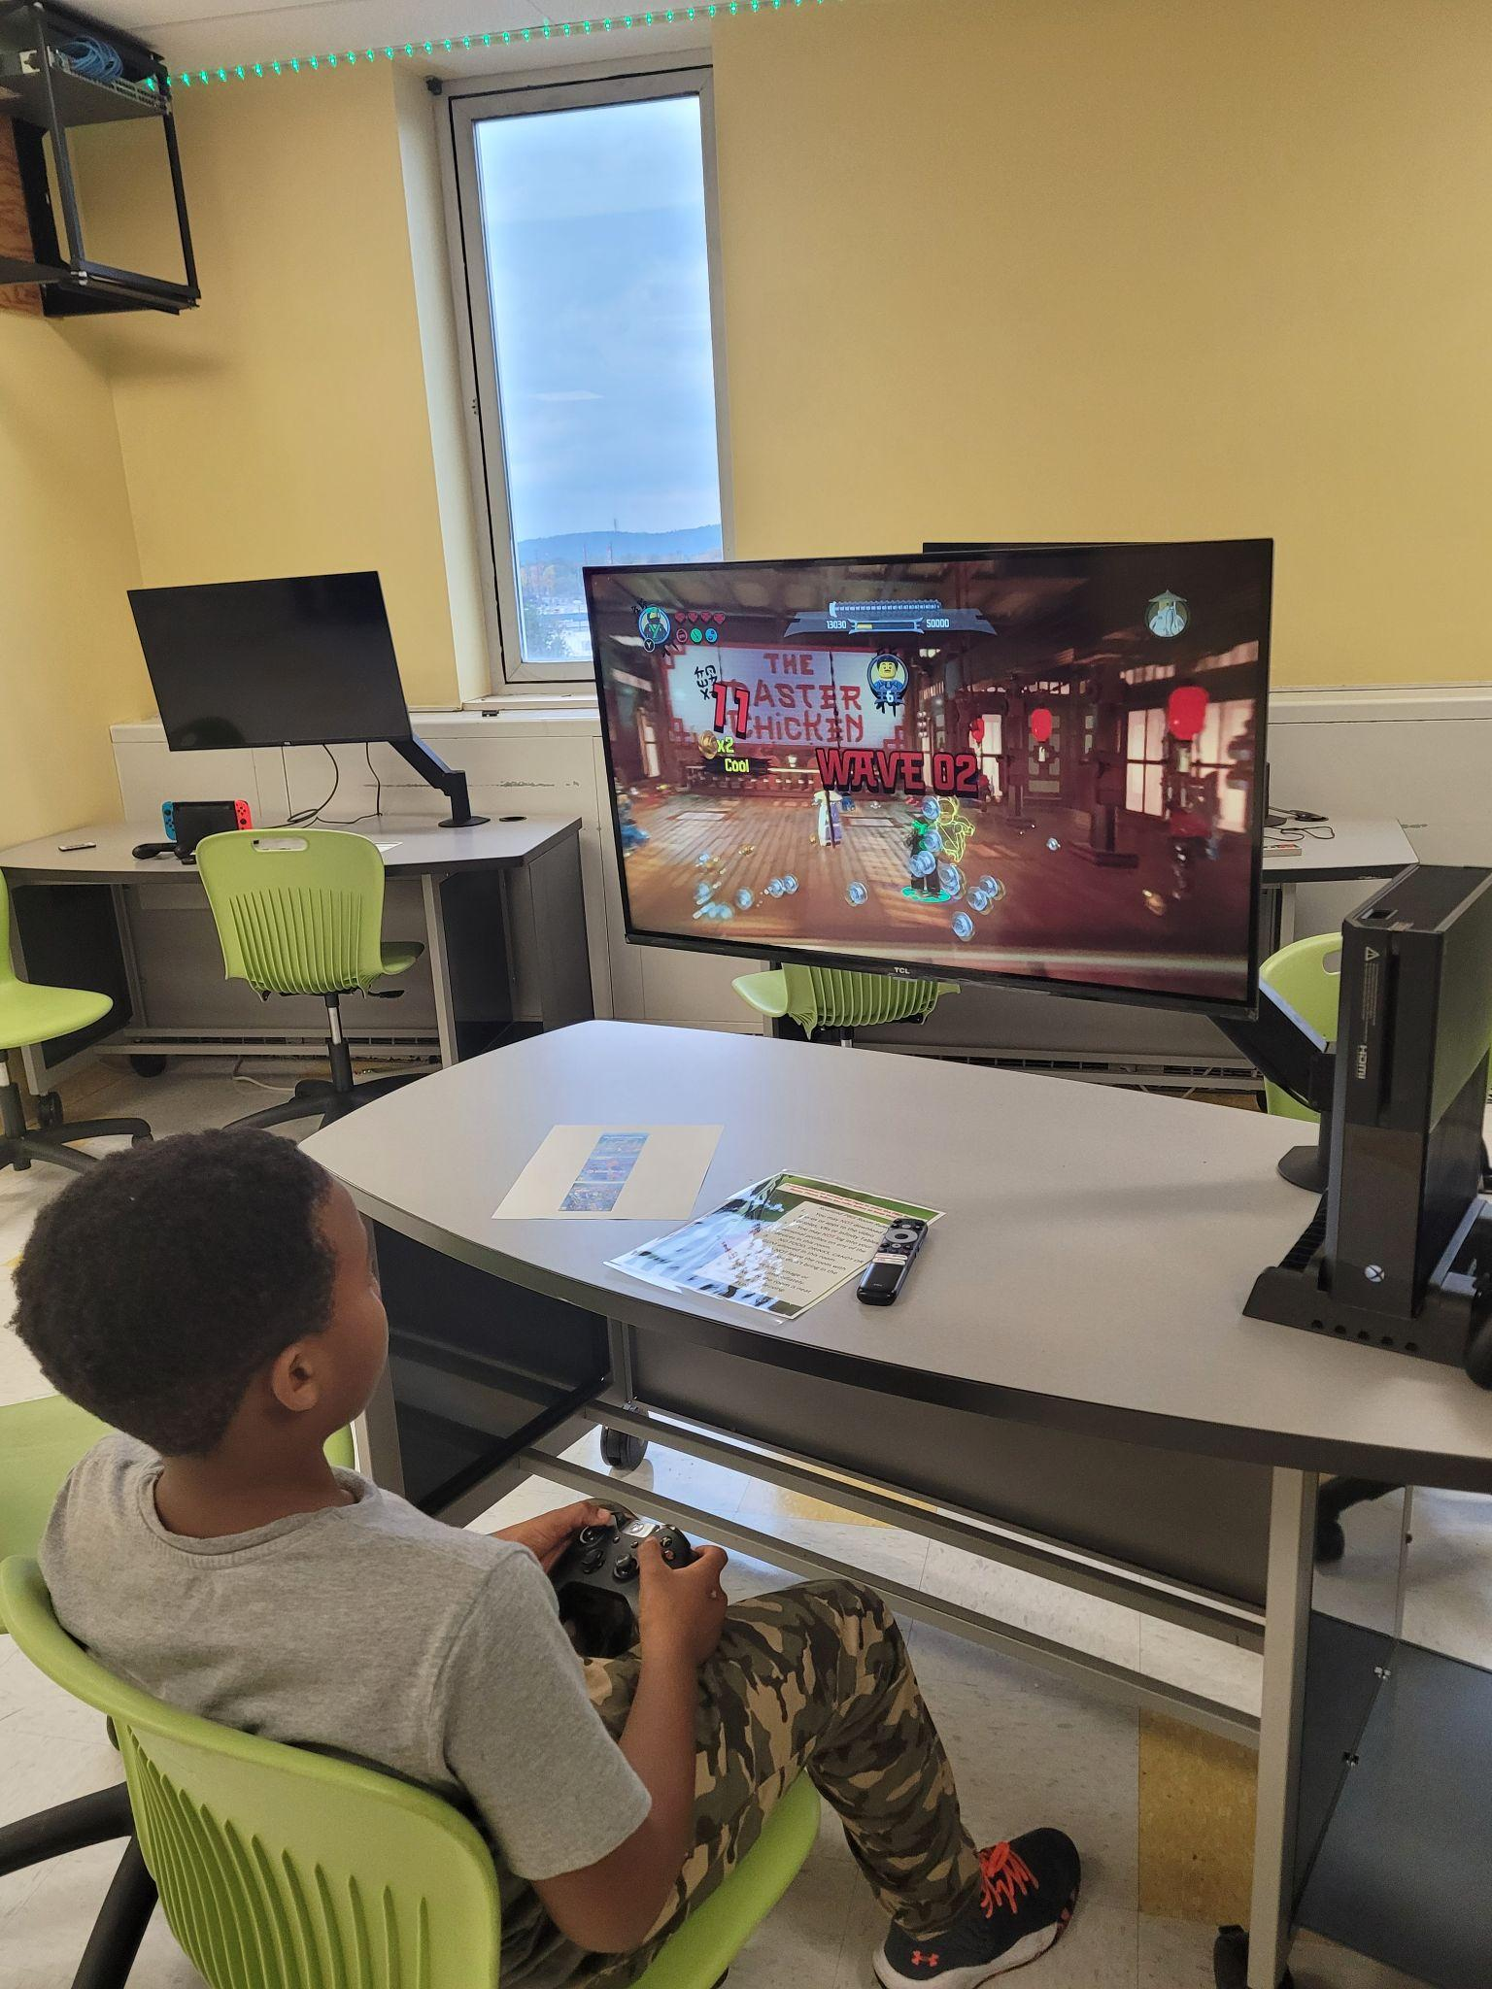
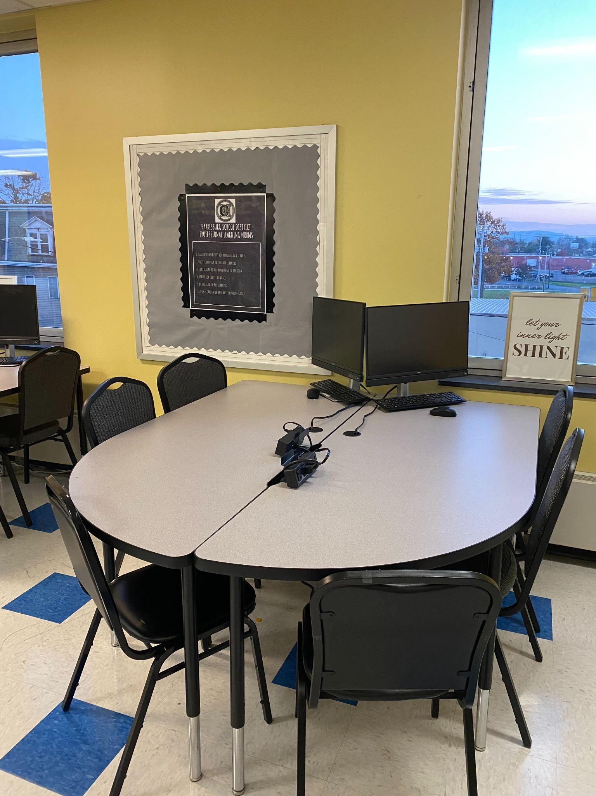
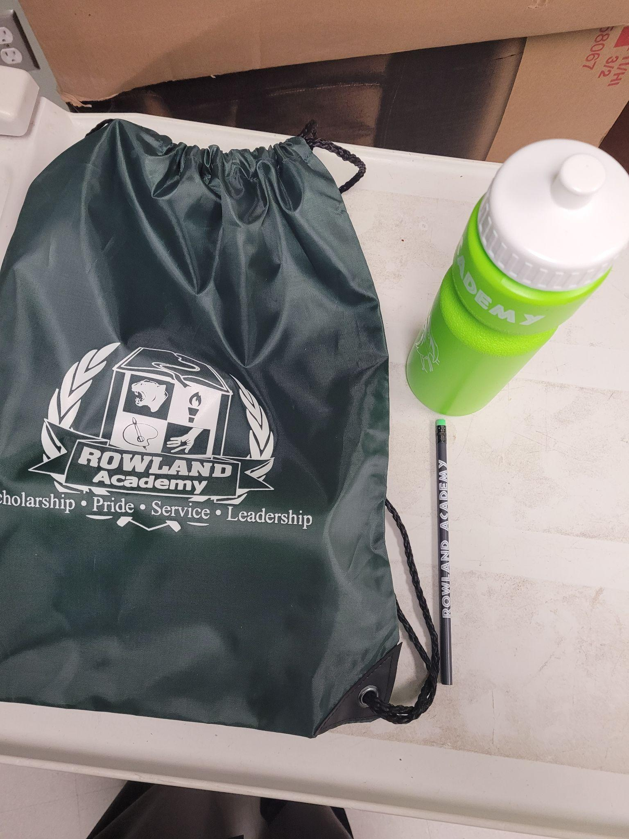
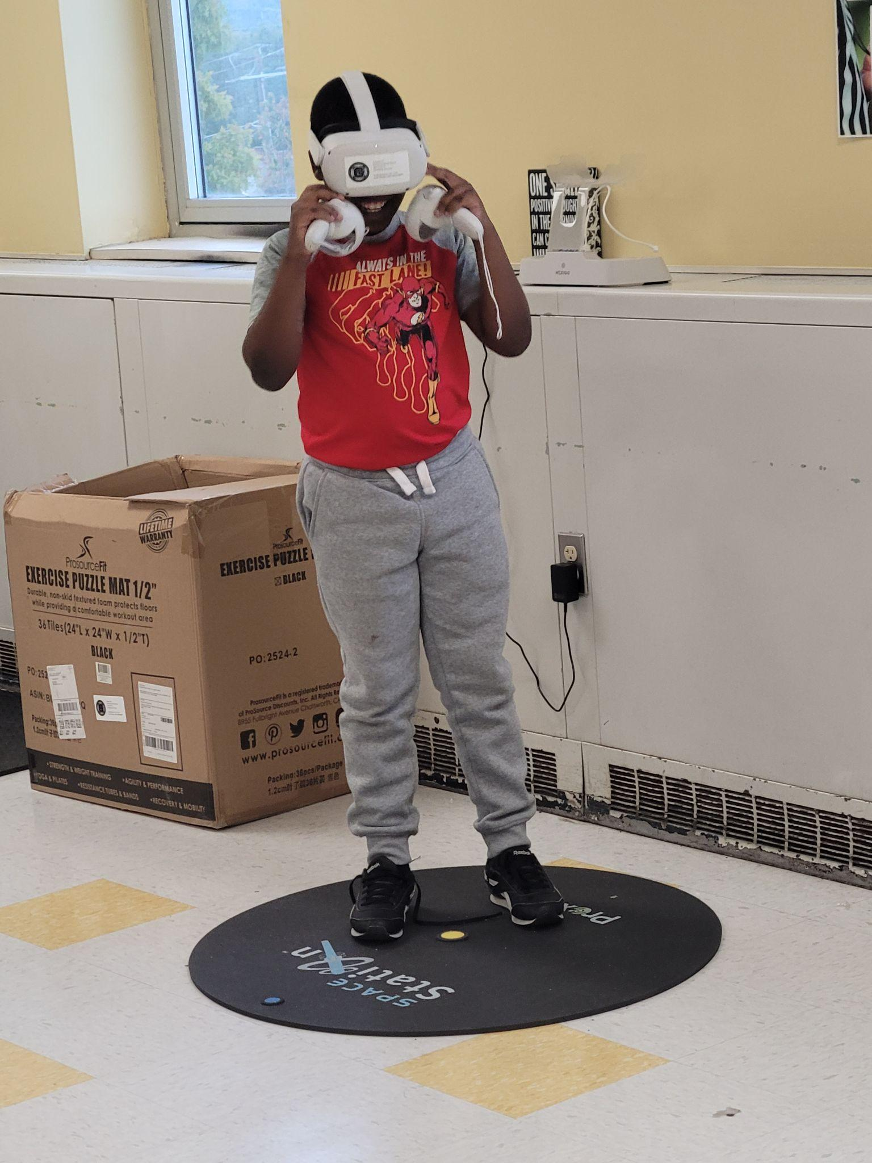
A TRIP DOWN ESSER FUNDING MEMORY LANE ROWLAND ACADEMY
“DON’T COUNT THE YEARS, COUNT THE MEMORIES.”
- UNKNOWN

Slide 6
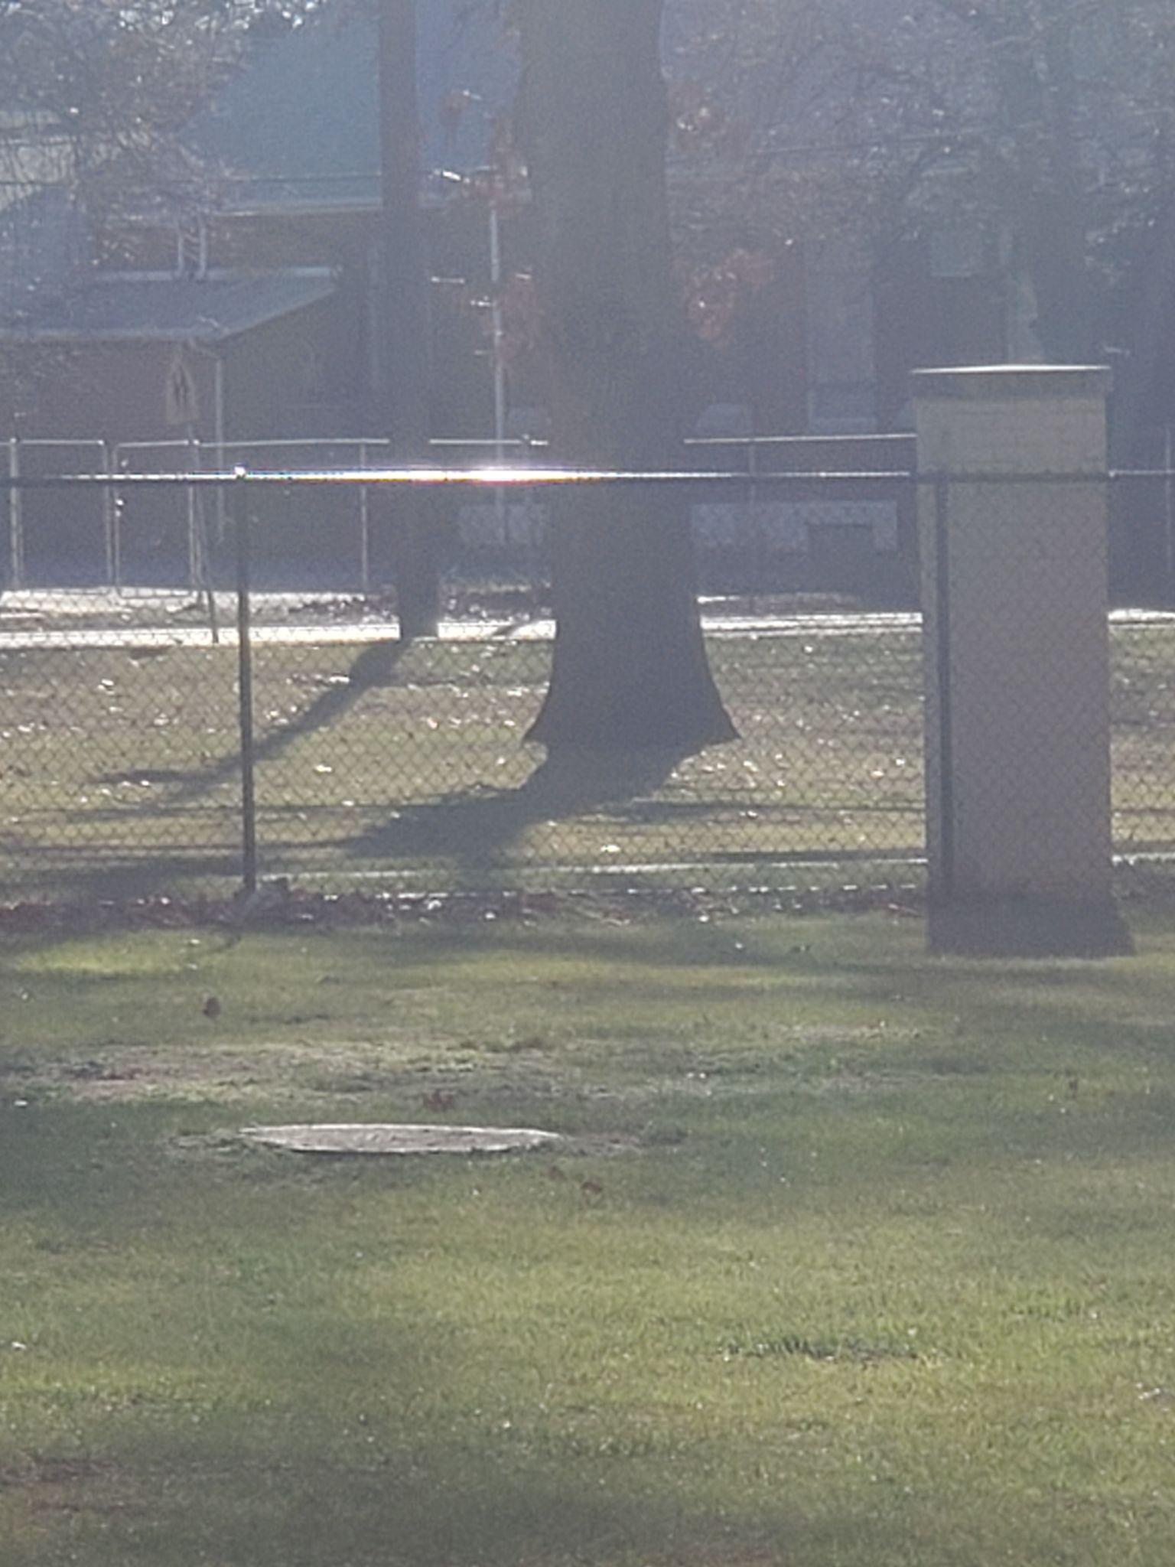
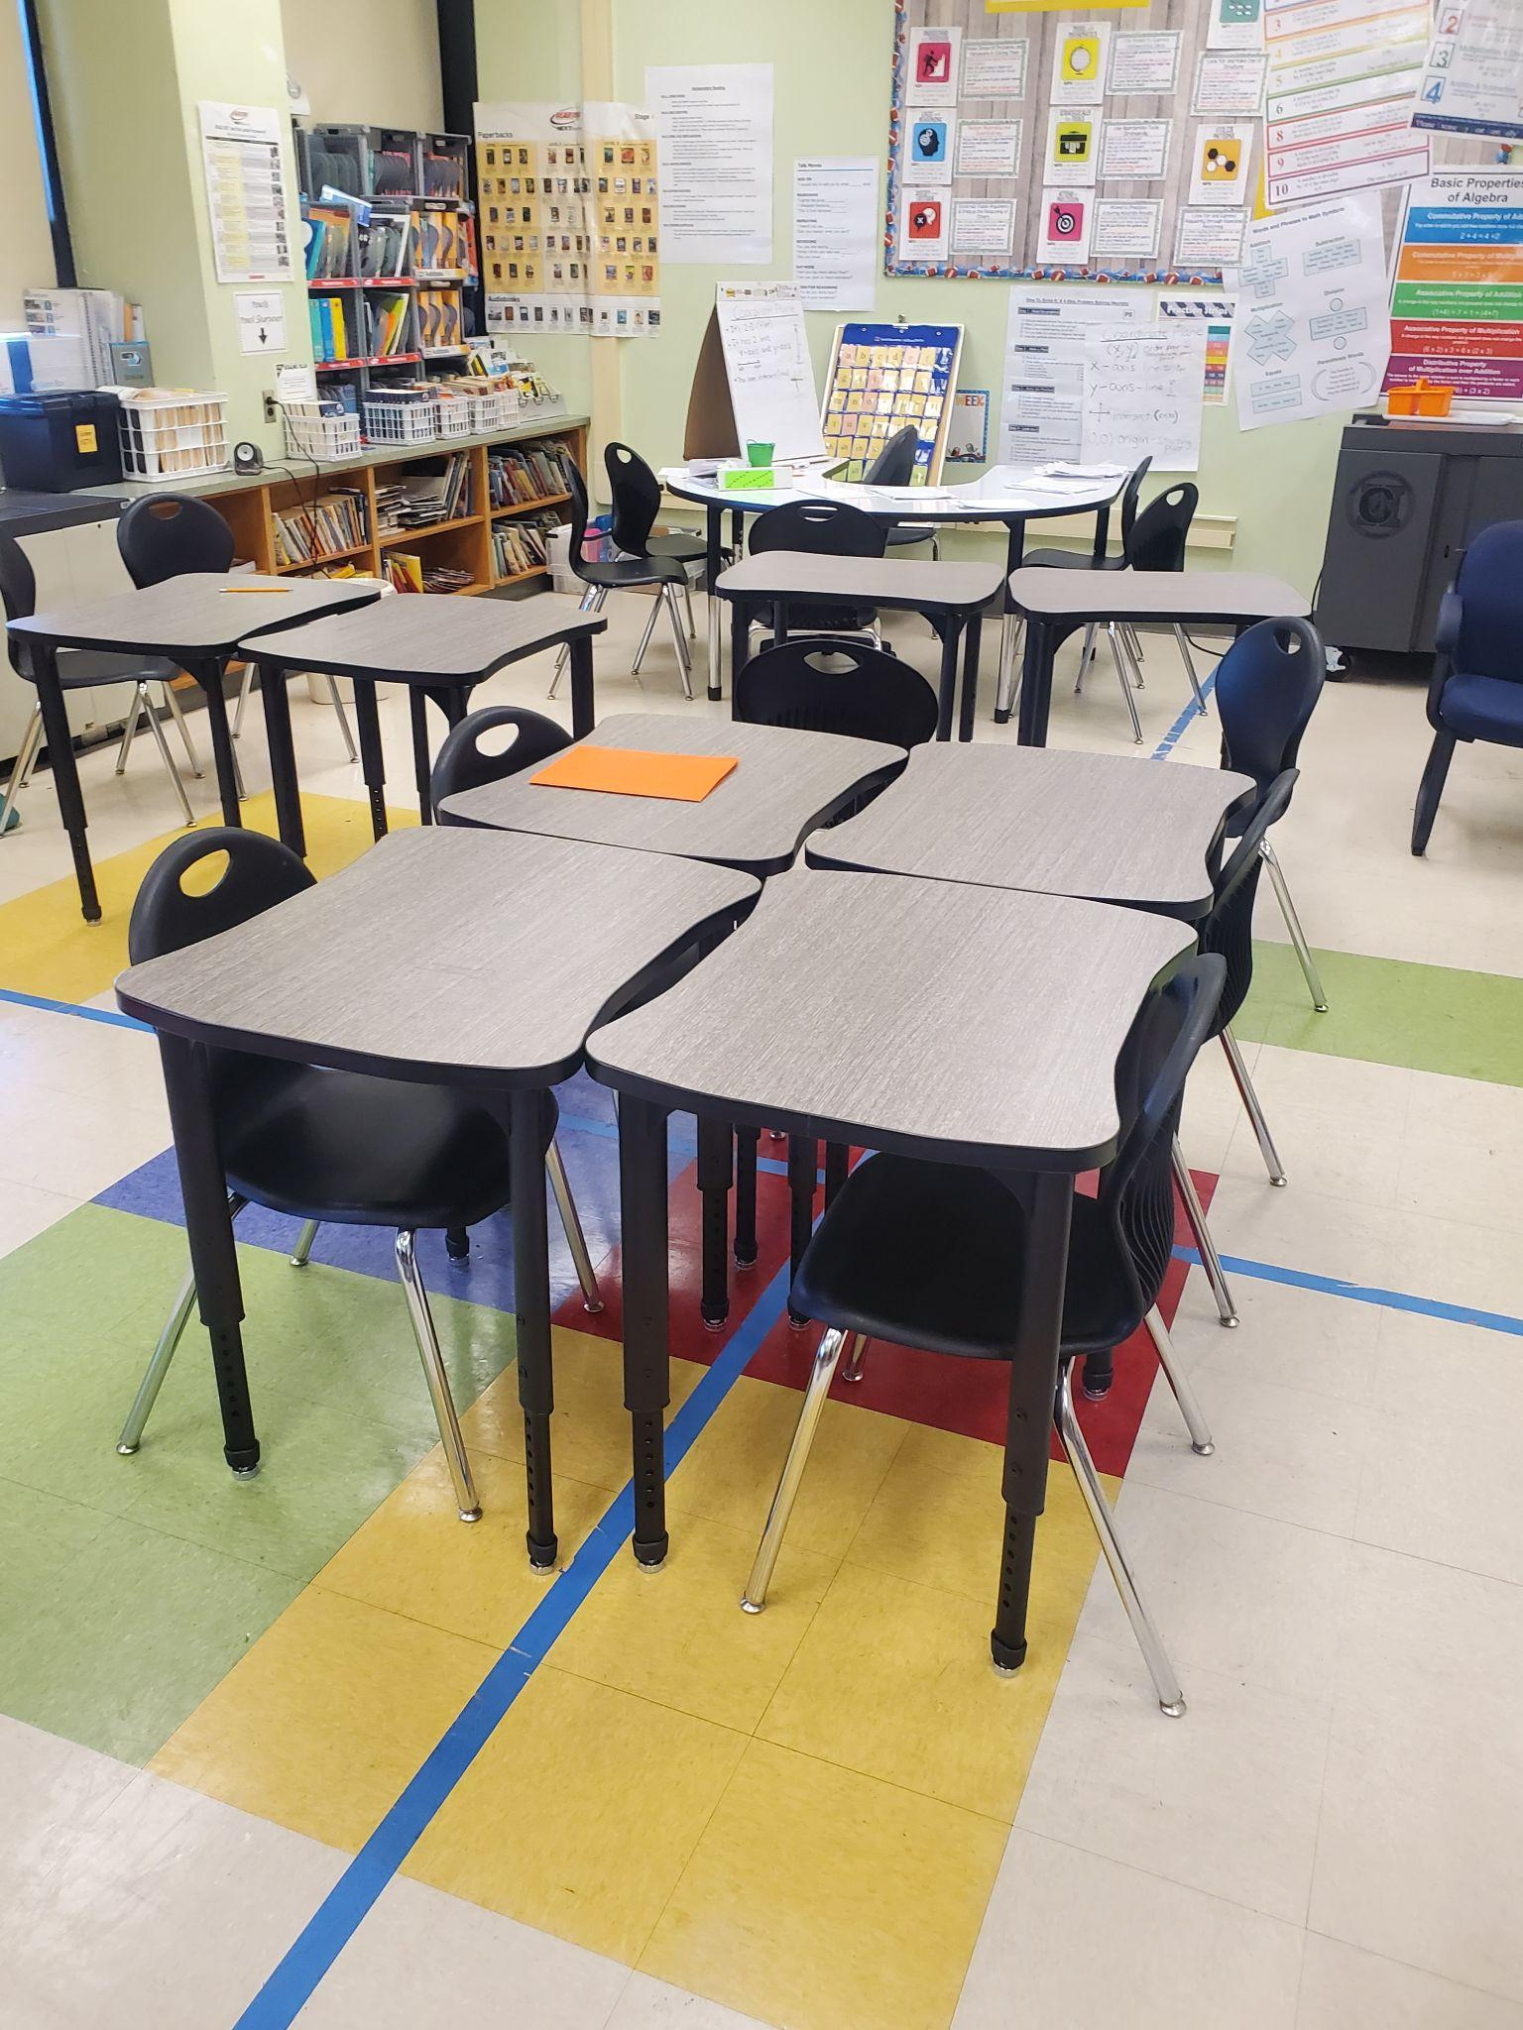
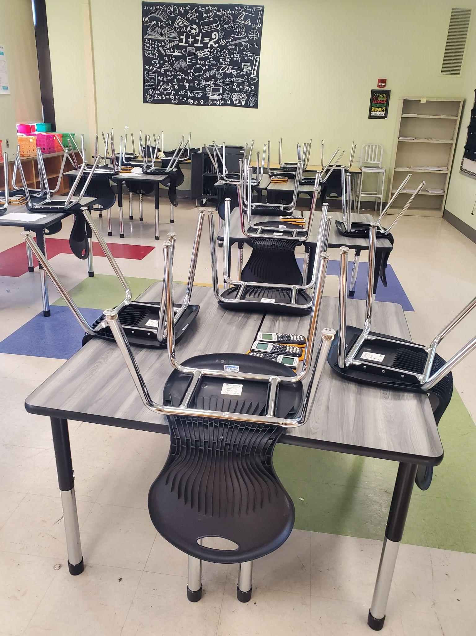
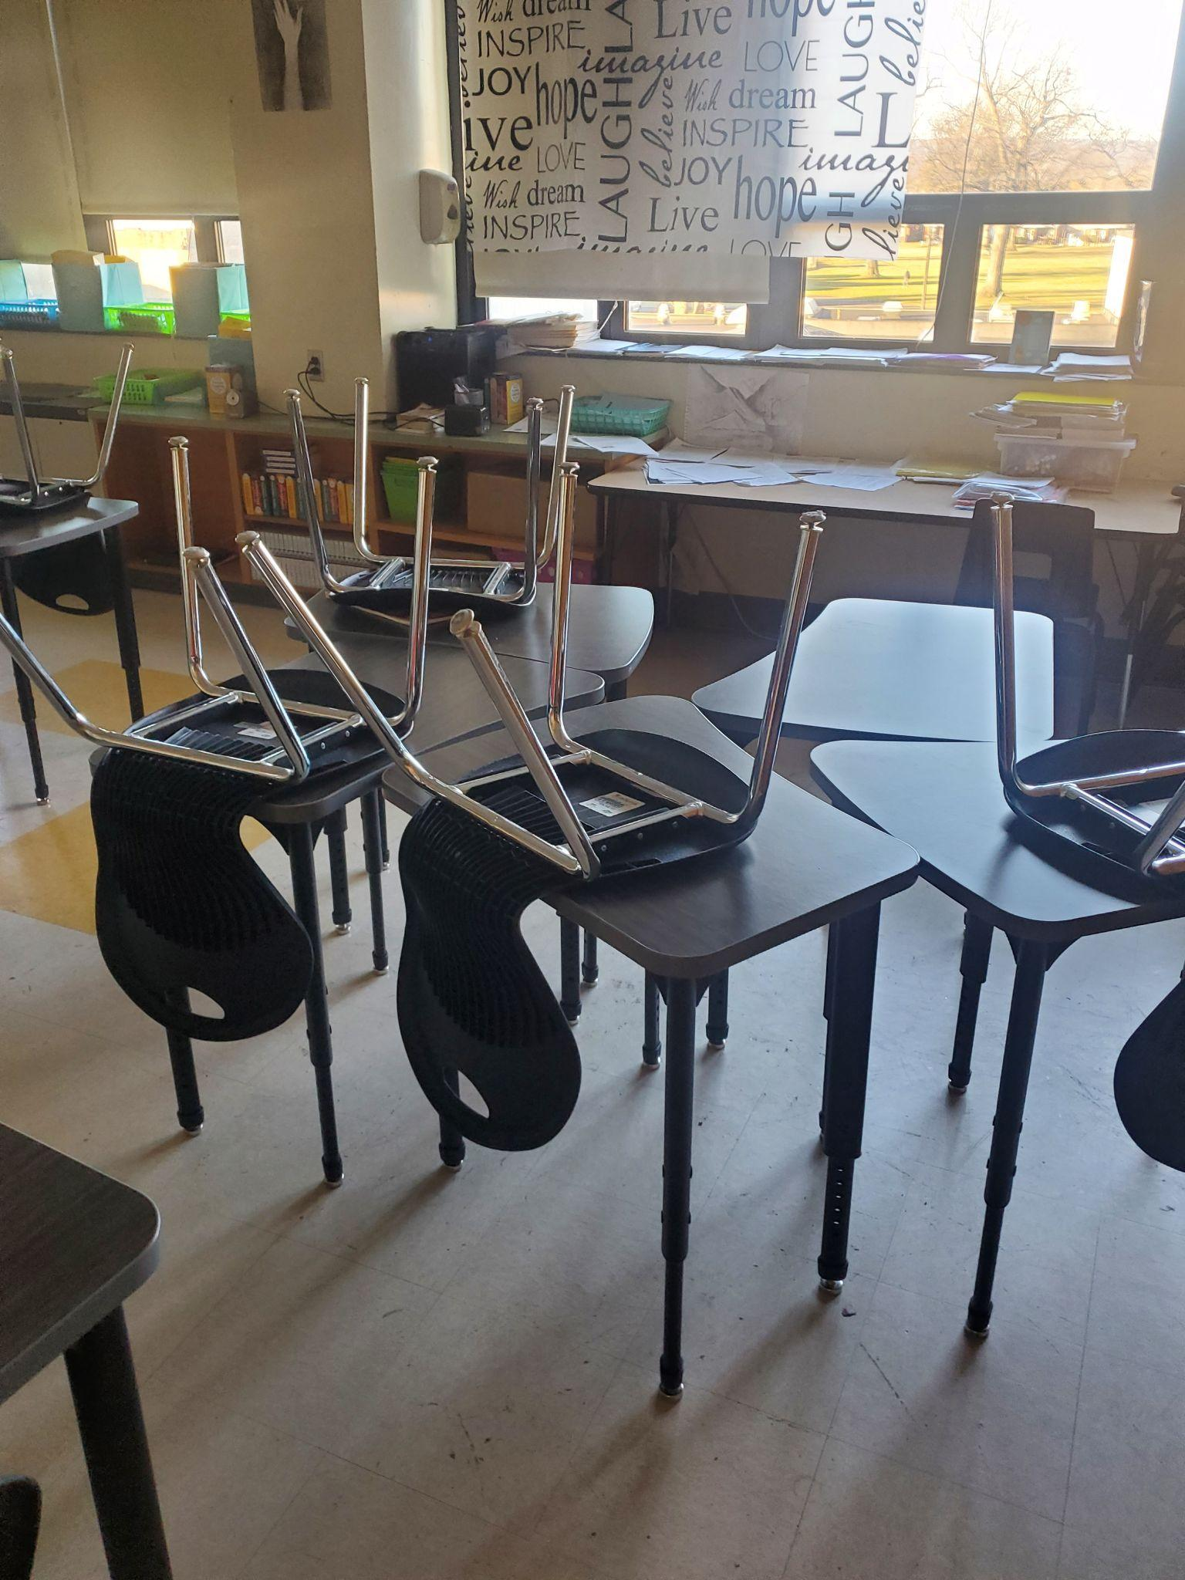
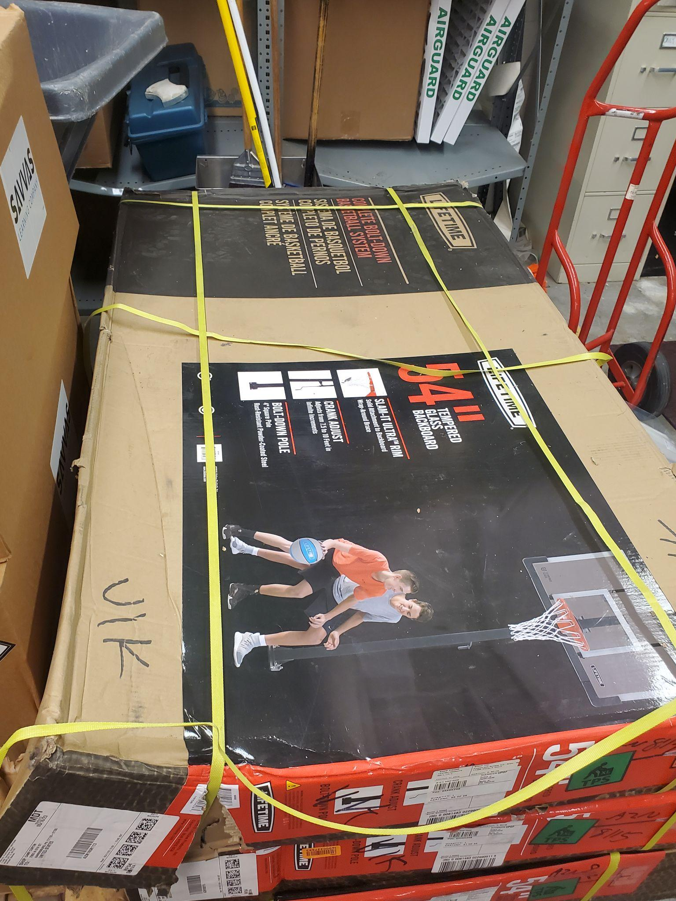
A TRIP DOWN ESSER FUNDING MEMORY LANE CAMP CURTIN
“DON’T COUNT THE YEARS, COUNT THE MEMORIES.”
- UNKNOWN

Slide 7
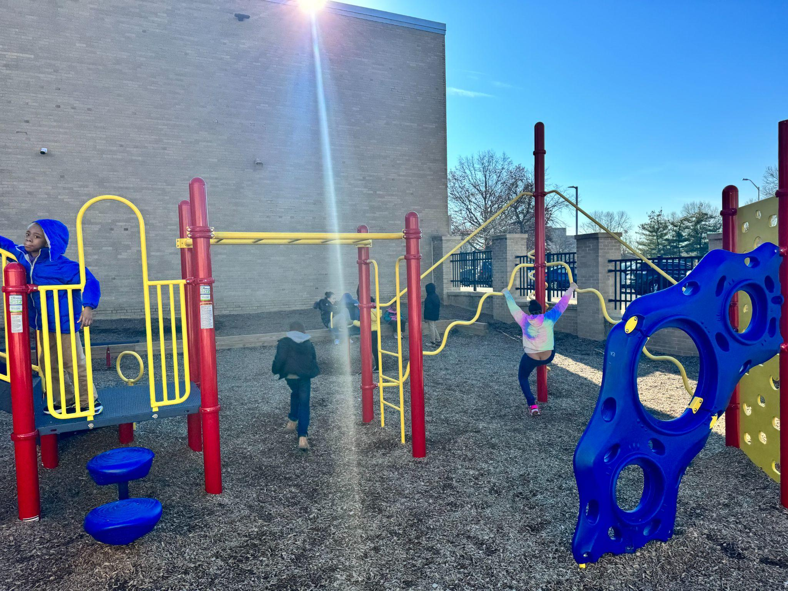
A TRIP DOWN ESSER FUNDING MEMORY LANE BEN FRANKLIN ELEMENTARY

Slide 8
A TRIP DOWN ESSER FUNDING MEMORY LANE DOWNEY ELEMENTARY

Slide 9
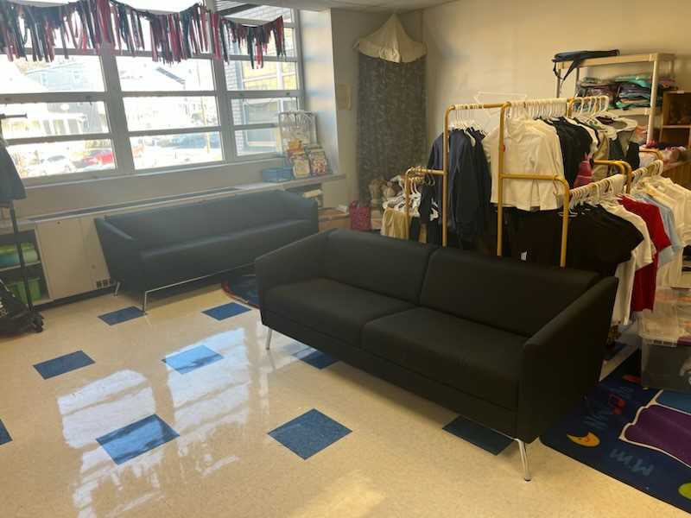
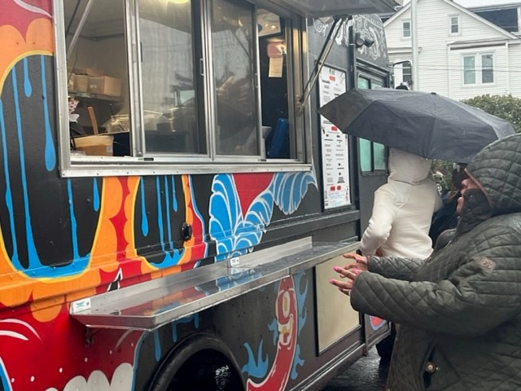
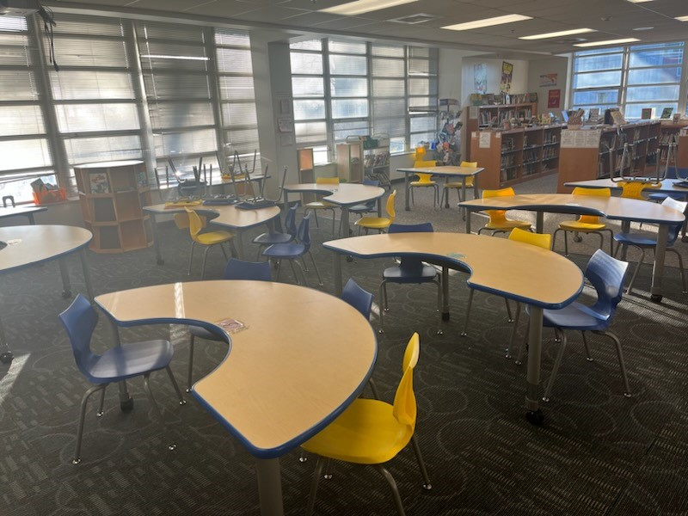
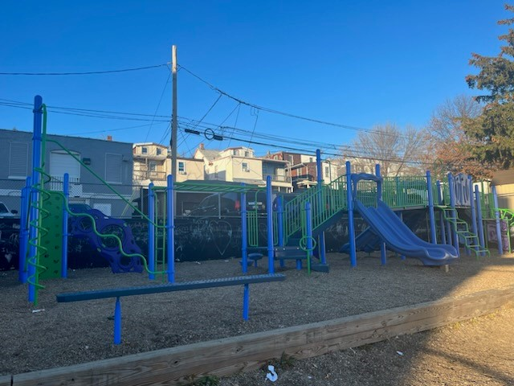
A TRIP DOWN ESSER FUNDING MEMORY LANE SCOTT ELEMENTARY
“DON’T COUNT THE YEARS, COUNT THE MEMORIES.”
- UNKNOWN

Slide 10
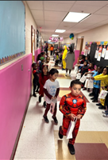
A TRIP DOWN ESSER FUNDING MEMORY LANE MELROSE ELEMENTARY
“DON’T COUNT THE YEARS, COUNT THE MEMORIES.”
- UNKNOWN

Slide 11
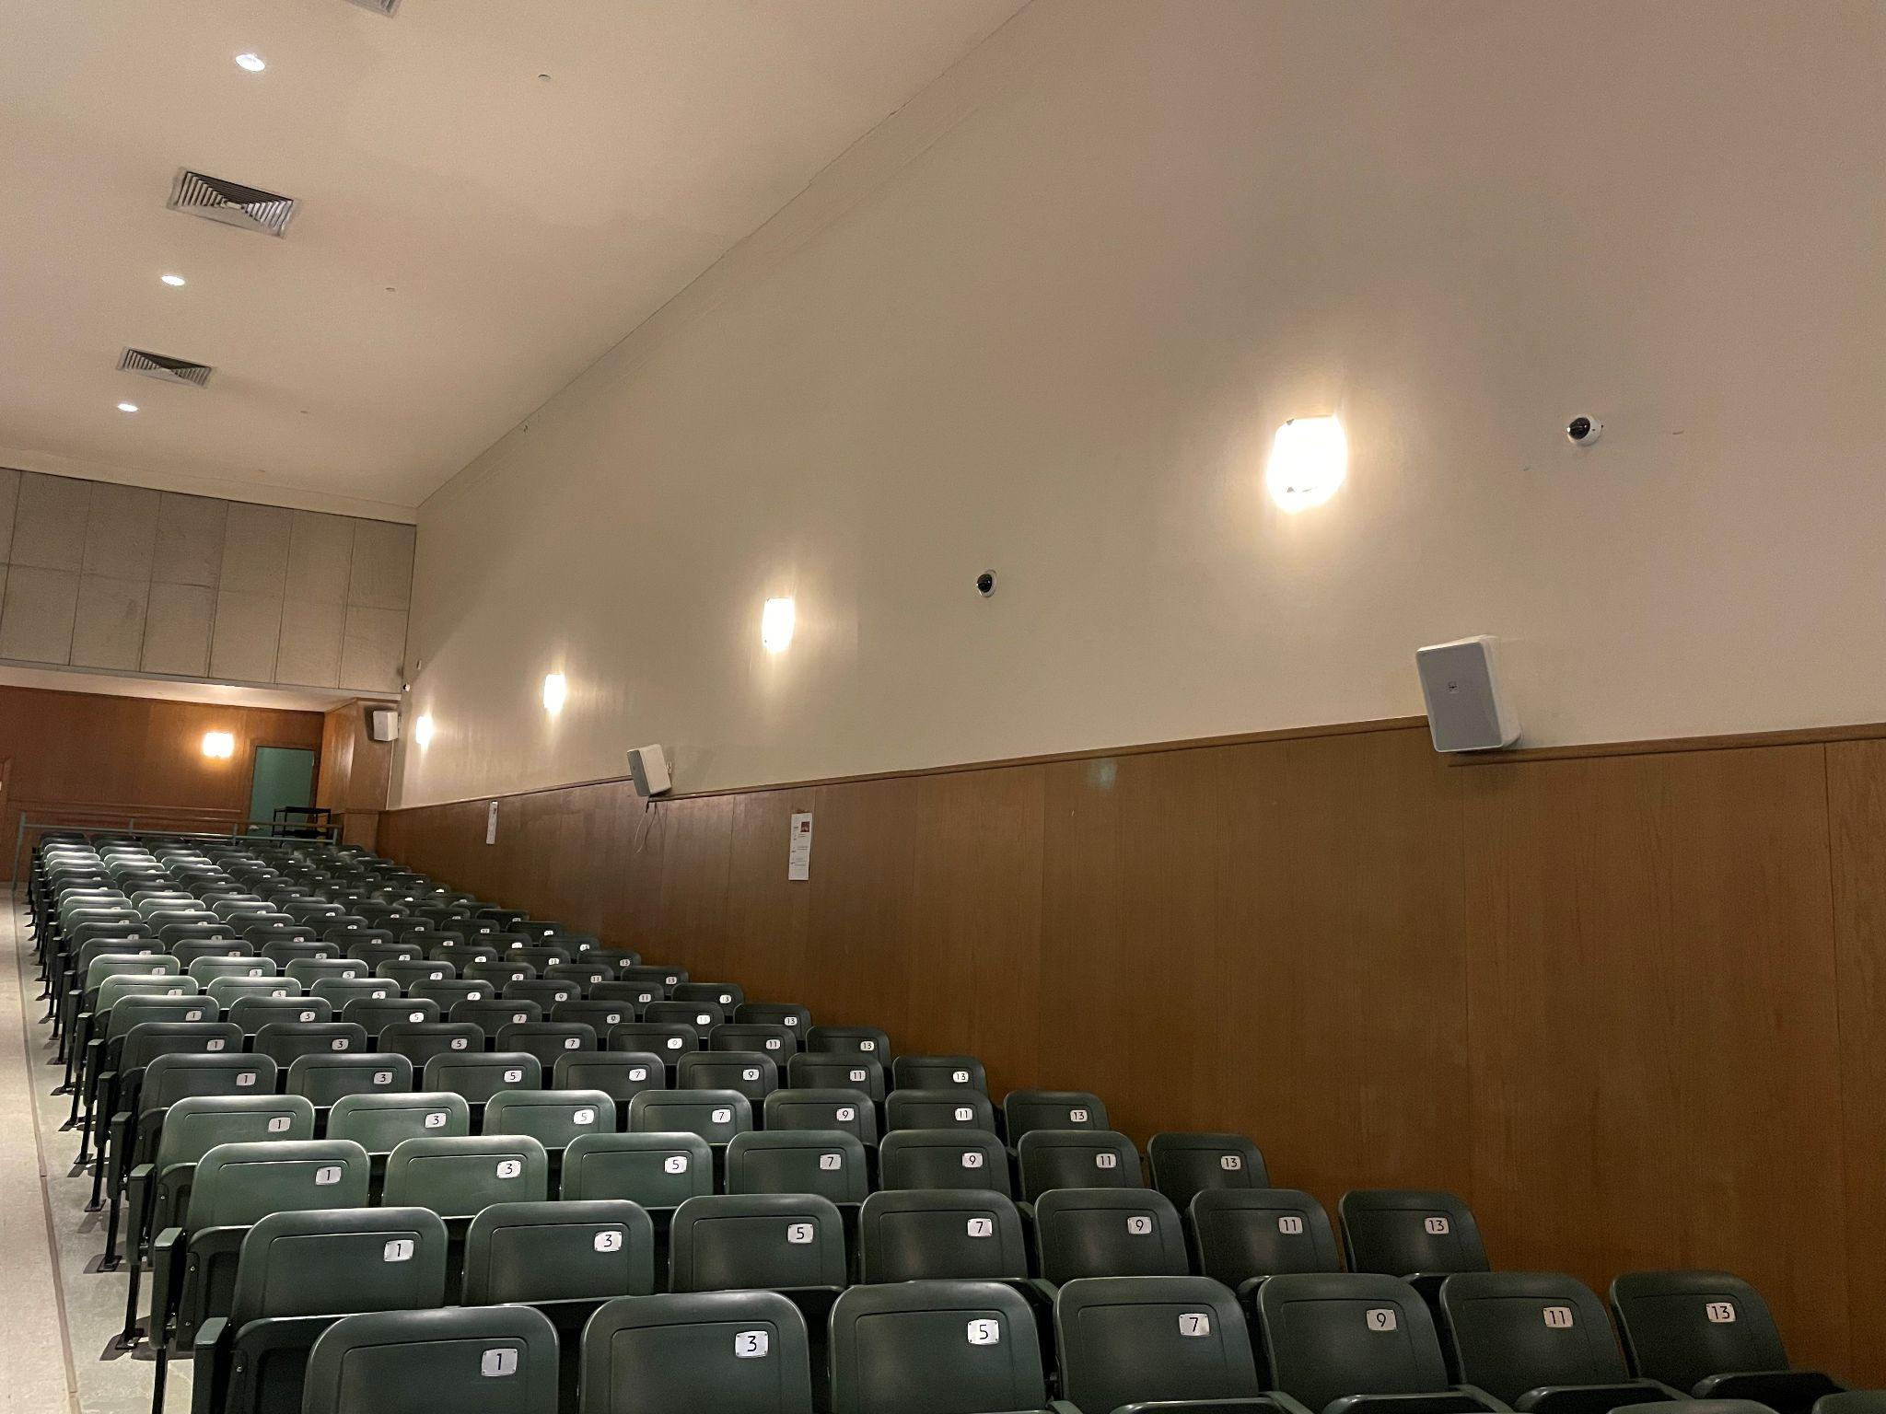
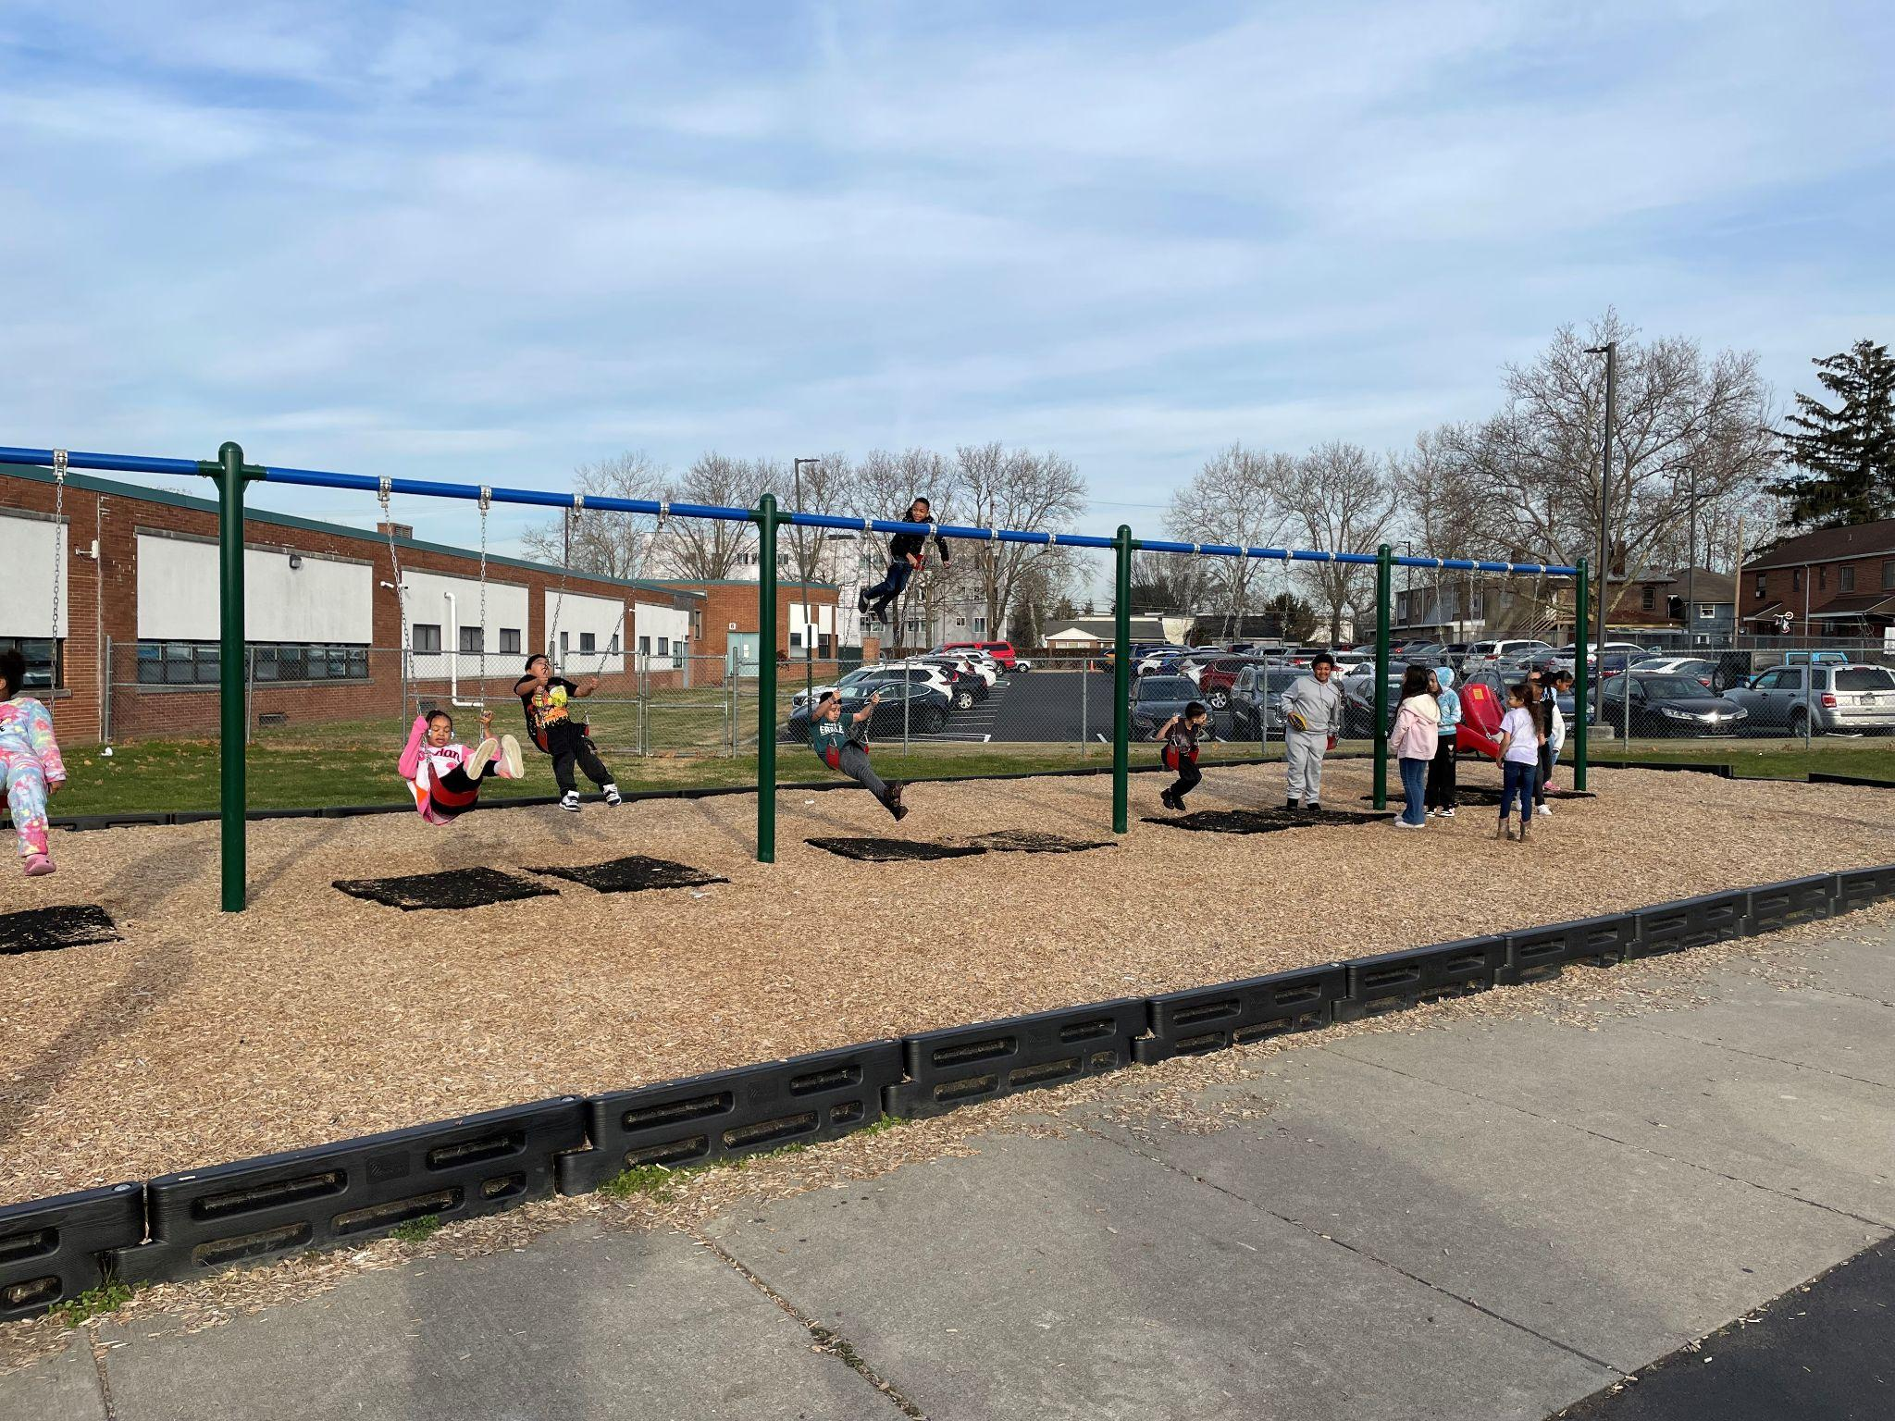
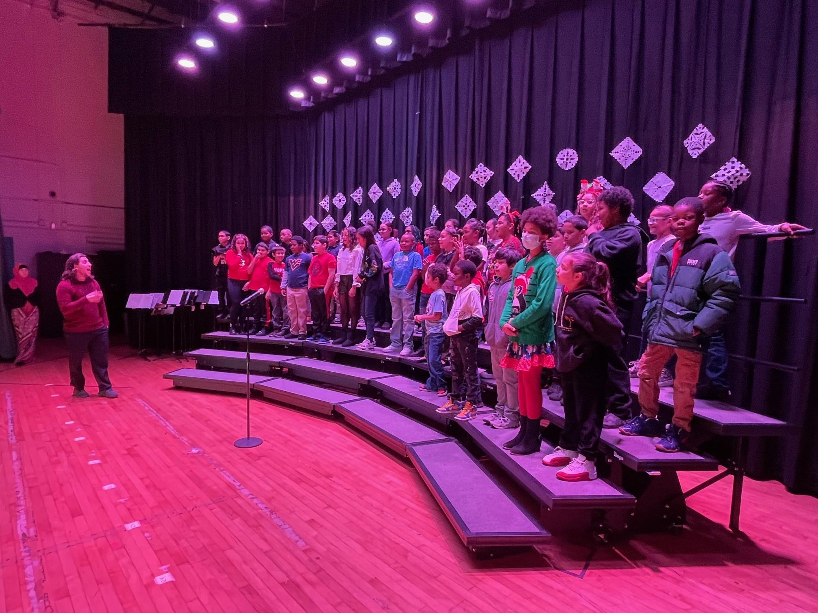
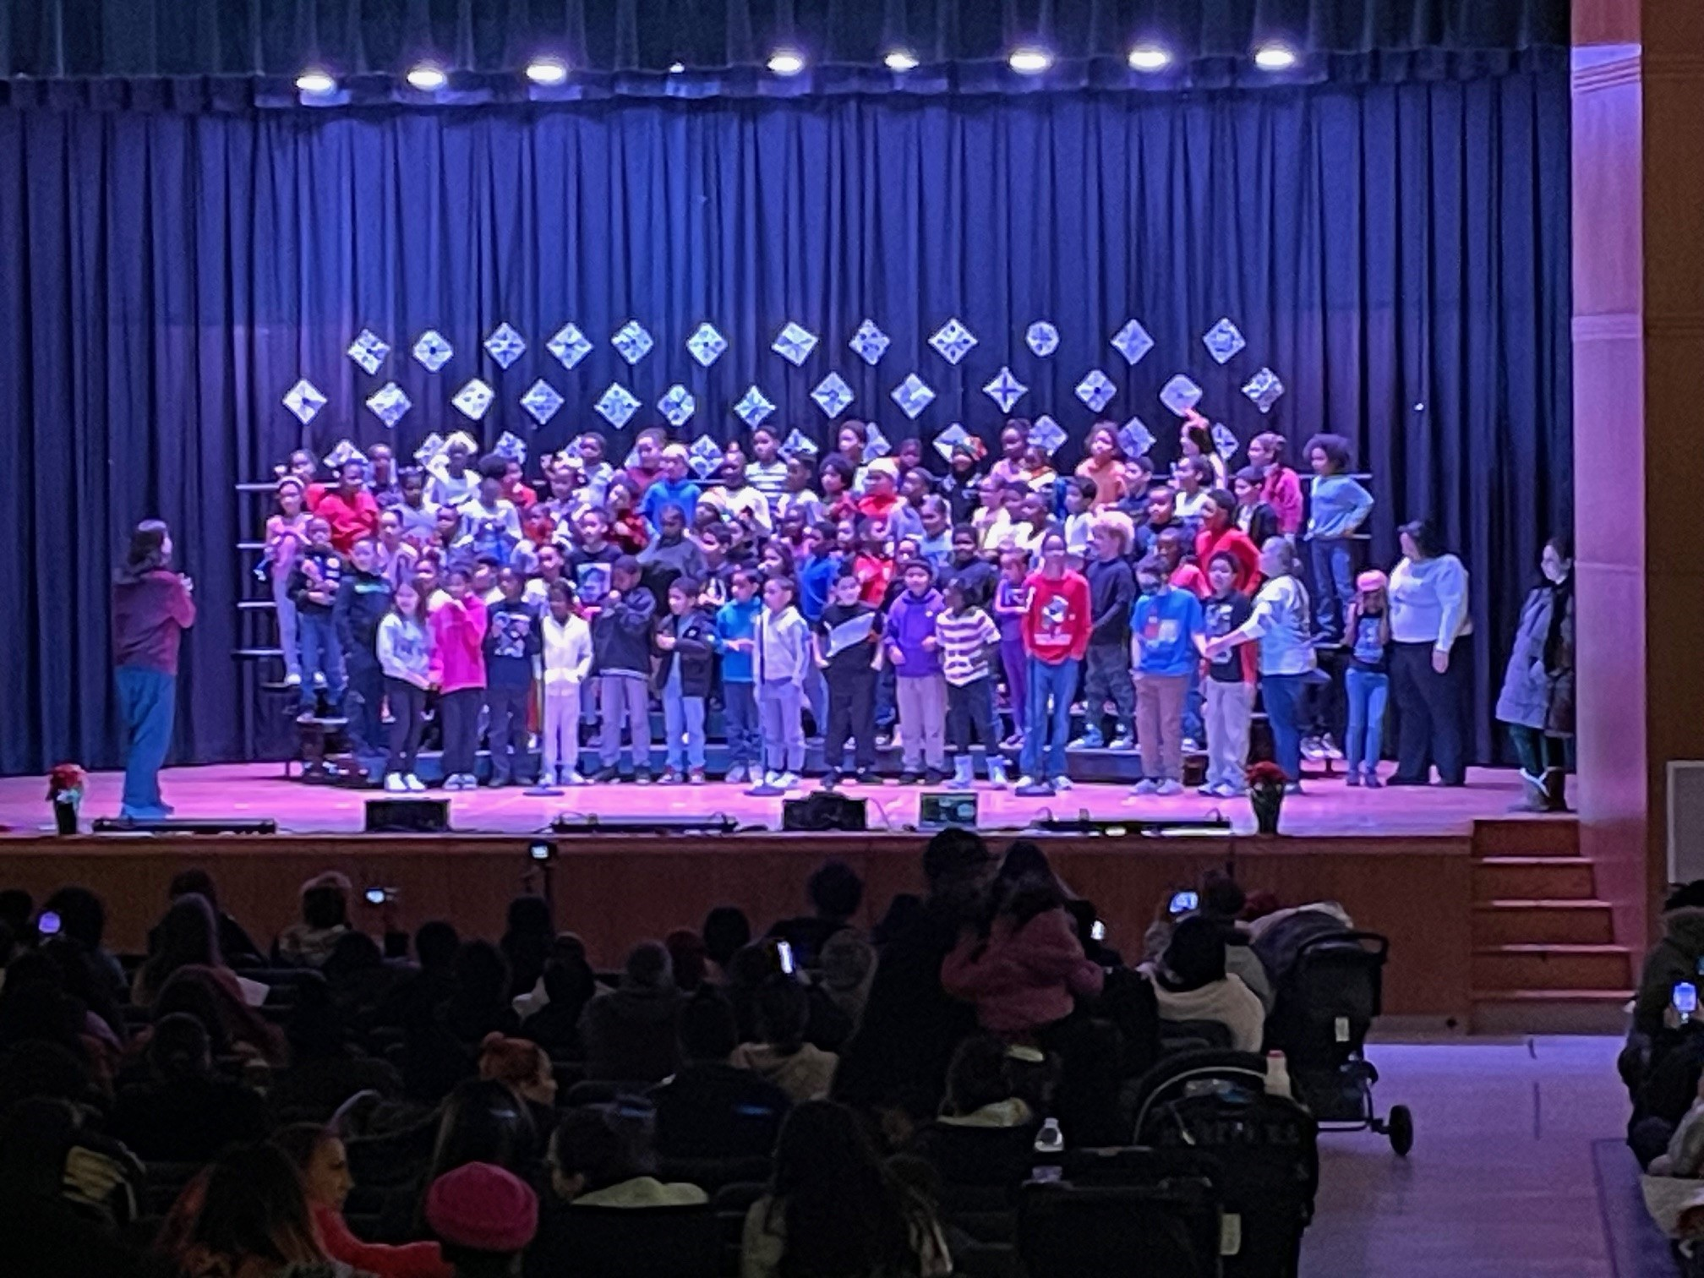
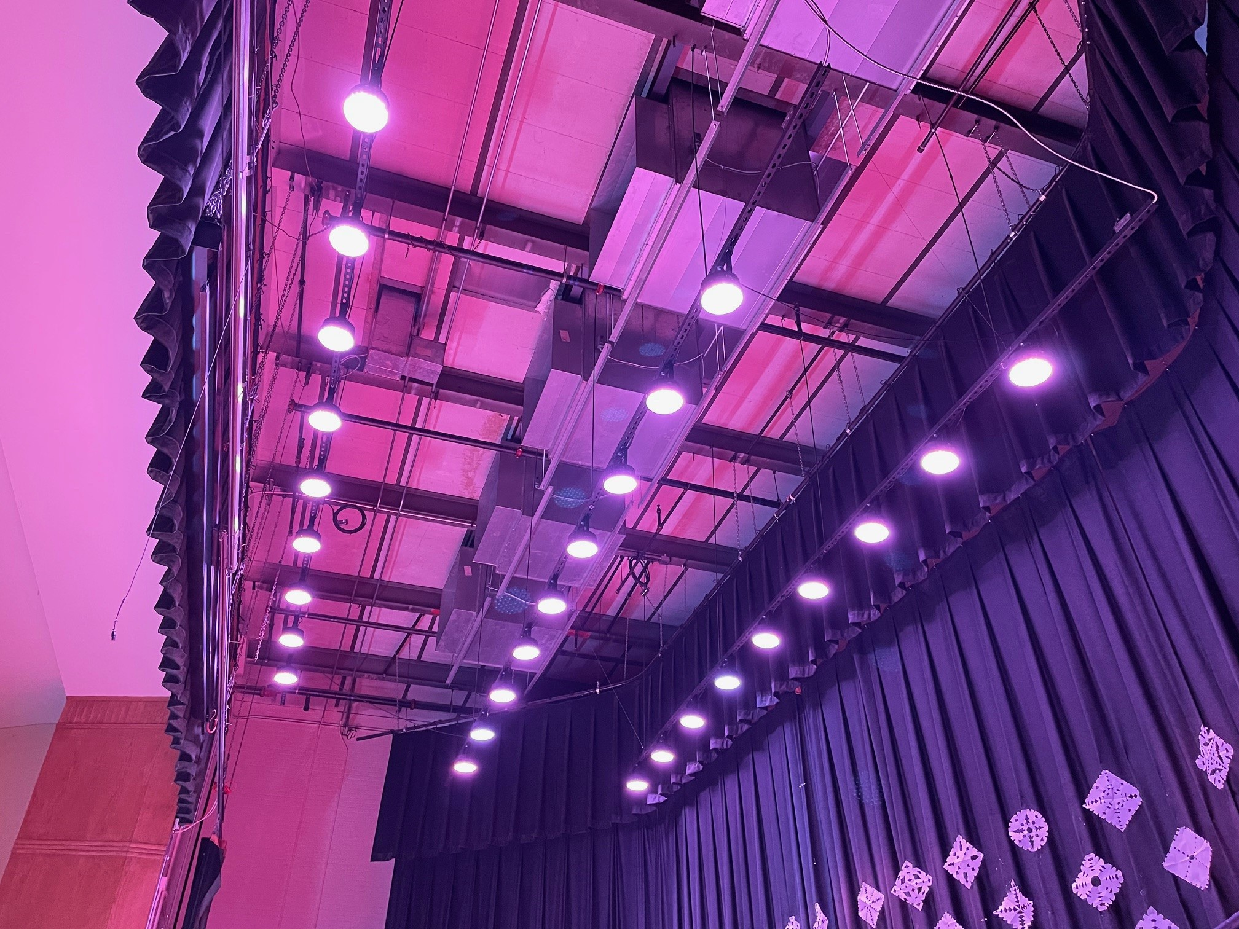
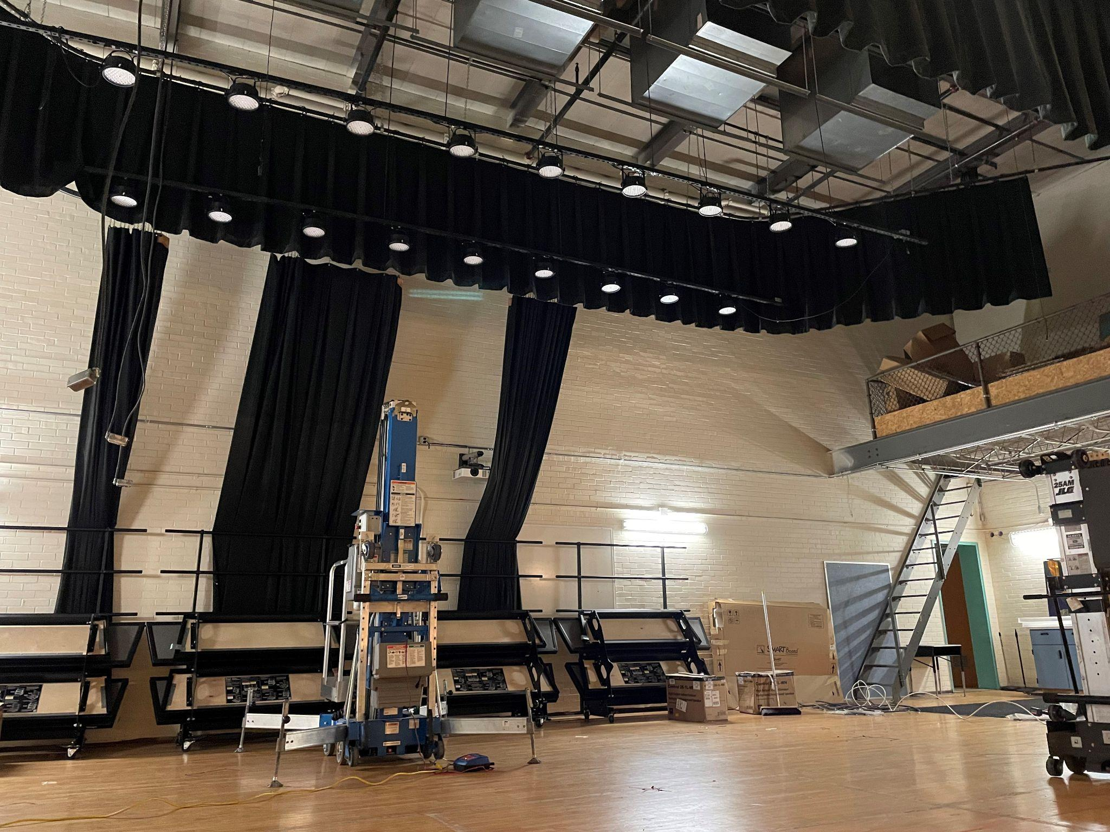
A TRIP DOWN ESSER FUNDING MEMORY LANE FOOSE ELEMENTARY

Slide 12
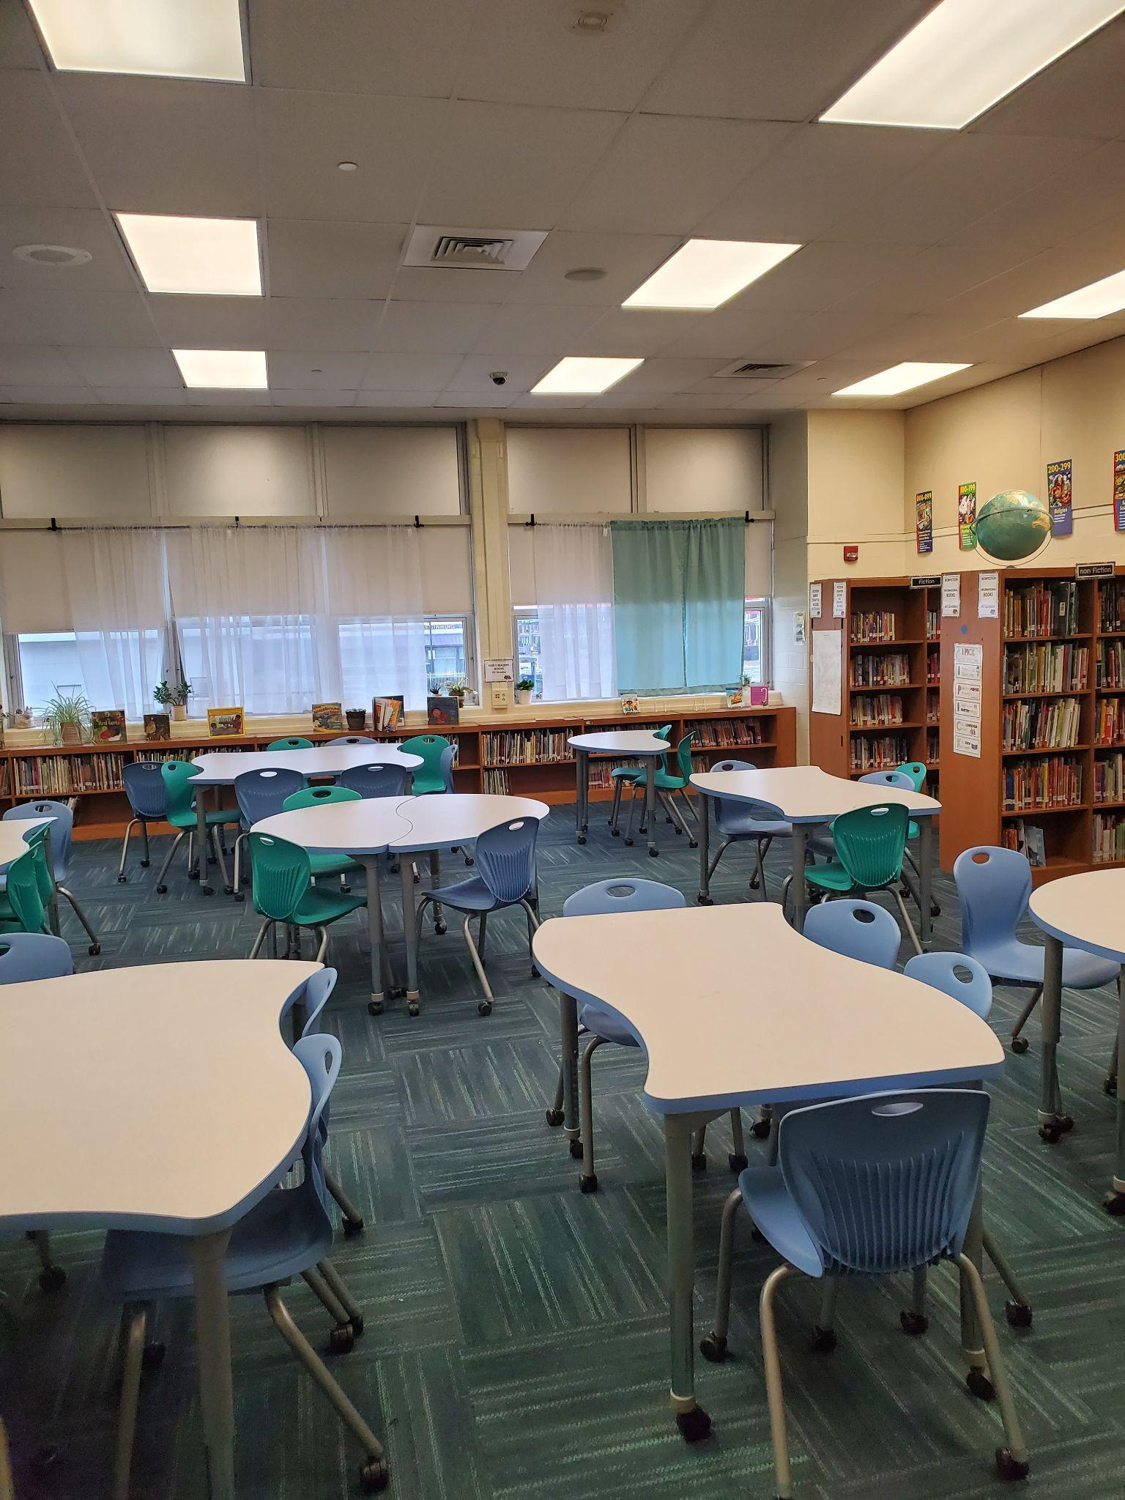
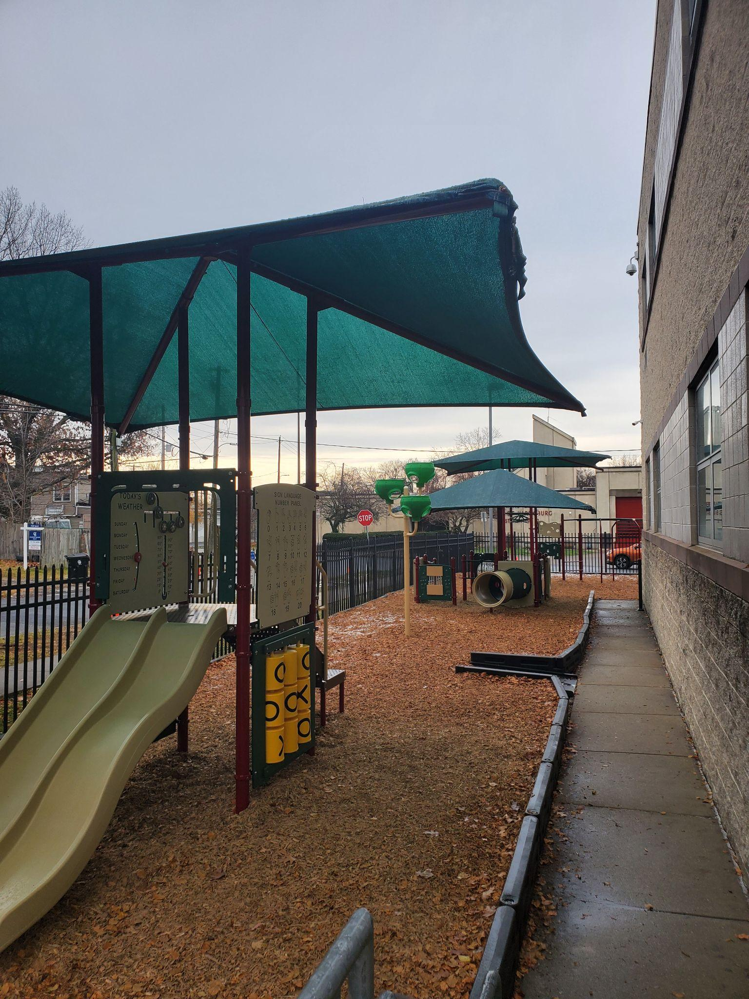
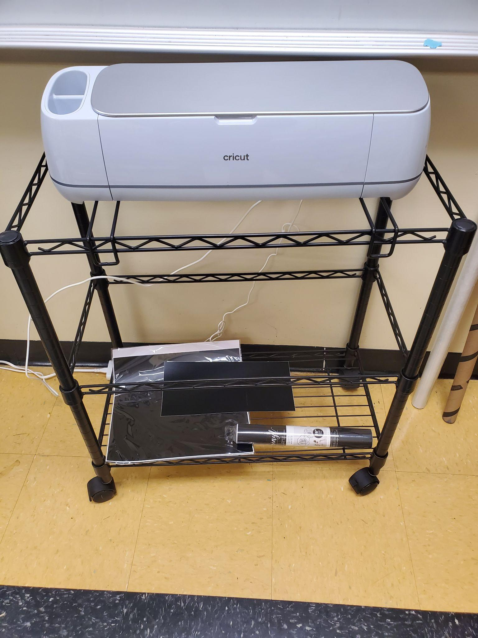
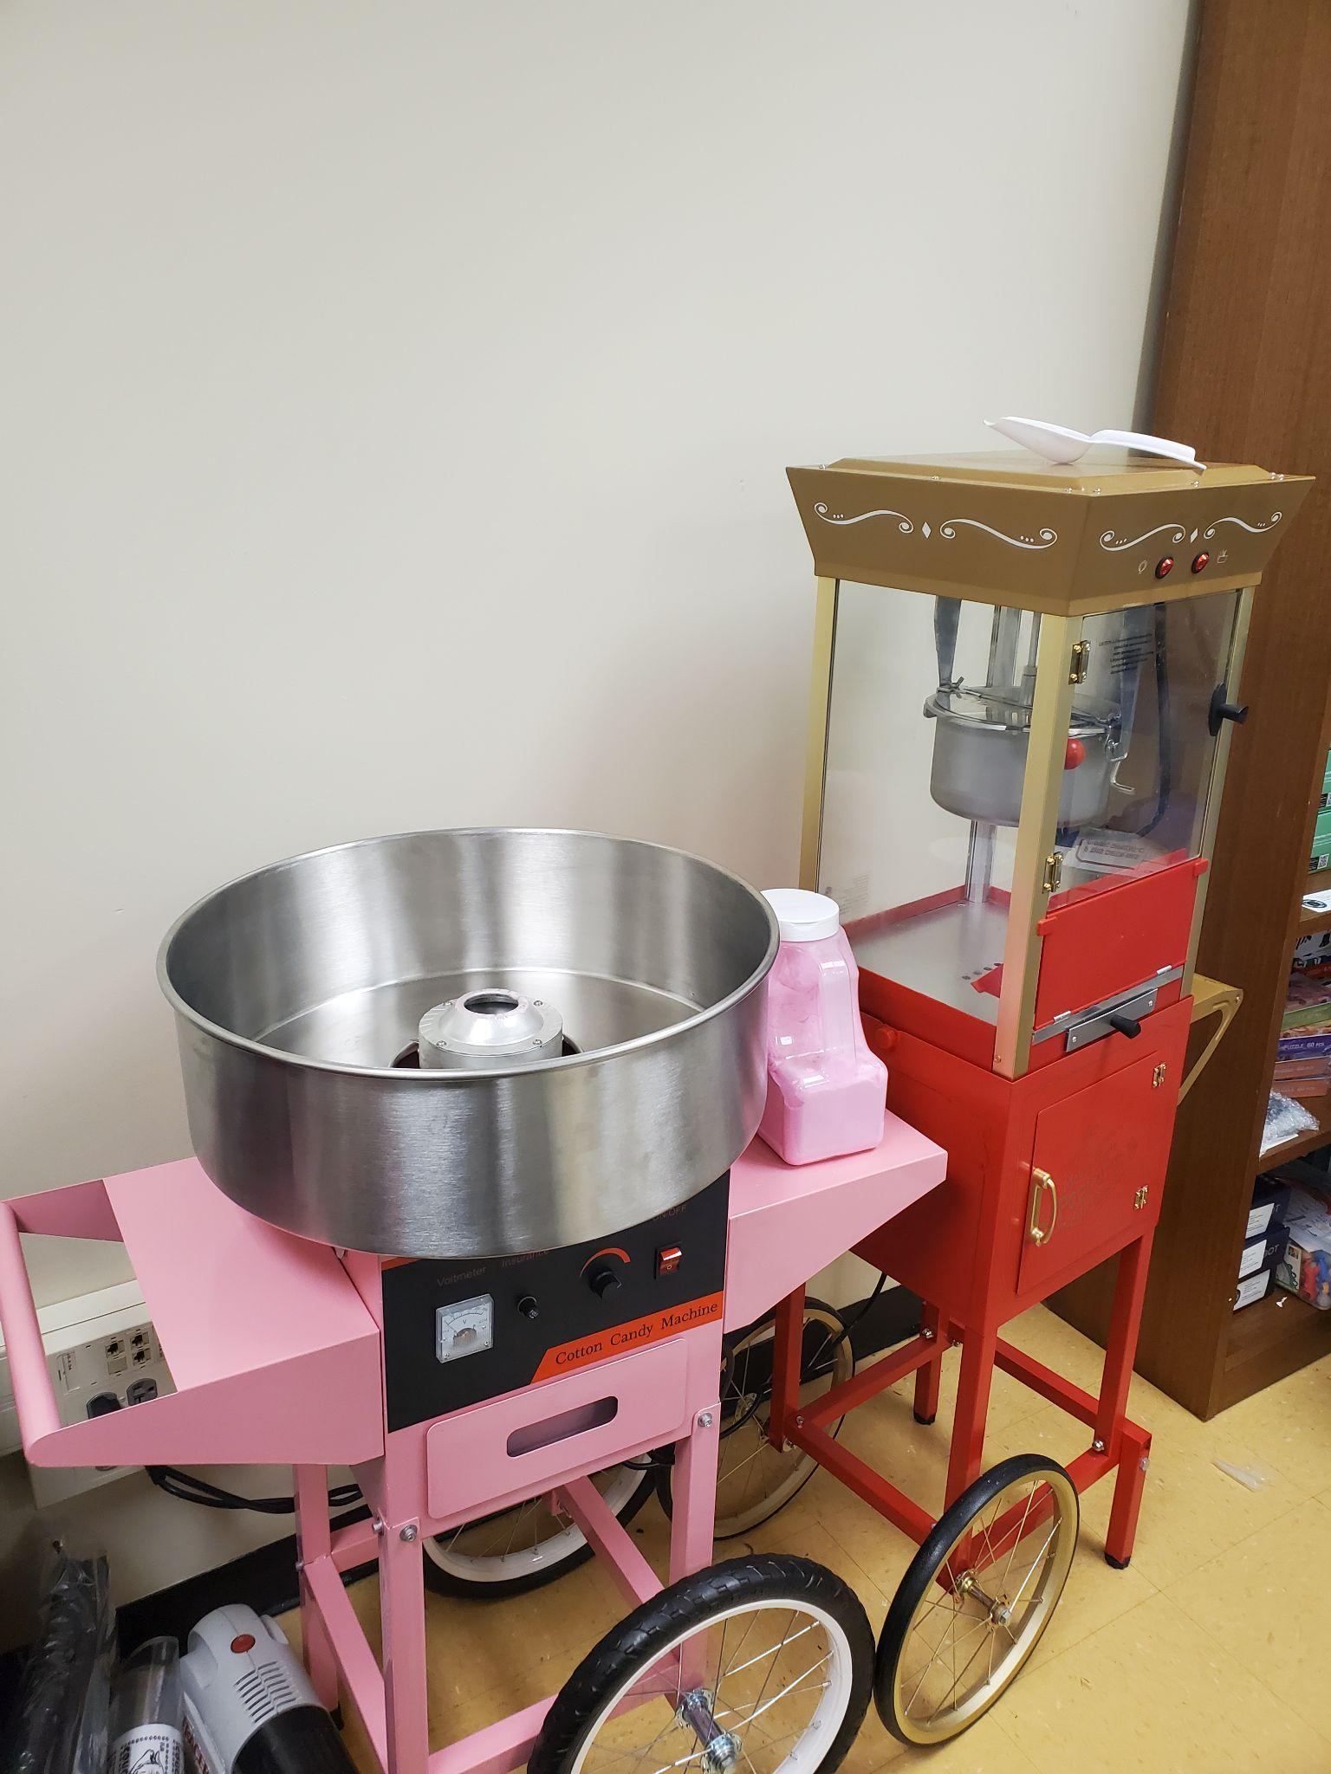
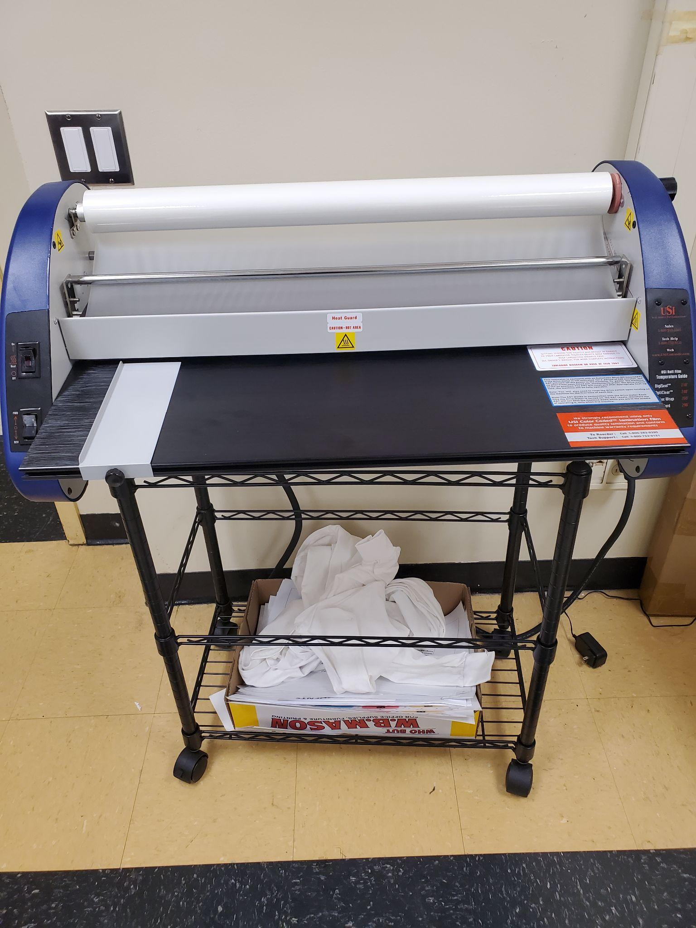
A TRIP DOWN ESSER FUNDING MEMORY LANE COUGAR ACADEMY
“DON’T COUNT THE YEARS, COUNT THE MEMORIES.”
- UNKNOWN

Slide 13
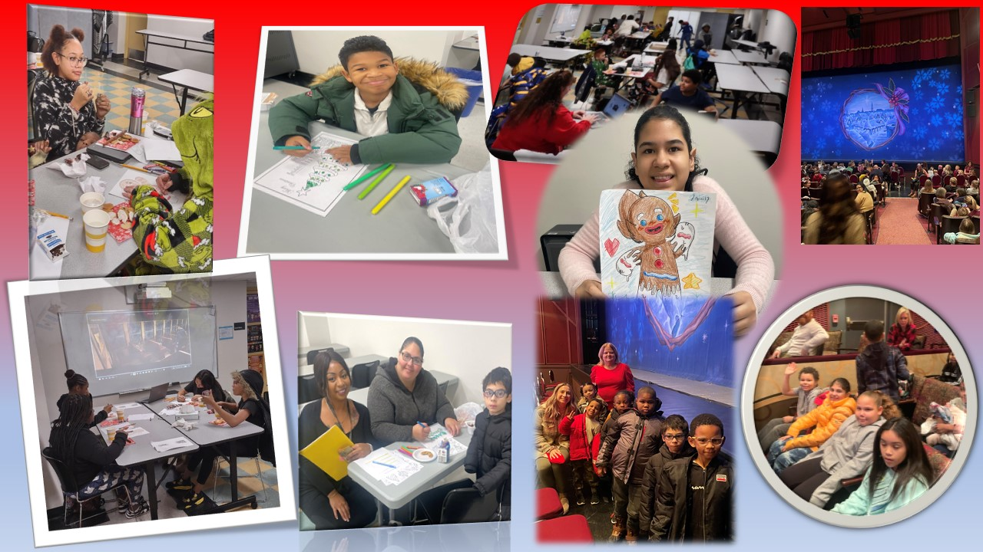
A TRIP DOWN ESSER FUNDING MEMORY LANE HVLA
“DON’T COUNT THE YEARS, COUNT THE MEMORIES.”
- UNKNOWN

Slide 14
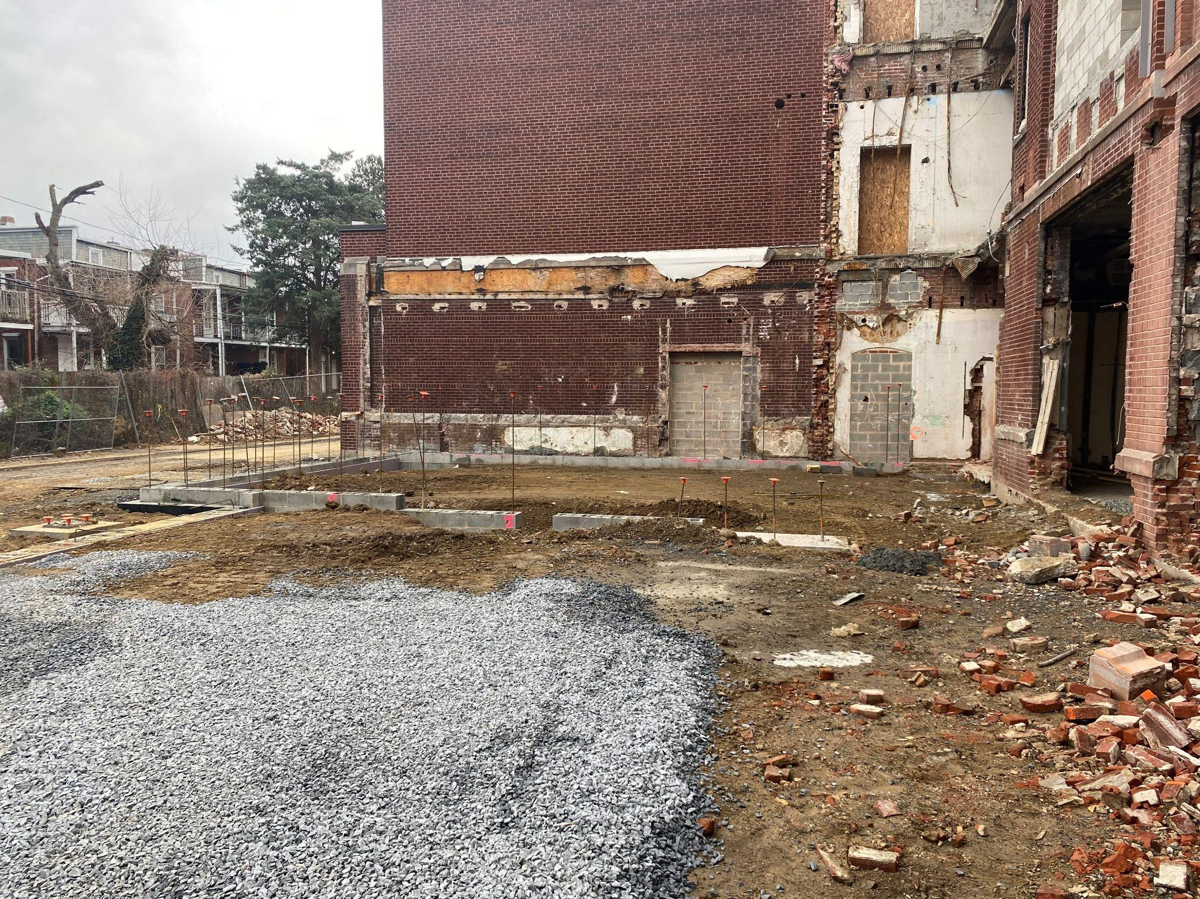
STEELE ELEMENTARY RENOVATIONS
STEELE ELEMENTARY RENOVATIONS

Slide 15
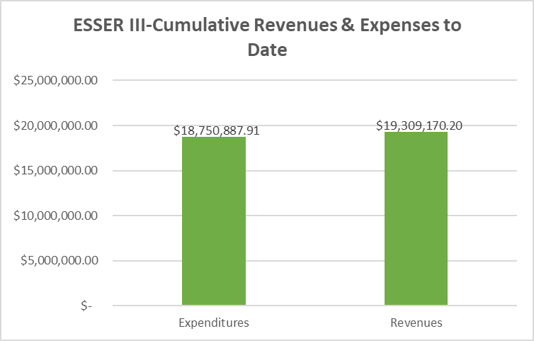
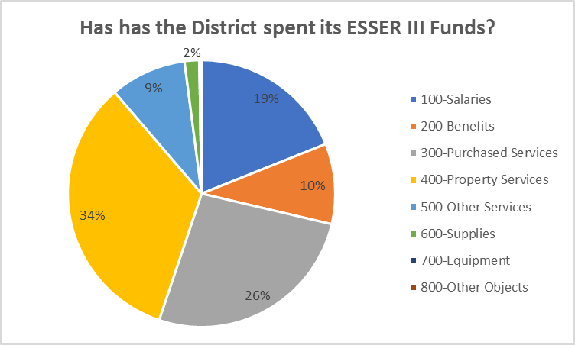
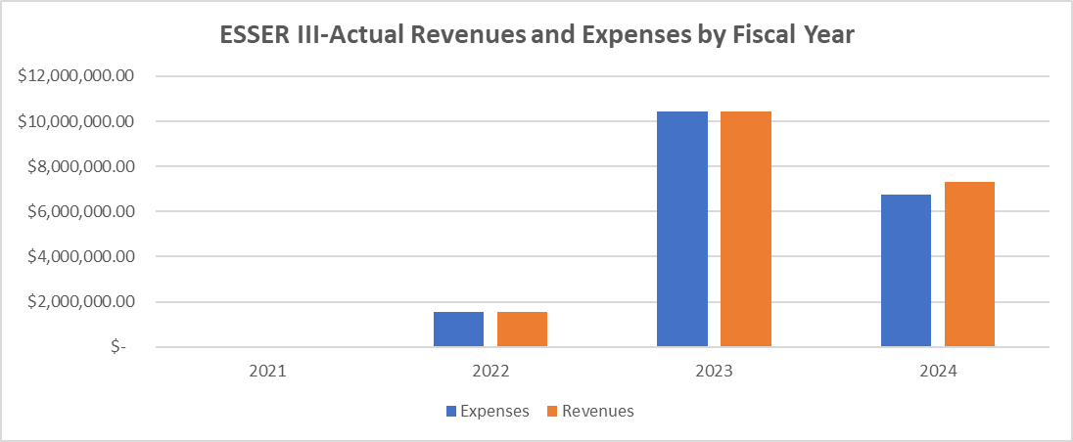
ESSER III SPENDING FORECAST

Slide 16
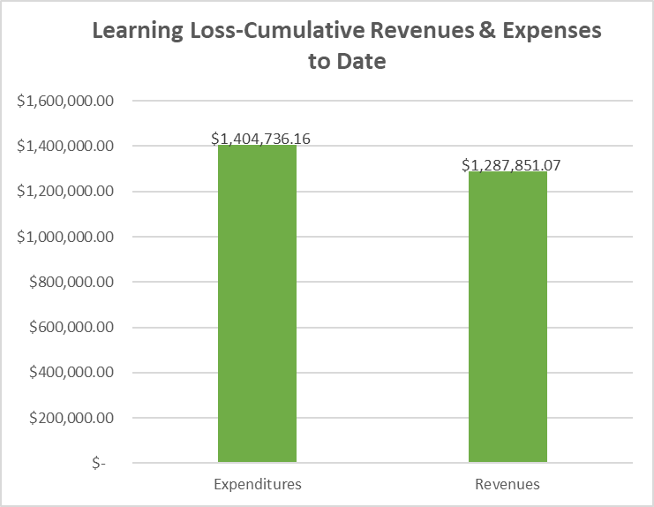
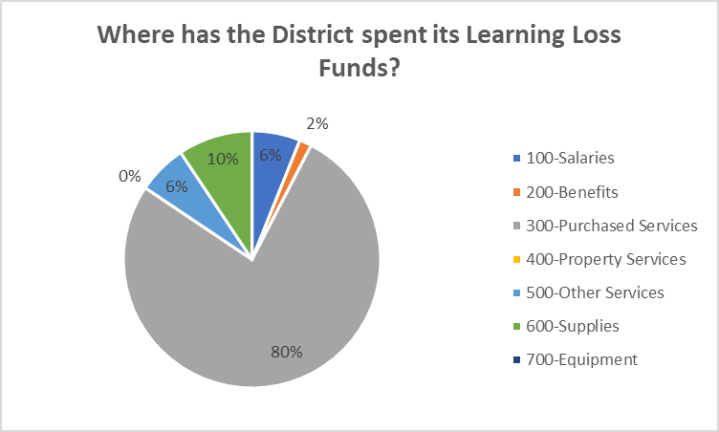
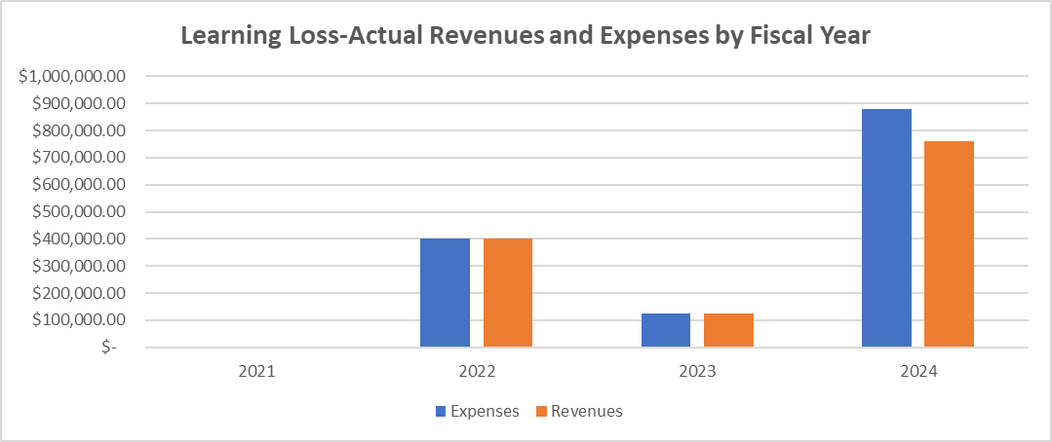
LEARNING LOSS SPENDING FORECAST

Slide 17
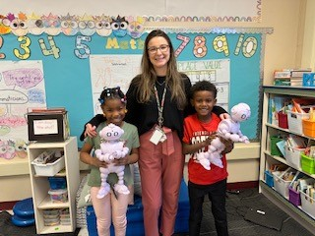
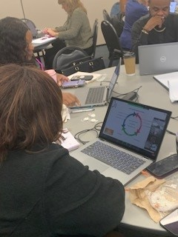
A TRIP DOWN ESSER FUNDING MEMORY LANE LEARNING LOSS
AIM Institute
ABii- Robots
“DON’T CONT THE YEARS, COUNT THE MEMORIES.”
- UNKNOWN

Slide 18
AFTER SCHOOL PROGRAM

Slide 19
Summer Programming

Slide 20
A TRIP DOWN
ARP HCY ESSER FUNDING MEMORY LANE McKinney Vento Holiday Bike Package

Slide 22
THANK YOU!

