Slide 1
HARRISBURG CITY SCHOOL DISTRICT ELEMENTARY AND SECONDARY SCHOOL EMERGENCY RELIEF FUNDS PROGRESS REPORT
Dr. Christy Thompson, ESSER Administrator
October 10, 2023

Slide 2
ELEMENTARY AND SECONDARY SCHOOL EMERGENCY RELIEF FUND IMPLEMENTATION

Slide 3
ESSER FINANCIAL
How has the district been fiscally responsible?
Spending Plans
Spending Forecast
for Principals
ESSER Pre-approval
Process Template
OnBase Approvals
External Partners
Accountability
Templates

Slide 4
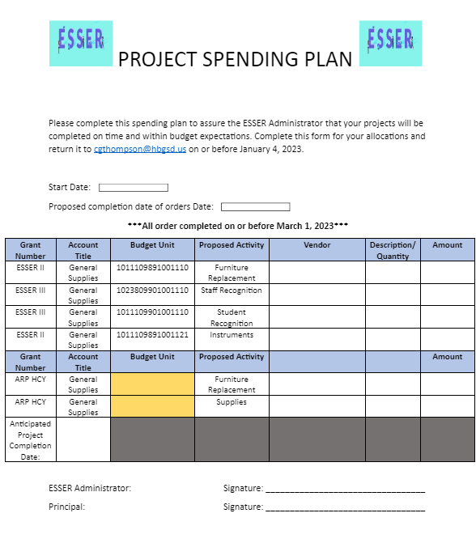
SPENDING PLANS
How has the district been fiscally responsible?

Slide 5
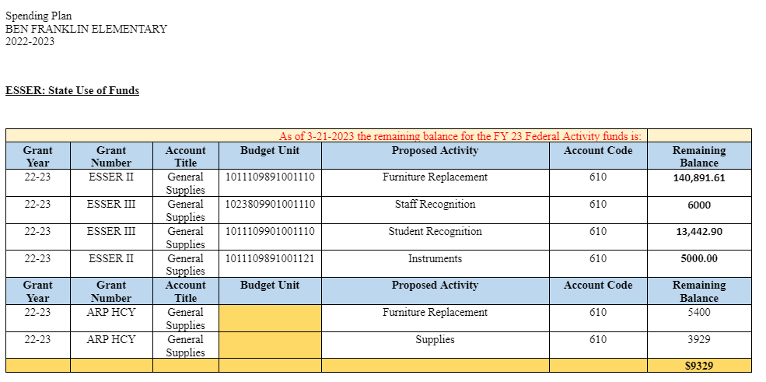
SPENDING FORECAST PRINCIPAL REPORTS
.
How has the district been fiscally responsible?

Slide 6
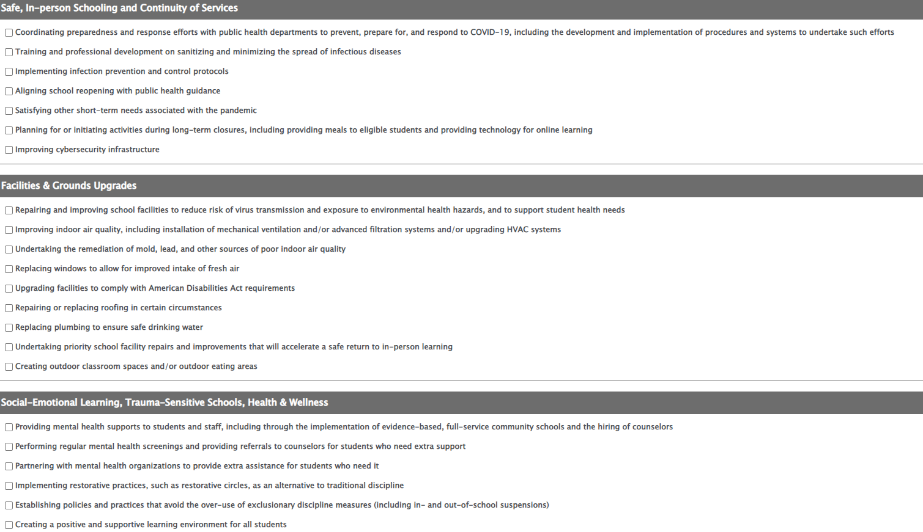
PREAPPROVAL TEMPLATE
How has the district been fiscally responsible?

Slide 7
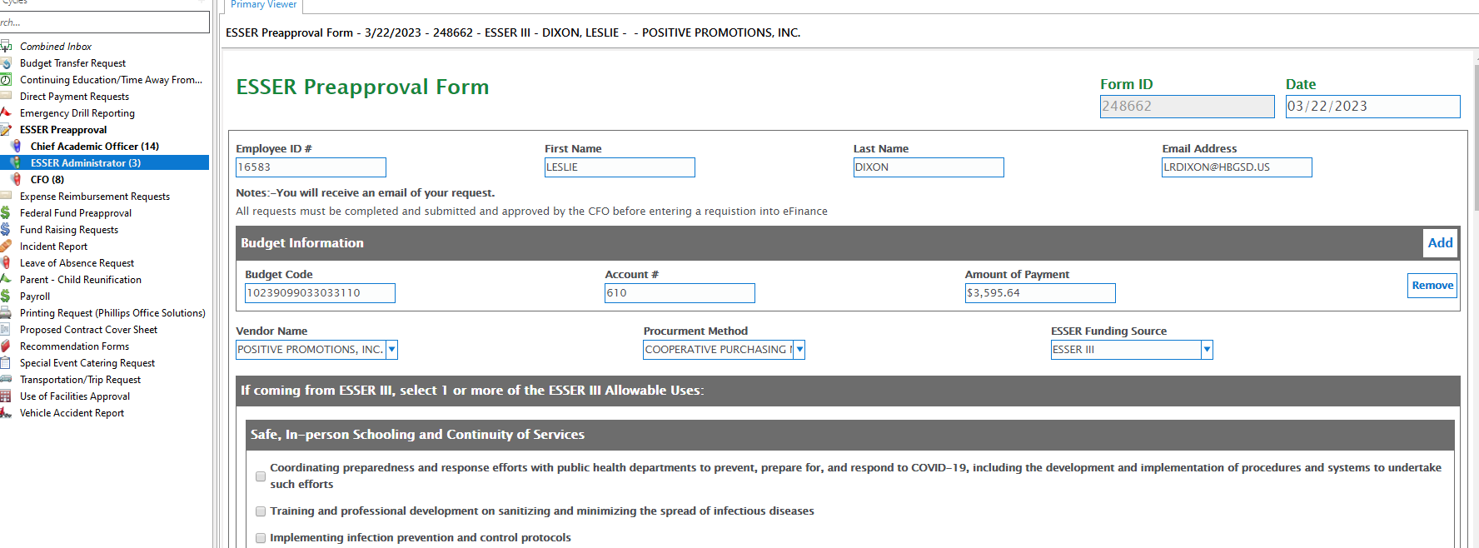
ONBASE APPROVALS
How has the district been fiscally responsible?

Slide 8
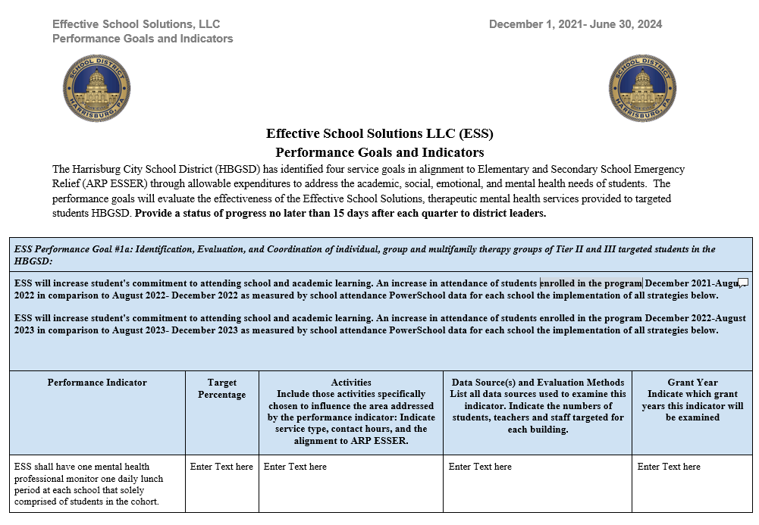
EXTERNAL PARTNERS ACCOUNTABILITY TEMPLATE
How has the district been fiscally responsible?

Slide 9
ESSER II ALLOCATION $24,873,106
How has the district spent its ESSER II Funds?

Slide 10
ESSER II ALLOCATION $24,873,106
How has the district spent its ESSER II Funds?
Retention Bonuses for teachers and paraprofessionals;
Overtime and class coverage for teachers and paraprofessionals;
Salaries/benefits for music, art, library/media specialist;
Multi-tiered Support System (MTSS) PD;
Online Program Tuition for MCIU Program;
PA Counseling Contract;
Renzulli Learning;
Chromebooks 1:1 Learning for students;
Summer School Programming;
Academic supplies;
Classroom furniture; and
HVAC projects.

Slide 11
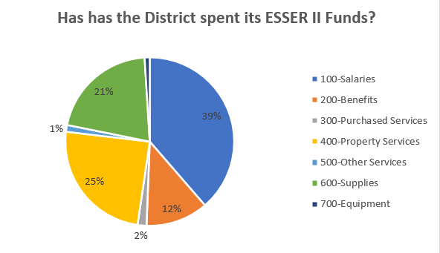
ELEMENTARY AND SECONDARY SCHOOL EMERGENCY RELIEF FUND IMPLEMENTATION
ESSER II FINANCIAL FORECAST

Slide 12
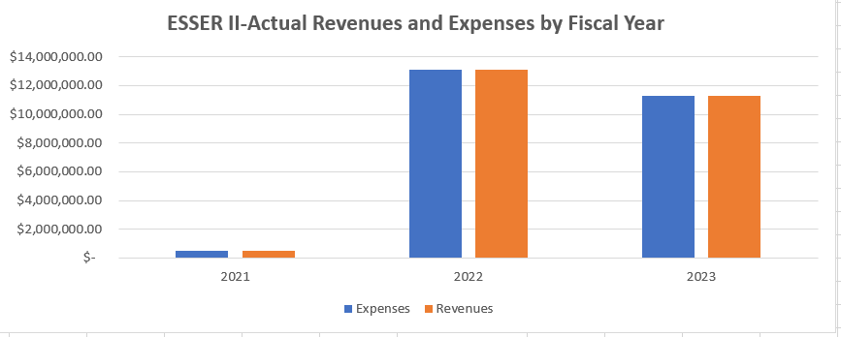
ELEMENTARY AND SECONDARY SCHOOL EMERGENCY RELIEF FUND IMPLEMENTATION
ESSER II FINANCIAL FORECAST

Slide 13
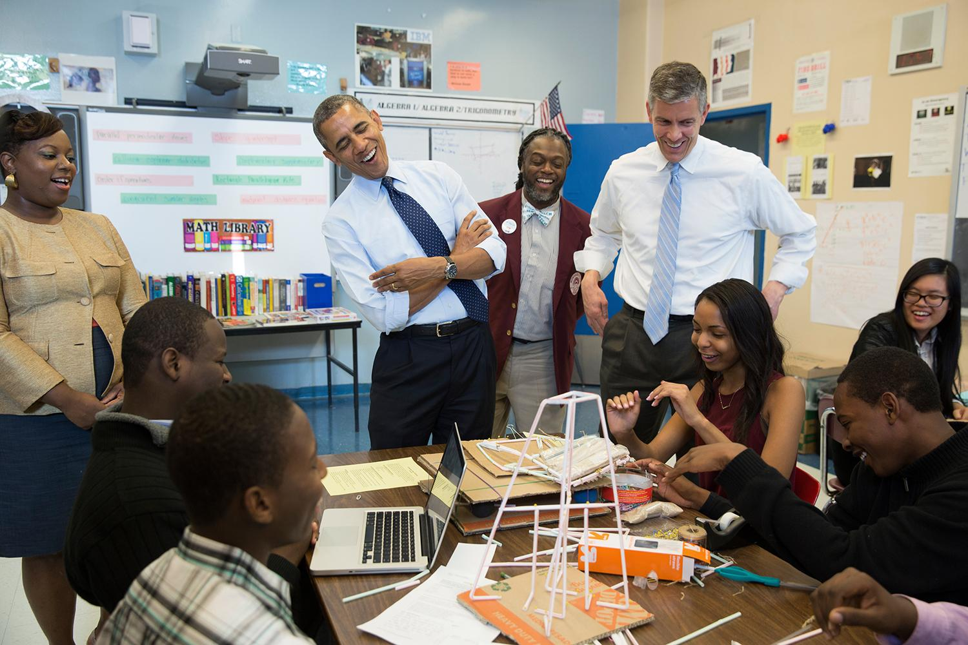
ESSER III ALLOCATION $50,311,096
How has the district spent its ESSER III Funds?

Slide 14
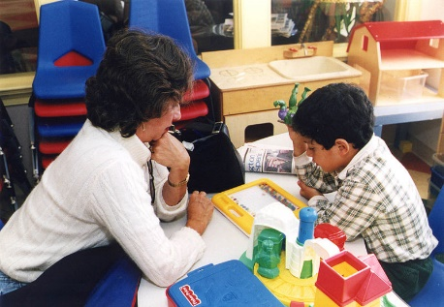
ESSER III ALLOCATION $50,311,096
HVLA Project Manager
HVLA Teachers
ESSER Administrator
LivingWell Contractor
Behavior Specialist Elementary, Middle and High
Supervisor of Extended Learning
Effective School Solutions Contractor
HVAC Replacements
Steele Renovations
Student Recognitions
Staff Recognitions
Technology
Academic Supplies/Subscriptions
Network Equipment

Slide 15
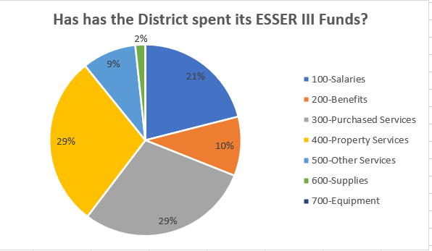
ESSER III FINANCIAL FORECAST

Slide 16
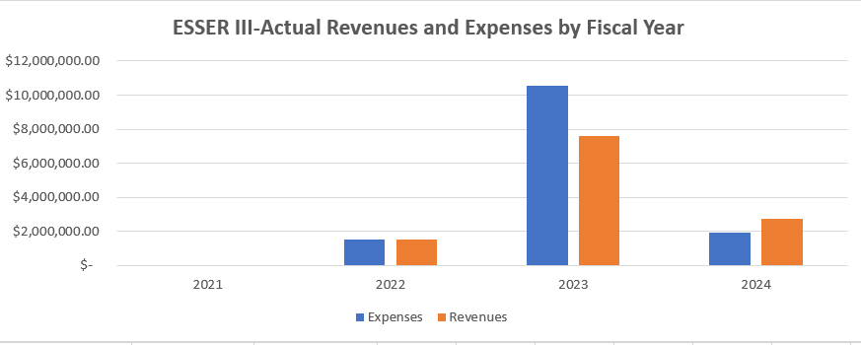
ESSER III FINANCIAL FORECAST

Slide 17
ARP SET ASIDE AFTER SCHOOL ALLOCATION
$558,615
How has the district spent its ARP ESSER Set Aside After School Funds?
22/23 School Year - Served over 250 students AND 23/24 School Year - Projected to serve 500 students
Elementary Foose, Downey, Ben Franklin, Cougar Academy,Melrose, Scott NEW for 23/24: Foose and Ben Franklin will provide a Tier 2 /3 Truancy Intervention Program for identified students that have demonstrated poor attendance that has impeded academics. | 22/23 K - 2:Super Power Hour Intervention St. were invited based upon benchmark composite scores that fell below the 40th percentile, as they represent students that are well below benchmark and are in need of strategic and/or intensive additional Tier 2/intervention. Split into 2 sessions based upon needs as determined by BOY and MOY assessment data. Overall goal would be for each student to grow at least 20% on their overall Reading Composite Score at the end of the 14 or 15 weeks 23/34 1 - 5 as needed Super Power Hour Intervention AND 4 - 5 Service Learning Passion Projects | 22/23 3 - 5: Service Learning Passion Projects Service Learning Passion Projects: A “Passion Project” is a student driven project that allows learners to use critical thinking skills, creativity, collaboration, risk taking, and an opportunity to transfer what they learn with an authentic audience. Students will... Take part in Goal-setting and learning targets: Because learning targets are transparent in a personalized, competency-based learning environment, students are aware of where they stand and what they need to do to move forward to ensure mastery of academic content and critical SEL skills. Experience Risk-taking and Failure: Learners are provided multiple opportunities and means of demonstrating mastery, encouraging problem-solving and critical thinking. It’s not about what they don’t know – but what they don’t know yet.
Middle Camp Curtin, Cougar Academy, MMSA | Academic Enrichment: Tutoring Spring College/Career Readiness Graduation Pathways Homework/Project Support Service Learning Passion Projects
High Sci Tech, John Harris, Cougar Academy | Academic Enrichment: Credit Recovery Tutoring Spring College/Career Readiness Graduation Pathways Homework/Project Support Service Learning Passion Projects

Slide 18
ARP SET ASIDE SUMMER SCHOOL ALLOCATION $558,615
21/22 SUMMER - Served over 365 students AND 22/23 SUMMER - Served about 200 students
Elementary 21/22 All elementary schools were hosted at: Foose, Downey, and Ben Franklin 22/23 All elementary schools were hosted at: Foose and Cougar Academy | 21/22 K - 3 Super Power Hour Intervention All elementary students invited to participate in a station rotation intervention model that encompassed SEL, researched based intervention, student voice and choice 22/23 K - 5 Super Power Intervention St. were invited based upon benchmark composite scores that fell below the 40th percentile, as they represent students that are well below benchmark and are in need of strategic and/or intensive additional Tier 2/intervention. station rotation intervention model that encompassed SEL, researched based intervention, student voice and choice Lego Education/STEM | 21/22 3 - 5: Service Learning Passion Projects Service Learning Passion Projects: A “Passion Project” is a student driven project that allows learners to use critical thinking skills, creativity, collaboration, risk taking, and an opportunity to transfer what they learn with an authentic audience. Students will... Take part in Goal-setting and learning targets: Because learning targets are transparent in a personalized, competency-based learning environment, students are aware of where they stand and what they need to do to move forward to ensure mastery of academic content and critical SEL skills. Experience Risk-taking and Failure: Learners are provided multiple opportunities and means of demonstrating mastery, encouraging problem-solving and critical thinking. It’s not about what they don’t know – but what they don’t know yet.
Middle 21/22 All Middle schools were hosted at MMSA 22/23 All middle schools were hosted at Camp Curtin | 21/22 6-8: Service Learning Passion Projects Service Learning Passion Projects: A “Passion Project” is a student driven project that allows learners to use critical thinking skills, creativity, collaboration, risk taking, and an opportunity to transfer what they learn with an authentic audience. See notes on 3-5 | 22/23 6 - 8 Intervention St. were invited based upon benchmark composite scores that fell below the 40th percentile, as they represent students that are well below benchmark and are in need of strategic and/or intensive additional Tier 2/intervention. station rotation intervention model that encompassed SEL, researched based intervention, student voice and choice Lego Education/STEM
High 21/22 All HS’s were hosted at John Harris 22/23 All HS’s were hosted at John Harris | 21/22 9-12: Service Learning Passion Projects AND Credit Recovery Service Learning Passion Projects: A “Passion Project” is a student driven project that allows learners to use critical thinking skills, creativity, collaboration, risk taking, and an opportunity to transfer what they learn with an authentic audience. See notes on 3-5 Credit Recovery: Edgenuity and Personalized Learning projects | 21/22 9-12: Credit Recovery Credit Recovery: Edgenuity and Personalized Learning projects College and Career Readiness: Support with college and career pathways goals for graduation
How has the district spent its ARP ESSER Set Aside Summer School Funds?

Slide 19
ARP ESSER TSI SET ASIDE ALLOCATION
$143,604
Foose
Collaborative STEM
activities and projects
Research based math
Instruction professional development
Number Worlds KG-5th
Grades
Imagine Math KG-5th
Grades
Educational Student
Incentives
DataWise professional
development
Scott
Research based Growth
Mindset professional development
Research based math
Instruction professional development
Number Worlds KG-5th
Grades
Imagine Math KG-5th
Grades
Educational student
incentives
DataWise professional
development
How has the district spent its ARP TSI ESSER Funds?

Slide 20
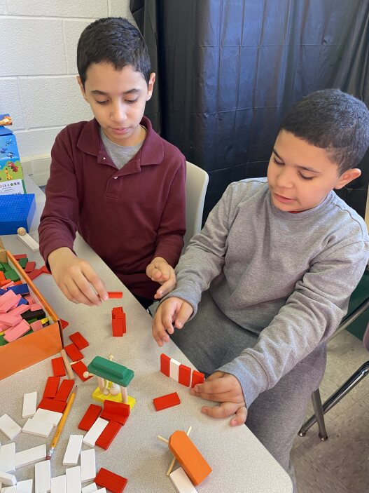
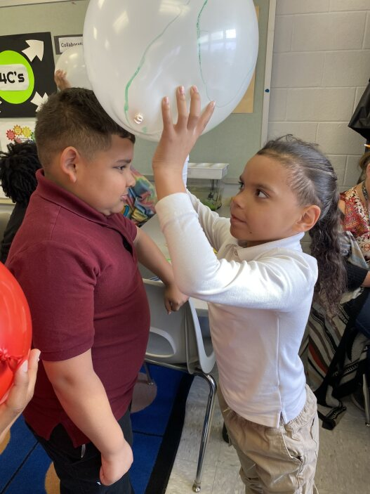
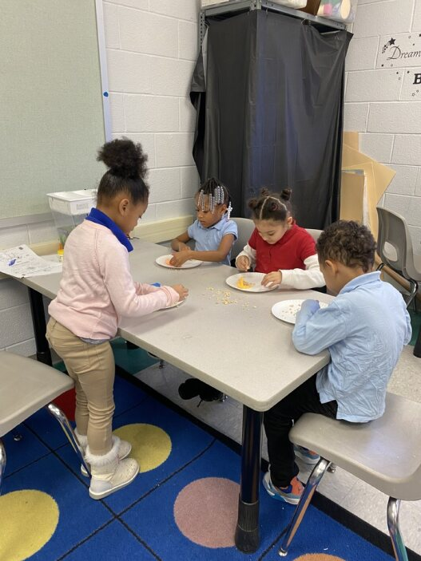
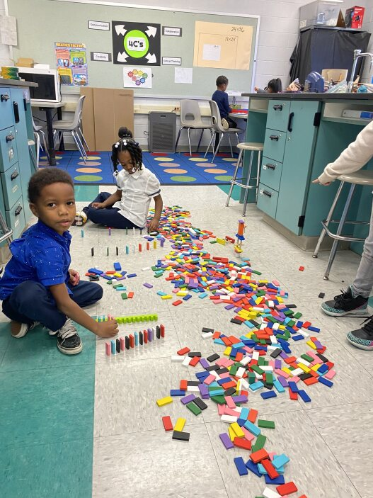
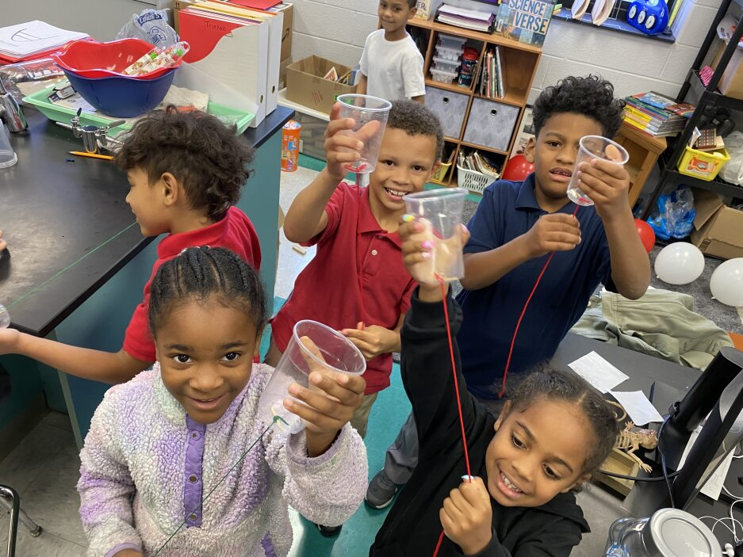
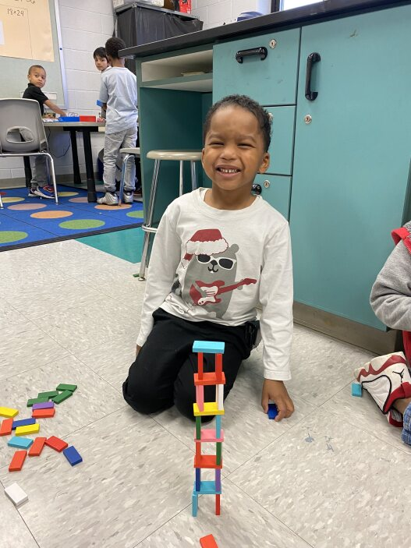
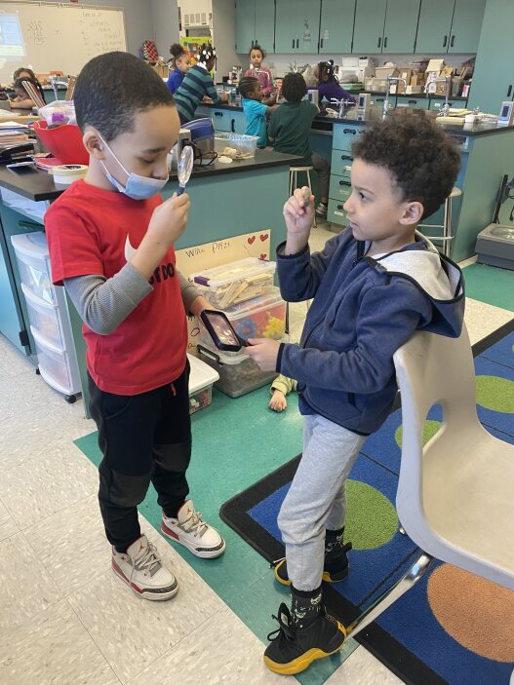
ARP TSI SET ASIDE ALLOCATION
$143,604
Foose
Scott
How has the district spent its ARP TSI ESSER Funds?

Slide 21
ARP LEARNING LOSS SET ASIDE ALLOCATION
$2,793,073
Credit Recovery High School
Reading Professional Development
Bullying Prevention K-5
Station Rotation
Academic Supplies and Subscriptions
Personalized Learning
Responsive Classrooms
Restorative Practices
Structured Literacy
After School 2023-24
Summer School 2024
How has the district spent its ARP ESSER Set Aside Learning Loss School Funds?

Slide 22
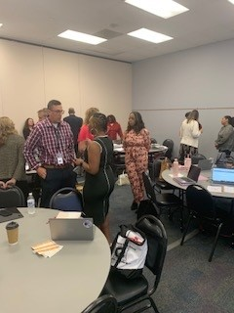
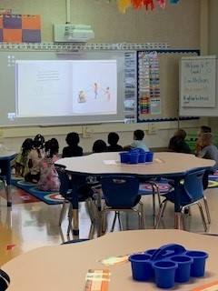
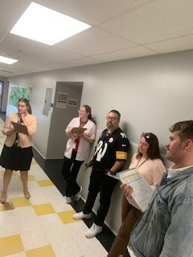
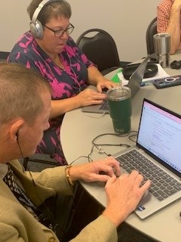
ARP LEARNING LOSS SET ASIDE ONGOING PROJECTS
How has the district spent its ARP ESSER Set Aside Learning Loss School Funds?

Slide 23
ARP ESSER IDEA PART B SET ASIDE ALLOCATION $298,419
100 iPads, 100 OtterBox cases, and 10 micro charging stations for use in special education classrooms
Sensory rooms at Foose and Ben Franklin
How has the district spent its ARP ESSER Set Aside IDEA Part B School Funds?

Slide 24
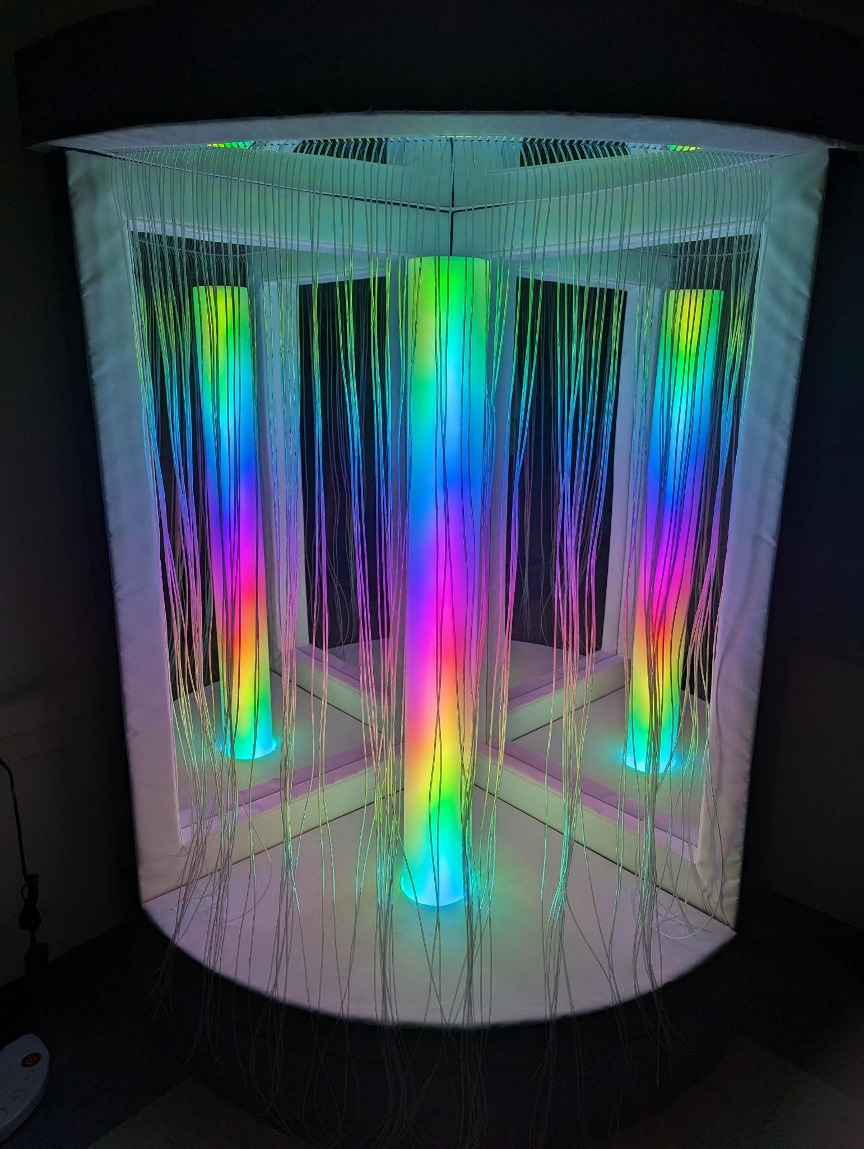
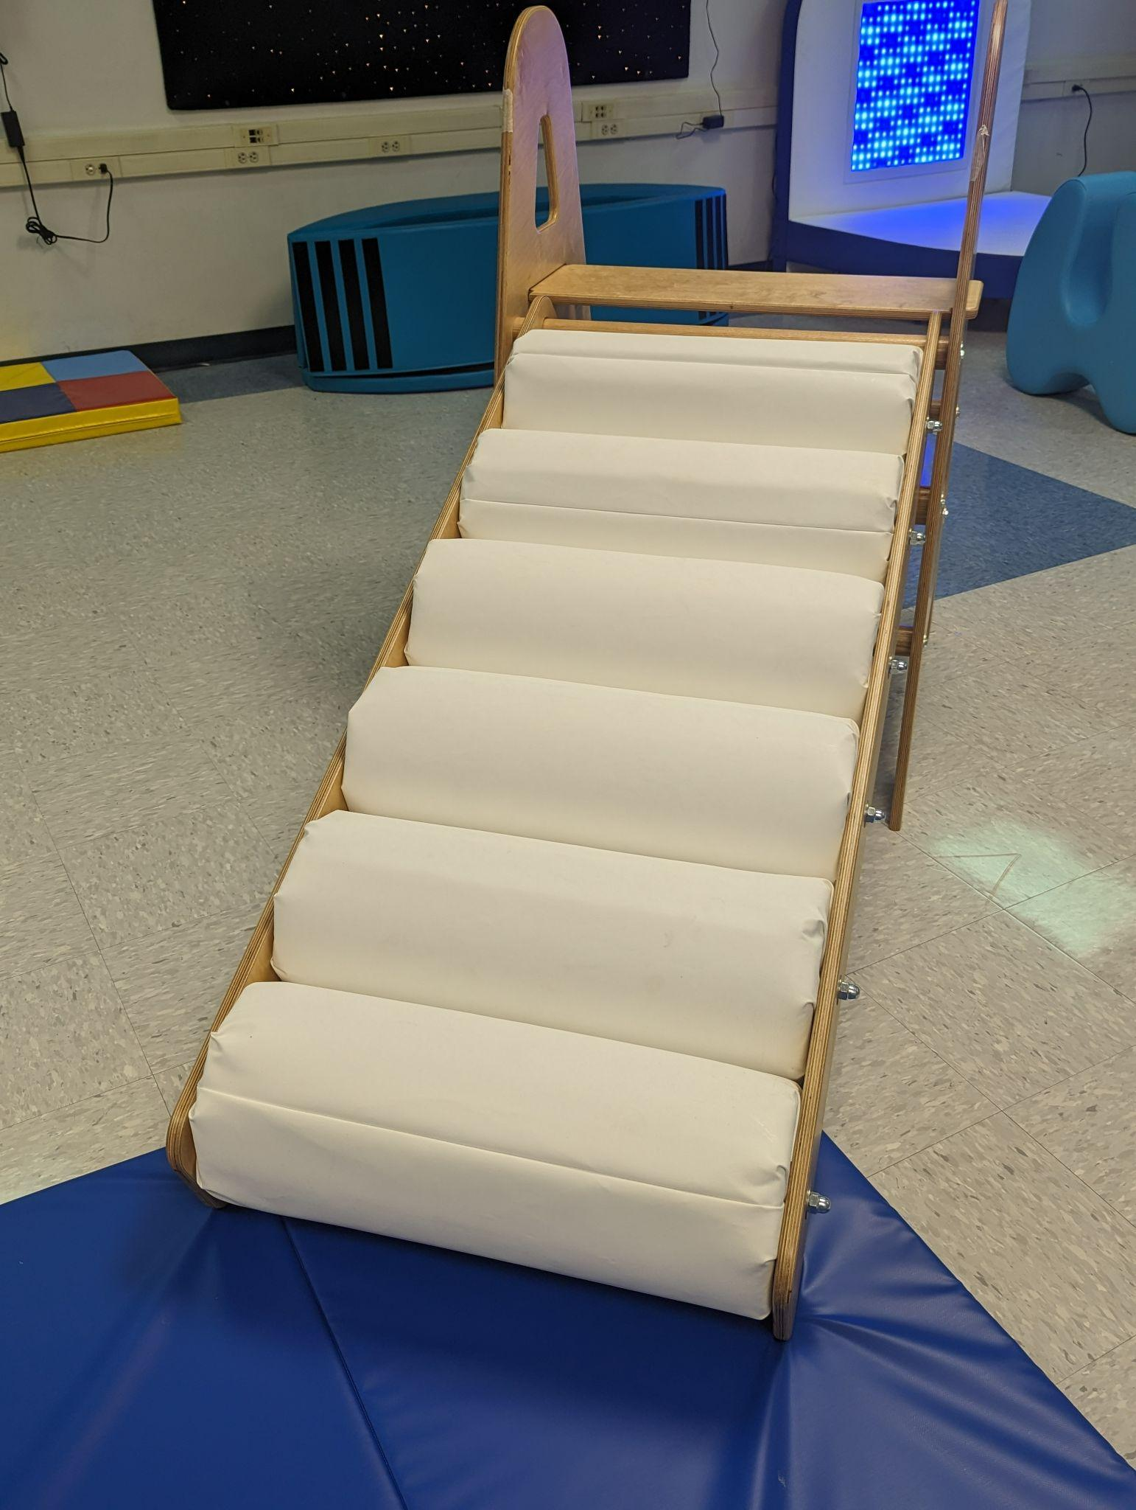
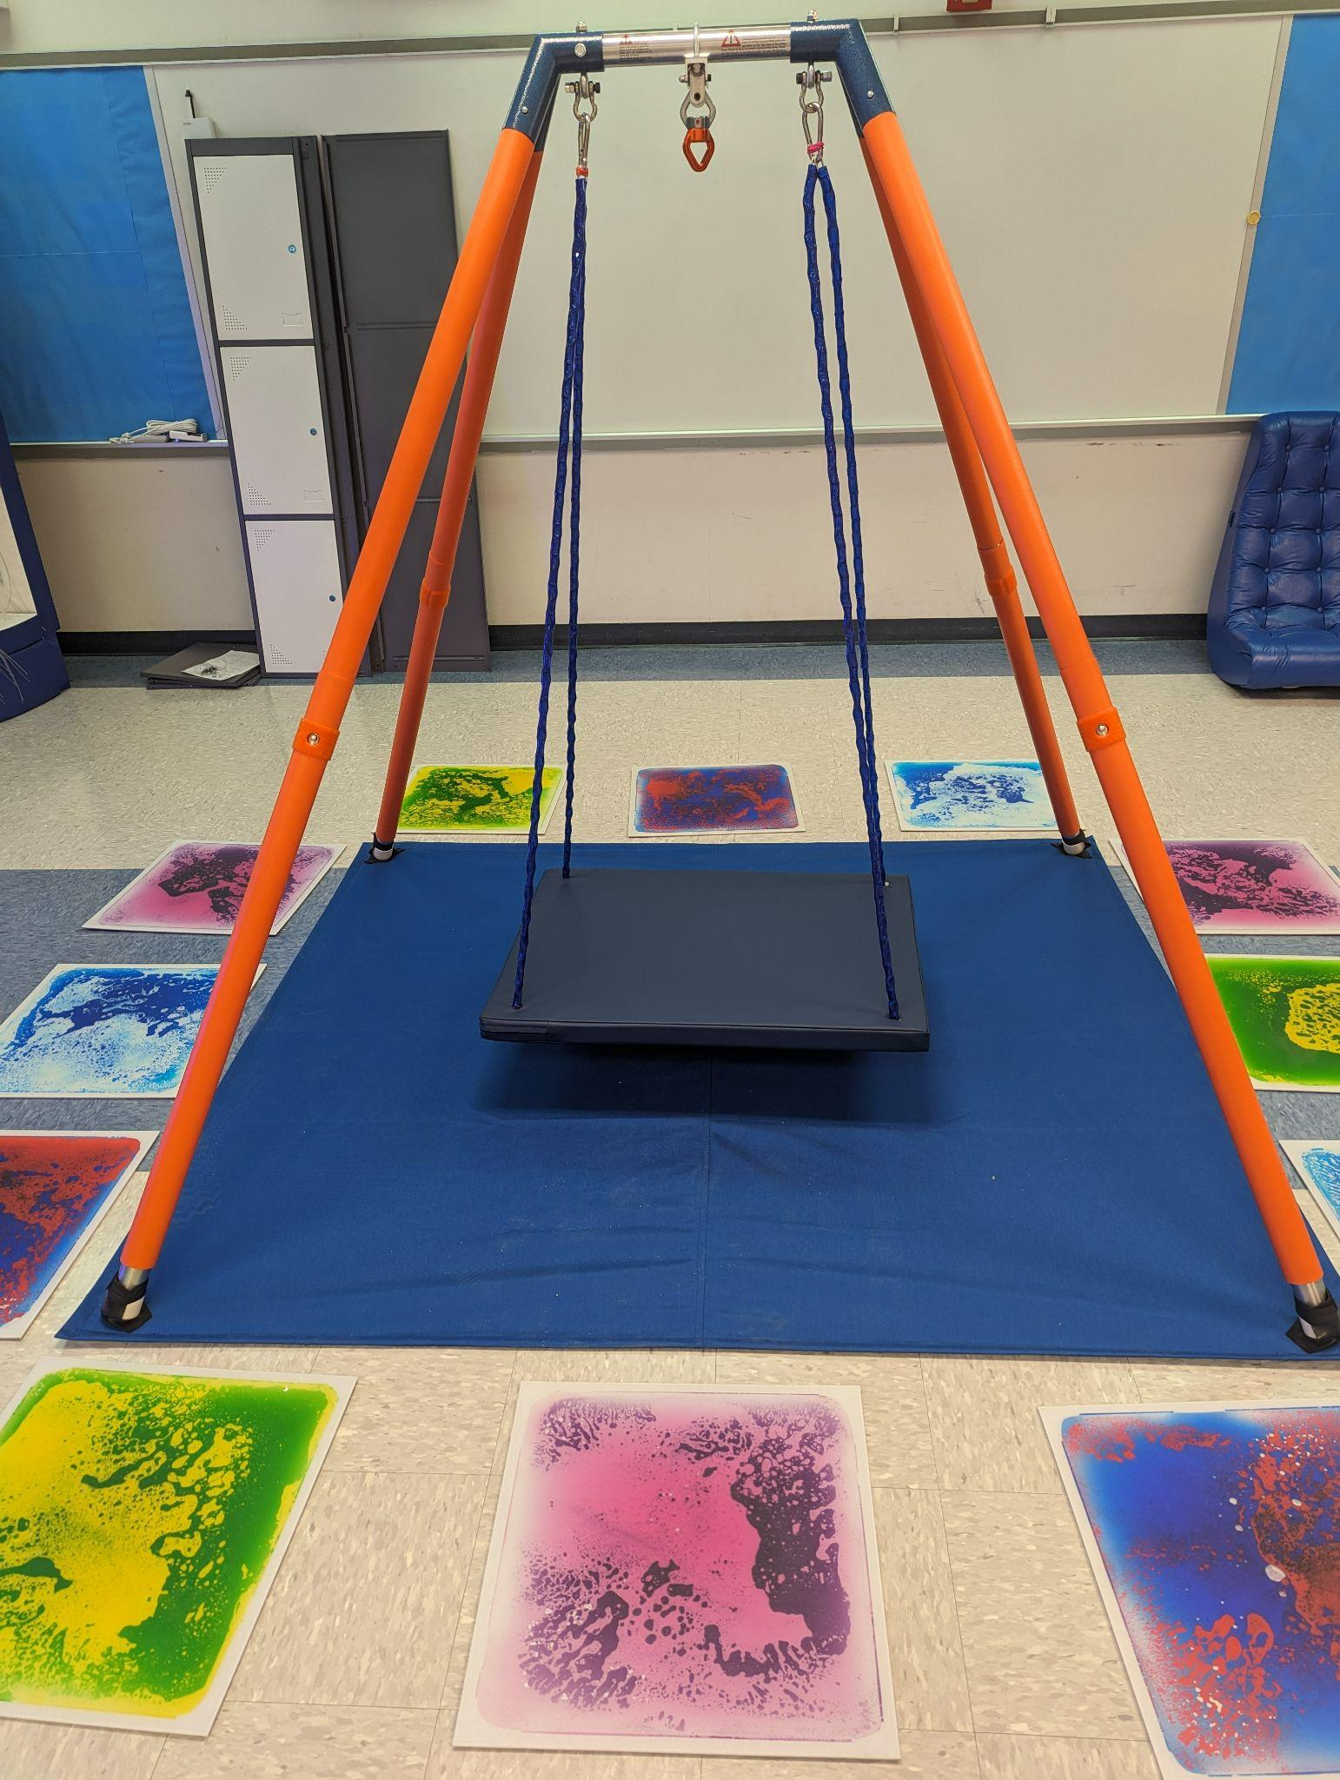
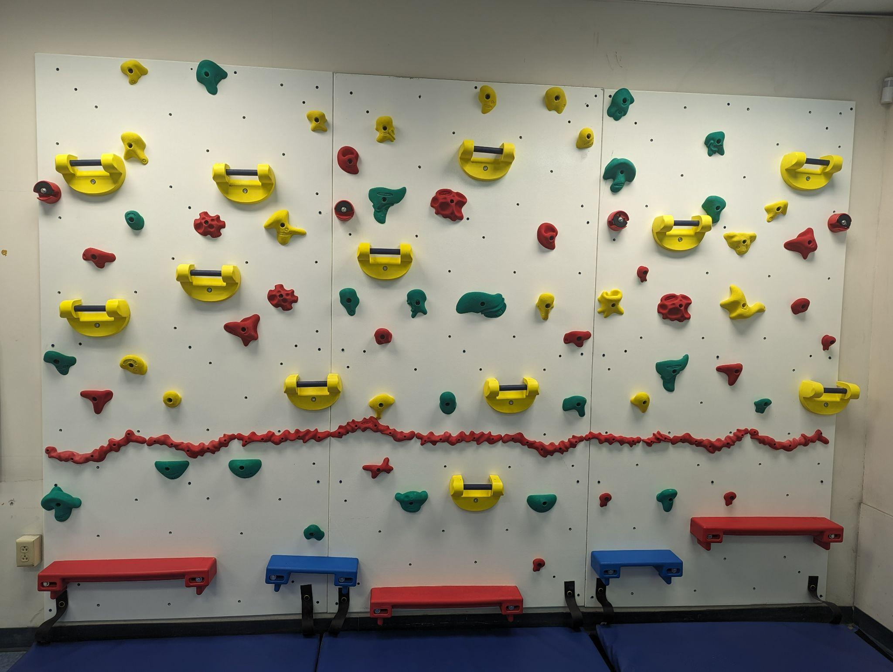
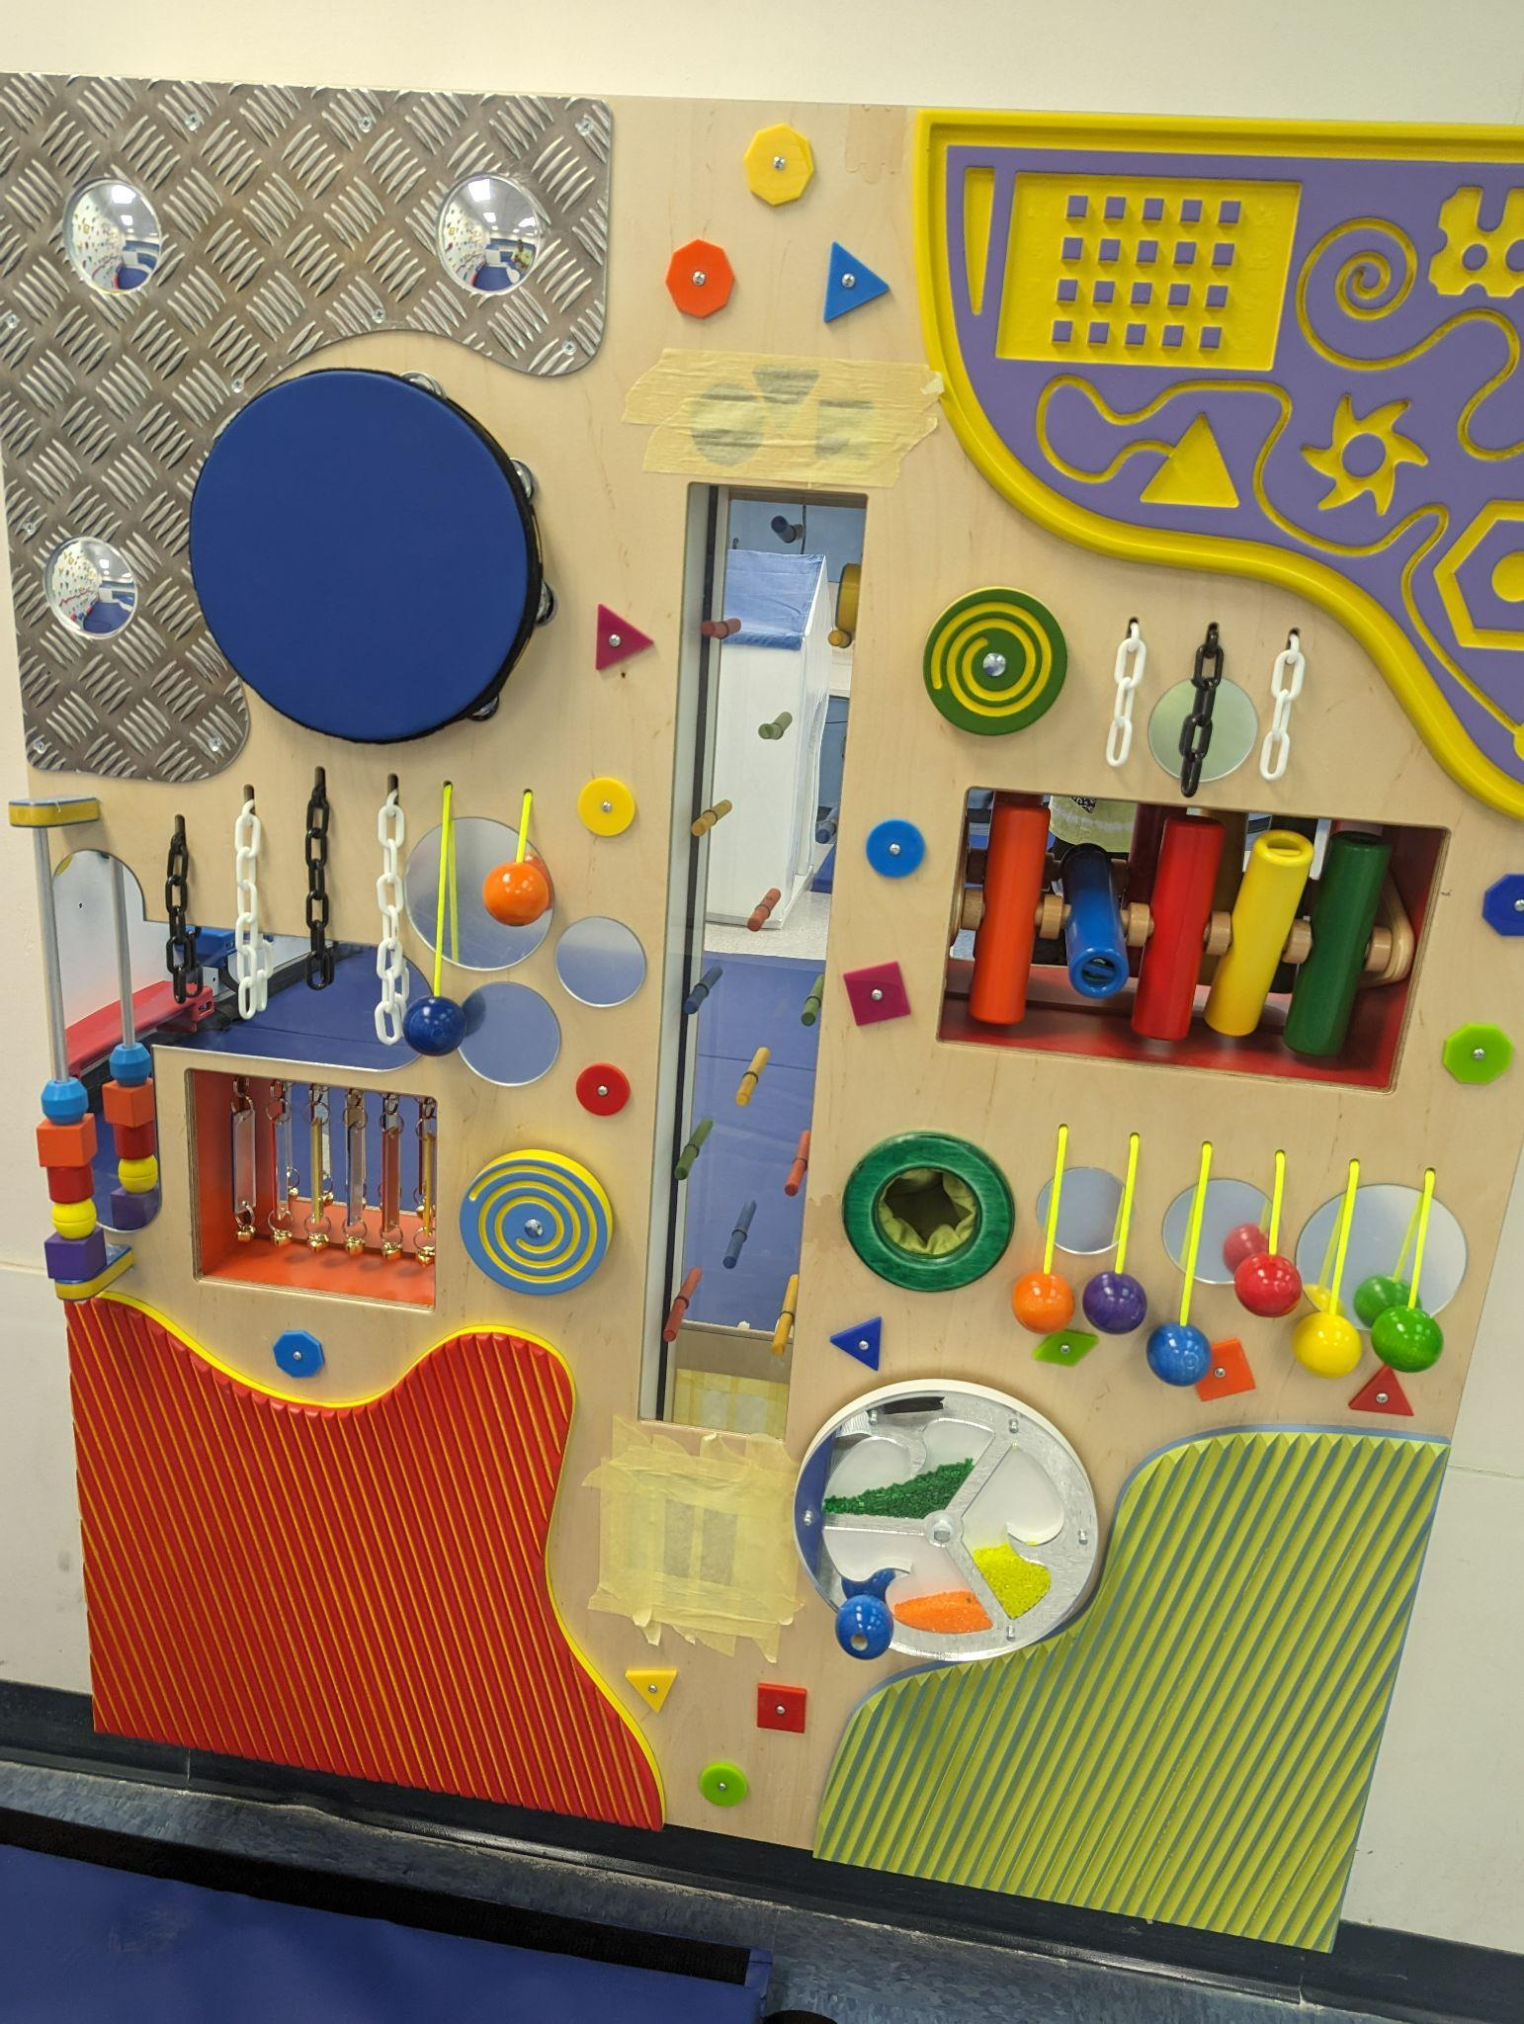
ARP ESSER IDEA PART B SET ASIDE ONGOING PROJECTS
How has the district spent its ARP ESSER Set Aside IDEA Part B
School
Funds?

Slide 25
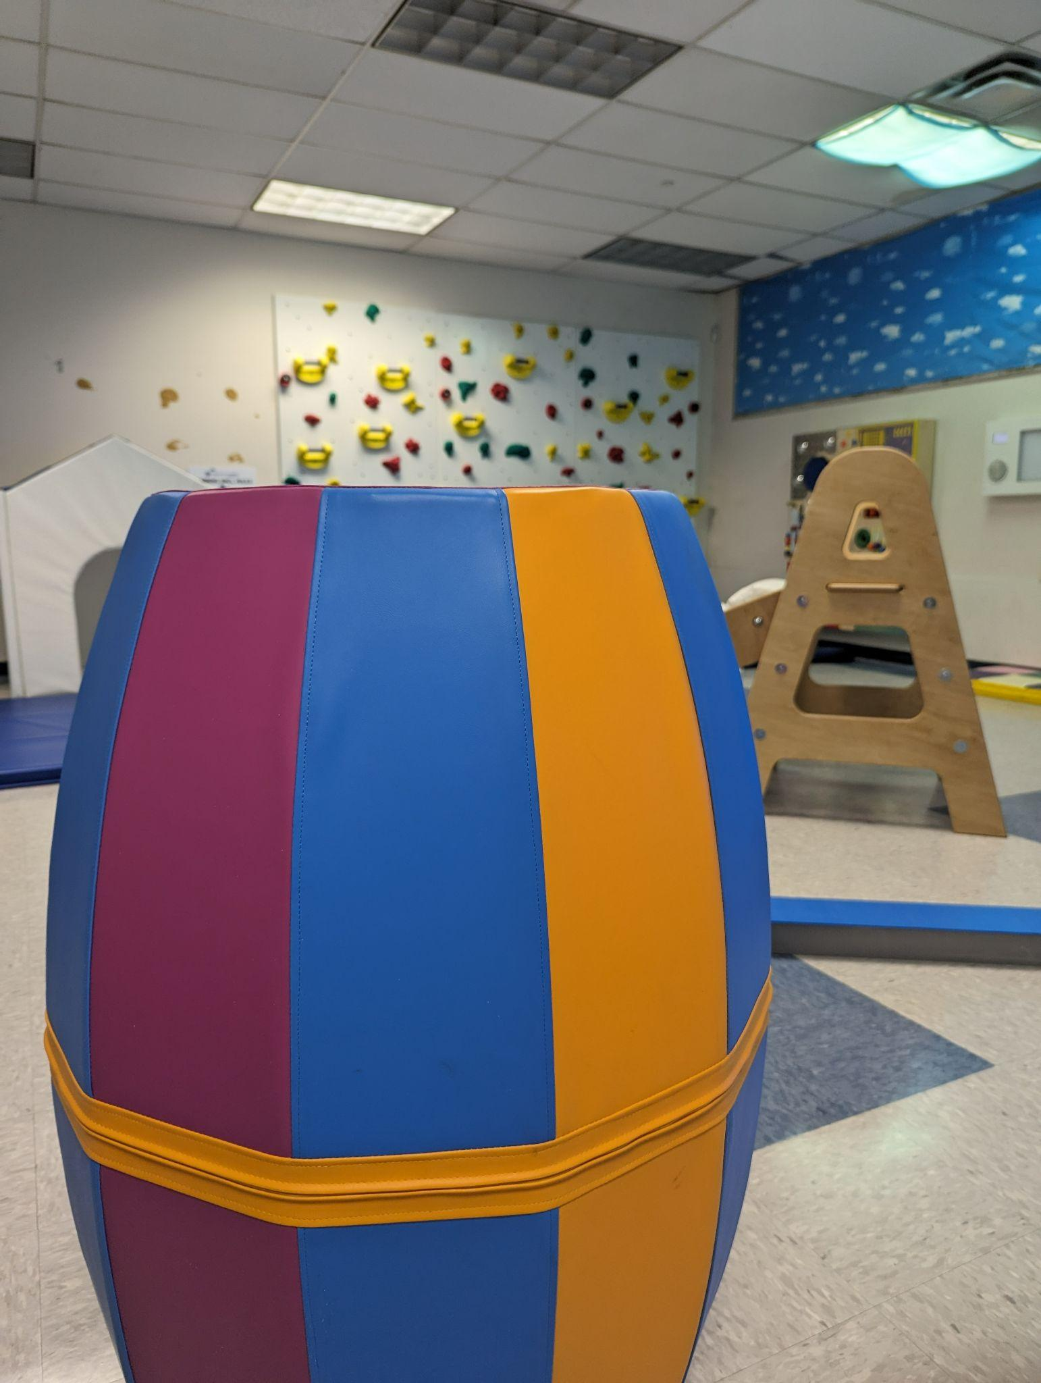
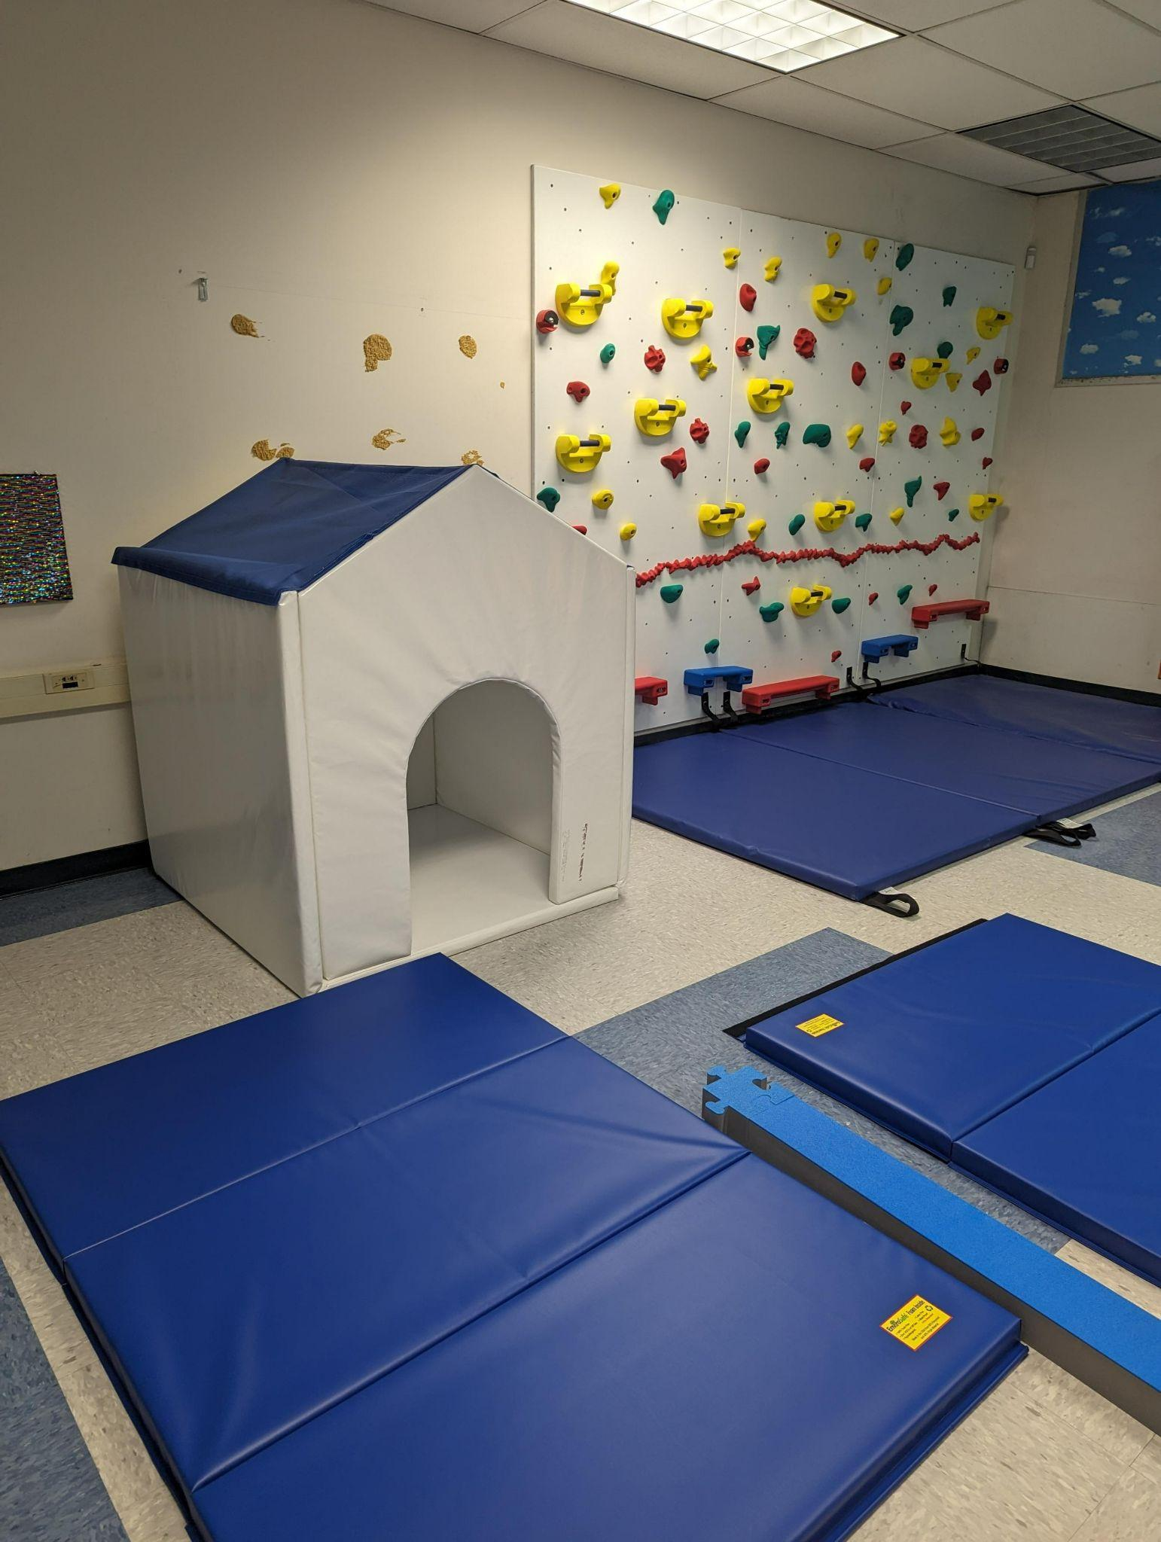
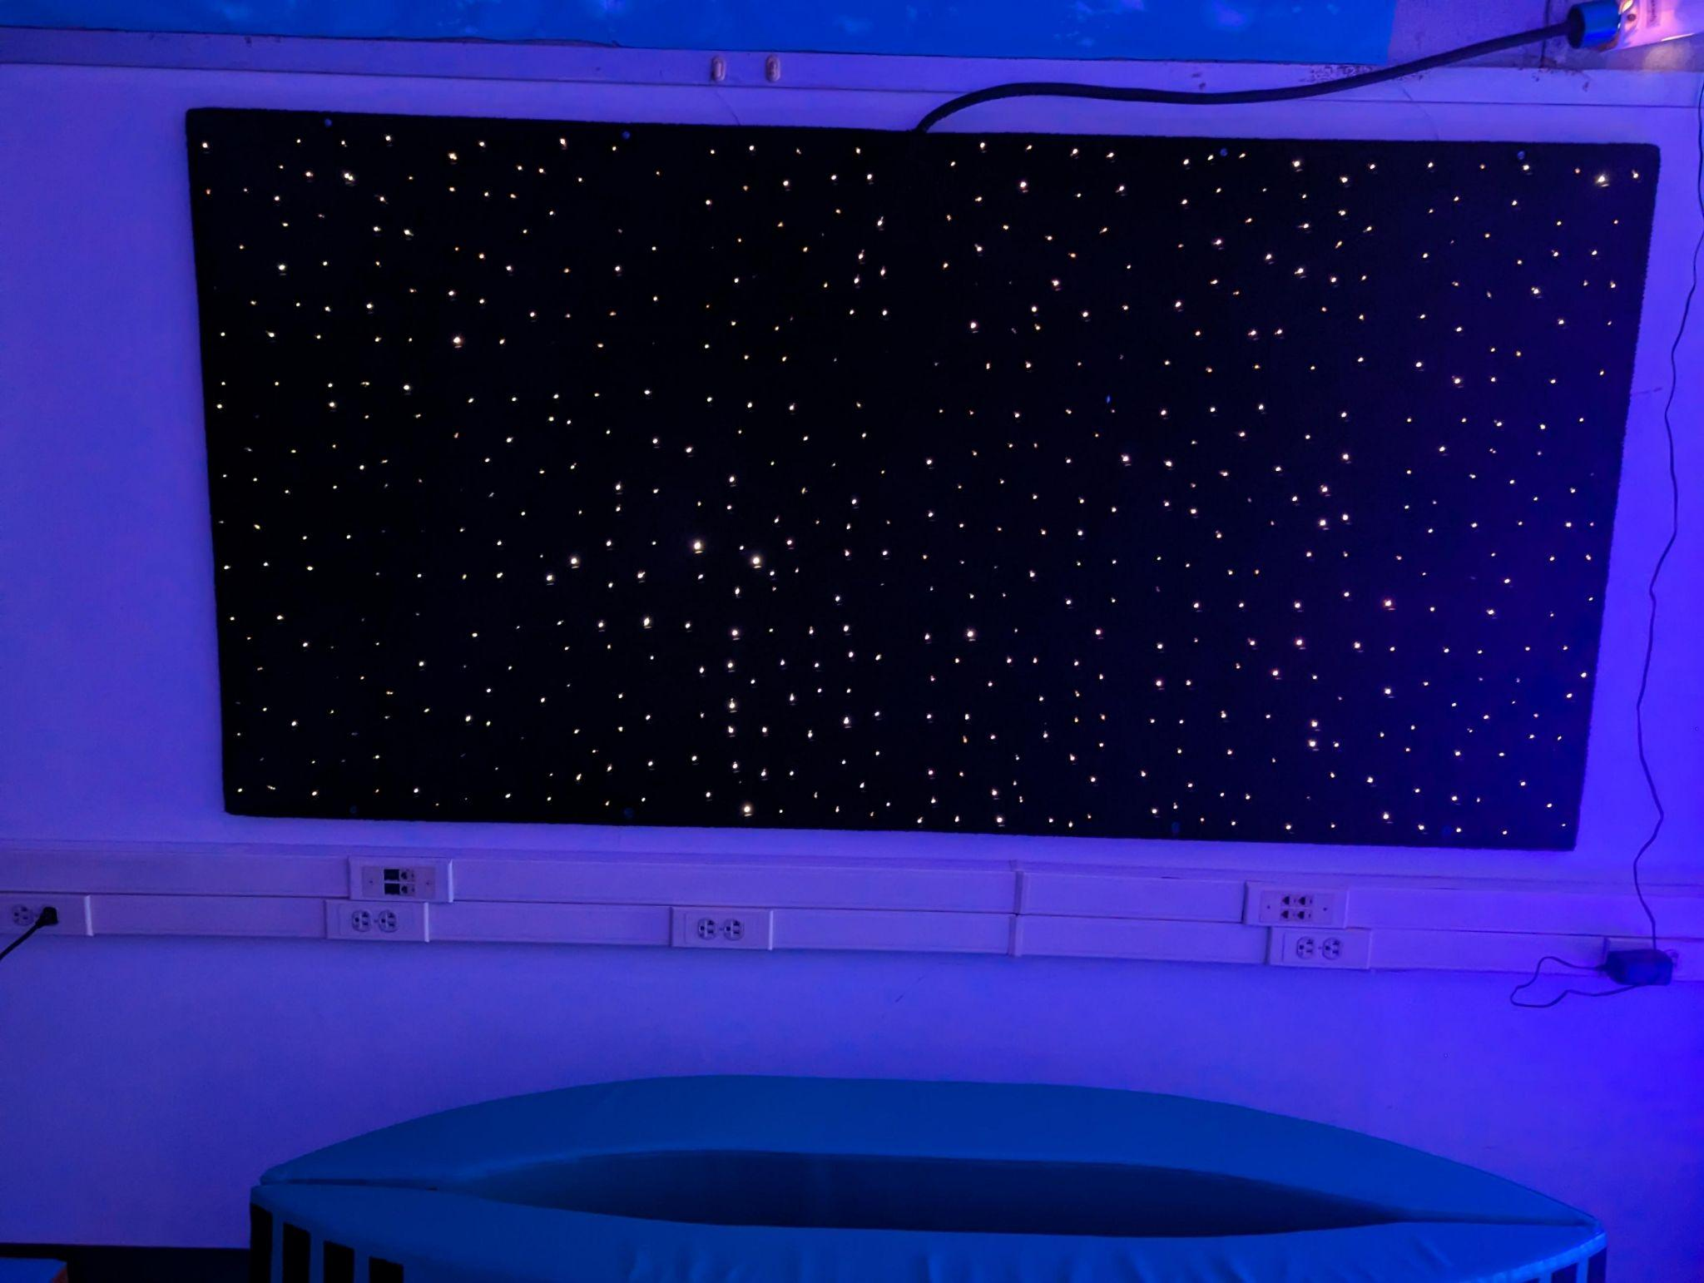
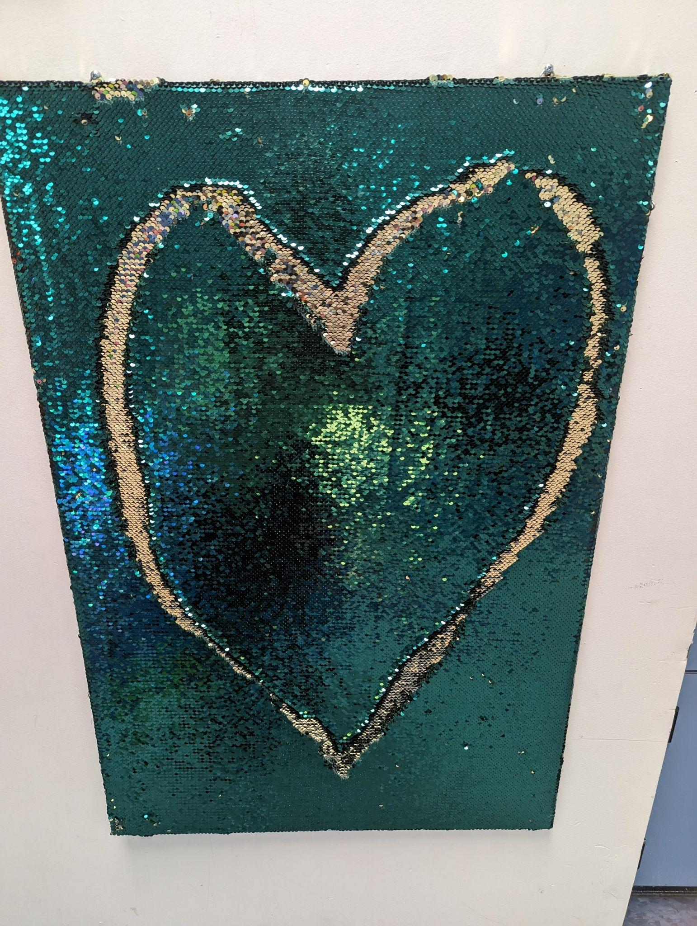
ARP ESSER IDEA PART B SET ASIDE ONGOING PROJECTS
How has the district spent its ARP ESSER Set Aside IDEA Part B
School Funds?

Slide 26
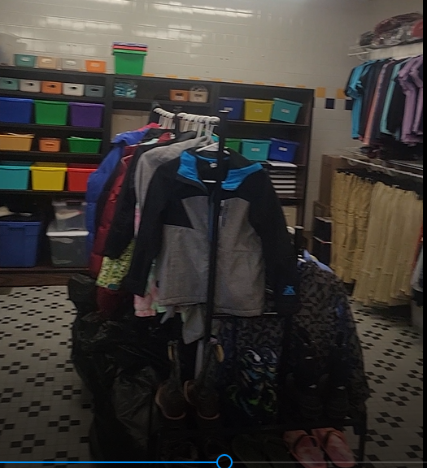
ARP ESSER HCY SET ASIDE ALLOCATION
ONGOING PROJECTS
FOOSE ELEMENTARY COUGAR CLOSET…
How has the district spent its ARP ESSER Set Aside HCY School Funds?

Slide 27
ARP ESSER HCY SET ASIDE ALLOCATION
$272,709
10 schools will open
Cougar Closets:
Washer and Dryers
School supplies;
Uniforms, coats,
sweaters, socks, underwear and toiletries;
Hygiene products; and
An area for parents to
wash laundry.
How has the district spent its ARP ESSER Set Aside HCY School Funds?

Slide 28
ESSER IMPLEMENTATION

Slide 29
QUESTIONS

