Slide 1
An Introduction to the Future Ready PA Index
Burgettstown Area School District
October 2018

Slide 2
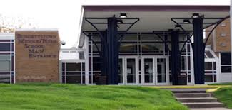
What is the Future Ready PA Index?
The Future Ready PA Index is the new school measurement tool for communities to evaluate how schools are doing in preparing students for college, career, and community after graduation.
Why is Pennsylvania adopting the Future Ready PA Index?
Pennsylvanians know that students, and the schools that serve them, are more than just standardized test scores, and wanted a tool for evaluating schools that doesn’t rely solely on standardized test results.
In 2015, the state Department of Education started engaging with communities around the state to learn what was important to them and to develop a new measure. As a result, in 2018 Pennsylvania reduced PSSA testing time by 20 percent, and established a new meaningful set of indicators.

Slide 3
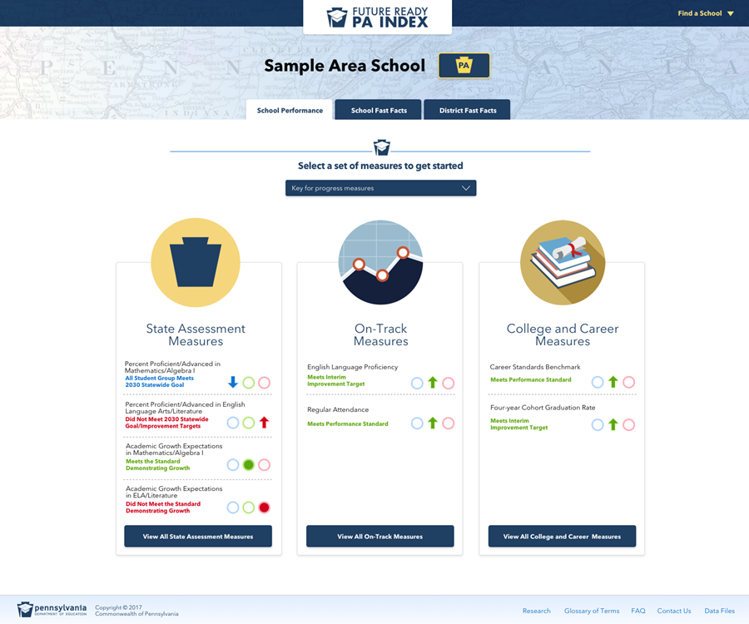
Indicators
Screenshot of index
State Assessment Measures
PSSA & Keystone Proficiency
Annual Growth
Percent Advanced on PSSA/Keystones
On-Track Measures
English Language Proficiency
Regular Attendance
Grade 3 Reading/Grade 7 Mathematics
College and Career Measures
Graduation Rate
Career Standards Benchmark
Industry-Based Learning
Percent Advanced on Industry Competency
Rigorous Courses of Study
Post-Secondary Transition to School, Military, or Work
PSSAs are administered in grade 3-8 in math and English Language Arts and grades 4 & 8 in science. Keystone Exams assess Algebra I, Literature and Biology.

Slide 4
Why a dashboard?
The Future Ready PA Index provides an opportunity for communities‒not the state‒to determine school success based on local priorities and values.
The dashboard provides a comprehensive snapshot that reduces dependence on standardized test scores, and gives educators an opportunity to focus on the curriculum that is important to their students and their communities.

Slide 5
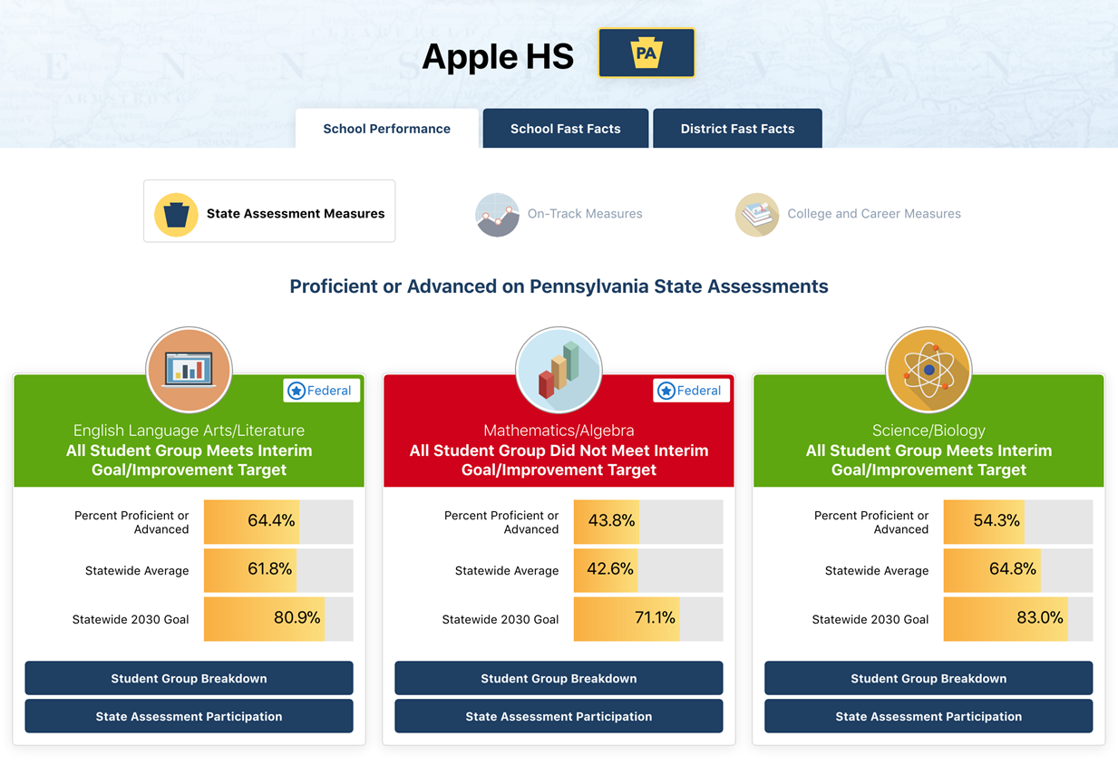
Why a dashboard?
Measures displayed on the dashboard are practical, and easy to read and understand.
The dashboard treats the accountability system as a tool for continuous improvement.
Overall school performance is apparent, and areas of strength or in need of improvement are evident.

Slide 6
Why is the Future Ready PA Index valuable to educators?
The Future Ready PA Index recognizes that students – and the schools that serve them – are more than just standardized test scores.
The Future Ready PA Index allows educators to determine successes and identify areas for improvement in their schools and programs.
The Future Ready PA Index’s easy-to-navigate, advanced search function allows an educator to find schools with similar demographics and collaborate to determine what is working for students in the commonwealth’s classrooms.

Slide 7
Watch a video that will help you learn how to navigate the Future Ready PA Index
https://youtu.be/rMBFM3wN5hU

