Slide 1
Seesaw Family Guide
October 2020
Regina D’Orio

Slide 2
Table of Contents
How does Seesaw Work?
Step One: Connect as a Family Member
Student Connection with the Class App
Using a district device to login to Seesaw
Connecting your child to their class with the Home Learning Code
Class App Student View
Checking Announcements
Responding to an Activity
Posting to the Journal
Using the Creative Tools
What’s NEW in the Drawing Tools
Helpful Resources

Slide 3
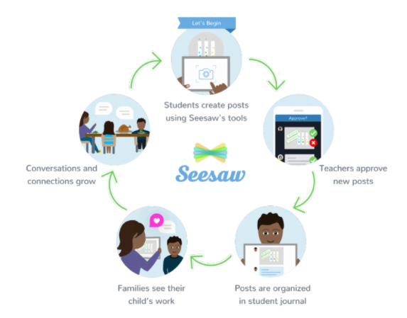
How does Seesaw work?
Seesaw is a digital student journal. It can be used both in school and at home.
Your child will add work to Seesaw to share their learning with you. The teacher will also send important messages and reminders using Seesaw.
When there are new posts or messages, you'll be notified and can see what's new!
Seesaw is private. You’ll only see posts created by your child. Learn more about Seesaw's commitment to privacy at web.seesaw.me/privacy.
Students create posts or complete activities and post to journal.
Conversations and connections grow!
Teachers approve all new posts and comments.
Family members view their own child’s posts and activities.
Posts are organized in the student journal by date and time posted.

Slide 4
Seesaw Class App
First, connect your child from home with the home learning code.
Both!
Students must use the Class app or log in as a Student at app.seesaw.me
✓ Post to their journal
✓ Complete assignments
✓ Respond to activities

Slide 5
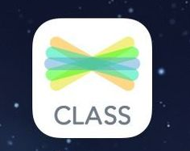
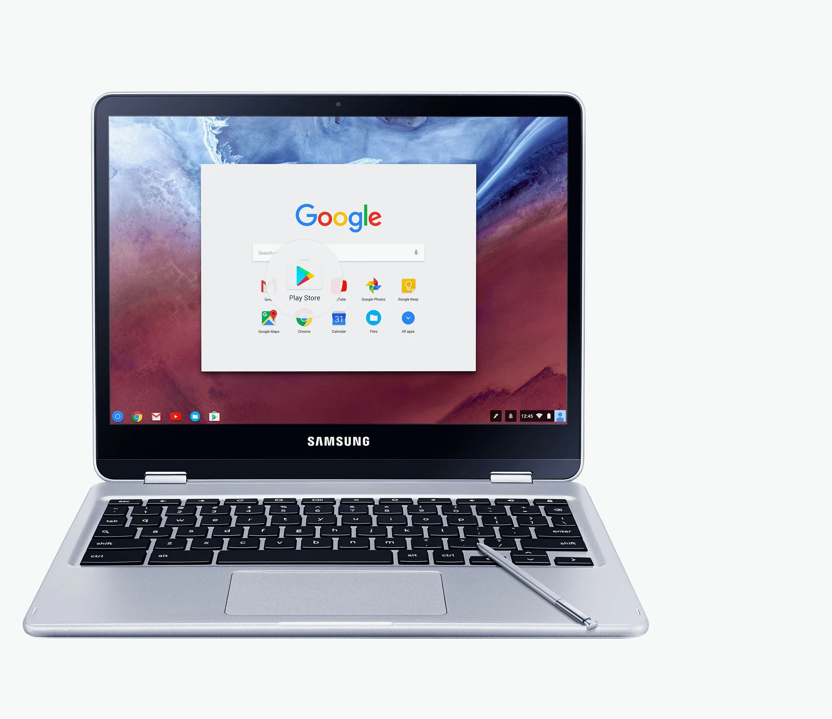
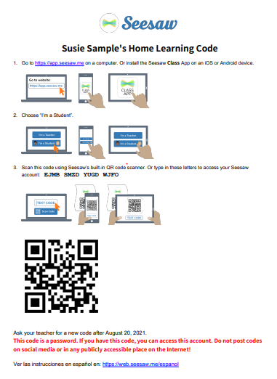
Student Connection with the Class App
Students will connect to Seesaw using the Class App. This will allow them to complete assignments by posting to the journal and responding to activities.
Your child will be learning how to connect to their Seesaw class in school. Teachers will be instructing students how to use Seesaw tools, complete activities and post to the journal in class.
You will receive a letter from your child’s teacher with directions for signing into Seesaw from home with a home learning code.

Slide 6
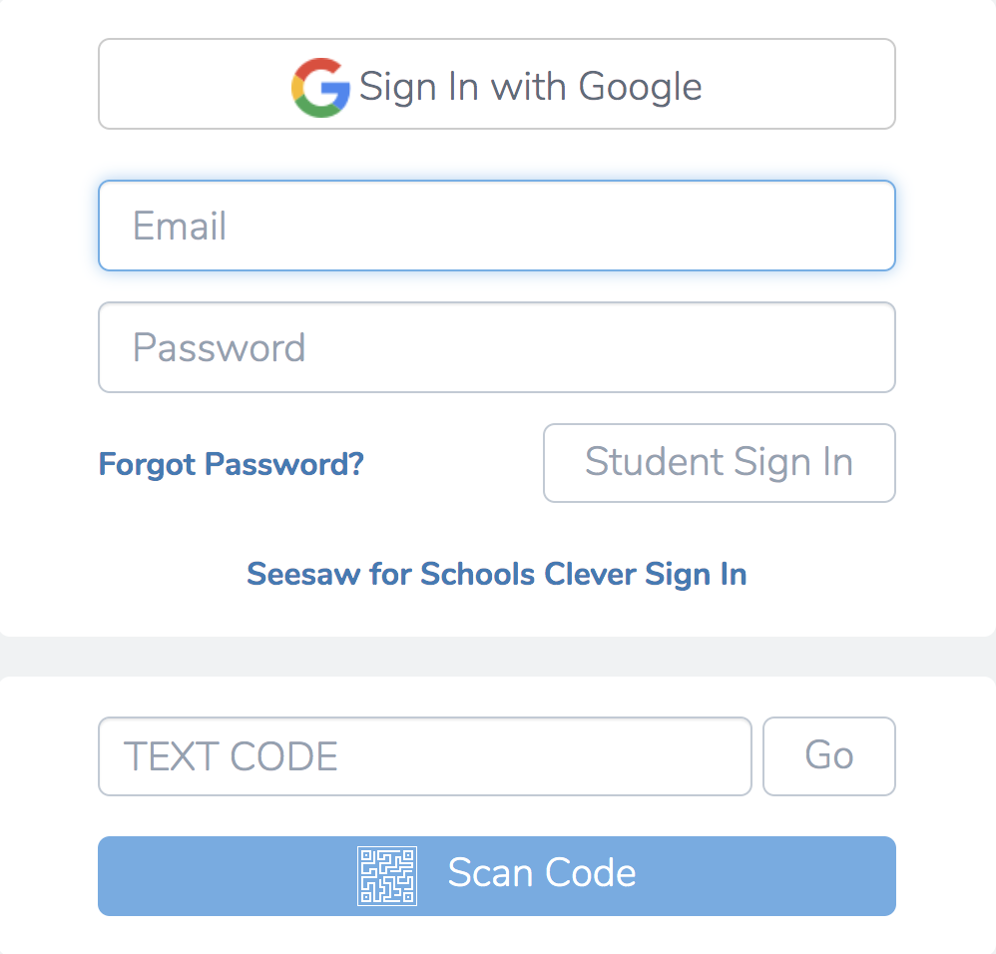
Step Two: Connect your Child to their Class
1. Download the Seesaw Class app on an iPad, go to https://app.seesaw.me on a computer, or click on the Seesaw Class app in the Class Link Library on the district chromebook.
2. Click “I’m a Student”.
3. Type the home learning code you received from your child’s teacher where it says “TEXT CODE”. It will be a 16 character capital letter code. Treat this as the student password. You could also scan the QR code from the letter you receive from your child’s teacher.

Slide 7
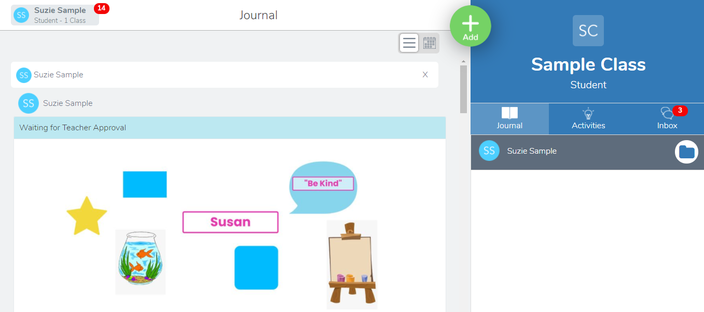
Class App Student View
New notifications
NEW! Click here to toggle between the classroom teacher and special area teachers’ Seesaw Classes with one sign in!
All student posts must be approved by the teacher.
Student and Teacher Posts will appear here in the class journal.
Activities Tab: Click here to find activities assigned for the day
Inbox Tab: Click here to get announcements from the teacher.

Slide 8
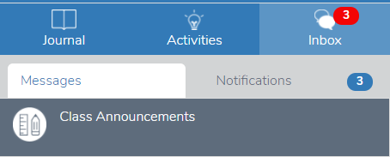
Checking Announcements
The Inbox is where your child will find messages from the teacher such as morning announcements or daily agendas. NOTE: This is NOT where you as the parent can message the teacher. Remember to use the Family App for private messages or questions to your child’s teacher.
Tap the Inbox tab.
Tap the Messages sub tab. Announcements from the teacher will appear on the left- hand side under “Messages”.
The Notifications sub tab shows your child all of their recent activity.
The number in the red dot indicates the number of messages or notifications.

Slide 9
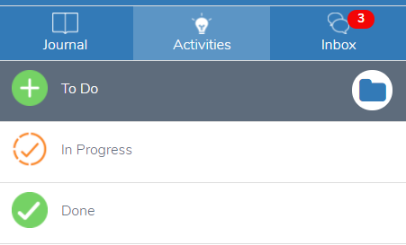
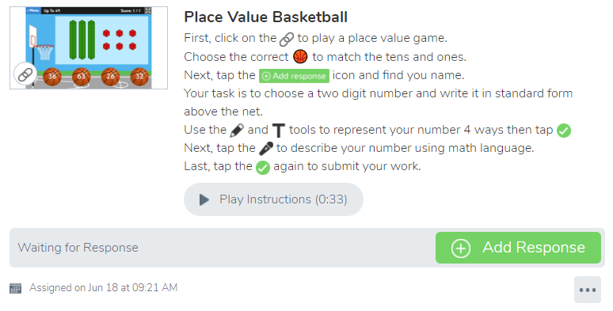
Responding to an Activity
The Activities Tab is where your child will find assignments from the teacher to complete each day. Your child can view activities that are in progress (still need to be completed) and done (these are completed and turned in). Click here to learn more about helping your child respond to an activity.
Tap the Activities Tab.
Select and Activity to Complete.
Click Add Response.
Follow the teacher’s directions for completion using the creative tools in Seesaw.
Click the green check to “turn it in”. It will get posted in your child’s journal.

Slide 10
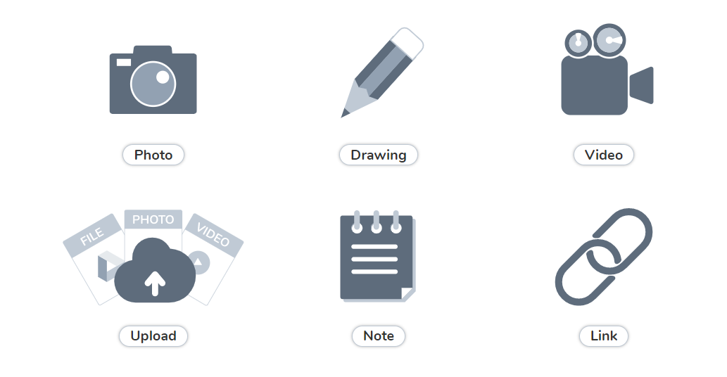
Posting to the Journal
1. Tap the Journal tab.
2. Tap the green Add button.
3. Your child will choose the type of post to add using one of these creative tools. Learn more about the creative tools on the next page.
4. After creating the post, your child will tap the green checkmark to complete the post and add it to the journal.

Slide 11
Using Creative Tools
Take a photo with your chromebook’s camera. Click here to learn more about this tool.
The drawing tool allows your child to create digital artwork and more! Click here to learn about the drawing tool.
The video tool allows your child to record a video. Click here to learn more about using this tool.
The upload tool allows your child to upload a photo, video, image or file from their device. Files should be converted to a PDF before uploading.Click here to learn more!
The link tool allows your child to add a link to a website. This can also be done using the new features in the drawing tool. Click here to learn how!
The note tool allows your child to write a text note. You can use the keyboard or voice recording. Click here to learn more!

Slide 12
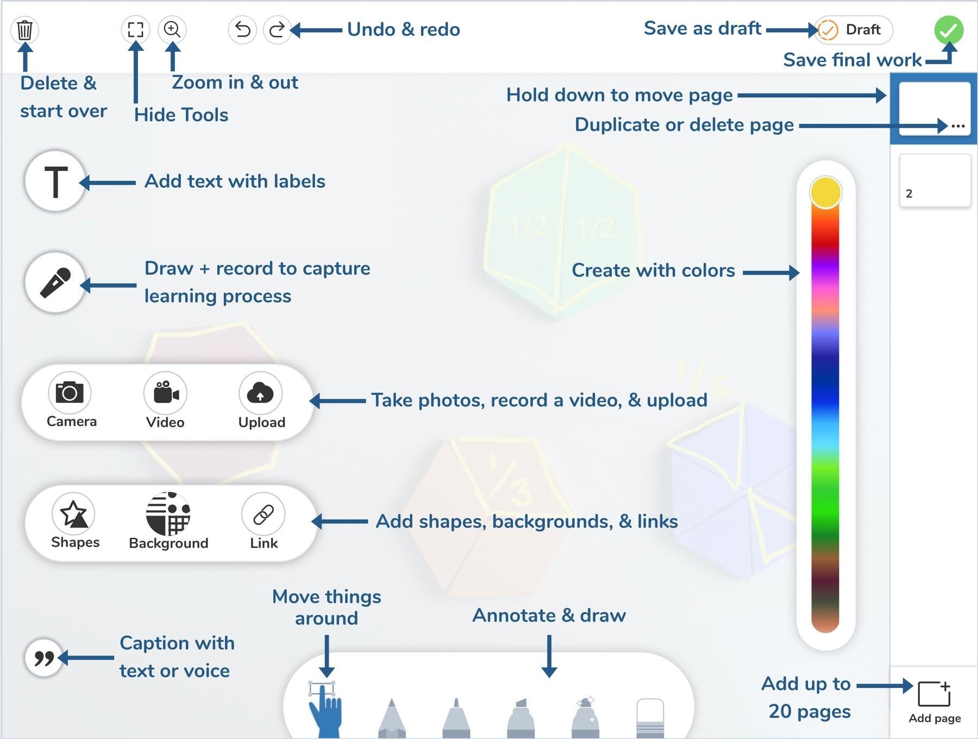
What’s NEW in the Drawing Tools
Here is an overview of some of the options within the drawing tool.

Slide 13
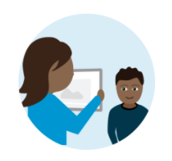
Helpful Resources
Help.seesaw.me Find FAQ for families or type your question in the search box.
Visit web.seesaw.me/parents for more information.
Type a question here!
Click here to watch a video on getting started with Seesaw for Home Learning.

Slide 14
Questions?
Should you have any questions about using Seesaw please contact your teacher
You can also ask a Tech Parent by clicking here: Tech Parent
There are also resources on the District Website here: Seesaw
Many thanks to Ms. D’Orio (Seaford Parent) for the work she did on this presentation and thoughtfulness in sharing with other Seaford parents.

