Slide 1
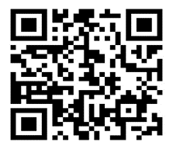
Recruiting Rising 7th & 8th Graders for STEM 2024-2025 Academic Year
PROSPECTIVE SKILLS
Motivation
Initiation
Creativity
Leadership
Critical – Thinking
Determination
Collaboration
Productivity
Communication
Persistence
Curiosity
ACTIVITIES AT A GLANCE
Vex Robotics
First Lego Robotics
Dissections
STEM Field Trips
Project- based Learning
Technology Student Association
High School Biology
Science & Engineering Fair
Hypotonic Gardens
3D Printers
Website Creation
Engineering
APPLICANT SELECTION PROCESS
2/26/24 STEM interest Application Released
2/26/24 Teacher Recommendation Form Released.
3/4/24 STEM Interest Application Due
3/4/24 Teacher Recommendation Form Due
3/7/24 Applicant Status Announced
Scan the QR Code here and complete the
Information if interested in STEM.

