Slide 1
Measure BB Bond
21st Century Classroom Improvements
March 26, 2024

Slide 2
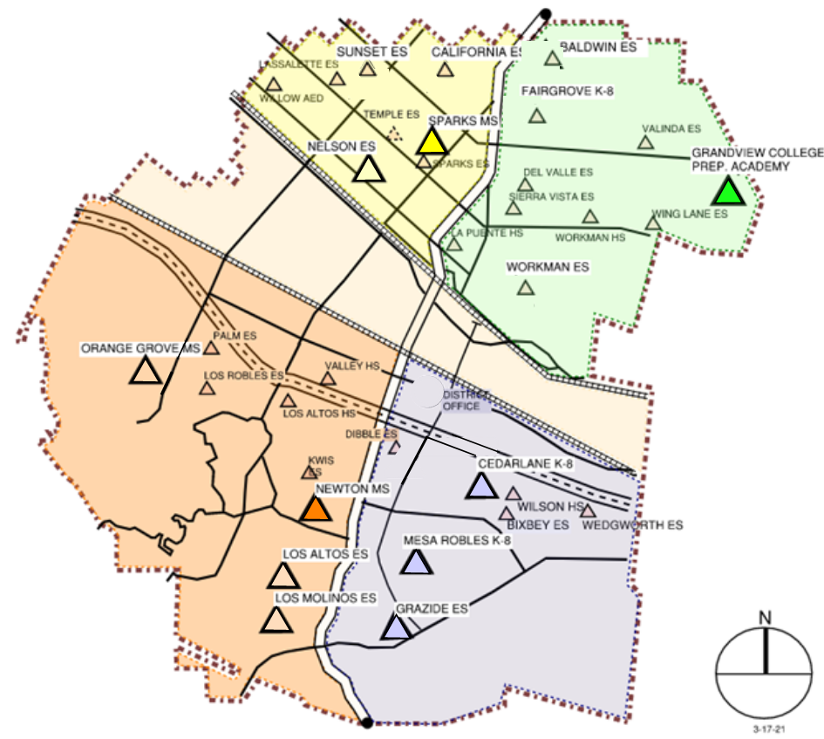
IN PROGRESS
CONSTRUCTION
La Puente HS
Workman HS
Los Altos HS
Wilson HS
Stimson EC
AT DSA FOR REVIEW
California ES this month
Baldwin ES this month
Los Molinos ES
Grazide ES
IN DESIGN
Kwis ES
Lassalette ES
Fairgrove K-8
Orange Grove MS
Sierra Vista MS
Palm ES
Valinda ES
Sparks ES
Wing Lane ES
IN PROPOSAL PHASE
Valley Alternative
COMPLETED
Nelson ES
Los Altos ES
Workman ES
Mesa Robles K-8
Cedarlane K-8
Sparks MS
Newton MS
Grandview K-8
STIMSON

Slide 3
PHASE B PROGRESS
1. Baldwin ES Construction Documents to DSA 1/23/2024 In Back-Check Process Out By 4/25/2024
2. California ES Construction Documents to DSA 1/23/2024 In Back-Check Process Out By 4/25/2024
Anticipated Construction Start Fall of 2024
3. Los Molinos ES Construction Documents at DSA 3/12/2024 Anticipated Plan Check Completion TBD
4. Grazide ES Construction Documents at DSA 3/12/2024 Anticipated Plan Check Completion TBD
Anticipated Construction Start Winter of 2024
5. Kwis ES Construction Documents Design Development
6. Lassalette ES Construction Documents Design Development
Anticipated Construction Start New Year of 2025
7. Palm ES Construction Documents Design Development Schematic Design
8. Valinda ES Construction Documents Design Development Schematic Design
Anticipated Construction Start Spring of 2025
9. Fairgrove K-8 Construction Documents Design Development
10. Orange Grove MS Construction Documents Schematic Design
Anticipated Construction Start Summer of 2025
11. Sierra Vista Construction Documents Design Contract Award
12. Sparks ES Construction Documents Design Contract Award
Anticipated Construction Start Summer -Fall of 2025
13. Wing Lane ES Construction Documents Design Contract Award
14. Valley Alternative Construction Documents Design Proposal
Anticipated Construction Start Fall of 2025

Slide 4
HIGH SCHOOL REFRESH PROJECTS

Slide 5
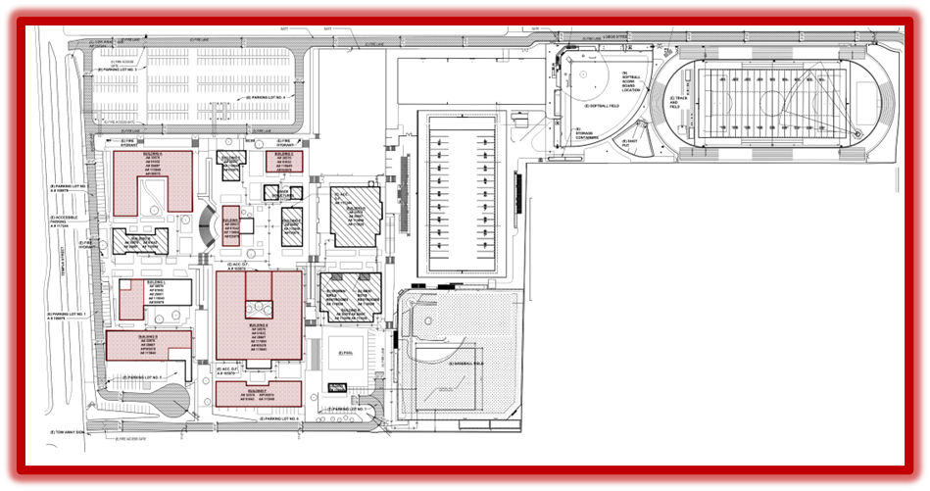
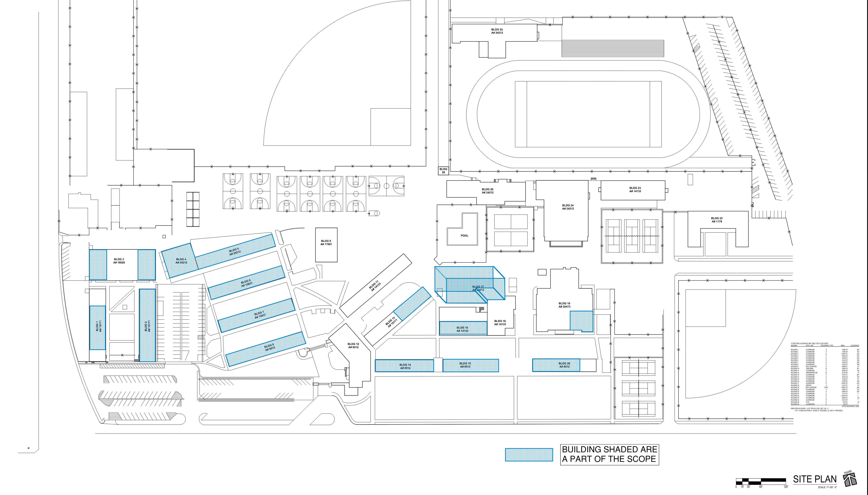
HIGH SCHOOL REFRESH #1
New LVT Flooring
New Wall Base
New Paint, Repair, Prep.
Walls
Trim
Ceilings
Doors
Windows
New Grilles at Heat Pumps
Repair and Replace Damaged Ceiling Tile
Repaint Ceiling Grid
Interior Brick cleaning
Re-lamp at light (By District)
Deep Cleaning
Hazmat Abatement
Scope Limited to Replacement of Finishes
Benefits:
Avoid DSA Review Requirements
Saving Time
Improvements Starting Sooner
Conserving Bond Funds
WORKMAN HIGH SCHOOL
43 CLASSROOMS
LA PUENTE HIGH SCHOOL
55 CLASSROOMS

Slide 6
REFRESH GROUP #1
Workman Classroom Phase 1 Complete Phase 2: Demo Has Begun
Before
During
Room A-11 Demo
Room A-12 Primer coat

Slide 7
REFRESH GROUP #1
Before
La Puente HS - Phase 1 Complete
Phase 2: Classroom 2, Before &
During Refresh
During

Slide 8
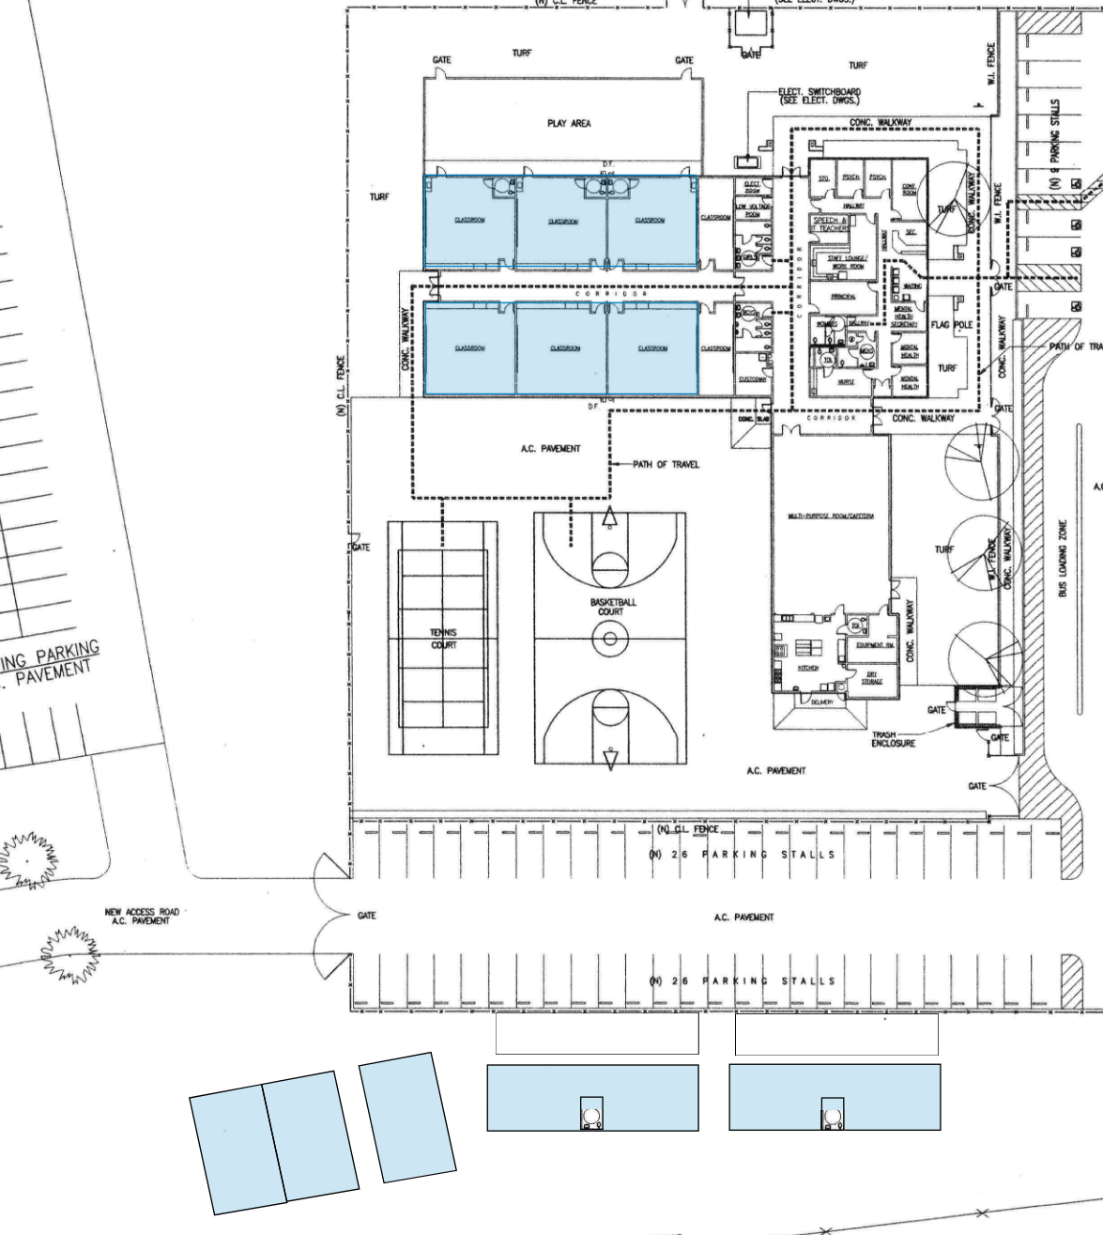
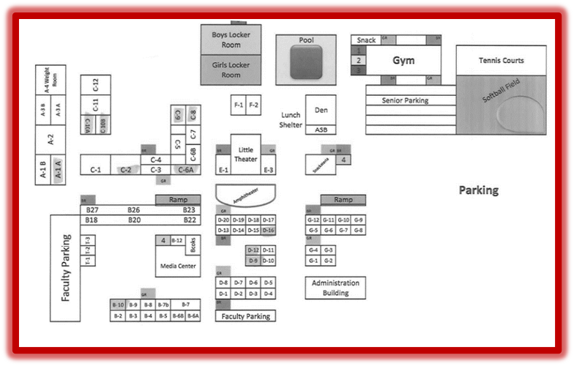
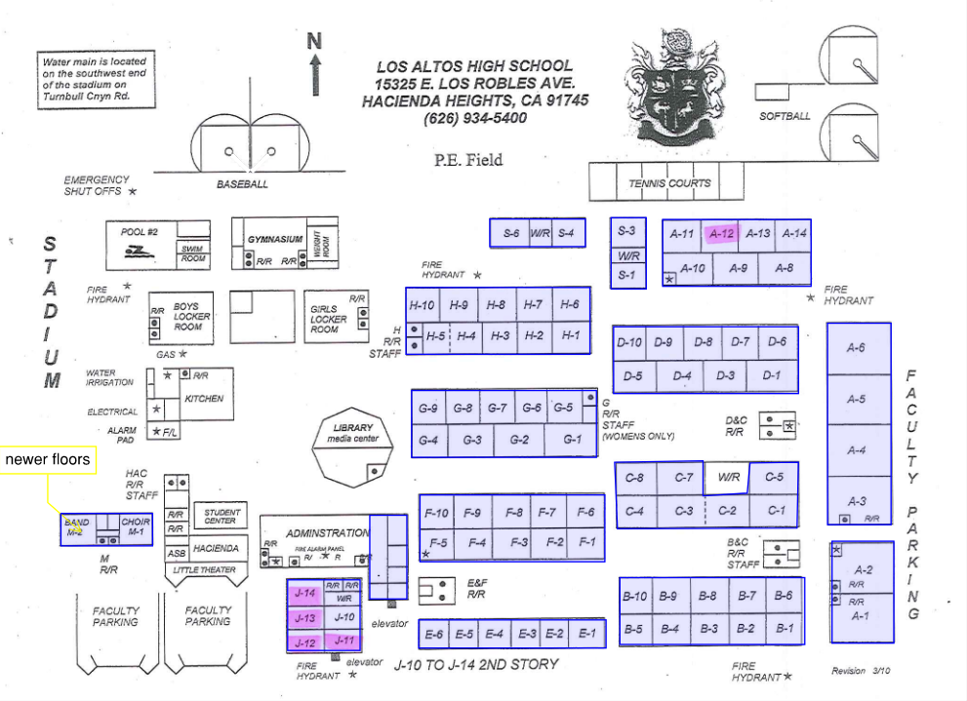
HIGH SCHOOL REFRESH #2
WILSON HIGH SCHOOL
59 CLASSROOMS
STIMSON LEARNING CENTER
10 CLASSROOMS
LOS ALTOS HIGH SCHOOL
69 CLASSROOMS

Slide 9
REFRESH GROUP #2
During
Wilson HS Phase 1
Classroom C-12 During New Floor Prep
During

Slide 10
REFRESH GROUP #2
Before
Los Altos HS Phase 1 Classroom B-4. Before and During Demo
During

Slide 11
QUESTIONS & ANSWERS

