Slide 1
HACIENDA LA PUENTE UNIFIED SCHOOL DISTRICT
La Puente Quad
Los Altos Quad
Wilson Quad
Workman Quad
School Site Improvement Projects
Regular Board Meeting March 26, 2024
Business Services
Notes:
Good evening Ma’dam President, Ms. Christine Salazar, Distinguish Board Members; Superintendent, Dr. Jimenez, Executive Cabinet, Colleagues, and community members.
A special greetings to our Principals, Administrators, staff member who are joining us via the virtual platform.

Slide 2
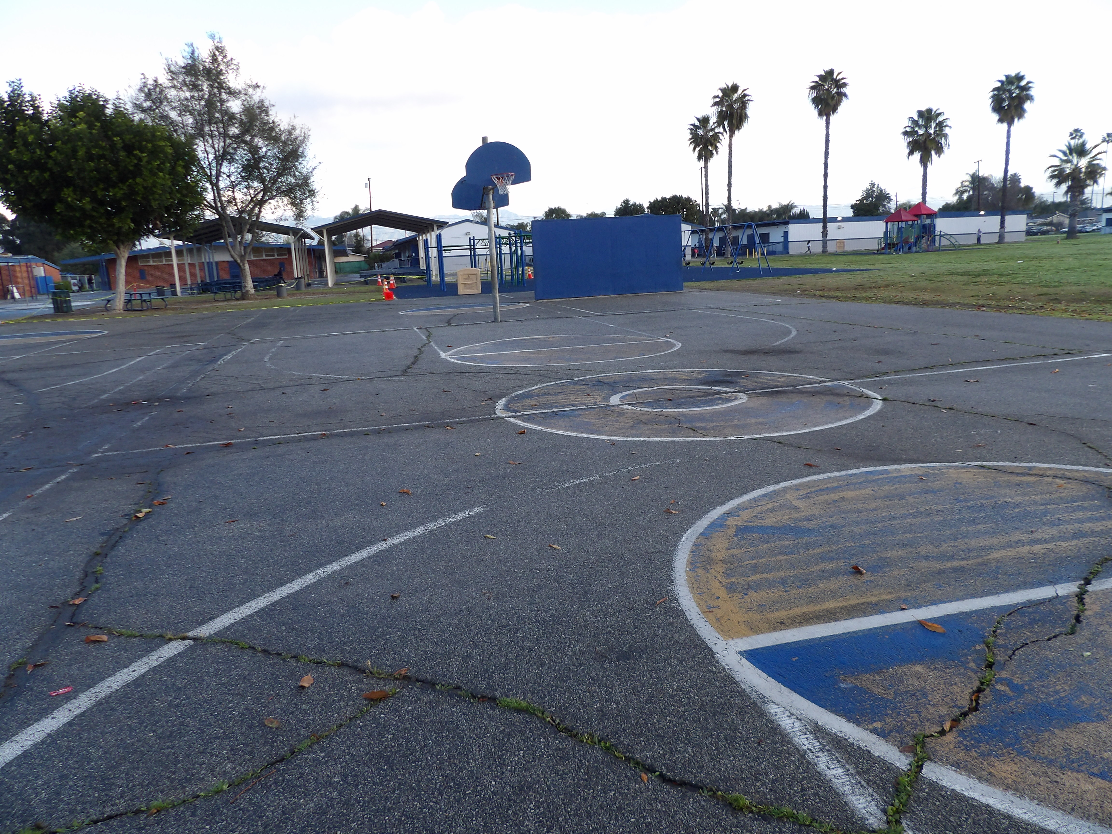
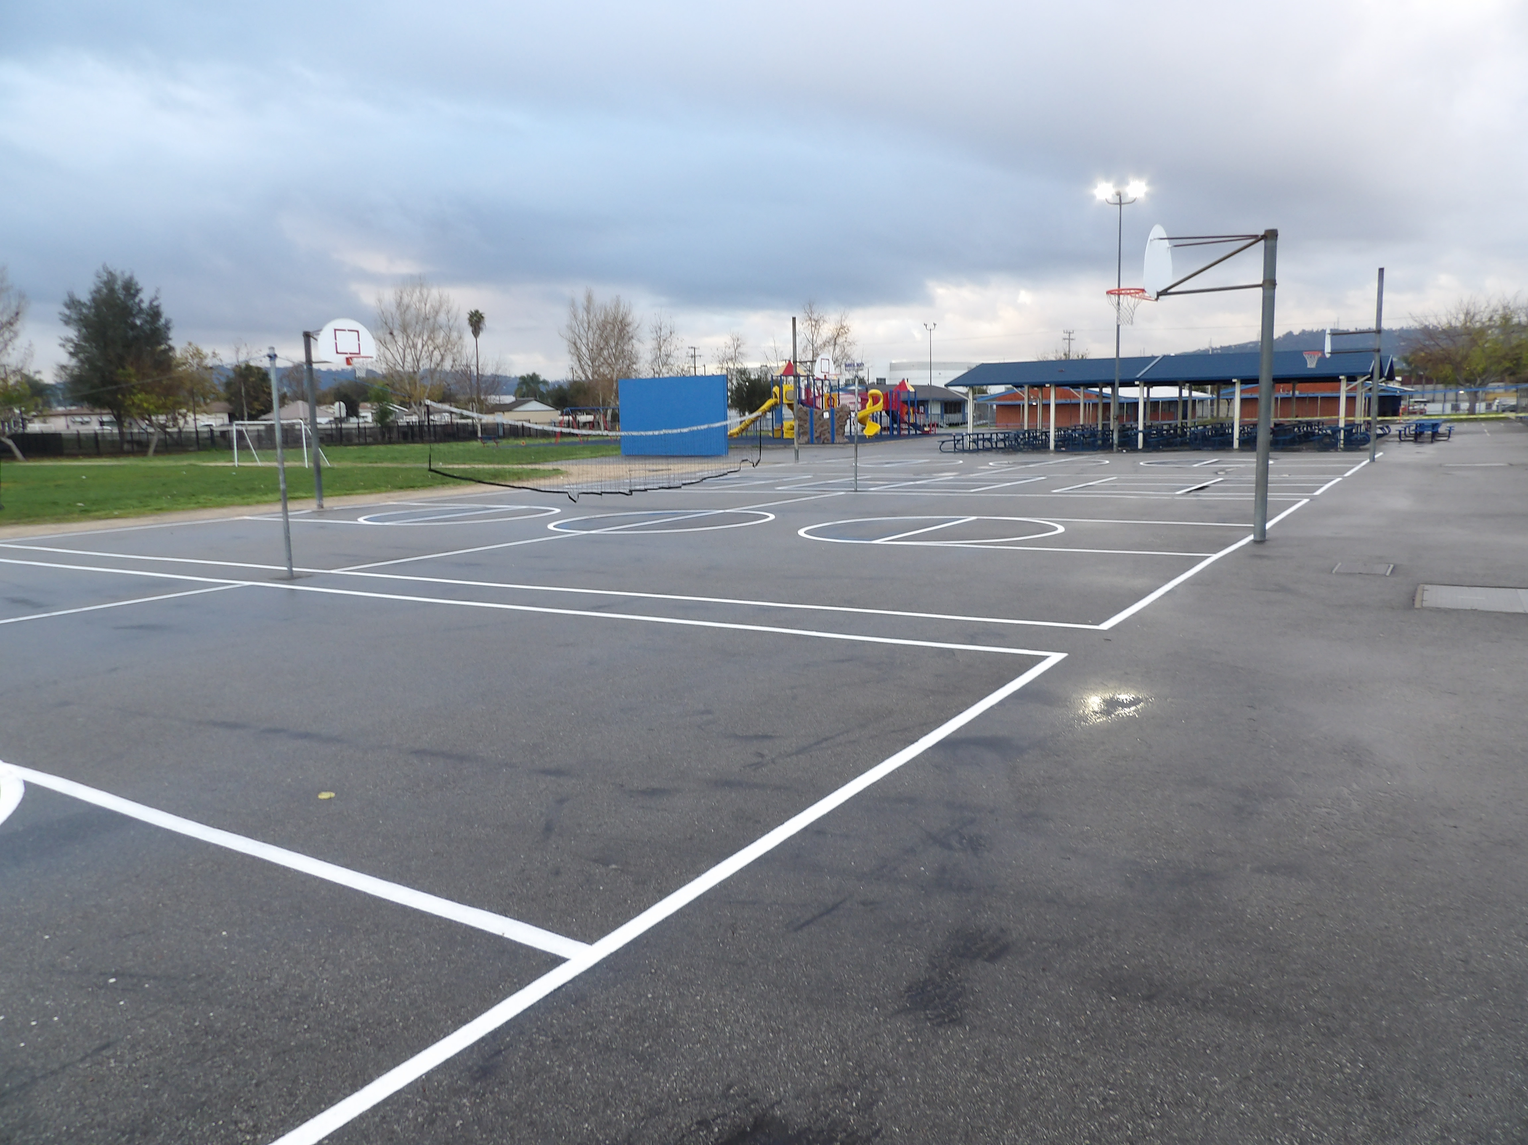
Projects Completed as of March 26, 2024 Baldwin Elementary Restriping Basketball Courts
BEFORE
AFTER
BEORE
AFTER

Slide 3
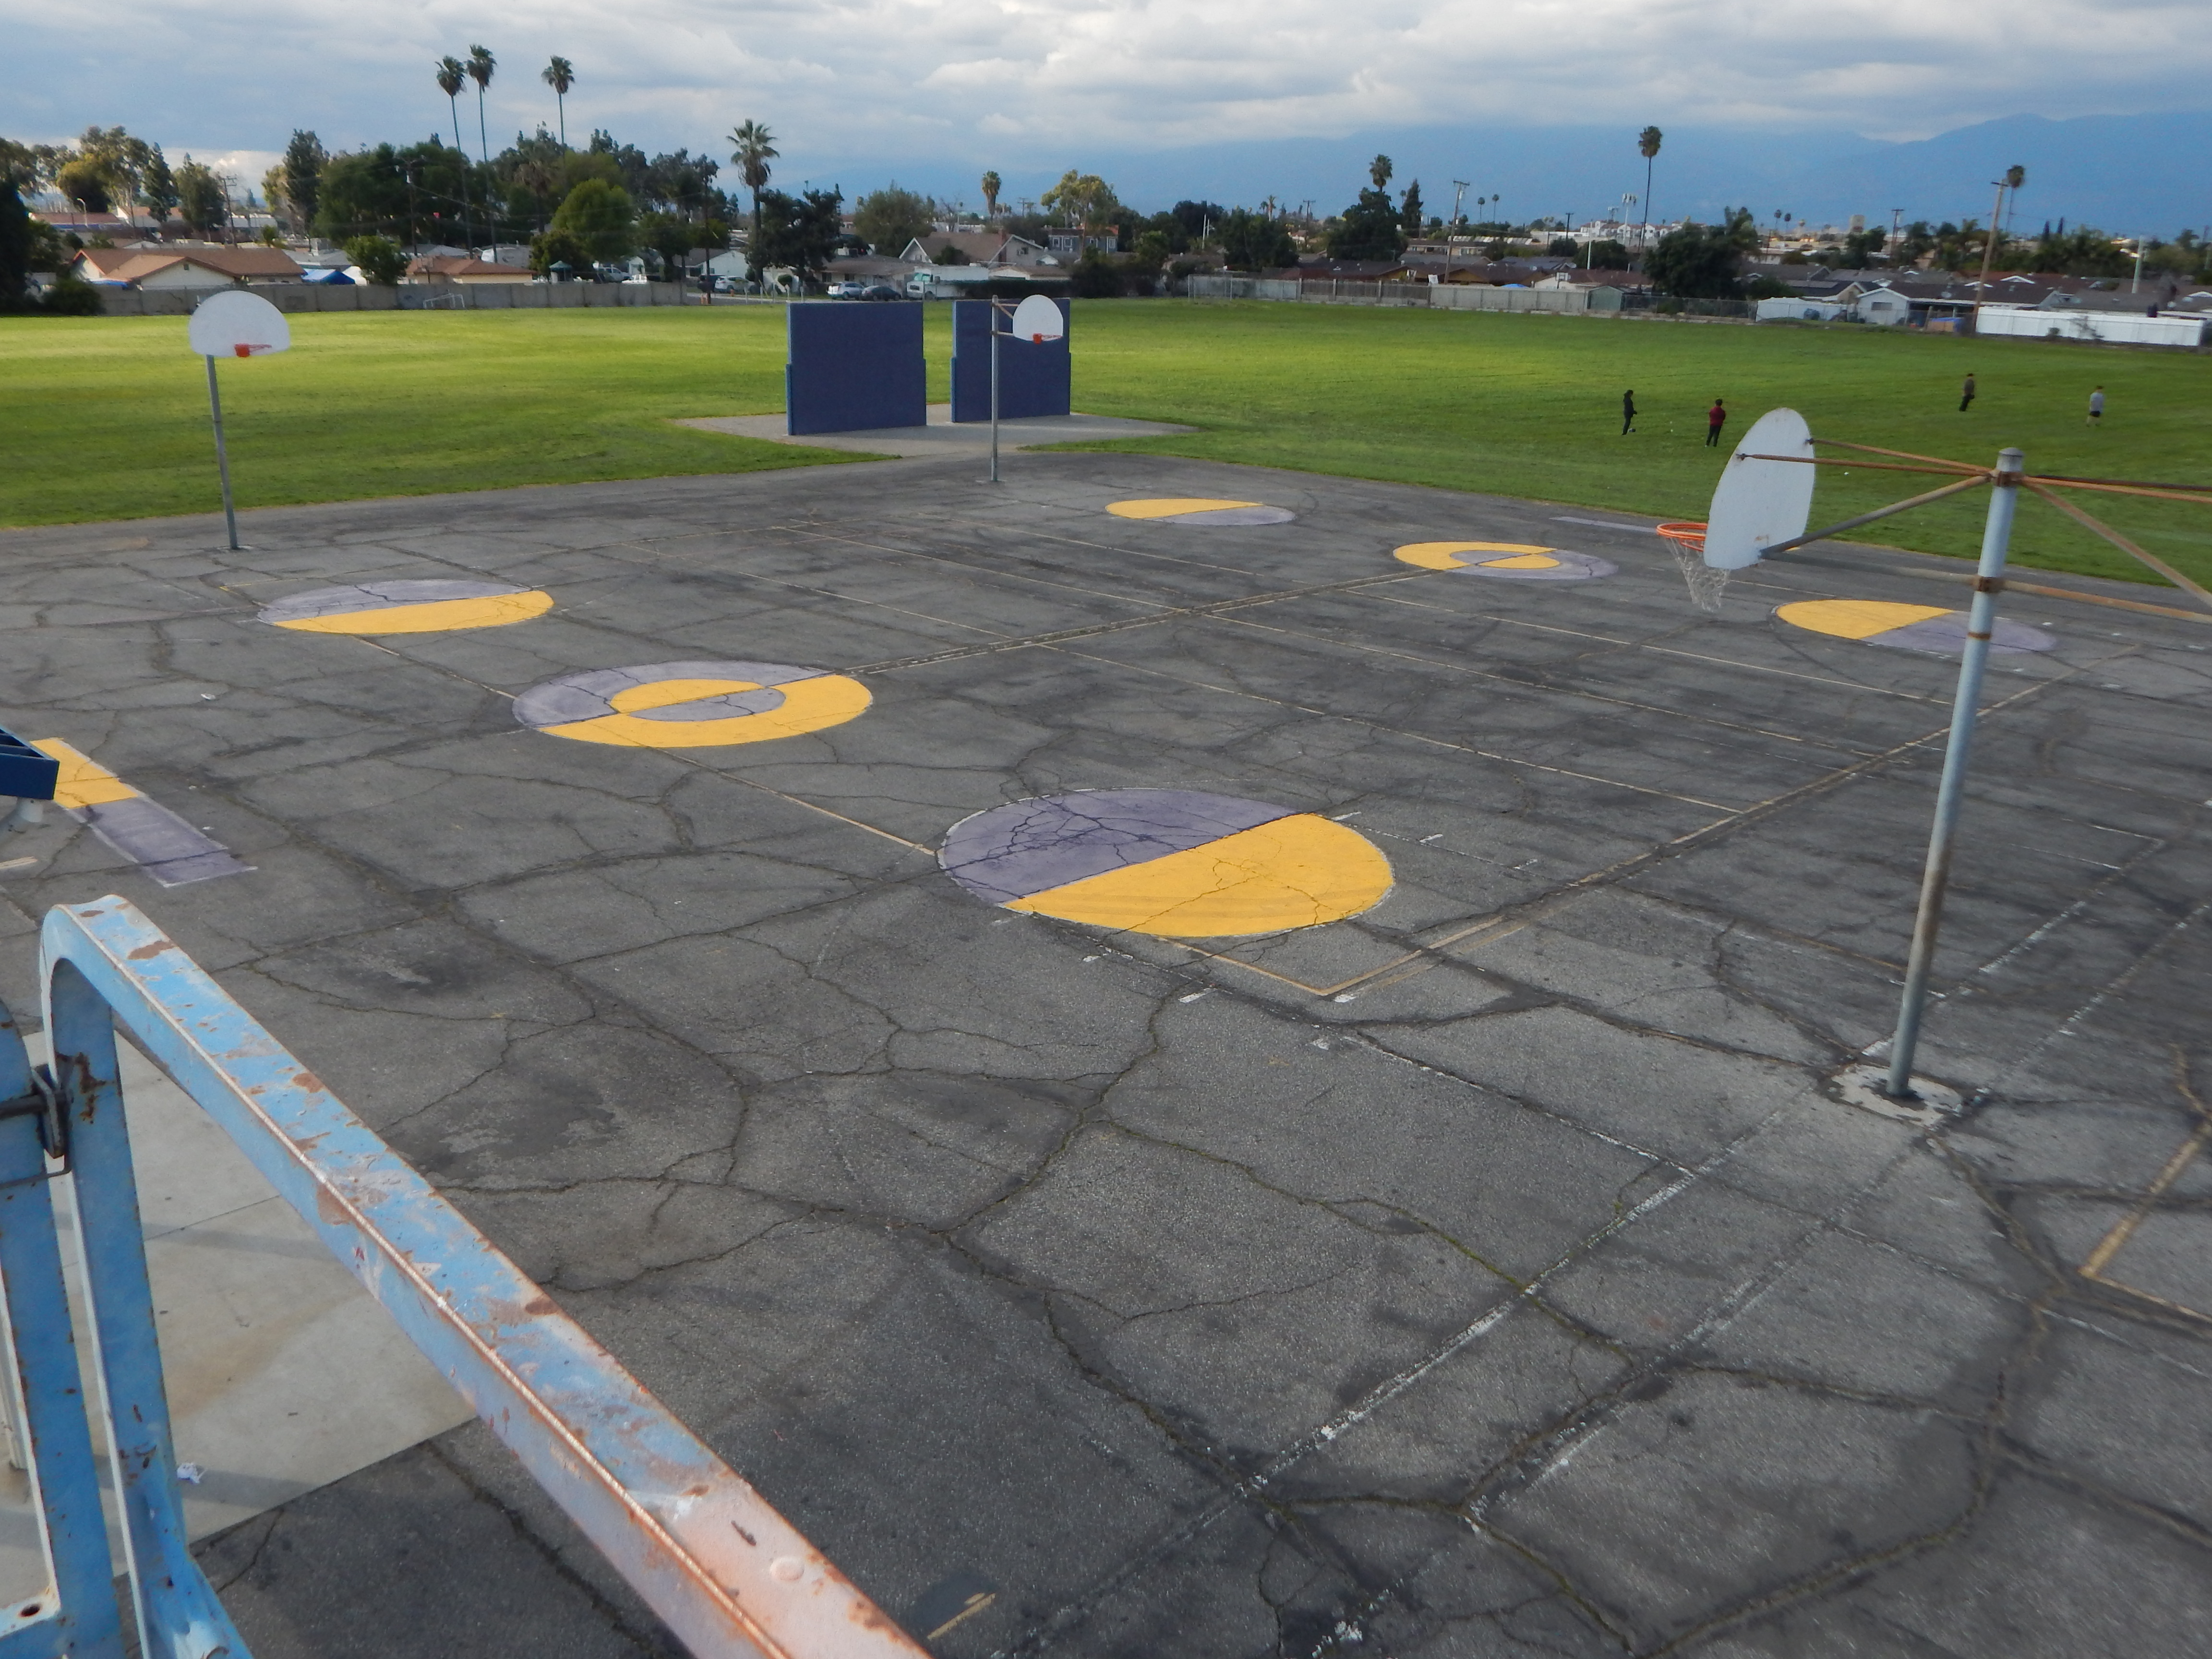
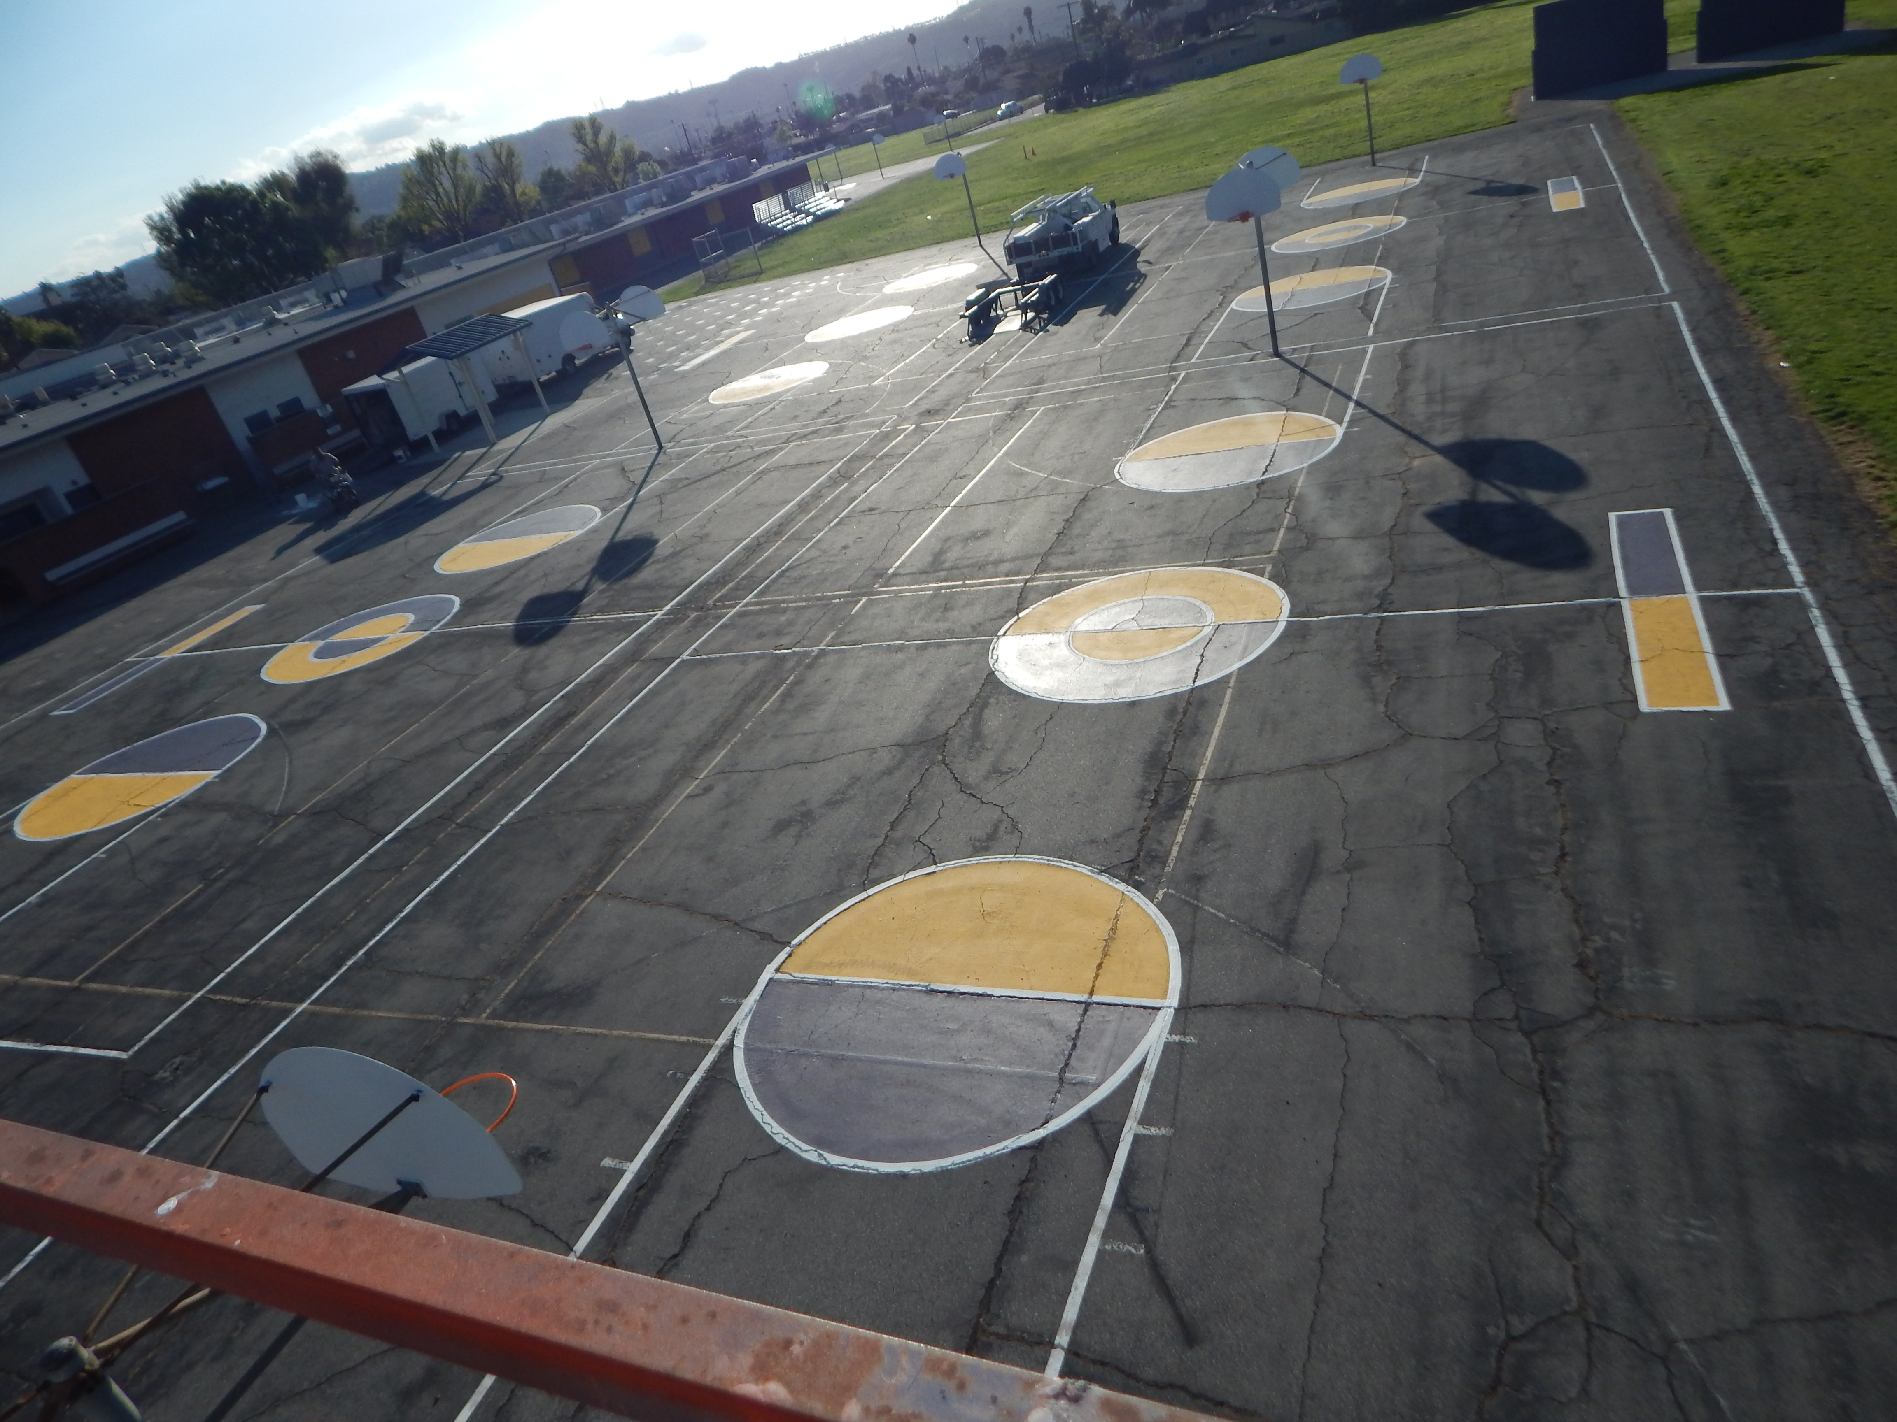
Projects Completed as of March 26, 2024 Sierra Vista MS Restriping Basketball Courts
BEFORE
AFTER
BEORE
AFTER

Slide 4
PROJECT COMPLETE LIST
2023-2024
Site | Item Description | Funding Source | Completed Date
Baldwin Elementary | Basketball Court Restriping | Facilities | 03/2024
California Elementary | Basketball Court Restriping | Facilities | 03/2024
Grazide Elementary | Basketball Court Restriping | Facilities | 03/2024
Kwis Elementary | Basketball Court Restriping | Facilities | 03/2024
Nelson Elementary | Basketball Court Restriping | Facilities | 03/2024
Palm Elementary | Basketball Court Restriping | Facilities | 03/2024
Winglane Elementary | Basketball Court Restriping | Facilities | 03/2024
Sierra Vista MS | Basketball Court Restriping | Facilities | 03/2024
California ES | Reroof Various Buildings | Deferred Maintenance | 03/2024
Cedarlane Academy | Reroof Various Buildings | Deferred Maintenance | 03/2024
District Office Bldg C | Reroof Various Buildings | Deferred Maintenance | 03/2024
Lassalette | Reroof Various Buildings | Deferred Maintenance | 03/2024
SSC (Sierra Vista) | Reroof Various Buildings | Deferred Maintenance | 03/2024
Sparks ES | Reroof Various Buildings | Deferred Maintenance | 03/2024
Stimson LC | Reroof Various Buildings | Deferred Maintenance | 03/2024
Valley Alt AS – CDS | Reroof Various Buildings | Deferred Maintenance | 03/2024
Workman ES 26/27 | Reroof Various Buildings | Deferred Maintenance | 03/2024
Workman HS | Reroof Various Buildings | Deferred Maintenance | 03/2024
Willow Adult Ed | Fire Alarm Installation | Adult Ed | 03/2024
Changes And Progress Since Last Report - Blue

Slide 5
Projects In Progress
2023-2024

Slide 6
Projects in Progress as of March 26, 2024
Facilities
Site | Item Description | Architect Plans | DSA Approval | Procurement | Construct | Funding Source | Target Completion Date
Los Altos High School | Reroof Various Buildings | NA | NA | Complete | In Progress | Deferred Maintenance | 05/2024
Wedgeworth | K-5 Permanent School | Complete | Approved | Complete | In Progress | COPS | 06/2025
Los Altos High School | Gym & Locker Room HVAC (65 tons of temporary HVAC units have been installed) | Complete | Approved | Complete | Pending | Approx. 3 months after DSA approval | Complete
Cedarlane Academy | Portable Installation | Complete | Pending | Pending | Pending | Facilities | TBD
Palm Elementary | Front of School Fencing | NA | NA | Complete | Pending | Facilities | TBD
Workman Elementary | Carpet Repair/Replacement in Front Office | NA | NA | Pending | Pending | Facilities | TBD
Changes And Progress Since Last Report - Blue

Slide 7
Projects in Progress as of March 26, 2024
Special Education
Site | Item Description | Architect Plans | DSA Approval | Procurement | Construct | Funding Source | Target Completion Date
Lassalette Elementary | Special Ed Playground | Pending | Pending | Pending | Pending | Special Ed | TBD
Adult Ed
Site | Item Description | Architect Plans | DSA Approval | Procurement | Construct | Funding Source | Target Completion Date
Willow Adult | Two-Story Medical Building | Complete | NA | Complete | Pending | Adult Ed | 04/2024
Dibble Adult | HVAC Replacement - MPR | Complete | NA | Complete | Pending | Adult Ed | 05/2024
Changes And Progress Since Last Report - Blue

Slide 8
Projects in Progress as of March 26, 2024
Child Development
Site | Item Description | Architect Plans | DSA Approval | Procurement | Construct | Funding Source | Target Completion Date
Winglane ES Headstart | Portable Installation | Complete | Approved | Complete | Pending | Child Development | TBD
Nelson Elementary School Head Start | Playground & Shade Structure | Complete | Approved | Pending | Pending | Child Development | TBD
Workman Elementary School Head Start | Playground & Accessibility Path of Travel | Complete | Pending | Pending | Pending | Child Development | TBD
Fairgrove Academy Headstart | Playground & Shade Structure | Complete | Approved | Pending | Pending | Child Development | TBD
Amar Center | Entry Security Project | Complete | Pending | Pending | Pending | Child Development | TBD
Sierra Vista - SSC | SSC Office Reception Counter | Complete | NA | Pending | Pending | Child Development | TBD
Changes And Progress Since Last Report - Blue

Slide 9
Projects in Progress as of March 26, 2024
Nutrition Services
Site | Item Description | Architect Plans | DSA Approval | Procurement | Construct | Funding Source | Target Completion Date
District Office | Warehouse Freezer | Complete | NA | Pending | TBD | Food Services | TBD
Wilson High School | Kitchen Modernization | Complete | Pending | Pending | TBD | Food Services | TBD
Mesa Robles Middle School | Kitchen Renovation | Complete | Pending | Pending | TBD | Food Services | TBD
Baldwin Elementary School | Kitchen Renovation - Three Compartment Sink Installation | Complete | NA | Pending | TBD | Food Services | TBD
Changes And Progress Since Last Report - Blue
Notes:
Kwis Baseball – Will be Re-Bid, uncertified entry was added to scope of work into the project.
Cedarlane Portable – In design phase with PBK architecture. Soils samples being conducted.
Willow Adult School = Two Story Building continues to be under construction. It coming along very well.

Slide 10
Projects with Division of State Architect (DSA) Waiting on Approval
Facilities
Site | Item Description | Architect Plans | DSA Approval | Procurement | Est. Construct Start | Target Completion Date
Los Altos High School | Stadium Press Box & Bleachers | Complete | Approved | Pending | TBD | TBD
La Puente High School | Custom Shade Structure | Complete | Pending | Pending | TBD | TBD
Wilson High School | Stadium Press Box & Bleachers | Complete | Pending | Pending | TBD | TBD
Workman HS | Phase II Stadium and Baseball Field (Phase I Track & Field and Softball Field Complete) OPTION B | Complete | Pending | Pending | Pending | TBD (14-18 months after Board approval of the Bid)
Changes And Progress Since Last Report - Blue
Notes:
Amar- In DSA, waiting for approval
LAHS- HVAC-
Press Box- working on the rehabilitation for DSA Approval
LPHS- Addressing DSA comments and awaiting approval
WIHS- Addressing DSA comments and awaiting approval
Wing Lane- Project Bid, waiting for Board Approval

Slide 11
Projects in Design
Site | Item Description | Architect Plans | DSA Approval | Procurement | Est. Construct Start | Target Completion Date
Districtwide | HVAC System Replacements | Pending | TBD | TBD | TBD | TBD
Changes And Progress Since Last Report - Blue
Notes:
Amar- In DSA waiting for approval
LAHS- HVAC-
Press Box- working on the rehabilitation for DSA Approval
LPHS- Addressing DSA comments and awaiting approval
WIHS- Addressing DSA comments and awaiting approval
Wing Lane- Project Bid, waiting for Board Approval

Slide 12
Next Report – May 26, 2024

