Slide 1
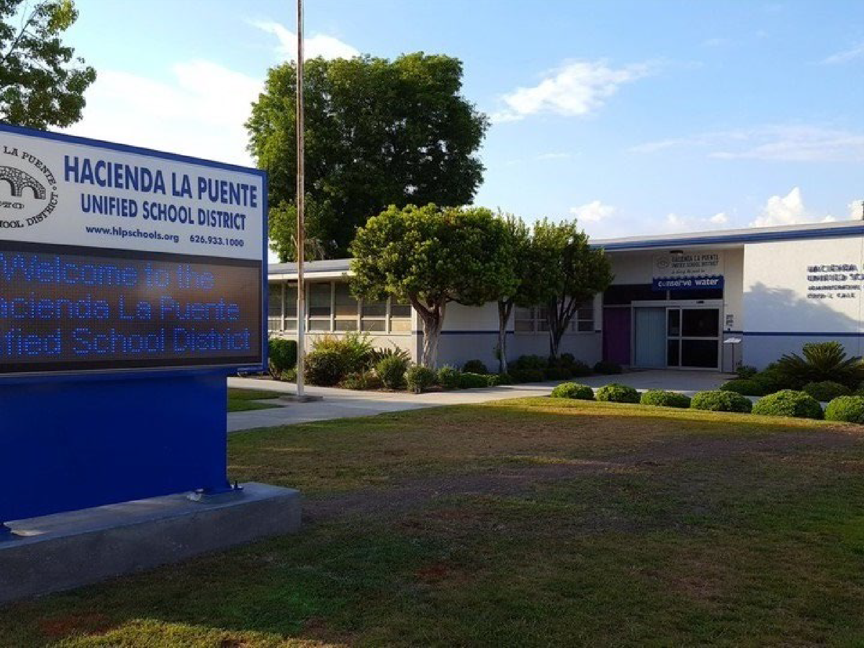
Hacienda La Puente Unified School District
CITIzens Bond Oversight Committee
2022 ANNUAL REPORT
For Measure BB

Slide 2
Message from the Citizens Bond Oversight Committee (CBOC) Chair
Dear Community Members,
It is my pleasure to submit the fifth annual report for Measure BB passed by the voters in November 2016 for $148 million.
This report covers bond activities during fiscal year July 2021 through June 2022. This report is intended to summarize the bond activities. For detailed information and full bond transparency, links to relevant information may be found on the District website at https://www.hlpschools.org/community/citizens-bond-oversight-committee-cboc. Historic context leading up to fiscal year 2022 activities or subsequent events which took place after 2022 may be included only as needed to explain and give context to activities and/or events.
The continued commitment from the Citizens Bond Oversight Committee (CBOC) is praiseworthy. These members volunteer their time reviewing numerous documents and data. The members who represent several different community groups engage in discussions that support bond transparency and accountability.
The annual report is organized into several sections for ease: Purpose of Annual Report, Measure BB information, CBOC Roles and Responsibilities, Financial information, 2022 Accomplishments, Annual Compliance Statement and CBOC Compliance Statement.
I am pleased to report that the District Staff along with Program Manager, Cummings, completed modernization projects at various School Sites across the district.
Sincerely,
Reina Schmitz
Chair

Slide 3
Citizens Bond Oversight Committee Members (2021-22)
Name | Representation
Leticia Covarrubias | Business Organization Member
Philip Kraft | Parent/Guardian of Child in District and Actively Involved
Gabriela Navar | Parent/Guardian of Child in District
Charlie Klinakis | Taxpayer Organization Member
Adria Ybarra | At-Large Community Member
Reina Schmitz | Senior Citizen Representative
Louis Perez | Senior Citizen Representative
Neal Noborio | Parent/Guardian of Child in District and Actively Involved
Olivia Roberts | At-Large Community Member

Slide 4
Purpose of this Report
The State of California requires Citizens’ Bond Oversight Committees to inform the public and taxpayers concerning the Proposition 39 (55% local school bond measures) expenditures and use of bond funds at least once a year.
ANNUAL STATEMENT COMPLIANCE REQUIREMENT
The 2022 CBOC Annual Report for the fiscal year ending June 30, 2022, is submitted to the Board of Trustees by the Committee in accordance with Education Code Section 15278 (b).
The Committee advises that, to the best of its knowledge based on available information provided by the District, HLPUSD is in full compliance with the requirements of Article XIIIA, Section 1 (b) (3) of the California Constitution.
INDEPENDENT AUDIT REVIEW
The auditor issued an unqualified opinion that no deficiencies or unallowable expenses were discovered that should not be charged to the Bond Program. The auditor also conducted a performance audit that concluded the District is in compliance with Measure BB. The audit was received and accepted by the Board of Trustees on January 12, 2023.

Slide 5
Measure BB Information
The Hacienda La Puente Unified School District bond program, funded by Measure BB is a $148 million general bond obligation passed by the board on August 11, 2016. The voters approved the measure at the November 2016 elections.
Measure BB voter approved expenditures
“To upgrade/repair all neighborhood school classrooms and retain/attract quality teachers by renovating all science, technology, engineering, art/math labs/classrooms, and athletic facilities; ensuring drinking water safety; repairing, constructing, equipping/acquiring educational facilities to prepare students for college and 21st century vocational jobs/careers, shall Hacienda La Puente Unified School District issue up to $148,000,000 in bonds at legal rates, requiring audits, citizens' oversight, no money for administrators' salaries, and all funds”
Proceeds from sale of bonds authorized by the Measure shall be used only for the purposes specified in the Measure, including but not limited to:
Repairing or replacing roofs, floors, plumbing, and electrical systems; Upgrading classroom technology; Repairing classrooms and school buildings; Providing and maintaining up-to-date technology infrastructure; Repairing athletic facilities and infrastructure; Automating fire alarm systems; Repairing fire safety equipment, and adding sprinklers and fire safety doors; Upgrading and installing security systems, such as security lighting, fencing, smoke detectors, and fire alarms; Upgrading emergency communication systems; Installing energy-efficient systems; Improving heating, ventilation, air-conditioning, and lighting systems, doors, and windows to increase energy efficiency; Upgrading and expanding wireless systems, telecommunications, and Internet and network connections; Upgrading electrical wiring, data networks, and broadband; Upgrading and replacing computers, hardware, and infrastructure systems, classroom and library technology, and teaching equipment.
Bond proceeds may not be expended on teacher and administrator salaries and non-bond operating expenses.

Slide 6
CBOC Roles, Responsibilities, Duties
Roles & Responsibilities of CBOC
The committee’s role is to review and report on District spending of taxpayers’ money for authorized expenditures per Bond Measure. The oversight committee’s purpose is to provide a public accounting of the District’s bond expenditures and report to the community whether the District complies with bond expenditure requirements. Committee members represent the community and appointed by the Governing Board.
Primary duties
Review bond expenditures to ensure that proceeds have been expended for the purpose set forth in Measure BB.
Inform the Public concerning the Districts expenditures of bond proceeds.
Present to the Districts Governing Board an annual report of the committee’s proceedings and activities of the previous year.
Provide a statement indicating whether the District is in compliance with bond requirements.

Slide 7
CBOC Membership, Bylaws
HLPUSD Bond Committee Membership
A two-year term: Members in good standing are eligible for up to three consecutive two- year terms.
Attendance at four quarterly meetings per year. Meeting dates are identified at the start of each year, and generally run between 60-90 minutes.
Participation in periodic campus facilities tours modernized under Measure BB to view construction projects in progress.
HLPUSD committee is comprised of at least 7 members and is appointed by the Governing Board.
CBOC bylaws
The DISTRICT adopted CBOC bylaws to clearly identify the oversight committee purpose, duties, activities, membership and other conditions. All CBOC meetings and the oversight members comply with the Ralph M. Brown Public Meetings Act. Above mentioned bylaws can be accessed via the following https://www.hlpschools.org/community/citizens-bond-oversight-committee-cboc

Slide 8
Financial Information
MEASURE “BB” GENERAL OBLIGATION BOND BUILDING FUND OF HACIENDA LA PUENTE UNIFIED SCHOOL DISTRICT
Balance Sheet
June 30, 2022
 | Measure "BB"
ASSETS
Deposits and investments | $ 32,501,174
Accounts receivable | $ 90,615
Total Assets | $ 32,591,789
LIABILITIES AND FUND BALANCE
Liabilities
Accounts payable | $ 512,529
Fund Balance
Restricted for capital projects | $ 32,079,260
Total Liabilities and Fund Balance | $ 32,591,789

Slide 9
Financial Information
MEASURE “BB” GENERAL OBLIGATION BOND BUILDING FUND OF HACIENDA LA PUENTE UNIFIED SCHOOL DISTRICT
Statement of Revenues, Expenditures, and Changes in Fund Balance
For the Fiscal Year Ended June 30, 2022
 | Measure "BB"
REVENUES
Other state revenues | $ (1,297)
Interest earnings | $ 209,168
Total Revenues | $ 207,871
EXPENDITURES
Current:
Salaries & benefits | $ (15,820)
Plant services | $ 1,733,978
Capital outlay | $ 3,079,997
Total Expenditures | $ 4,798,155
Net Change in Fund Balance | $ (4,590,284)
Fund Balance, July 1, 2020 | $ 36,669,544
Fund Balance, June 30, 2021 | $ 32,079,260

Slide 10
Outstanding General Obligation Bonds
District issued bonds of $70,000,000 (2017 Series A) on July 11, 2017.
The outstanding general obligation bonds of the Measure “BB” as of June 30, 2022.
Fiscal Year | Principal | Interest | Total
2022-2023 | $ 235,000 | $ 2,553,375 | $ 2,788,375
2023-2024 | $ 320,000 | $ 2,542,275 | $ 2,862,275
2024-2025 | $ 415,000 | $ 2,527,575 | $ 2,942,575
2025-2026 | $ 515,000 | $ 2,506,400 | $ 3,021,400
2026-2027 | $ 625,000 | $ 2,477,900 | $ 3,102,900
2027-2032 | $ 5,350,000 | $ 11,733,750 | $ 17,083,750
2032-2037 | $ 9,130,000 | $ 10,198,725 | $ 19,328,725
2037-2042 | $ 13,995,000 | $ 7,638,544 | $ 21,633,544
2042-2047 | $ 21,895,000 | $ 3,432,744 | $ 25,327,744
2047-2048 | $ 5,415,000 | $ 108,300 | $ 5,523,300
Total | $ 57,895,000 | $ 45,719,588 | $ 103,614,588

Slide 11
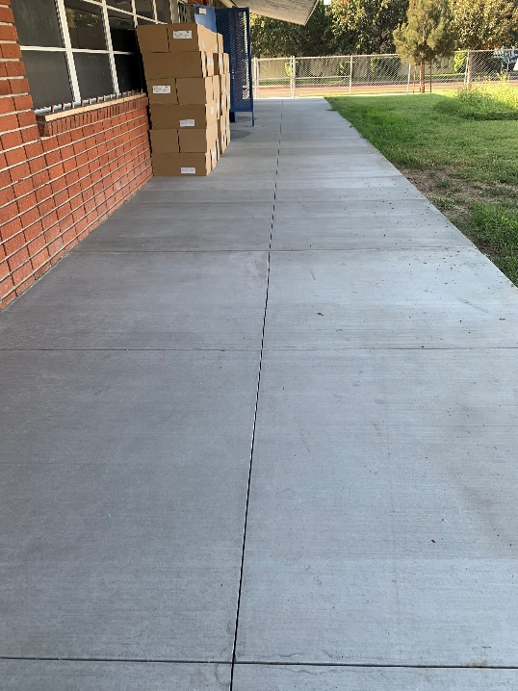
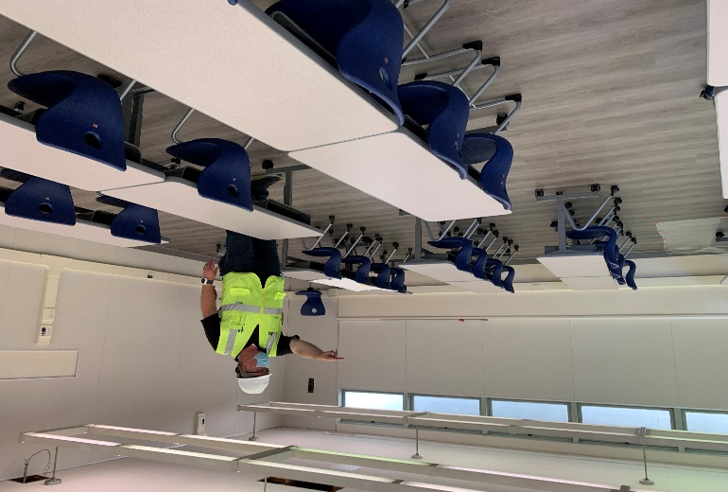
2021-2022 Accomplishments
Elementary School Sites
LOS ALTOS ELEMENTARY SCHOOL – 19 ROOMS CLOSED OUT AND CERTIFIED AT DSA
Interim Housing Completed
21st Century Classroom Completed
NELSON ELEMENTARY SCHOOL – 19 ROOMS
CLOSED OUT AND CERTIFIED AT DSA
21st Century Classroom Completed
WORKMAN ELEMENTARY SCHOOL – 19 ROOMS
CLOSED OUT AND CERTIFIED AT DSA
Interim Housing Completed
21st Century Classroom Completed
Los Altos ES
Nelson ES
Measure BB Bond Project Progress

Slide 12
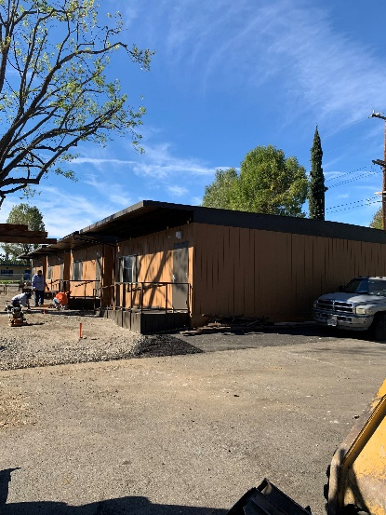
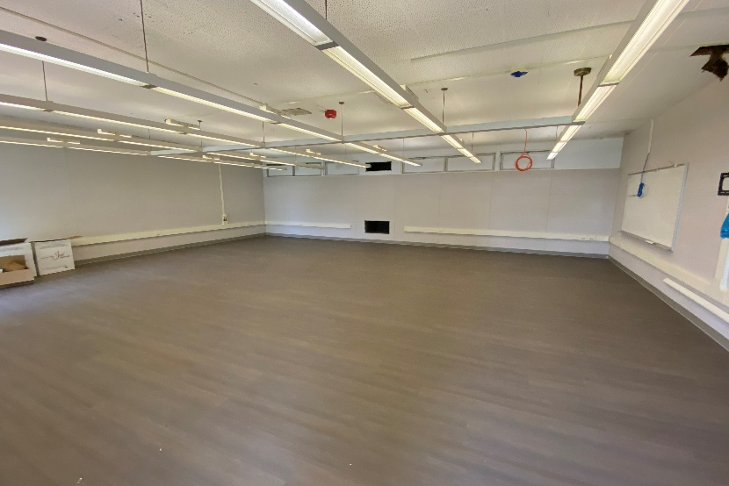
2021-2022 Accomplishments
Middle School Sites
DSA Approved 6-30-21:
SPARKS MIDDLE SCHOOL – 13 ROOMS
NEWTON MIDDLE SCHOOL – 21 ROOMS
Completed April 2022:
NEWTON MIDDLE SCHOOL – 4 INTERIM HOUSING CLASSROOMS
K-8 School Sites
MESA ROBLES K-8 SCHOOL
CLOSED AND CERTIFIED 10/21/22
Interim Housing Completed
(39) 21st Century Classroom Completed
CEDARLANE ACADEMY
CLOSED AND CERTIFIED 8/1/22
Interim Housing Completed
(25) 21st Century Classroom Completed
GRANDVIEW ACADEMY
DSA Approved 6-25-21
Los Altos ES
Newton
Nelson ES
Cedarlane
Measure BB Bond Project Progress

Slide 13
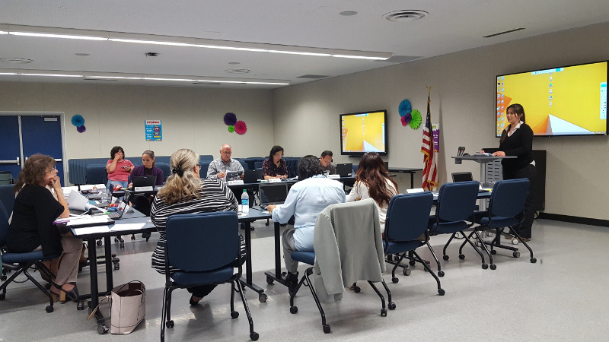
2022 Accomplishments
Projects Complete 21st Century Classrooms Completed:
Newton MS – 4 Interim housing rooms
Closed out and Certified at DSA:
Workman ES – 19 rooms
Los Altos ES – 19 rooms
Nelson ES – 19 rooms
Mesa Robles K8 – 39 rooms
Cedarlane Academy – 25 rooms
Technology Added to rooms
Signal Infrastructure Replacement with CAT 6 and CAT 6A Cabling
All New Power, Wiring and Outlets
Dual Wireless Access Points (WAPs) in Each Room
High Powered Compact Computer in Each Room
76” Interactive, Touch Screen, Monitor in Each Room
New Document Cameras in Each Room
Projects Initiated
For Bid in September 2022-2023 School Year
Grandview College Preparatory Academy
Newton Middle School
Sparks Middle School
Phases 3 and 4 Program & Construction Management
Architects Selected and Contracted.
Programming and Schematic Design Started
Baldwin Academy
California ES
Fairgrove Academy
Orange Grove MS
Los Molinos ES
Grazide ES
Stimson LC

Slide 14
Annual Compliance Statement
The District is subject to one annual audit of the bond program which require oversight from the CBOC. The audit is performed by an independent professional auditing firm according to published standards and guidelines.
DISTRICT Fiscal Year 2021-22 Financial audit report is included as a link to this report. The audit report combines both financial and performance audit.
Prop 39 requires a basic performance audit to determine whether:
Use of bond funds is restricted to construction, furnishings and equipment.
Bond funds are spent only on Listed Projects from their ballot measures.
The audit report reflects District compliance.

Slide 15
CBOC Compliance Statement
The voters of the community who approved the Bond Construction Program have been provided oversight and transparency through CBOC quarterly meetings including this annual report.
It is our opinion, based upon the District bond activities and a review of the independent financial and performance audits, that the District is in compliance with the requirements of Article XIIIA, Section 1(b)(3) of the California Constitution.
With the presentation of this Annual Report, the CBOC members are informing the HLPUSD Board of Education and voters that Measure BB bond expenditures have been properly made and have been utilized for projects consistent with those identified in the Bond Measure.

Slide 16
QUESTIONS

