Slide 1

Putnam is Open for Business!
Some Available Commercial Properties
April 2024
Town of Putnam
Economic & Community Development Department
Mary Ann Chinatti, Director 860-963-6800 x200
Maryann.chinatti@putnamct.us

Slide 2
Featuring:
#1 – 364 School St.
#2 – 26-28 Union St.
#3 – 465 School St.
#4 – 82-84 Providence St.
#5 – 333 Pomfret St.
#6 – 83 Canal St.
#7 – 181 Killingly Ave.
#8 – 20 Bates Ave.
#9 – 124 Pomfret St.

Slide 3
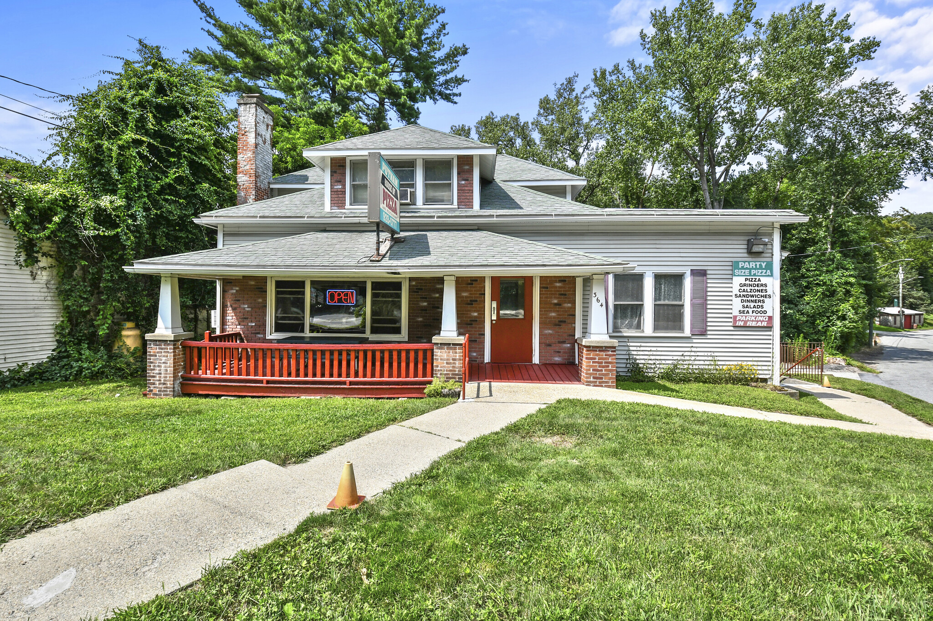
364 School Street
Zone: HC
Listed by: SR Commercial Realty
Contact: Paul Bonglornie
413-459-0579
BUILDING SIZE: 2,064 SF
Lot Size: 0.17
Year built: 1960
Living space upstairs
Parking in rear
Located in Opportunity Zone
$350,000
#1

Slide 4
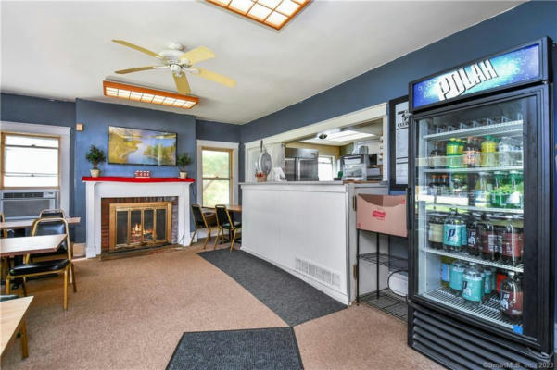
Dining Room / Counter Area
#1

Slide 5
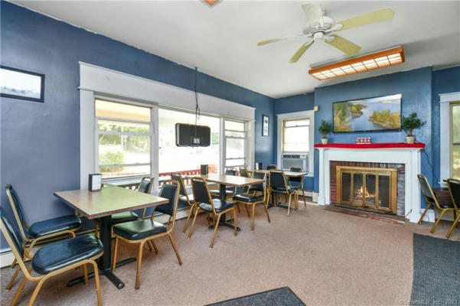
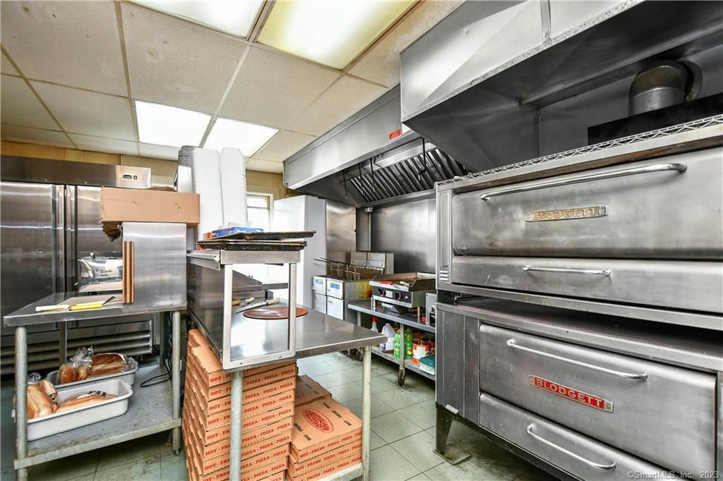
Dining room and Kitchen
#1

Slide 6
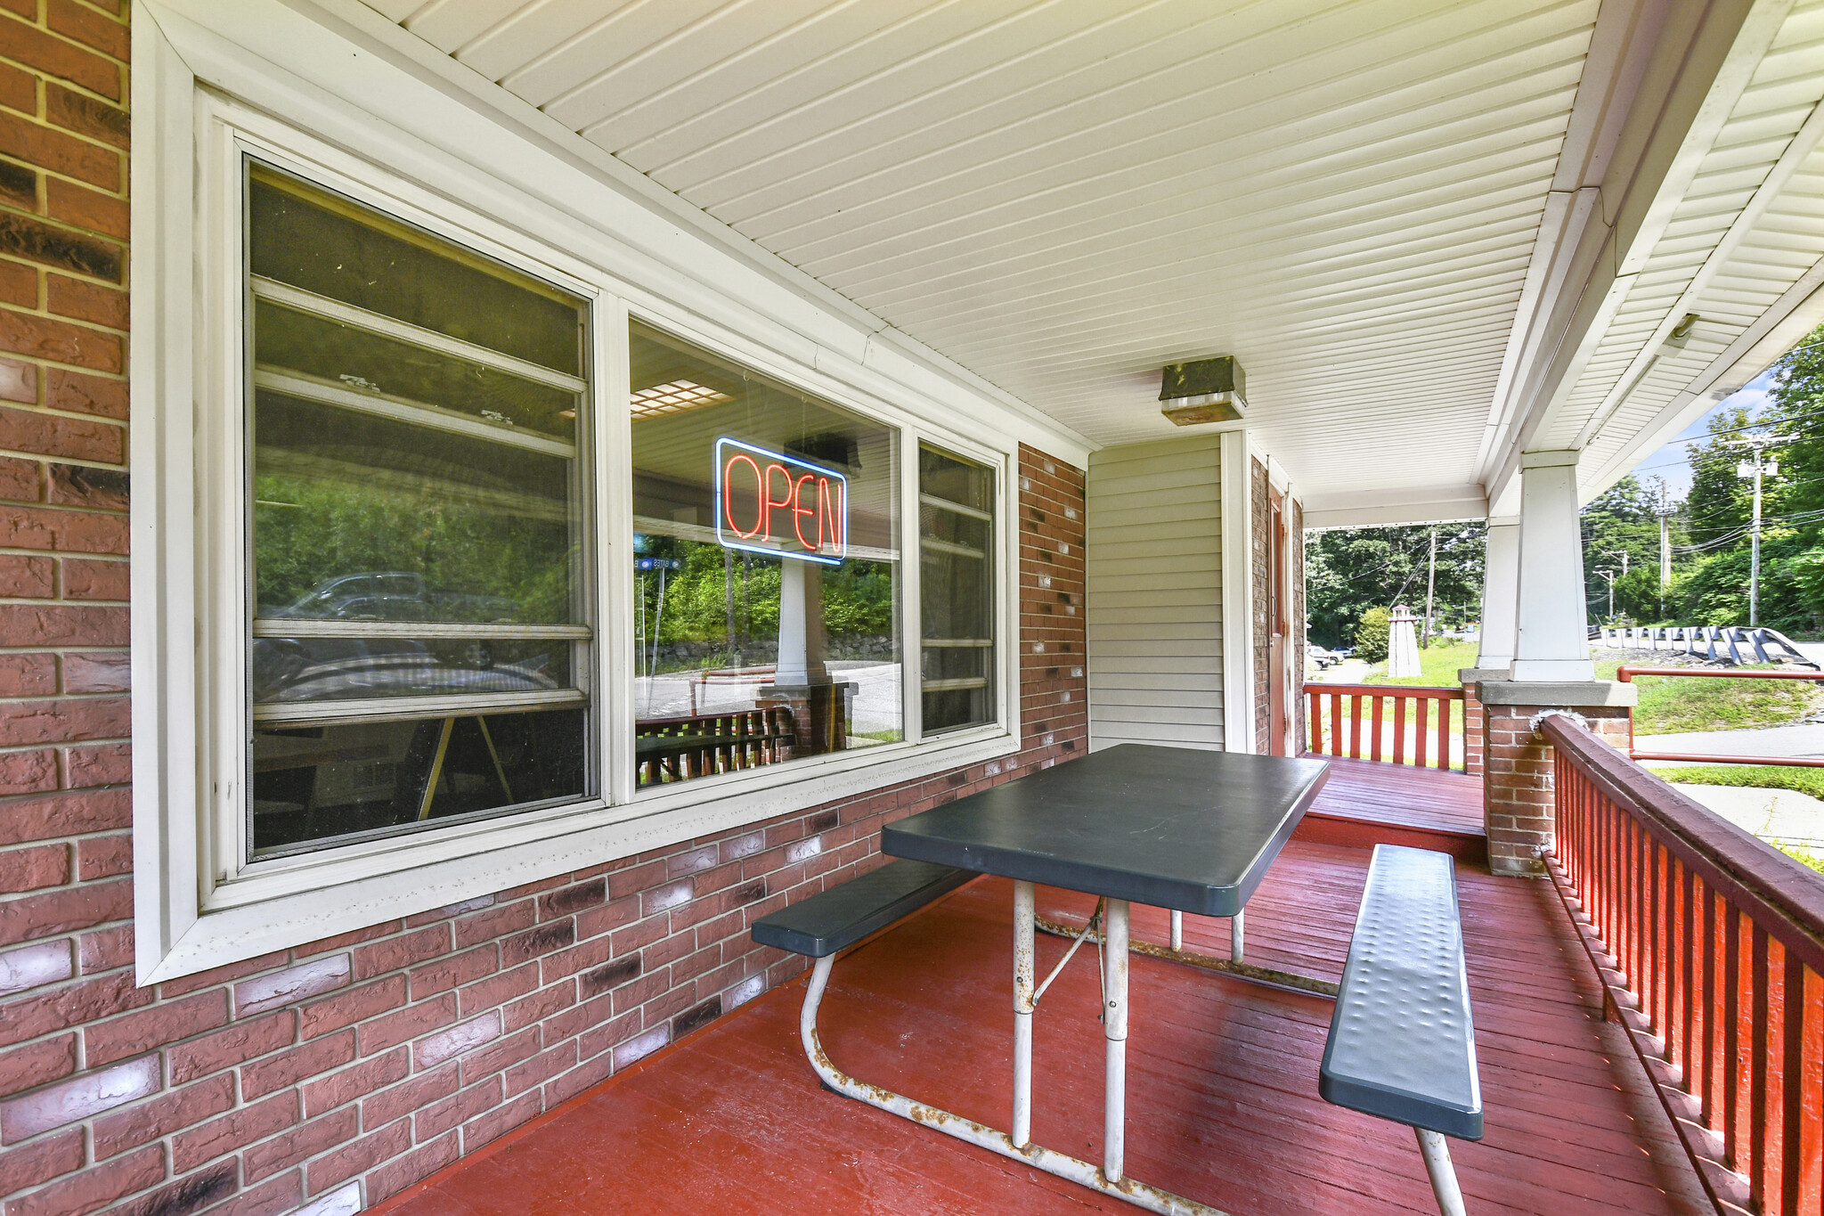
Outdoor dining
#1

Slide 7
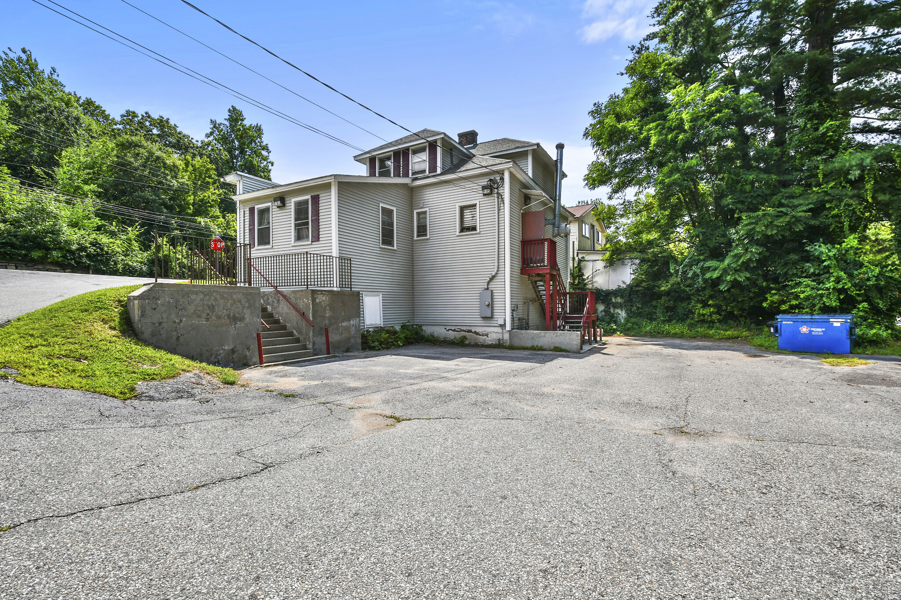
#1

Slide 8
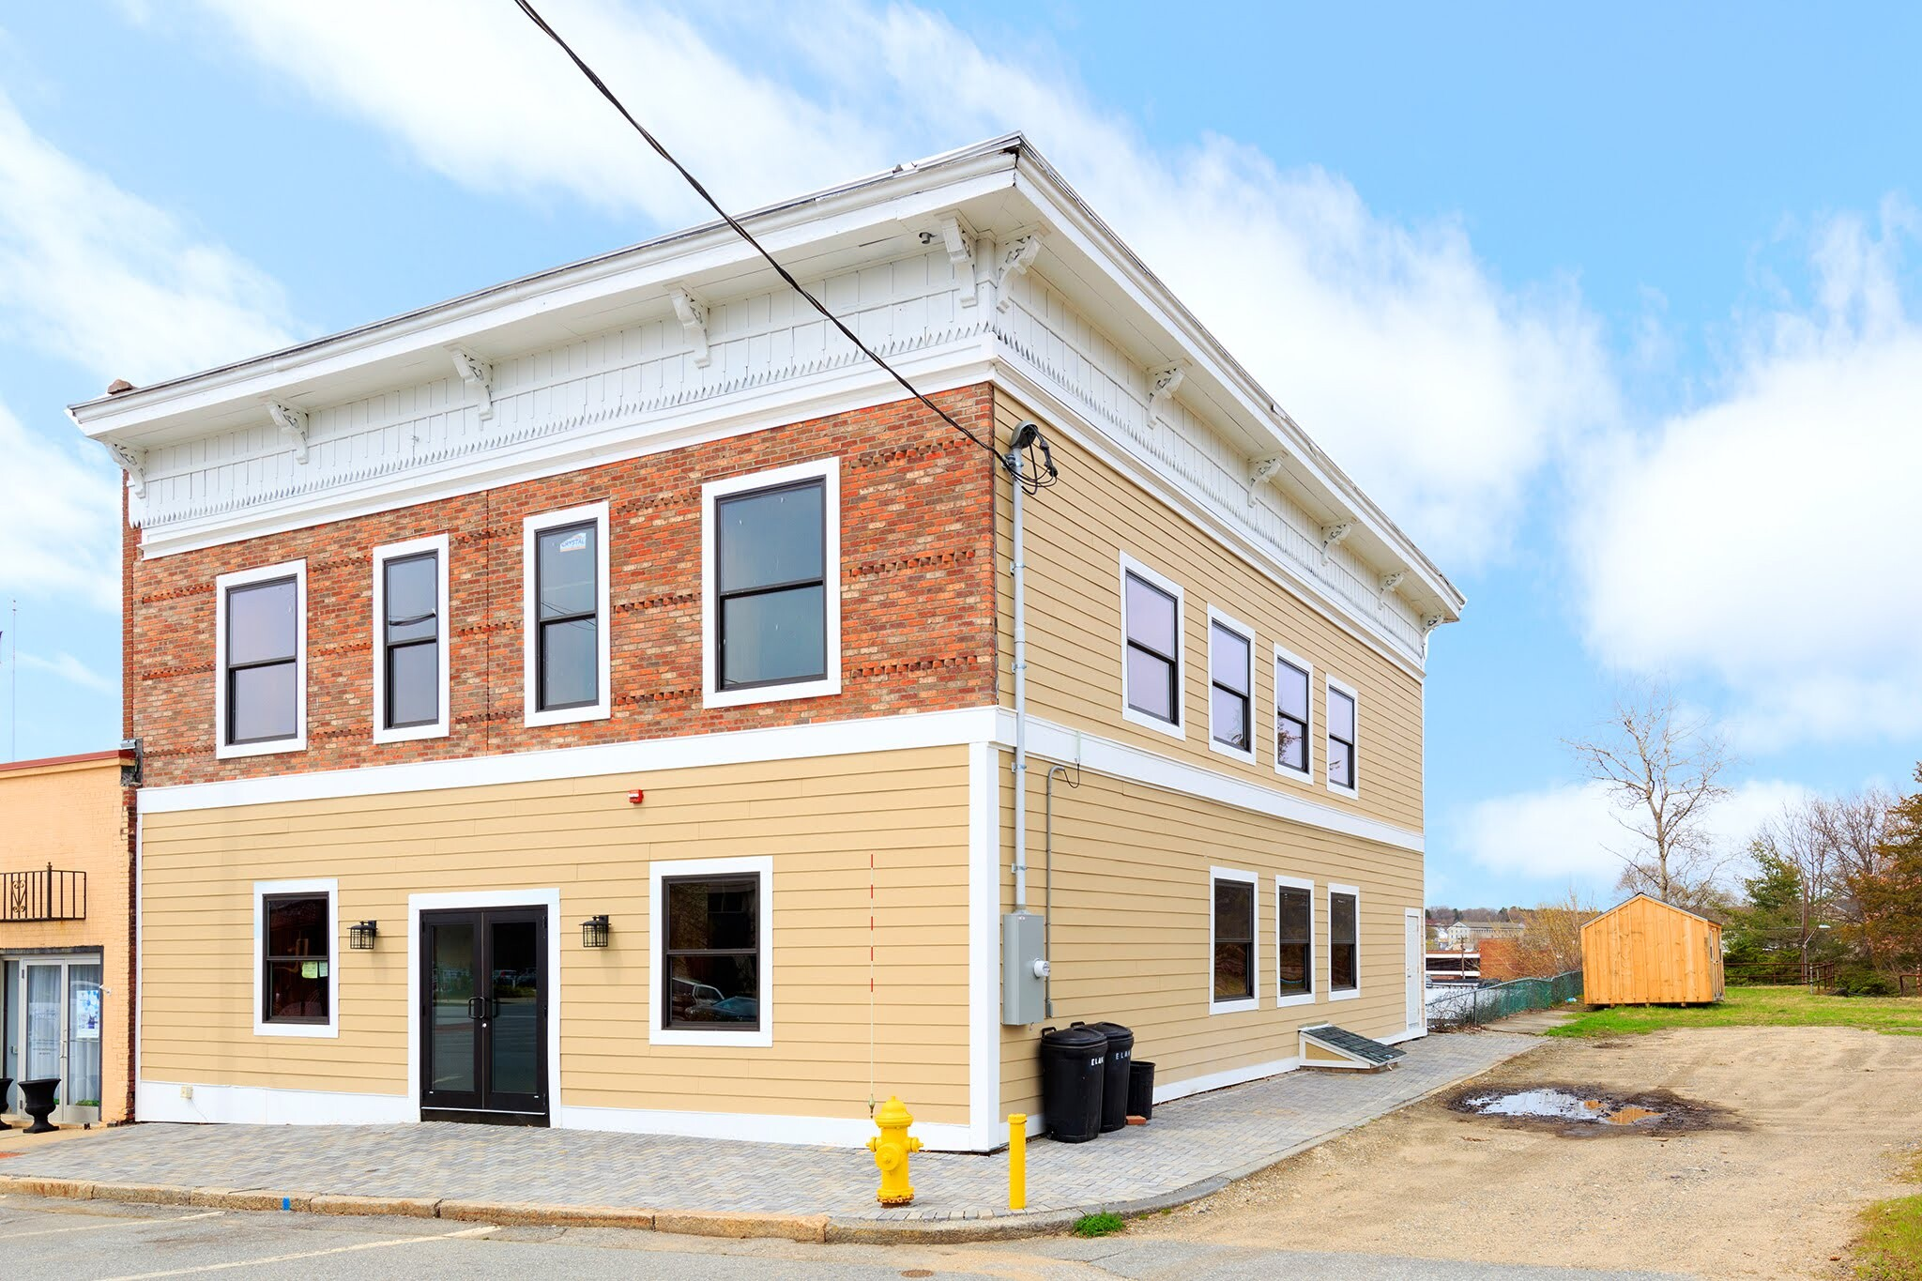
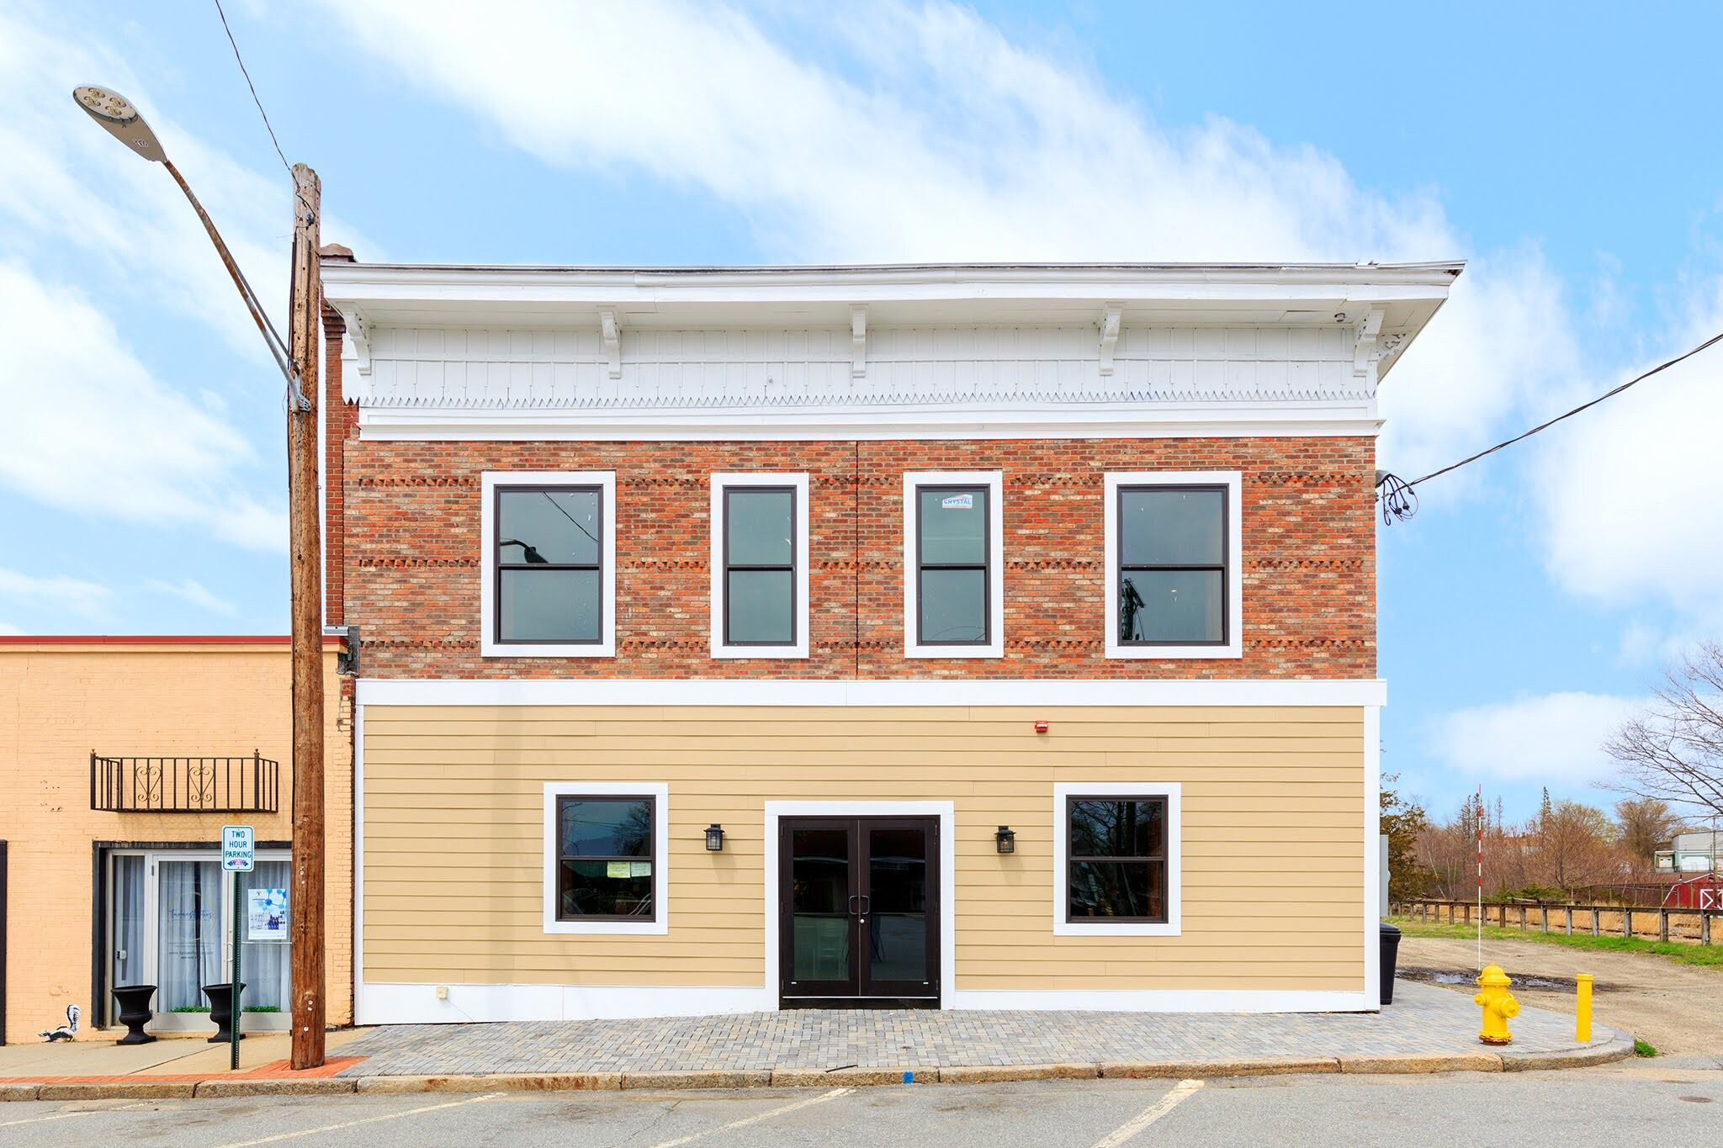
BUILDING SIZE: 5,194 sq. ft. 2-floors
LOT SIZE: .06 ac
LOCATED IN OPPORTUNITY ZONE
YEAR BUILT/RENOVATED: 1875/2019
SOME KITCHEN EQUIPMENT
3 WALK-IN FREEZERS/2 NEW
SECURITY SYSTEM, ACCENT LIGHTING, STORAGE SPACE, AIR CONDITIONING
$750,000
Location: 26-28 Union St.
Zone: PD
Listed by: Kazantis Real Estate
Contact: Andrea Kazantis
860-208-8331
#2

Slide 9
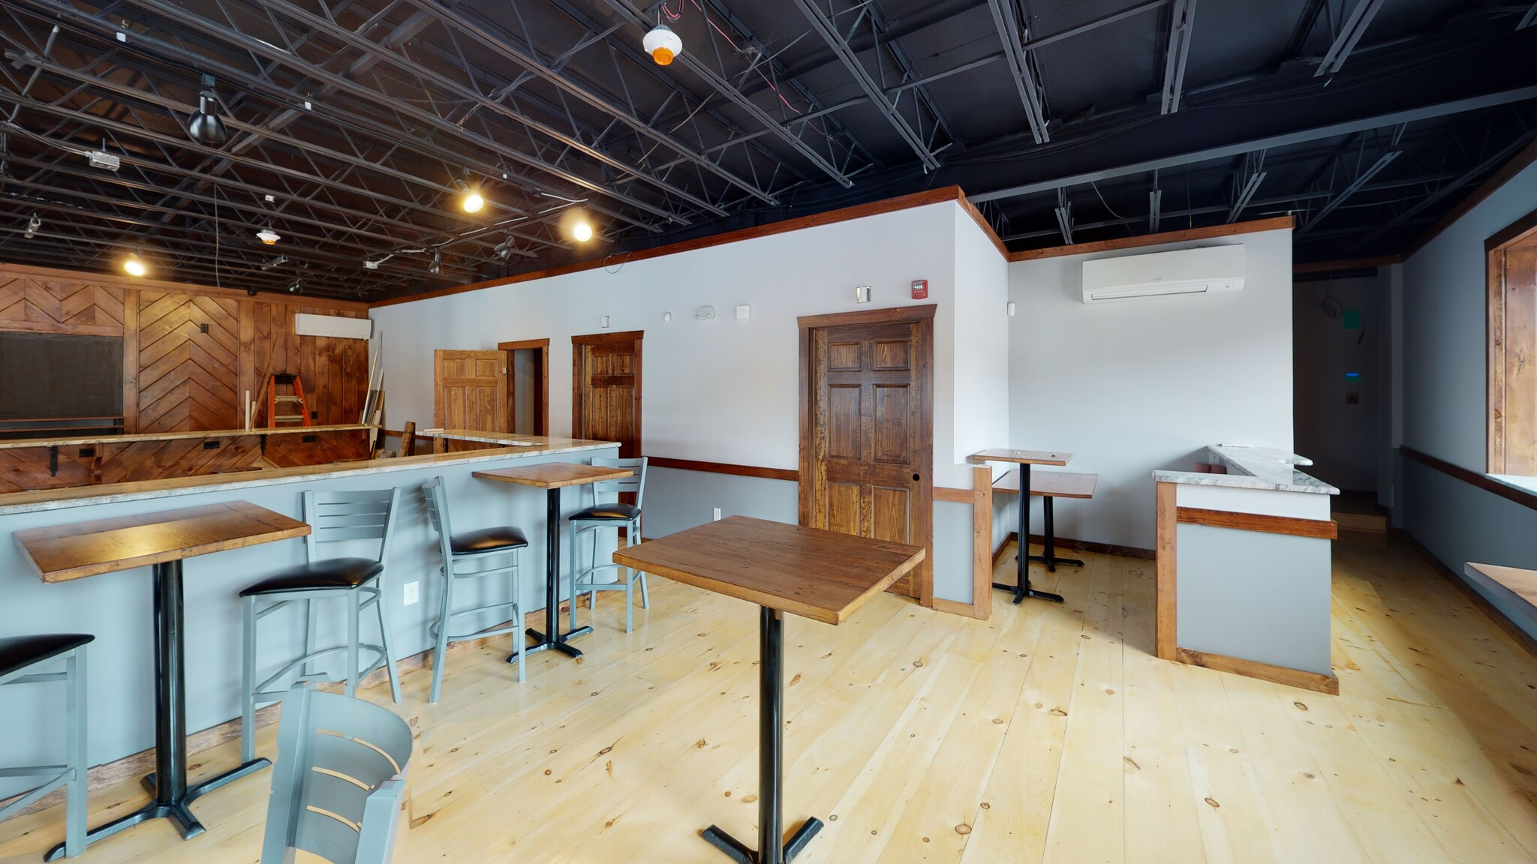
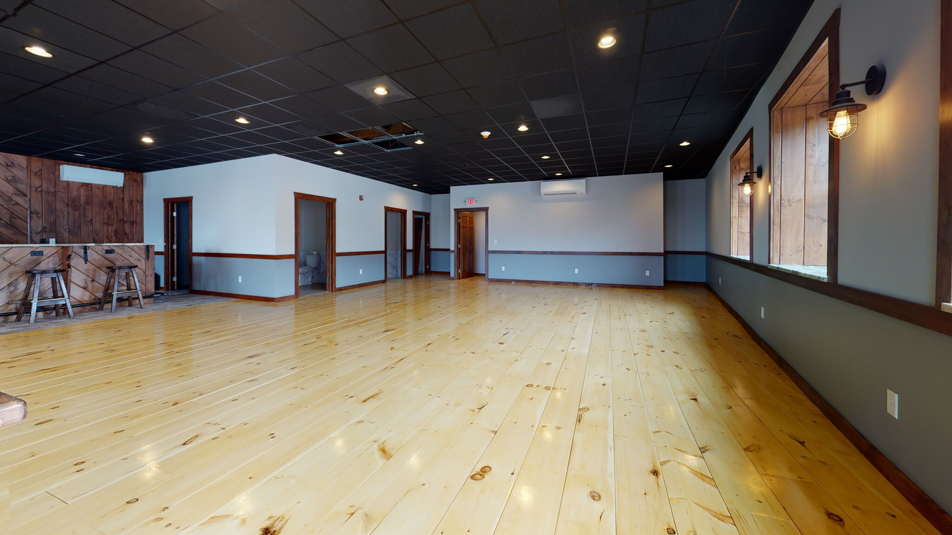
Main floor
#2

Slide 10
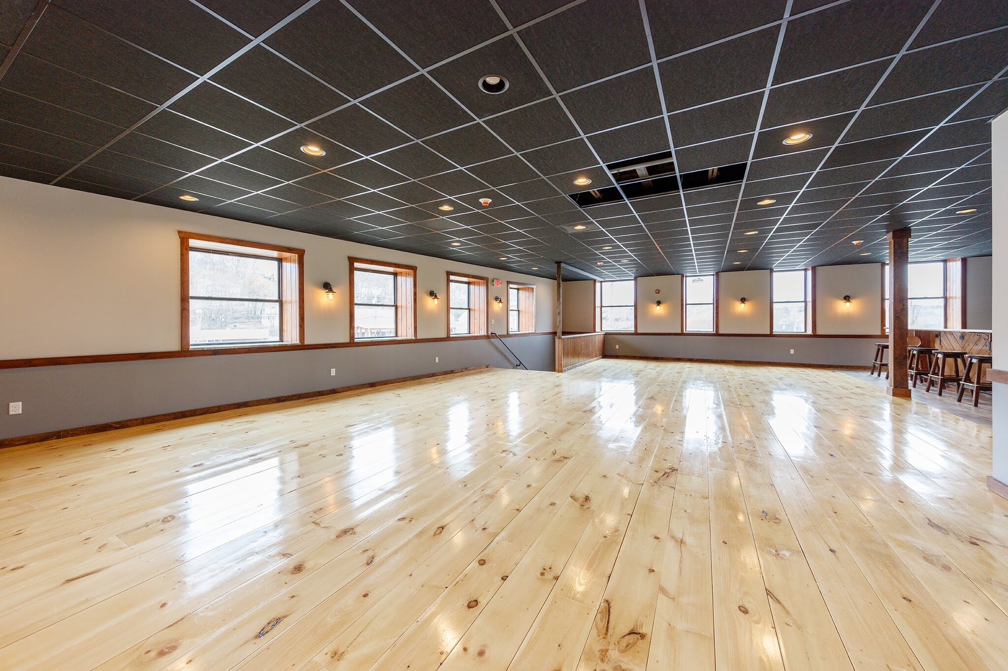
Upper floor
#2

Slide 11
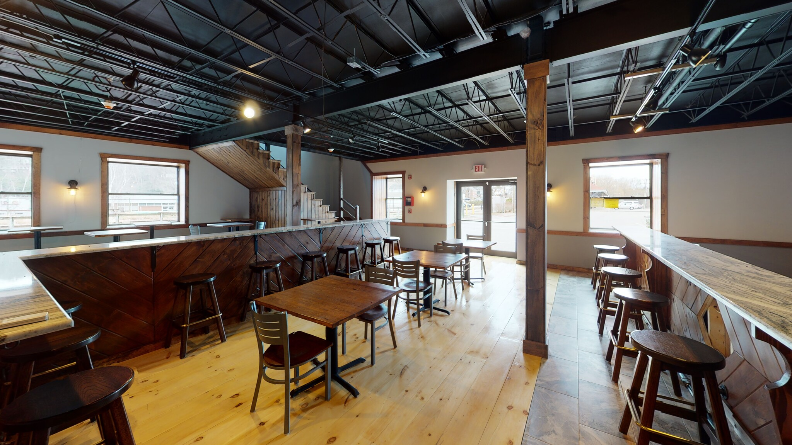
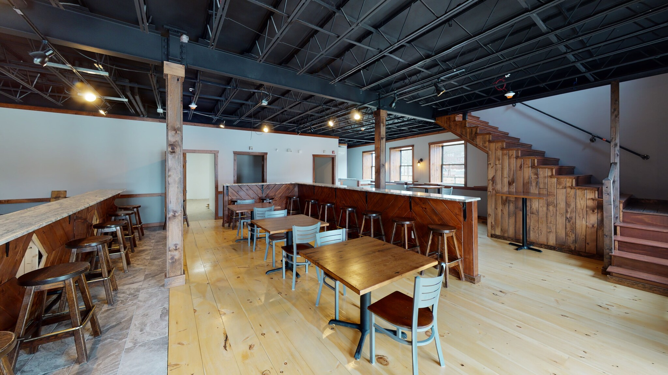
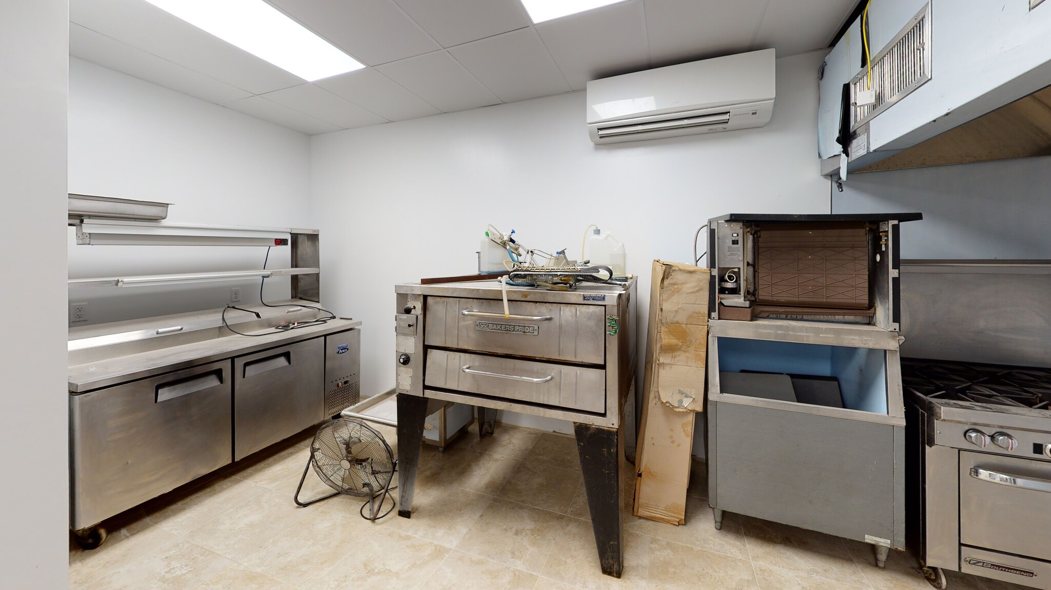
#2

Slide 12
Multi-Family 40 Units Proposed
465 School St.
FOR SALE
$250,000
⇒ Acres: 9.8
⇒ Opportunity Zone
⇒ Public Water & Sewer Available
⇒ Prior Wetlands Approval, (has since expired)
⇒ Frontage: 50 Ft.
⇒ Zone: R-10
#3

Slide 13
RON LYMAN
Main Office: 1160 Boston Post Rd. Westbrook, CT 06498 Mailing Address: 73 Second Ave. Westbrook, CT 06498 860-887-5000 Office ronl@lymanre.com
LYMAN REAL ESTATE BROKERAGE & DEVELOPMENT
www.LymanRE.com
#3

Slide 14
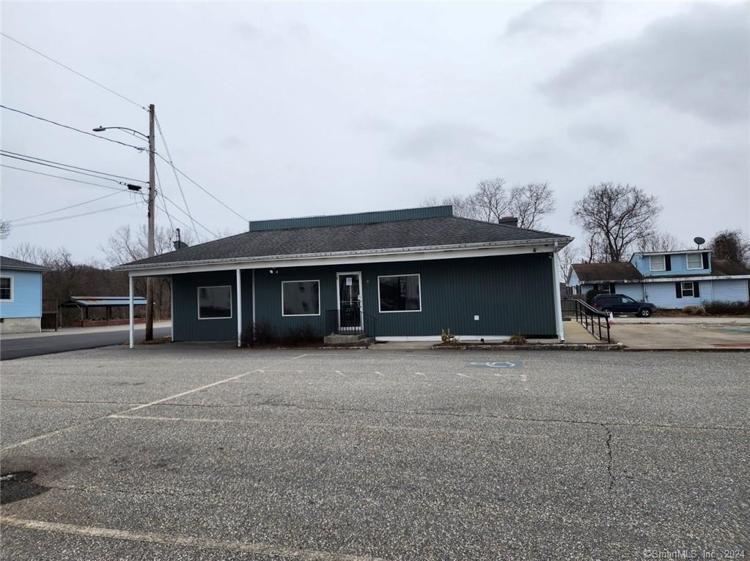
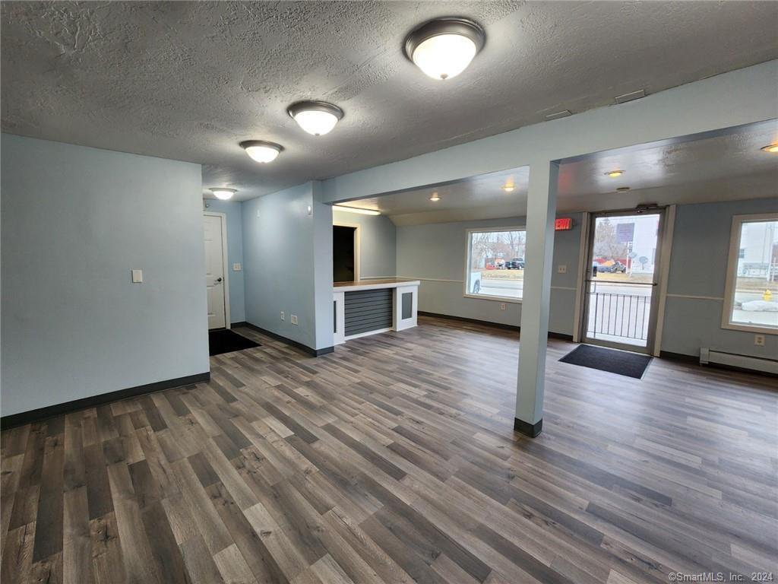
Location: 82-84 Providence St.
Zone: GC
Listed by: CR Premier Properties
Contact: Kerri Mullen
860-481-5605
2 BUILDINGS ON 1 LOT
UNIT 1: 1140 SQ FT
UNIT 2: 1440 SQ FT
LOT SIZE: .27 AC
YEAR BUILT: 1950
12 PARKING SPACES
$399,000
#4

Slide 15
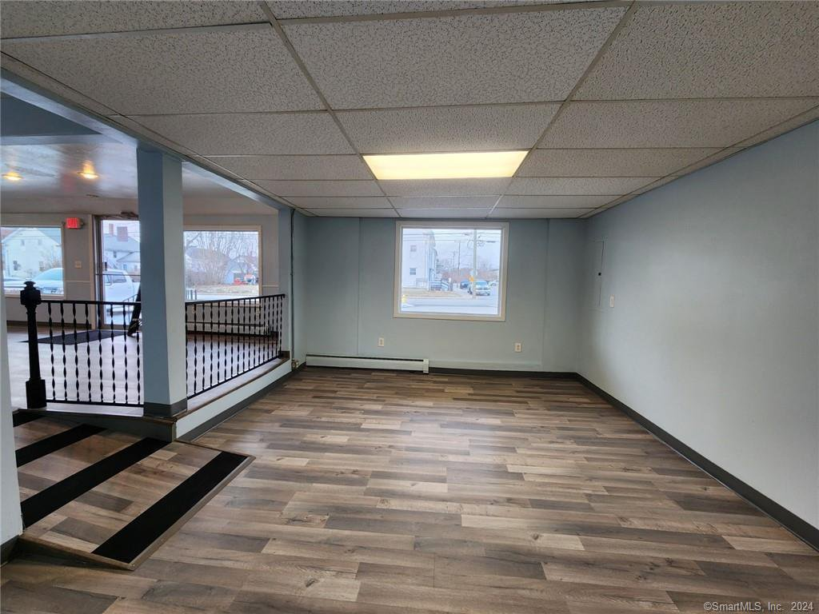
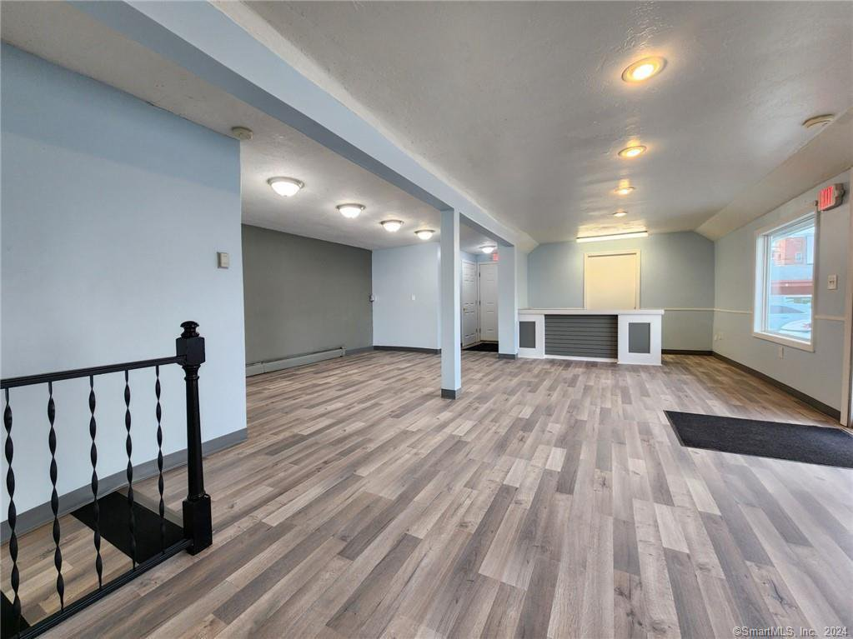
#4

Slide 16
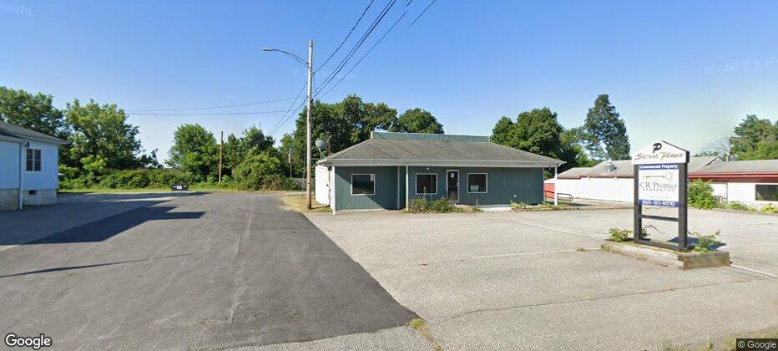
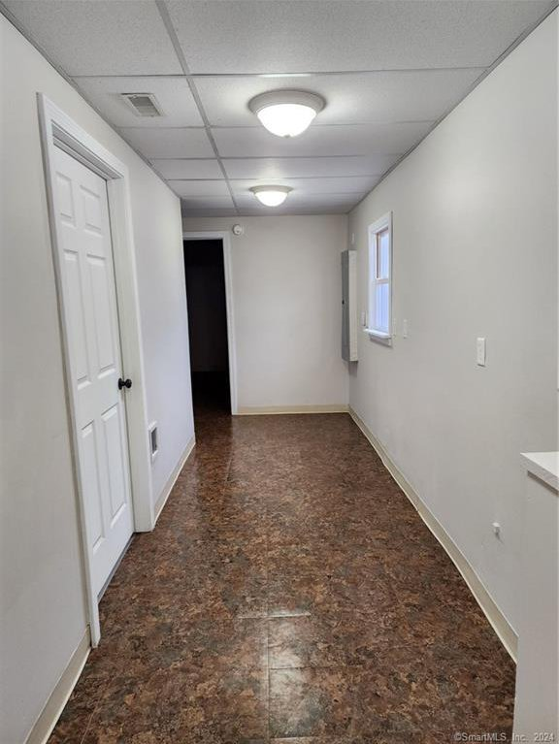
#4

Slide 17
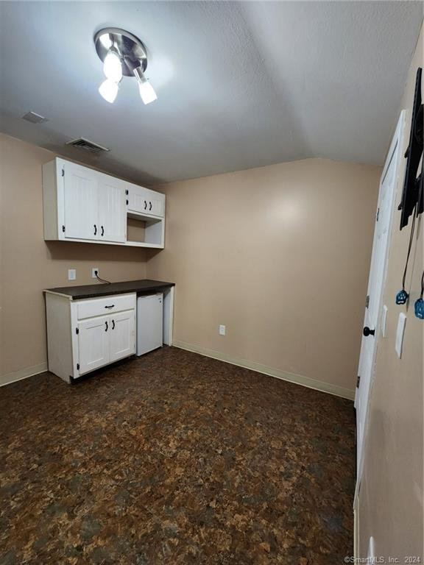
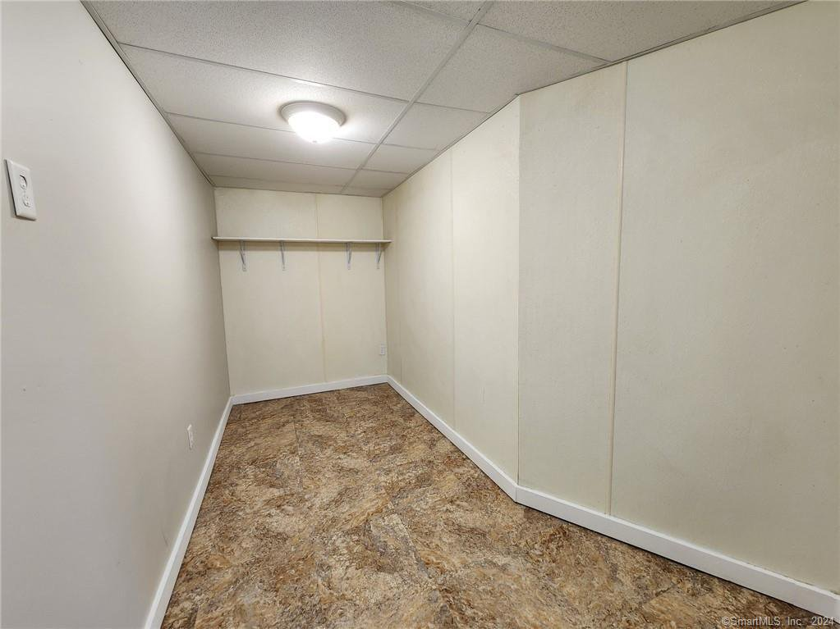
#4

Slide 18
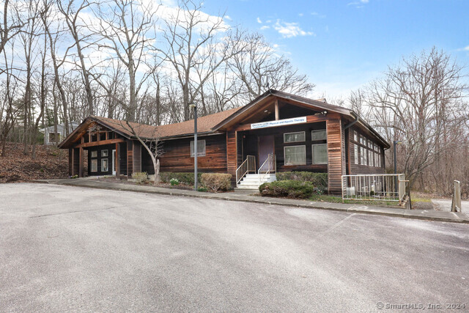
Location: 333 Pomfret St.
Zone: M/OD
Listed by: Chabot & Assoc.
Real Estate
Contact: Tony Chabot
508-847-0902
BUILDING SIZE: 8,062 SQ FT
LOT SIZE: 1.5 AC
YEAR BUILT: 1983
LOCATED ACROSS THE STREET FROM DAY KIMBALL HOSPITAL
WALK-OUT GROUND LEVEL UN-
FINISHED SPACE
PLENTY OF PARKING
$695,000
#5

Slide 19
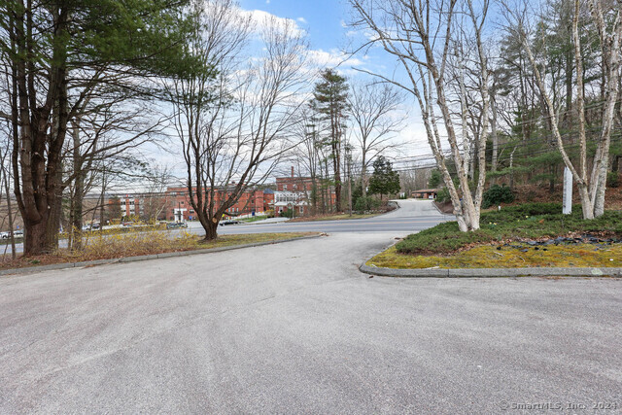
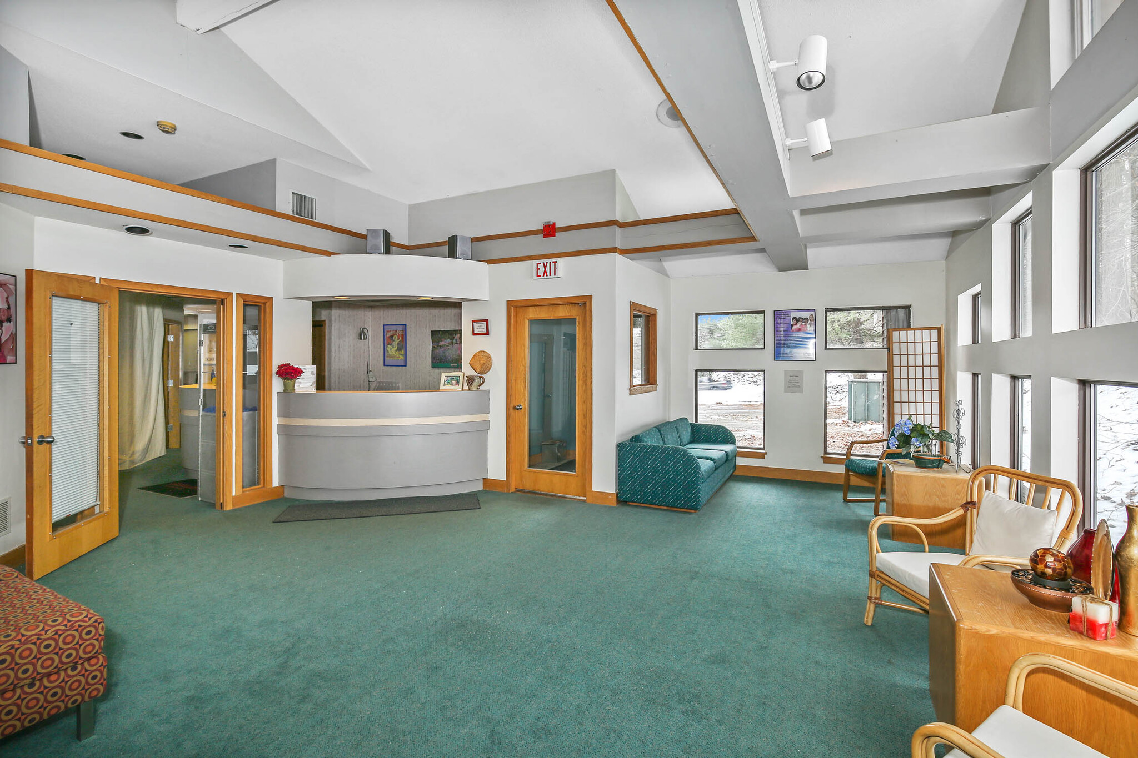
#5

Slide 20
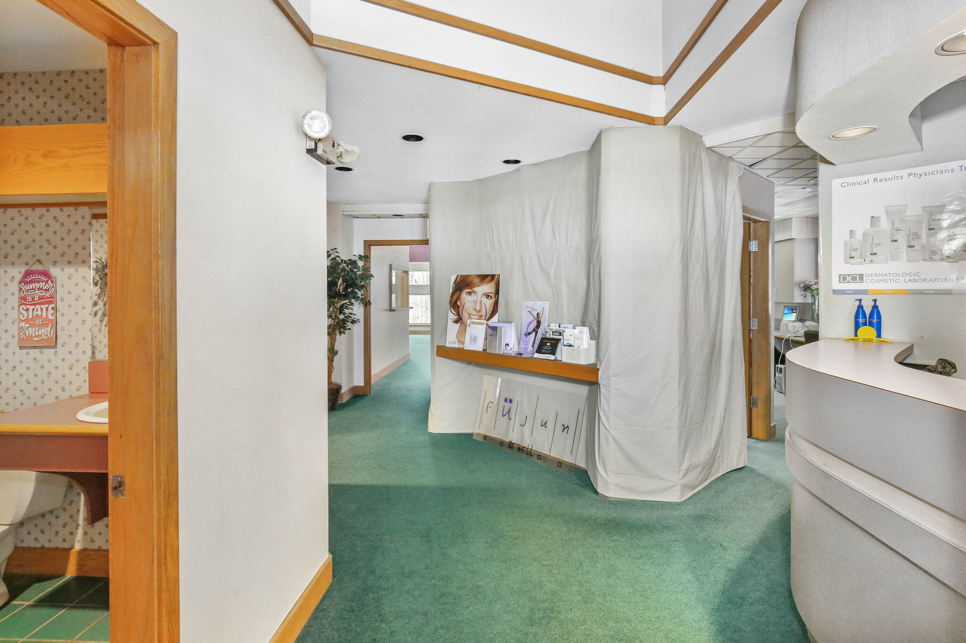
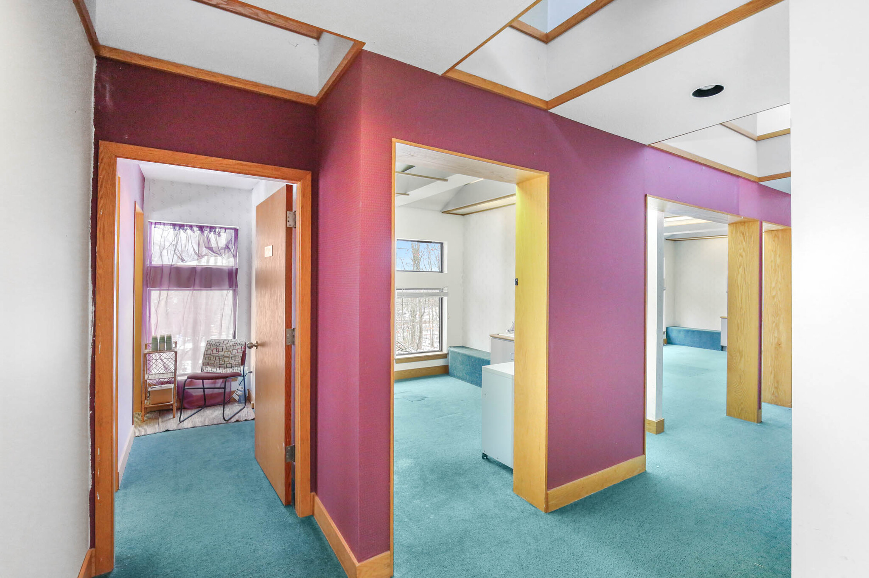
#5

Slide 21
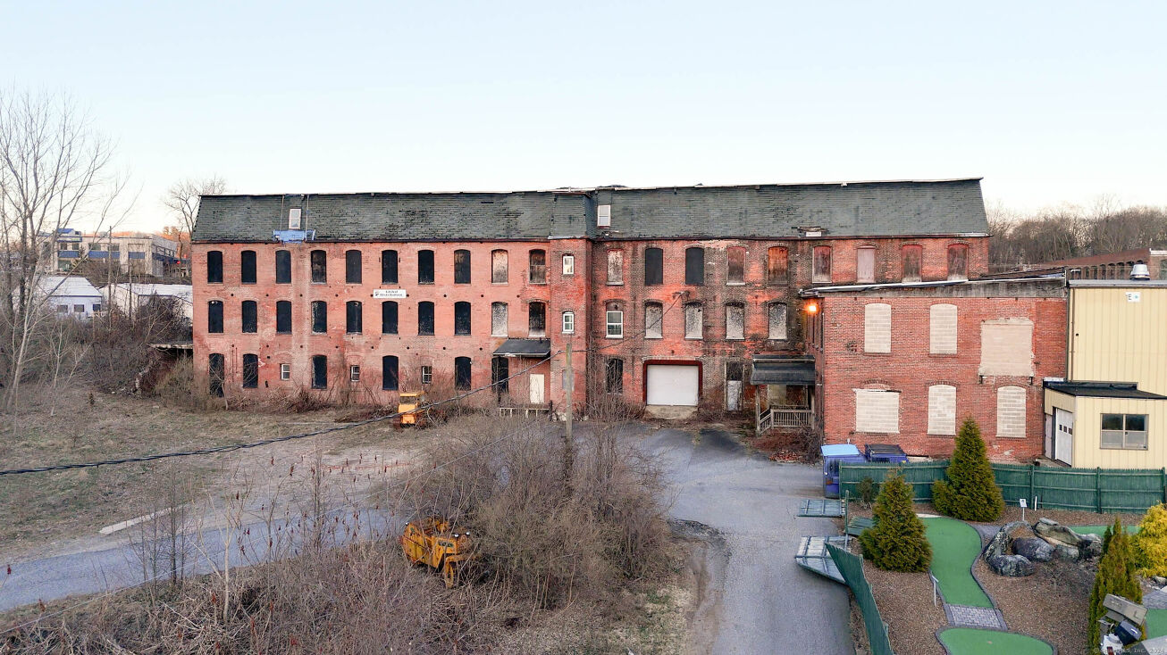
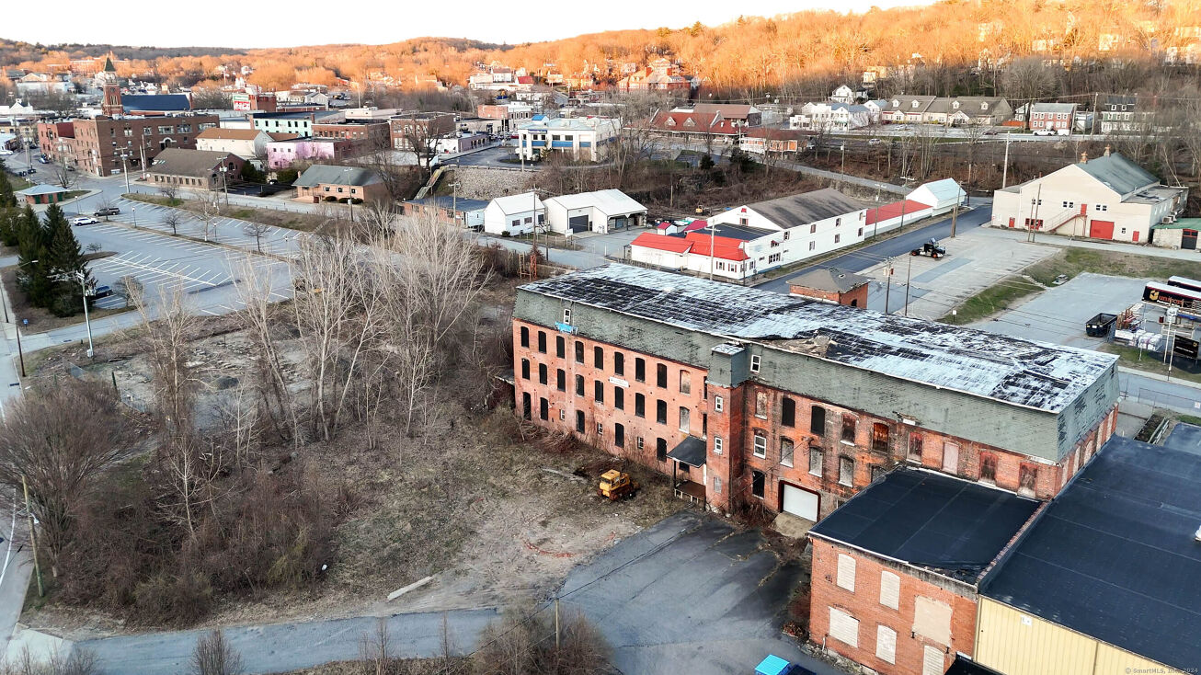
Location: 83 Canal St.
Zone: IHOD
Listed by: Chabot & Assoc. Real Estate
Contact: Tony Chabot
508-847-0902
BUILDING SIZE: 45,140 SQ FT
LOT SIZE: 2.01 AC
YEAR BUILT: 1847, 1900
LOCATED IN OPPORTUNITY ZONE
$1,600,000
#6

Slide 22
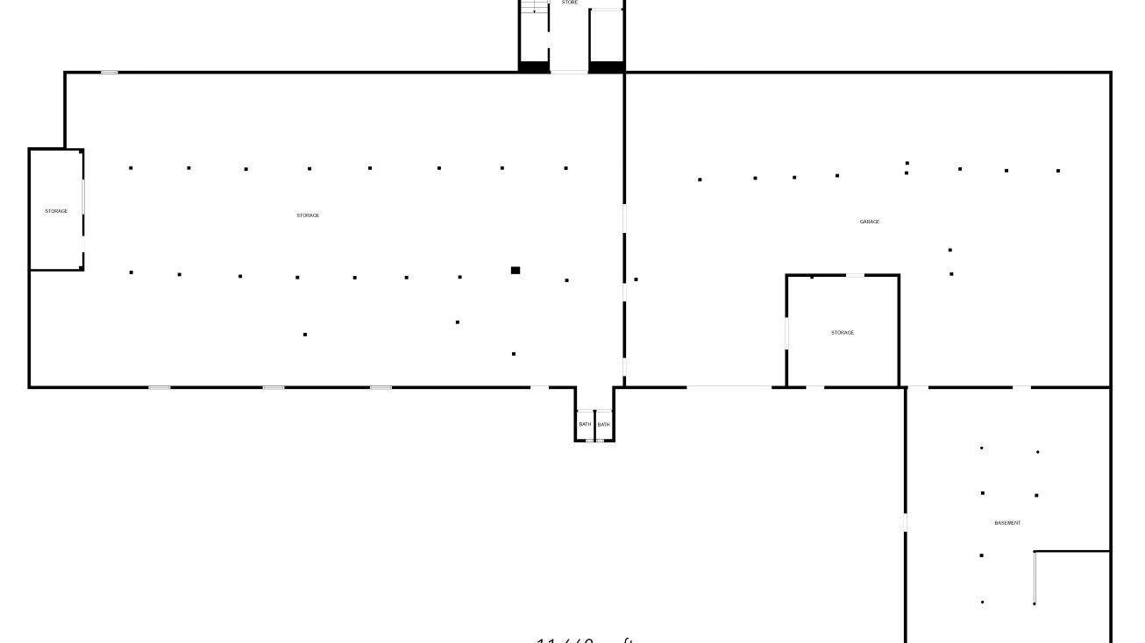
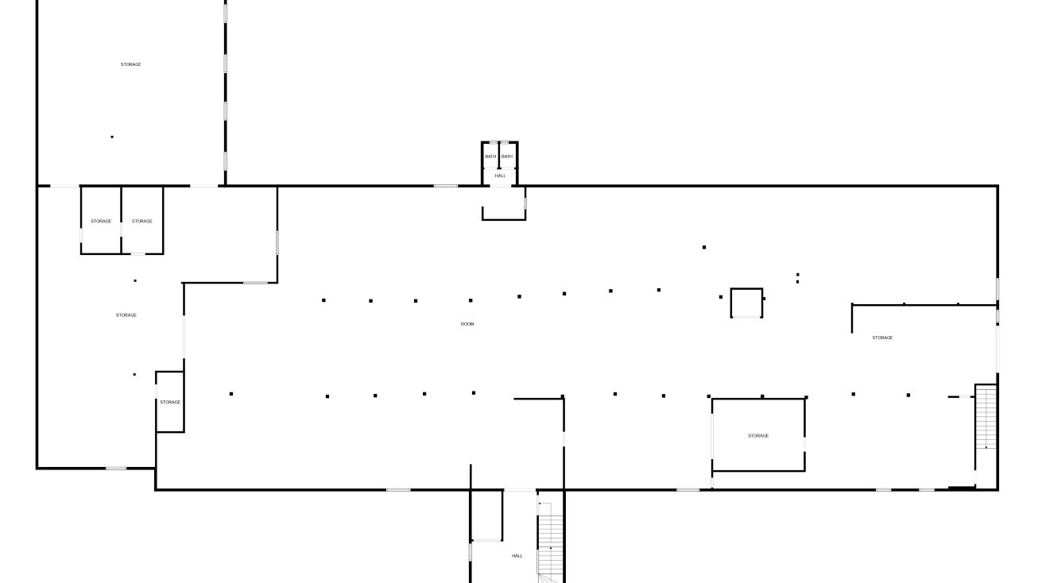
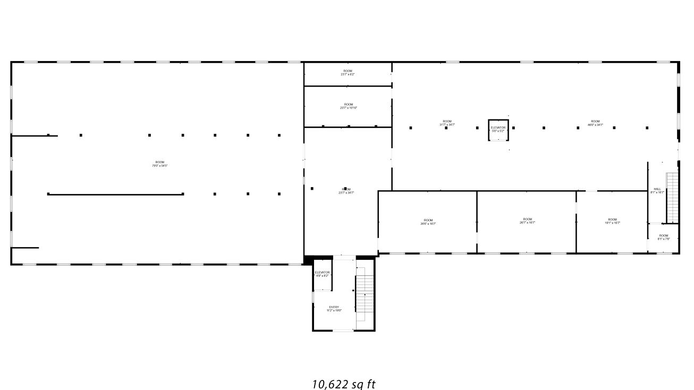
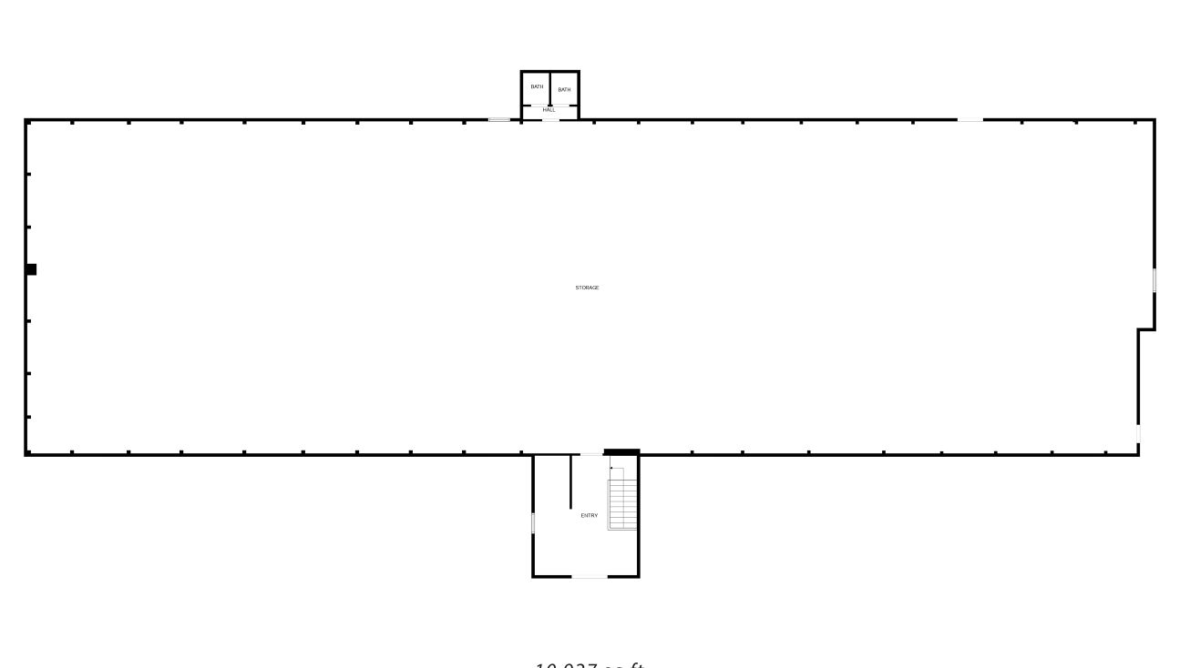
#6

Slide 23
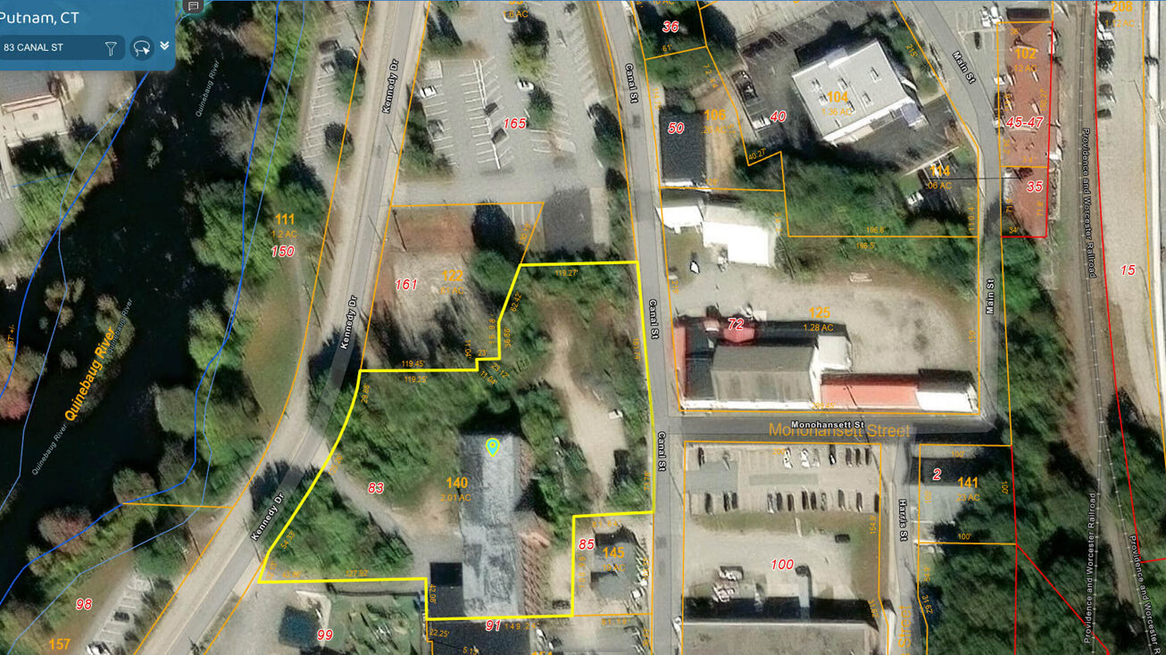
#6

Slide 24
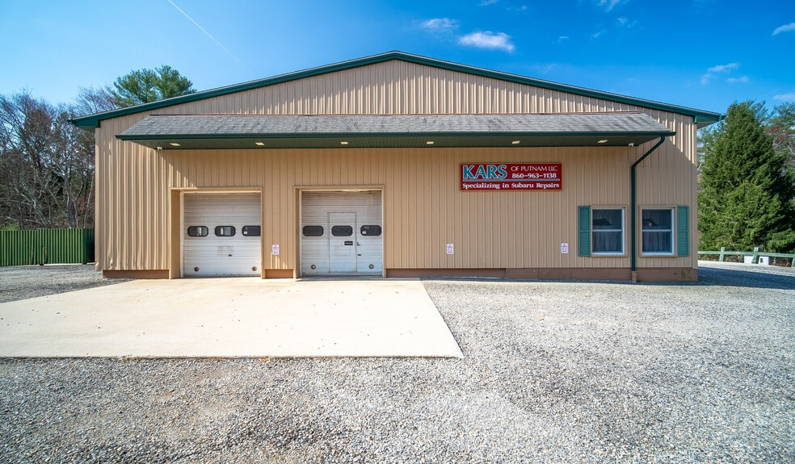
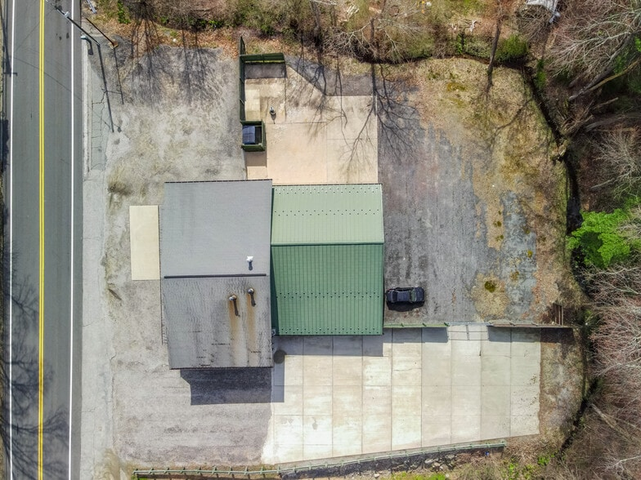
Location: 181 Killingly Ave.
Zone: R-40, APA
Listed by: CR Premier Properties
Contact: Carol Ryniewicz
860-942-9293
BUILDING SIZE: 3,856 SQ FT
LOT SIZE: .7 AC
YEAR BUILT: 1937
12’ CEILINGS
5 BAYS
6 LIFTS
$525,000
#7

Slide 25
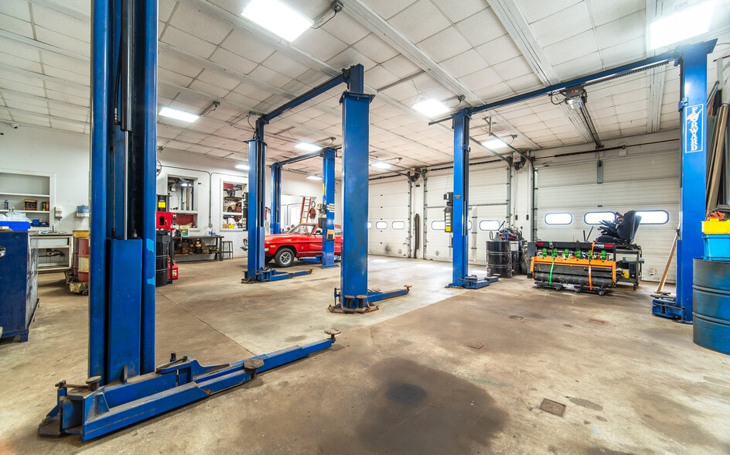
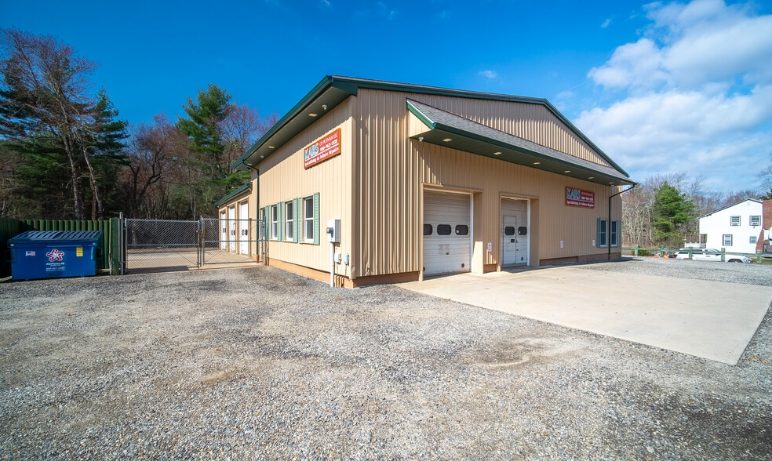
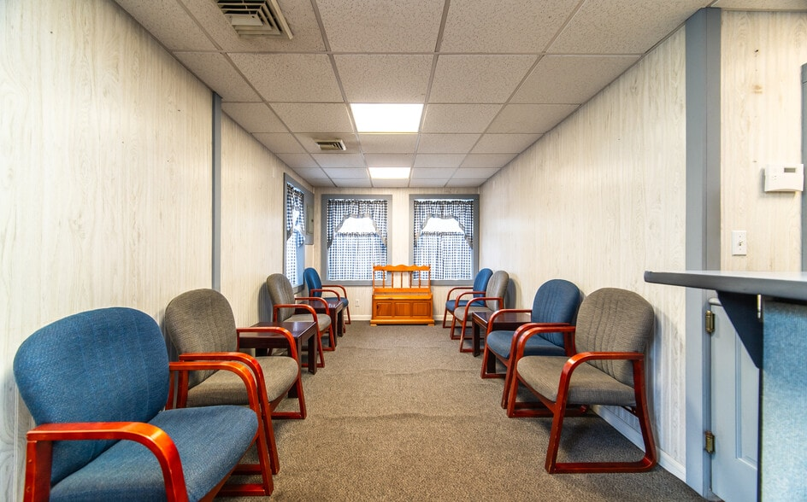
#7

Slide 26
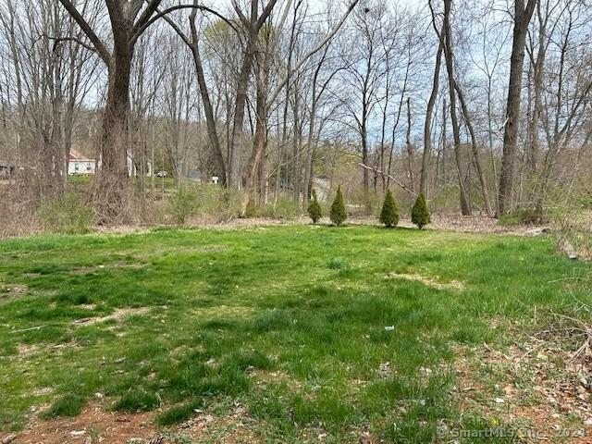
Location: 20 Bates Ave.
Zone: HC
Contact: Re/Max Bell Park Realty
860-928-7991
VACANT PARCEL
LOT SIZE: .4 AC
LOCATED JUST OFF OF RT. 44 PROVIDENCE PIKE, WEST OF I-395
PERFECT FOR SMALL COMMERCIAL BUILDING
$52,500
#8

Slide 27
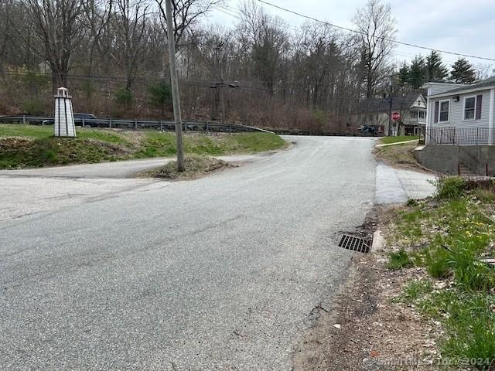
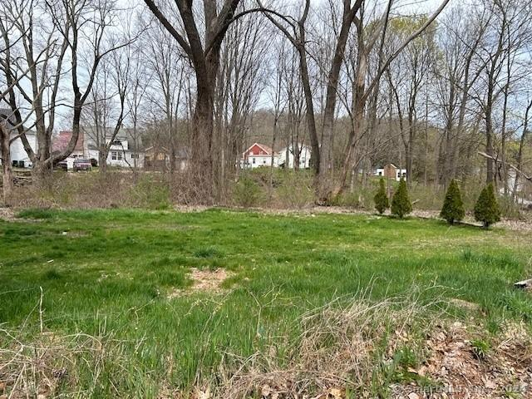
#8

Slide 28
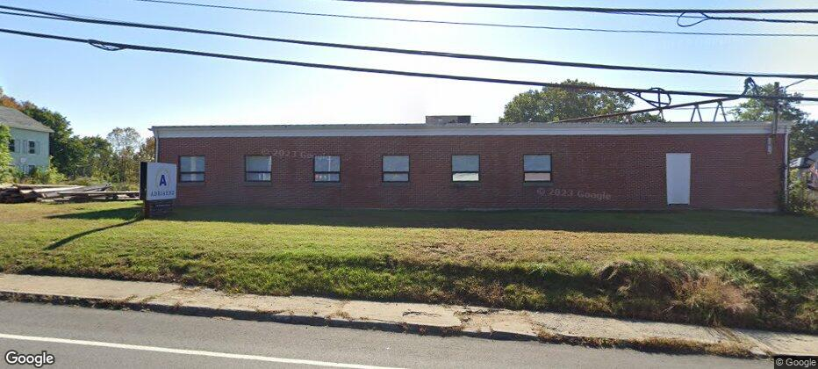
Location: 124 Pomfret St.
Zone: I
Listed by: NAI Glickman Kovago & Jacobs
Contact: Jeff Borus 508-753-9100
BUILDING SIZE: 16,050 SQ FT
LOT SIZE: 2.29 AC
YEAR BUILT: 1959
CEILING HEIGHT: 10’ – 16’
LOADING DOCK
LESS THAN 1 MILE FROM
I-395
$850,000
#9

Slide 29
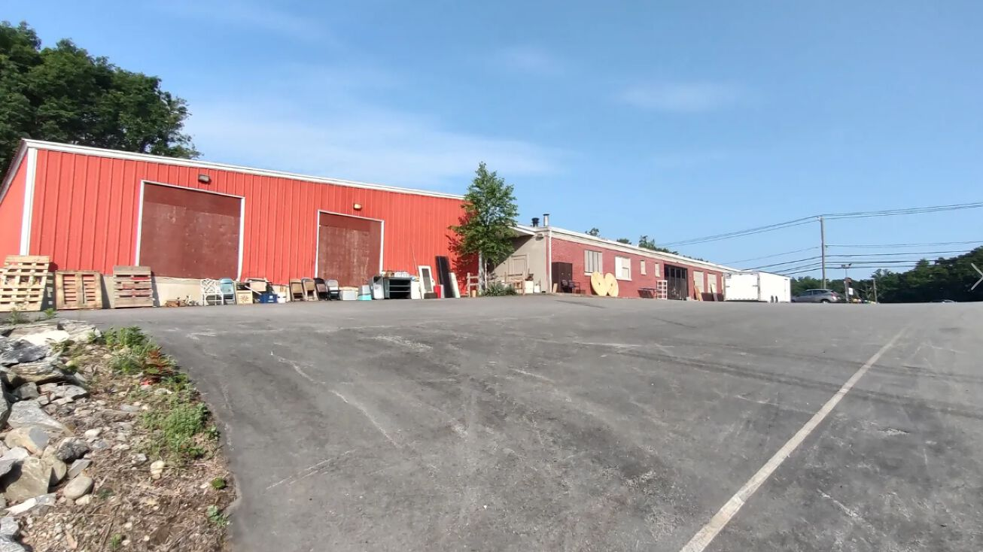
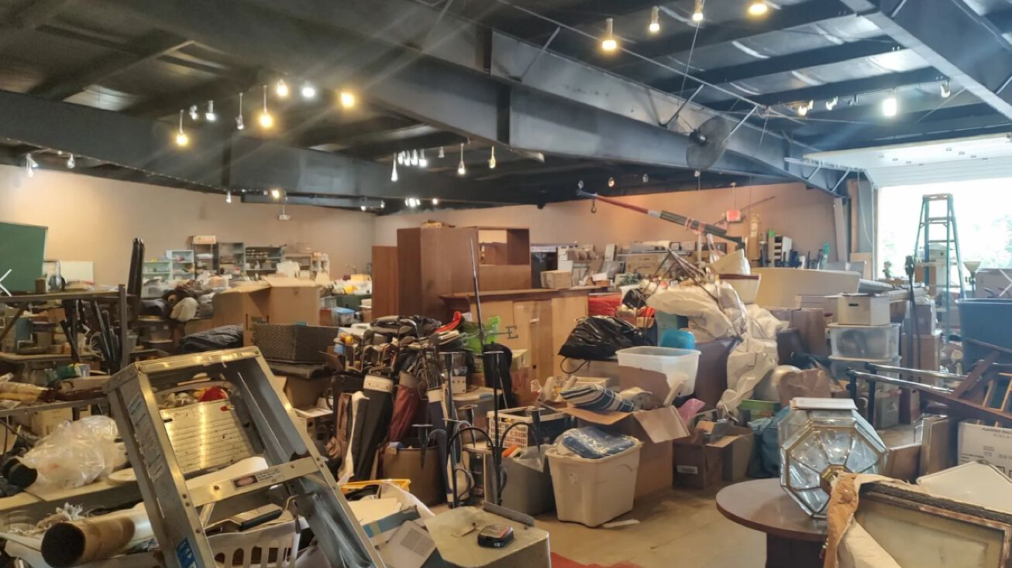
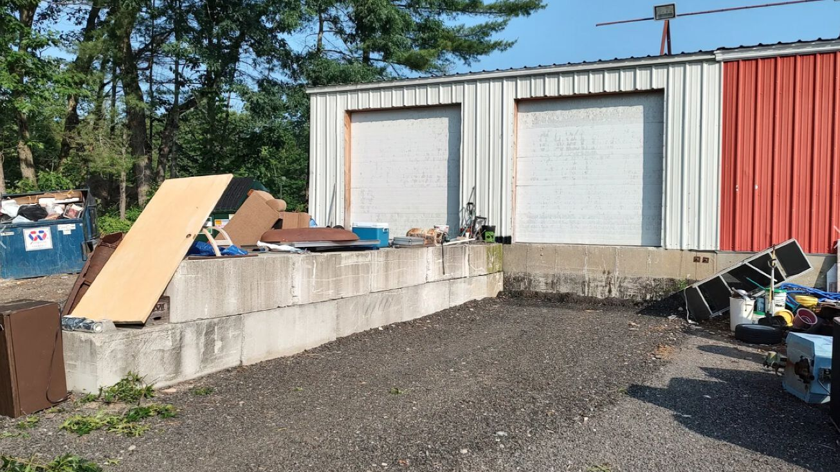
#9

Slide 30
If you’re interested in any of these properties, contact the agents listed, or the Putnam Economic & Community Office (contact info on the cover page of this presentation), and we’re happy to help you bring your business to town or expand your existing Putnam business.
More featured properties coming soon!

