Slide 1
The Roanoke Valley Governor’s School for Science and Technology

Slide 2
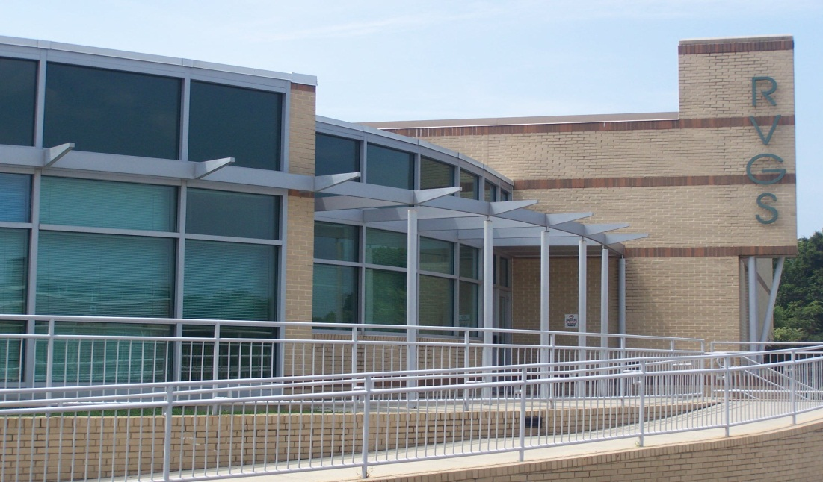
Background on the School
For the past thirty-eight years, the Roanoke Valley Governor’s School has provided the surrounding region with innovative and challenging math, science, and computer technology classes.

Slide 3
The Basic Facts
Grades 9-12
Students attend either morning or afternoon sessions
Students are from:
  Bedford County, Botetourt County, Craig County, Floyd County, Franklin County, Roanoke City, Roanoke County, and Salem City.

Slide 4
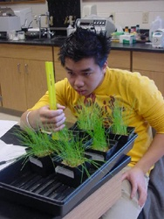
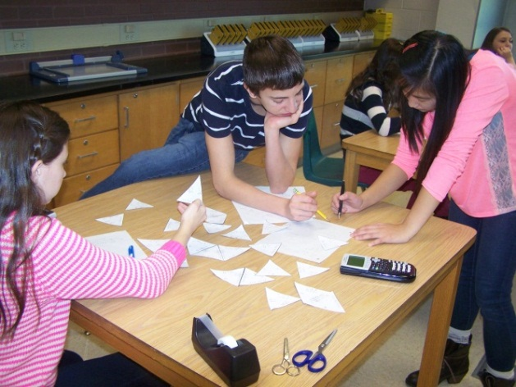
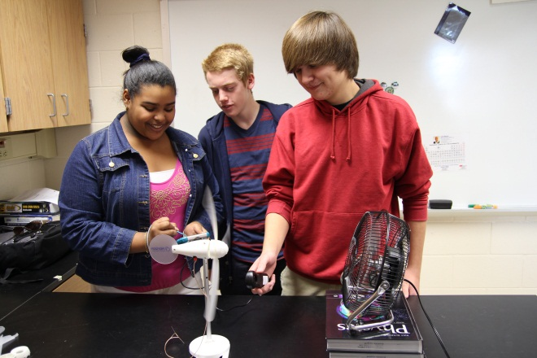
What’s Important
A friendly environment that encourages critical thinking and independent learning.
The relationship between teachers and students.
Intensive hands-on laboratories that stress inquiry and discovery, not memorization.
Preparation for university studies

Slide 5
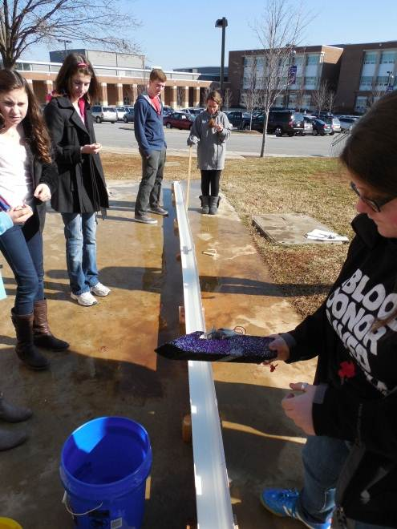
The Schedule
Daily Schedule
  Extended time for labs
2 Semesters
Intersession
  Time in January when students work on their research project

Slide 6
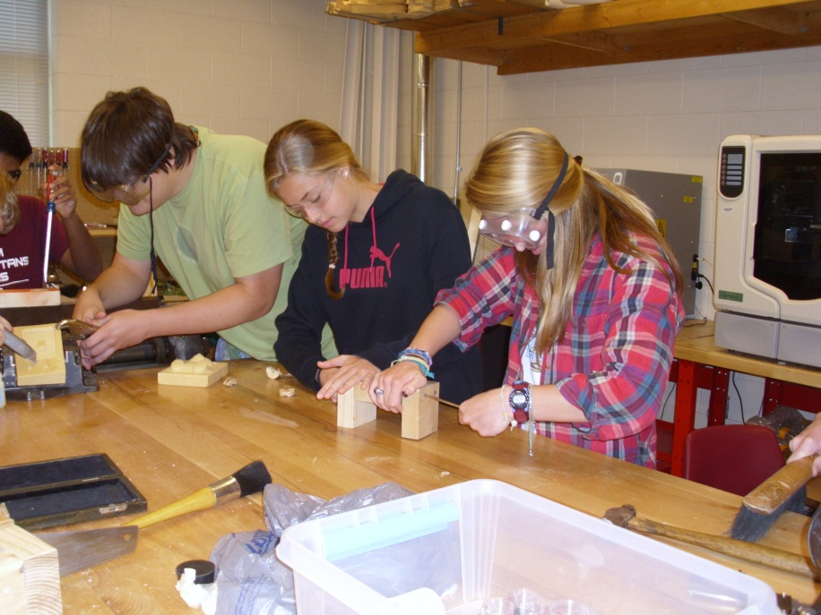
The First-Year Experience
RVGS Physics
RVGS Algebra II
Fundamentals of Research

Slide 7
Gov School Science Courses
AP Physics
AP Physics
12th grade
AP Environmental Science
AP Environmental Science
AP Chemistry
AP Chemistry
11th grade
RVGS Biology
RVGS Chemistry
10th grade
RVGS Physics
9th grade

Slide 8
Governor’s School Math Courses
AP Calculus BC
RVGS Multivariable Calc
12th grade
AP Statistics
AP Calculus AB
11th grade
AP Accelerated Calculus BC
RVGS Pre-Calculus
10th grade
RVGS Algebra II
9th grade

Slide 9
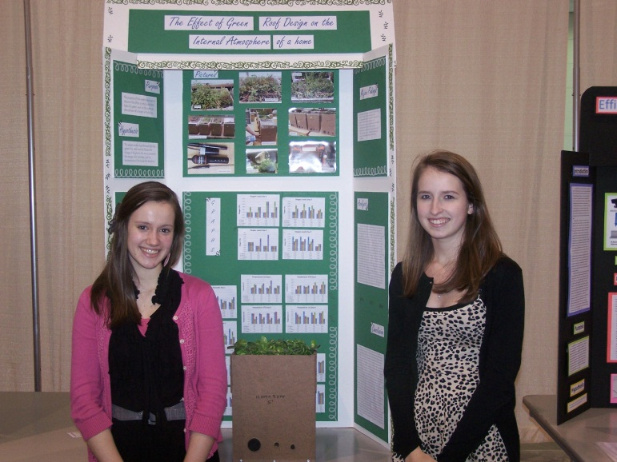
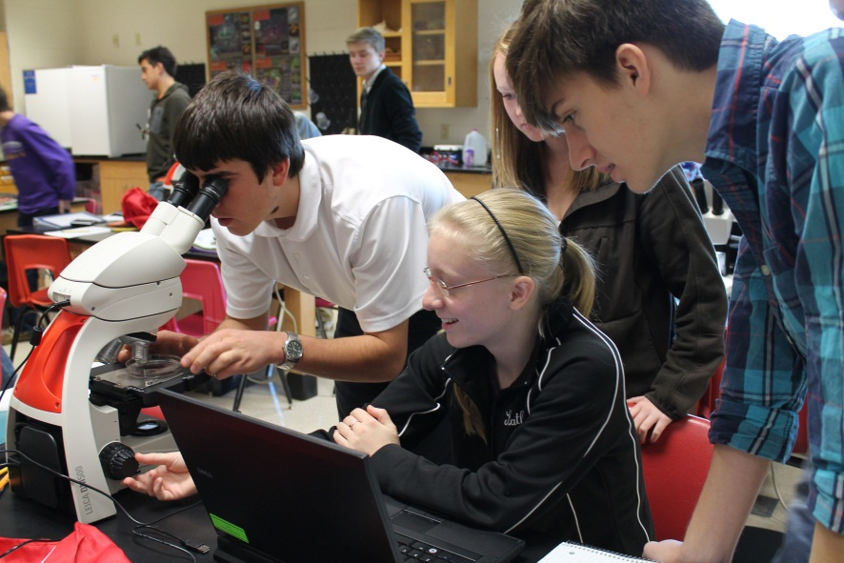
Electives
Biotechnology and Bioinformatics
Chemical Research
Computational Biology
Directed Study
Environmental Research
Fundamentals of Research
Mentorship
Product Design Engineering
Python Programming
Engineering Design & Fabrication
Research Psychology

Slide 10
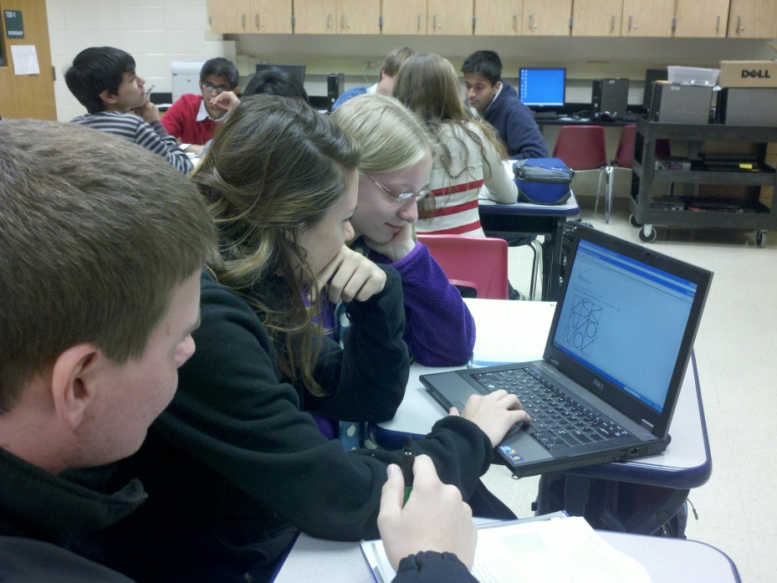
How To Prepare
Demonstrate initiative in areas of science & math
Take challenging courses
Maintain a good grade point average

Slide 11
Prerequisites
Students applying to the Governor’s School will
need to have completed the following courses and passed the SOL tests for those courses:
Prerequisite
courses
Algebra I
Geometry

Slide 12
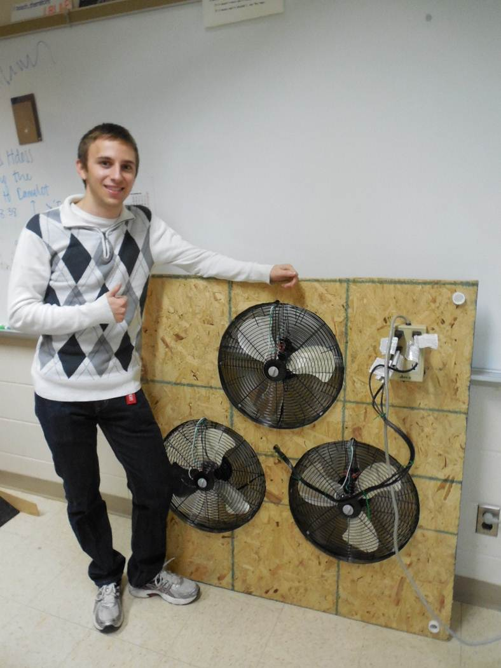
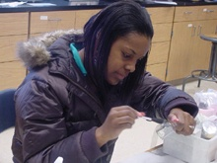
Applying
Student and one parent/guardian attend an Informational Session in January
Complete online application
Tuesday, January 9th, 6:30 p.m. RVGS
Thursday, January 11th, 6:30 pm FCHS
Tuesday, January 16th, 6:30 pm RVGS
Thursday, January 18th, 6:30 pm SRHS
Tuesday, January 23rd , 6:30 pm RVGS

Slide 13
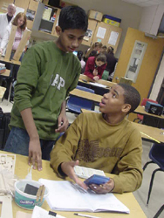
The Application
Parts of the application:
  General information, extracurricular,
  Student essay , counselor form, 2 teacher recommendations
Applications due to home school – Feb. 1
Letters of acceptance mailed in late March

Slide 14

Visiting
Students can come spend a session with our current students and observe what goes on in the classroom
Call to set up an appointment
853-2116 Mrs. Kathy Sebolt, School Counselor

Slide 15
2022-2023 Senior Student Accomplishments
$3.5+ Million in scholarship offerings
(54 Graduates)
1390 average total SAT score
30 average ACT composite score
Our 54 grads are attending 20 different colleges/universities

Slide 16
2022-23 Science Fairs & Symposiums
Project Forum Feb 4
Roanoke City Science Fair
Roanoke County Science Fair
Central VA Regional Science Fair
Western VA Regional Science Fair March 11
VA State Science Fair
International Science and Eng. Fair May
VJAS

Slide 17
The Roanoke Valley Governor’s School for Science and Technology
For more information visit our website at
WWW.RVGS.K12.VA.US
Or call 853-2116

