Slide 1
Wellness for elementary school
Karen Garlow, MS, LPSC, CTS
Roanoke County Public Schools
Title 1 Parent Night
Notes:
Welcome to the Title 1 parent presentation about Wellness for Elementary School parents and their students. My name is Karen Garlow and I am the Supervisor of Counseling for Roanoke County Public Schools and it is a pleasure to be talking with you tonight. We know many parents are concerned about their students and how they are handling the pandemic combined with school. We are here to help and hope to provide some practical things you can use at home to assist your child.

Slide 2
What is wellness?
Wellness is an active process of becoming aware of and making choices toward a healthy and fulfilling life.
Notes:
Tonight’s presentation is focused on Wellness. So that we all understand what we are talking about, we will operate with the definition of wellness as an active process of becoming aware of and making choices toward a healthy and fulfilling life. Now this may sound like something that elementary children are not good at, or not really focused on, but you may consider wellness as part of a one’s ability to make sure their needs and wants are met, even at a young age. Think about babies for example—they cry when they are hungry, tired or need a diaper change, they laugh and coo when someone is talking to or looking at them, etc. Young children are similar, in that they might not always use words like “I need help right now mom”, but instead their behavior might be communicating that they have a need. We as trusted adults in their lives try to help guide them into healthy ways of seeking and asking for needs to be met, and to healthy ways of coping with daily life and stressors.

Slide 3
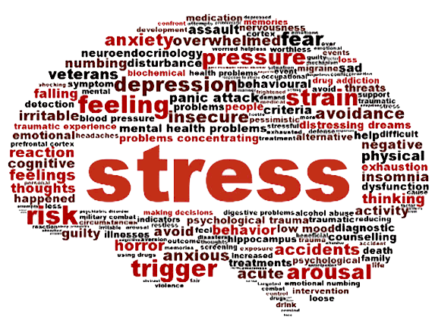
What is stress?
Stress is a feeling or emotion.
Stress may feel like-
Being overwhelmed
Pressure
Confusion
Too much to do
Like a weight on your shoulders
Notes:
Do elementary children experience stress? Of course they do. It might look and sound different than adult stress, but it definitely happens and exists. Some stress can be positive, for example, a student may feel stress about an upcoming Math test, so they study and get parent to call out problems to them. This can positively impact their motivation to do well or improve their grade. On the other hand, if they have negative thoughts about Math or math tests, have soccer practice, have 3 siblings that are loud and make it hard to study, the upcoming Math test might be a negative stressor for them. They may feel like---

Slide 4
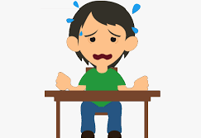
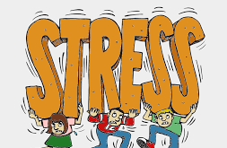
Stress in children
Decreased appetite, other changes in eating habits.
Headache.
Nightmares and sleep disturbances.
Upset stomach or stomach pain.
Other physical symptoms with no physical illness.
Notes:
Other symptoms of stress that parents might observe are (read slide). Elementary children will often show stress in different behaviors or words—adults have to be tuned in to their child and read between the lines sometimes. Examples might be “ I feel sick, I have a headache, I’m tired”. Stress might manifest as the child not wanting to play with friends, or join their sports team, or become disinterested in something they used to love. While this doesn’t always mean they are experiencing stress (Maybe they are just changing habits or interests), it is something to watch for.

Slide 5
stress
Stress can be positive and negative. Sometimes it can motivate you to complete a task or try something new. Can you think of a time when stress helped you do something well?
But sometimes stress can be overwhelming and cause you to question yourself or make it harder to complete tasks.
Notes:
This slide continues with how stress might be positive or negative for a child. If you think your student is experiencing more negative stressors, you might talk to them about how stress can be both positive and negative. Ask them if they can think of a time that stress helped them do something well or try something new? Acknowledge that the pandemic has been hard and school may be extra challenging right now, and if they feel overwhelmed, disappointed, sad, STRESSED, it is ok and there are things to do to help with stress—even for very young children.

Slide 6
Protective factors
Positive attitudes, values or beliefs.
Conflict resolution skills.
Good mental, physical, spiritual and emotional health.
Positive self-esteem.
Success at school.
Good parenting skills.
Parental supervision.
Strong social supports.
Notes:
These protective factors are some things that help students be resilient when facing stress.

Slide 7
EXERCISE
Physical health is tied to mental health. As a family or as one on one time with your student, you could:
Go outside
Take a nature walk
Play a game or sports activity
Take a bike ride
Do yoga poses and stretches
Scavenger hunt
Family activities—board games, books, cards, etc.
Notes:
Here are some things you can try with your student. Many of our students know and use stretches and poses at school, so they might be able to show you or teach you some of them at home. There is a lot of research behind being in nature, physical activity, poses and stretching, etc. that shows these types of activities are helpful to a stressed brain, and can help the brain “reset” during times of stress.

Slide 8
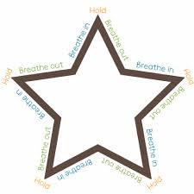
Practice deep breathing
Notes:
Deep breathing is one thing to try with your student. This is called Star breathing. You trace your finger around the star, following the directions on each side. So breathe in, hold, breathe out and repeat all the way around the star. This one is useful visual that can be hung on the fridge, taped to student’s desk, or shown on the laptop screen.

Slide 9
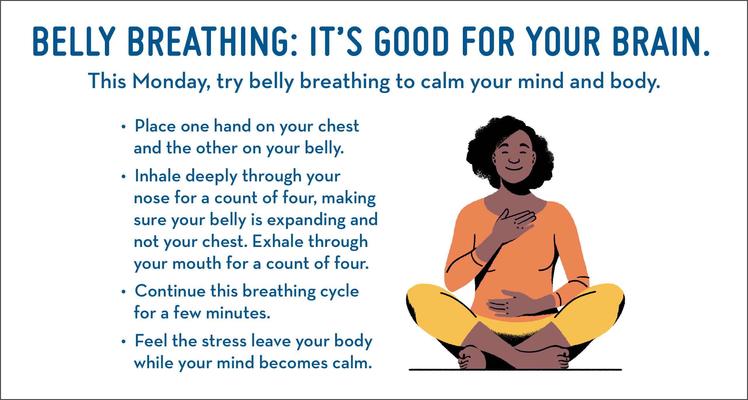
Notes:
When it comes to deep breathing, the technique can be important. When people think of deep breathing, they might imagine that you just breathe in through your nose and out through your mouth. Belly breathing is actually a more productive way to practice deep breathing. (provide demonstration of how to belly breathe—idea is to inflate your stomach like a balloon, then release breath through your mouth. Some students like to put a small stuffed animal, beanie baby on their tummy and watch it rise and fall as they belly breathe. For young students, Elmo has a short video on Sesame Street website that teaches them how to belly breathe.)

Slide 10
More Deep Breathing
Notes:
With the cold weather, or simply because they love hot chocolate, you might try Calm down Cocoa, pretending to hold a cup of cocoa, breathe in nose for 5, out of mouth for 5, and try to cool down your hot cocoa. (Demonstrate)

Slide 11
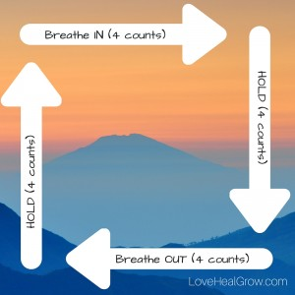
More Deep breathing
Notes:
Lazy 8 Breathing, Square breathing (can trace on your desk or table) Here are a few more visuals that can be hung on fridge or desk or laptop. (demonstrate)

Slide 12
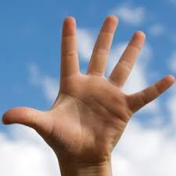
Grounding
What are 5 things you can see?
What are 4 things you can hear?
What are 3 things you can touch?
What are 2 things you can smell?
What is 1 thing you can taste?
Notes:
Another strategy is grounding. This is a good one to try during moments of extreme stress. This helps distract one’s emotional part of their brain and become more centered in the moment by noticing what is around them. (Demonstrate)

Slide 13
Calming strategies for kids
Colors –Start with filling your toes and feet with a color of your choice, then imagine the color filling up your ankle, your leg and shin, your thigh, your hip, your stomach……to the top of head. And when you’re ready, let that color slide out of the top of your head. (5 minutes)
Notes:
I mention this strategy for bedtime. When they are in the beds, or lying down with the nightly routine, try Colors. Get them to imagine a color slowly filling their toes and feet, then move up slowly to the ankle, slowly to the shin, the leg, the thigh, etc. Up their face to the top of their head. Offer that when they are ready, they can let the color slide out of the top of their head. This helps calm their amygdala, self regulate some emotions and extra energy. ***If they are very excited and “wound” up before, you can try this; be cautioned that some children will need more practice than others.

Slide 14
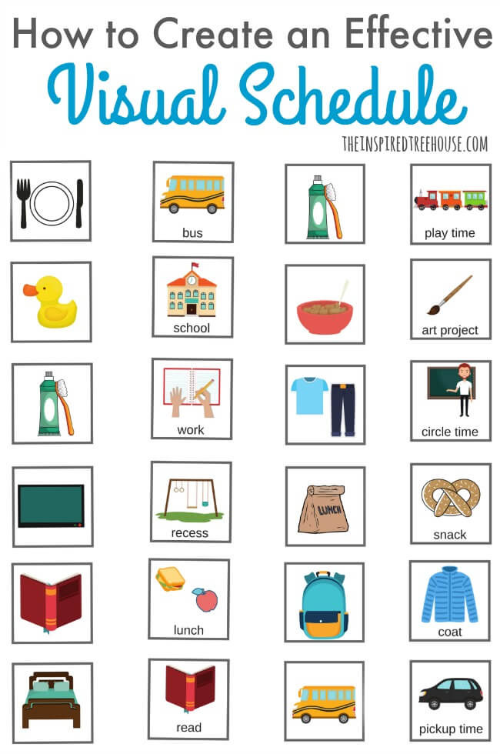
Routines create feelings of safety, security, and predictability
Wake up about the same time each day
Have a morning routine—get up, get dressed, eat breakfast, brush teeth, etc.
Have a school routine--pack lunch, get backpack, kiss dog goodbye, etc. For virtual, have office/desk, gather materials for class, grab water bottle, log onto laptop, etc.
Have an evening routine– go over HW, make dinner, take bath, watch show together, etc.
Have bedtime routine—brush teeth, read a book, talk about your day, hugs and rituals, etc.
Notes:
Creating routines is very helpful to young students. Knowing what’s going to happen and being able to predict with some certainty what will happen provides security and consistency for children. A visual schedule might help them when they are stressed –they can go look to see what is next for that day, or you can point it out to them. Having routines for adults is helpful as well. It provides a schedule and sense of purpose to each day. Rituals can be grounding and helpful as well, especially if the ritual involves some special time for parent and child together.

Slide 15
Possible discussions
Sunshine/Cloud—Discuss the best/worst parts of your day.
What is in our control? Focus on these ideas.
What are we thankful for? Gratitude Jars, journals, etc.
Limit the exposure to media and social media—dependent on the child’s age and developmental level.
Discuss temporary nature of stress, pandemic, different routines at home and school. Discuss things we are looking forward to.
Discuss any positives that have come from the pandemic.
Create cards, give thanks to community helpers.
Notes:
For older elementary students who might be more communicative and verbal, talks and discussions may help alleviate some stressors. Knowledge can be powerful for older elementary students and should be given at a developmentally appropriate level ( you know your child and what information they can handle and what is too much for them.) Here are some ways to initiate discussions or further communicate about their perceptions of stress as a young person.

Slide 16
Elementary
Notes:
I want to share this short youtube video clip. It reminds us that as the trusted adults in the children’s lives, we are tasked with providing the peace and calm that helps them to learn how to navigate stress.

Slide 17
Resources
School Counselor
Family doctors and healthcare providers
School Psychologists
Blue Ridge Behavioral Healthcare—local CSB
Notes:
Here are some resources you may reach out to if your child is experiencing large amounts of stress for long periods of time, or if the stress is impacting their daily functioning. There is help available for you and your child! Thank you for attending this presentation. If I can be of any assistance to you or your family, please don’t hesitate to contact me.

