Slide 1

Financial Aid 101
An Investigation Into Financing
a College Career

Slide 2
What Are We Going To Talk About?
Reality Check - College Costs in 2024
Applying for Financial Aid
Types of Financial Aid
Additional Notes
Agenda – What are we going to talk about?

Slide 3
Reality Check: College Costs in 2024
How much did you say it was going to
cost my student?
Costs are rising at rates greater than inflation
Estimated 3% to 5% increase each year
    College Board’s College Cost Calculator online at: http://apps.collegeboard.com/fincalc/college_cost.jsp
  Visit the College’s website
But wait... there is good news!
College Costs for the Future

Slide 4
Financial Aid continues to be a priority!
  At Roanoke College, 85% of our enrolled students receive aid
  At Radford University, 70% of their students receive aid
Remember… most families are not expected to pay the whole college bill with no financial aid!
DO NOT dismiss an institution right away just because of “sticker price”!
College Costs for the Future

Slide 5
Applying for Financial Aid
Institutional Aid
College grants and scholarships are gifts that do not need to be repaid
May require separate application
  College Board Financial Aid Profile (CSS Profile)
    Series of 200 questions
    Fee charged
    Check with the individual school on requirements
Awarded for a variety of reasons
  Proven High School performance
  Competition
  Athletic/Music/Choral ability
Applying for Financial Aid

Slide 6
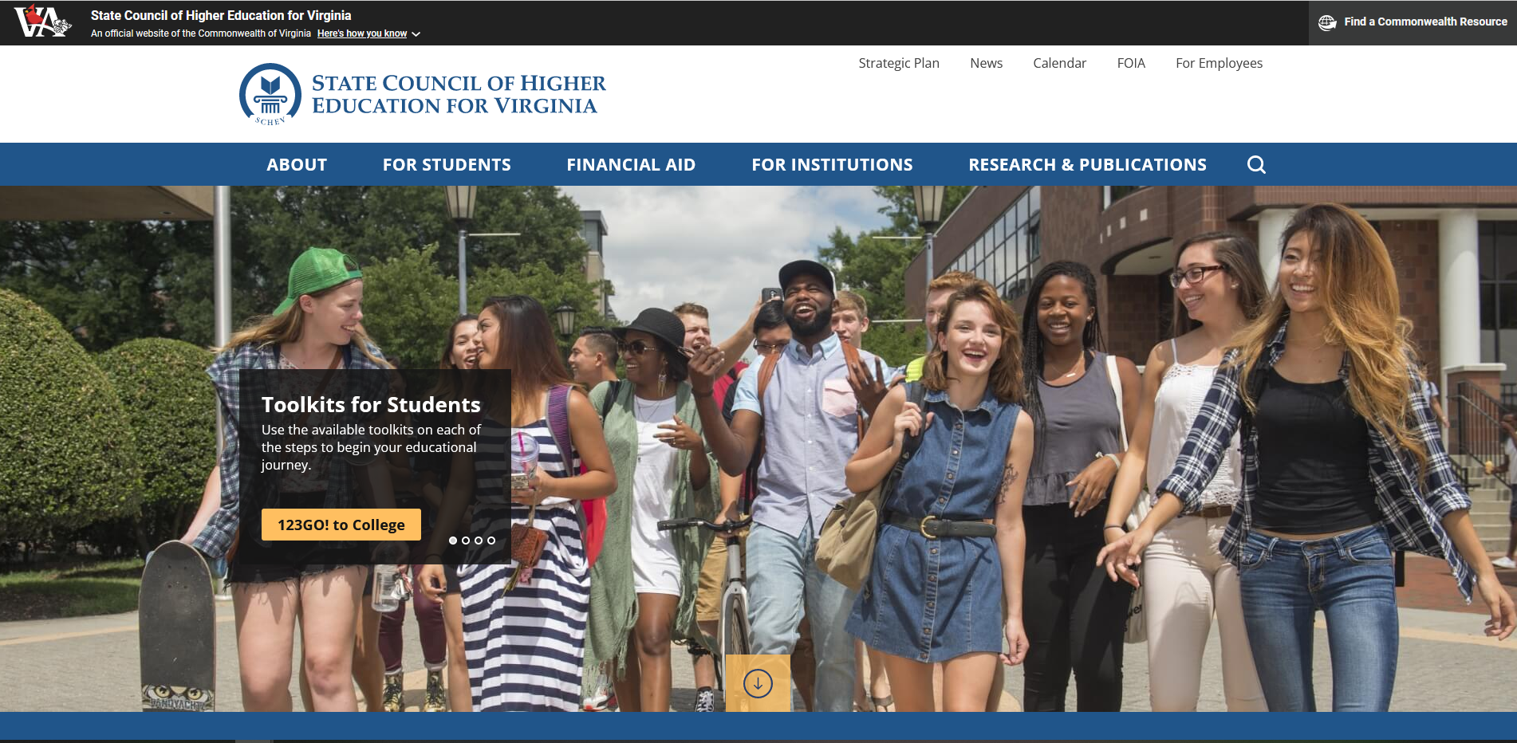
Federal Aid
Completion of the Free Application for Federal Student Aid (FAFSA) is recommended for everyone!
  Applications typically available online on October 1
    https://studentaid.gov
    THIS YEAR ONLY – available December 2023
  Deadlines for states or colleges will vary
    Check with the institution about their specific deadlines
    State Council of Higher Education for Virginia (www.schev.edu)
Applying for Financial Aid

Slide 7
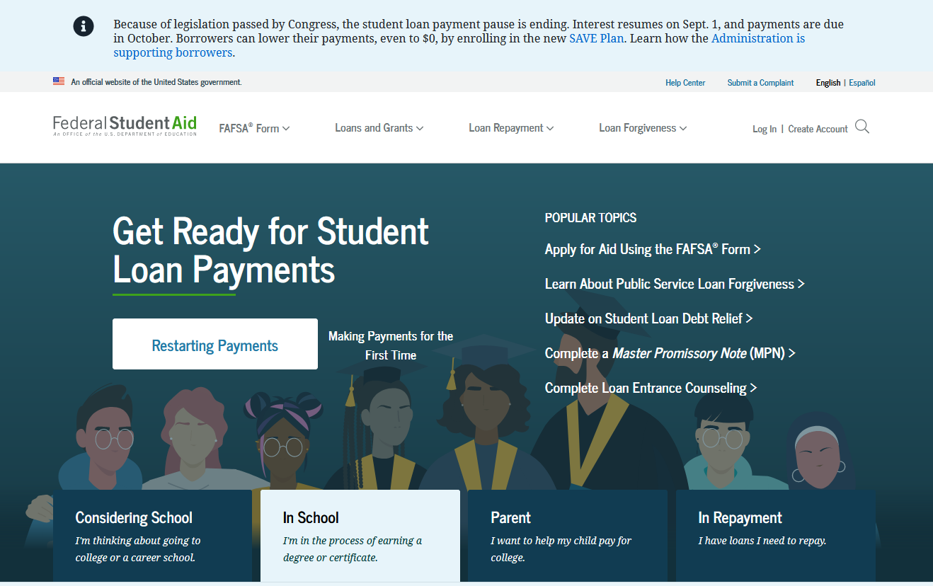
How Does the Student Access the FAFSA?
FAFSA can be filed on the web at https://studentaid.gov
Free US Department of Education website
Safe, secure and fast (results within 72 hours of submission)
Applying for Financial Aid

Slide 8
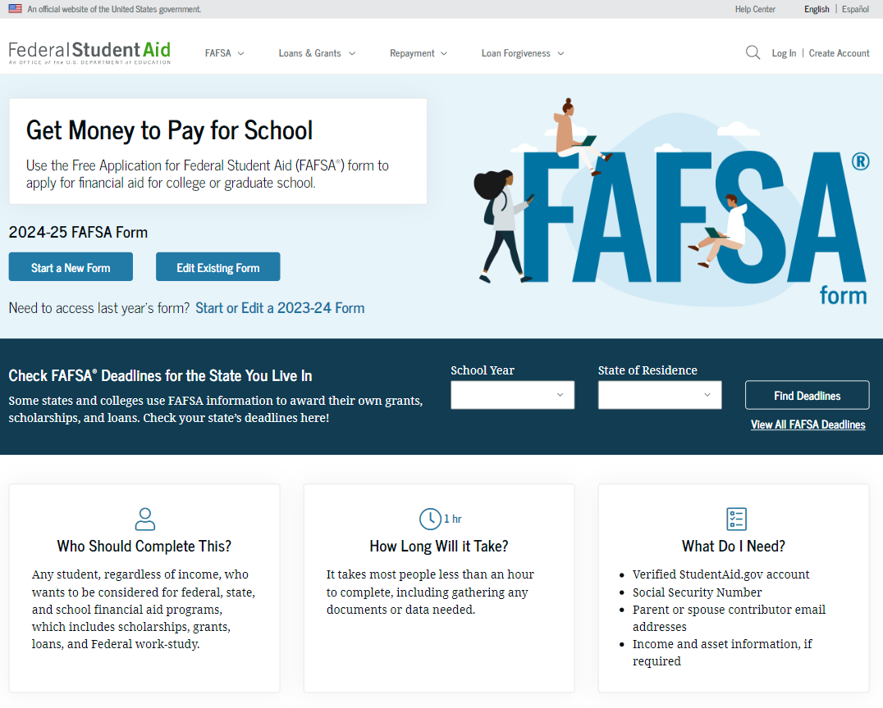
Applying for Financial Aid

Slide 9
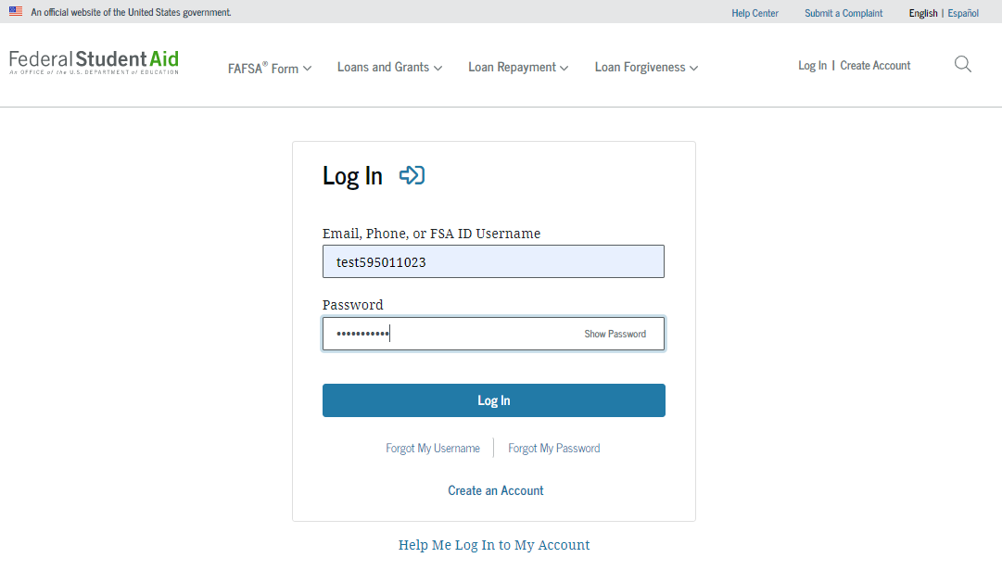
What is the First Step to filing the FAFSA?
An FSA ID (account username and password) is required to access
  Student AND at least one parent (if dependent) must have
Applying for Financial Aid

Slide 10
What type of information will be collected?
  Identity Information
  High School Information
  Parent information (Biological or adoptive; If parents are divorced/separated = Who provides the greater portion of the student’s financial support?)
  Financial Information
    Consent to retrieve and disclose federal tax information from IRS
      No consent = not eligible for federal student aid
      For the 2024/25 FAFSA form = 2022 tax information
    Family Size/Number in College
    Grants/Scholarships/AmeriCorps Reported as Income on your tax return
    Child Support Received
    Earned Income Tax Credit
    Foreign Earned Income Exclusion
    Assets (liquid and non-liquid)
Applying for Financial Aid

Slide 11
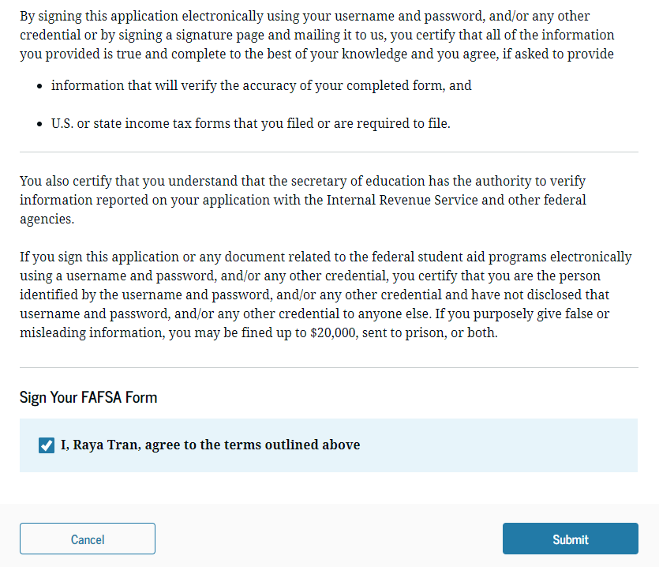
  Additional Demographic Information
    Gender
    Race & ethnicity
    Citizenship status
  List of up to 20 colleges to send
  the FAFSA results
  Electronic Signatures
Applying for Financial Aid

Slide 12
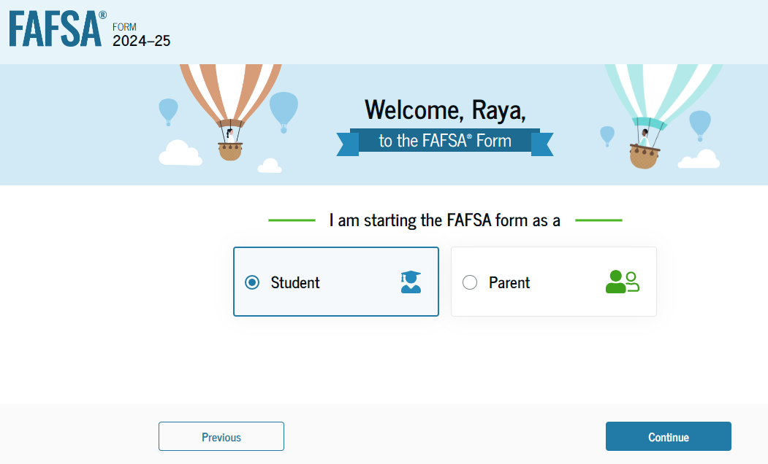
Can initially be started by either the student (applicant) or the parent
Applying for Financial Aid

Slide 13
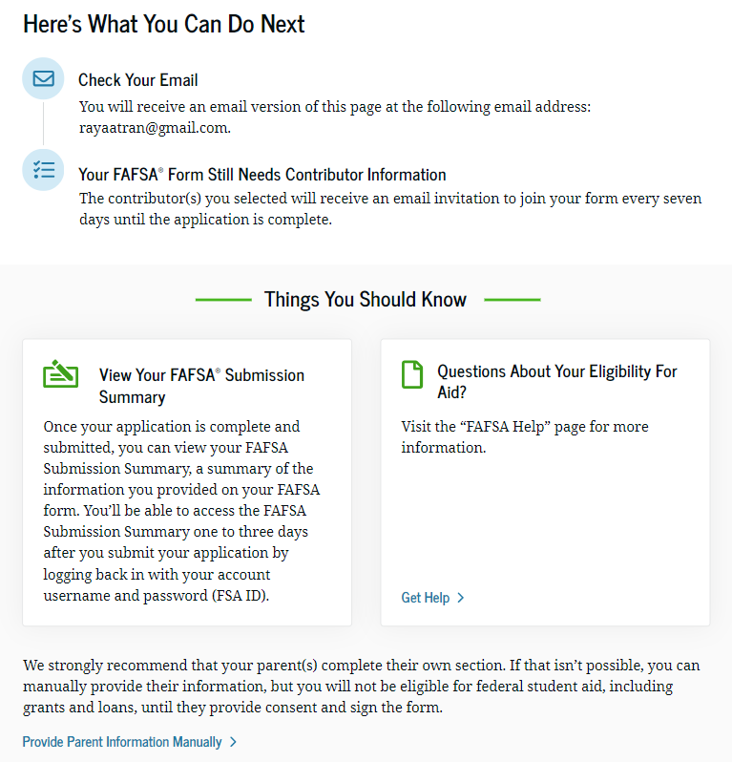
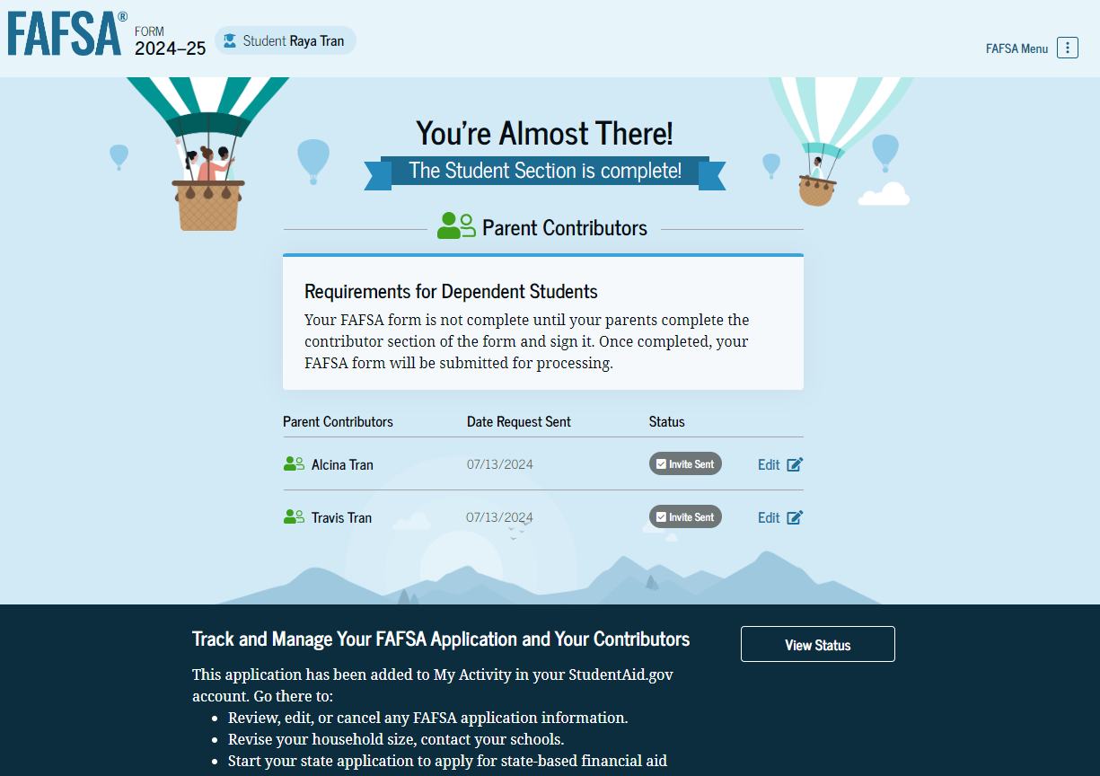
  Next steps identified:
    Parent contributor(s) need to complete the contributor section of the form and sign it.
      Legal parents are biological or adoptive (not grandparent, foster parent, legal guardian, widowed stepparents, aunts, uncles or siblings)
      If parents are divorced/separated = Who provides the greater portion of the student’s financial support?
Applying for Financial Aid

Slide 14
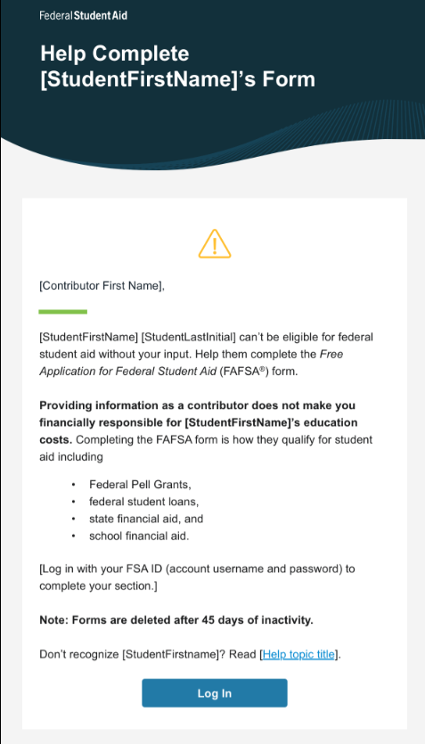
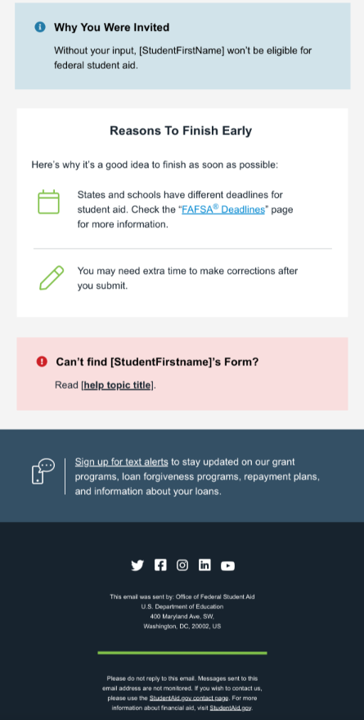
Parent receives the FAFSA invitation via email and logs in with their FSA ID
Applying for Financial Aid

Slide 15
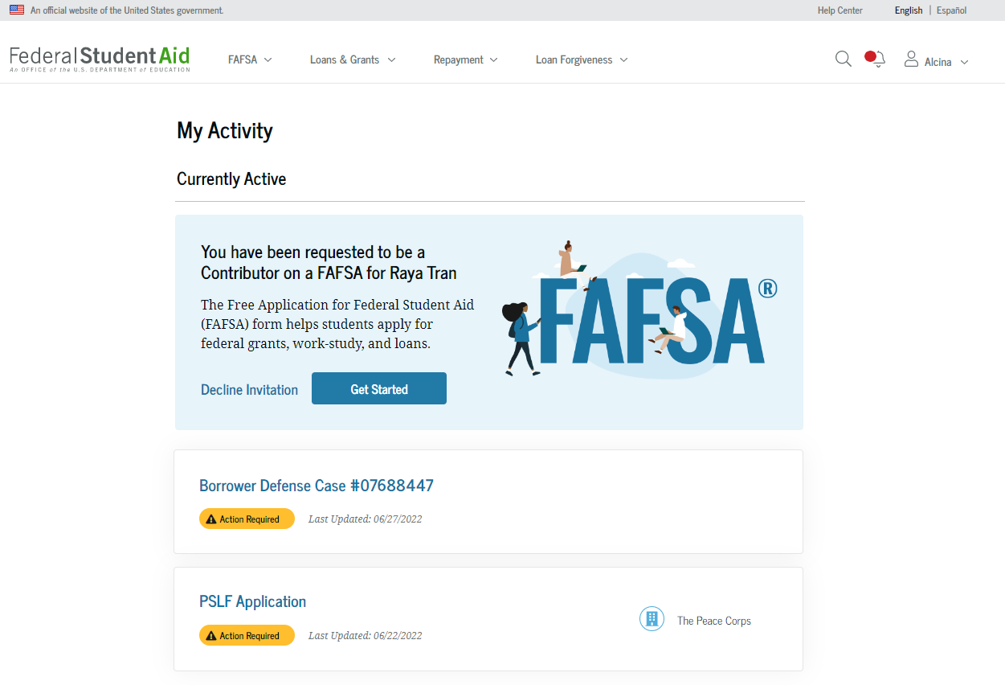
Applying for Financial Aid

Slide 16
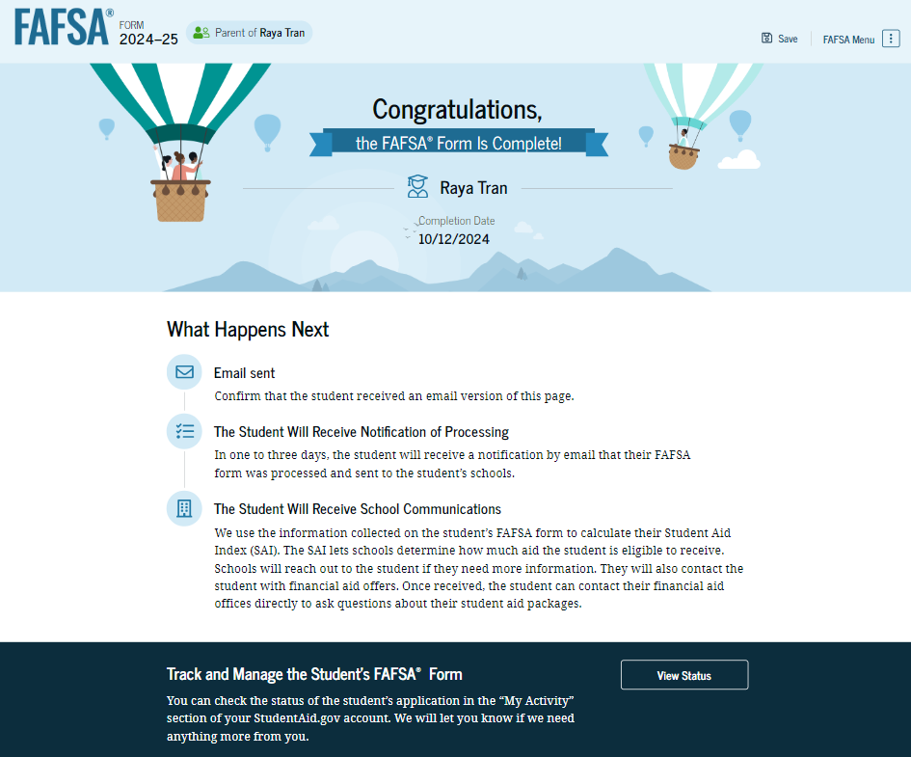
Applying for Financial Aid

Slide 17
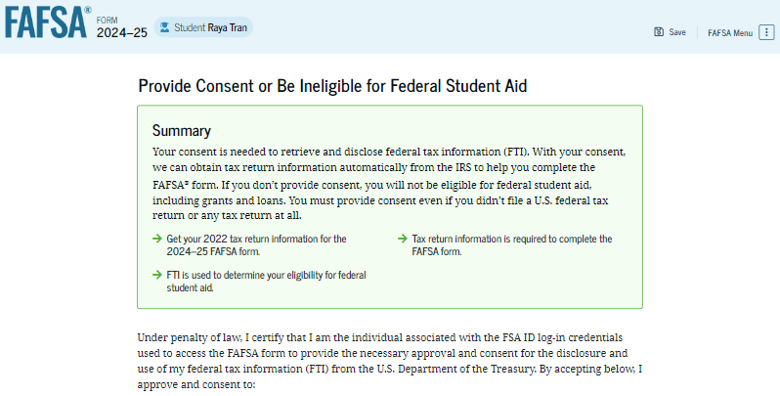
Behind the Scenes: Data Collected Via the IRS Direct Data Exchange
  “Consent” required each year
  No consent = not eligible for federal student aid
  For the 2024/25 FAFSA form = 2022 tax information
  Includes:
    Adjusted Gross Income
    Income Earned from work
    Untaxed Income (tax exempt income, retirement distributions and/or tax-deductible payments to a traditional IRA or self-employed retirement account)
    US federal income tax paid
    Education credits
    Net Profit/Loss – Schedule C
    Foreign Earned Income Exclusion
Applying for Financial Aid

Slide 18
What Happens After the FAFSA has been submitted?
Application sent to Mount Vernon, Illinois for processing
Calculation of Student Aid Index (SAI) Begins!
Not a random process
Based on a calculation that is composed by Congress (Federal Methodology)
Formula created by Congress
  Parent Income
    Taxed and Untaxed
    Protection allowance for taxes and basic living expenses
  Parent Assets
    Stocks, bonds, trusts, savings and business assets
    Allows for an asset protection allowance
  Student Income
  Student Assets
-
Applying for Financial Aid

Slide 19
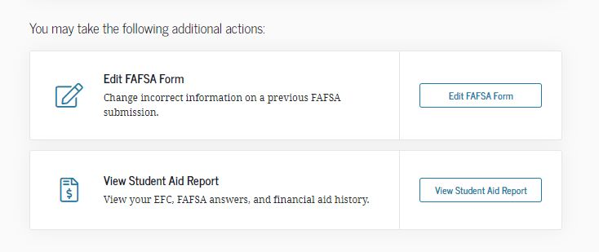
After the calculation is completed, what’s next?
The student will receive a FAFSA Submission Summary from the processor
  Notification will be emailed to student (usually within 72 hours)
  Check SPAM folders
  Link is only active for a short period of time
Applying for Financial Aid

Slide 20
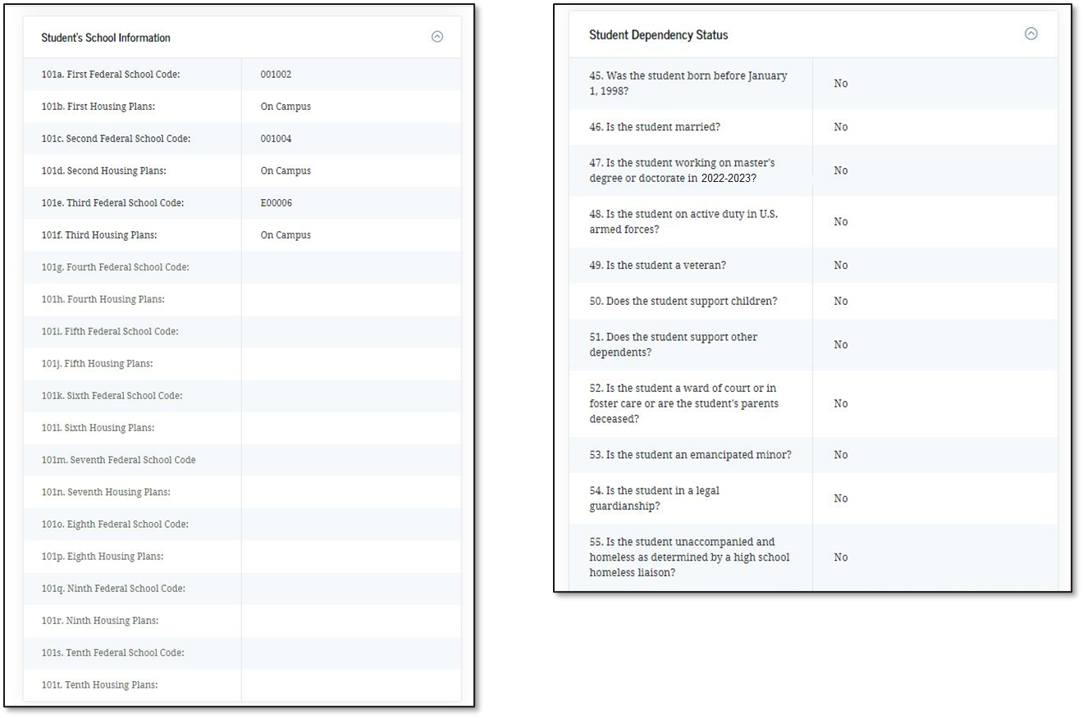
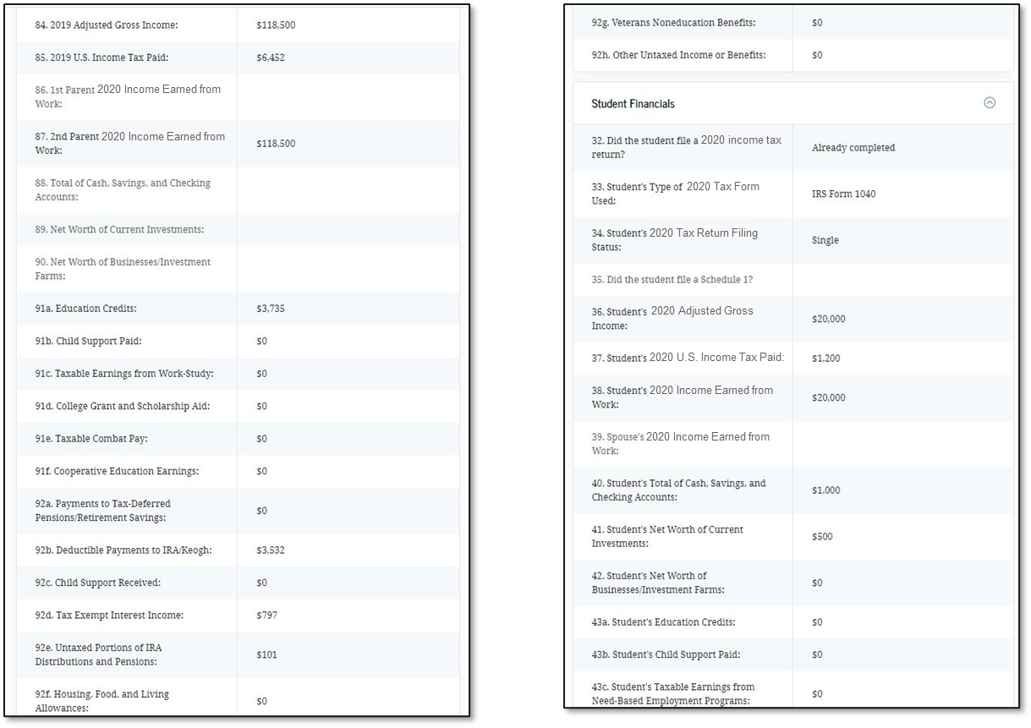
Additional Things to Note About the FAFSA Submission Summary
All institutions listed on the FAFSA will receive an electronic copy of the same FAFSA submission summary
Each school will initiate awarding of federal and/or state funds.
It is VERY IMPORTANT that the information on this form is accurate!
  Be sure to check your summary over carefully for errors!
  Both parent and student should review entire form, paying particular attention to the first page
Applying for Financial Aid

Slide 21
Common Errors to be Aware of When Filing the FAFSA
Check for the following:
  Is everything spelled correctly?
  Are email addresses correct?
  Do names match social security cards?
  Do you have the correct “parent(s)” listed?
  If parent completing, did they answer questions about the student correctly?
    Student section v Parent section
Other issues to be aware of (highlighted on the first page of the FAFSA submission summary):
    Citizenship Issue
    Social Security Conflict
Applying for Financial Aid

Slide 22
Types of Financial Aid
Five Types of Assistance
  Institutional Scholarships/Grants
  Entitlement Awards
  Need Based Aid
  Outside Funding
  Payment Options
Types of Financial Aid

Slide 23
Institutional Scholarships/Grants
Scholarships and Grants are gifts that DO NOT need to be repaid
May require separate application
Can be awarded to students based on any of the following:
  High school GPA
  Standardized test scores, if available
  Athletic ability
  Musical abilities
Scholarship competitions and/or honors programs
Renewability up to the individual school
  It’s important to ask each school what their policy is
Types of Financial Aid

Slide 24
Entitlement Awards
Entitlement funds are awarded according to either geographical location or religious affiliation.
Institutional Awards
Virginia Tuition Assistance Grant
  Bona-fide residents of Virginia who are enrolled in a VA Private college
Virginia Guaranteed Assistance Program (VGAP)
  Graduates of Virginia HS (2.5 GPA) who are enrolled in a Public VA University
  Awards Range by institution
  Renewed for up to 3 additional years
  Virginia Transfer Grant Program
  Recipient must be a first-time transfer minority student from an accredited institution
  Award amount is $1,000 per academic year
  Requires applicants to have a cumulative transfer GPA of at least 2.0
  Minimum number of college-level courses prior to transfer
Types of Financial Aid

Slide 25
Need-Based Aid
Automatic review for need-based programs upon FAFSA receipt
  Grants
  Loans
  Work
Types of Financial Aid

Slide 26
Need-Based Aid
The Federal Pell Grant Program
  Made to undergraduates with high need.
  Awards for 2023-2024 range from $767 to $7,395.
  Eligibility linked to family size, federal poverty level and enrollment intensity
    Usually families with adjusted gross incomes of $50,000 or less
  Federal Supplemental Educational Opportunity Grant (SEOG)
    Provides grants to students with high financial need, with consideration given to Federal Pell Grant recipients.
    The typical Roanoke College award ranges from $200 to $400.
Types of Financial Aid

Slide 27
Need-Based Aid
Supplemental Grant
  Awarded to students who can demonstrate financial need.
  Designed to help middle class families.
Virginia Commonwealth Award
  High need, Federal Pell Grant recipients from Virginia
  Must attend a PUBLIC University in VA
  Undergraduate and Graduate students
  Students with the greatest need receive the largest awards
  Amount: Varies by institution
  Renewal requires Satisfactory Academic Progress
Types of Financial Aid

Slide 28
Need-Based Aid
  Federal Student Loans
    Subsidized
      Available to all students who demonstrate financial need
      Government pays the interest, principle deferred
    Unsubsidized
      Available to all students who do not demonstrate financial need
      Student pays interest, principle deferred.
    Loan amounts:
      Freshmen: $5,500 (no more than $3,500 Sub)
      Sophomore: $6,500 (no more than $4,500 Sub)
      Junior/Senior: $7,500 (no more than $5,500 Sub)
    Interest Rate: 5.50% fixed for 23/24
    6 month grace period, 10 year repayment
Types of Financial Aid

Slide 29
Need-Based Aid
    Federal Work-Study Program
  Allows students to earn money while working in a campus job.
  Awards may range depending on institution
  How do student’s find jobs?
    Some institutions may assign positions to students
    Others will leave it up to the student to find employment on their own
      Interview
      Application
  Where might I work?
    Commonly on campus
    Select off campus locations
      America Reads
      Community Service Organization
      Must be an approved location – decision made by school
Types of Financial Aid

Slide 30
Outside Funding
Gates Millennium Scholars Program
United Negro College Fund
  Provides scholarships for outstanding low-income minority students
National Merit Scholarships
Military Scholarships
Robert C Byrd Scholarships
  Awarded to students based on academic achievement and excellence
  Recipients may receive up to $1,500 a year
  Students will be judged on GPA, test scores, letters of recognition, extra curricula activities, and community involvement
  To apply, students should contact the Department of Education in their
  home state
Types of Financial Aid

Slide 31

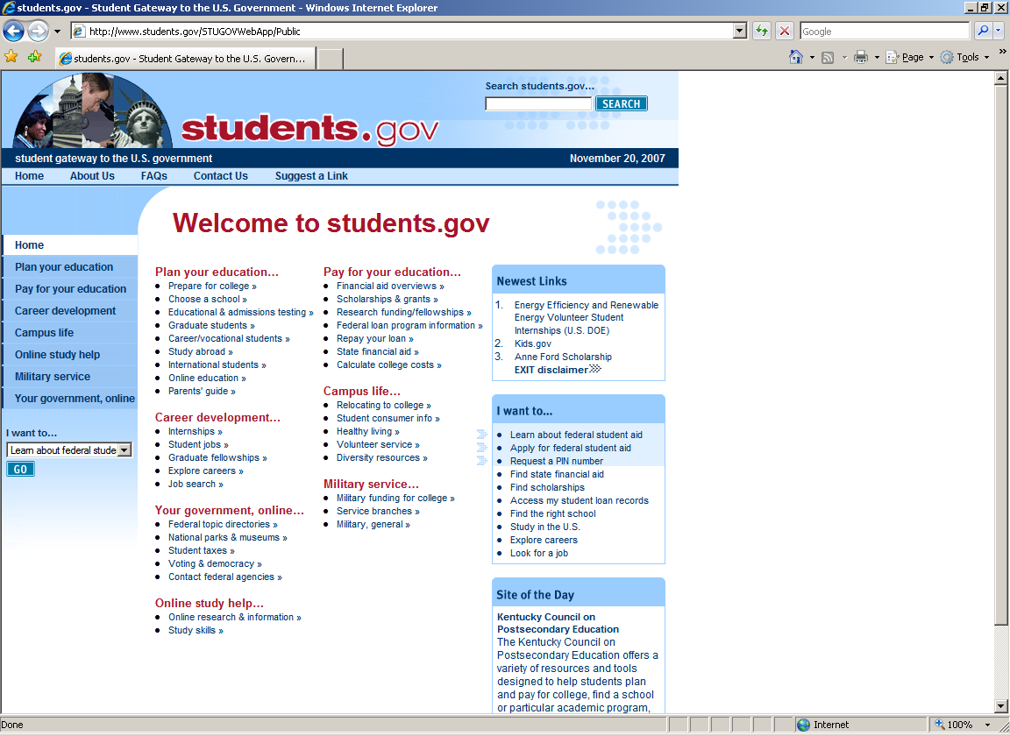
Scholarship Search Engines
www.fastweb.com
www.students.gov
Types of Financial Aid

Slide 32
Payment Schedules
  Cash Payment
  Credit Card Payment
    May have convenience fees
  Monthly Payment Plan
  Parent Loan for Undergraduate Students
    Provides non-need-based loans to assist parents of dependent students
    Credit check required
    Interest rate: Fixed 8.05% begins within 60 days of full disbursement
  Alternative Loans Student Loan.
    Co-signer is required.
    Credit check will be done.
    Wide variety of lenders and interest rates
Types of Financial Aid

Slide 33
Additional Notes
Use the Financial Aid Office as a resource!
Visit campus AND talk with Financial Aid while you are there
Respond to all requests in a timely manner
Use the financial aid calculators on each website
Communicate Special Circumstances
  Send each Financial Aid Office a detailed letter explaining your individual circumstances
  Send appropriate documentation (copies of W-2’s, tax returns, projections of income)
  Examples:
    Loss of job or benefit
    Separation or divorce after you have already filed the FAFSA
    Extraordinary out-of-pocket medical expenses (not covered by insurance)
    Sibling Educational Expenses
    Parent Educational Expenses
Additional Notes

Slide 34
Other Helpful Notes
  Meet the deadlines put into place!
      Late filing may mean missing out on aid opportunities
  Utilize IRS Education Credits
      American Opportunity Credit
      Lifetime Learning Credit
  Parents with multiple students
      Separate FAFSAs need to be submitted on each student
Additional Notes

Slide 35
Questions?
Melissa Lacombe
Director of Admissions & Financial Aid Operations
Roanoke College
mlacombe@roanoke.edu
or
(540) 375-2235

