Slide 1
Creating an FSA ID

Slide 2
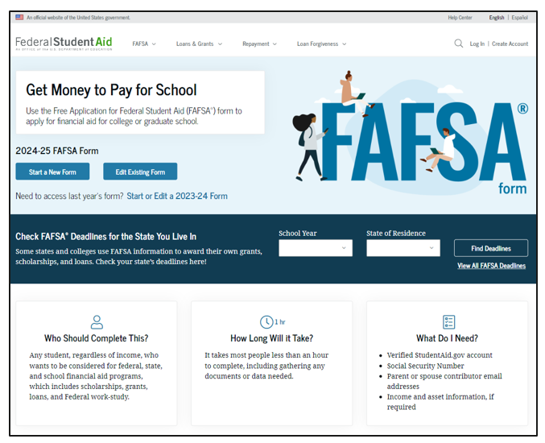
FAFSA
The FAFSA, or Free Application for Federal Student Aid, is your first step in applying for federal and state financial aid programs.
Complete the FAFSA every year for financial aid to help with college expenses.
Find the 2024-25 FAFSA at FAFSA.gov by December 31, 2023.
To access and sign the FAFSA, students and parents will need to create an FSA ID (Federal Student Aid Identification) at StudentAid.gov.

Slide 3
Used to determine your eligibility for financial aid
Used to determine your eligibility for financial aid
Also used to apply for some forms of
state aid
Required each year if you’re an Oklahoma’s Promise Scholarship recipient
Why should you complete the FAFSA?
Also used to apply for some forms of
state aid
Required each year for Alabama seniors as a graduation requirement

Slide 4
FAFSA Facts
The high school class of 2022 left about $3.6 billion in Pell Grants on the table by not completing the FAFSA.
Seniors who complete the FAFSA are 84% more likely to immediately enroll in postsecondary education.
By 2025, nearly
three out of four jobs will require education or training beyond high school.

Slide 5
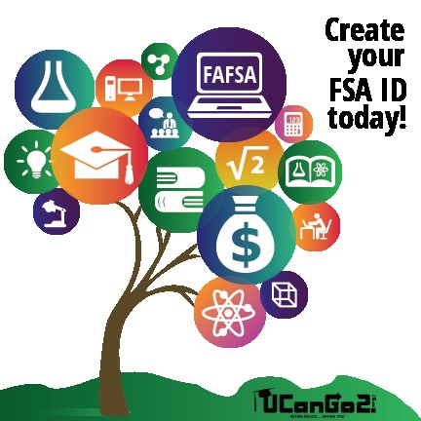
FSA ID
Username and password
Student and parent will each create their own FSA ID
Will be used each year to renew your FAFSA
Serves as your electronic signature
Create the FSA ID at StudentAid.gov
Will take 3-5 days to confirm your FSA ID

Slide 6
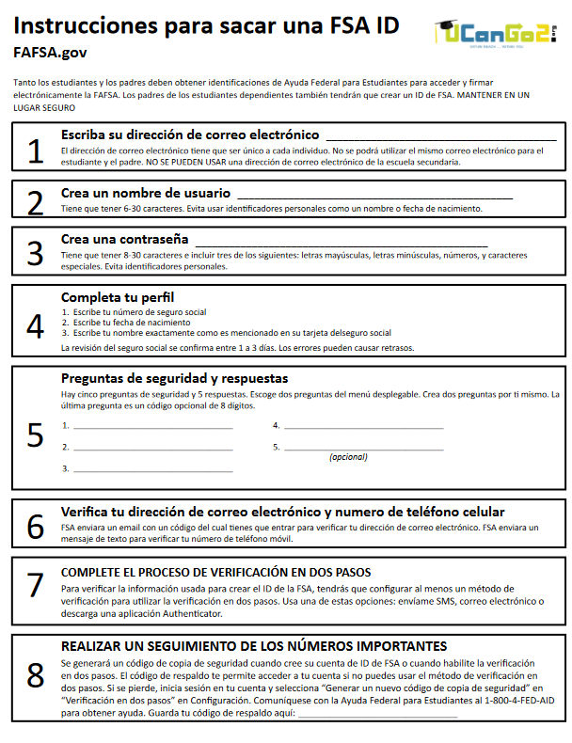
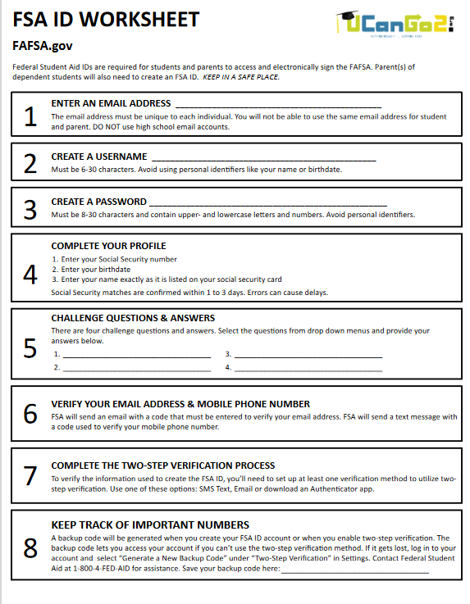
FSA ID Worksheet
Visit UCanGo2.org to print the FSA ID Worksheet in English or Spanish.
As you set up your FSA ID, you can record your information here for future reference.
Be sure to keep the worksheet in a safe place.

Slide 7
Full, legal name
Date of birth
Social Security number
Home address
Email address; don’t use your school email address
You can set up a free email account at one of these sites –
Gmail
Yahoo
Download a two-factor authentication app –
Google Authenticator
Duo Mobile
You will need these items to set up your FSA ID

Slide 8
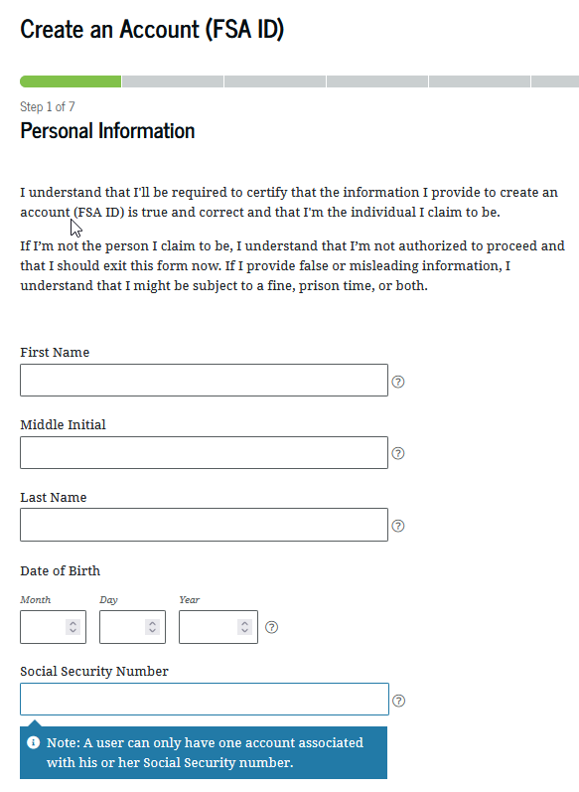
Personal Information
Enter your name, exactly how it appears on your Social Security card.
Enter the correct month, date and year of your birth.
Enter your Social Security Number accurately.

Slide 9
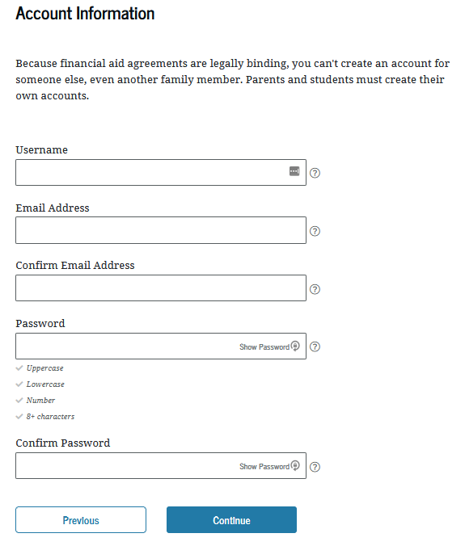
Username and Password
Username can be 6-30 characters long—a combination of letters and numbers. Not case sensitive.
Enter your name, exactly how it appears on your Social Security card.
Create and confirm your password; 8-30 characters long—a combination of numbers, upper- and lowercase letters.
Ener the correct month, date and year of your birth.
Choose ‘Show Password’ to see the information you’re entering.
Enter your Social Security number accurately.

Slide 10
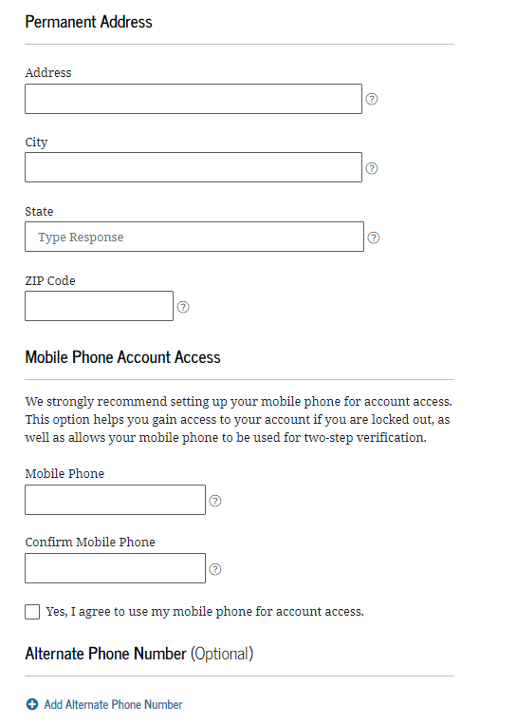
Contact Information
Enter and confirm your mobile phone number. (You can’t use the same cell phone number as your parent.) Your confirmation gives Federal Student Aid permission to send you a secure code if you should need to reset your password.
Enter your name, exactly how it appears on your Social Security card.
Enter your complete home address
Ener the correct month, date and year of your birth.
Enter your Social Security number accurately.

Slide 11
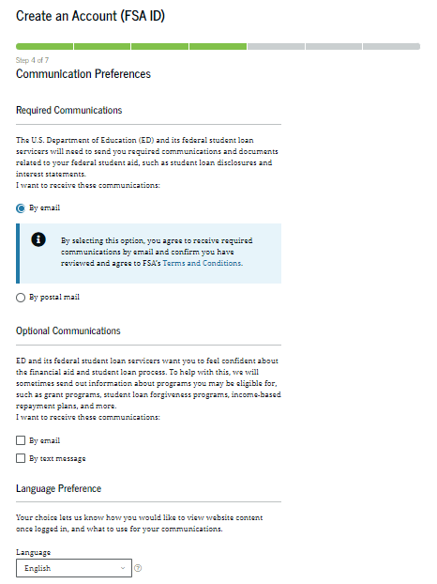
Contact Information
Enter your name, exactly how it appears on your Social Security card.
Choose how you would like to receive communication about your FAFSA
Email
Postal Mail
Text
Ener the correct month, date and year of your birth.
You can also request to have your FAFSA information provided in English or Spanish
Enter your Social Security number accurately.

Slide 12
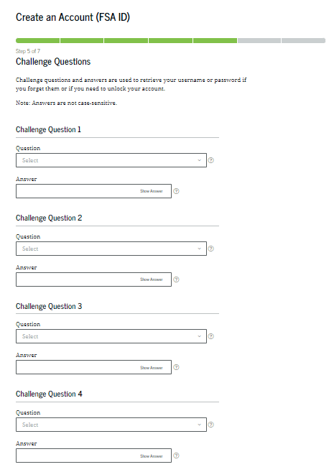
Challenge Questions
Enter your name, exactly how it appears on your Social Security card.
Choose four different challenge questions and enter each of your answers under the corresponding question.
Ener the correct month, date and year of your birth.
Enter your Social Security number accurately.

Slide 13
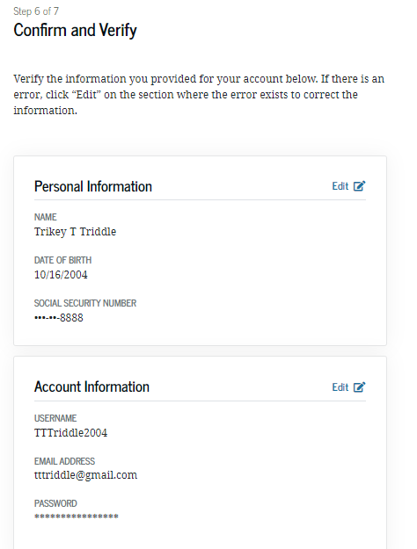
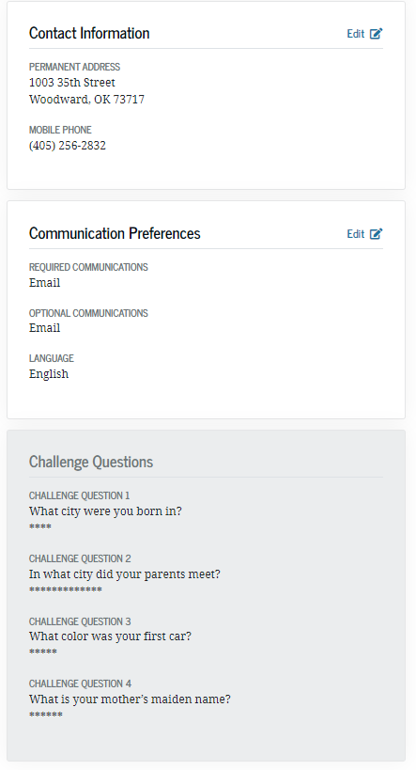
Confirm & Verify
Confirm and verify the information you’ve provided is accurate.
Ener the correct month, date and year of your birth.
Enter your Social Security number accurately.

Slide 14
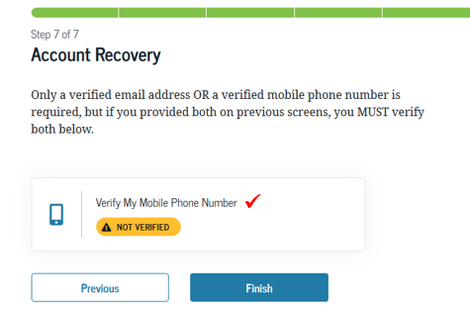
Verify Email & Phone Number
Student Aid will send a code to your cell phone and/or your email address. You’ll provide the code here to set up your FSA ID. The code will serve as confirmation of the information you’ve provided.
768523
Enter your Social Security number accurately.

Slide 15
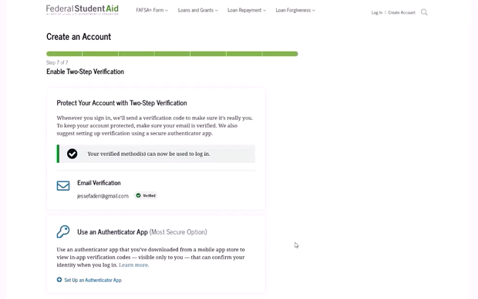
Two-Step Authentication
Installing an Authenticator App isn’t required, but it’s recommended as an added way to keep your information safe and secure.
You can download your own Authenticator App, or set one up directly from the FSA ID creation screen.
student@gmail.com
Enter your Social Security number accurately.

Slide 16
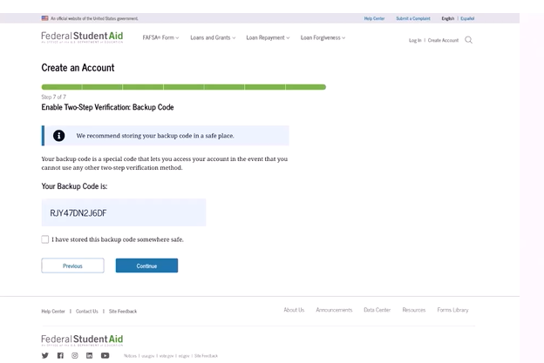
Backup Code
When your two-step authentication has been set up, you’ll receive a backup code.
This is the code you’ll use to login when you no longer have access to any of the methods you’ve just set up.
Store the code in a safe place.
Student Aid will send a code to your cell phone and/or your email address. You’ll provide the code here to set up your FSA ID. The code will serve as confirmation of the information you’ve provided.

Slide 17
Who Needs
an FSA ID Flowchart
Enter your Social Security number accurately.
UCanGo2.org

Slide 18
Where Can I Use My FSA ID?
Confirmation of your FSA ID can take from 3-5 days.
Once your FSA ID has been confirmed, you can use it to sign your FAFSA and access other Federal Student Aid websites.
Complete student loan paperwork and the Master Promissory Note (MPN)
Student loan entrance and exit counseling
Monitor student loan balances
Apply for student loan discharge under certain circumstances
Enter your Social Security number accurately.

Slide 19
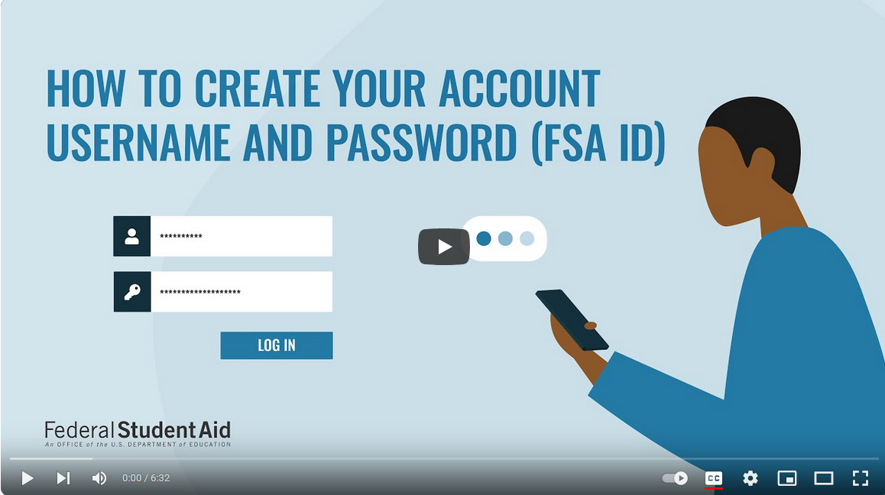
Creating My FSA ID Video
StudentAid.gov
Enter your Social Security number accurately.

Slide 20
Completing the FAFSA
The FAFSA for the 2024-25 school year will be available by December 31, 2023.
Find the FAFSA at FAFSA.gov.
Fill this form out every year to apply for financial assistance to help with college costs.
When completing the FAFSA, it’s best to have your parents with you. They will need to include some of their personal information.
Enter your Social Security number accurately.

Slide 21
Information you may need
to complete the FAFSA
Social Security Numbers for student and parent
Email addresses for student and parent
Alien Registration Number if not a U.S. citizen
Full, legal name for student and parent
Cell phone numbers for student and parent
2022 Federal Income Tax return for student and parent
Date of birth for student and parent
Date of marriage, divorce, separation
Enter your Social Security number accurately.
Value of assets, cash and savings

Slide 22
Contact Us
405.234.4239
866.443.7420 (toll free)
UCanGo2@ocap.org
This presentation is for educational purposes only, and is not intended to be construed as financial, investment, legal and/or tax advice.

