Slide 1
Student Instructions
EJHS 2020-2021

Slide 2
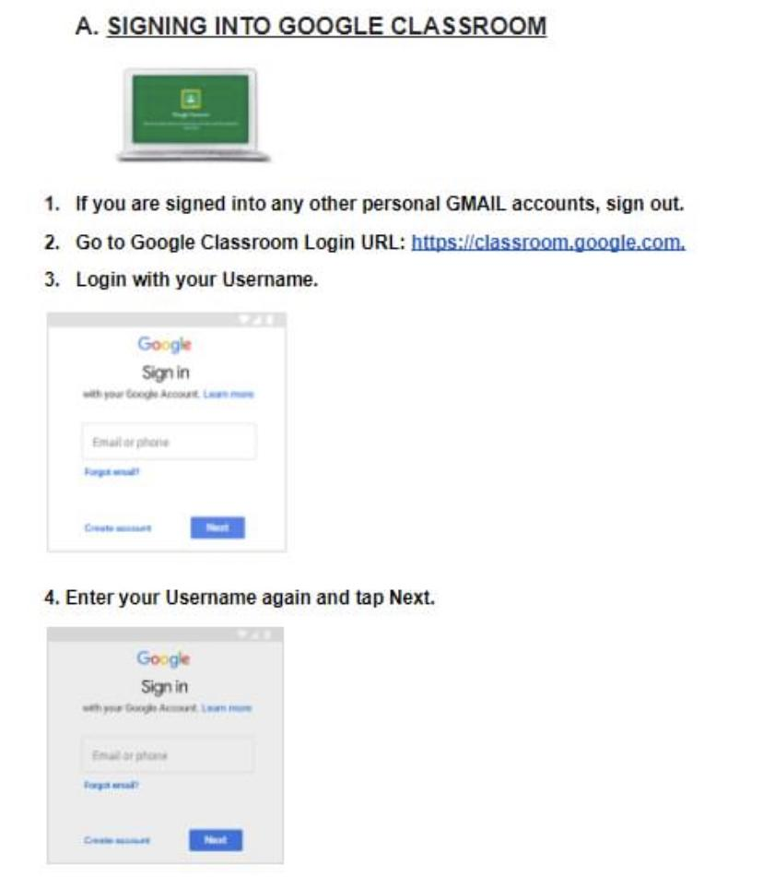
Google Classroom Instructions for Students

Slide 3
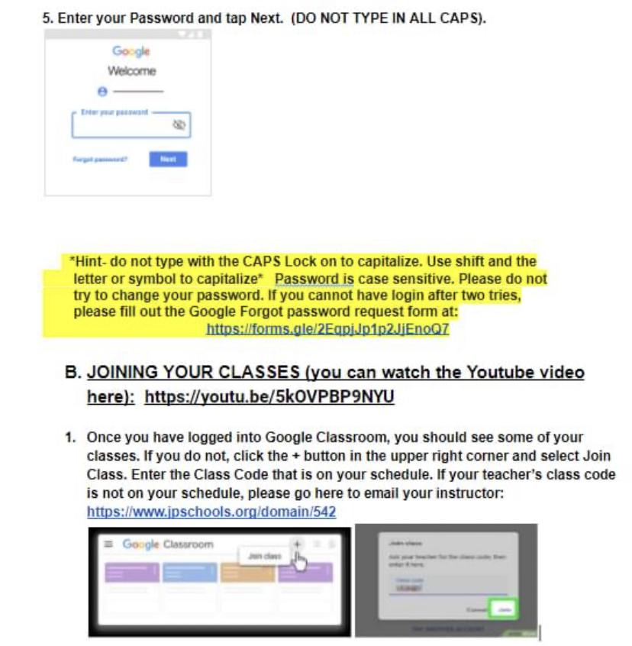
More instructions for students

Slide 4
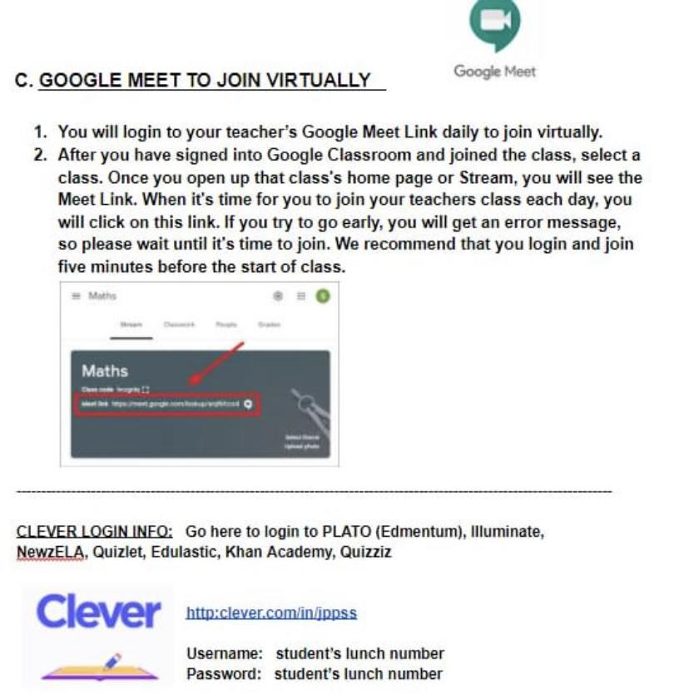
Student instructions to join Google Meet

