Slide 1

School District
Purchasing Essentials
Presented by: Deborah Ottmers, ECISD Chief Financial Officer
July 2022

Slide 2
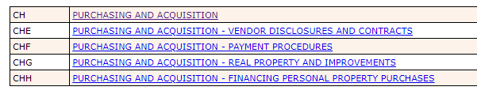
Policies – CH series

Slide 3
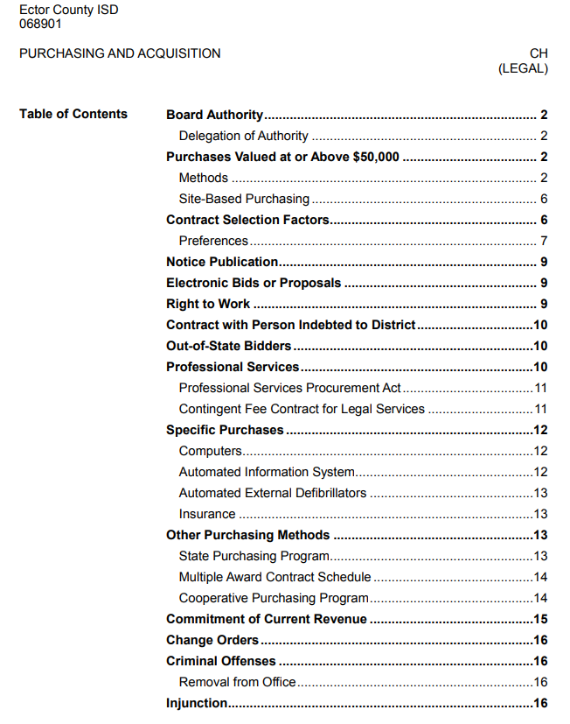
Policies – CH (legal)

Slide 4
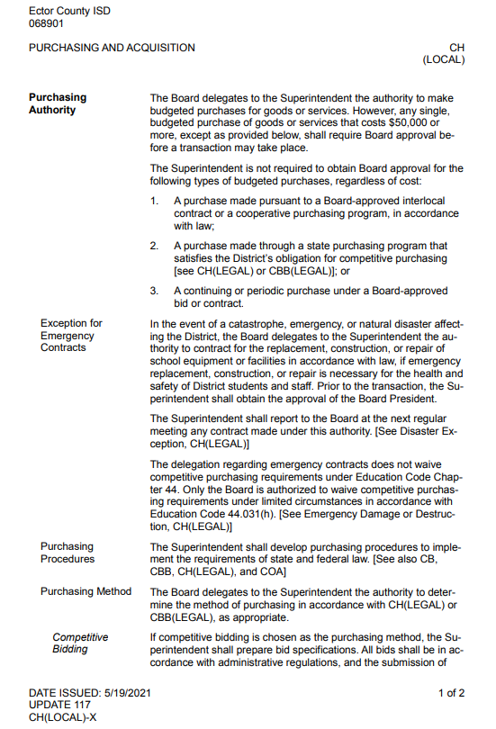
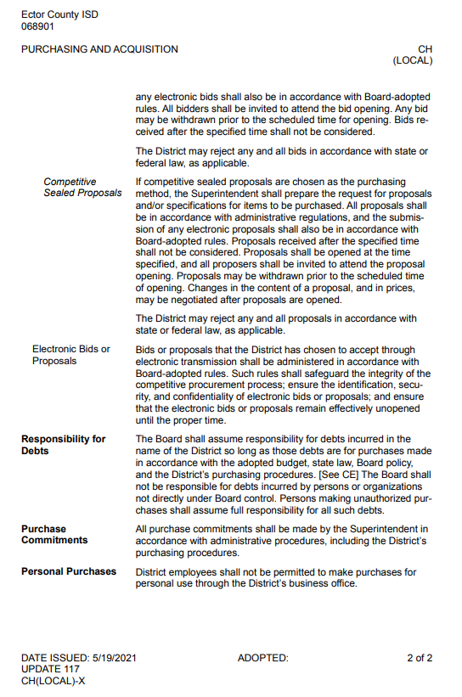
Policies- CH (local)

Slide 5
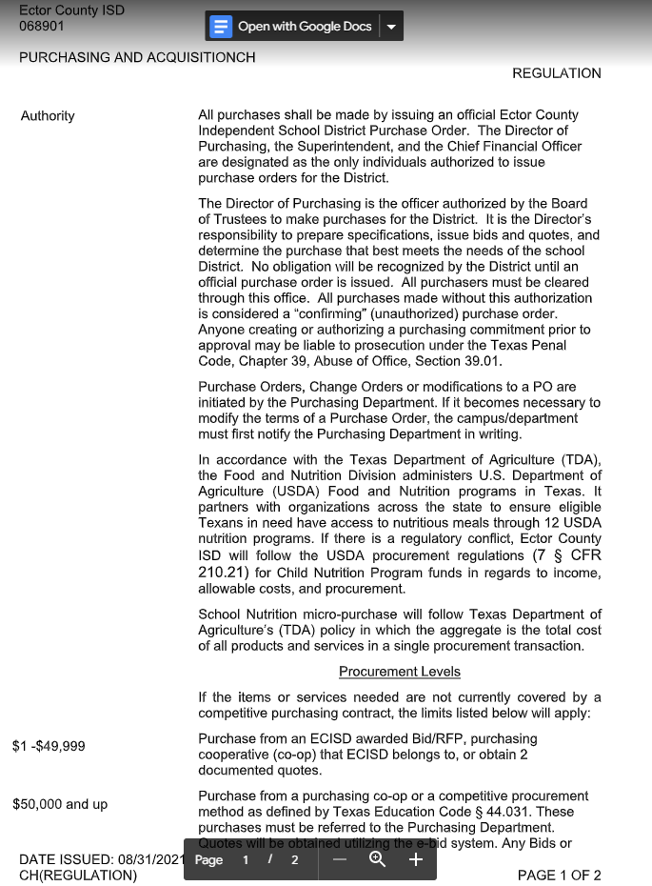
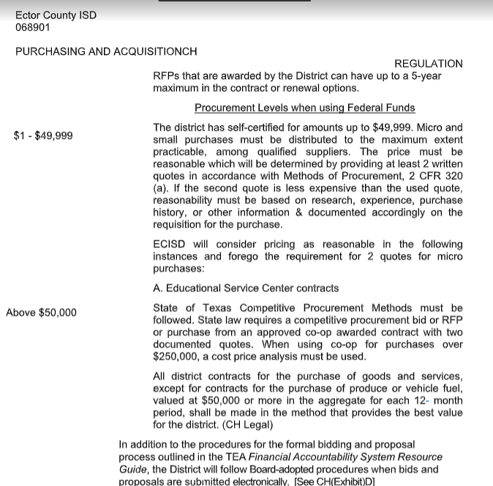
Policies- CH (regulation)

Slide 6
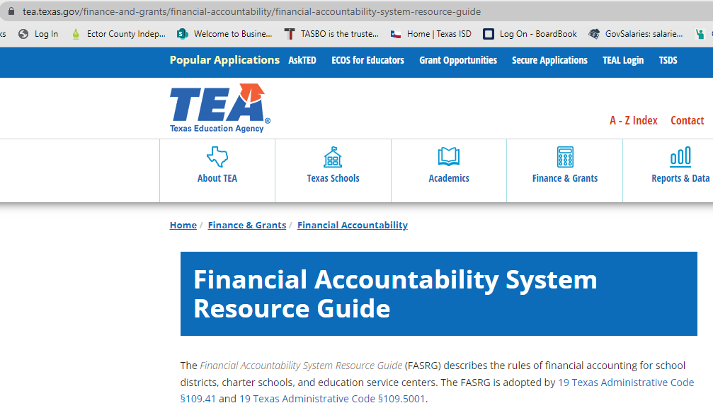
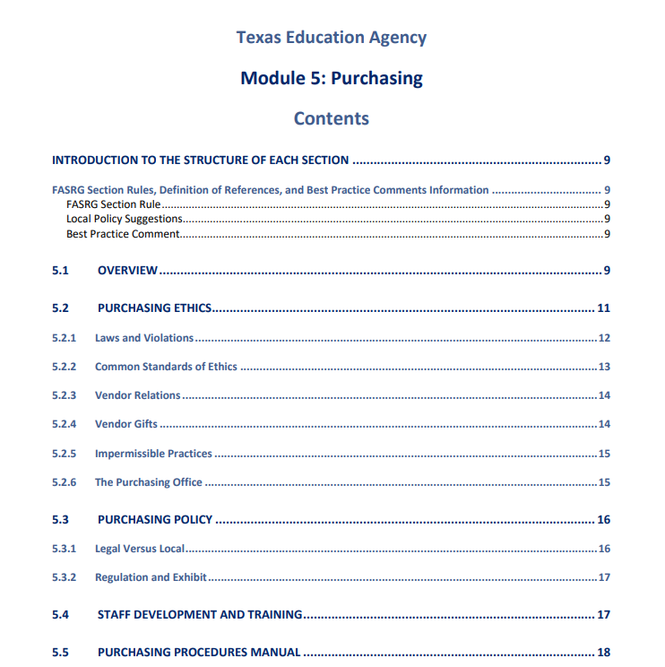
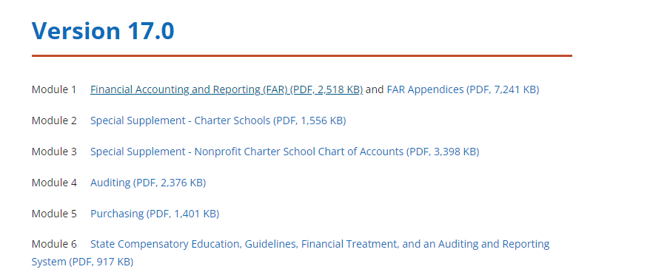
FASRG – 91 pages on TEA website

Slide 7
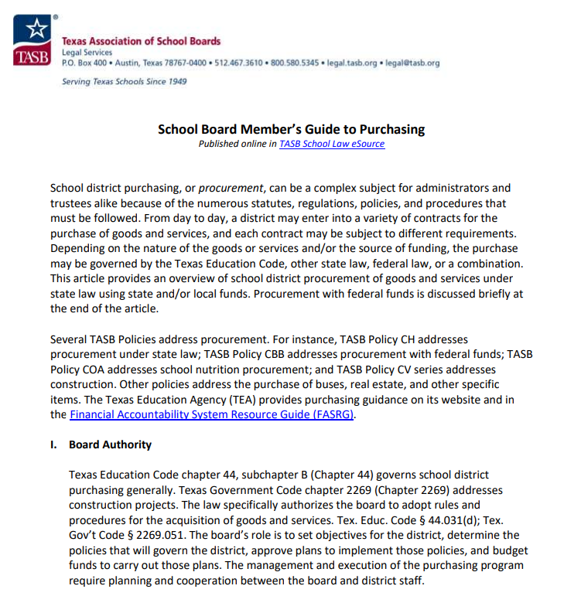
TASB -13 page document for Board members

Slide 8
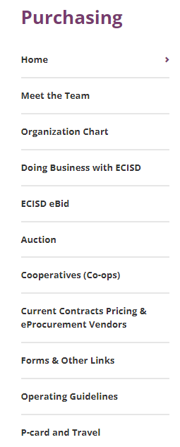
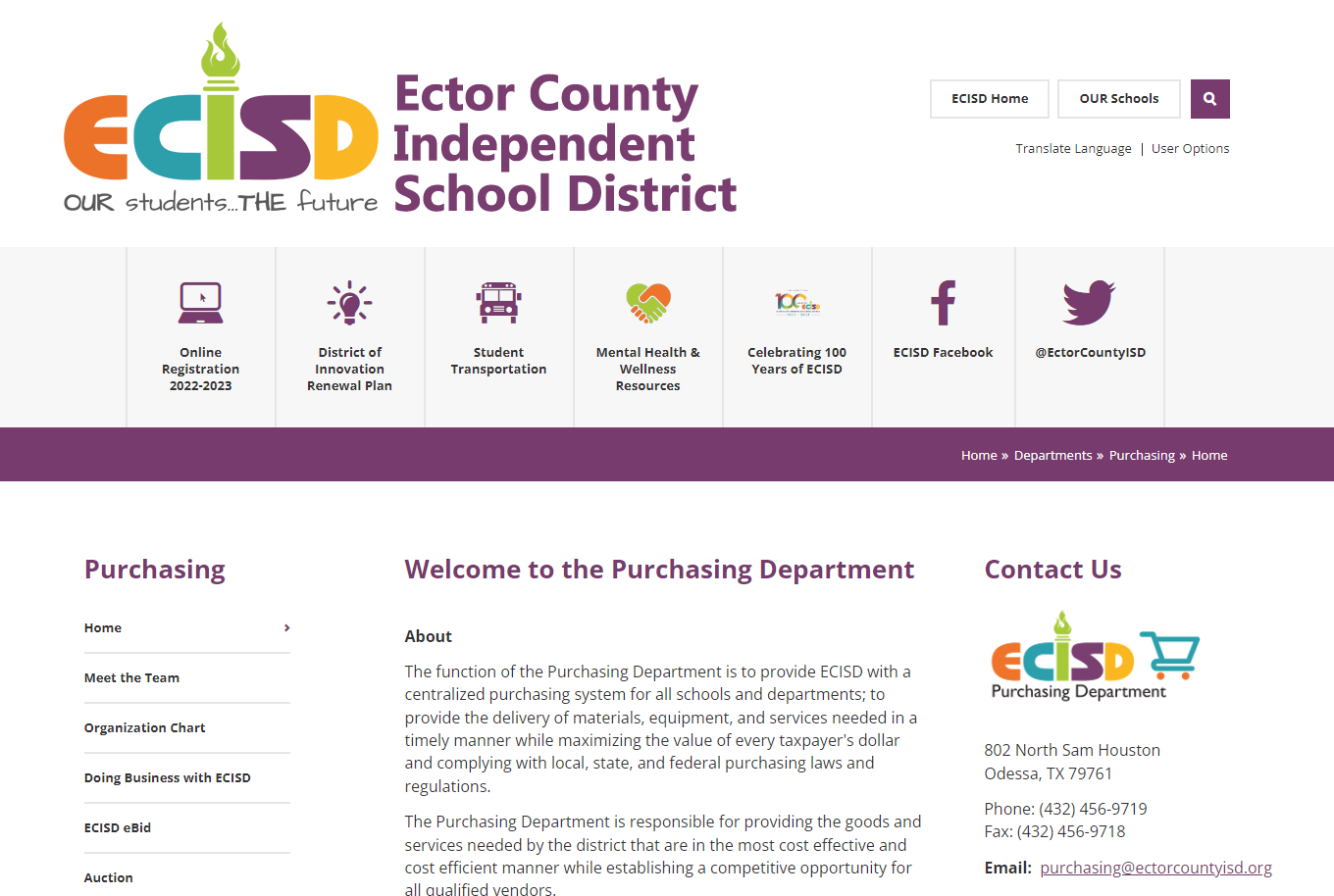
Purchasing Department website

Slide 9
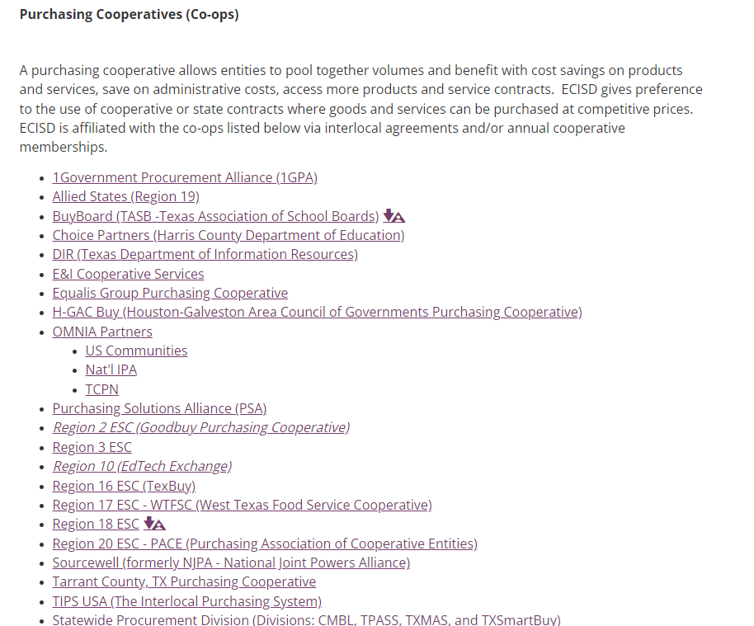
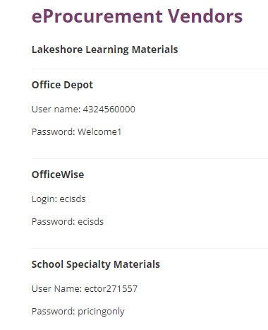
Purchasing Department Website

Slide 10
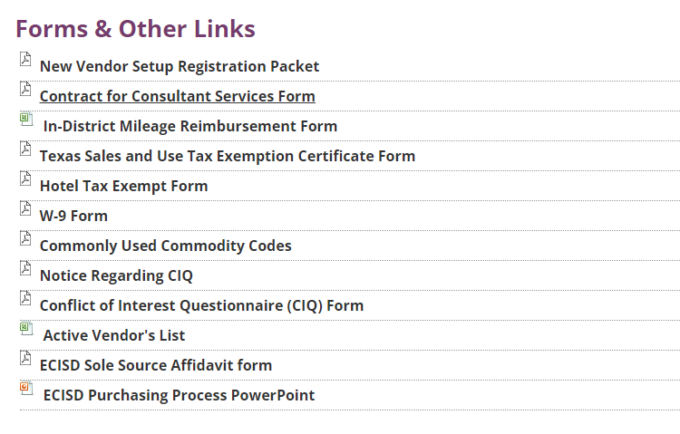
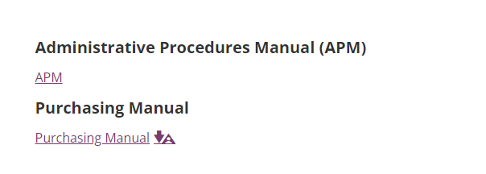
Purchasing Department Website

Slide 11
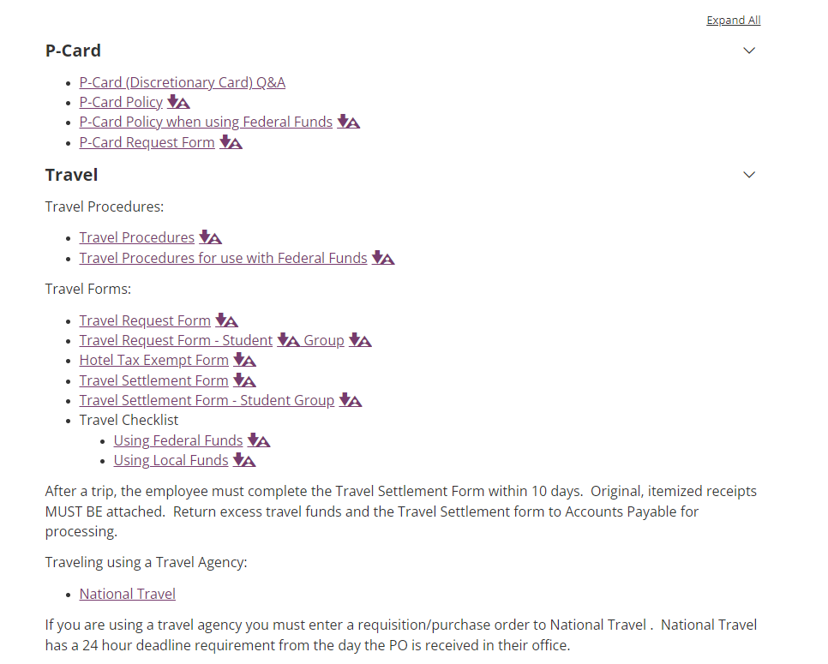
Purchasing Department Website

Slide 12
Exempt Status
Texas public school districts are exempt organizations
This means we do not pay tax on most purchases and we have special exemptions regarding paying tax on revenues generated
We do not apply for IRS 501c3 status, but we are statutorily exempt (TAC 3.322) as a political subdivision of the state of Texas (TGC 172.003)

Slide 13
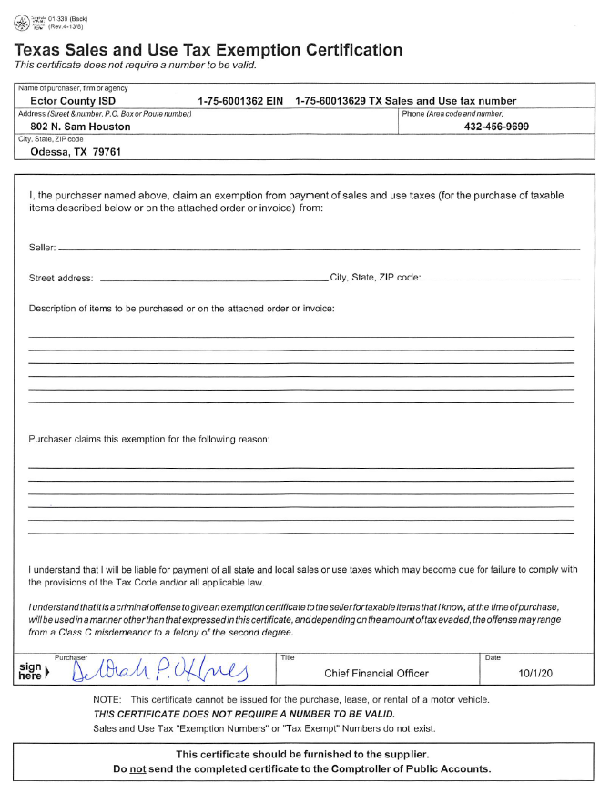
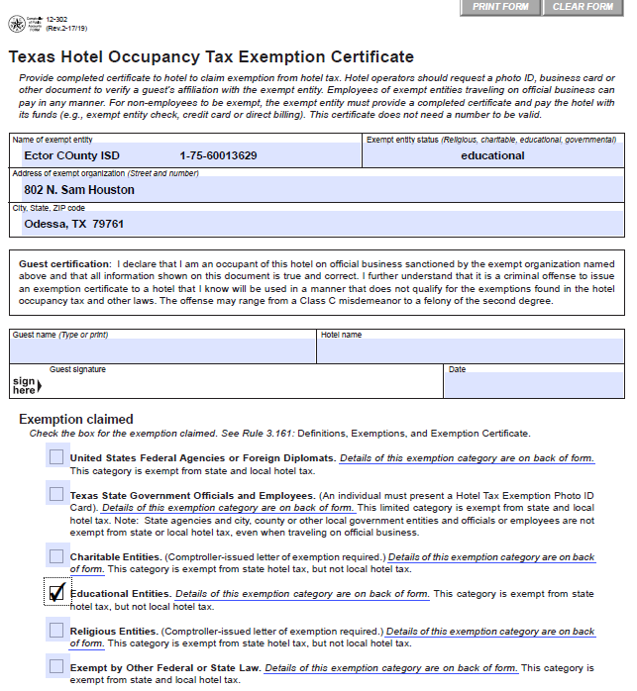
Do not pay most taxes when providing exemption form

Slide 14
Issues to be mindful of
  Do not purchasing goods or services without a PO in place
  Include the correct account code on a purchase requisition
  Including location on the req in the “reference” section and then campus/department is not printed on the shipping label (for Amazon in particular).
  Generally you should not pay sales tax when using P-card (except for individual meals and local hotel taxes and airline and fuel taxes)
  Turning in travel requests late and expecting funds loaded on a P-card
  Settling up travel late

Slide 15
School District
Purchasing Essentials
Presented by: Deborah Ottmers, ECISD Chief Financial Officer
July 2022

