Slide 1


Josette Dobbins
Director of Purchasing for ECISD
Josette.Dobbins@EctorCountyISD.org
Office Phone: 432-456-9719
July 2021
1

Slide 2
Who are the people behind all the smoke and mirrors?
Introducing:
Josette Dobbins, Director of Purchasing
Sylvia Luna, Senior Buyer, Travel and P-Card Administrator, Purchasing
Aundretta (Shanta) Harris, Contracts Specialist, Purchasing
Monica Lopez, Purchasing Clerk, Purchasing
Robert Sertuche, Coordinator, Instructional Materials & Records Management
Jaime Subia, Supervisor, Print Shop, Mail, and Central Receiving

Slide 3
OUR GOAL / OUR MISSION
Our Goal
Our goal is to select suppliers that bring the best value to our District.
Our Mission
Our mission is to provide exceptional customer service and guidance procuring various goods and services to all campuses and departments.

Slide 4
FUNCTIONS OF THE PURCHASING DEPARTMENT
The function of the Purchasing Department is to provide ECISD with a centralized purchasing system for all schools and departments; to provide the delivery of materials, equipment, and services needed in a timely manner while maximizing the value of every taxpayer's dollar and complying with local, state, and federal purchasing laws and regulations.
The Purchasing Department is responsible for providing the goods and services needed by the district that are in the most cost effective and cost efficient manner while establishing a competitive opportunity for all qualified vendors.

Slide 5
ADDITIONALLY, ECISD is a taxing entity so we must follow the laws and regulations of the State of Texas. These laws and regulations are in the Board Policy CH (Legal), CH (Local), and CH (Regulation).
These Purchasing laws and regulations can be found on the District’s webpage:
  Go to https://www.ectorcountyisd.org/Page/1
  Hover over Our District and click on Board of Trustees
  Click on Board Policy Online to review the policies in detail

Slide 6
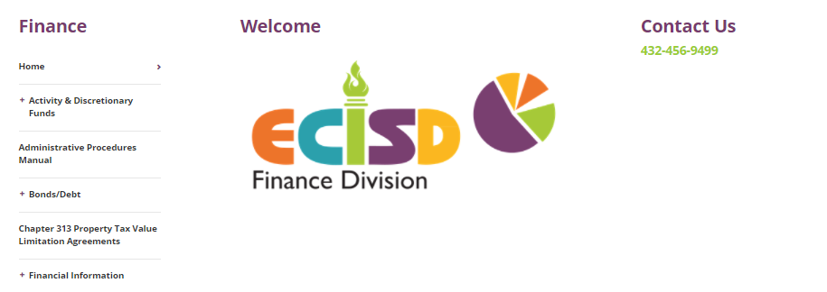
Administrative Procedures Manual (APM)
ECISD webpage > Departments > Finance Division > Administrative Procedures Manual
The Administrative Procedures Manual (APM) is an administrative business operating and federal procedures manual that contains policies and procedures dealing mostly with the finance, procurement, travel, federal regulations, and the administrative side of the district.
This online document is the official Administrative Procedures Manual.

Slide 7
Purchasing Processes
The Wheel of Purchasing Services
Determine Need
Explore and Select Vendor(s)
Submit Requisition
Convert Requisition to Purchase Order
Receive Goods
Submit Invoice to A/P for Payment

Slide 8
Before entering a Requisition
    Determine the need
        The need is identified by the user’s department
    Explore and select a vendor
        Do your due diligence
        Get at least two quotes

Slide 9
Vendor Due Diligence
Are reasonable steps taken by a person in order to satisfy a legal requirement, especially in buying or selling something.
    Determine the need
        The need is identified by the user’s department
    Explore and select a vendor
        Get at least two quotes

Slide 10
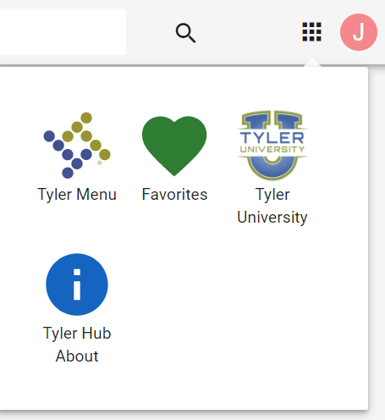
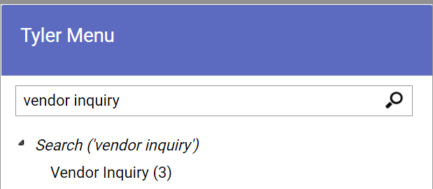
How to look up a vendor
Open Munis
Click on the nine pixeled squares in the top right hand corner of your Tyler Hub page
Click on Tyler Menu
Type Vendor Inquiry in the search box
Hoover over Vendor Inquiry (3), right click > click Add to Favorites for future use
Meanwhile click on Vendor Inquiry (3)

Slide 11
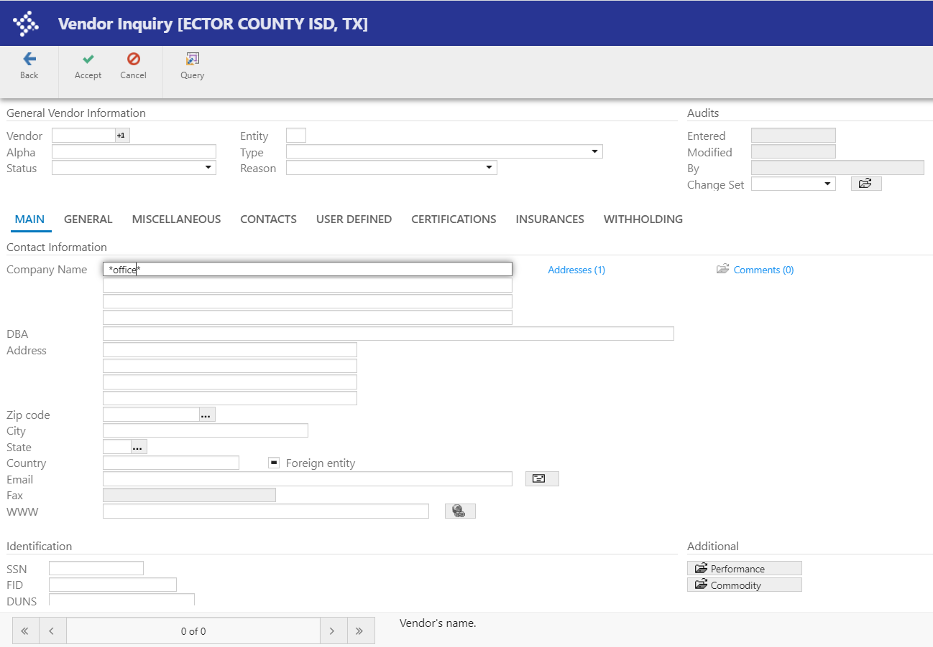
How to look up a vendor continued
Click Search on the ribbon panel
If you do not have the vendor # do this…Type in your search surrounded by two asterisks in the Company Name or DBA (for example *Office* to use a partial name search) A word surrounded by two asterisks will bring back all vendors that have the word “office” in it. To narrow your search add more letters (e.g. *officewise*). To broaden your search type in less letter (e.g. *off*)
Make sure the Status is Active for available usage; otherwise contact Purchasing for setup
Also note: You may search on any box; for example if you only have the vendor’s address

Slide 12
What if the vendor is not setup in Munis?
Send a Vendor Setup Packet to the vendor
Email the completed vendor packet to the Purchasing Department
Purchasing will ask:
  Who is the vendor?
  Will the vendor be working with students?
  Why are you requesting the vendor to be setup?
  How is the vendor unique from the District’s existing vendors?
  How will this benefit the District?
  Who in Technology approved the software application request?
  How much do you plan to spend with this vendor?
  Are you using General funds or Federal funds?

Slide 13
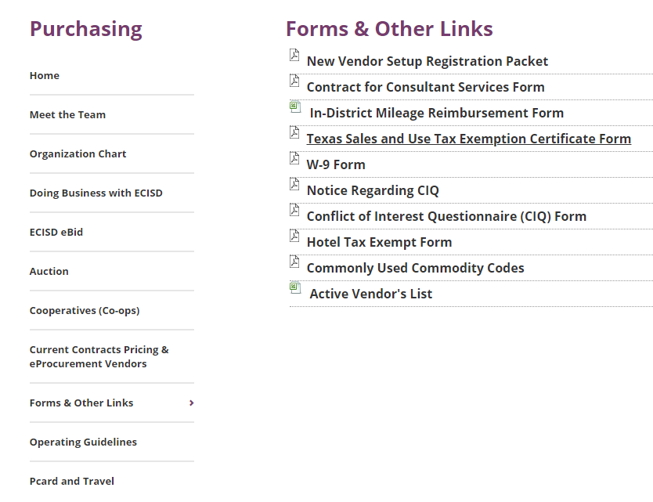
Vendor Setup Packets
ECISD webpage > Departments > Purchasing > Forms & Other Links

Slide 14
Vendor Setup Compliance Checkpoints
If the vendor is going to be working with students the vendor will have to get:
  A Background Check
  Fingerprinted, and
  A Urinalysis
      (these checks are initiated by Human Resources)
Vendors must complete the vendor setup packet in its entirety
Vendors must certify they do not have Felony Convictions and do not have a Conflict of Interest doing business with the District
Check the SAM.gov registry-Confirms whether the vendor is excluded from a federal contract or grant.
Check the Debarment List-Confirms vendor has not been excluded from doing business on the federal level.
Check the Divestment List-Confirms vendor does not and will not boycott Israel and confirms the vendor does not do business with a foreign terrorist organization.
ALL CLEAR…now the Vendor can be setup to do business with the District

Slide 15
Submitting a Requisition

Slide 16
Different Types of Requisitions
A requisition is the documents district employees use to order products or services on behalf of the District.
Normal Requisition
Long-term Requisition
eProcurement (aka Shop Online or Punchout)
Warehouse Requisition

Slide 17
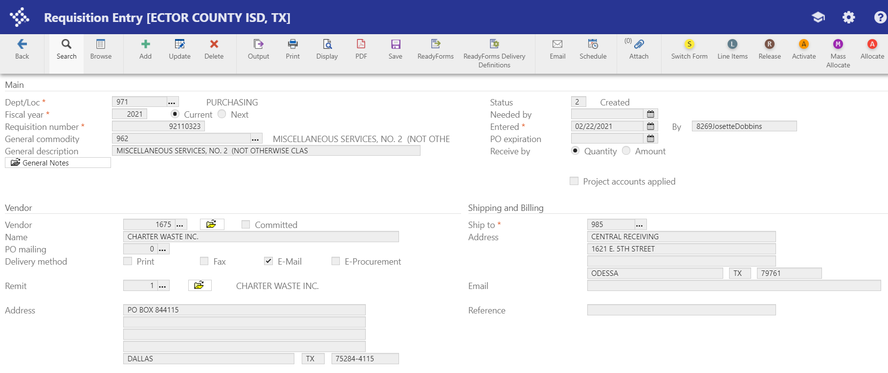
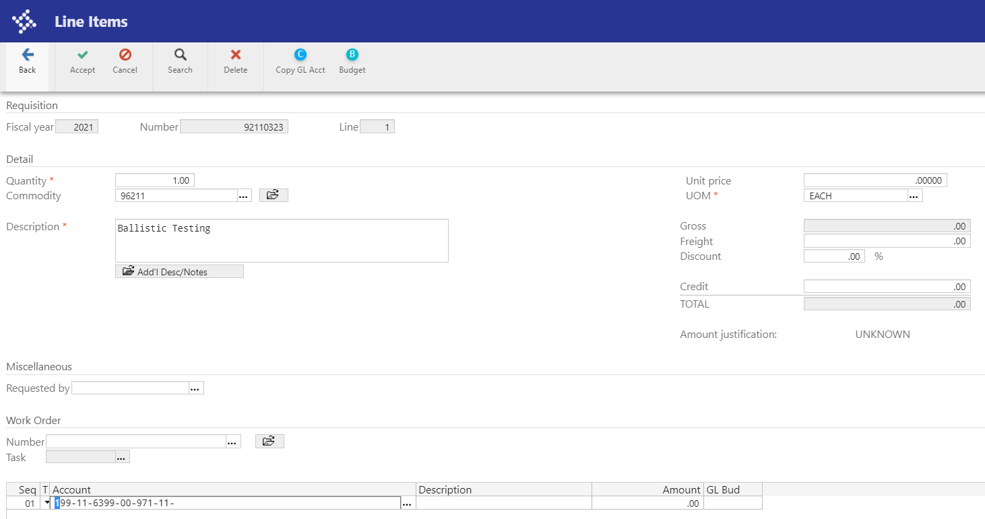
How to enter a NORMAL requisition
Open Google Chrome
Click Managed bookmarks on your toolbar
Select Munis Live from the list
After you login, click Add on your ribbon panel
Your Dept/Loc # is set to automatically appear and until you’re a pro at entering reqs. TAB is your trusted friend to guide you through the requisition entry process
Tab until you reach General Commodity (a list of commonly used commodity codes can be found on the Purchasing webpage) > enter your three-digit code here (Please note: all five numbers you will need them on the Line Item page)
Tab > enter the General Description
Tab > enter the Needed by date (for Sam’s orders ONLY)
Tab > enter the Vendor #
Tab > enter a Reference (i.e. dept. name & contact person or RFP#)
Click Accept
Click Add on the Line Items page on your ribbon panel
Tab > enter Quantity
Tab > enter the five-digit commodity code (a list of commonly used commodity codes can be found on the Purchasing webpage)
Tab > enter the Description
Tab > enter the Unit Price
Tab > enter the Account code (e.g. xxx-xx-xxxx-xx-xxx-xx- or project code xxx-xx-xxxx-xx-xxx-xx-xxxxx)

Slide 18
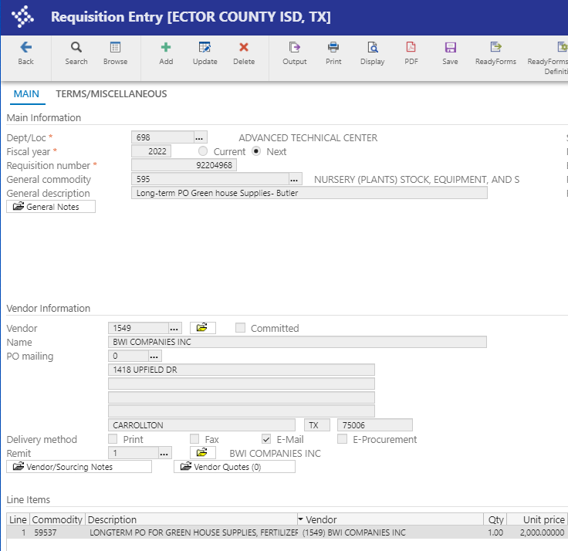
How to enter a LONG-TERM requisition
Repeat steps 1 thru 6 on the previous slide
Step seven enter the General Description and Description (Type in the words Long-term PO description line to notify Purchasing & A/P your requisition will be paid using multiple invoices)
Repeat steps 8 thru 17 on the previous slide
A Long-term Purchase Order is the preferred method for placing orders which will require multiple payments over a period of time. Reoccurring purchases like a phone bill or document shredding, etc.

Slide 19

eProcurement
eProcurement/Shop Online/Punchout are all phrases used when referring to purchases made using electronic communication. Using punchout, an end-user can access vendor catalogs and then purchase products seamlessly.
eProcurement Vendors
Lakeshore Learning Materials
Office Depot
OfficeWise
School Specialty Materials
CDW-G (for Purchasing & IT use only)

Slide 20
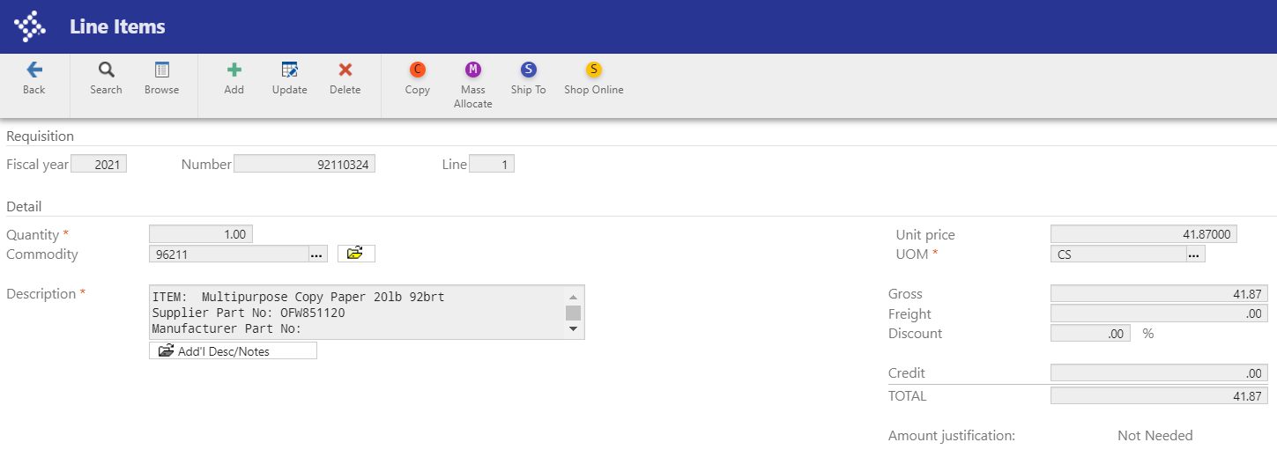
How to enter a SHOP ONLINE requisition
Repeat steps 1 thru 8 on slide seven
Step 9 enter the eProcurement Vendor’s # (i.e. Amazon, CDW-G, Lakeshore Learning, Office Depot, OfficeWise, or School Specialty)
Repeat steps 10 thru 11 on slide seven:
  Tab > enter a Reference (i.e. dept. name & contact person or RFP#)
  Click Accept
Click Shop Online on the ribbon panel (first-time users may have to login – the Username and Password can be found on the Purchasing webpage)
Make selection(s), Add to Cart, when complete > Checkout
Click It is OK to close this page
Click Continue on the ribbon panel
Your selections will automatically populate into the document
Click Update on the ribbon panel
Do not forget to enter the five-digit Commodity Code for each line item
Tab > enter the Account code

Slide 21
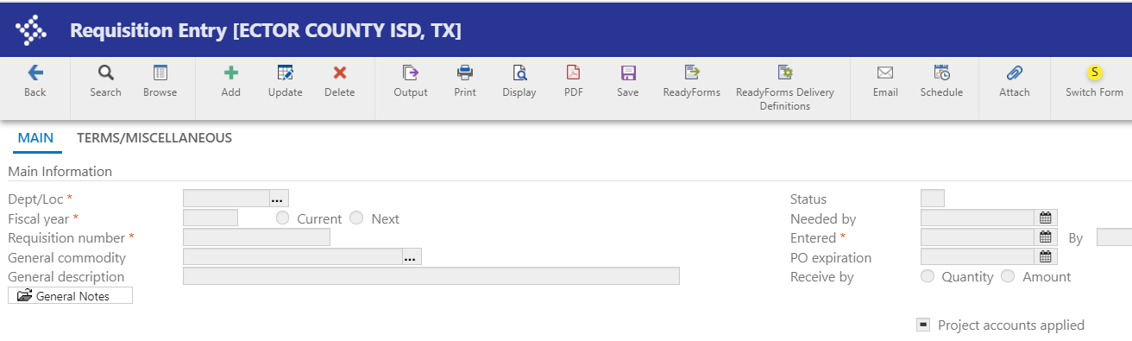
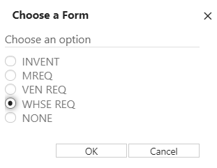
How to enter a WAREHOUSE requisition
Open Google Chrome
Click Managed bookmarks on your toolbar
Select Munis Live from the list
After you login, click Add on your ribbon panel
On the ribbon panel click Switch Form > choose form option WHSE REQ > click OK
Tab through so the system can auto-populate the fields with an red * > Tab until you reach General Commodity (For WHSE REQ, the general commodity code will be either 310 (plain envelopes) or 645 (paper, for office/print shop use). No other general commodity codes should be selected for WHSE REQ) (Please note: all five numbers you will need them on the Line Item page)

Slide 22
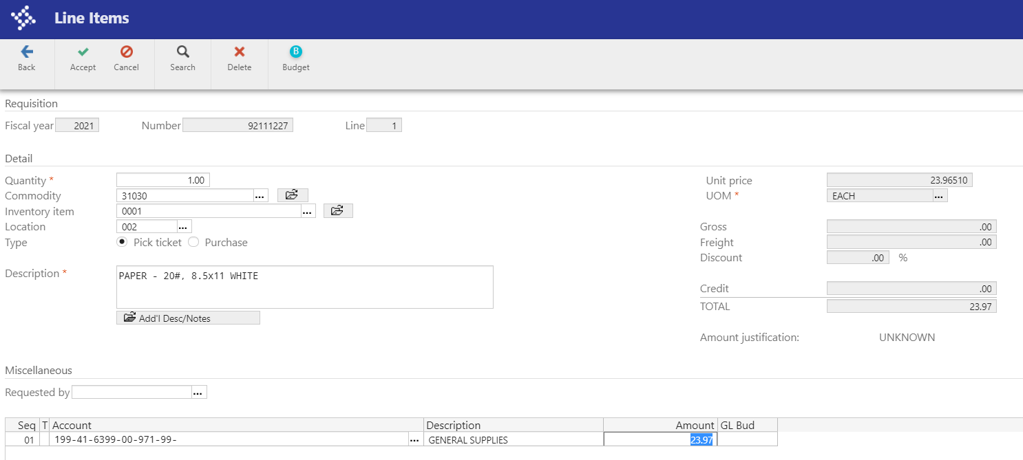
How to enter a WAREHOUSE requisition continued…
Step seven enter the General Description, click Accept when done – this will take you to the Line Item screen > click Add on the ribbon panel
Enter the Quantity
Enter the five digit Commodity Code
Enter Inventory Item
Enter the Location
Select Pick ticket Very Important step (If you forget to click Pick Ticket you will have to start over)
Description Do not change the description that has populated into the description box
Enter your Accounting Code > tab once, click Accept on the ribbon panel
Click Back on the ribbon panel
Click Release on the ribbon panel to release the document for Approval Do not forget this step otherwise your document will stay in your queue and never progress

Slide 23
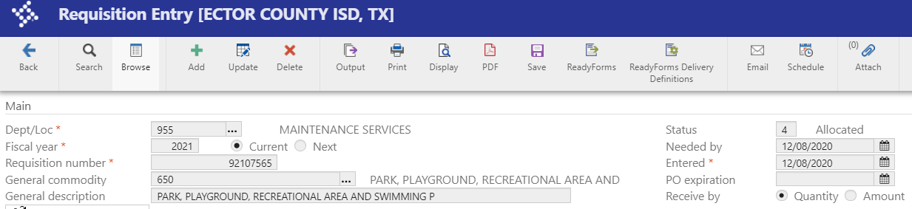
Workflow
With Workflow, the following specifies the current approval Status of a selected requisition:
  1 = Rejected – Needs attention, refer to your email for further instruction
  2 = Created – indicates you’ve started a req, but have not entered an accounting code
  4 = Allocated – indicates you’ve enter all of the required data, but have not Release the document for approval
  6 = Released – indicates you’ve released the document for approval
  8 = Approved – indicates the req is going through the approval process
  Click on the “Approvers” button at the bottom of each requisition to see who is next in line to approve a “Released” requisition
  0 = Converted – means the req has been converted into a Purchase Order

Slide 24

Unauthorize purchases are considered a “Confirming” purchase
A confirming purchase is an unauthorize purchase of goods and services submitted for payment after a purchase has been initiated. Employees who make purchases without a proper PO (or who make unauthorized purchases) may be personally responsible for making payment to the vendor.
Examples | Confirming
An invoice submitted for payment or reimbursement after a purchase | Yes
If you submit a professional service contract one day after an event’s start date | Yes
If you submit a invoice for payment for an annual membership renewal | No

Slide 25
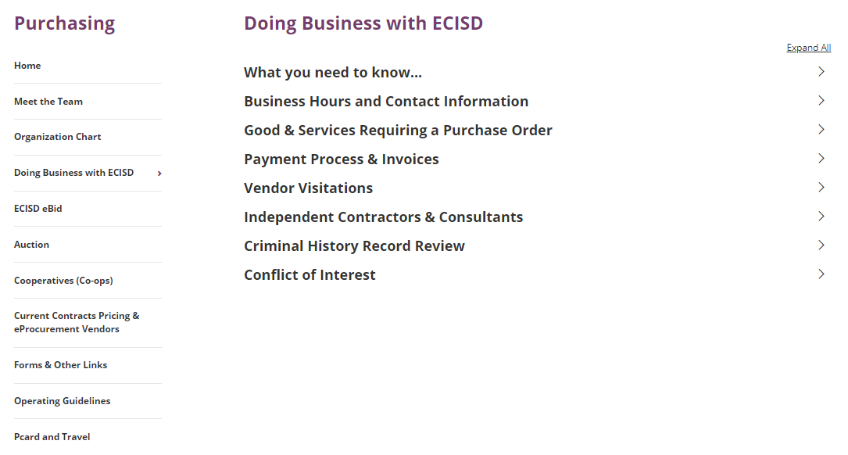
Payment and Processing Invoices – See Doing Business with the District
ECISD webpage > Departments > Purchasing > Doing Business with ECISD
VERY IMPORTANT:
Attach Quotes to Requisitions
Send INVOICES to Accounts.Payable@EctorCountyISD.org

Slide 26
Purchasing Thresholds and Requirements

Slide 27
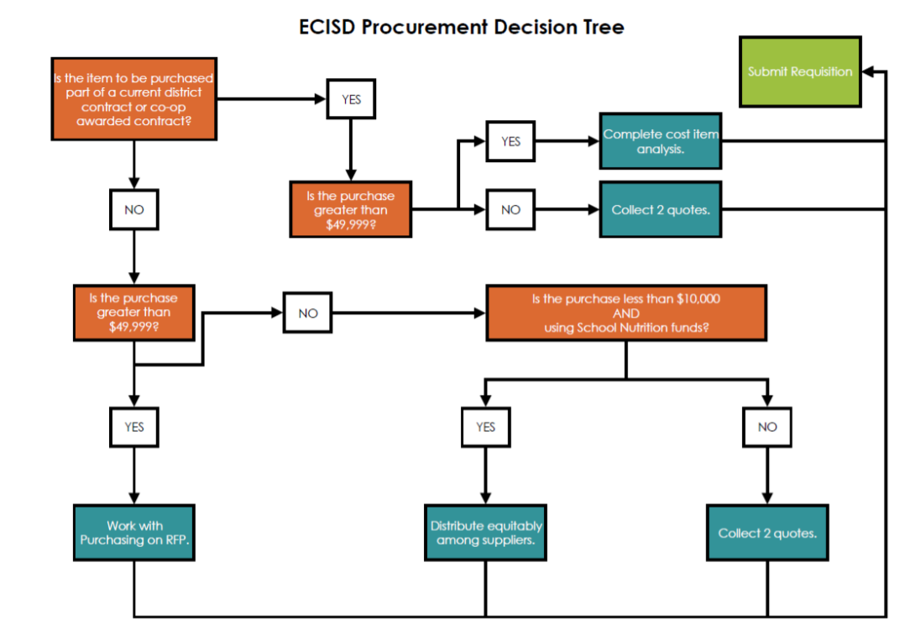
The Procurement Decision Tree

Slide 28
Purchasing Thresholds/Requirements – Local Funds
Purchase Commitment Amount | Support Required | Additional Forms | RFP Required | Board Approval Required | Advertising Required
$.01 - $49,999 | 2 written quotes, 1 quote if purchase is apart of a Cooperative (Coop), or Purchased from an Awarded RFP | No | No | No | No
$50,000 and up | 1 quote if purchase is apart of a Cooperative (Coop), otherwise Competitive Procurement Required | Yes – Bid Proposal and Bid Tabulation | Yes | Yes | Yes (15 days minimum)
Sole Source $50,000 and up | 1 quote | Notarized Sole Source Affidavit | No | Board Agenda Item Required | No

Slide 29
Purchasing Thresholds/Requirements – Federal Funds
Purchase Commitment Amount | Support Required | Additional Forms | RFP Required | Board Approval Required | Advertising Required
$.01 - $49,999 | 2 written quotes even if purchase is apart of a Cooperative (Coop), Educational Service Center Contract, or Purchased from an Awarded RFP | No | No | No | No
$50,000 and up | 2 written quotes even if purchase is apart of a Cooperative (Coop), Purchased from an Awarded RFP, or Competitive Procurement Required | Yes – Bid Proposal and Bid Tabulation | Yes | Yes | Yes (15 days minimum)
Sole Source $50,000 and up | 1 quote | Yes – Must be approved by TEA | No | If TEA approved, a Board agenda Item will also be Required | No

Slide 30
Other Methods of Procurement

Slide 31
Other Methods of Procurement
May be subject to board approval
  Use of Cooperative (Co-op)
  Use of Interlocal Agreement
  Use of contracts from other governmental agencies (piggyback)
  Emergency Purchases
  Sole Source Purchase

Slide 32
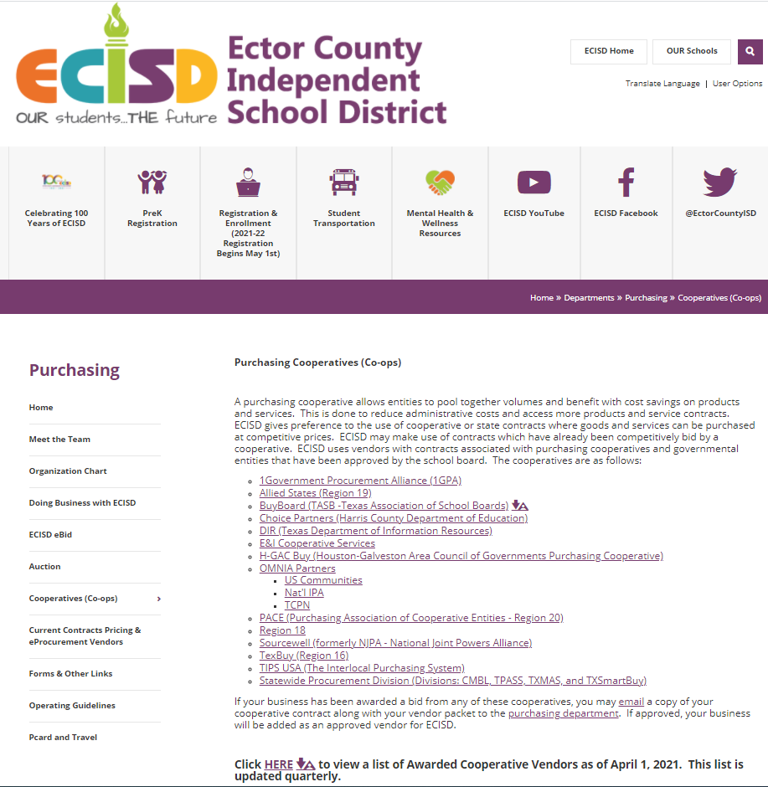
Cooperative or Co-op
  A purchasing cooperative allows entities to pool together volumes and benefit with cost savings on products and services. This is done to reduce administrative costs and access more products and service contracts.
  A listing of the District’s approved co-ops can be found on the Purchasing webpage.

Slide 33
  Interlocal Agreement
§ 791.001. The purpose of this chapter is to increase the efficiency and effectiveness of local governments by authorizing them to contract, to the greatest possible extent, with one another and with agencies of the state.
An interlocal agreement must be between another local governmental entity, (including public corporations created by a local government), the state, or an agency of the state.
  It cannot be with a private organization.
  Both sides of the agreement must have legal authority to engage in the contracted procedure.
      Approvals required:
        Department Head approval
        Superintendent and/or CFO approval
        Board approval
        Purchasing approval

Slide 34
  Piggybacking
Piggybacking is approved between local governments in the Texas Local Government Code. a. TXLGC 271.102 (a) à A local government may participate in a cooperative purchasing program with another local government or a local cooperative organization.
Essentially, Piggybacking is the use of a contract by another agency that was not, itself, a party to the original solicitation and contract award. Agencies choosing to piggyback on another agency's contract are bound by the terms, conditions and pricing provided for by the contract.
      Approvals required:
        Department Head approval
        Superintendent and/or CFO approval
        Potential Board approval
        Purchasing approval

Slide 35
Emergency Purchase
This justification is used when purchases are made in an emergency situation
  An Emergency justification is submitted to Purchasing which includes the following:
    Vendor name and cost
    Description of the emergency and the goods or services needed
    An outline of steps that will be taken to avoid the same emergency in the future
    Explanation of rationale for why that vendor was chosen
    Approvals required:
      Campus/Department Head approval
      Superintendent and/or CFO approval
      Potential Board approval
      Purchasing approval
Rarely Used

Slide 36
Sole Source
This justification is used when purchases are made from a sole source (only one vendor can provide the specific good or service needed by the District)
The District recognized that there may be instances when sole source purchases must be made, but such purchases must be appropriately justified according to Education Code 44.031. Additionally, a bona fide sole source purchases are rare. In most cases, there are products/services of similar form, fit, and function available from other sources.
TEA states that the affidavit or sole source letter from a vendor is not sufficient documentation to issue a noncompetitive procurement. TEA continues by stating that under the new regulations, Sole Sources must be proven and adequately documented, and will seldom be used in federal procurements.
SS Purchases made with Local Funds | SS Purchases made with Federal Funds
Requires a notarized ECISD Sole Source Affidavit | As of October 2020, Sole Source usage must be approved by TEA
Submit to Purchasing for approval and processing | TEA processing can take several weeks to respond

Slide 37
Competitive Bidding, Securing Bids, and Making Awards

Slide 38
Competitive Bidding
  Procurements for goods and services must, whenever possible, be accomplished through competitive bidding. If the District spends over $50,000 for certain commodity codes the District must prepare on a bid or make the purchase through a state purchasing program (co-op) that satisfies the District’s obligation for competitive purchasing.

Slide 39
Securing Bids and Making Awards
Purchasing is working to standardize and streamline the bidding process, resulting in the best possible value and/or lowest possible cost to the District. Below is a flow chart that will help refine each stage in the process.
Developing the Project Bid Proposal/Specifications Consider all aspects of the project from implementation to inspection
Recruiting, Qualifying, Registering Vendors in eBid - Consider requesting samples or conducting a demonstration as a means to narrow down the selection
Preparing the RFP Packet should include specs, draft contract, bidding instructions, e.g. closing date, process of submitting Q&A, submitting bid proposal.
Developing a Bid Summary Report - Prepare a bid tab or side-by-side report to compare bids. Identify categories and any exceptions to the specs. The purpose is to show “apples to apples” comparison.
Presenting the Bid Summary Report or Supporting memo to the Board for approval The supporting document is used to justify the request for approval. The documentation should include: the purpose, background info, Cost, funding source, & supplier recommendation
Awarding the Project - Once Board approvals, Purchasing award electronically using eBid, prepare a letter awarding the contract, wrap up details.

Slide 40
RFPs, RFQs, & RFIs are used as part of the competitive bidding process
RFPs (Request for Proposals) are written solicitation requesting the submission of proposals.
RFQs (Request for Qualifications) are written solicitation requesting the submission of qualifications or specialized services. (e.g. property insurance, technology, etc.)
RFIs (Request for Information) is generally done to gather information to help make decisions on what steps to take next.

Slide 41

Electronic bidding (eBid)
eBid
eBid/Ion Wave is the software used to perform the competitive bidding process and supplier management. Potential bidders/suppliers may register and upload sealed bid proposals. eBid can be access through the Purchasing webpage at www.ectorcountyisd.org/ecisdbid.
Bid Advertisements
Current bid/proposal solicitations are announced in the local newspaper (Odessa American) for 15 days before being awarded to a supplier. Note: Awards over $50,000 must be Board approved first.

Slide 42
Contracts
  All awards result in either a contract or a Purchase Order
  Contracts typically will have renewal options
  The number of renewals are noted in the specifications and is determined by the user’s campus or department

Slide 43
On another note…

Slide 44
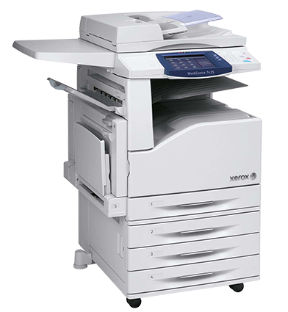
Copiers
Departments seeking to lease a copier must coordinate with the Purchasing Department.
Copiers leases are 36 months.
Copier leases are handled executed by the Purchasing Department.
Copiers requisitions are created by the Purchasing Department and are billed to the departments or campuses annually using a long-term PO.

Slide 45

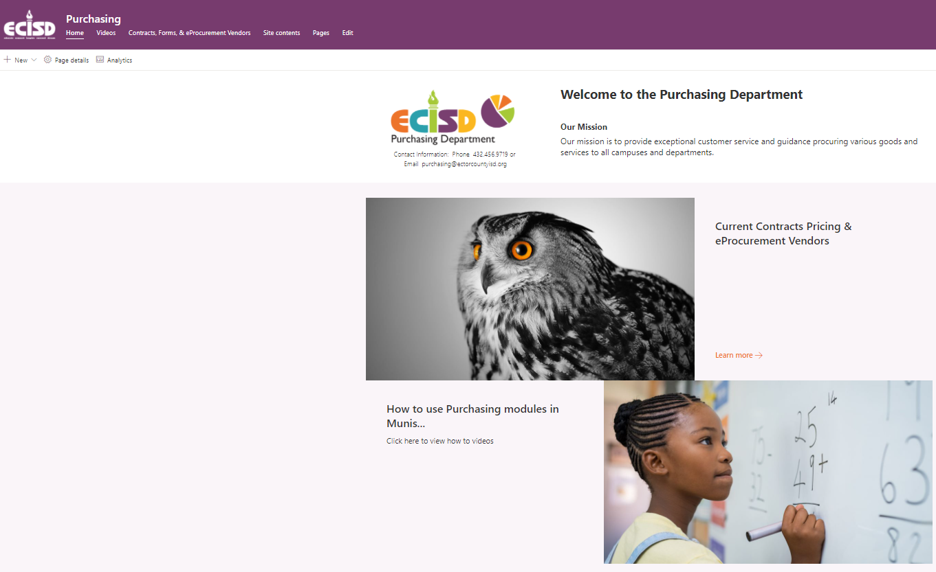
Visit Purchasing on the SharePoint site to access
How to videos and other Internal Documents, Forms, and Quotes
This Photo by Unknown Author is licensed under CC BY-ND

Slide 46

Thank You
July 2021

