Slide 1
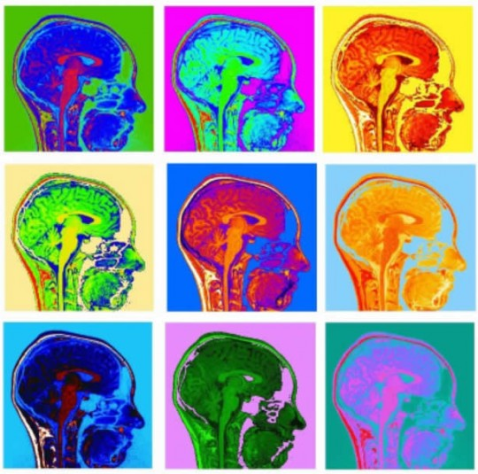
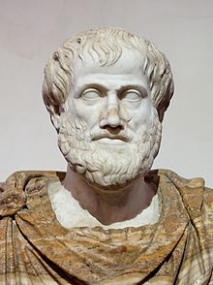
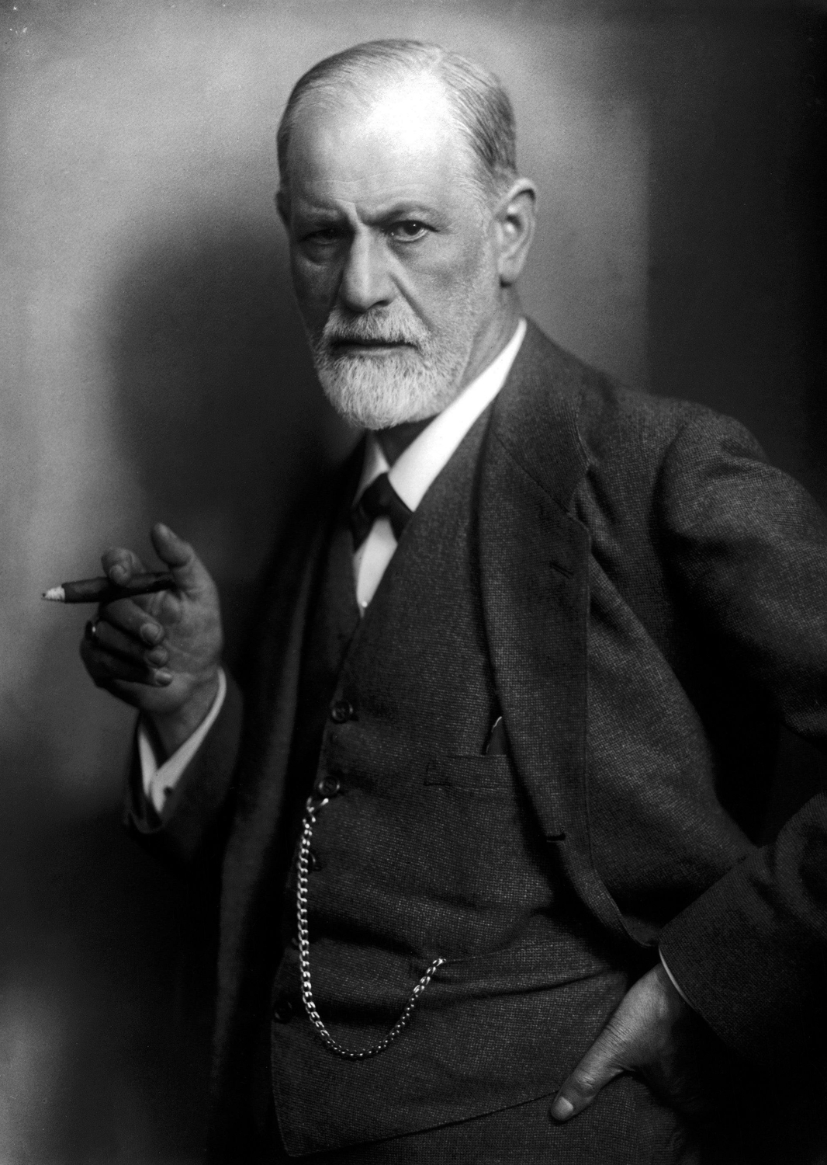
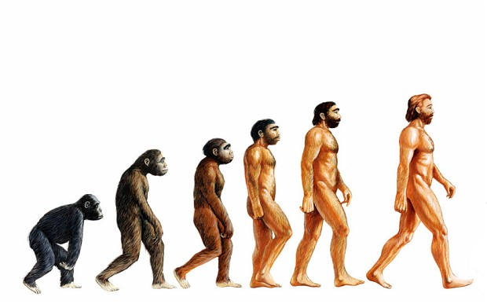
Introduction to Psychology
Historical Figures and Approaches to Psychology

Slide 2
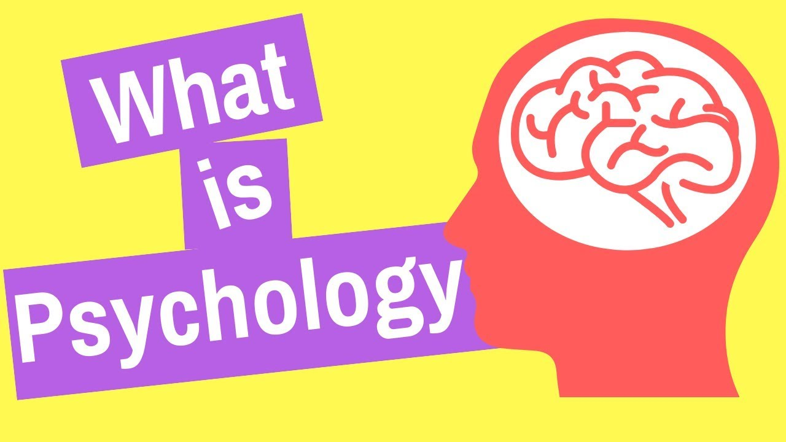
Psychology is the scientific study of the mind and behavior.
“We are like islands in the sea, separate on the surface but connected in the deep.”
- William James

Slide 3
Philosophy: The study of the fundamental nature of knowledge and reality.
What is truth?
What is real?
How do we know what we know?
What is knowledge?

Slide 4
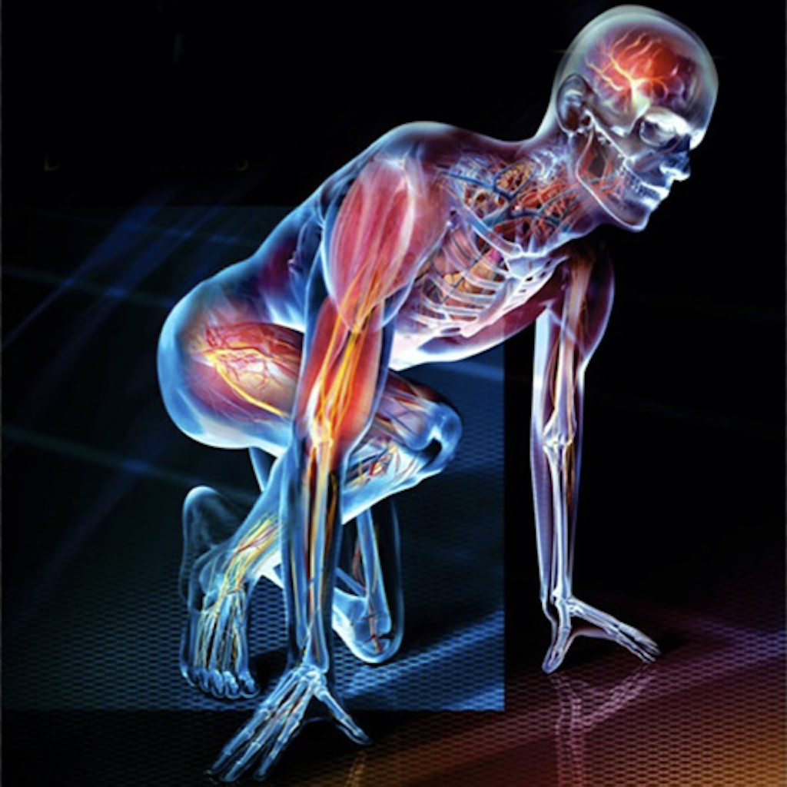
Physiology: The branch of biology that studies the way a living organism’s body functions.
How do cells in the brain communicate?
How do hormones work?
How do the different divisions of the nervous system work together?

Slide 5
Empiricism: The idea that knowledge comes from experience, and that observation and experimentation allow us to gain scientific knowledge.
In modern psychology, we rely on empirical research to understand human thought and behavior.

Slide 6
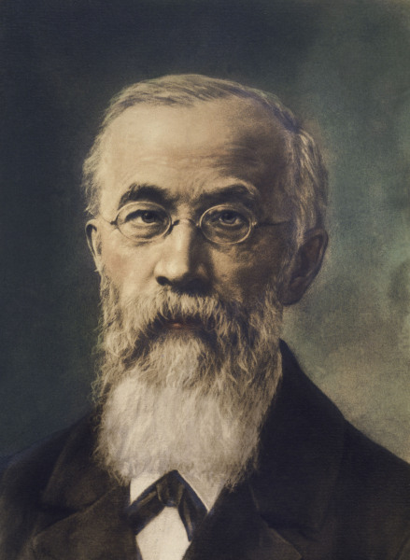
The Beginning
Wilhelm Wundt
“Father” of psychology
Founded the first psychological laboratory in Leipzig, Germany in 1897.
Established psychology as a science

Slide 7
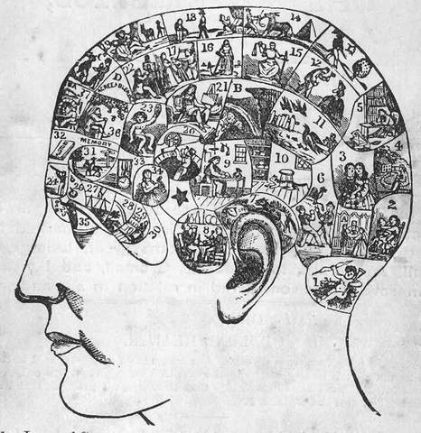
Structuralism
Sought to understand the human mind by breaking it down into its most basic components (structures).
Sensations
Mental images
Feelings, etc.
Examined how these elements combine to form more complex experiences.

Slide 8
Structuralism
Think of it like a periodic table of mental structures/elements.
---------------------------------------------------------------------------
Basic idea: the whole can be understood by examining its parts.

Slide 9
Structuralism
Used Introspection:
Process of looking inward, observing one’s mental experiences/sensations, and reporting them back to the researcher.
What sensations, images, or feelings are you experiencing?
Unreliable because the results are subjective and inconsistent

Slide 10
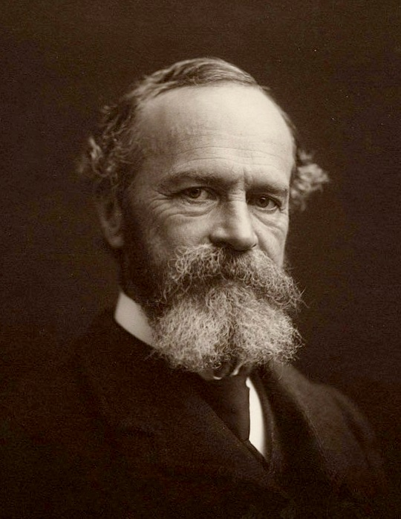
Functionalism
William James
Wrote the first psychology textbook called Principles of Psychology
Was critical of structuralism
Established school of functionalism

Slide 11
Functionalism
Examined the function of the human mind—what purpose does it serve?
Was concerned with how the mind allows us to adapt and survive.
Was heavily influenced by Darwin’s theory of evolution
Focused on the mind’s purpose, not its parts.

Slide 12
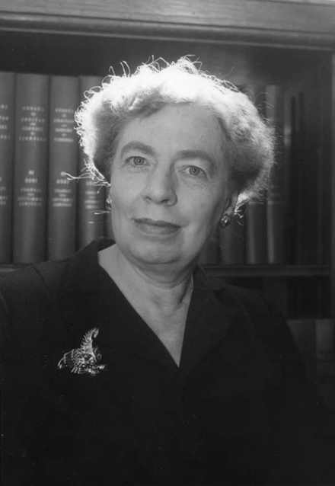
Mary Whiton Calkins
Student of William James
First female to complete all PhD requirements at Harvard
Was denied degree because she was a woman
First female president of the American Psychological Association

Slide 13
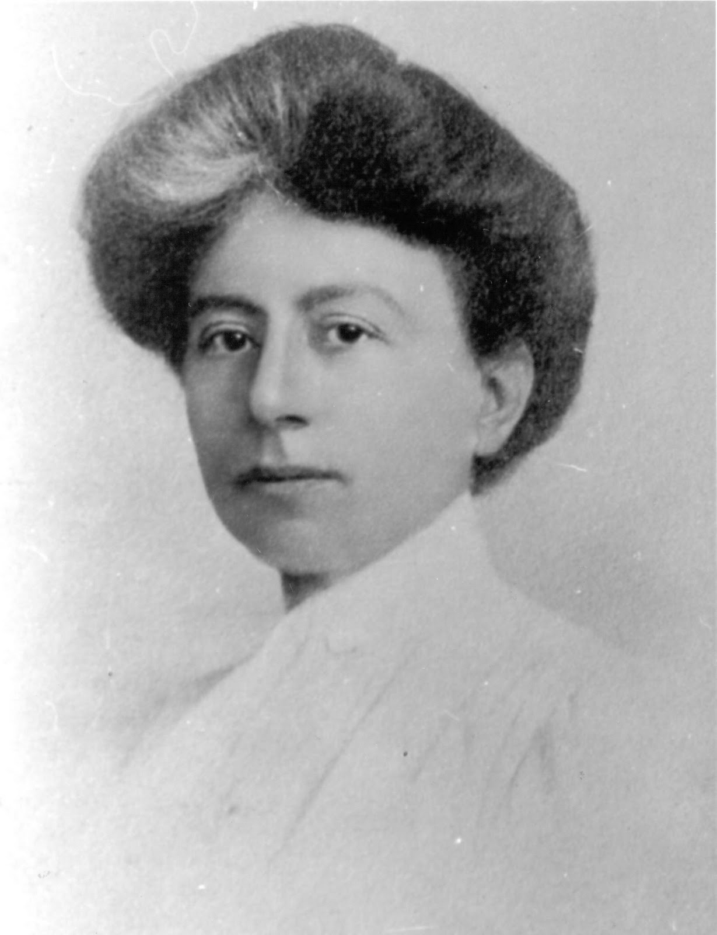
Margaret Floy Washburn
First female to earn PhD in psychology
Studied animal behavior and wrote a book called The Animal Mind
Second female president of the American Psychological Association

Slide 14
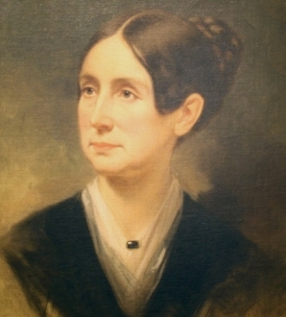
Dorothea Dix
American activist on behalf of the severely mentally ill
Lobbied Congress to create first generation of mental asylums.

Slide 15
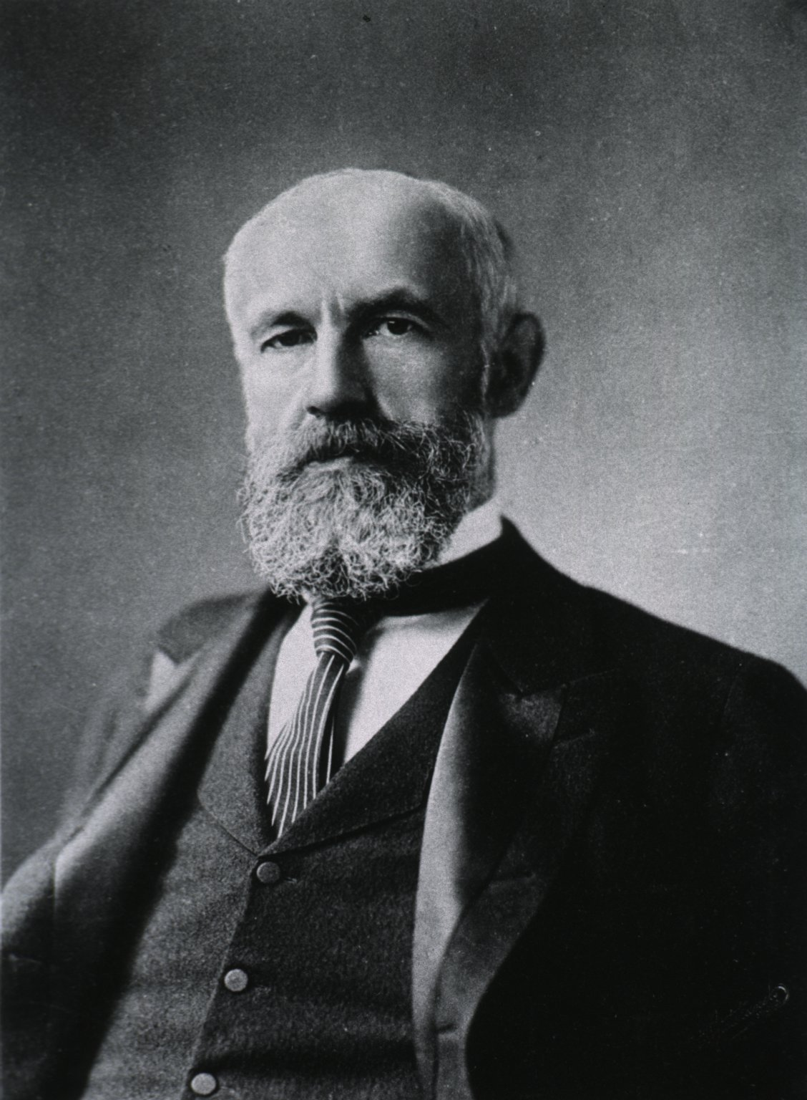
G. Stanley Hall
Helped found the American Psychological Association (APA)
Created first psychology laboratory in the US
Founded the first psychology research journal

Slide 16
Sigmund Freud
Austrian neurologist
Believed psychological illness was different than physical illness and could be cured with “talking therapy.”
Founder of psychoanalysis

Slide 17
Psychoanalytic Approach
First approach developed outside of a university setting.
Focused on the cause, development, and treatment of abnormal behavior.
Emphasized the role of the unconscious mind: the memories, feelings, and drives that are outside of our awareness.

Slide 18
Psychoanalytic Approach
Believed that early childhood experiences influence personality and behavior.
Believed that we are driven primarily by unconscious desires and feelings.
Criticized as being unscientific since the unconscious mind cannot be studied objectively.

Slide 19
Psychodynamic Approach
A modernized version of the psychoanalytic approach
Moved away from some of Freud’s more controversial ideas

Slide 20
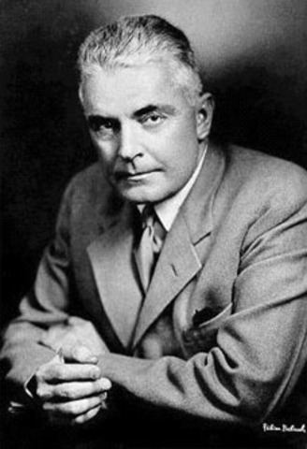
John B. Watson
One of the founders of the behavioral approach
Believed psychology should only focus on what could be objectively measured
Conducted infamous Little Albert experiment

Slide 21
Behavioral Approach
Established as a revolt against introspection.
Said psychology should only be concerned with what can be objectively observed and measured
Redefined psychology as the scientific study of observable behavior.

Slide 22
Behavioral Approach
Not concerned with things that cannot be directly observed, such as thoughts, feelings, and the unconscious mind.
Believes behavior is learned (conditioned by environmental factors)
Focuses on how behaviors are learned and modified

Slide 23
Cognitive Approach
Studies how thinking and perception influence behavior.
How we direct our attention
Memory
Thinking
Problem solving
Decision-making
COGNITION = thinking / information-processing

Slide 24
Cognitive Approach
In the cognitive view, an individual’s mental processes are in control of behavior through memories, perceptions, images, and thinking.

Slide 25
Humanistic Approach
Addressed perceived flaws in both the psychoanalytic and behavioral approaches
Focuses on people’s potential and their drive to be their best
Has a more positive outlook on people than the behavioral or psychoanalytic approaches

Slide 26
Humanistic Approach
Emphasizes a person’s positive qualities
Emphasizes the capacity for human growth/reaching one’s potential
Emphasizes the freedom to choose one’s destiny

Slide 27
Sociocultural Approach
Emphasizes the impact of people’s culture, religion, ethnicity, gender, income level, and overall environment on a person’s thinking and behavior.
Compares behavior across countries
Compares behavior within ethnic and cultural groups

Slide 28
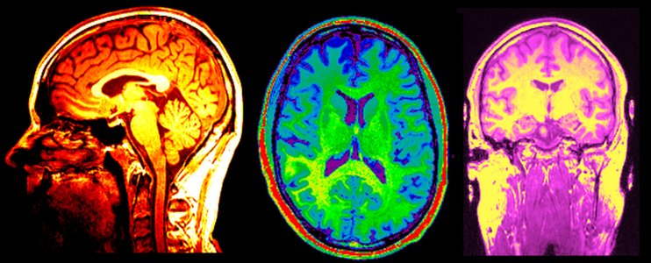
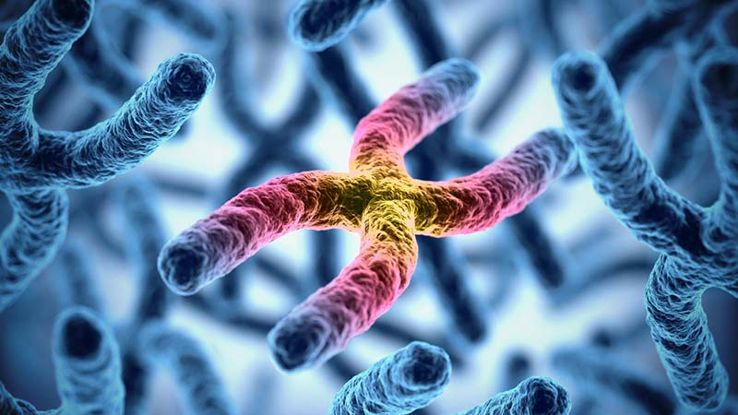
Biological Approach
Focuses on how genetics, the nervous system, hormones, and brain structures influence a person’s thinking and behavior.
Neuroscience: the study of the brain and nervous system.

Slide 29
Biological Approach
Is concerned with the biological causes of human thought and behavior
Is interested in how biological treatments (medicine, surgery, etc.) may improve certain psychological conditions

Slide 30
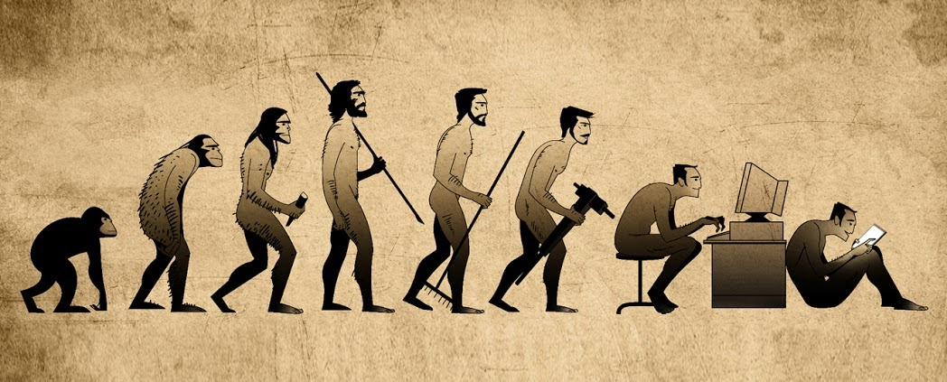
Evolutionary Approach
Began with Charles Darwin
Emphasizes how evolution influences thinking and behavior.
Looks for aspects of human thought and behavior that help us and our genes survive over time.

Slide 31
Evolutionary Approach
Focuses on humans as a species; does not focus on specific individuals
Example: examines why many people are attracted to sugary and fatty foods.
These foods are high in calories and helped our ancestors survive.

Slide 32
Biopsychosocial Approach
Emphasizes that biological, psychological, and social forces all influence behavior
No person or behavior can be explained by one perspective alone
The approach that best helps us understand human thought and behavior

Slide 33
Biopsychosocial Approach
Helps us confront psychology’s most persistent issue:
nature-nurture: the controversy over how much our psychological traits and behaviors can be explained by genes (nature) and how much can be explained by experience (nurture)

Slide 34
Introduction to Psychology
Psychology’s Fields/Careers

Slide 35
Psychiatrist
Medical doctor specializing in the diagnosis and treatment of mental illness.
Typically prescribes medication to treat mental illness
Works in hospitals, clinics, rehabilitation centers, and private practices

Slide 36
Clinical Psychologist
Psychologist who specializes in the diagnosis and treatment of mental disorders
Provides counseling/therapy (does NOT prescribe medication)
Works in hospitals, clinics, rehabilitation centers, and private practices

Slide 37
Counseling Psychologist
Assists people with personal problems (often related to school, work, relationships, etc.)
Provides counseling/therapy
Most commonly works in private practices or clinics

Slide 38
Industrial/Organizational Psychology (I/O)
Uses psychological training in the workplace
Helps companies select and train employees, boost morale and productivity, design products, and implement systems

Slide 39
Cognitive Neuroscience
Studies the biological processes that enable cognition (thinking, perceiving, memory, etc.).
Brain structures
Neural networks

Slide 40
School Psychologist
Tests students for learning and emotional struggles
Helps create individualized education plans for students with learning and emotional struggles
Occasionally provides counseling, but not often

Slide 41
Educational Psychology
Researches how people learn and remember information
Helps develop more effective curriculum, testing procedures, classroom structures, etc.
Does not focus on individual students like a school psychologist

Slide 42
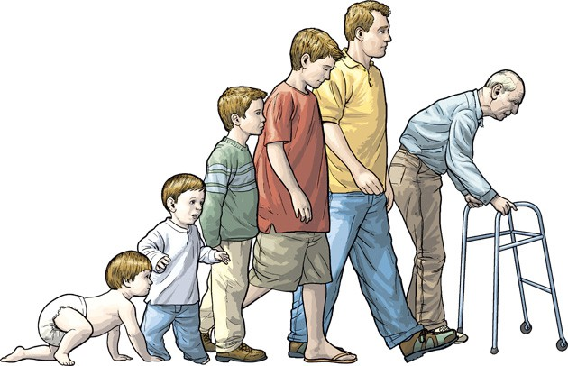
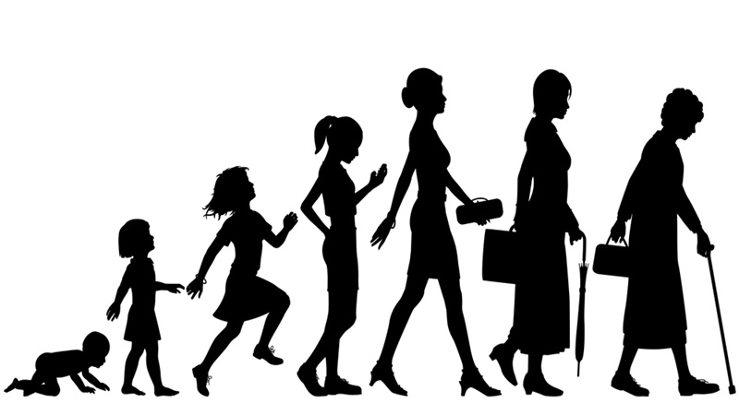
Developmental Psychology
Studies how people change and develop over their lifespan.
Cognitive and motor development, language acquisition, emotional development

Slide 43
Personality Psychology
Studies people’s characteristic patterns of thinking, feeling, and acting.
Social Psychology
Studies how we think about, influence, and relate to other people.

Slide 44
Experimental Psychology
Using experiments to study human thought and behavior
Applied Research
Research that is undertaken to solve a particular problem, not just to learn something new

Slide 45
Psychometrics
Focuses on the construction of assessment tools, measurement instruments, and formal models that help study and observe human thoughts and behavior.
These would be used in research studies and clinical settings

Slide 46
Human factors psychology
Studies the interplay between humans and technology/machines
Focuses on improving technology and equipment to work better with human behavior and capabilities.
Sometimes called engineering psychology
Example: helps Apple design an operating system that is more efficient and easier to use

Slide 47
Health Psychology
Examines how biological, social, and psychological factors influence health and illness.
Designs conducts, or evaluates programs that help people live healthier lives (quitting smoking, improving sleep, managing pain, etc.)

Slide 48
Positive Psychology
The scientific study of human flourishing
Goal is to discover and promote the strengths and virtues that help individuals and communities thrive
Focuses on both individual and societal well-being

