Slide 1
Incident Management Updates
Aveene R. Coleman
9/21/2021

Slide 2
Agenda
Updates for the 2021-22 School Year
Review of Reporting Requirements
Update Data Review Tools
Level Data
Real Time Data Report
Overview of Data

Slide 3
Understanding Discipline Data
All discipline and truancy data must be reported in Incident Management System for the 2021-22 school year.
Security is set by groups
  Discipline and Truancy
Data from Incident Management will be used to compile the state and federal reports listed above, it is critical that all data entered be reviewed and verified for accuracy.
It is important that all discipline and truancy data are coded in Incident Management and not log entries.
Do not add additional codes to Incident Management. To request a new code please send an email to acoleman@ed.sc.gov.

Slide 4
Understanding Discipline Data
Discipline Data Processing:
School Level PowerSchool Entry
Submission To SCDE
Review ADT Reports
Update Data in PowerSchool
Resubmission to SCDE
State and Federal Reporting

Slide 5
Understanding Discipline Data
School grounds
School Events
School Transportation

Slide 6
Understanding Discipline Data
Reporting incidents occurring on school grounds/events/transportation involving (*Required for PDS Reporting) :
Student
Staff*
Non-School Personnel*

Slide 7
Incident Management –New Codes
Behavior Codes
295 Sexting
585 Drug Paraphernalia

Slide 8
Incident Management-New Code
295 Sexting
Creating, possessing, or sharing nude, partially nude, or other sexually explicit or suggestive images, videos, or visual representations using non-digital means (e.g., printed materials) or electronic communication, including but not limited to texting, emailing, or posting on social media platforms. These acts are prohibited whether or not the subjects of the images, videos, or visual representations consent to their being created, possessed, or shared.

Slide 9
Incident Management-New Code
585 Drug Paraphernalia
Paraphernalia” as “any instrument, device, article, or contrivance used, designed for use, or intended for use in ingesting, smoking, administering, manufacturing, or preparing a controlled substance and does not include cigarette papers and tobacco pipes but includes, but is not limited to: (a) metal, wooden, acrylic, glass, stone, plastic, or ceramic marijuana or hashish pipes with or without screens, permanent screens, hashish heads, or punctured metal bowls; (b) water pipes designed for use or intended to use with marijuana, hashish, hashish oil, or cocaine: (c) carburetion tubes and devices; (d) smoking and carburetion masks; (e) roach clips; (f) separation gins designed for use or intended for use in cleaning marijuana; (g) cocaine spoons and vials; (h) chamber pipes; (i) carburetor pipes; (j) electric pipes; (k) air-driven pipes; (l) chilams; (m) bongs; (n) ice pipes or chillers.
Code of Laws - Title 44 - Chapter 53 - Poisons, Drugs, And Other Controlled Substances (scstatehouse.gov)

Slide 10
Incident Management-CRDC Updates
CRDC removed the following offenses from reporting for the 2020-21:
  Robbery with a firearm or explosive device
  Physical attack or fight with a firearm or explosive device
  Threat of physical attack with a firearm or explosive device

Slide 11
Federal Reporting Requirements-School Report Card
Every Student Succeed Act (ESSA) Discipline Reporting will be based on Office of Civil Rights (OCR) Reporting:
  All Suspensions and Expulsions (all offenses)
  School-related arrests
    Arrested (ARR)
  Referrals to law enforcement
    Call to Law Enforcement (CTL)
  In-School Suspension (all offenses)
  Bullying
  Harassment

Slide 12
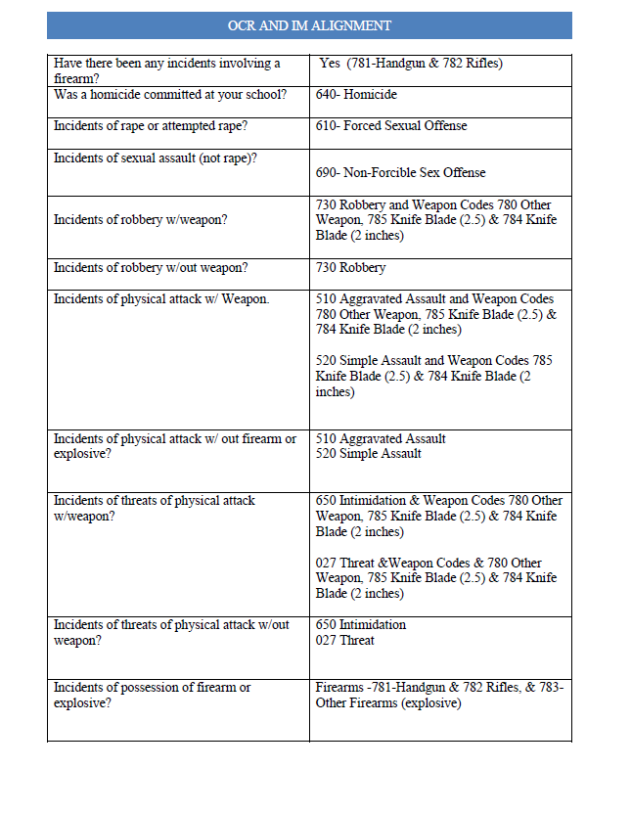
Federal Reporting Requirements-School Report Card
Updated 2021

Slide 13
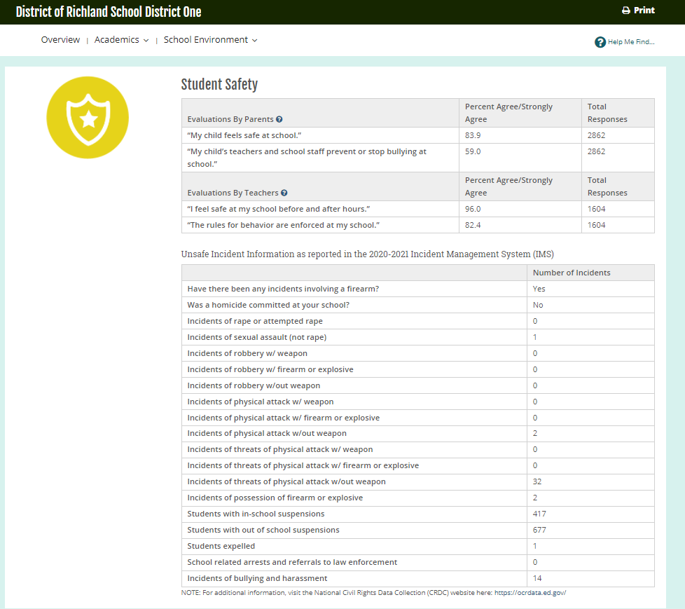
Report Card Information

Slide 14
Federal Reporting Requirements
Uniform Management Information Reporting System (UMIRS) is a data collection system required by ESSA
510- Aggravated Assault
610- Forcible Sex Offense
640- Homicide
570- Drug Distribution
575- Drug Usage
580- Drug Possession
660 Kidnapping/abduction
730- Robbery
All three codes will be reported in federal and state reports.

Slide 15
Federal Reporting Requirements
789 Weapons (Specify in Objects)
Subcodes for Weapons
  780- Other Weapons
  781- Handguns
  782- Rifles/Shotguns
  783- Other Firearms
  784-Knife Blade> 2 inches (State)
  785- Knife Blade>2.5 inches (Federal)
Object Subcodes for Weapons must be coded.
Action Taken must be coded

Slide 16
Federal Reporting Requirements
650-Intimidation
651- Bullying
652- Cyberbullying
151-Truant
152- Habitual Truant
153- Chronic Truant
Intervention Plan
Family Court Referral
Violation of Court Order
009 Fighting
012 Harassment*
260 Bomb Threat
An incident number should be assigned to the student who is truant. No student should have the same incident number as it relates to truancy.

Slide 17
Federal Reporting Requirements
Guns Free Act
Number of Incidents
  781-Handguns
  782-Rifles
  783-Other Firearms
Indicate the total Number of Incidents involving students who brought firearms to or possessed firearms at school and the type of weapon involved.
Indicate the Number of Students Expelled from school for possessing a firearm
Indicate the number of Expulsions by Elementary, Middle and High School by Types of Firearm

Slide 18
Federal Reporting Requirements-PDS
South Carolina public school or charter school will be considered "persistently dangerous“ if its conditions expose students to injury from violent criminal offenses for a period of three consecutive years. The Unsafe School Choice Option—which is mandated by Section 9532 of the Elementary and Secondary Education Act (ESEA) of 1965, as amended by the ESSA(Incidences of Violence)
Required Fields
  640- homicide,
  610- forcible sex offenses,
  660- kidnapping/abduction,
  510- aggravated assault,
  570- drug distribution,
  575- drug usage
  580- drug possession
  730- robbery
  780, 781, 782, 783, 784, 785 weapons offenses

Slide 19
Federal Reporting Requirements
  Table 5: Report of Children with Disabilities Subject to Disciplinary Removal
  PowerSchool IM Fields
    Incident Date
    Participant Role
    Last, First, Middle Names
    Action
    Action Subcodes
    Duration
    Behavior Codes (IAES Actions)
    Behavior Subcodes (IAES Actions)
      Object Code (Behavior = Weapons)
      Object Subcode (Behavior = Weapons)
  PowerSchool SC Specific Fields
  (Include in IM Query)
    Gender
    English as a Second Language (ESL)
    Ethnicity/Race
  Special Education Status
    Instructional Setting
  Enrich Fields
    Primary Disability
    State ID
    Last, First, Middle Names
    Initial Placement Date
    Exit Date
  Matching PS + Enrich Data
    Link Primary Disability
    Compare Active Dates to Incident Date
Notes:
edited

Slide 20
Incident Management Coding
All incidents coded must have an offender associated with the incident.
All incidents coded must have a behavior associated with the offender.
All incidents coded must have an action associated with the behavior.
All removals must be coded with removal type, subcode if applicable, and duration.
All IAES removals must have behavior and/or object codes with any corresponding subcodes to indicate if the removal was for drugs, weapons, serious bodily injury, or by a hearing officer for likely injury to self or others.

Slide 21
Incident Management Coding 101
Reminder: Behavior Code must be dragged and dropped on the top of the participant’s name. The Action Code must be dragged and dropped on the top of the behavior.
  Offender Name
  Behavior (must be dragged and dropped on Participant's name)
  Action (must be dragged and dropped on the behavior)
  Additional Behavior (must be dragged and dropped on Participant's name)
  Action(must be dragged and dropped on the behavior.
  The incident below was coded using Chrome.

Slide 22
Discipline Scenarios-Poll Question
Scenario 1: Two ninth grade male students got into a serious fight in the hallway. Both students had scratches and one student may have a broken arm.
How do you code this incident?
One incident of fighting with two students coded on the same incident.
Two incidents of fighting each student coded on a separate incident.
One incident of fighting with two students involved and the physical injury that occurred.
None of the Above

Slide 23
Incident Management Coding
  How should I code incident for the following scenario.
Two students are involved in a fight at one high school.
  Code as one incident
  Code all Two participants under the one incident
  Make sure you assign the role offender(s) and/or victim(s) for each participant
  Make sure you code the behavior for each participant
  Make sure you code the action taken by associating it to the behavior for each participant

Slide 24
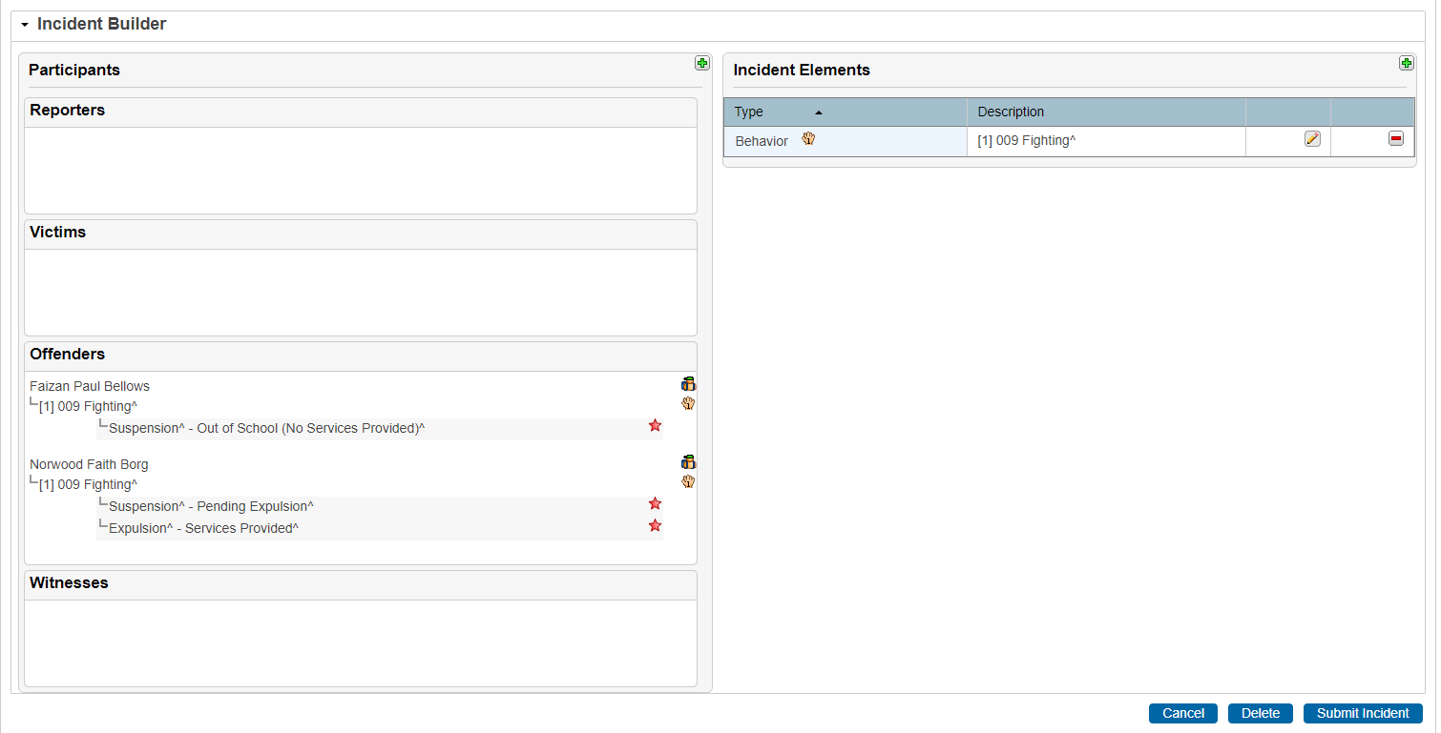
Properly Coded Incident
Any incidents involving more than one student, occurring at the same time and same location is coded as one incident. Examples-Fighting, Drug Distribution, Aggravated Assault
All Pending Expulsion or Recommend For Expulsion must have a final action coded.

Slide 25
Incident Management Coding
  How should I code incident for the following scenario?
Two students involved in a fight at one high school, but one student attends another high school in the district.
  Code as one incident at the high school in which the incident occurred
  Code all participants under the one incident
  Make sure you assign the role offender(s) and victim(s) for each participant
  Make sure you code the behavior for each participant
  Make sure you code the action taken by associating it to the behavior for each participant
  Make sure in the attributes you code the school for each student.

Slide 26
Discipline Scenario-Poll Question
Scenario 2: A 2nd grade student brought his Dad’s gun on the school bus to show his friends.
How do you code this incident?
Code the incident as a bus incident.
Code the incident as a bus incident, include the weapon behavior and weapon subcode and call to law enforcement.
Code the incident as a bus incident and include the weapon behavior.
Call to law enforcement

Slide 27
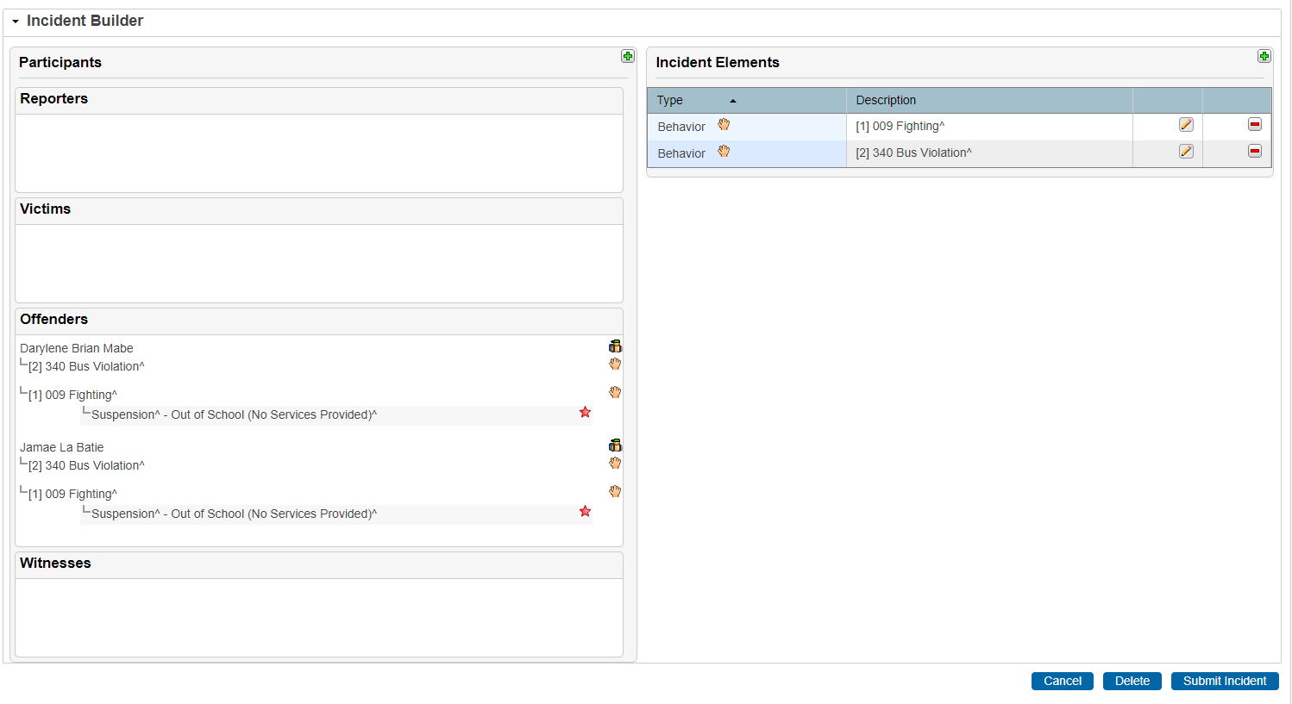
Coding a Bus Incident
All bus incidents must include the behavior.

Slide 28
Discipline Scenario-Poll Question
Scenario 3: A middle school student brought a taser to school.
Which code should be used?
  783 Other Firearms
  004 Contraband
  780 Other Weapons
  390 Unauthorized Device

Slide 29
Incident Management Coding
Do not use students' names in the title or Suns ID.
Toy bullets, toy guns, toy cap guns, toy pellet guns should be coded as 789 Weapons-OBJ Misc. Objects. Do not code as 781,782, & 783.
BB Guns should be coded as 789 as Other Weapons-sub code Other Weapon-sub code 780-Other Weapons.
783-Other Firearms – examples- devices designed to expel a projectile, grenade, explosive
Fireworks should be coded as 010 Fireworks.(page 40 IM Guide)
780-Other Weapons- examples- razor blade, ice pick, Chinese star, chain, brass knuckle, billy club, stun gun, mace, tear gas, hatchet, Taser, pepper spray

Slide 30
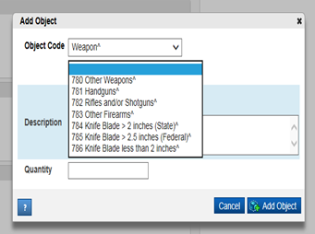
Incident Management Coding
Weapon Coding-Adding Object

Slide 31
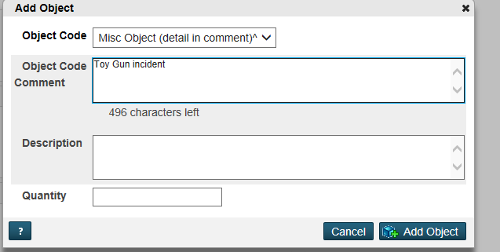
Weapon Coding-Misc. Object
Adding Misc. Object

Slide 32
Incident Management Coding
All SUX-Pending Expulsion should be resolved before the 180th day reporting (Expulsion, Alternative School, OSS, Overturn Expulsion or other outcome).
All SPC-Pending Parent Conference should be resolved and updated before the 180th day reporting.
When coding 789 Weapons you must coded a sub code and action taken. (Subcodes 780,781, 782, 783, 784, 785, & 786)
All weapons incidents must have a final action. All of the following are weapons incident:
  781-Handguns
  782-Rifles
  783-Other Firearms
Please note that a call to parent is not a final action for the incidents listed above.
Summer Incidents occurring after July 1st that results in a school removal for the 2020-21 school year, will be reported in the 2021-22 school year data collection.

Slide 33
Discipline Scenario-Poll Question
Scenario 4: If a student receives a discipline referral and is sent home for the day by the principal/assistant principal?
How should this student be coded in PowerSchool?
  Excused absence
  OSS and Incident Coded as an OSS
  Unexcused absence
  OSS

Slide 34
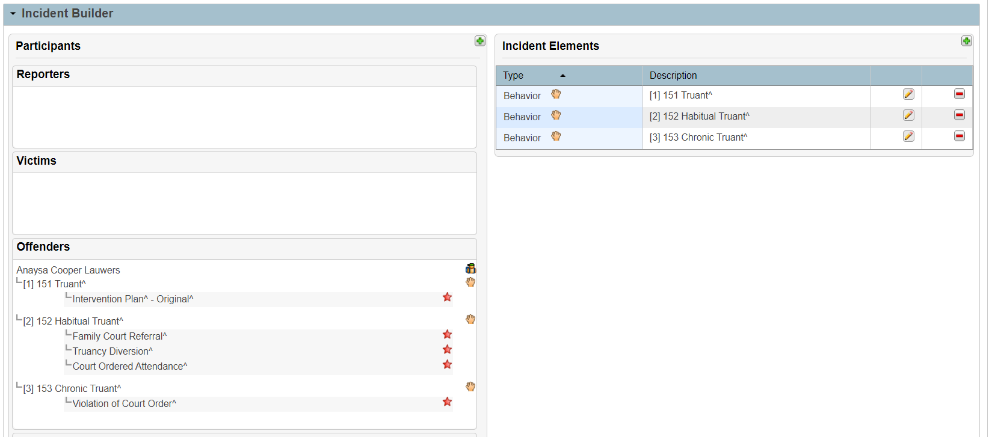
Action Association
Actions must be associated with the Behavior for the removal and duration to generate on reports and the IM Query.

Slide 35
Understanding Discipline Data-Data Review Tools
ADT Reports
Level Validation Reports
Real Time Reports

Slide 36
ADT Reports
Please review
  Truancy Numbers
  Suspension/Expulsion Numbers
  ISS Reports
  Call to Law Enforcement/ Arrest Numbers
  Review Error Report
  Chronic Absenteeism-Numbers of Days Students are Suspended

Slide 37
Reviewing Incident Data Reports-
Report with Errors
Errors must be corrected in PowerSchool during the 45th, 90th, 135th, and 180th submission

Slide 38
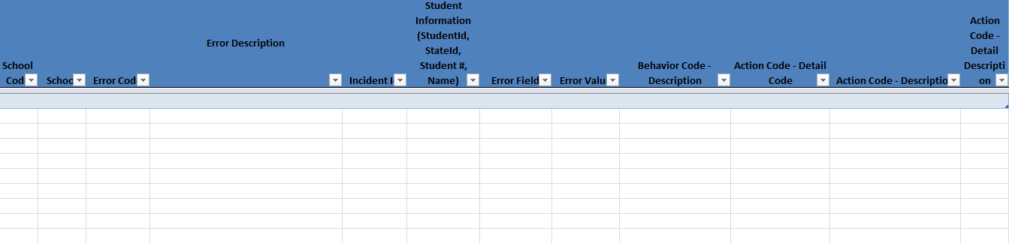

Reviewing Incident Data Reports
Report without Errors

Slide 39
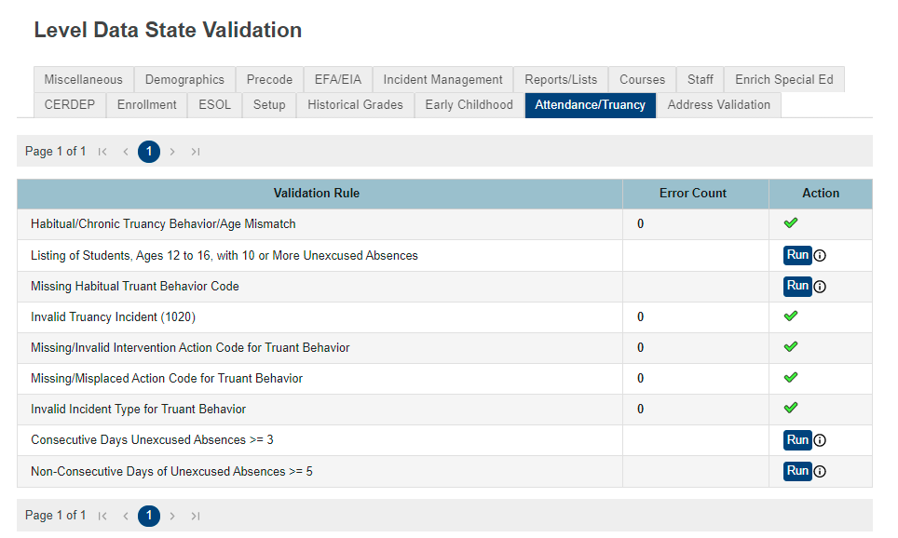
Level Data State Validation

Slide 40
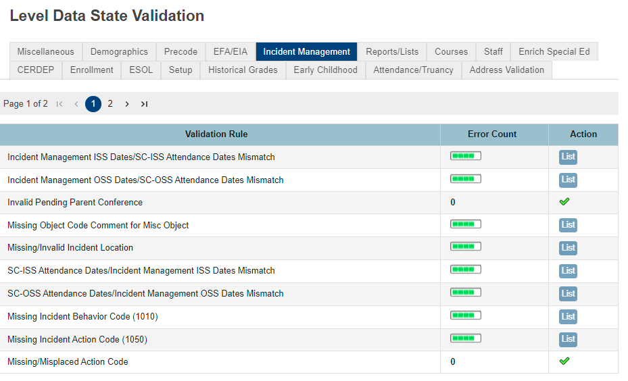
Level Data State Validation

Slide 41
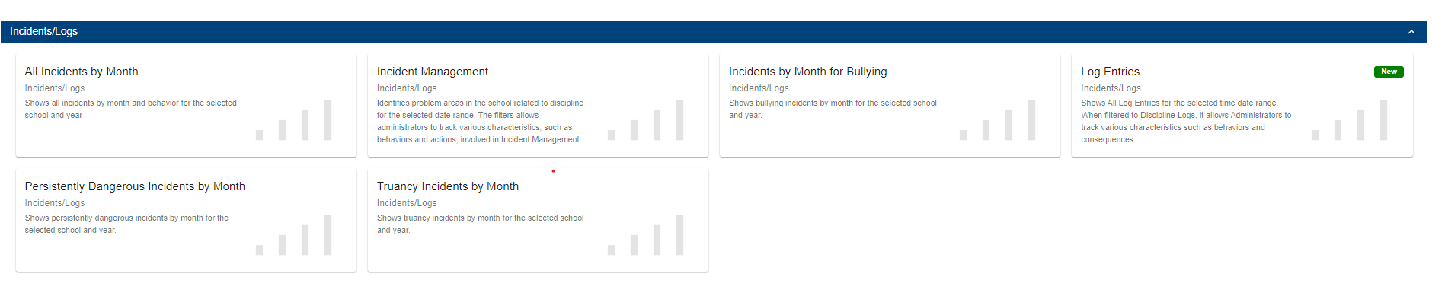
Real Time Report

Slide 42
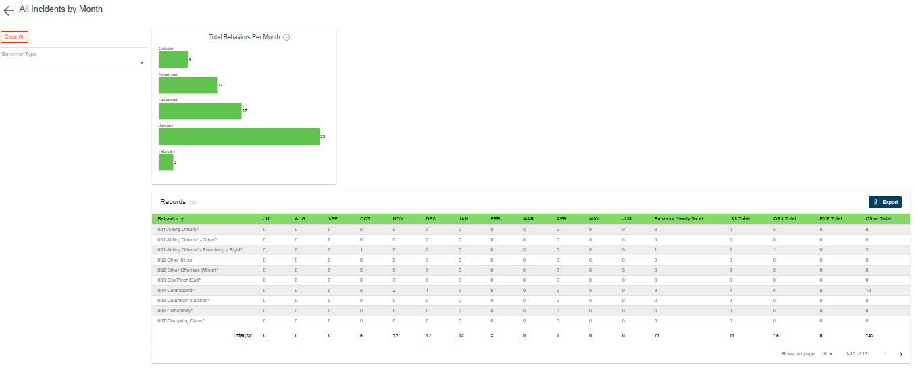
Real Time Report

Slide 43
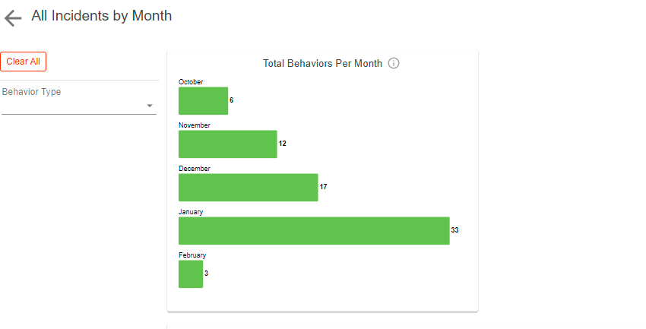
Real Time Report

Slide 44
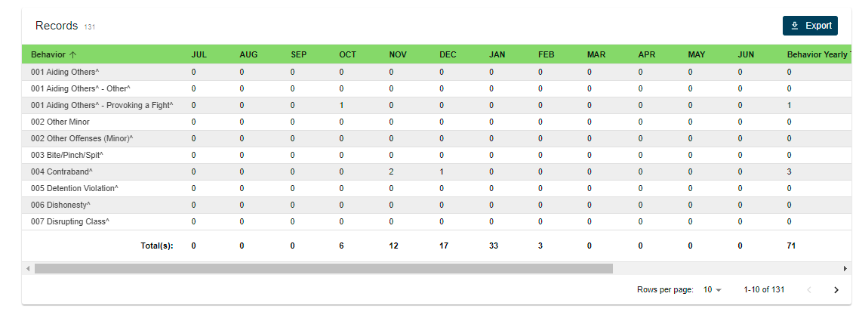
Real Time Report

Slide 45
Questions

Slide 46
Incident Management
Contact Information
Student Intervention Services
Sabrina Moore, Director, 803-734-8433 or smoore@ed.sc.gov
Aveene Coleman, Education Associate, 803-734-3057 or acoleman@ed.sc.gov
Kim Smith, Education Associate, 803-734-8113 or kwsmith@ed.sc.gov
Special Education Services
Carolyn Bostick, Education Associate, 803-734-1263 or
cbostick@ed.sc.gov
Internal Technology Services
LEA IT Support Staff may submit an IT Support Request: https://eservices.ed.sc.gov

