Slide 1
ANNUAL
STUDENT ACTIVITY WORKSHOP
FY 2023 - 2024
AUGUST 3, 2023

Slide 2
FINANCIAL SERVICES
STUDENT ACTIVITY WORKSHOP
FY 2023 – 2024
WELCOME & INTRODUCTION
Sherri Mathews-Hazel, CPA
Chief Financial Officer

Slide 3
FINANCIAL SERVICES
STUDENT ACTIVITY
WORKSHOP
GREETINGS
Dr. Craig Witherspoon

Slide 4
FINANCIAL SERVICES
FINANCIAL UPDATES
Sherri Mathews-Hazel, CPA
Chief Financial Office

Slide 5

FINANCIAL SERVICES
Finance 101
  August 10th : Student Activity
  August 22nd :Procurement & Accounts Payable
  August 29th :Budget & Grants
  September 6th :Payroll/Kronos

Slide 6

FINANCIAL SERVICES
Salary Increases
  A Step Increase for Teachers and non-teaching staff.
  4.5% COL increase for teachers
  3% COL pay increase for non-teachers
  Retirees paid 100%

Slide 7

FINANCIAL SERVICES
First Pay
.
  1st pay and salary increases for 9 and 10 month employees: September 1st
  1st pay and salary increases for 11 month employees: August 16th
1st pay for 12 month employees: Effective, July 1st , but will be reflected in their August 16th pay. The retroactive amounts from July 2023 will be a separate paycheck on August 16th

Slide 8

FINANCIAL SERVICES
Upcoming Incentives:
  Perfect Attendance: August 7th
  Retention Incentive: Sept. 29th
    $1,000 (Certified)
    $500 (Classified)
  Excess 90 Sick Days-August 21st

Slide 9

FINANCIAL SERVICES
Teacher Supply Funds.
  State: Increased from $300 to $350
  General Fund: $250
    Requisitions
    Warehouse Requisitions
    Student Activity

Slide 10
FINANCIAL SERVICES
STUDENT ACTIVITY WORKSHOP
PETTY CASH
Prior Year Reimbursements
Online Orders

Slide 11
FINANCIAL SERVICES
Policy DIBA Foundations/Booster
Clubs and other Organizations
Schools must enter into an agreement between the PTO/PTA/Foundation by signing a memorandum of agreement (MOA).
MOAs are renewed by clusters. Next renewal date is October 1, 2023. An email is forthcoming to Principals.

Slide 12
FINANCIAL SERVICES
STUDENT ACTIVITY REVIEW
By Cynthia Johnson
Student Activity Monitor

Slide 13
FINANCIAL SERVICES
STUDENT ACTIVITY REVIEW
Turn in Money Daily
Monthly Reports
Deposits/4-Digit Receipt Number
Payment to Vendors
Multiple Activities by Sponsors
Book Fairs

Slide 14
FINANCIAL SERVICES
STUDENT ACTIVITY REVIEW
PTO Sponsored Events
Collecting Funds for Field Trips and Other Events
Combination to Safe
Rolled Coins
Carowinds

Slide 15
FINANCIAL SERVICES
STUDENT ACTIVITY
CRITICAL POINTS
By Sheila Washington
Preparing to Write Checks
Receipting of Funds
Monthly Reports

Slide 16
FINANCIAL SERVICES
Credit Card Payments
EDLIO Online School Payment System
Training today 1:00 – 3:00 pm

Slide 17
FINANCIAL SERVICES
STUDENT ACTIVITY
WORKSHOP
BREAK

Slide 18
FINANCIAL SERVICES
ACCOUNTS PAYABLE UPDATES
Caroline Smith
Supervisor of Accounts Payable

Slide 19
WELCOME
FY 2023-2024

Slide 20
WHAT YOU NEED TO KNOW
ACCOUNTS PAYABLES

Slide 21
WHO’S WHO
Caroline H Smith Accounts Payable Supervisor
              803 231 7025 or 97525
Kimberly Smith Senior Accountant A/P Team Lead A-G
              803 231 7528 or 97528
Jennifer Howze A/P Clerk H-O
              803 231 7526 or 97526
Tosha Seabrooks A/P Clerk P-Z
              803 231 7529 or 97529
Andrea Duncan A/P Clerk Pre-pays/ Utilities/ Student Nutrition
              803 231 7527 or 97527
Tunisia Covington * Travel and In District Mileage
              803 231 7178 or 97178

Slide 22
CHECK RUN SCHEDULE
You will be receiving a document containing documents which you will need at some point this school term.
Included will be the Check run Schedule as well as a Use Tax run schedule.
Pay close attention to the “due by date” for timely processing.

Slide 23
Best practice for Best results
Receive it in Munis
Use district mail when necessary
Remember deadlines
Tax exempt is not for everything

Slide 24

GOAL: PROVIDE BEST POSSIBLE SERVICE
IN A TIMELY MANNER
REQUEST
RECEIVE
PROCESS
GET IT PAID

Slide 25



TRAVEL
BE PREPARED
EDUCATORS AND PROFESSIONAL DEVELOPEMENT
STUDENTS AND FIELD TRIPS

Slide 26
PREPAID PURCHASE ORDERS
ALLOW TIME FOR PROCESSING ATTACH A QUOTE OR SOME FORM OF BACK UP VERIFY CORRECT MAILING ADDRESS INSTRUCTIONS FOR THE PRINTED CHECK FOLLOW UP WITH RECEIPT TO AP

Slide 27
PO CENTRAL
GREAT TOOL
YOU CAN FIND….
PAYMENT STATUS
CHECK BUDGET
RECEIVING FROM WAREHOUSE
GREAT TOOL USE IT OFTEN
YEAR END IS NOT SO BAD WHEN YOU KNOW

Slide 28
SOME OTHER THINGS……
DUPLICATE SHIPMENTS CAUSE MAJOR PROBLEMS
KNOW WHAT COMES INTO YOUR SCHOOL
ALL PROFESSIONAL DEVELOPMENT REQUIRES SIGN IN SHEETS
ACCOUNTS PAYABLE CLERKS DO NOT RECEIPT MONEY
EXTENUATING CIRCUMSTANCES/ EXCEPTIONS DO COME UP

Slide 29
HELPFUL HINTS TOO…
Track your spending
USE Open PO reports
Submit invoices for payment timely
Receive in Munis always
Use Check Run Schedule

Slide 30
Have an awesome
2023-2024 school year!!!

Slide 31
FINANCIAL SERVICES
BUDGET SERVICES UPDATES
Ciera Bing
Director of Budget Services
Bobbi Jean Flowers
Budget Analyst

Slide 32
School Component Budget Operations
Processes and Procedures
FY 2023-2024
Presented by Ciera Bing, Director of Budget Services and Bobbi Jean Flowers, Budget Analyst

Slide 33
FY24 Budget Updates
Teachers Salary Schedule increase by 4.5% plus a step
Non-Teachers Salary Schedule increase by 3.0% plus a step
Language Immersion increase to include Middle School
Receptionist for Elementary Schools
Jobs for America's Graduates (JAG) at all High Schools
Weapon detectors for all Middle Schools
Ombudsman position
Paid parental leave for all district employees
Decrease in district general fund travel

Slide 34
Component Budget Allocations
Initial “Base” per student allocations for FY 2023-2024 are based on the FY 2022-2023 45-day count
“Base” per student amounts are allocated in each of the approved categories
Revised allocations for FY 2023-2024 will be made on the FY 2023-2024 11-day ADM and posted to accounts when the rollover occurs.

Slide 35
Component Budget Operations
Transfers from a component budget category will be allowed with proper approval. Transfers of 1,500.00 and above need to have the approval of the school’s Executive Director.

Slide 36
Procedure for Transfer Request
A budget transfer form must be completed and forwarded to the appropriate Executive Director for approval. The form must include the account you wish to transfer funds from and to, as well as the dollar amount. Once the transfer is approved, the form may be forwarded to Budget Services via e-mail or inter-office mail. E-mailed request will likely speed up the processing time.

Slide 37
Budget Overlay Accounts
Budget allocations for the operation of a special program at a school location funded by the General Fund must be spent for that program.
No transfers from that program to another budget category will be approved (i.e. Project GOAL, Montessori, Honors, IB).
Percentages of orders for supplies, printing, etc. can be charged to these programs when orders are placed.

Slide 38
How will the system work?
Each category and overlay has been assigned a unique “Roll up” code in MUNIS.
MUNIS will look at all the accounts in the “Roll up” code in total before it determines that the requisition can proceed or be blocked
Proper coding of expenditures is important and reflects on your individual location reports and reflects on the district spending habits as a whole.

Slide 39
Budget Category for Teacher Supplies (Object 410130)
Teacher Classroom Supplies ($250 per teacher) – will be accounted for through use of a designated object code (410130).
Schools will receive a report that will reflect the budgeted amount, expenditures to date and remaining balances.
Amounts are based on the number of teachers assigned to your location as their home school.
Itinerant teachers should only receive one allocation from their home school.

Slide 40
Budget Categories for Central Office
Athletic Transportation for recognized athletic events and programs includes:
  Scheduled high school league competitions
  Middle school competitions
  Scheduled scrimmage events
  Transportation to practice sites (if not available on campus).
Schedules must go through the office of District Athletic Director for approval and will then be provided to the Transportation Office.

Slide 41
What can you do now?
A temporary budget has been loaded into the MUNIS system in order for you to begin the requisition process for FY 2023-2024.
The budget has been loaded in the various categories we listed.
This is not the final allocation. The final allocation will be made in the Fall and will be based on the 11-day ADM.

Slide 42
What limitations will you have once final allocations are made?
Final allocations will be made when the rollover occurs.
A minimum of 75% per category of expenditures applies to the final allocation.

Slide 43
How will you know?
Reports are available via your MUNIS hub that will provide you with the following information:
  Budget report
  Open Purchase Orders
  Year to Date Expenditures
  Percentages Spent

Slide 44
Who to call?
General Fund/Position Control Questions: Bobbi Jean Flowers 231-7046, ext. 91746
Special Revenue Questions:
Natasha Kelly 231-7045, Ext. 91745
Director of Budget Services:
Ciera Bing 231-7006, Ext. 91706

Slide 45

Budget Services
Questions and Answers

Slide 46
FINANCIAL SERVICES
PROCUREMENT UPDATES
LaShonda Outing
Director of Procurement Services

Slide 47
Student Activity/Bookkeepers Workshop
PROCUREMENT SERVICES

Slide 48
Procurement services team
LaShonda Outing, CPPB
Director of Procurement, Warehouse and Printing Services
Timika Beaver
Procurement Manager
Bridgette Williams
Admin. Asst/Records Retention Specialist
Yolanda Cuttino
Procurement Specialist
P-Card Administrator
VACANT
Procurement Specialist
C Leigh Hodges
Construction Contracts Manager
Stephanie Conrad
Procurement Specialist

Slide 49

The PRO-curement Crew

Slide 50
Authorization Level
Effective
July 1, 2022
Procurement Requirements | Procurement Thresholds (All Sales Tax charges shall not be included, when determining the proper threshold)
No Competition Required | $0-$5,000 POs only
3 Informal written quotes, (Use District Form) | >$5,001.00 - $25,000.00
3 Formal Quotes, bids or proposals (Must be advertised & must include written clauses) | >$25,001.00 - $100,000 +

Slide 51
First and Foremost
PURCHASE ORDERs
Purchases up to $5,000K – Provide Support for purchase (Quote/Shopping Cart, etc.
Full Justification (Quote, support documents, etc) Required.
2-5 Days to process
Must be educational (Classroom/student/teacher related).

Slide 52
Vendor Applications
Completed Vendor Apps accepted from the Schools/Departments
Check the website at
www.richlandone.org
Procurement Services Page
Vendors must return completed Form to You..!

Slide 53
Procurement Portal
Submit the following to
Procurement@richlandone.org
New/Updated Vendor Applications
Ratifications (copy your buyer)
Donation Forms
PLO Approval Forms

Slide 54
PLO Memo & PLO Approval Form

Slide 56
Meal Purchase Justification Form

Slide 57
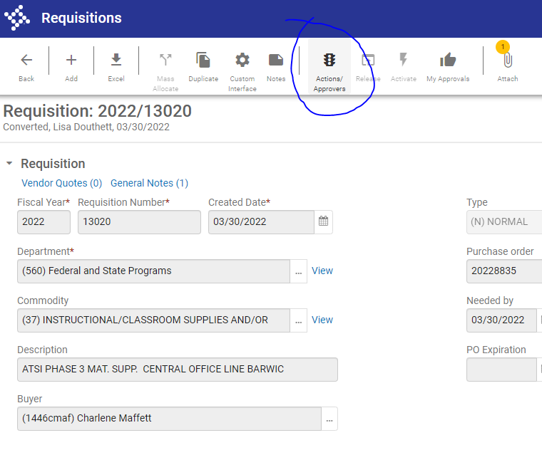
MUNIS Tip

Slide 58
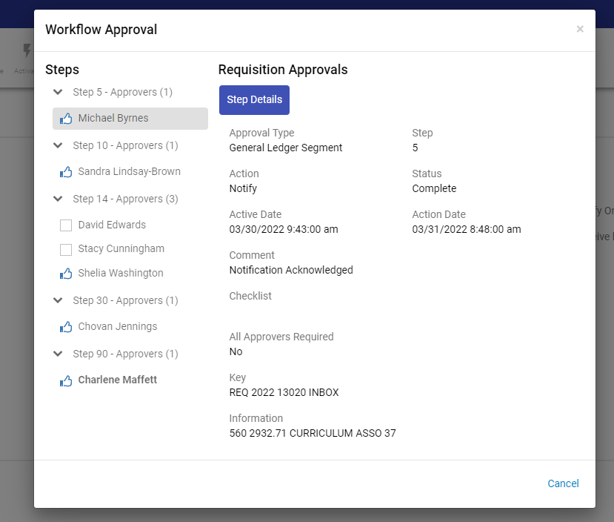
MUNIS Tip

Slide 59
Proper Fund Code
Important/Required:
Use of proper fund codes on all line items
i.e. Equipment, PD, Food, Miscellaneous, Office Supplies
(Org – Object – Project)

Slide 60
Sole Source
What type of purchases require sole source forms?
A Sole Source is defined as:
Inability to obtain competition; May result in only one vendor or supplier who possess the unique or capability to meet the particular requirements.
All Justifications will be vetted.

Slide 61
Change Orders
What is the definition of a Change Order?
A written modification or amendment to an EXISTING contract.
vs
NEW PO
Goal – Decrease Changes Orders
Note: Changes +/- $300.00 does not require a written change order

Slide 62
Change Orders
Submit all COs to
Budget Services via email
Do not batch/group multiple POs
Must be individual records per PO
Note: Copy your buyer as information only.
Budget must approve BEFORE any MUNIS changes.

Slide 63
Change Orders
Current Naming Sequence for
All Change Orders before emailing to Budget Services
PO Number.Vendor.Dept Code:
“2223XXXX.DellComputers.770”

Slide 64
UNAUTHORIZED PROCUREMENTS
Ratification is a S-I-N
An agreement, a commitment, or an order for goods or services, or changes to existing contracts by any person who does not have express written procurement authority to bind the District.
Ratification Requirements:
Memo/Letter to Director of Procurement Services with Explanation
Expenditure Request
Corresponding Invoices
Approval by Director of Procurement Services
Note:
Excessive ratifications may result in disciplinary action, loss of purchasing rights, or reimbursement to the District.
Delays payment to vendor.
Quarterly reports of each ratification will be sent to EDs

Slide 65
Procurement Services:
Contact Information
When unsure, contact the Procurement Services Team:
LaShonda Outing: 803-231-7040 – lashonda.outing@richlandone.org
Bridgette Williams: 803-231-7033 – bridgette.williams@richlandone.org
Timika Beaver: 803-231-7037 – timika.beaver@richlandone.org
Yolanda Cuttino: 231-7039 – Yolanda.cuttino@richlandone.org
Leigh Hodges: 231-7052 –carolyn.hodges@richlandone.org
Stephanie Conrad: 231-7031 – stephanie.conrad@richlandone.org

Slide 66
Procurement Department
Questions ???
Visit our webpage
www.richlandoneone.org/procurementservices

Slide 67
FINANCIAL SERVICES
PAYROLL UPDATES
Alma Neubig
Director of Payroll / Accounts Payable

Slide 68
Financial Services
Key Kronos Highlights and Training
Sherri Mathews-Hazel, Chief Financial Officer Cheslyn Jackson, Executive Assistant of Chief Financial Officer

Slide 69

Kronos Timekeeping and Absence Recording
Kronos is our timekeeping and absence software.
All hourly and salaried non-exempt employees are required to swipe in and out of Kronos. There are very few exceptions to this rule.

Slide 70
Workflow to Payroll
Director or Principal
Posts job opening
Applicant
Applies for Job
Director or Principal
Recommends applicant to work.
Adds Dates employee working, pay rate and Org, Object, Project
Executive Director Approves
Budget Approves
Personnel Analyst
Verifies Employee Numbers
Rates
Dates
Org, Object, Project
Personnel Analyst Downloads information from Frontline to Excel, Formats for Payroll to upload
Payroll Uploads and additional pay screens are created for additional pay

Slide 71

Negative Impacts to Employees When the Workflow Fails
If employees are working prior to the “Frontline” process being completed this will delay their pay .
If employees are working prior to the “Frontline” process being completed the hiring manager is in violation of HR process.

Slide 72

Frontline
All Frontline applications should be completed two weeks prior to the employee’s start date so employee will be able to swipe at clock.
All questions pertaining to Frontline are handled through Human Resources.

Slide 73
Employees
Clocking in/out
Employees working Additional Work (Hourly)
  Examples of Additional Work:
    After school
    CRP
    Federal Programs

Slide 74
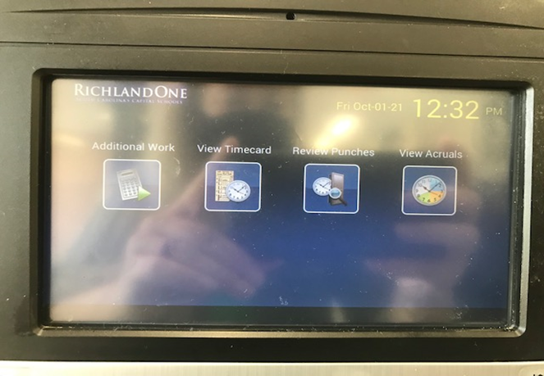
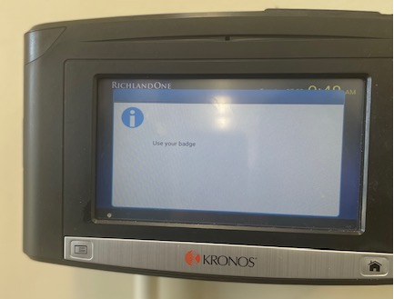
How to Swipe for Additional Work
Touch the Additional Work button and then hold your badge up as if you are swiping in.

Slide 75
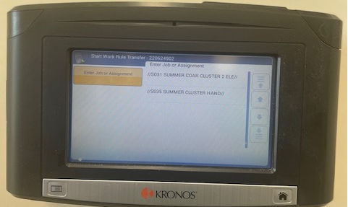
How to Swipe for Additional Work
Select your job from the drop down menu.

Slide 76
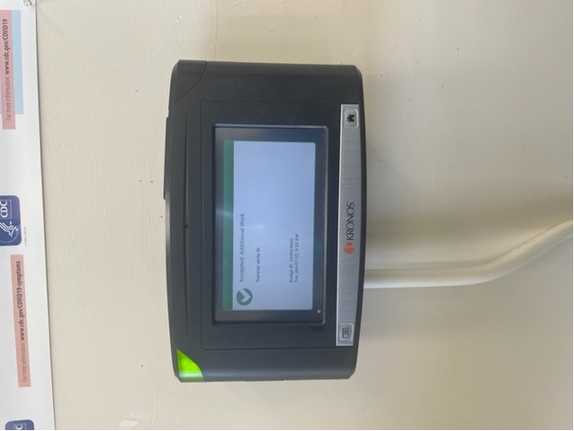

How to Swipe for Additional Work

Slide 77
How to Swipe for Additional Work
To Swipe out, simply hold your badge up to the clock as normal.

Slide 78

Timeclock Error
If an employee does not see his/her job on the drop down list please do the following.
  Collect the missed punch form for that employee.
  Immediately check Frontline status to ensure that the employee’s process in Frontline has been completed for that program.
    If their status is not complete, please contact HR to see what needs to be completed so that this employee can be paid at the correct rate and budget code.
    If their status is complete, please contact Payroll. Payroll will put in a ticket to IT to correct the problem.

Slide 79
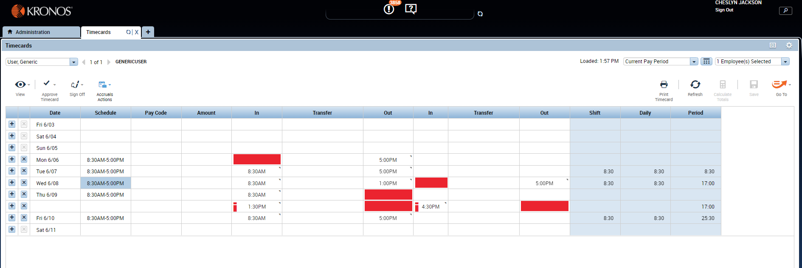
Missed Punches
Incomplete Timecard. This shouldn’t be approved!

Slide 80
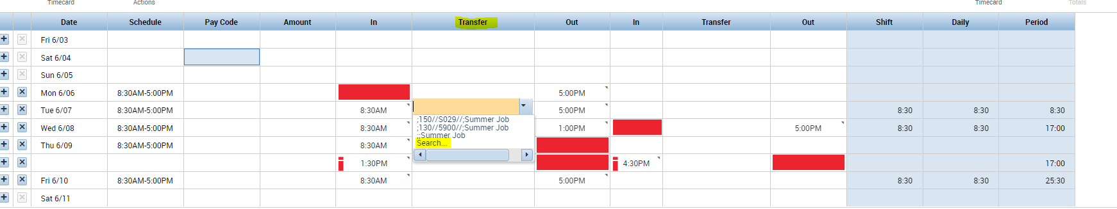
Transfer codes for Missed Punches Only
Click the Transfer Block and Search

Slide 81
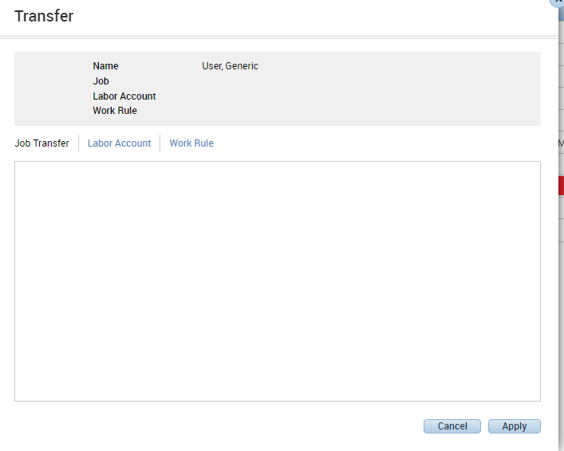
Transfer codes for Missed Punches Only
Once search is clicked this is what will pop up.

Slide 82
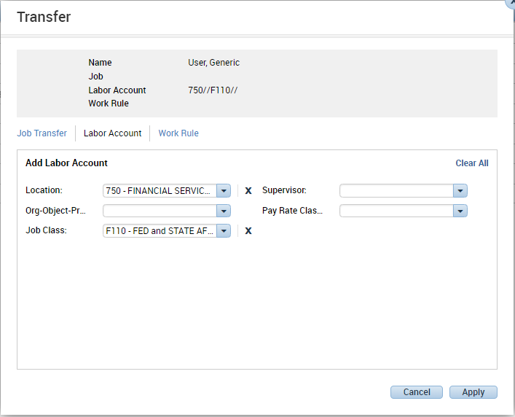
Transfer codes for Missed Punches Only
Next Click Labor Account. Select the Location and Job Class

Slide 83
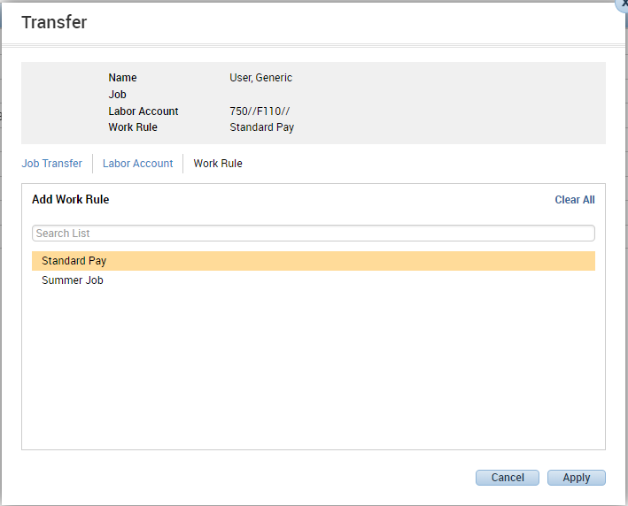
Transfer codes for Missed Punches Only
Next, click Work Rule and select Standard Pay. Lastly, click Apply.

Slide 84
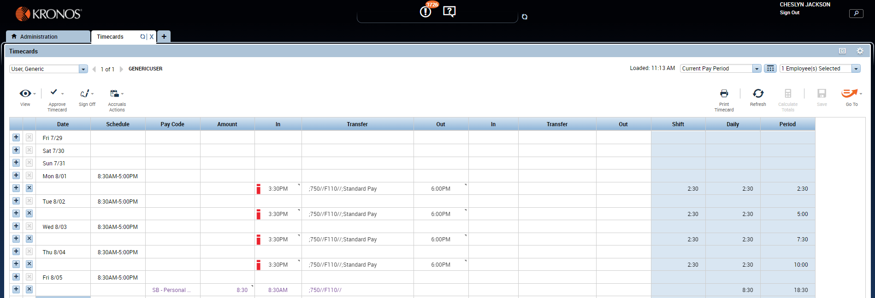
Transfer codes for Missed Punches Only
This is example of a completed Timecard with all codes.

Slide 85

Kronos Approval
Approving time in Kronos is legally attesting that all employees’ hours have been reviewed and are accurate.

Slide 86

What to Look for Before Approving Kronos
First your paymasters should review and edit all missed punches, correct any AM/PM errors, put in proper transfer code and key any absences.

Slide 87

What to Look for Before Approving Kronos
Before approving Kronos, it is important to review each employee’s timecard for accuracy first.
This will prevent under and overpayments which can potentially have a negative impact on their paycheck.

Slide 88
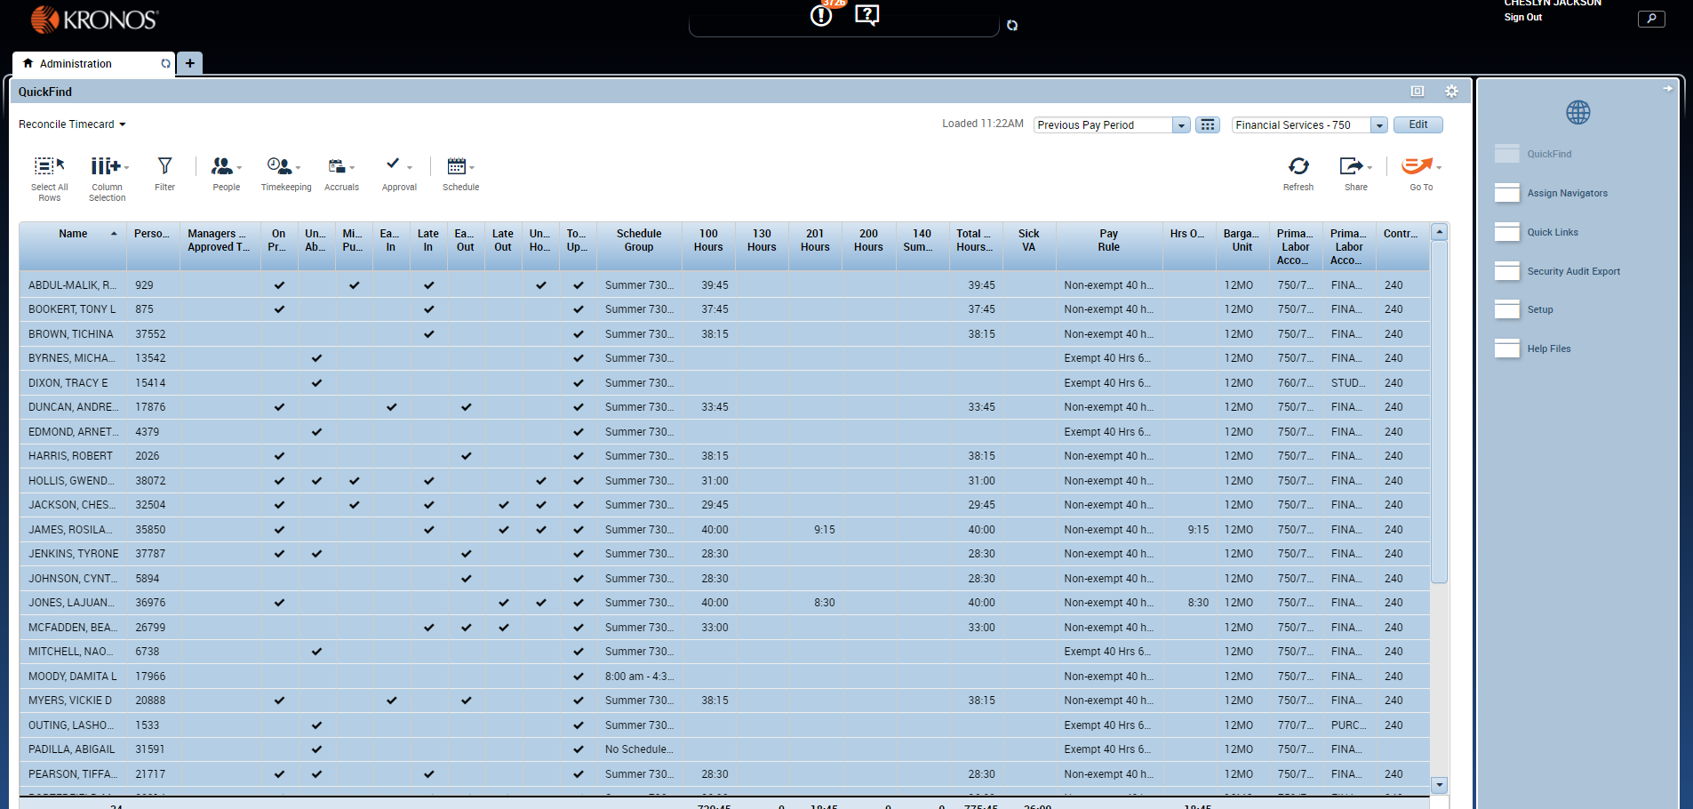
Approving Timecards
Click Select All Rows or hold CTRL and click the employees you will like to approve.

Slide 89
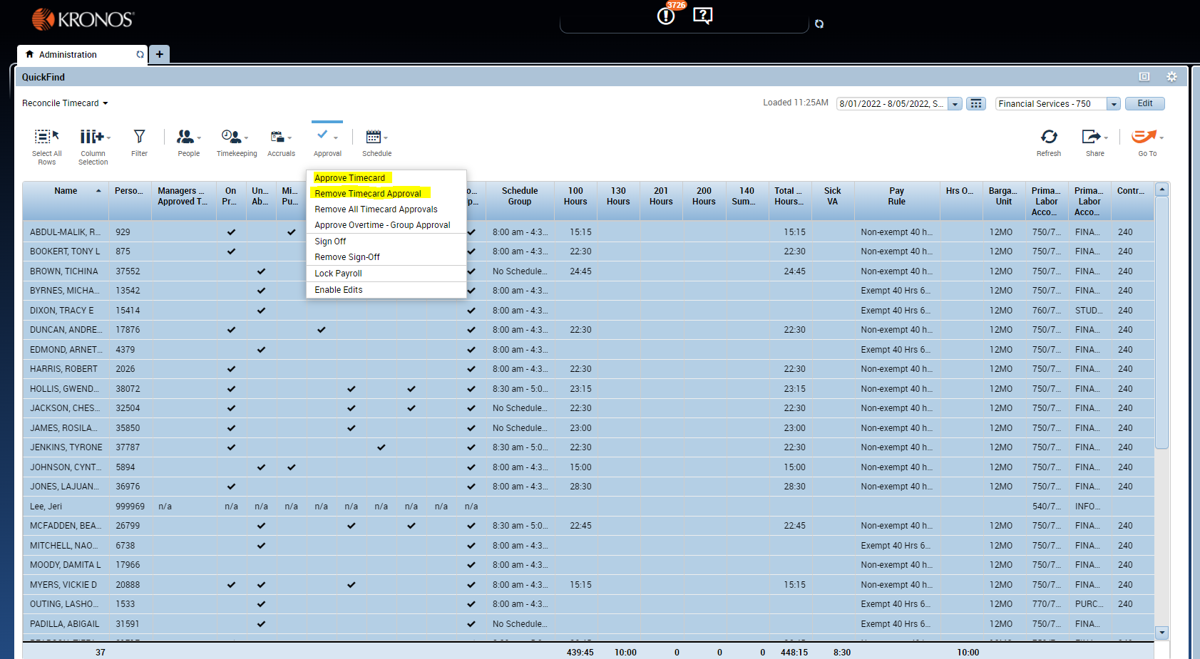
Approving Timecards
Click Approval and the drop down menu will appear. Click Approve Timecard or Remove Timecard Approval.

Slide 90
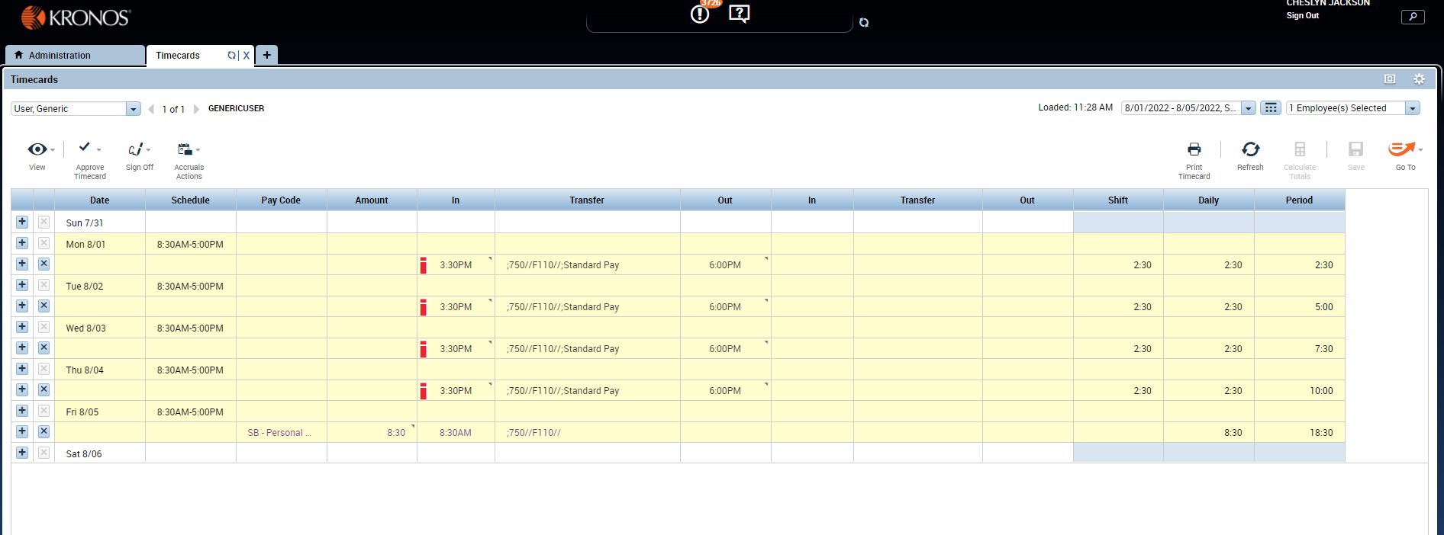
Approving Timecards
Timecards are officially approved when the timecards turn yellow.

Slide 91
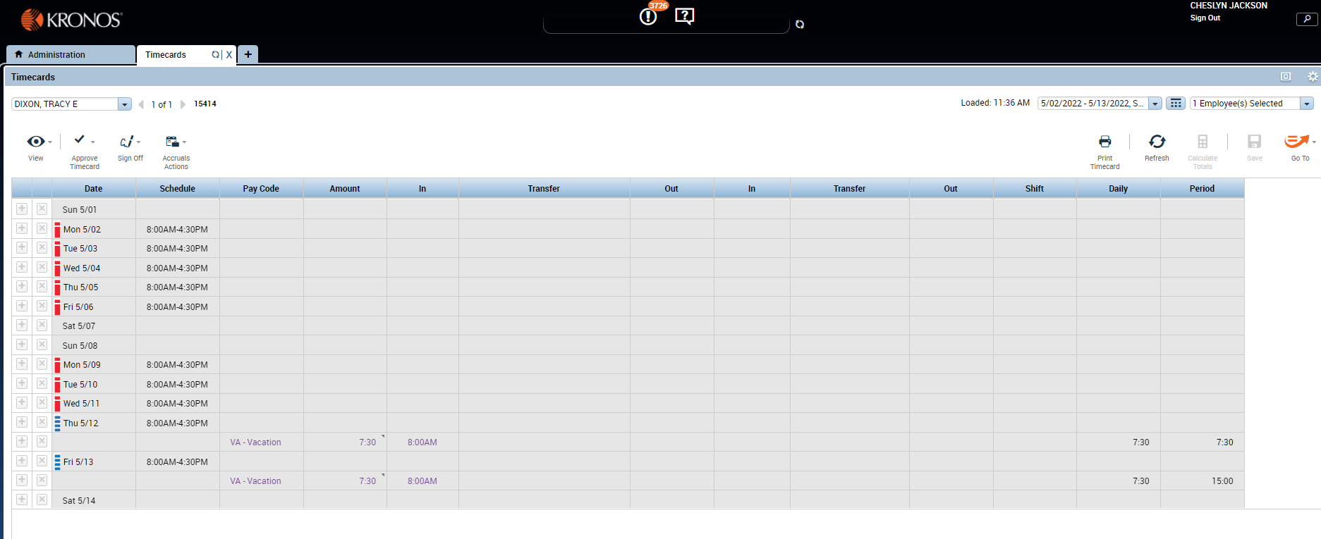
Approving Timecards
Timecards are locked when the timecard turns gray. Locking the timecards are done by payroll. This allows no changes to be done.

Slide 92
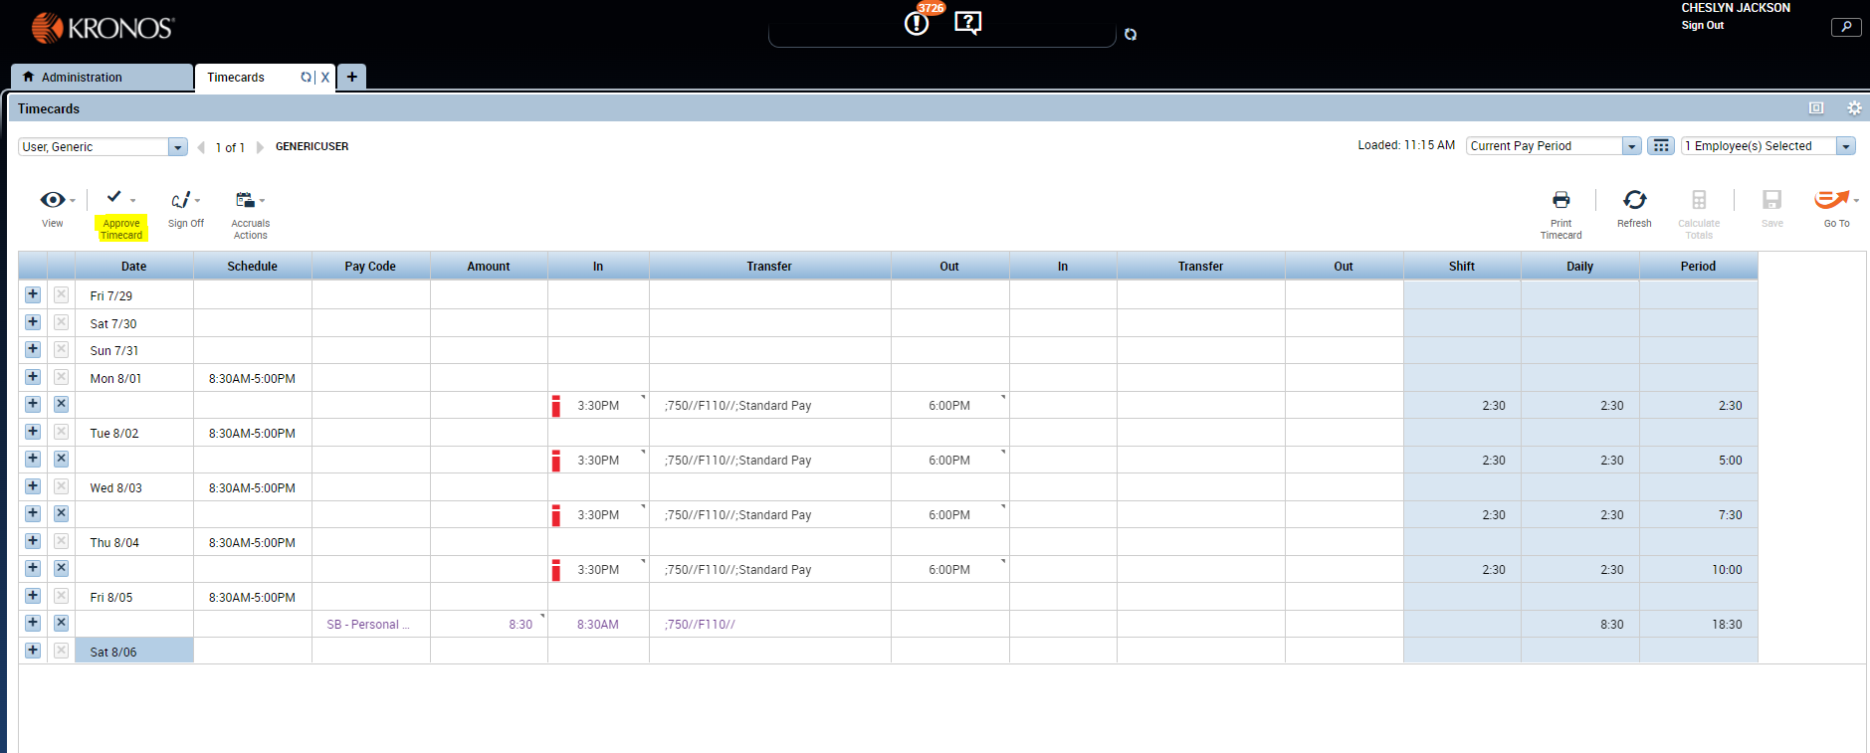
Approving a Timecard
Click Approve Timecard

Slide 93
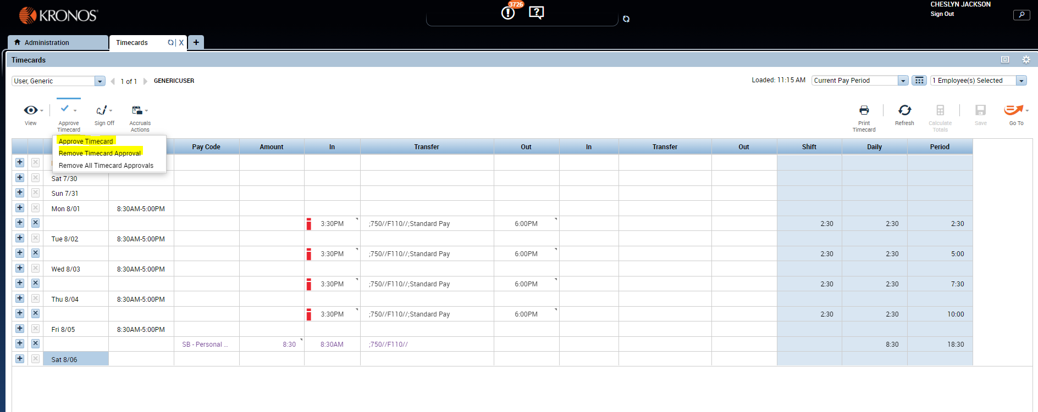
Approving a Timecard
A drop down menu comes and click Approve Timecard or Remove Timecard Approval.

Slide 94

Kronos Reminders
Paymasters should collect and key all missed punches daily so problems can be corrected early in process.
Missed punch forms should not be sent to payroll unless requested.
The paymaster may not edit their punches. It must be completed by their supervisor.

Slide 95

Kronos Reminders
Approvals of payroll must be timely to ensure employees are paid timely.
7 minute Rule.
Short hours.

Slide 96
Kronos Roster
A missing employee is an indication that something may not be complete in the hire or transfer process.
This is a key indicator of a potential problem. This needs to be addressed quickly to ensure timely payment.
Employees appearing on your Kronos who do not work for your location also require additional action.
Please verify whether a Form A needs to be submitted, a transfer, or whether the employee is on leave and needs to be coded.
Code AU for any employees who do not work at your location if you are uncertain of the above status.
We do not want to overpay employees who may not be working.

Slide 97

What to do if an employee does not get paid on payday?
The paymaster will need to contact the Payroll Office on behalf of the employee.

Slide 98

Questions
Questions ?

Slide 99
FINANCIAL SERVICES
HUMAN RESOURCES UPDATES
Kathy Parker
Personnel Analyst

Slide 100
QUESTIONS AND ANSWERS
    ?
    ?
    ?

Slide 101
STUDENT ACTIVITY WORKSHOP
FY 2023 - 2024
AUGUST 3, 2023
Thank you for coming !!!
Have a Great Year !!!!!
We Look Forward to Serving You in the New Year !!

