Slide 1
MVHS Course Selection
Class of 2028
INCOMING FRESHMAN INFORMATION

Slide 2
WELCOME TO MILL VALLEY!
Meet the Counselors! Students are assigned to counselors based on their last name:
Mrs. Chandler (A-D)
Ms. Hayes (E-J)
Mrs. Mixon (K-P)
Mr. Wallace (Q-Z)

Slide 3
Welcome to MVHS!
Click below for a video!

Slide 4
How many classes will I be taking?
All MVHS students take a total of 8 classes
Block scheduling--Blue/Silver Days
Four classes each day
Freshmen are required to take the following 5:
English
Math
Biology
World Geography/Civics
Physical Education
That leaves 3 blocks for YOU to choose

Slide 5
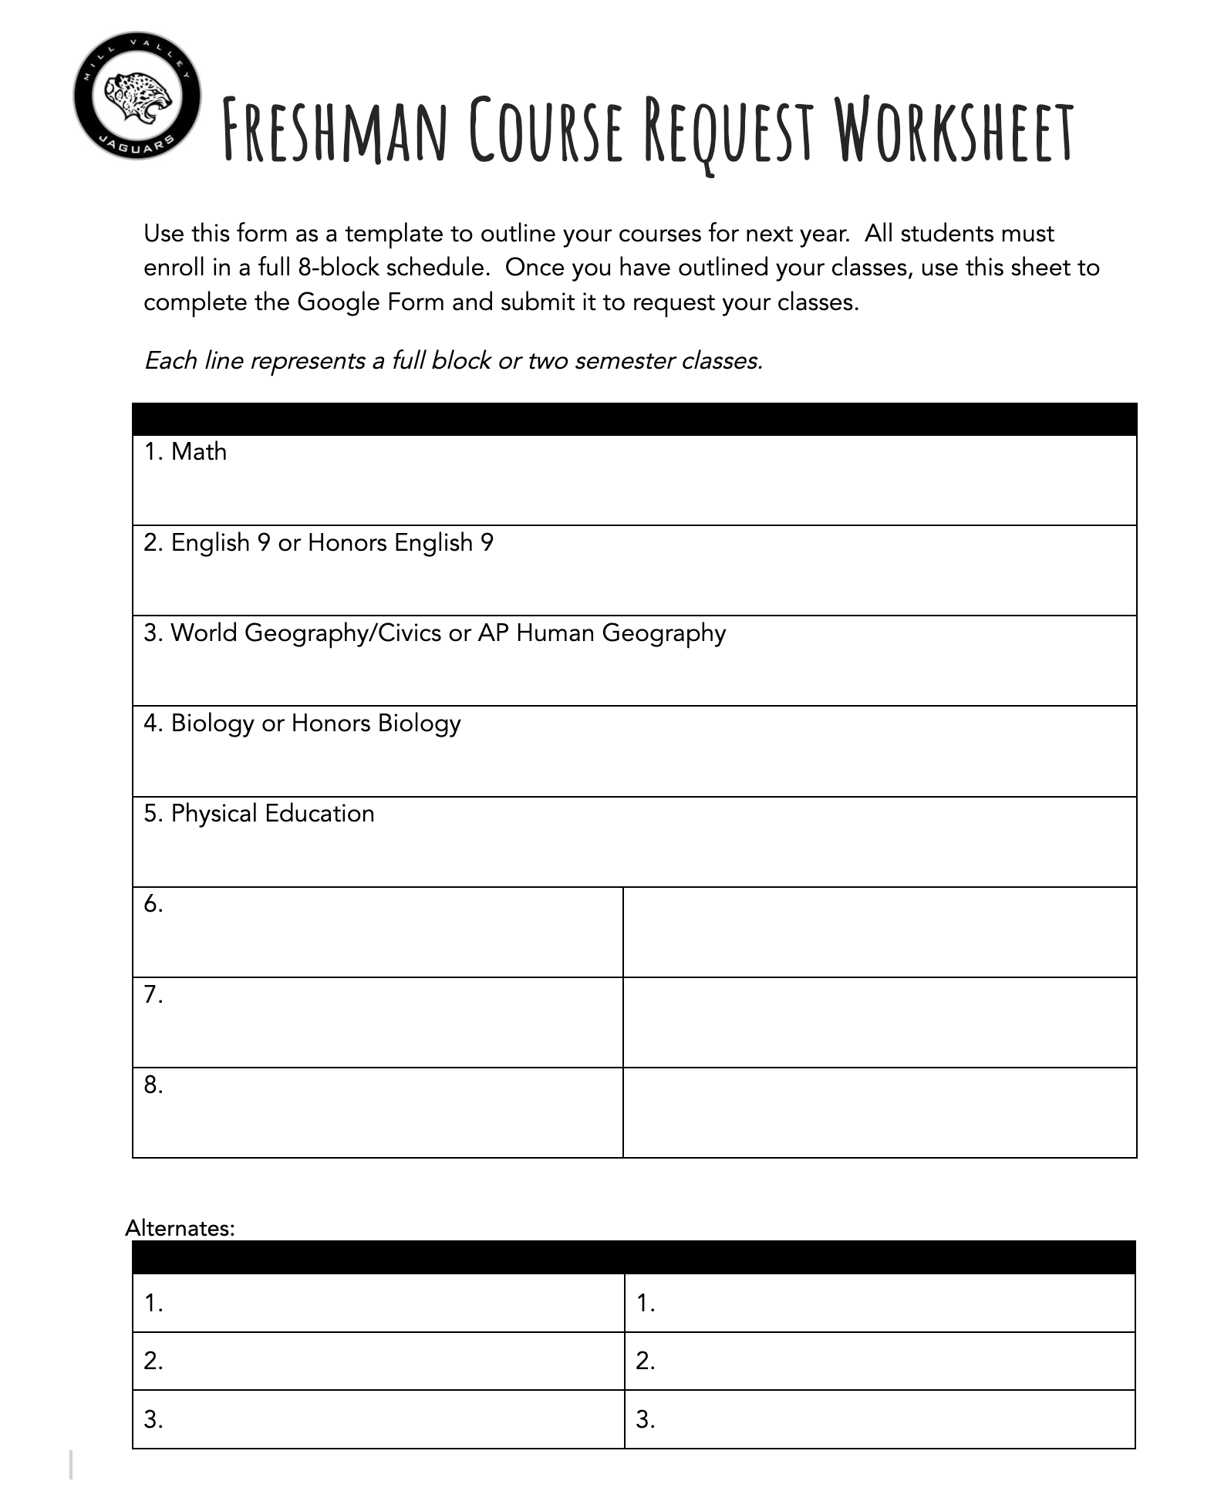
*Math recommendations made by current teacher
Notes:
2/22 Math Rec will be available

Slide 6
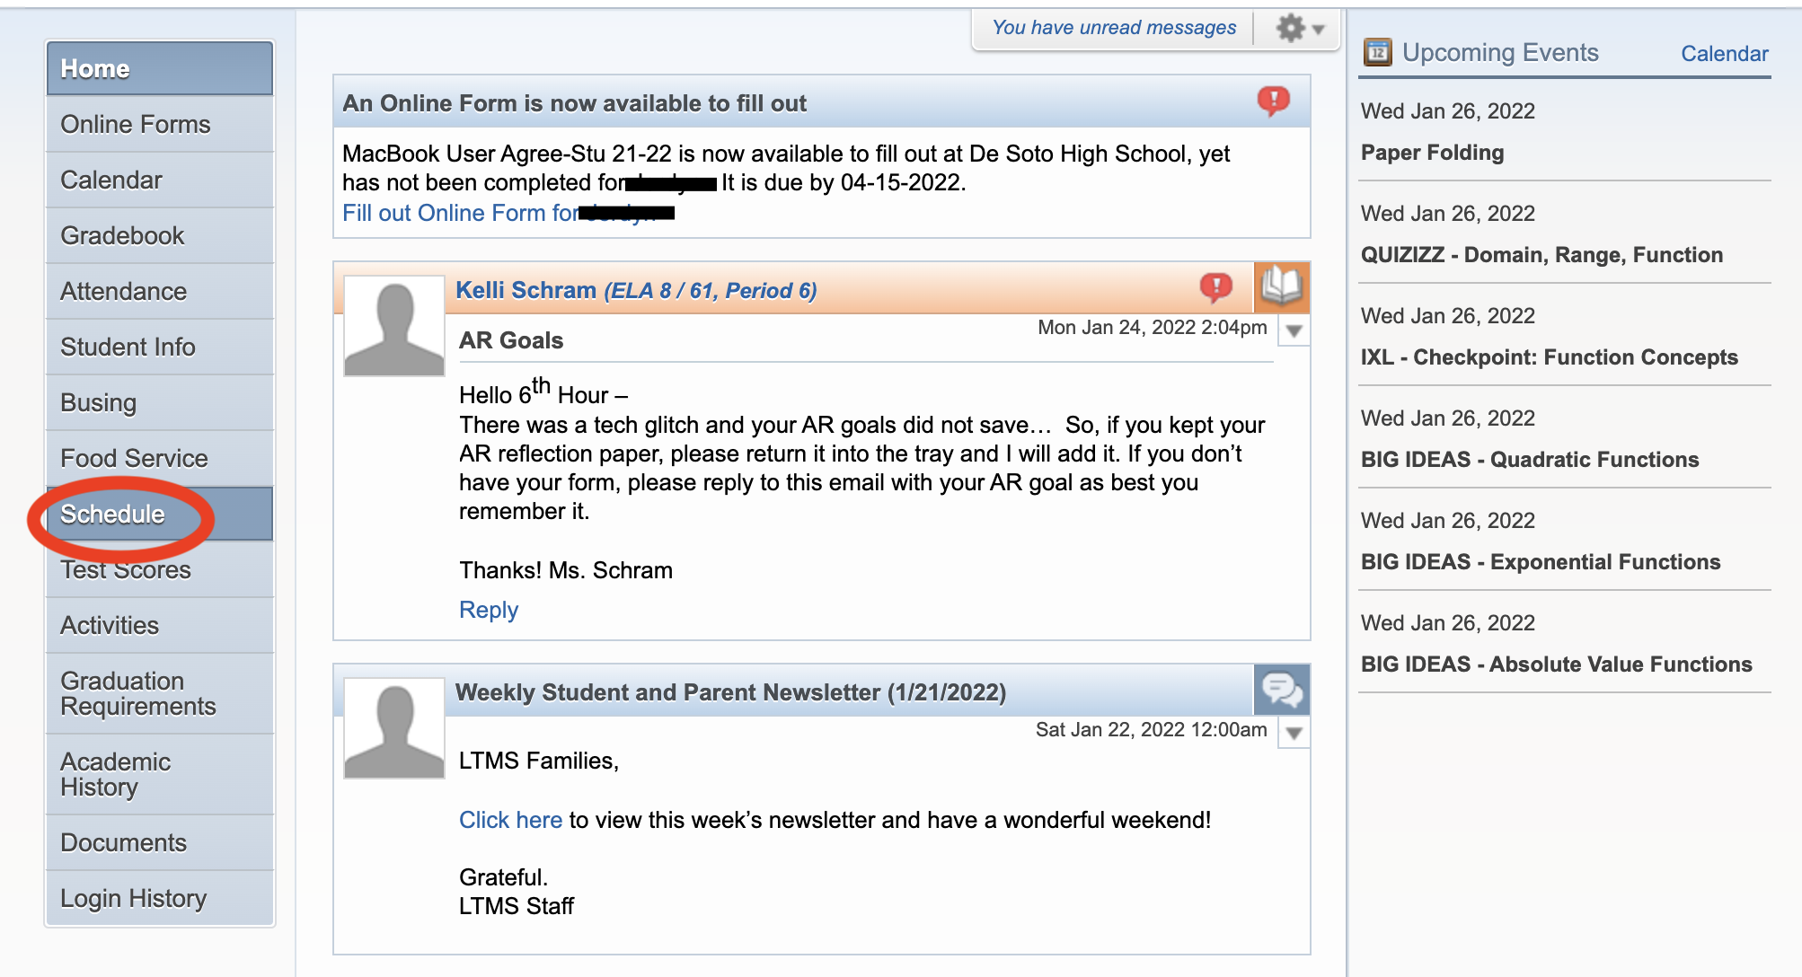
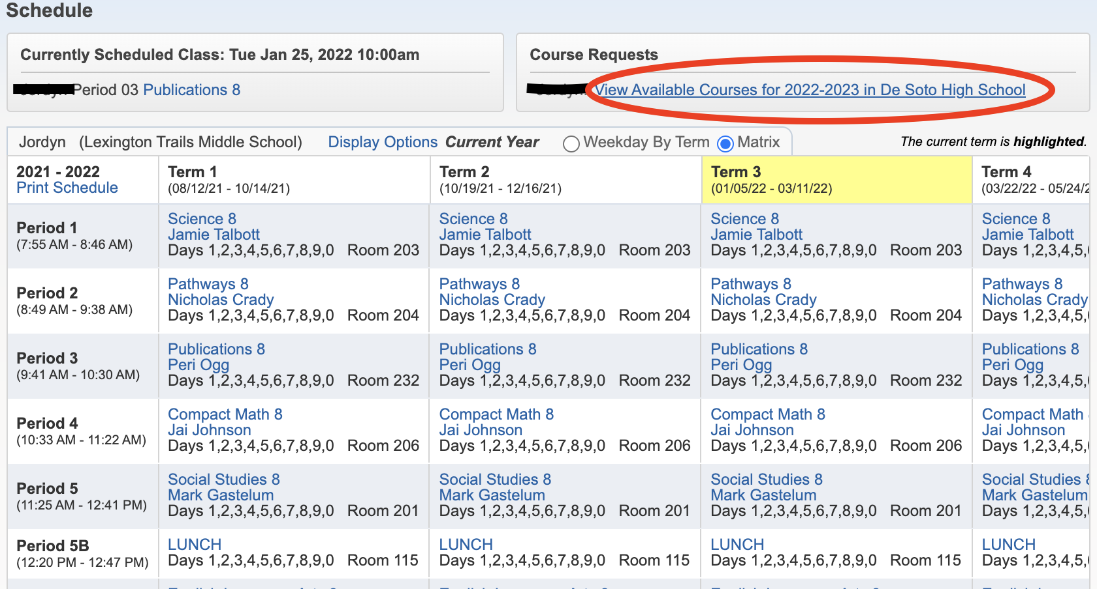
Recommendations: Math
Notes:
Recommendations will be able to be viewed in Skyward. We recommend having a conversation with your current Math Teacher.

Slide 7
How do I know what to take?
Things to consider:
Graduation Requirements
Board of Regents Requirements
Kansas Scholars Curriculum
Honors/AP vs. Grade Level courses
Career Pathways
Cedar Trails Exploration Center (CTEC)
Areas of Student Interest
Available Electives for Freshmen

Slide 8
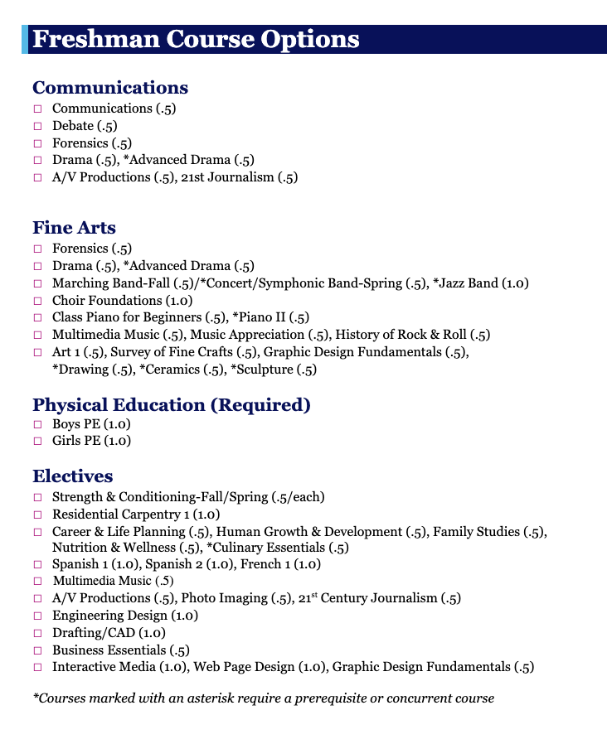
Courses
Available for Freshmen
All Freshmen will select an additional 3 blocks of electives to create a complete schedule
See the Course Guide for course descriptions and information:
Course Guide

Slide 9
USD 232 Graduation Requirements
All students must earn 25 credits in the following areas:
Communication
English: 4 credits
Communications: .5 credit
STEM
Math: 4 credits
Science: 3 credits
STEM Elective: 1 credit (11th-12th)
Society & Humanities:
Social Studies: 3.5 credits
Fine Arts: 1.0 credit
Employability and Life Skills:
Financial Literacy: .5 credit (11th-12th)
Physical Education: 1 credit (9th)
Health: .5 credit (10th)
Electives: 6.0 credits
2 or more Post Secondary Assets (PSA)
1 credit=Full Year .5 credit=Semester

Slide 10
Kansas Board of Regents
University of Kansas, Kansas State University, Pittsburg STate University, Emporia State University, Fort Hays State University, Wichita State University
Qualified Admissions
English 4 credits
Math 3 credits
Social Science 3 credits
Science 3 credits
*must have Biology
Electives 3 credits
Kansas Board of Regents Qualified Admissions
Scholars Curriculum
English 4 credits
Math 4 credits
Science 3 credits
*must be Biology, Chemistry, Physics
Social Studies 3 credits
Foreign Language 2 credits
*both years must be taken during high school
Kansas Board of Regents Scholars Curriculum

Slide 11
Honors/AP vs. grade level classes
Things to think about:
-What subjects am I interested in?
-How much time do I have outside of school? (sports, activities, job, family)
-Current teacher input?
Honors vs. Grade Level Course Information
Notes:
AP Human Geo–College Level Course

Slide 12
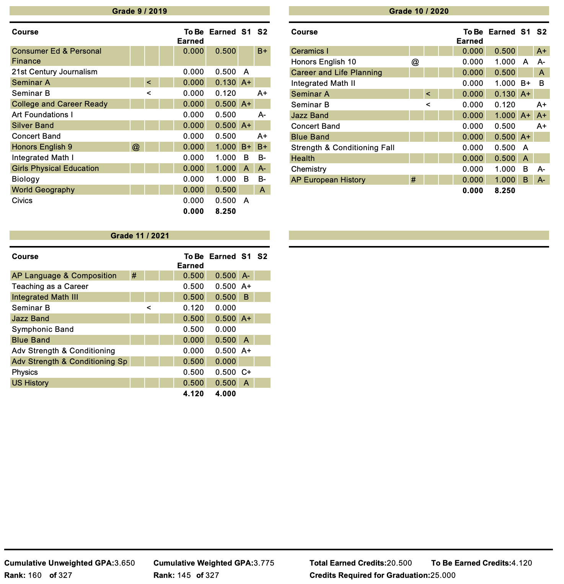
Why are my grades important?
From the first day of high school you are creating your transcript--a permanent record of your academic career.
Transcripts are used to apply for programs and scholarships.
Start off strong! Ask for help if you need it--don’t wait!

Slide 13
Career and Technical Education Pathways/Off Campus Opportunities (Juniors/seniors)
Pathways offered:
Bioscience: Biochemistry & Biomedical
Business
Finance
Construction & Design
Digital Media
Engineering & Applied Mathematics
Family, Community & Consumer Services
Graphic Design
Manufacturing
Marketing
Programming & Software Development
Teaching/Training
Web & Digital Communications
Cedar Trails Exploration Center (CTEC):
Bioscience
Design
Emerging Technologies
Johnson County Community College (JCCC):
Kansas City Kansas Community College (KCKCC):
Eudora Technical Education (EDTEC):
Off Campus Programs Link

Slide 14
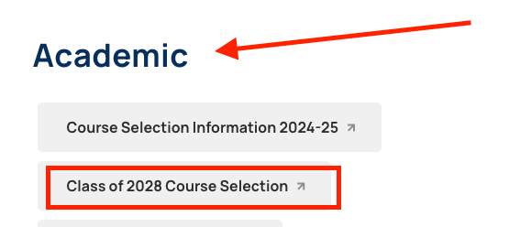
Where can I find information?
The Counseling Website!

Slide 15
How do I submit my Course Requests?
Complete the Google Form:
Freshman Course Selection Form
Available to complete January 26, 2024
Students must be signed into their USD 232 account to complete
Due by February 21, 2024
Still have questions?
Student Ambassadors ELT Visits
Monticello Trails Middle School: 2/6 & 2/20
Mill Creek Middle School 1/26 & 2/13
Incoming Freshman Night
February 5, 2024
5:30-7:30 MVHS
Elective showcase, Honors/AP info, & MVHS Overview
Jaguar Jumpstart
Coming in August!
Tours/Activities/Athletics Information
Notes:
**ADD Freshman Form

Slide 16
Where can I find information?
The Counseling Website!

Slide 17
Welcome to the MVHS Family!
We look forward to seeing you next fall!

