Slide 1
ELPAC Overview DESCRIPCIÓN GENERAL DE ELPAC
What is ELPAC? ¿Qué es ELPAC?
ENGLISH VIDEO
SPANISH VIDEO

Slide 2
Visit the ELPAC Website Visite el sitio web de ELPAC

Slide 3
Finding Resources

Slide 4
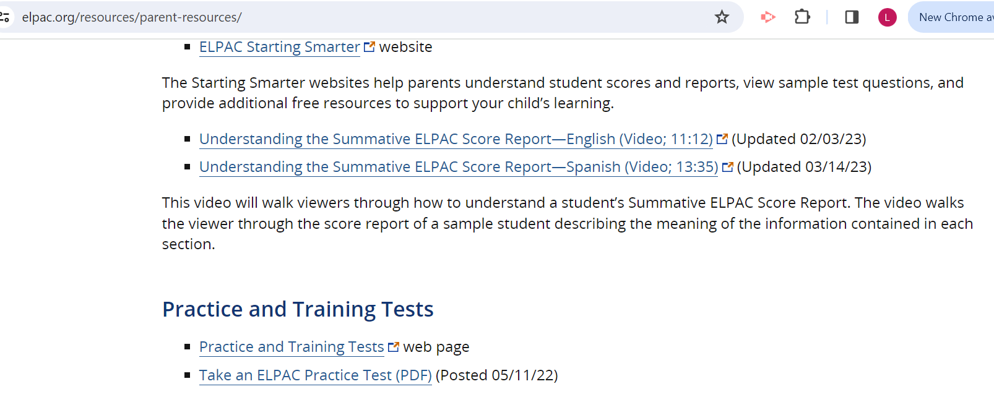
ELPAC Practice Tests
Pruebas de práctica ELPAC
Notes:
Topic discussed - reading at home, importance of home language, attendance, etc.

Slide 5
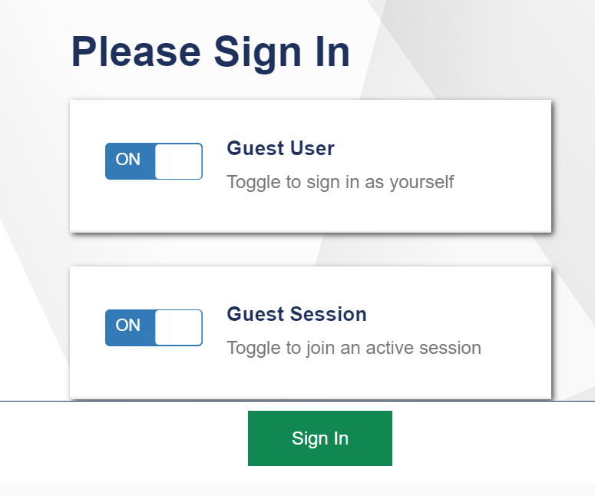
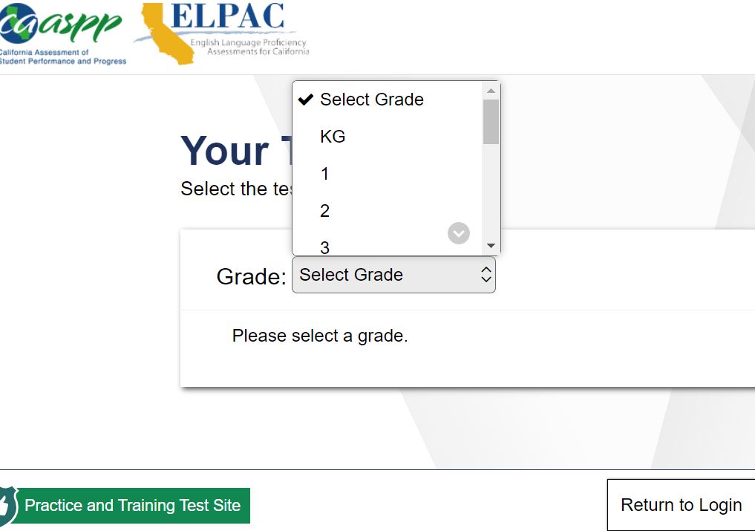
ELPAC Practice Tests
Pruebas de práctica ELPAC
Notes:
Topic discussed - reading at home, importance of home language, attendance, etc.

Slide 6
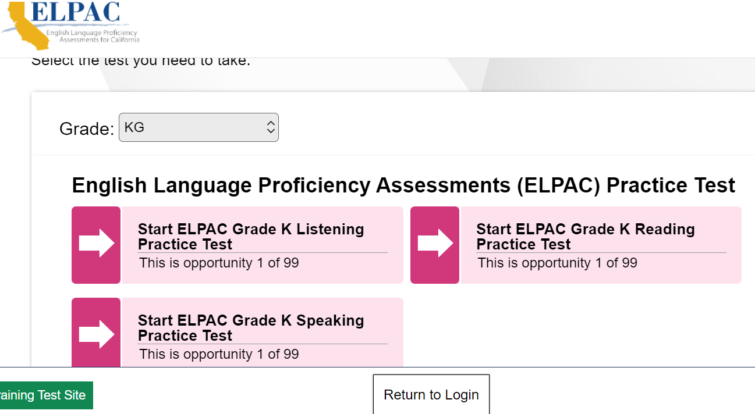

Slide 7
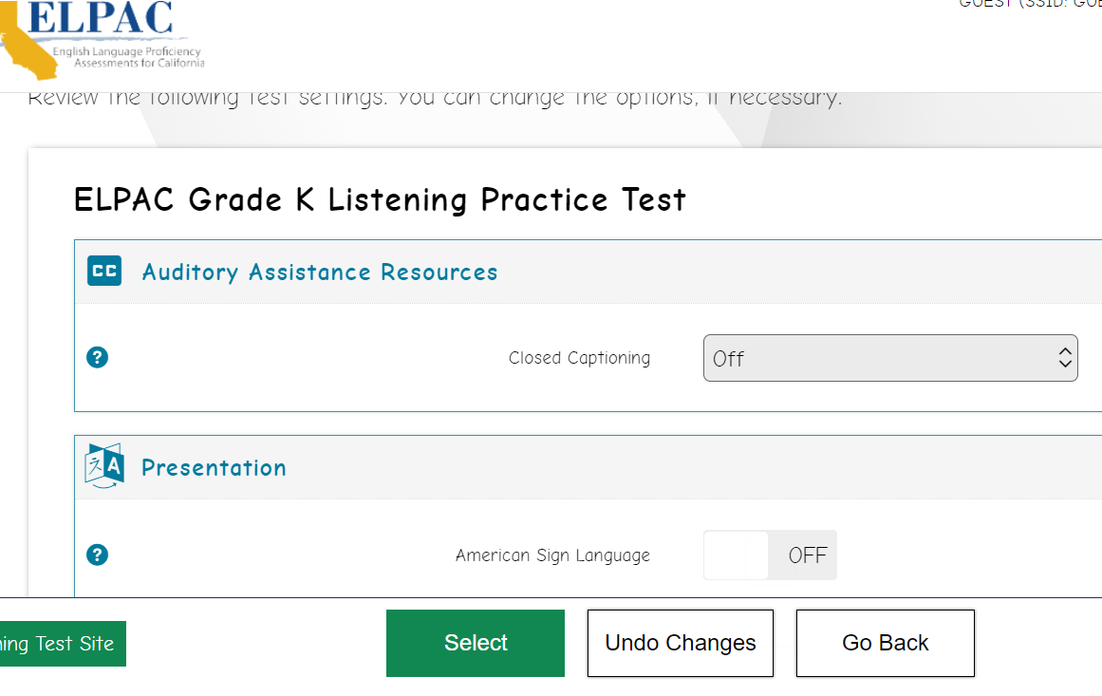

Slide 9
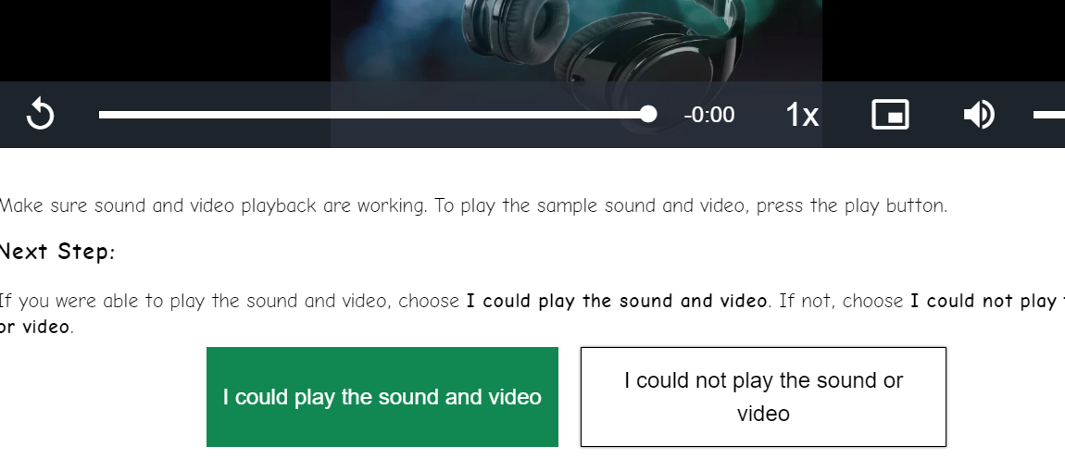

Slide 10
