Slide 1
DISTRICT RECORDS MANAGEMENT TRAINING
Retention and Disposition requirements
Notes:
Hello everyone, We will wait just a couple more minutes to give everyone time to log in and then we will get started here pretty soon. Ok, lets get started. Good morning my name is Robert Sertuche and I am the Records Management Officer for ECISD. Thank you all for being here with us this morning. With me today is Bethany Ibarra she is the policy and retention specialist and Martha Lopez is my Records Liaison. You will be hearing from both of them here in a little bit.

Slide 2
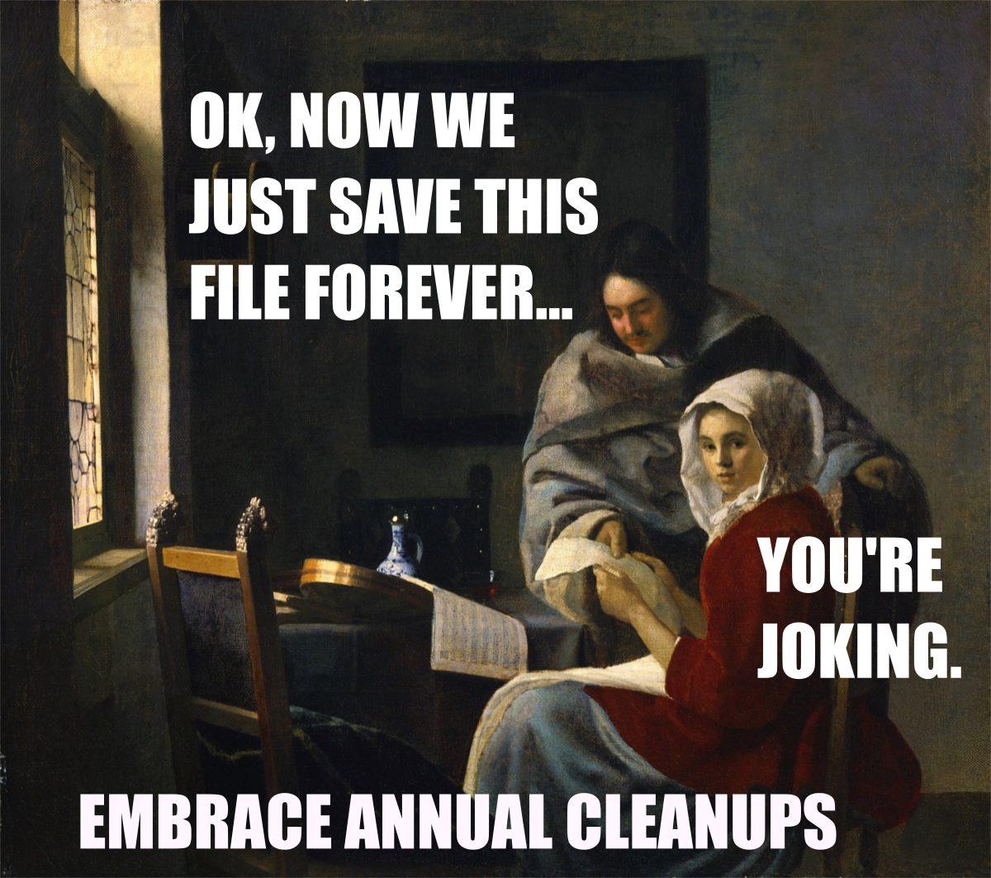
Records Management
Records Management is the application of management techniques to the creation, use, maintenance, retention, preservation, and disposal of records for the purpose of reducing costs and improving the efficiency of record-keeping.
Proper Records Management also keeps ECISD in compliance with the Local Government Records Act of 1989.
Notes:
Records Management is pretty simple. We manage records. But as you all know paper especially can get out of hand so we want to retain records as legally necessary and then dispose of when the retention period is over. And this picture is pretty much saying that. No need to hold on to things forever. Talk about what you saw at Ector.
Explain the picture
Talk a little bit about the RMO responsibilities

Slide 3
What is a Record?
A “ local government record means any document, paper, letter, book, map, photograph, sound or video recording, microfilm, or other information-recording medium, regardless of whether public access to it is open or restricted under the laws of the state, created or received by the District or any of its officers or employees pursuant to law or in the transaction of public business.
Local Gov’t Code §201.003(8)
Notes:
Explain what a record can be

Slide 4
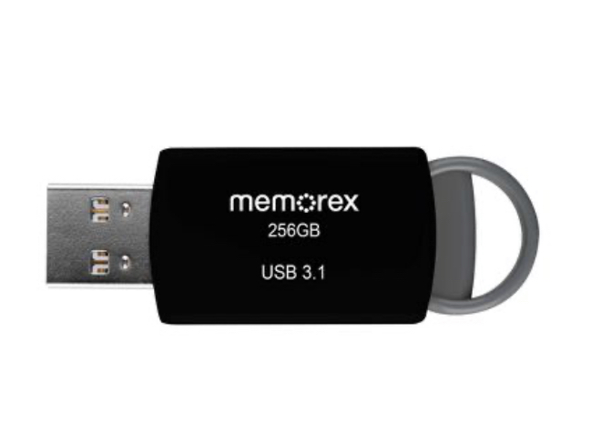
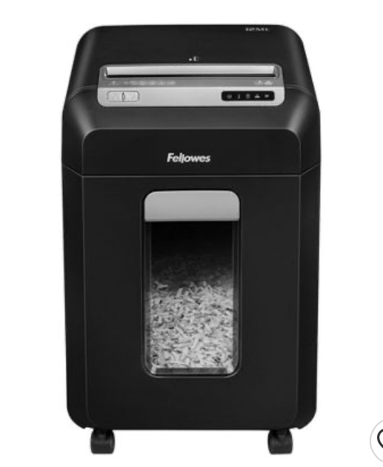
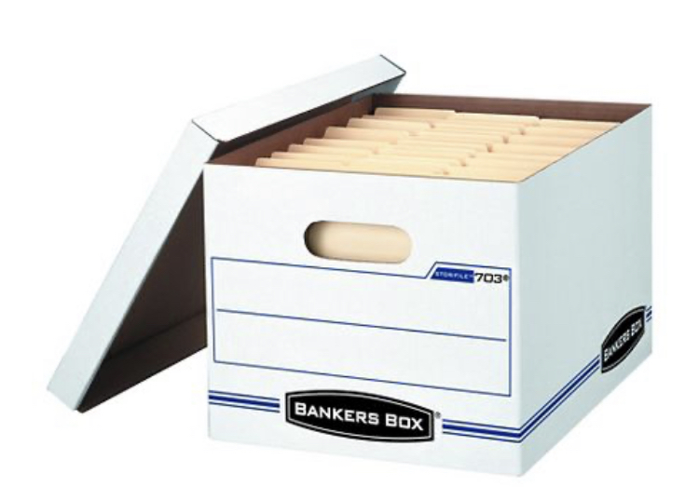
Records Life-Cycle
Creation or Receipt
Retention and Maintenance
Destruction of Archiving
Notes:
The life cycle of a record begins at its creation or at the receipt of the record. After creation or receipt records must then be maintained and retained until their retention period has expired. Once the retention period is over records can then be disposed of or destroyed. We only recommend cross shredding for destroying records, they must never be thrown in the trash. Many of the records we all keep contain sensitive information like social security numbers. As the keepers of these records it is important that we are careful with not only keeping records safe but with also disposing of them correctly.

Slide 5
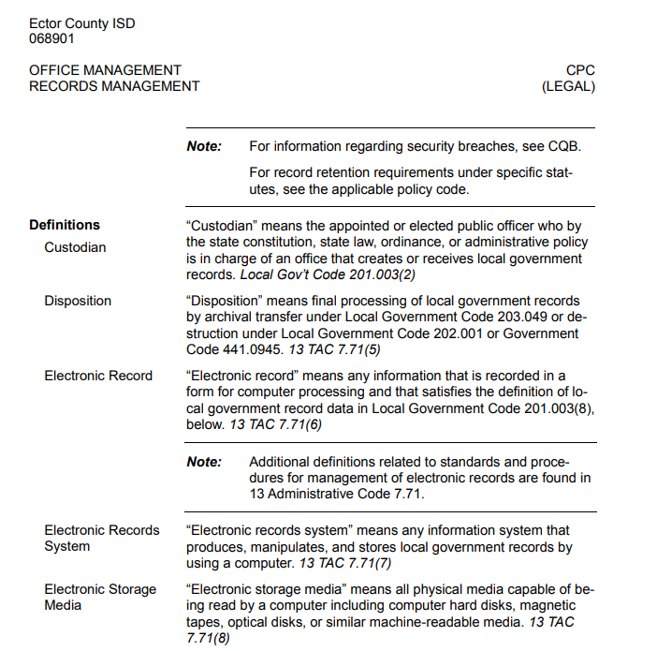
Notes:
This slide and the next show our policy for records management. Most of the slides will also have policy listed so that you know where to find the information we are giving you today.

Slide 7
Texas Law Library & Archives
Local Board of Trustees
Superintendent
Sets local policies
Appoints District Records Management Officer
Sets and enforces state and local policies. Custodian of records for students who have graduated or withdrawn
District Records Management Officer
Works directly with the District Records Management Officer to enforce state and local policies
Campus Administrator-Principal/Department Head
Campus Records Designee
District Records Management Liaison
The custodian of all records of currently enrolled students on their campus
Responsible for maintaining and securing all student records on their campus
Sets state policies and local retention schedules
Records Management Chain of Command
Notes:
This screen shows the Chain of Command for records management. At the top we start with TSLAC, they set the schedules our board adopted those schedules, we have the superintendent, then myself, then Martha my liaison and then all of you. So we are in the middle of you and the state records commission and that’s pretty much what we do we are the middle men here to assist you with your records.

Slide 8
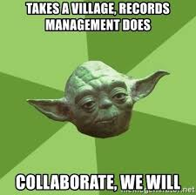
The Custodian of Records Role
Each department head/principal shall designate a member of his or her staff to serve as Custodian of Records for the implementation of the records management program in the department/school.
Custodians of Records have the responsibility of cooperating with the Records Management Department in carrying out the policies and procedures established by the District for the efficient and economical management of records and in carrying out the requirements of the Act.
Loc. Gov’t Code §203.022
Notes:
The custodian of records for each campus is the Principal and for each department it is the department head. We all have different type of records that we are responsible for so as the custodian you designate some of these responsibilities to your staff. These responsibilities are usually designated to Admin. Assistants or secretaries. It is important to have communication with this person and make sure that they are carrying out their records management responsibilities because at the end of the day you are still considered the custodian for your records. TEA can come and perform audits so please make sure that you check in from time to time with your designee.

Slide 9
Campus and Departments Records Management Duties
Adequately document the transaction of District business and the services, programs, and duties for which they and their staff are responsible
Complete all District Records Management trainings
Maintain the records in their care and carry out the preservation, destruction, or other disposition of the records in accordance with the policies and procedures of the District’s records management program
Follow TSLAC’s retention schedule
Participate in a records storage audit if scheduled
Local Gov’t Code §203.022 & 203.023
Notes:
These are the responsibilities of each campus and department Records Manager and designee. Read slide
Now that I have talked about all of our roles and responsibilities we will now go into Records retention. I’m going to pass it over to Bethany and she will discuss types of records and retention periods and schedules and how to find this info within the TSLAC website.

Slide 10
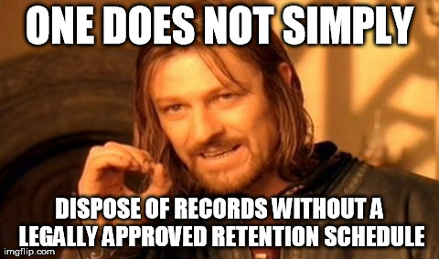
Retention Schedule for Records of Public School Districts
ECISD follows the retention schedules adopted by the
Texas State And Archives Commission
https://www.tsl.texas.gov/slrm
Local Schedule GR – Records Common to All Governments
Local Schedule EL – Records of Elections and Voter Registration
Local Schedule TX – Records of Property Taxation
Local Schedule SD – Records for Public School Districts
13 TAC 7.125
Notes:
These are the retention schedules ECISD has adopted from TSLAC. Most of you will only need and use SD and GR. These can be found on the tslac website…..

Slide 11
Common Records Retained by Campuses & Departments
Enrollment Lists and Rosters
Enrollment and Withdrawal Reports
Student Records (Cumulative Folder)
Access of Information, Records From
Federal Impact Aid Survey Forms
Attendance Reports
Accident Reports
Cumulative Health Card or Record
Health Screening Documentation
Reports to Enforcement Agencies
Discipline Records
Notes:
These are some of the most common records kept by our district. Some of these might pertain to you and some may not. For example health screening documentation is kept and retained by nurses.

Slide 12
Common Records Cont.
Curriculum Planning Documentation
District and Campus Improvement Plan Documentation
Daily Food Service Records
Transportation Records
Performance Appraisal Records
Visitor Logs
Magnet Applications
Parent Permission
Time Sheets
Purchase Orders
Budget Documentation
Discretionary Receipts &Deposits
Requisitions
Payroll
Service Request/Work Orders
Notes:
We wanted to list several different type of records so that every department can see their records documented here…….

Slide 13
Common Records Cont.
Requisitions
Payroll
Service Request/Work Orders
Workers Compensation
Leave Records (FMLA)
Unemployment Claims
Drug Testing, DOT pre-employment and DOT random
Notes:
Most of you will not keep FMLA records but many department and campuses do have requisitions or payroll records.

Slide 14
Navigating TSLAC
Notes:
I’m now going to go into TSLAC and show you my screen so that you can all see what it looks like. This is where you will find all of the records you are required to keep and how long you are required to keep or retain them. Go to tslac. Go into SD and GR and point out different type of records.

Slide 15
Common Retention Codes
AV
As long as administratively valuable (purpose served)
CE
Calendar Year End: December 31st
FE
Fiscal Year End: June 30th
Fiscal Year End: June 30th
PM
Permanent (never destroy)
US
Until superseded (keep until replaced by an updated version)
Notes:
AV - As long as administratively valuable. This means you can dispose of the record as long as there is no business need for the record or after its immediate purpose has been served.
CE - Calendar Year End: December 31st
FE - Fiscal Year End: June 30. Many financial records, like invoices, have a retention period of FE+3 years. So, if an invoice that was received in May of 2021, it can be disposed of on July 1, 2024.
PM - Permanent! You can never destroy you have to retain it permanently.
US - Until superseded. So, for example - You have a policy and procedures manual which has a retention period of US+5. This means destroy five years after it has been replaced by a new one.
I will now pass this over to Martha.

Slide 16
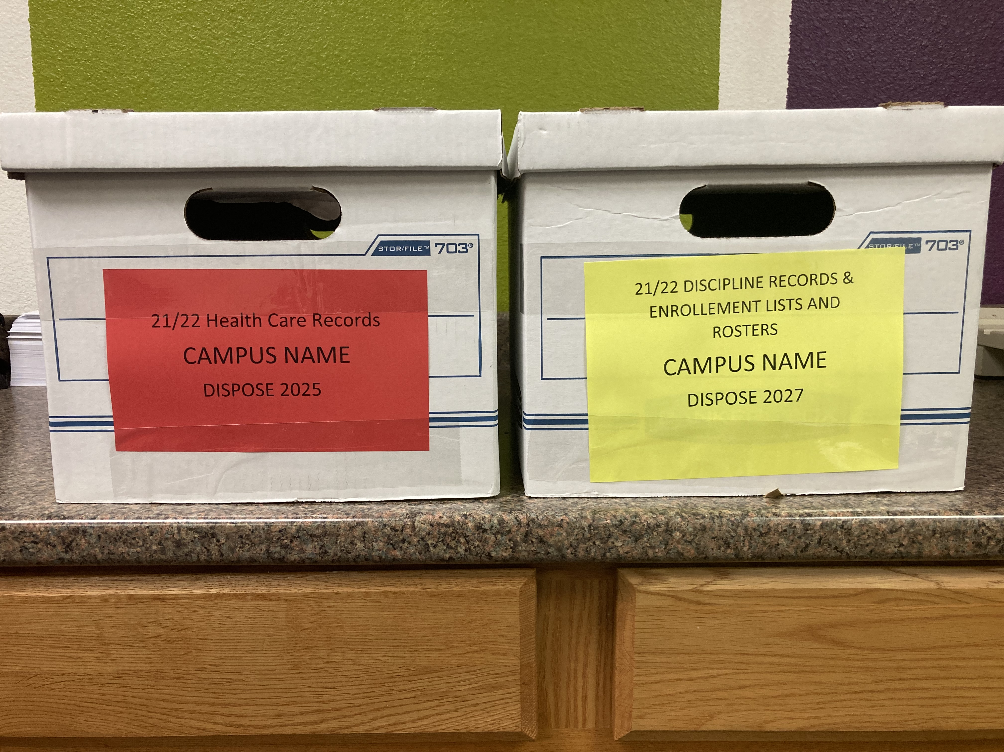
Preparing and Storing Your Records For Retention
Store records where they are accessible if needed
Label with information in the box and store by shred date
Store in safe location to protect from fire, water, steam, structural collapse, unauthorized access, theft, and other similar hazards including sunlight
Keep records or storage boxes off the floor
Notes:
Ok so after finding which records you need to retain and how long to retain them you will now want to store them. The picture shows a couple of examples that we use here in our department. We have over 1000 boxes along with 52 filing cabinets to give you an idea of how organized we need to be. Every year we use a different color label with the contents of what is in the box and the date these records can be disposed of. If you think about it some of you may not be at the same campus or department when the time to dispose of the records you are retaining. This would be very helpful to those that then come in after. Some campuses fill out the disposition log with the dates the records can be disposed and tape that to the front of the box. I’ll be showing you that log just here in a minute if ya’ll aren’t familiar with it. It really is up to you how you choose to organize for retention just keep all of this here in mind.

Slide 17
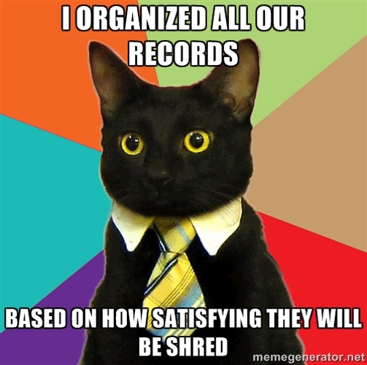
Can I destroy… ?
Extra copies created for convenience
Original that have been scanned
Records that have been requested by the public
Records on hold due to litigation
Notes:
Copies for convenience yes
Originals that have been scanned yes. TSLAC recommends keeping records that have been scanned for at least 6 months before disposing of them and of course you will want to make sure it is ok with your RMO, your campus principal or dept. head.. There may also be some records that can not be disposed. We here have transcripts that are permanent records. They do need to be kept in two locations. We have scanned these but do also still keep them after scanning. So if you are in doubt please reach out to us and we can help. Records requested by public can not be destroyed if you have the request before the retention period is up. If the retention period has expired and the records have been destroyed they then send a request there is of course nothing you can do at that point and it is perfectly understandable that you can no longer supply them. If there is a hold do to litigation you can not and should not any under circumstance dispose of those records until you have been cleared to do so.

Slide 18
Destruction of Records A District Record may be intentionally destroyed under any of the following conditions:
TSLAC’s retention schedule states that the records retention period has expired or it has been electronically stored in accordance with legal standards.
The record appears on a list of obsolete records approved by TSLAC.
A destruction request is filed with and approved by TSLAC for a record not listed on an approved control schedule.
The district court issues an expunction order for the destruction or obliteration of the records, pursuant to state law.
The records are defined as exempt for scheduling or filing requirements or listed as exempt by TSLAC.
§202.011: 13 Tex. Admin. Code § 7.78 (a)

Slide 19
Legal Consequences
Anyone who knowingly alters, destroys, mutilates, conceals, covers up, falsifies, or makes a false entry in any record, document, or tangible object with the intent to impede, obstruct, or influence the investigation of proper administration matter within jurisdiction of any department or agency of the United States or any bankruptcy case, or in relation to or contemplation of any such matter or case shall be fined, imprisoned not more than 20 years, or both. 18 U.S.C. 1519
Notes:
There are legal consequences to destroying records before the retention period. As you have seen on most our slides we have included the policy or law that states we are responsible for retaining records so please make sure that when you go into TSLAC you are finding and labeling your records with the correct retention period to stay in compliance.

Slide 20
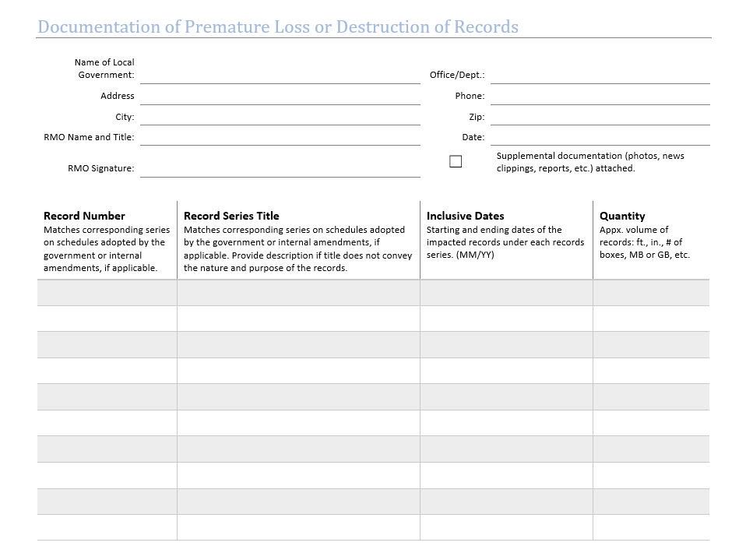
If any documents are prematurely destroyed fill out Documentation of Premature Loss or Destruction of Records and submit to the district RMO Robert Sertuche.
Notes:
Now I know I just said that we should not shred before the retention period is up and that there are legal consequences but accidents have happened and that is why we recommend boxing up and labeling your records with the disposition date visible so that it doesn’t happen but if it does happen it is important that you fill out this form and send it to us. Recording what is shredded is a mandatory permanent record. This form can be found in our sharepoint.

Slide 21
A Records Disposition Notification Form must be sent to the Records Department before a Department or Campus destroys any records for approval by the Records Management Officer or the Records Liaison.
Local Gov’t Code §203.023
Notes:
This is the disposition form that will need to be filled out and sent to us before disposing of any records. I have listed here a few different examples. If you are unsure of what Record or Item number a record falls under or you can’t find that you can call or email us and we can help you find that. All disposition logs are usually filled out by the designees those would be the secretaries or admin assistants. We do however need the records custodian to sign off before sending this form to us. That would be the principal or department head. Records can be disposed of beginning in July of each year once our districts fiscal year has closed. This is when you would fill and send these to us for our sign off. When we receive these we then double check everything within tslac and if it is all correct we sign and return to you as the ok for you to begin disposing. I would like to say that we should be receiving one of these every year from every campus and from many departments. In the 7 months I have been here I have received very few so we are hoping to receive more as most should have something they are disposing every year. Our dept. is required to keep these forms forever they are considered permanent records so even though you have shredding what is on you form we keep record of when they were disposed permanently.

Slide 22
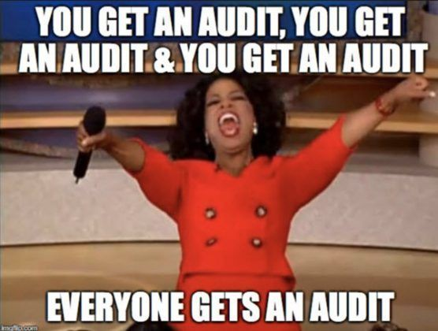
Audits
If an audit is performed by our department we will call or email you to schedule a date and time. An audit does not mean you are in any trouble it is simply to help guide you and make sure we are all in compliance.
Notes:
So Oprah says everyone gets an Audit! An audit might sound bad but it isn’t meant to be. We don’t want to go out and get anyone in trouble but like Robert said at the beginning one of the jobs of this department is to make sure that you are all informed and to assist you with records management compliance. So because there are so many records we are required to keep legally we plan on going out in April and November to visit and see if you are storing your records and to see if you need any help with setting any up.

Slide 23
Important Links
TSLAC Local Retention Schedules
https://www.tsl.texas.gov/slrm/localretention
Disposition log
https://www.ectorcountyisd.org/Page/660
Local Schedule SD for local school districts
http://www.tsl.state.tx.us/slrm/recordspubs/sd.html
Local Schedule GR
http://www.tsl.state.tx.us/slrm/recordspubs/gr.html
Local Government Records Act
https://www.tsl.texas.gov/slrm/pubs/bulletind

Slide 25
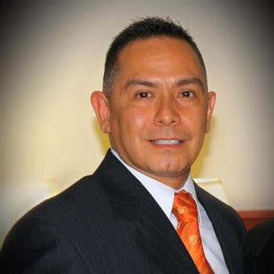
Robert Sertuche – Records Management Officer
robert.sertuche@ectorcountyisd.org
432-456-8971
Bethany Ibarra – Policy and Records Retention Specialist
bethany.Ibarra@ectorcountyisd.org
432-456-9500
Martha Lopez - Records Liaison
Martha.lopez@ectorcountyisd.org
432-456-8979

