Slide 1
RECORDS MANAGEMENT
2023/2024
Notes:
*recording will happen.Before we get started I want to say that I know we have a lot of new clerks and this is a lot of information that we are about to share.If you have any questions please feel free to type them in the chat or wait until the end to ask them, we will designate some time at the end to address them.

Slide 2
Presenters:
Martha Lopez – Records Management Liaison
martha.lopez@ectorcountyisd.org
Valeria Ortega- Records Management Clerk
valeria.ortega@ectorcountyisd.org
Notes:
*

Slide 3
Understand ours and your role in records management
Learn about record security
Learn about cumulative folders
Understand the record request and transfer process
Understand when and how to centralize your records
Notes:
*

Slide 4
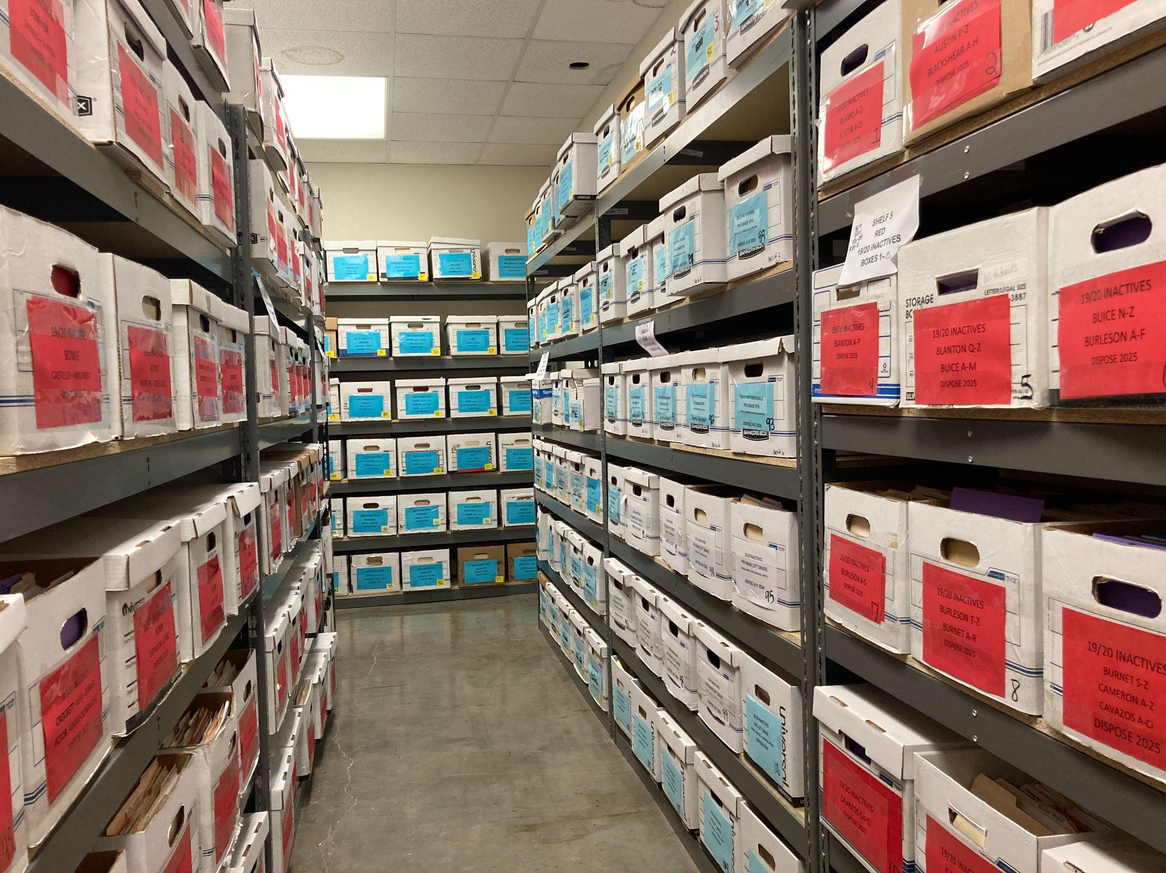
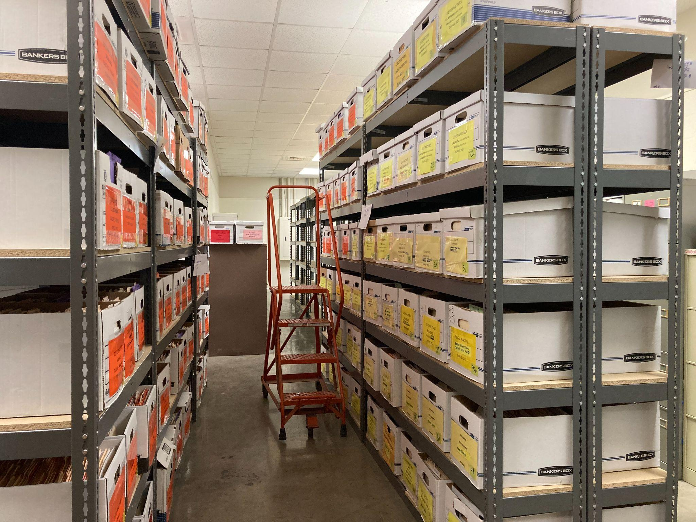
The Records Department
We have three people in our department.
In May 2023 we moved our department to the ECISD Business Operations Warehouse formally known as the ECISD Print Shop.
We retain all inactive and graduate records for 5 years per TSLAC’S retention schedule then dispose by shredding at the end of the retention period.
We keep Permanent (transcripts and EOC scores) records FOREVER.
We fulfill record request for campuses, the public, secondary institutions, and government agencies
We are responsible for holding record trainings, performing record audits and providing assistance and resources regarding records management to ECISD staff.
Just how much do we have?
We have over 25,000 files and growing at this time
799 boxes
66 shelves
40 filing cabinets
Notes:
We have three people in our department, Everett Elmore is our records management officer, Martha Lopez is our records management liaison and I am Valeria Ortega the records clerk. Here are a couple of pictures of one of our rooms here at our new location. You can see we got some new shelves. These are taller than the shelves we previously had. We are able to fit more boxes per shelf and that is the ladder we use to reach those that are up there on top. They are also made for banker boxes and that is why we ask for the size box we do because they can not hold the longer boxes. You can also see our labels with the different colors per year. Every year when ya’ll centralize we ask for labels to be in a specific color because as you see we have 799 boxes and will be receiving close to 100 more from all of you by the end of Feb. All of our filing cabinets are for transcripts. We have no number on those. But we are required to keep transcripts for every student that earns credits in our district. 2 of the filing cabinets are from when blackshear was a high school and we also have filing cabinets that contain Ector transcripts and those older ones are pretty neat to look at.

Slide 5
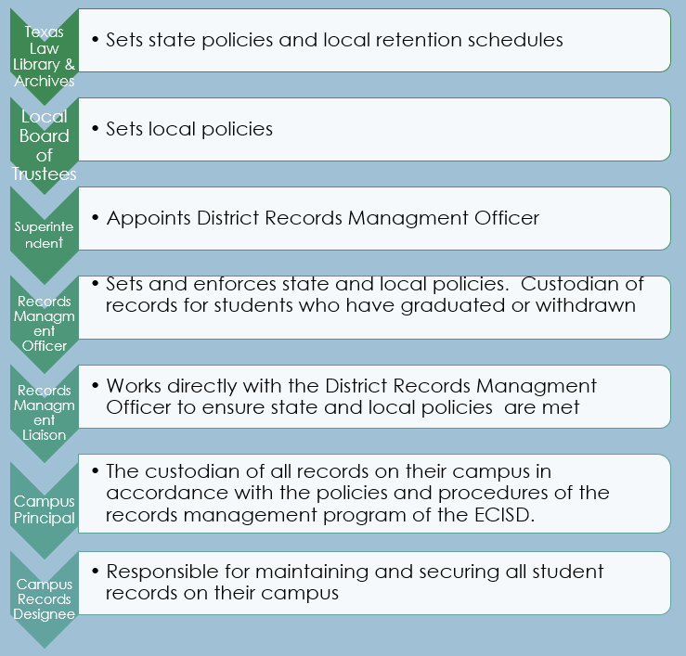
Records Management Chain of Command
Notes:
This is the chain of command for Records Management Tslac sets the state and local retention schedule that we follow. Our board sets policies, the superintendent appoints the Records Officer which is now Everett Elmore and he sets and enforces the state and local policies, the Liaison Martha works with everette to ensure that the policies are met. Then at the campus level we have principals as custodian of records and then they assign a campus records designee.

Slide 6
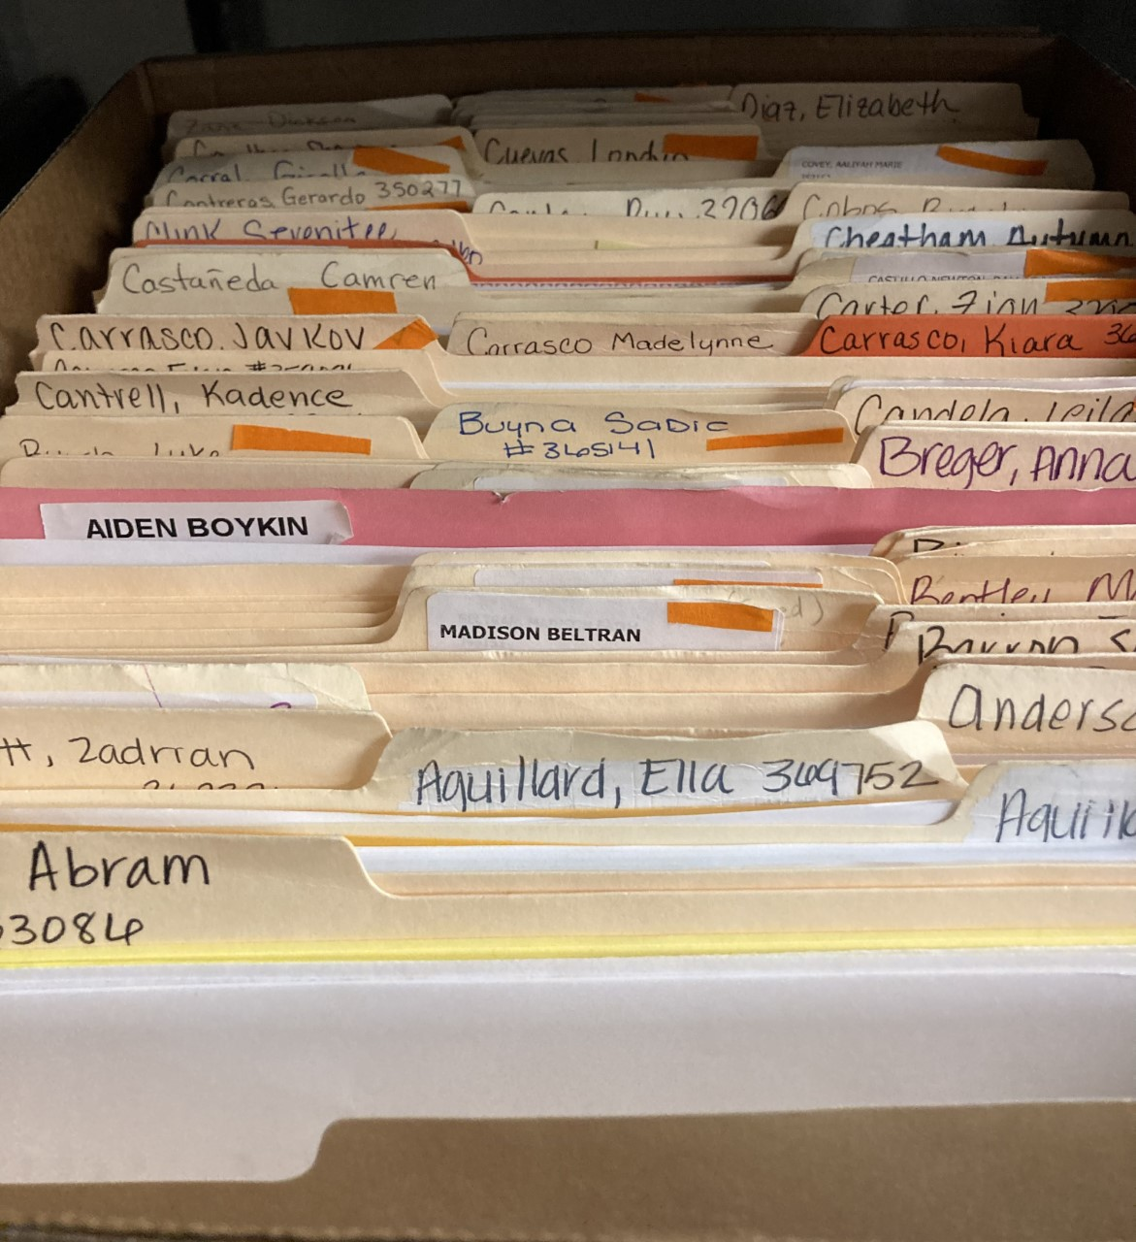
Campus Records Designee
The Principal of each campus is the custodian of all records for currently enrolled students. A principal may designate an assistant principal, registrar or clerk to maintain all student records. The principal, however, remains the primary custodian and has the primary responsibility for the care of all student records.
Responsibilities
Keep records organized and safe
Makes new folders for new to district students
Requests records from previous campus/district
Fulfills record requests
File all required documents in all students folders
Notes:
Summarize

Slide 7
RECORD SECURITY
Records confidential sign must be posted on records room door or in the area of filing cabinets.
sign can be found in the manual on page 19
Filing cabinets or records room must have restricted access and be kept locked when records clerk or records designee is not present.
Risers are recommended for filing cabinets in case of flooding.
Records must not be on the floor even if in boxes.
Records sign in/out log must be kept near filing cabinets.
sign in/out log can be found in the manual on page 17
Records binder with signed request forms must be kept in this area.

Slide 8
Cumulative Folder Content List
Below is a list of items that must be in each student’s folder:
Record of Access/Written Consent to Access Records
Entry/Withdrawal Forms
Birth Certificate
Social Security Card (if applicable)
Parent/Guardian ID
Immunization Records
McKinney Vento/Transfer Permission (if applicable)
Educational Assessments Card
Cumulative Grade Report (CGR)
Final Report Card for each school year
Student At Risk Profile
Permanent Record Card (Elementary campuses only)
Home Language Survey (HLS)
If records are “uploaded” into FOCUS, it is the clerk’s responsibility to ensure records are legible. If the records are not legible, the clerk must contact the parent/guardian to receive clear copies.
**This list is subject to change. If changes are made the Records Department will notify all registrars and record clerks. **
Notes:
You'll notice ethnicity and parent waiver forms have been removed from the content list, FOCUS can run a report with this data
this list can be found in the manual on page 14 and should be in sharepoint. This may change. Other documents that can be in the file are legal documents like Subpoenas/Custody Orders/Guardianship Notarized Letter, GT letters, documents received through Trex or other districts, orange bilingual folder and yellow TPRS folders. A more detailed list can be found in the manual.

Slide 9
When should you create a new folder?
Is the student new to ECISD?
YES
NO
After searching for student in FOCUS did you find them in the system?
Does the students' previous campus have a folder for student?
NO
YES
NO
File has been centralized
YES
After searching for student in FOCUS and see no record of student ever attending ECISD, create a new file
Do not create a folder. Request and pick up folder from previous campus.
Does the records department have students file?
YES
NO records dept. states that they disposed of the record after 5 years of retention
Do not create a folder. Request and pick up folder from the records dept.
Only make a folder once instructed to do so by the records dept. staff
Notes:
Making duplicate folders instead of requesting the students existing folder has become a problem. We have been working on combining folders we have here centralized for over a year now. Currently at our warehouse, we have over 400 students that have two files in our inactive files. It is very time consuming and there's no telling how long this will take us as we are so busy filling records requests. when creating a different folder, please do not use different color folders as it can be confusing and unorganized. Bilingual uses orange folders and TPRS uses yellow folders. Why is is important to not create a duplicate/dummy folder : PREVIOUS CAMPUS MAY HAVE LEGAL DOCUMENTS THAT YOU NEED TO BE AWARE OF SUCH AS PROTECTIVE / CUSTODY ORDERS…..

Slide 10
Requesting Files for New/ Returning Students to the District
TREx Requests are done for students who previously went to a campus instate.
Some private schools are not included in TREx.
ScribTransfer Requests are done for student who previously went to a campus out of state or for private campuses not on TREX. A campus/ school district will let you know to requests records through ScribTransfer if they have it available. ScribTransfer is a free service for those campuses enrolled. We have a ScribOrder similar to ScribTransfer to fill requests. These are different accounts.
other campus/districts may use an application similar to ScribTransfer
Fax or Email Requests are done at the discretion of the other districts. Best practice is to call the campus the student previously attended and they will let you know what the process is for them.

Slide 11
Keep Records Clean and Organized
You should only have one of the following documents:
Birth Certificate
Social Security Card
Parent ID
At- Risk Profile (most recent)
Most updated Shot Record
Home language Survey – Only keep original form and NEVER replace this form unless authorized from a records officer or by the bilingual department.
*Purge of unnecessary or extra documents MUST be done prior to transferring records to next high-grade school.*
* All sensitive material MUST be shredded*
Notes:
TREx receipts do not have to be kept in the file, We keep them to help us see if we have already done a TREX for the student.
Parent Record Requests must be kept for two years in a binder or file cabinet on campus.

Slide 12
When a Student Leaves Your Campus/District

Slide 13
Who can request student records?
Students new school in and out of district
Parents/Guardians & Students over 18
Postsecondary institutions
Requests made by Judicial order or lawfully issued subpoena
FERPA is a Federal law that is administered by the Student Privacy Policy Office (Office) in the U.S. Department of Education (Department). 20 U.S.C. § 1232g; 34 CFR Part 99. FERPA applies to all educational agencies and institutions (e.g., schools) that receive funding under any program administered by the Department.
Notes:
Read Screen. If you receive any of these requests please fulfill within 10 days. We will go into more detail in the next few slides on records requests for these first two.
Post secondary institutions request student transcripts or test scores from High Schools and us. If the student is active or if we have yet to receive transcripts from our high schools then the high schools will fill these requests. Once those transcripts come in to us they will then be requested from us through Scriborder, this can be found on our webpage. If you receive a subpoena or a request from cps or law enforcement please fulfill within 10 days. All record requests forms written or email must be kept for two years.

Slide 14
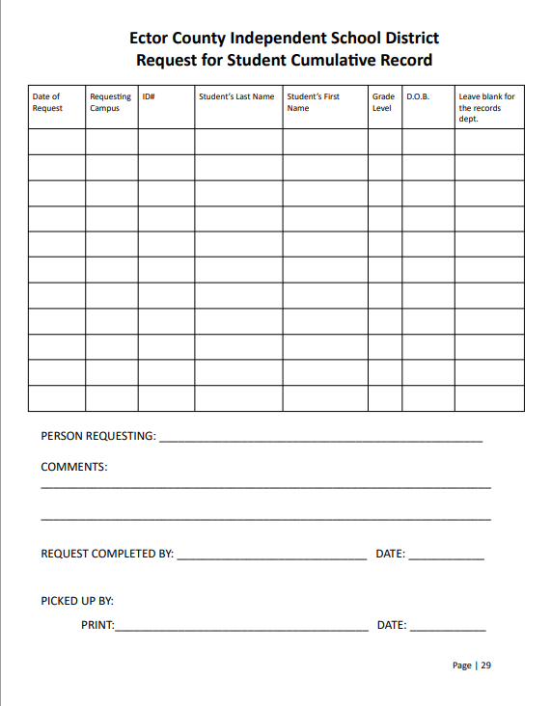
Record Request Form
Use this form for all in district records request
Search in FOCUS for students previous campus
Fill out request form
Email form to the students previous campus
Requests must be filled within 10 working days of request and picked up in person within 7 working days from requestee. Never send records through interoffice mail
Receiving clerk and clerk turning over files both sign and keep a copy of signed form
File form in records binder. Forms must be kept for 2 years for tracking purposes.
Take file back to your campus and file all necessary documents in students folder and file in filing cabinet
Physical folders must NEVER be given to a school not in ECISD. Only exchange folders with ECISD campuses. Example: OHS can request and pick up a folder from PHS but Odessa Christian can not make a request or pick up a folder from any ECISD campus. They must use Scribtransfer if they do not have access to TREX for records requests.
Notes:
Here you can see the form used for ECISD requests within the district. Please fill out this requests form completely before requesting a file from another ECISD school. Before requesting from our warehouse please requests records from the students previous campus.
If a school does not comply after sending two requests, please contact us and if necessary principals may need to get involved and communicate with the other campus principal to resolve the issue as they are the records officers for the campuses. and if a record is inadvertently given to the wrong campus please give eachother grace and be kind.
If you can, help eachother out. I know that a lot of what we have learned and know here comes from ya’ll. Ask Permian and OHS, we call them all of the time to ask questions. This year we have 14 new clerks at the beginning of the school year. Y'all know more than anyone how much is on your plate so please be patient and kind with one another and share the knowledge. If you know you have files to pick up from Reagan check and see if you have any files for them and take them with you. binder for two years to help protect you against any lost files and help us locate a file if missing
If you need this form it can be found in the Business Operations Sharepoint
IDEA and RIchard Milbourn are on TREx ; Odessa Christian Academy is not on TREx, you would have them request student file via ScribTransfer.

Slide 15
Alternative and AEC School Folders
Alternative Schools do not keep any original cumulative folders:
• 004- Alternative Education Center
• 005-Youth Center
Cumulative folders are to be retained at the HOME SCHOOL. Do not centralize these files with the Records Department. We only store and accept inactive student files when it is time to centralize.
If the Alternative Center or AEC receives or has any documents that need to be kept in the student’s cumulative file, it is their responsibility to contact the home campus registrar and make an appointment to go and file them in the student’s file.
If the student is sent to an alternative school and moves, the folder should go to the new home school.
Ex. Student was attending Permian when sent to the alternative school and moved to OHS district. If OHS is now the home school the student will return to, OHS will then need to request from Permian and maintain the student’s file.
Notes:
These files should not be centralized with us. We do not keep active student files.Files will end up being disposed of and then when the student returns to campus we might not have it. So since the goal is for these students to return to their home campus after some time, the home campus will keep the file.

Slide 16
Out of District Requests
TREx
All in state file requests have to go through TREx
TREx must be filled within the 10 day mandated period
For TREx requests for student students whose files have been centralized email records staff. North and eastside schools email Martha Lopez and South and westside schools email Valeria Ortega. Do not reject if you do not have the students file
Out of state schools can not use TREx. They must send a request for student files through ScribTransfer and must also be filled within 10 days.
Each campus is responsible for registering their Campus Record Designee and keeping up with requests
TREX training is scheduled by information systems and can be found in Eduphoria
TREX access and information can be found on the Information Systems SharePoint
*File TREX receipt or request from out of district school in the students file.
TREX Reports: Please be advised that your campus administrator, IS, and the records department will be notified if requests are not processed within the 10-day mandated period.
Notes:
Please check your Trex requests daily. This includes the requests that you have made. The system will also delete those incoming requests that you have made and then you won’t be able to go in and retrieve what has been sent to you.8 As soon as you see that you have a request for a file please let us know. We can’t always fill it the day that you notify us so if you let us know on the 10th day or right before it expires we may not get to it in time. *We have access to all campus accounts, DO NOT REJECT as we do not have a district account. When we fill a request for a campus that has centralized a students file we go under your campus account to fill the request. *If the student was a SPED student or received any 504 services please request these from Patricia Lopez in the Sped dept.

Slide 17
Out of State Requests
In April 2023, a new K-12 records transfer application was implemented for ECISD. This application provides an enhanced and more secure service for our transfer students, all record requests for our former students must be made online using our new student record request system. Training videos for Scribtransfer are available on the Business Operations SharePoint site.
All private schools and educational institutions outside of Texas must request records from ECISD through this application.
Fax, phone calls, emails, and mail will no longer be accepted
All Scribtransfer requests must be processed within 10 days
Each campus is responsible for checking the Scribtransfer application daily and fulfilling requests for their campus. The training videos within SharePoint discuss the processes of filling requests and transferring requests if the student's file is verified to be at another ECISD campus. Please be advised the records department will contact you if a request has been pending for more than 3 business days
Every ECISD school’s website should have a link to scribtransfer for all out of state and private school records requests under quick links. If a link is not on your campus webpage please contact Records Management
If you do receive an email or fax request, please respond with the notice that can be found in the documents section of the Business Operations SharePoint site
Notes:
Last April our district started using K12 transfer to fulfill incoming requests from out of state. More Secure. It's easy, quick and free for requesters to do this. So again this is only for incoming requests. If you do not have an account please let us know.

Slide 18
Campus Record Requests
A parent or guardian must submit a written request and provide ID when requesting any student information. We have created a form and flier for campuses to use at the discretion of each campus principal. If a campus already has their own form they may continue to use it or adopt ours. Whichever form they choose, a written request must still be submitted by the parent/guardian when they request records from their child's documentation(s)/cumulative folder.
Examples:
• Birth Certificates
• Social Security Card
• Parent/Guardian ID’s
FERPA requires that educational agencies and institutions comply with a request by a parent or eligible student for access to education records within a reasonable period of time, but not more than 45 days after receipt of a request.
34 CFR § 99.10(b).
We recommend staff members process these requests within 10 days.
All records requests must be kept for two years By law and regulation – 20 USC 1232g, and 34 CFR 99.32.
The flier and forms are written in both English and Spanish. These forms can be found on the manual page 35-37
Notes:
Parents have a right to request their child’s record for whatever reason. Some need documentation to show for taxes or immigration. If a mom comes in and she is not listed in Focus you should check the students BC. IF mom is listed and there is no legal order stated that she can’t have access to the child or records then we are required to fulfill the request. We can not deny a parent records without legal documentation stating that we can’t. If a student has a folder here centralized or at a previous campus you need that file for this type of situation. We don’t want to give records to someone that has given up their parental rights for example.

Slide 19
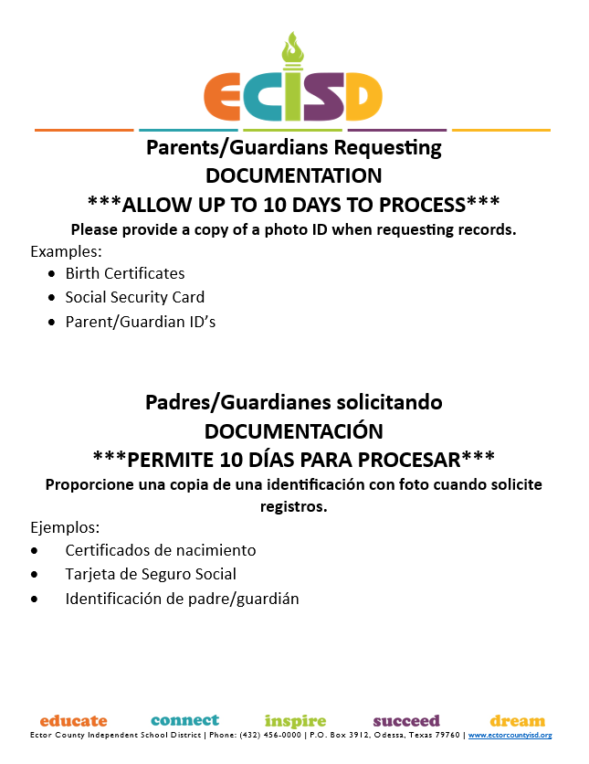
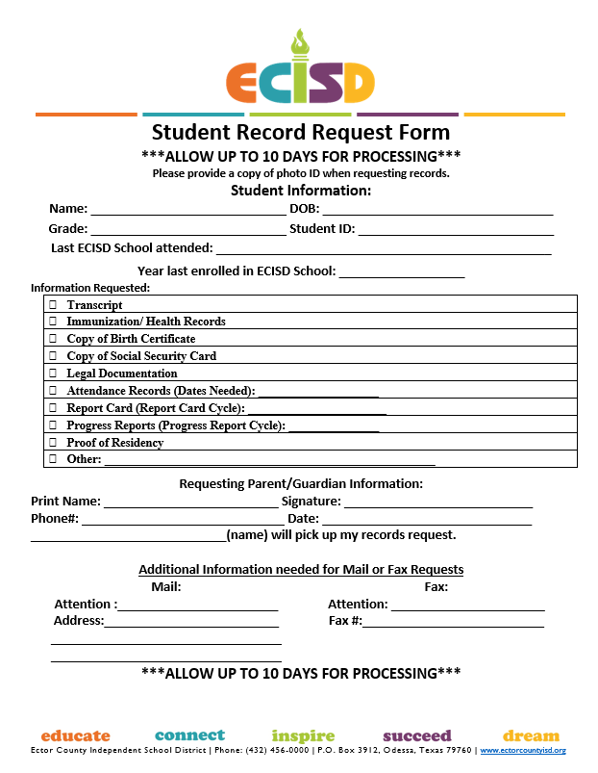
Notes:
We created this flier and form for campuses to post and use if they don’t already have their own. Some of you have your own with your campus logo and those are fine to continue using but if you don’t already have one. You can use these if you Principal signs off on it. Please show it to them first and get their ok. If they choose to use or not, a written letter or email from the parent can also be used. They do still have to show you ID before you can give them any records. If a parent is not listed on Focus as a guardian but you have a birth certificate with the parents name you can not deny them records. Unfortunately there are cases where one parent keeps the other off of student contacts but we can not deny a parent records unless we have a legal document that show they have no rights.

Slide 20
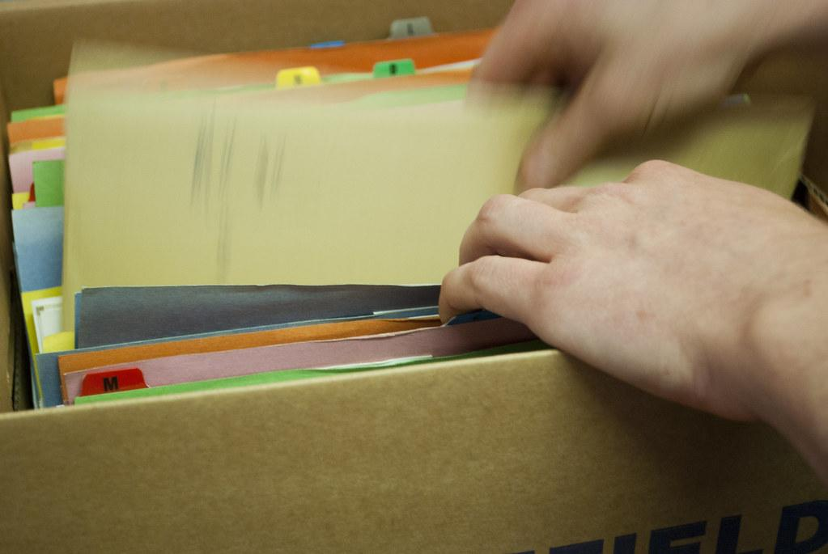
End of Year Record Preparation Process
**NO FOLDERS WILL BE TRANSFERRED TO ANOTHER SCHOOL OVER THE SUMMER*
End of the Year Process of 5th & 8th grades records & 6th for Cameron & Austin
May-August: (prior to opening of the next school year)
Preparing the transfer of BULK Cumulative Folders
Identify records moving from 5th to 6th grade campuses and records moving from 8th to 9th grade campuses.
Purge duplicate copies of the same records – only keep the most recent copy
But not limited to:
Parent ID
Birth certificate
Social Security card
Proof of residency/McKinney Vento Forms
Grading:
Each folder should have 1 report card for each grade level the student attended/completed ECISD.
File CGR
Affix testing labels if your campus has received them
Special Programs:
Ensure all special program information is in the correct color folder within the cumulative folder
Orange: English Language Learner (ELL)
Yellow: TPRS files
Start preparing the boxes for Transfer:
Sort the folders by middle/high schools
Sort the folders in alphabetical order
Start preparing the bulk transfer sheet (reference document on page 48 of the manual)
Box records in alphabetical order; ensure that each folder listed on the spreadsheet is the correct box
Place a label on the front of each box indicating which campus the files will be going to
Notes:
*Folders should not be transferred to the next campus over the summer before a student is active at the next campus but you can get ahead some by doing some preparation at the end of the school year.Talk about why folders can’t be transferred to another school over the summer. Identify. Purge. File. Box up. Create Lists. While discussing Purge talk about black folder.

Slide 21
Start of Year Record Transfer Process
Prior to transferring student files, the transferring school is responsible for checking that all students on the list prepared at the end of year record process are active at the requesting school before the physical transfer of records takes place.
If any student files are considered no shows (not active at any campus) the clerk/registrar will pull the file from the box and file it in their inactive files to be kept until a campus requests the file or it is time to centralize inactive records.
Each requesting school will contact the student’s previous campus, make an appointment, review folders, and sign and keep a copy each for two years.
** DO NOT drop folders off at the campus without communicating and reviewing files with the receiving clerk/registrar **
It is both schools’ responsibility to confirm folders match the bulk transfer sheet.
Make sure the following has been completed:
Purge and Update
Last Report Card
Testing Labels are affixed on test card
DO NOT accept the folders if the following tasks have not been completed:
• Folders have not been purged
• Testing labels not affixed on test cards
• End of Year Report cards in folders
***Contact District Records Management if any school is not in compliance***
Notes:
Make sure files are active at the transferring campus before they come and pick up. You can use the list that you prepared at the end of the year to check in Focus. Remove and cross out any that are not yet active or attending that campus.

Slide 22
No Shows
If a student is promoted to 6th , or 9th grade, but does not show up at the next school, the folder is inactive for the previous school. The folder is returned to the school the student was last enrolled in.
Receiving school should:
Folders from 5th to 6th grade: When student(s) completes the 5th to 6th grade, but does not show up at the next school (6th grade), the folder is inactive. The folder should be sent back to the 5th grade school.
EXAMPLE: If a student(s) completes the 5th grade in 2022/2023 school year and does not show up or enroll into the 6th grade school in 2023/2024 school year the student is inactive. The folder is returned to the 5th grade school to be kept with their 2022/2023 inactive files.
This can be avoided by only requesting and accepting records for students that are active (already attending) at your school. If a student has only enrolled but not yet attended, wait until they have at least attended one day of school to request their folder.
*If a receiving school inadvertently receives a no-show folder, it is their responsibility to properly transfer the folder back with documentation to the previous active campus.
Notes:
A student registers but does not show up.It is always best to not pick up any files until they are active.

Slide 23
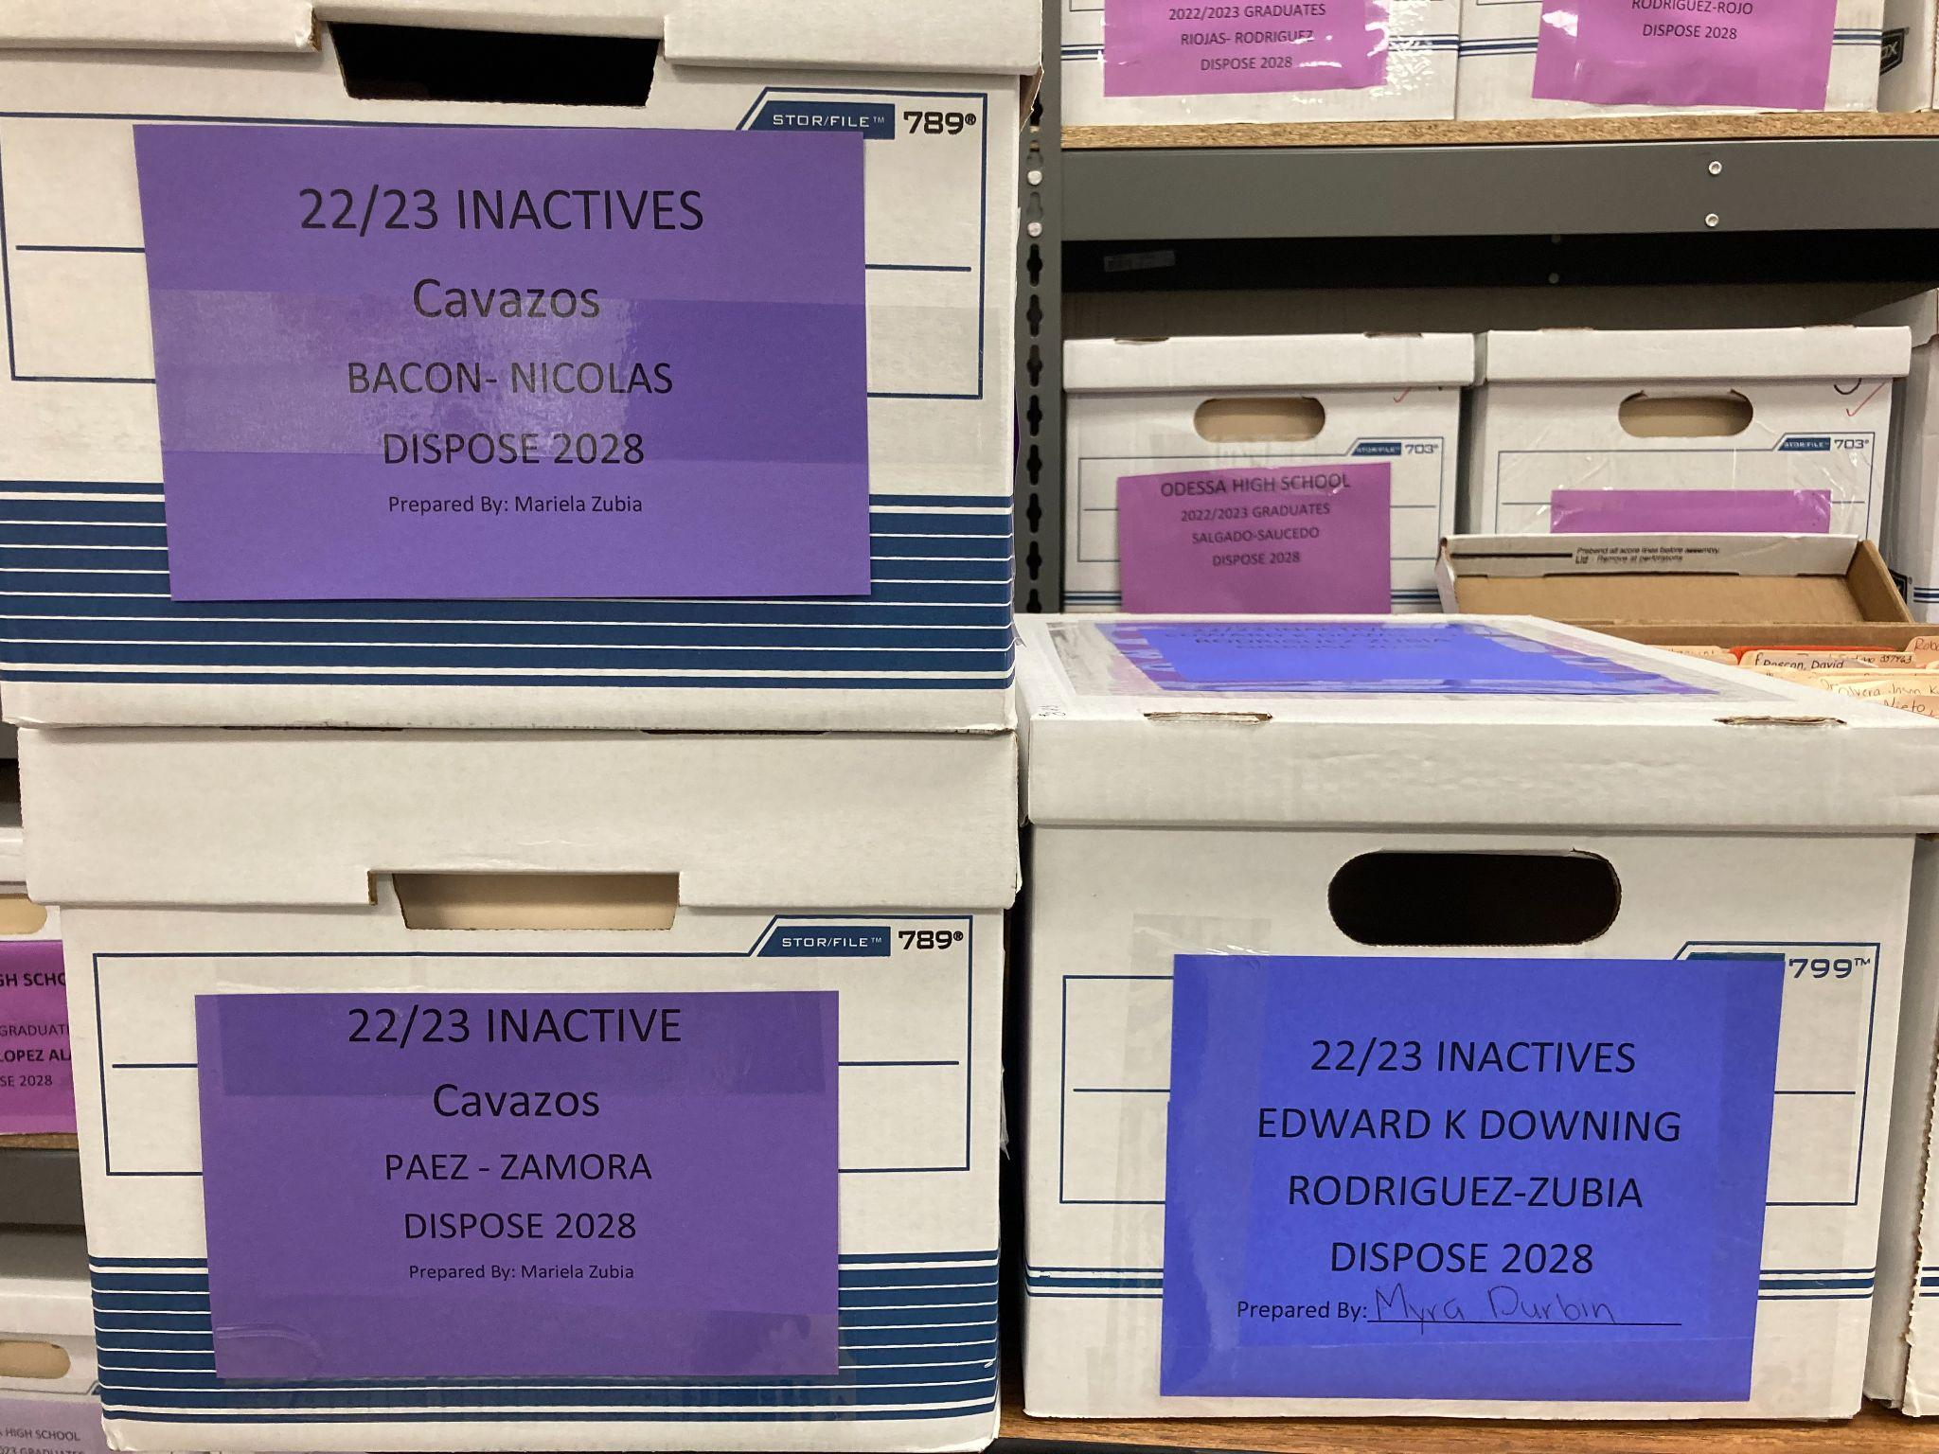
Centralizing Inactive Files
Files to be centralized this year will be for students that became inactive on dates 8/09/2022-08/08/2023
All files must be in banker boxes; we will only accept banker boxes
Files must be alphabetized
Bring a list of all files in boxes.
This year box labels will be purple
Instructions and dates for centralizing files will be emailed at least 2 weeks before. Email will include label template.
Notes:
summarize. Talk about the process when they bring in files.

Slide 24
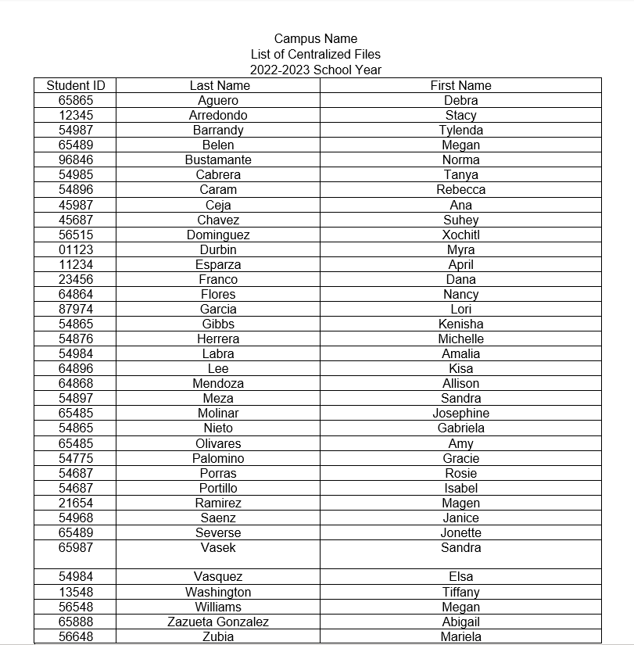
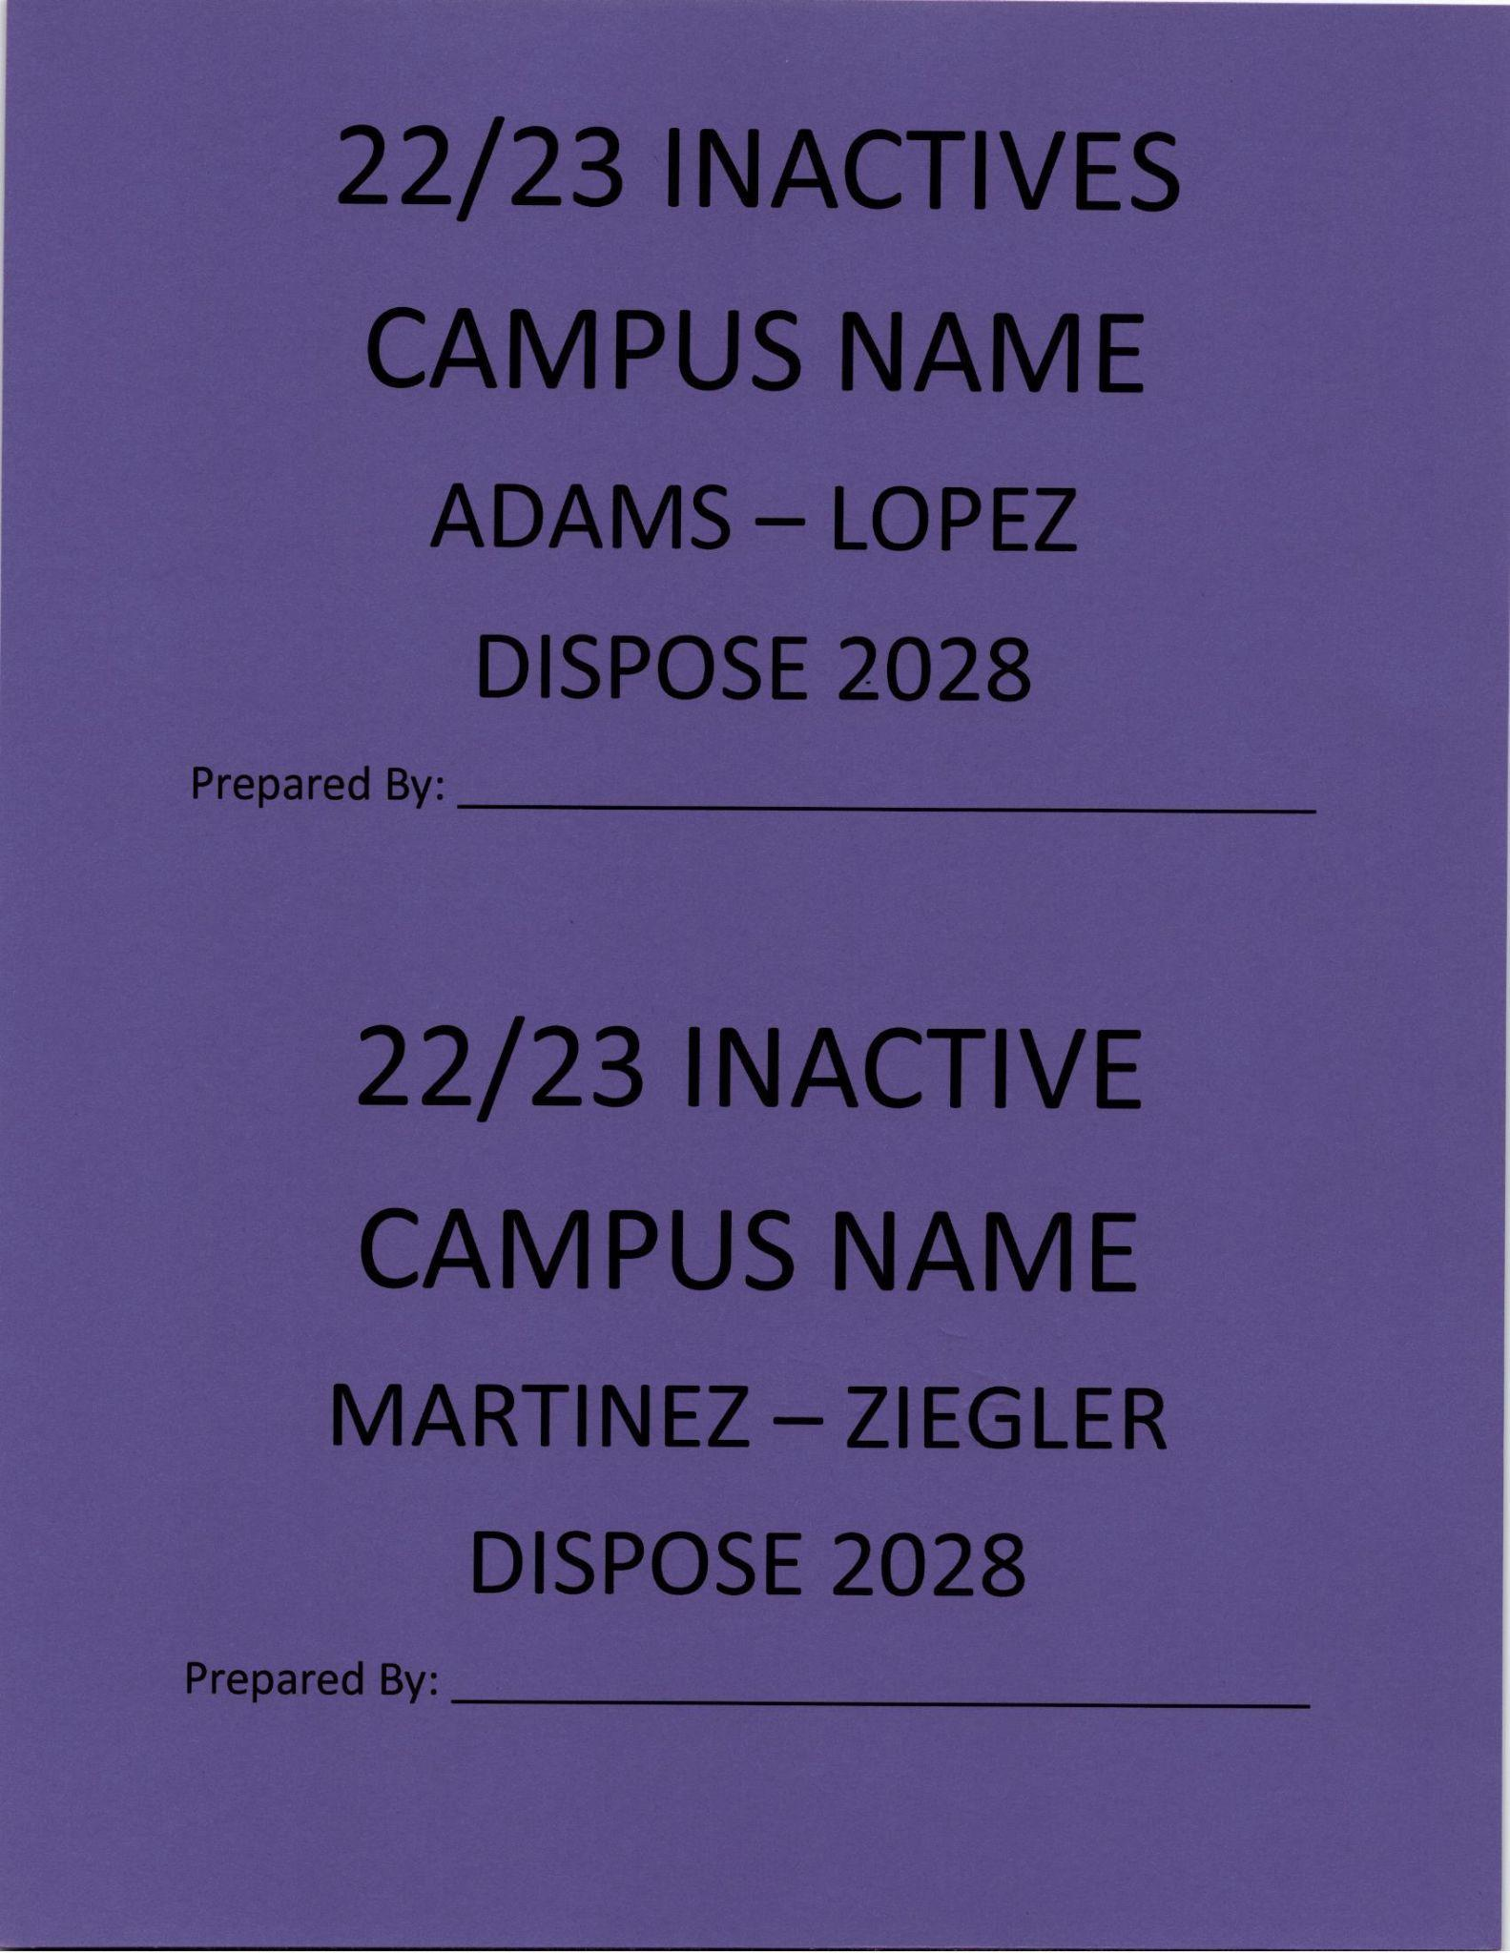
List of Centralized Files Example
Banker Box Label Example
Notes:
*WE are only accept 22/23 inactive files this school year. We will check these lists after you’ve brought in your files. If we find any current actives (students that withdrew this year) we will return them to you. Why you keep your current inactives….

Slide 25
Notes:
Audits are done in November and April. Before going to your campus we will email/schedule a time with you. An audit takes 15-30 minutes. Audits are performed to help us help you. How is the audit performed? After an audit we submit a report to you and your campus principal.

Slide 26
Important Dates
October: Pre-K campuses and elementary campuses centralize inactive records
November: Records Department performs records audits
January: Secondary campuses centralize inactive records
April: Records Department performs records audits
May: Pre-K campuses bring in all exiting pre-k 4 student files
May 24: Records Day (day after last day of school)
July 24: Testing Stickers should be ready for pick-up
July: High Schools centralize graduate files, transcripts and diplomas
TBD: Record Retention Training
Notes:
Records Day- go into detail.

Slide 27
Important Links
Scriborder: https://ectorcountyisdtx.scriborder.com
TREX:https://tealprod.tea.state.tx.us/TSP/TEASecurePortal/Access/LogonServlet
TSLAC: https://www.tsl.texas.gov/slrm/localretention
Dept. Pg. https://www.ectorcountyisd.org/Domain/2907
SharePoint Business Operations: https://ecisdonline.sharepoint.com/sites/intranet-BusinessOps/
SharePoint Information Systems- Student Services: https://ecisdonline.sharepoint.com/sites/bs/isstudent/
Notes:
Scriborder main page is for those needing transcripts, graduation verification and for K12 schools to request records from us. Trex

Slide 29
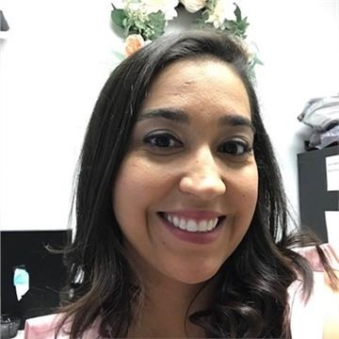
Everett Elmore
Records Management Officer
everett.elmore@ectorcountyisd.org
432-456-3751
Martha Lopez
Records Management Liaison
martha.lopez@ectorcountyisd.org
432-456-8972
Valeria Ortega
Records Office Clerk
valeria.ortega@ectorcountyisd.org
432-456-8970
Notes:
Thank you all for joining us and for all that you do…..If you think of any questions later on please reach out to us we are here to help. Here are our emails and phone numbers.

