Slide 1
Engagement Summary
Heather Smith, Lockhart Independent School District
April 2, 2024
What are some topics you would like to discuss in tonight's Family Feedback Forum?

Slide 2
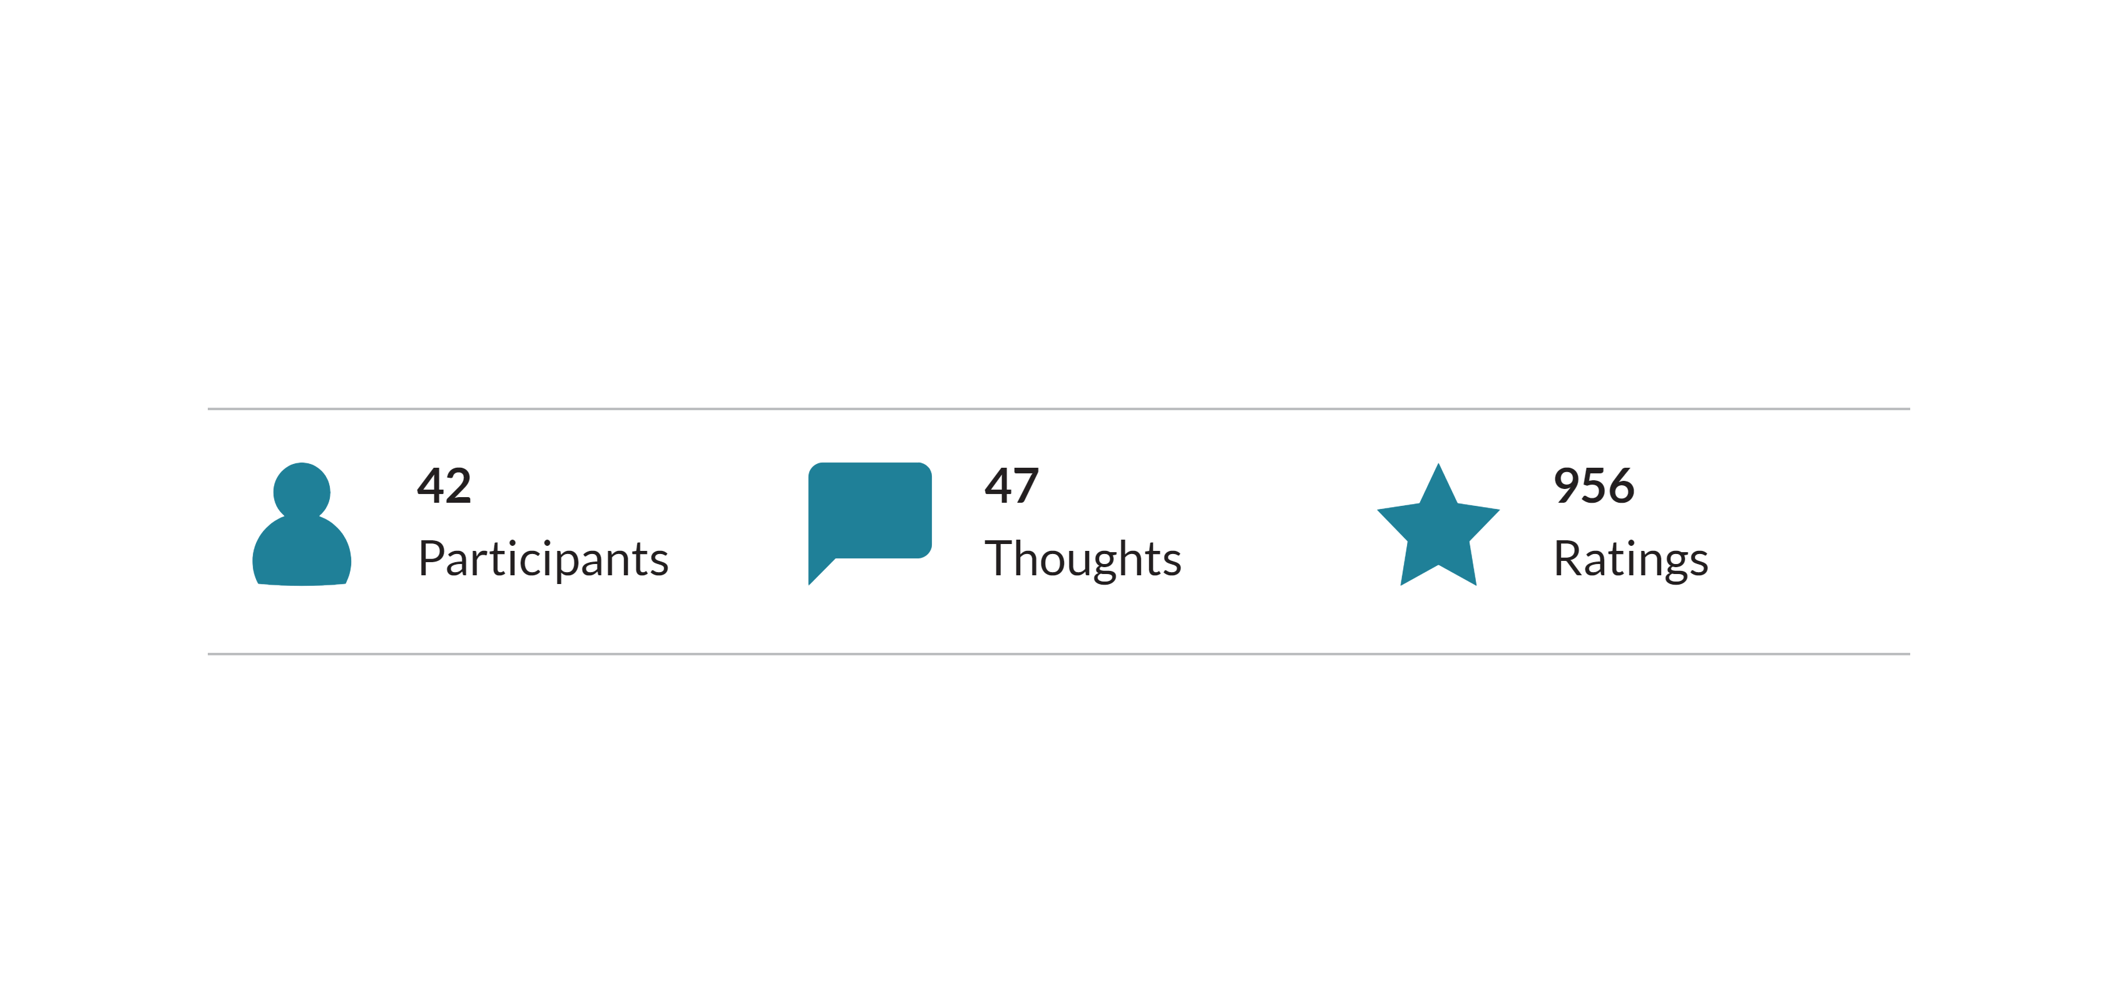
PARTICIPATION
Breakdown of Participation

Slide 3
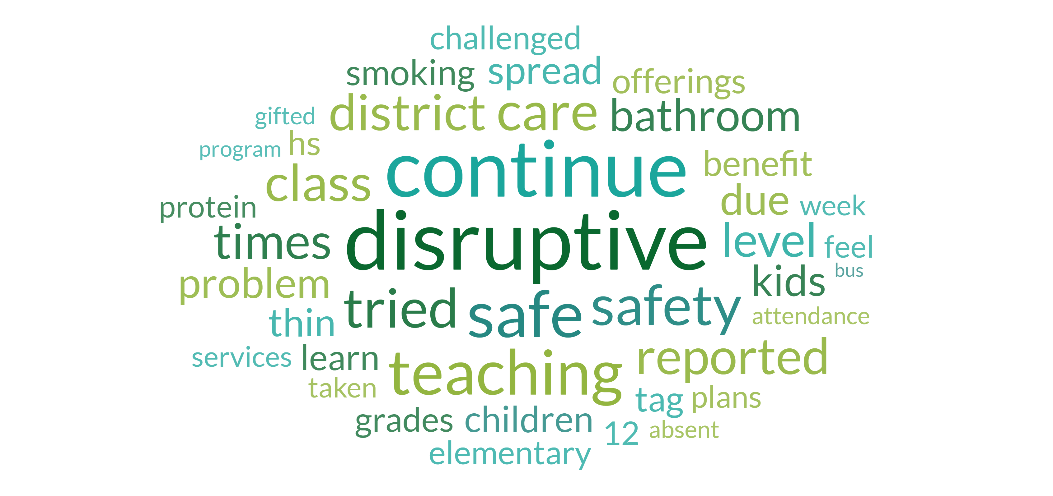
WORDCLOUD
Top Rated

Slide 4
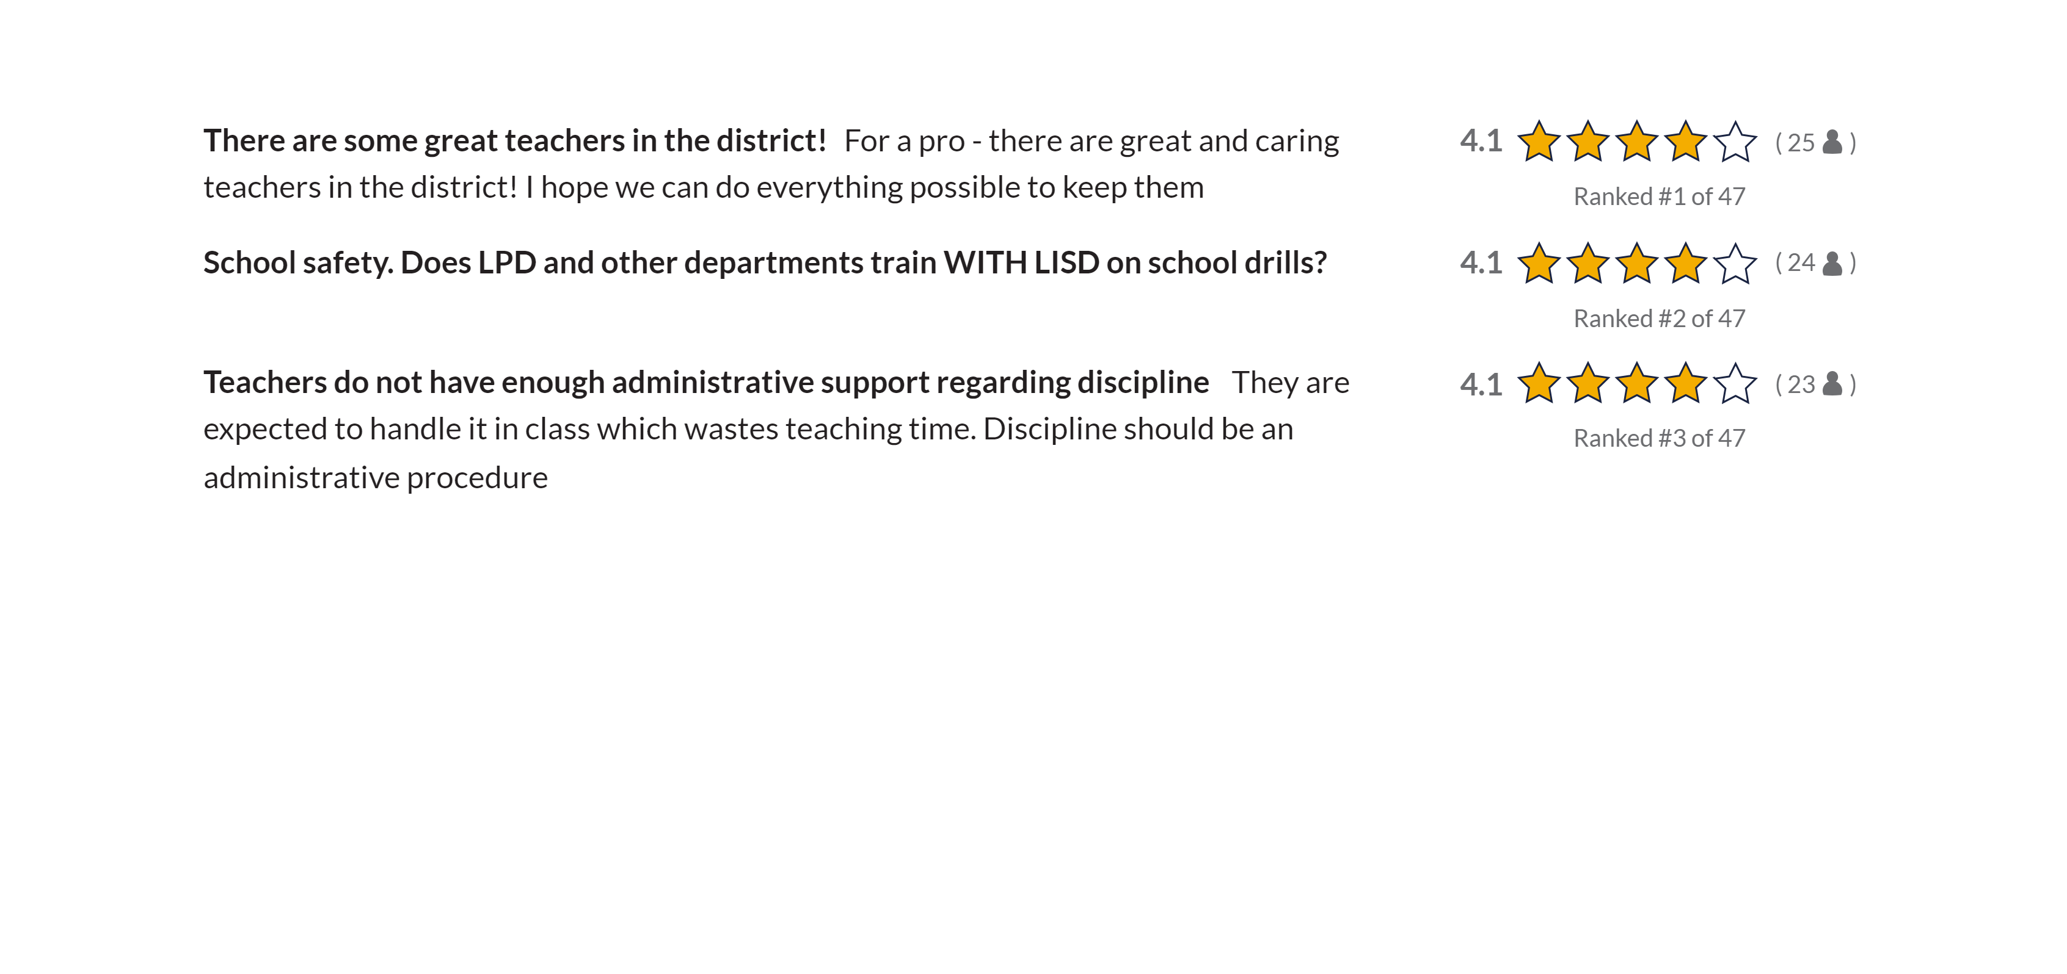
THOUGHTS
Key Thoughts

Slide 5
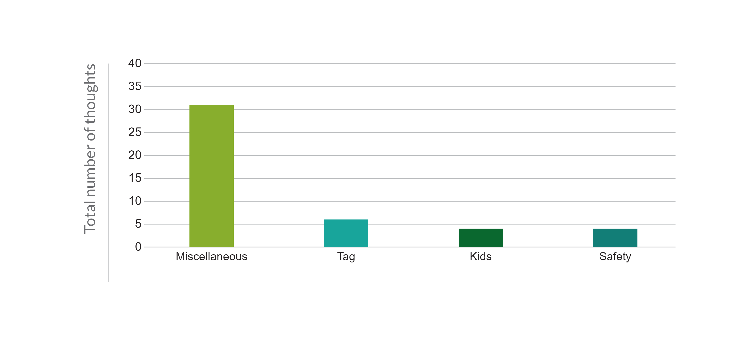
KEYWORD THEMES
Top Themes by total thoughts

Slide 6
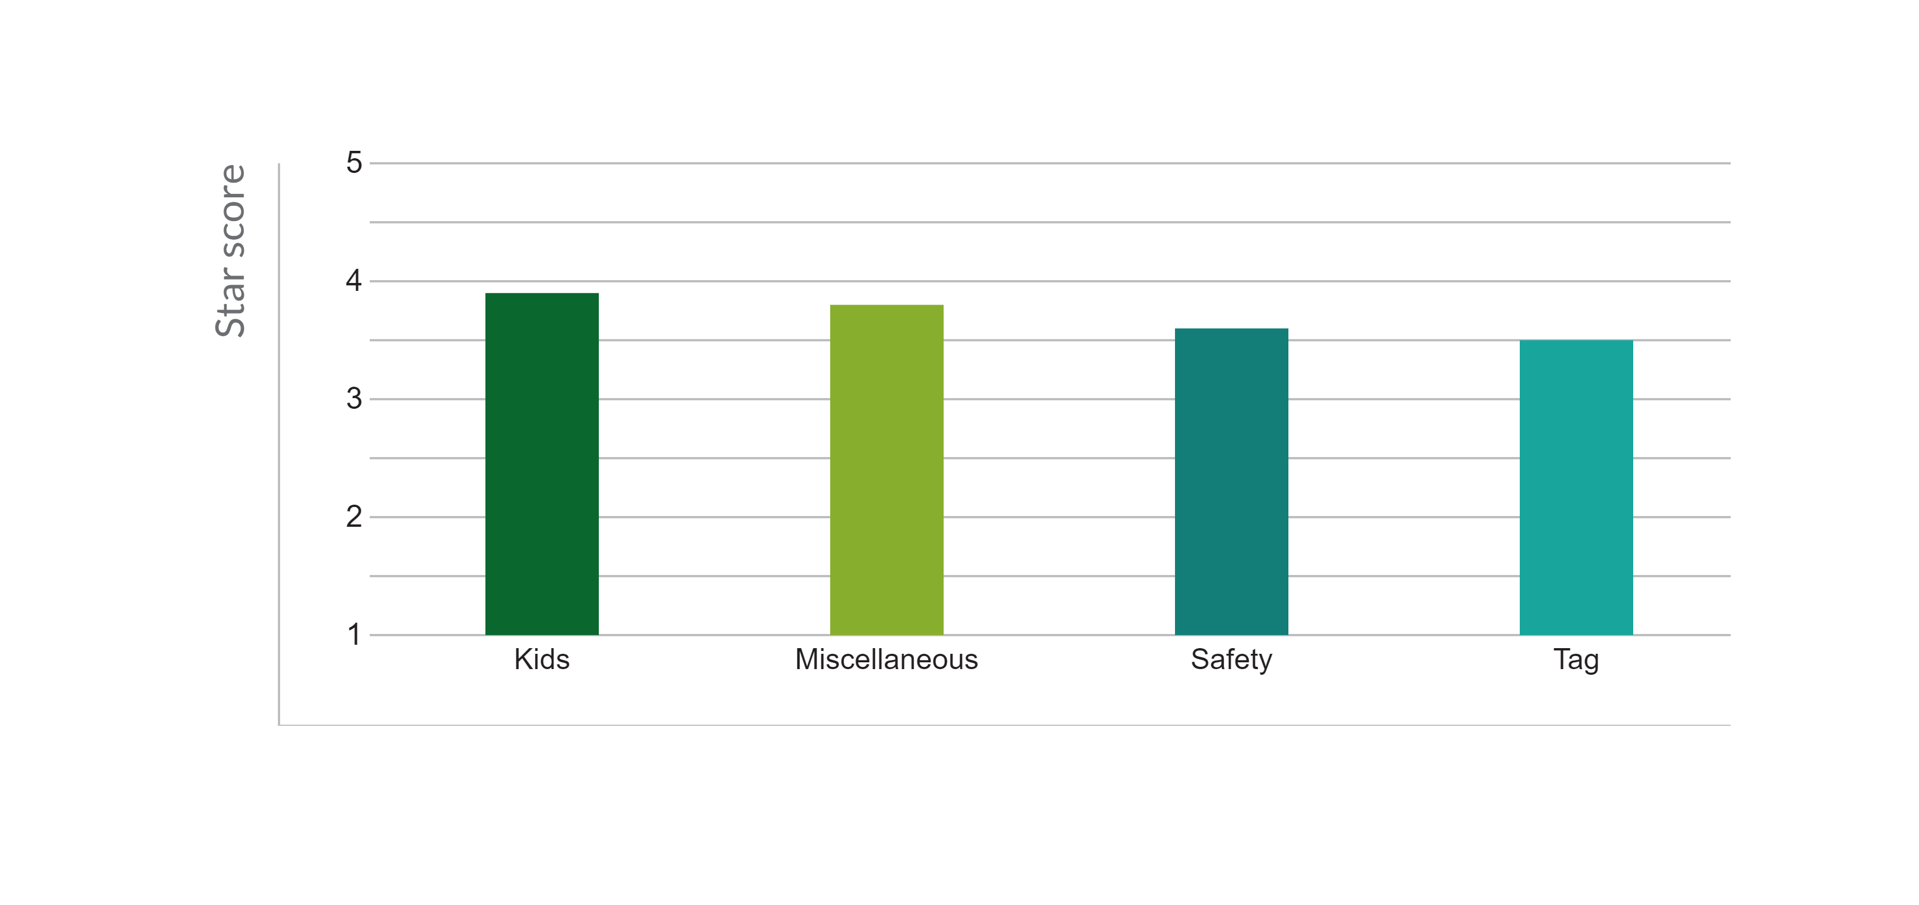
KEYWORD THEMES
Top Themes by star score

Slide 7
THOUGHTS
Kids

Slide 8
THOUGHTS
Miscellaneous

Slide 9
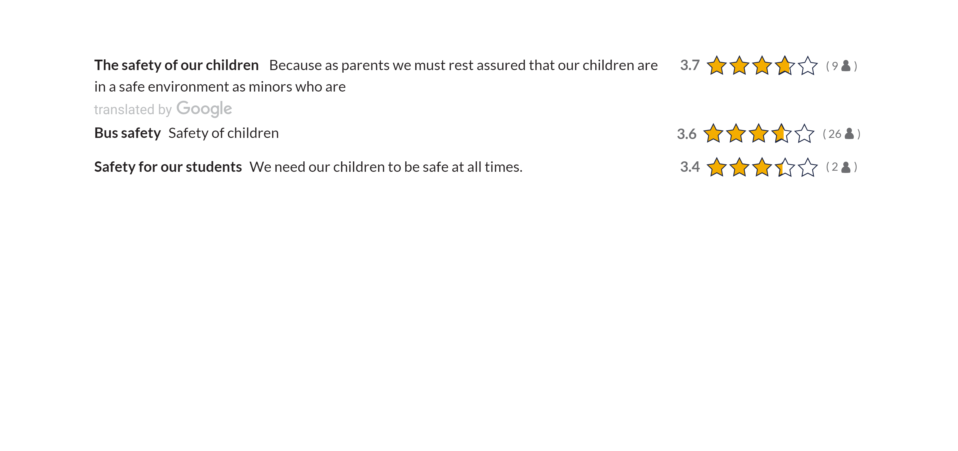
THOUGHTS
Safety

Slide 10
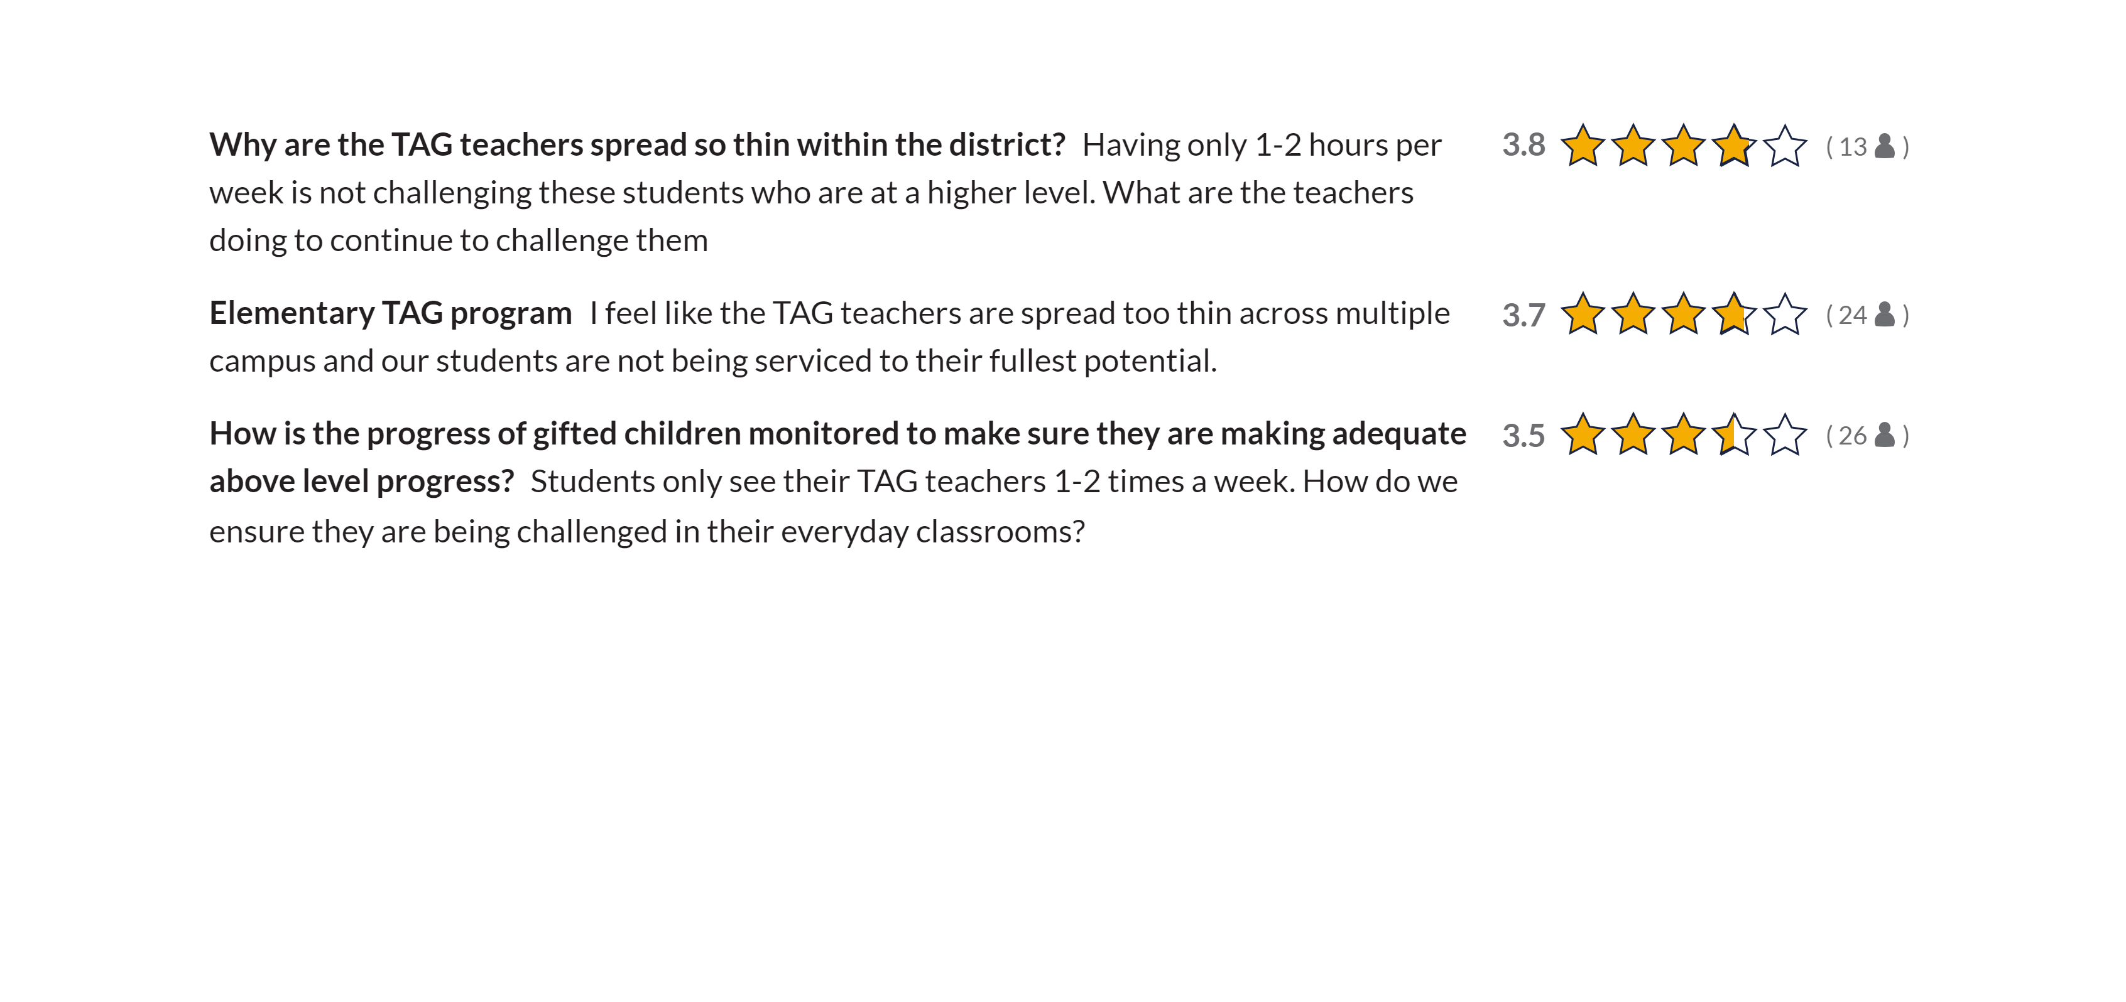
THOUGHTS
Tag

Slide 11
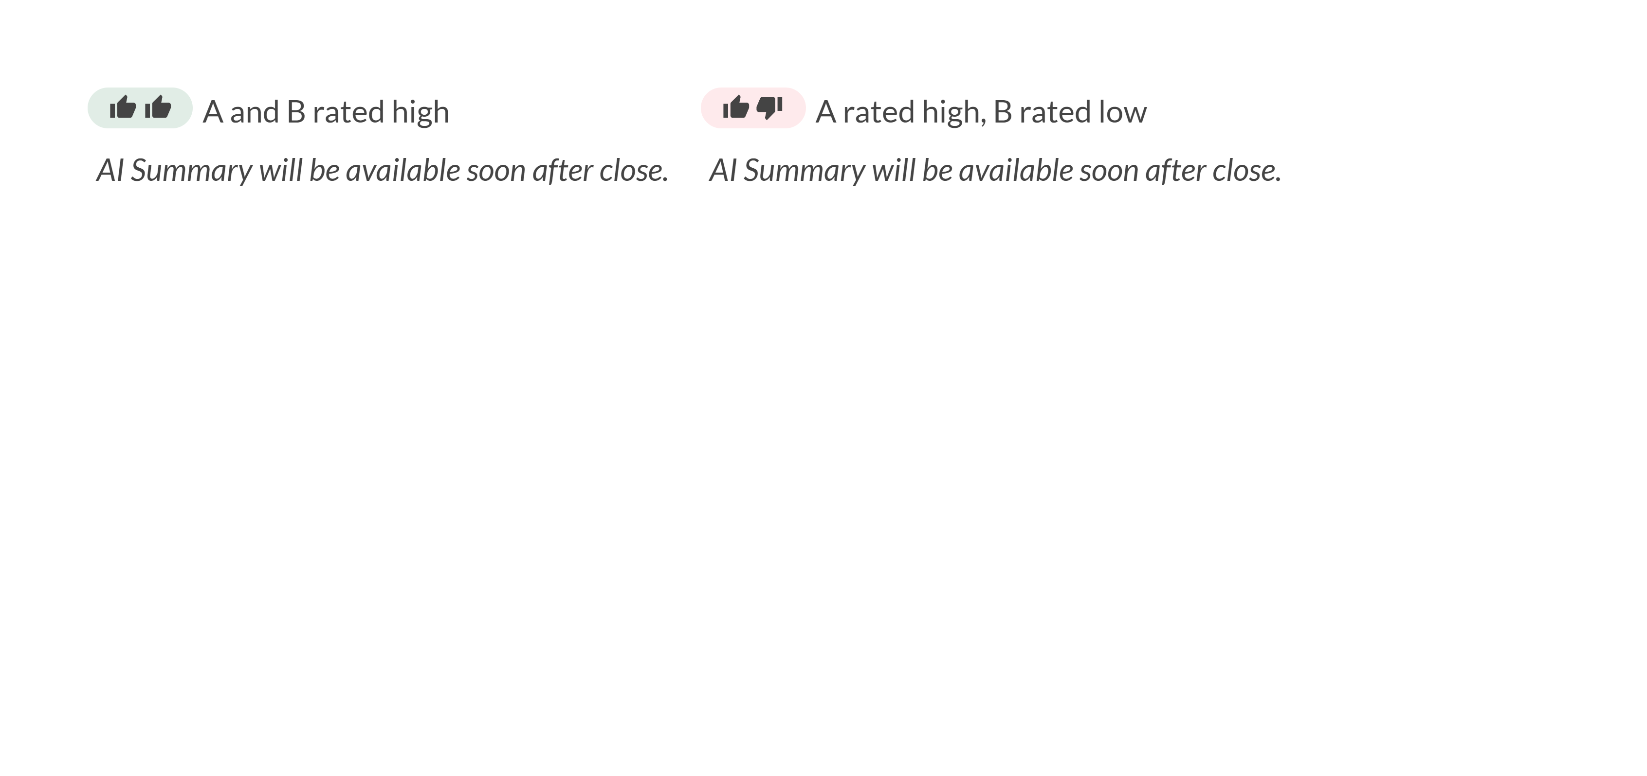
DIFFERENCES
Kids That Care [18 | 7]

Slide 12
DIFFERENCES
Safety Of Children [17 | 4]

Slide 13
DIFFERENCES
Tag Program [20 | 7]

Slide 14
WRAP UP
Next Steps
Thanks for participating
We'll be carefully considering what we learned and sharing our actions back with you.

