Slide 1
Cafeteria Waste Sorting
SPPS Recycling & Organics Program

Slide 2
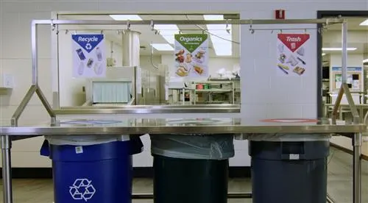
“How to Sort”

Slide 3
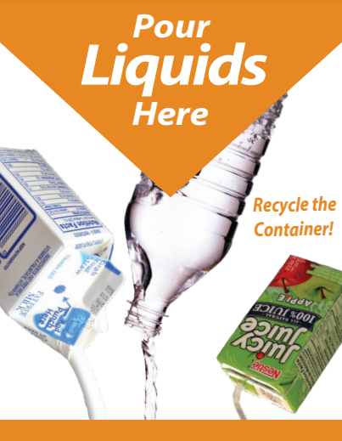
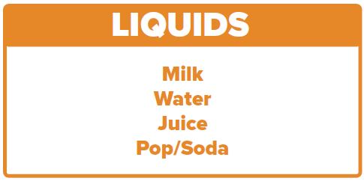
Liquids/Beverage Waste (Orange)
Empty all liquid waste into the liquids collection container
Notes:
Any liquids waste. Only the liquid waste, not the carton or bottle, thats why there is a screen/strainer.

Slide 4
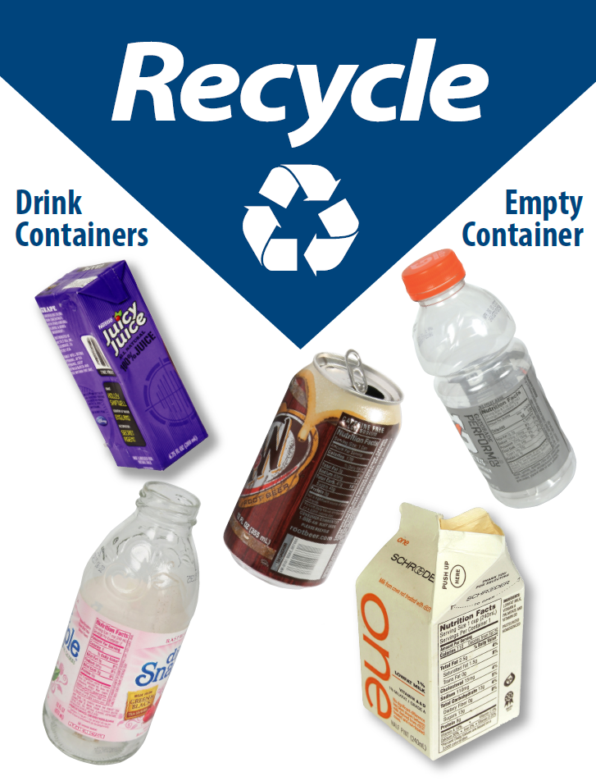
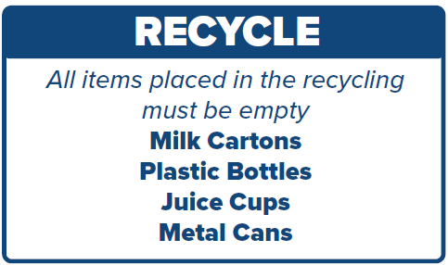
2. Recycling (Blue)
Empty: No Liquids/Food
No Plastic Film, Bags, or Cutlery
Notes:
Needs to be empty!!

Slide 5
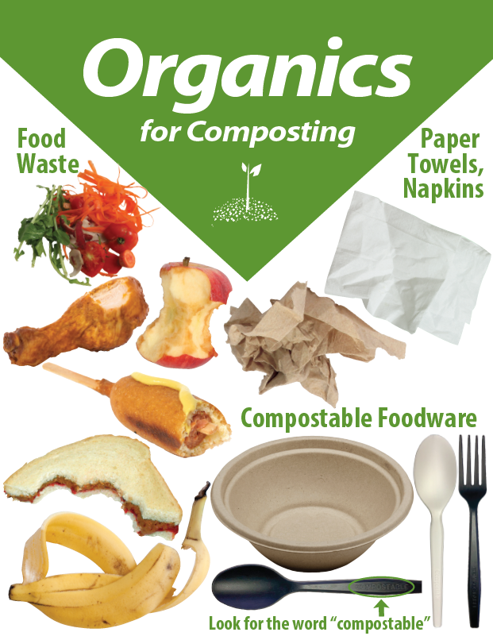
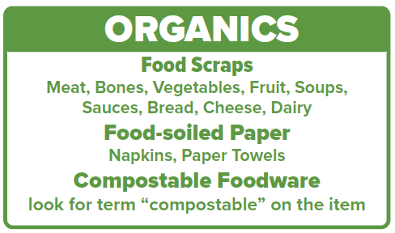
3. Organics (Green)
Remove plastic packaging on food Condiment Containers = Trash
Notes:
Food scraps includes bones, shells, peels, and wooden sticks!
Food-soiled napkins and papers towels are always accepted.
Foodware must say “compostable” on it. Nutrition Services currently provides: black compostable cutlery, compostable rice bowls, and compostable trays.

Slide 6
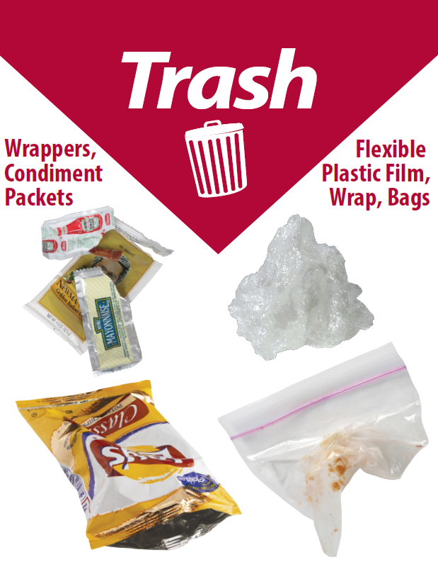
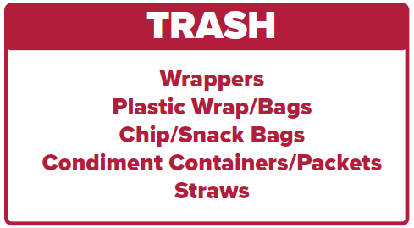
4. Trash (Red)
Non-compostable and
Non-recyclable packaging.
Notes:
Everything else.

Slide 7
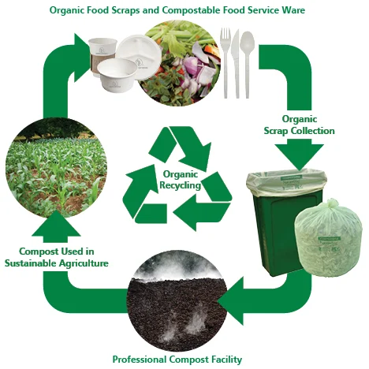
What is Organics?
Organics recycling is the recycling of organic material- anything that was once alive- into compost.
Compost is mixed with soil to help plants and gardens grow!
Our food scraps, napkins, paper towels and compostable items are sent to a commercial compost facility in Rosemount, MN
Notes:
Food scraps, food-soiled papers such as napkins and paper towels plus compostable foodware such as compostable trays, cutlery, and rice bowls are sent to SET a commercial compost facility in Rosemount, MN. This food waste is mixed with yard waste, placed into windrows (long rows of mixed organics) and is turned into nutrient rich compost within 3-6 months.

