Slide 1
Cafeteria Waste Sorting
SPPS Recycling & Organics Program

Slide 2
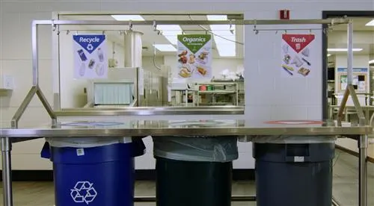
“How to Sort”

Slide 3
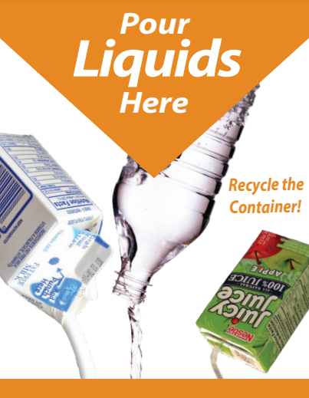
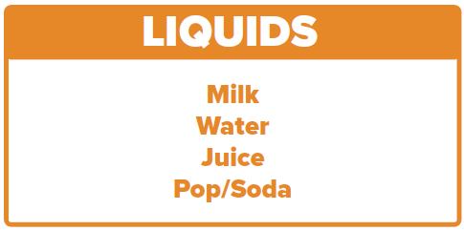
Liquids/Beverage Waste (Orange)
Empty all liquid waste into the liquids collection container
Notes:
Any liquids waste. Only the liquid waste, not the carton or bottle, thats why there is a screen/strainer.

Slide 4
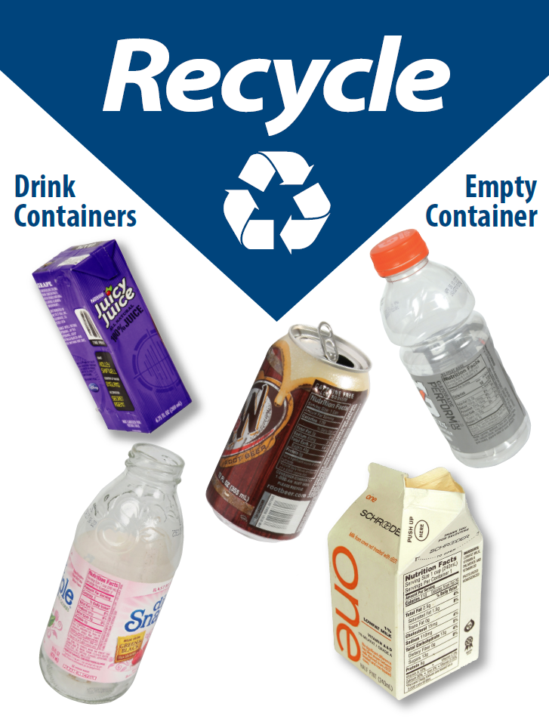
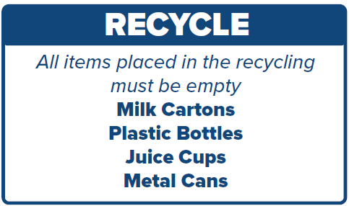
2. Recycling (Blue)
Empty: No Liquids/Food
No Plastic Film, Bags, or Cutlery
Notes:
Needs to be empty!!

Slide 5
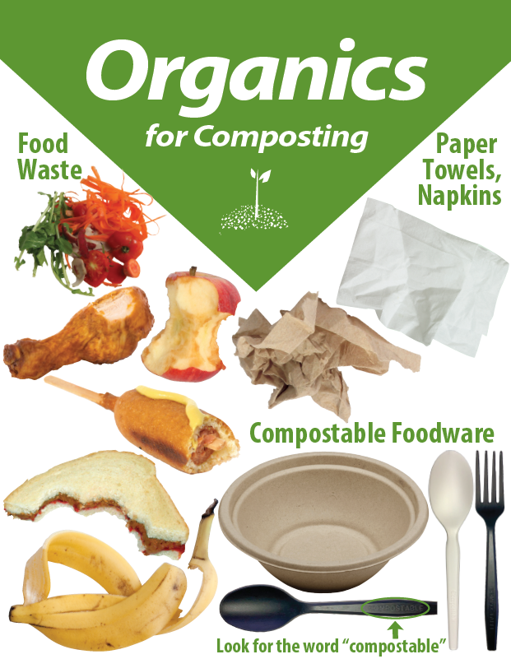
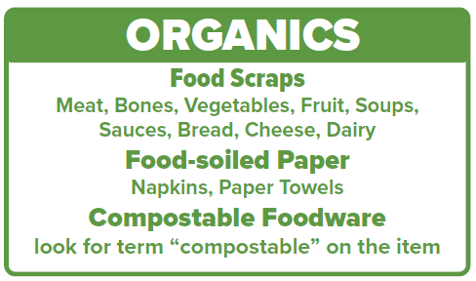
3. Organics (Green)
Remove plastic packaging on food Condiment Containers = Trash
Notes:
Food scraps includes bones, shells, peels, and wooden sticks!
Food-soiled napkins and papers towels are always accepted.
Foodware must say “compostable” on it. Nutrition Services currently provides: black compostable cutlery, compostable rice bowls, and compostable trays.

Slide 6
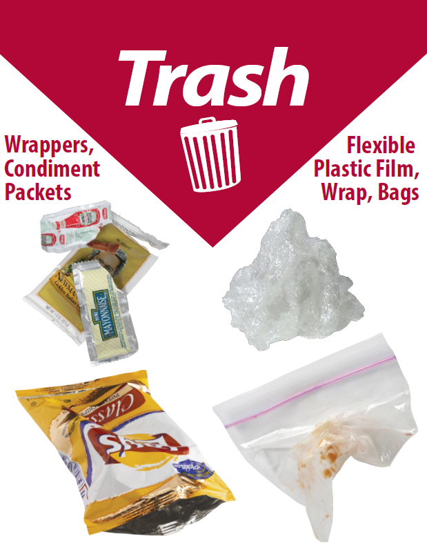
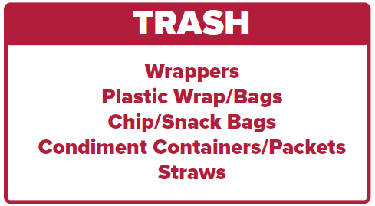
4. Trash (Red)
Non-compostable and
Non-recyclable packaging.
Notes:
Everything else.

Slide 7
“What Happens to Our Waste”
Recycling is Real, and Works!

Slide 8
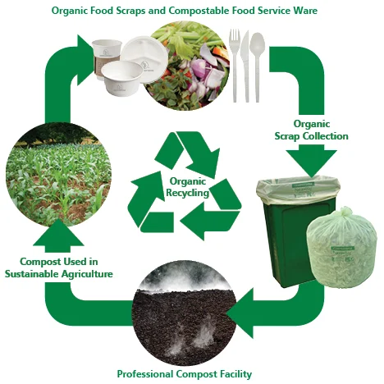
What Happens to our Organics?
Our food scraps, napkins, paper towels and compostable items are sent to a commercial compost facility in Rosemount, MN
Organics recycling is the recycling of organic material- anything that was once alive- into compost.
Compost is mixed with soil to help plants and gardens grow!
Notes:
Food scraps, food-soiled papers such as napkins and paper towels plus compostable foodware such as compostable trays, cutlery, and rice bowls are sent to SET a commercial compost facility in Rosemount, MN. This food waste is mixed with yard waste, placed into windrows (long rows of mixed organics) and is turned into nutrient rich compost within 3-6 months.

Slide 9
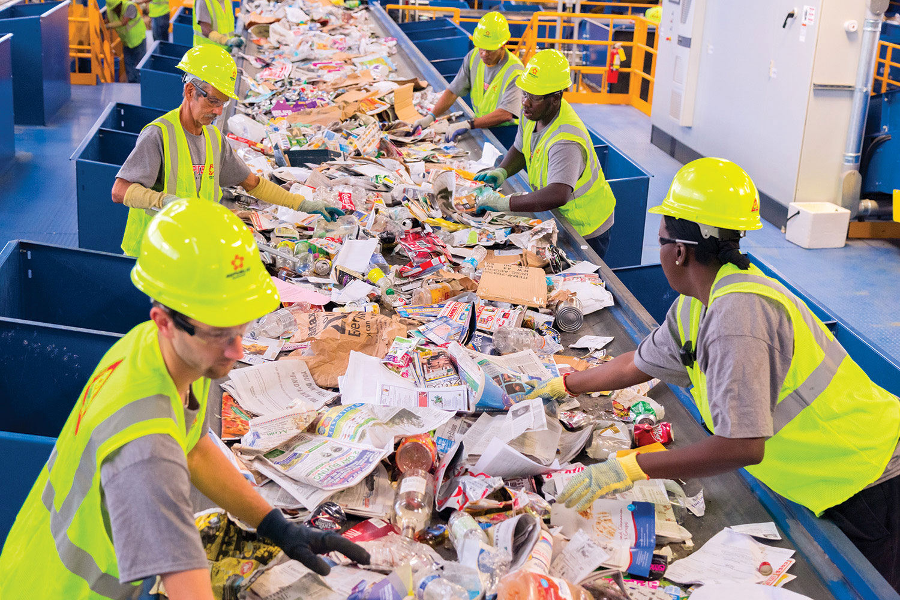
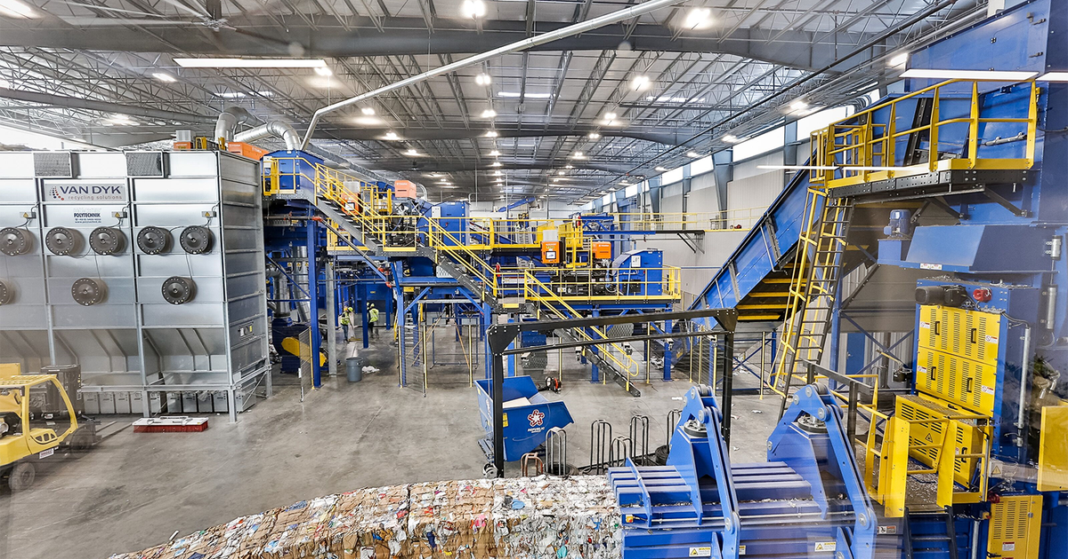
What Happens to our Recycling?
Our recycling is taken to a local material recovery facility (MRF) where people and machines sort the recycling into material types, which are sent to many different companies to be made into new “recycled” products.
Notes:
Our waste hauler Republic, has their own MRF (pronounced murf) where they process and sort all of the different types of recycling streams. These different types of recyclable are then sold to other companies to be made into recycled products. Recycling is quite local to the midwest, Saint Paul even has our own paper mill called West Rock.

Slide 10
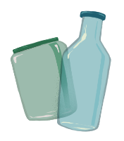
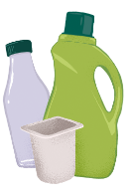
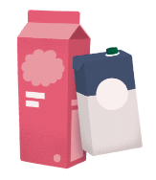
“Recycled” into new Products
Milk and juice cartons are sent to Sustana Fiber in Wisconsin to make material for new paper products.
Paper mills like West Rock in Saint Paul mix paper and water together to make a pulp, which is then flattened, dried and rolled into new boxboard. The boxboard is used to make cereal boxes.
Bottles and jars are sorted by color at Strategic Materials in Saint Paul. Clear glass is sent to Anchor Glass in Shakopee to make new food and beverage bottles.
Plastics are sorted, shredded, and melted into pellets. Avon Plastics in Paynesville, MN turns milk jugs and detergent bottles into durable decking. Plastics bottles and get made into new bottles in Wisconsin and Ohio.
Photo::https://recyclingexists.com/

Slide 11
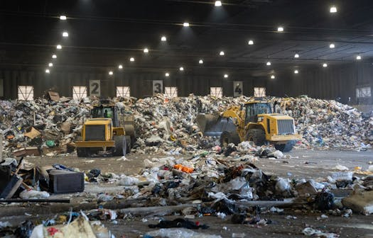
What Happens to our Trash?
Trash is sent to the Recycling & Energy Center (R&E Center) in New Port, MN
Trash gets incinerated (burned) and turned into a refuse-derived fuel used by power plants in Mankato and Red Wing, MN.
Photo: ALEX KORMANN, STAR TRIBUNE
Notes:
SPPS has to pay 70% tax on trash, 0% tax on organics and recycling. All trash in ramsey and washington county is required to be brought to R&E center by our waste hauler. Trash is expensive!

