Slide 1
Champ Cooper
Title I Annual Meeting: About Us

Slide 2
Title I Program
Title I funds are federal funds that are allocated to provide additional academic support and learning opportunities to assist students as they master challenging Tier I curricular and address standards in core academic content areas. Champ Cooper is a school that receives Title I funds. These funds support our learning environment in a variety of ways by providing extra interventions and/or instructional materials for students in reading and mathematics as well as technology to enhance performance of all students and reinforce concepts taught in the classroom.

Slide 3
Our School
An Overview
Title I School
PreK-8th Grade
1219 students
4 Administrators
3 Secretaries
68 Teachers
3 Speech Therapists
2 Counselors
8 Custodians
Ponchatoula, Louisiana

Slide 4
1219 students
641 males
578 females

Slide 5
the schoolwide plan
School Wide Goals for Success!

Slide 6
School Wide Goal #1
Students
Champ Cooper School will increase the School Performance Score from 66.4 to 69.4 in 2023-24.
2023 Leap Data | ELA | Math | Science | Social Studies
Advanced | 15 | 9 | 16 | 26
Mastery | 167 | 142 | 120 | 100
Basic | 168 | 196 | 213 | 176
Approaching Basic | 125 | 192 | 194 | 150
Unsatisfactory | 69 | 115 | 111 | 202

Slide 7
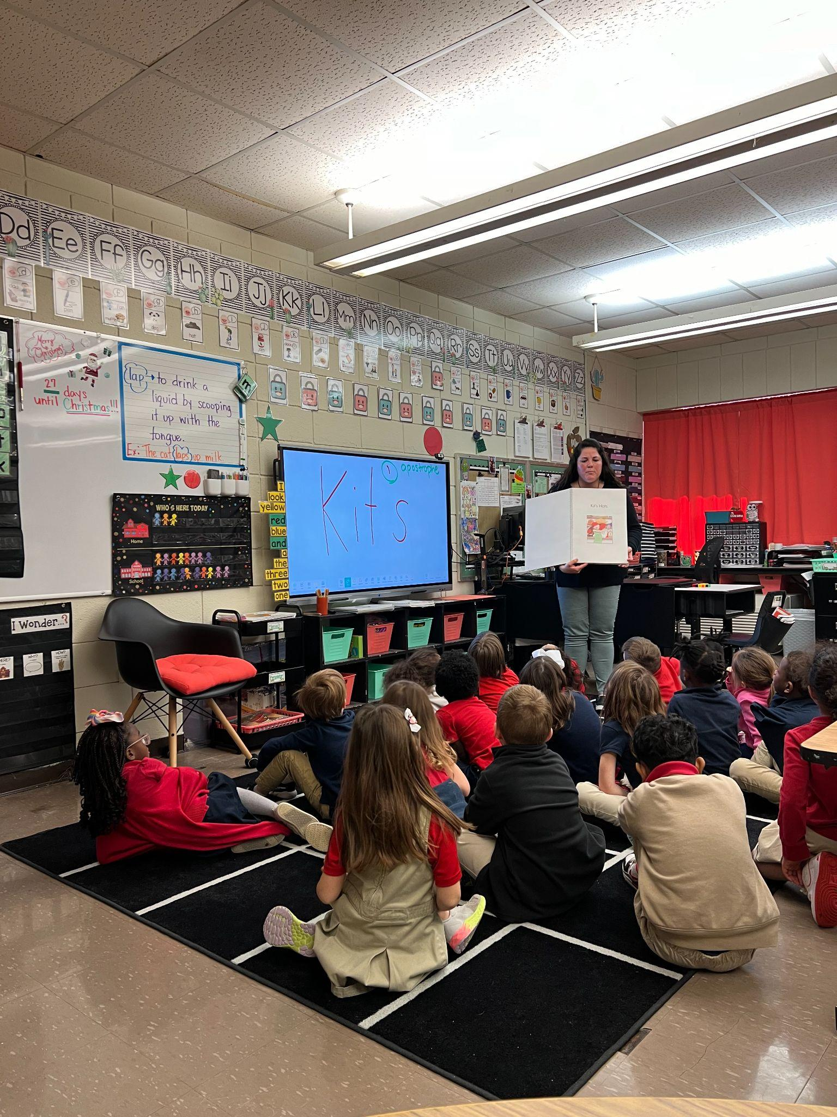
School Wide Goal #2
Reinforce ELA
Tier I curriculum will be followed in all grade levels at Champ Cooper
Wit and Wisdom in grades K-2 will be the ELA curriculum used
CKLA in grades K-2 will support phonics instruction
Guidebooks will be the ELA curriculum for 3rd - 8th grades
Accelerate will be implemented.

Slide 8
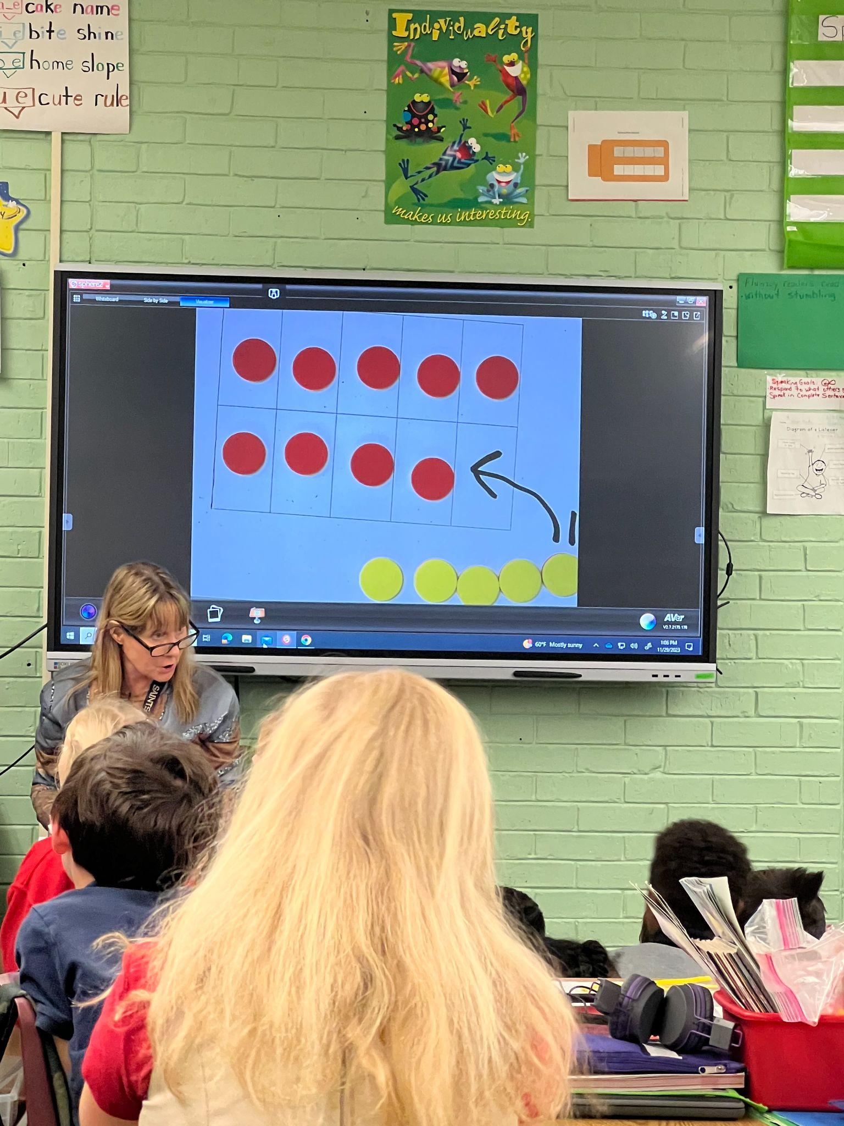
School Wide Goal #3
Accelerate Math
Eureka Math and Zearn will be used in grades K-8th
Acceleration/Extended Day Program
Interventions by the classroom teacher - with the use of software and small group.

Slide 9
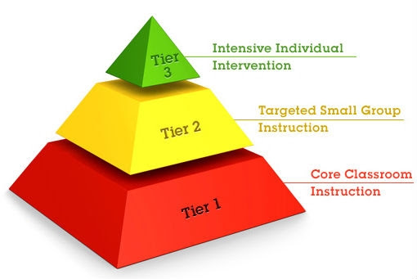
School Wide Goal #4
18% to 21% in ELA and 21.5% to 24.5% in math.
PreK – 3rd grade self-contained utilizes the Unique curriculum
4th-8th grade self-contained utilizes the Unique curriculum
Some Sped Teachers utilizes System 44 as a supplemental curriculum

Slide 10
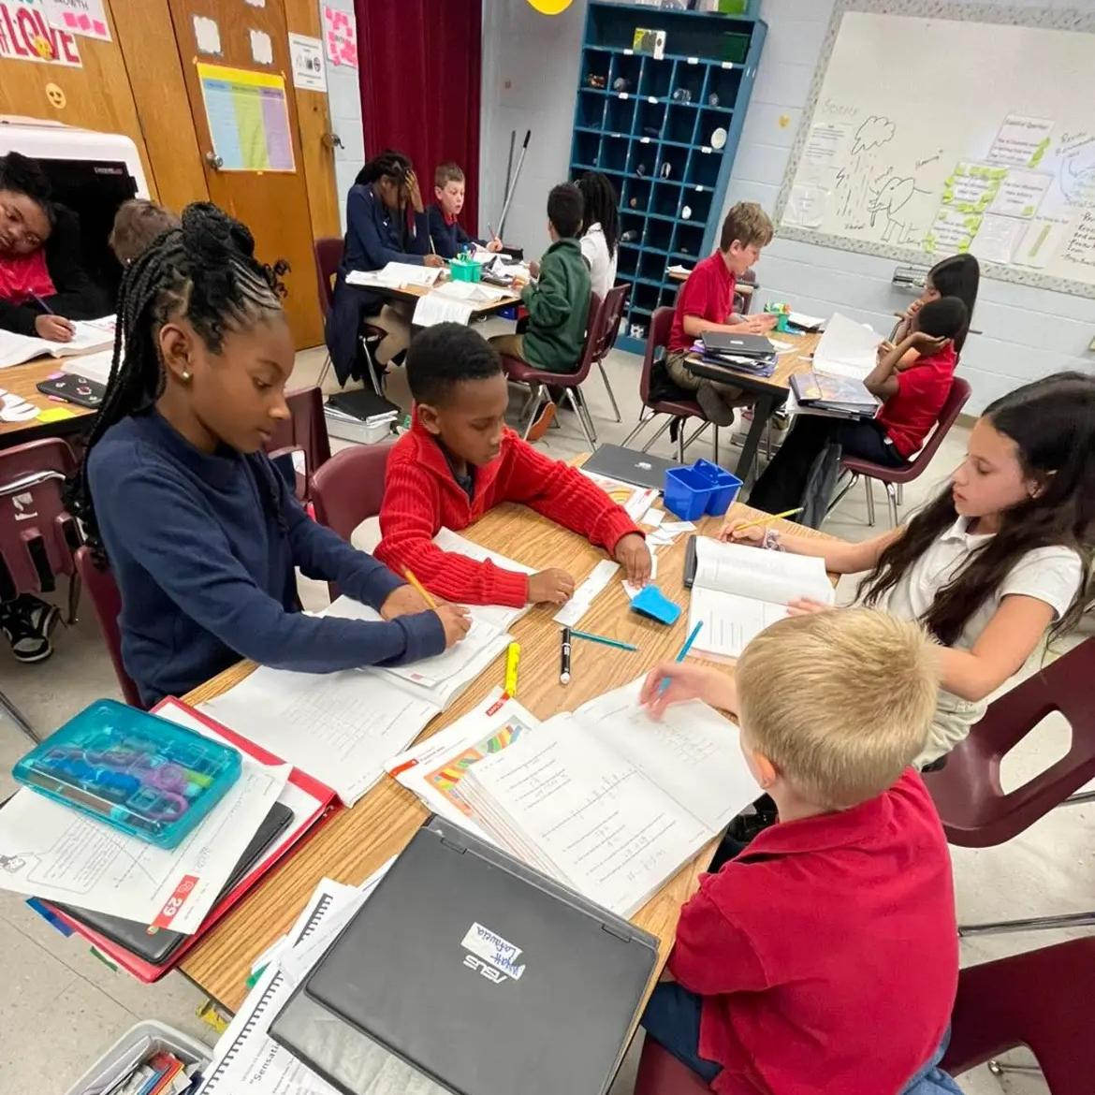
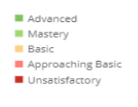
School Wide Goal #5
ELA
Anchor charts will be used school wide Collaboration meetings will be used to focus the implementation of Tier I curriculum.
An Instructional Curriculum Coach was implemented this year. She is used to support all grade levels in the use of the Tier 1 curriculum.
A Content ELA teacher leader, Content Math teacher leader and Content Intervention teacher leader are on staff to provide support to teachers.
Math

Slide 11
School Wide Goal #6
Discipline
Number of Discipline Incidents:
2020-2021: 409
2021-2022: 724
2022-2023: 1287
Number out-of-school Suspensions:
2020-2021: 104
2021-2022: 122
2022-2023: 108
Number of in-school Suspensions:
2020-2021: 42
2021-2022: 96
2022-2023: 126
School-wide PBIS program- includes individual, class and school-wide incentives.
PBIS committee meets each six weeks to review discipline data and make adjustments as necessary. Students are awarded each six weeks for good behavior. Daily, students can earn Paw Points which can be used to purchase coupons, items from the PBIS teacher store, and to attend the six week reward celebrations.
Digital point system for students to earn Paw Points - PBIS App or ClassDojo.
Check-In/Check-Out program for students who need additional behavior support.

Slide 12
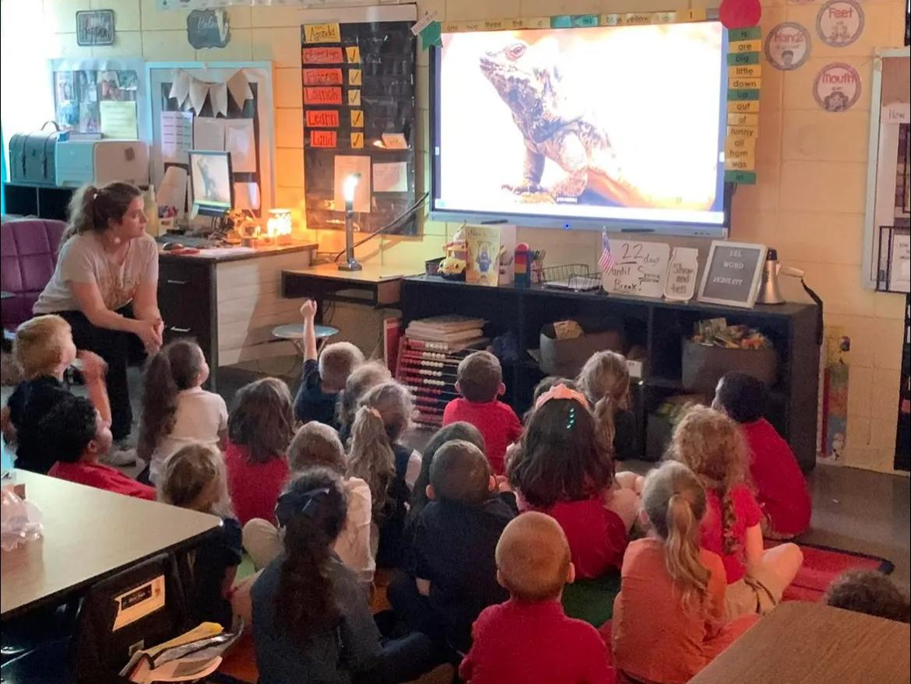
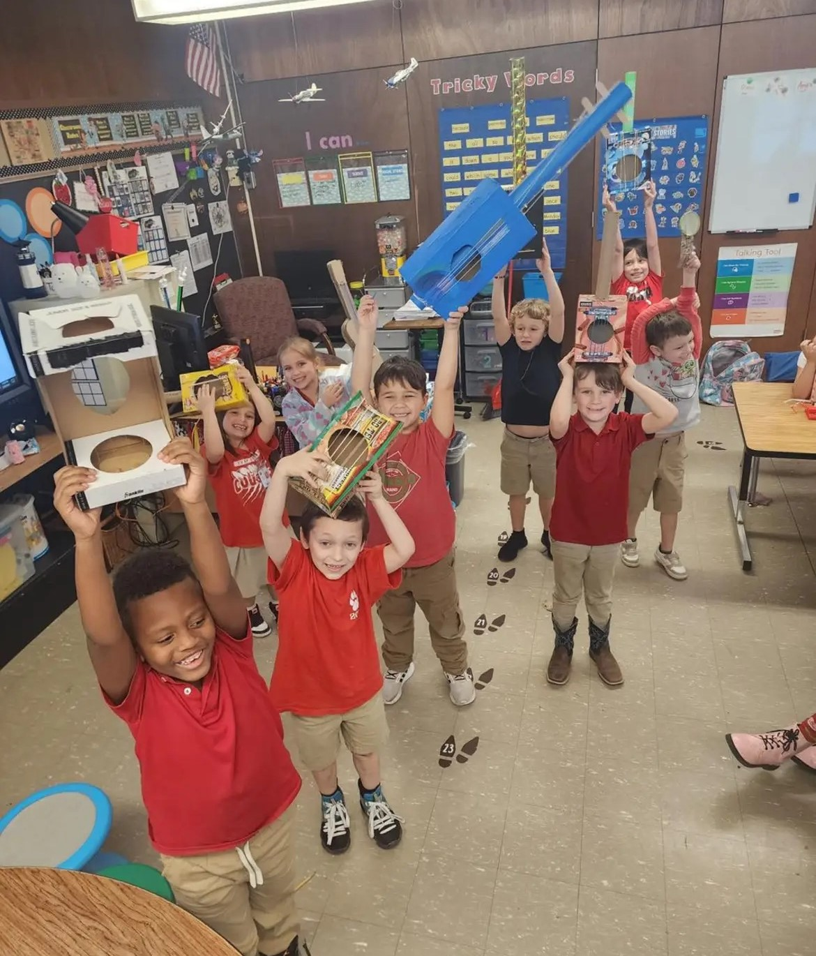
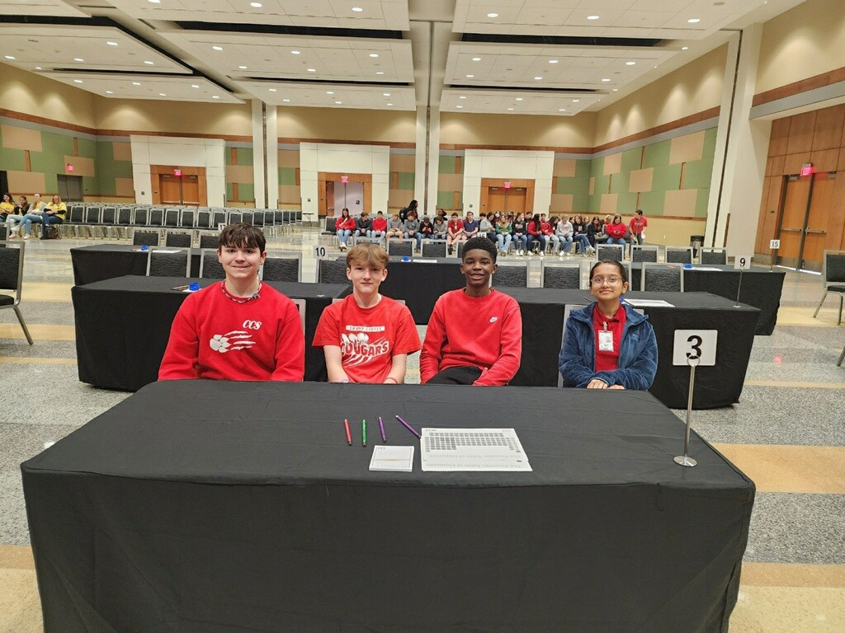
School Wide Goal #7

Slide 13
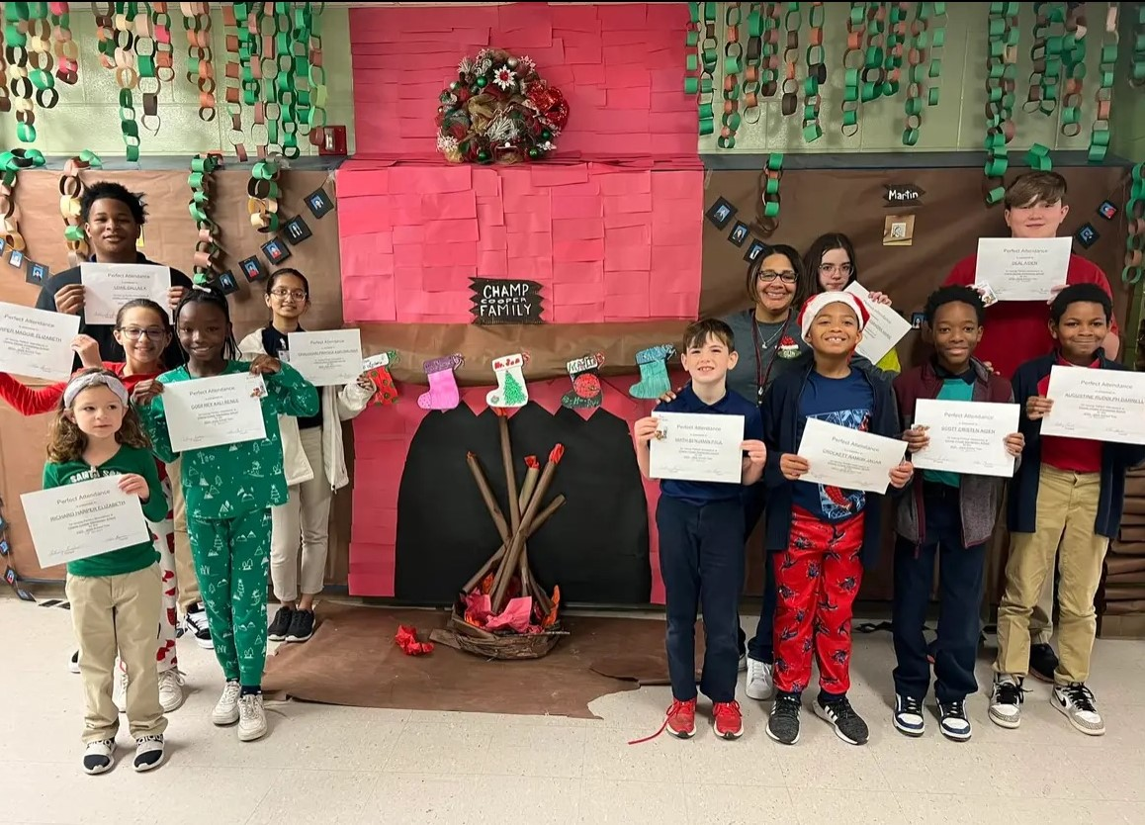
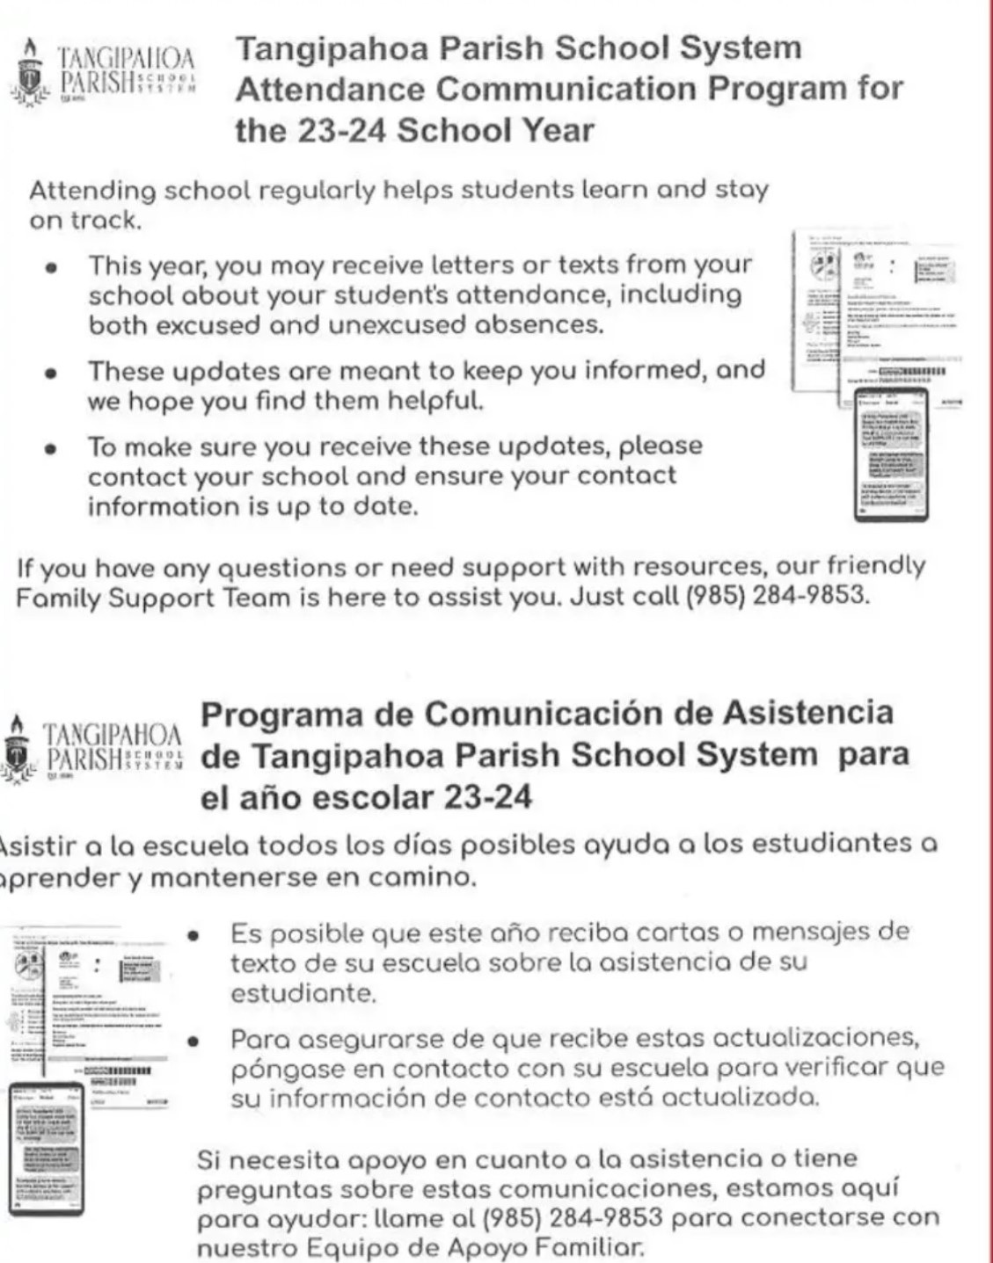
School Wide Goal #8

Slide 14
How parents & guardians can help us reach our goals…
“We need you!”

Slide 15
Suggestions:
Prioritize education - attend school regularly on time
Support the learning environment - maintain communication
Establish routines for learning - read with children
Encourage efforts and motivate growth
Participate and develop a partnership with the learning environment
Develop goals to focus your child

Slide 16
Timeline of Parent/Family Engagement
2023-2024

Slide 17
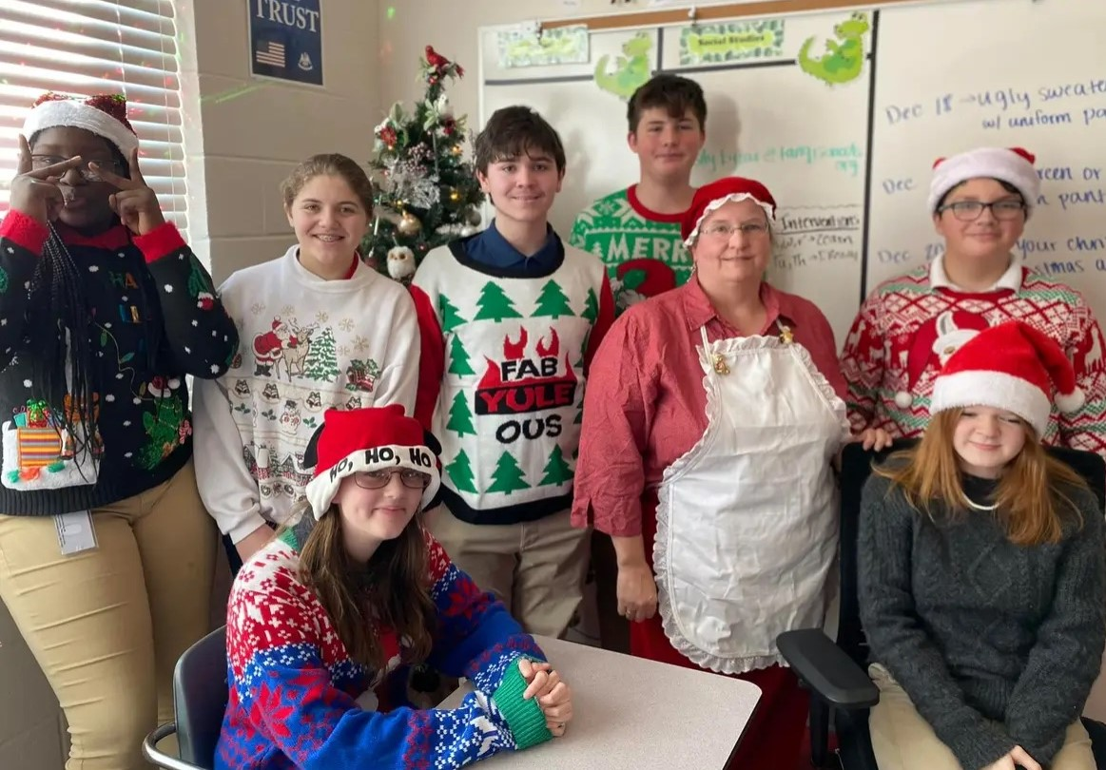
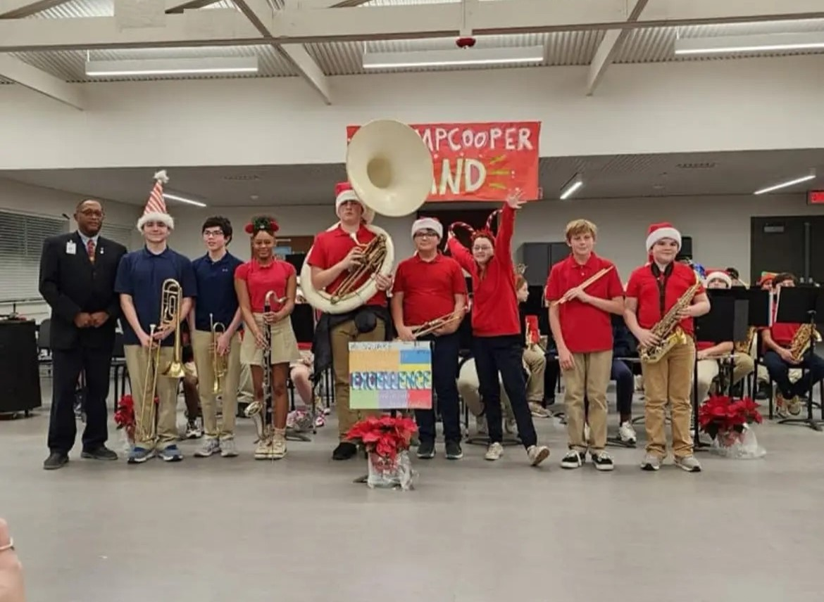
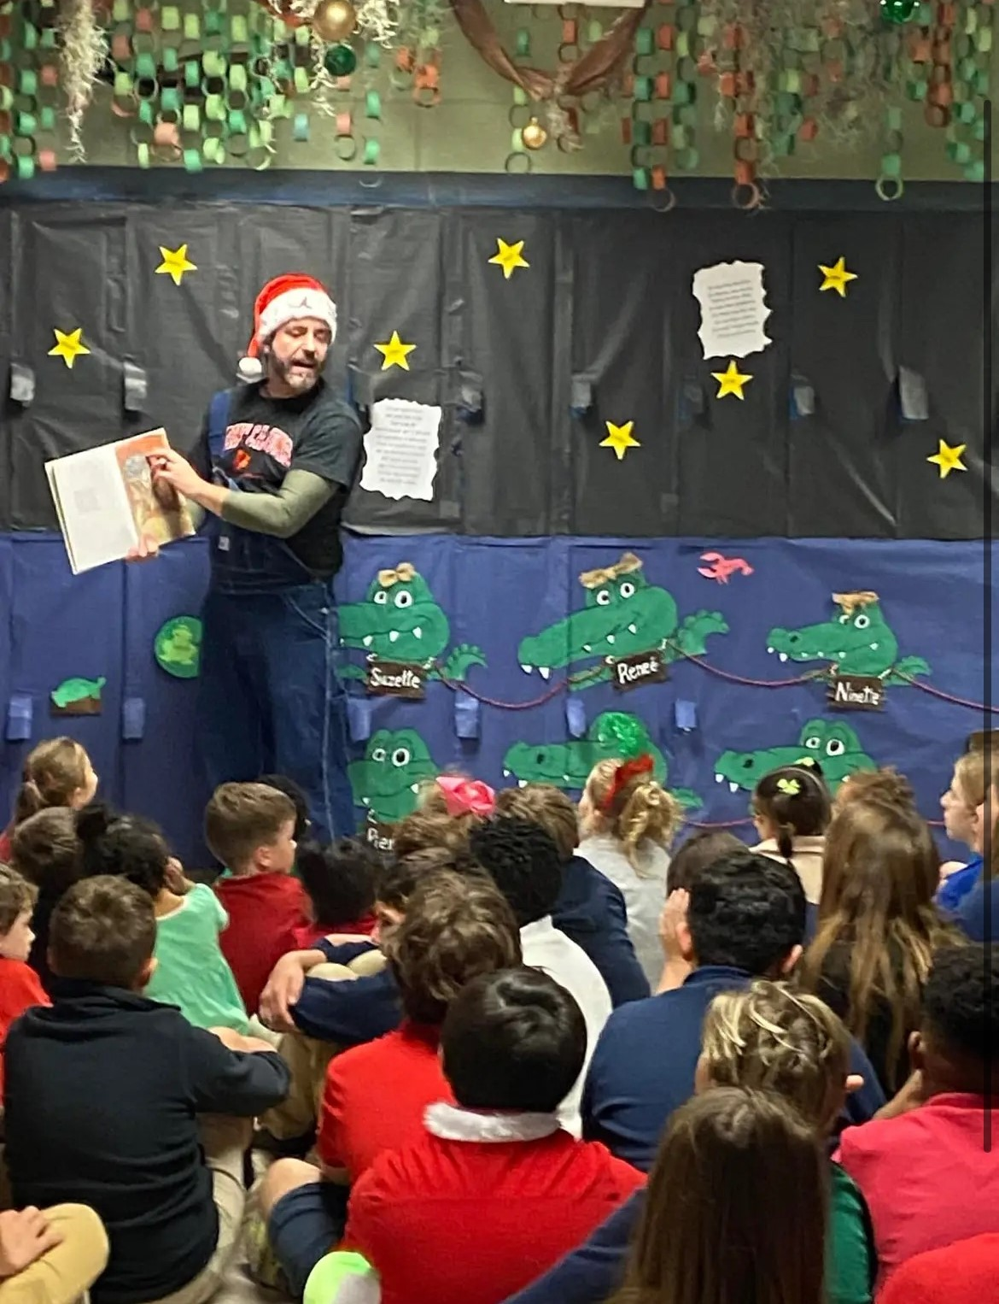
Band Night Family/Student
PBIS Activities/Social Studies Fair/You Be The Chemist
Open House
August
December
December/January
February
March/April
Social Studies Fair
Beginning of School Activities
Annual Meeting
Spring Fling
PreK
Bi-Yearly
Parent Conferences

Slide 18
the school parental involvement policy - An Overview
Parents are INTEGRAL to the SUCCESS of students’ learning!
Parents are PART of the plan.
Parents assist in the PLANNING, REVIEWING, and IMPROVING.
Goal is to build a strong partnership between teachers and parents for improved student academic achievement.

Slide 19
Support your school…
Support your children and their teachers by ensuring your children are prepared for their classes.
Communicate with your children and their teachers, especially if you have questions or concerns.
Emphasize the importance of school and how education impacts the future.
Check your child’s progress on Oncourse regularly.

Slide 20
Support your children…
Have a schedule and routine for your children to complete activities.
Ensure your children attend school each day unless there is an illness or other circumstances that warrant them not attending.
Encourage your children to do their personal best every day and attempt every task even if it is difficult.
Have frequent discussions with your children about the appropriate way to use social media and warn them of the consequences that misusing it can bring.
To boost inquiry, ask your child questions and encourage him/her to ask questions about the world.

Slide 21
Support your children…
If your child is a virtual student:
Create a place free of distractions for your child to work.
Encourage your child to get dressed and participate as if they were attending traditional school.
Set a daily schedule for learning.
Ensure that there is a learning partner at home to offer support when needed.
Have
12

Slide 22
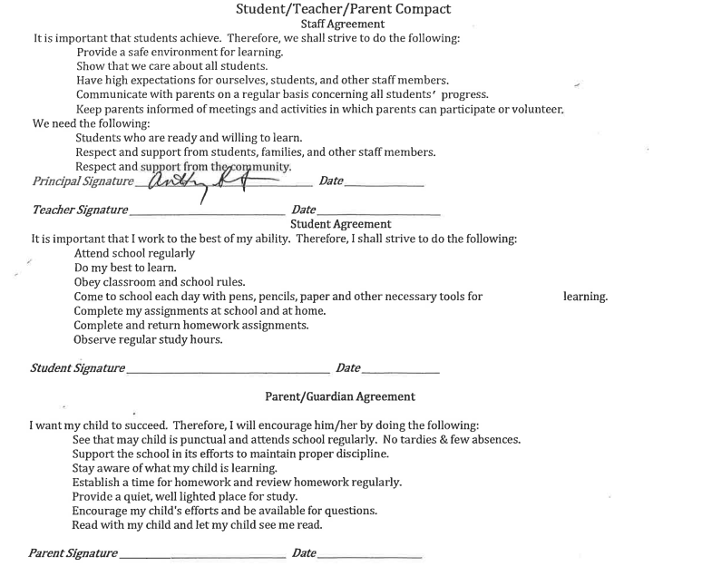
The School-Parent Compact

Slide 23
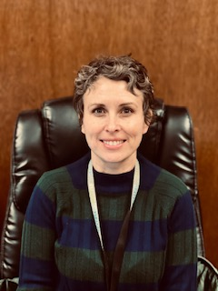
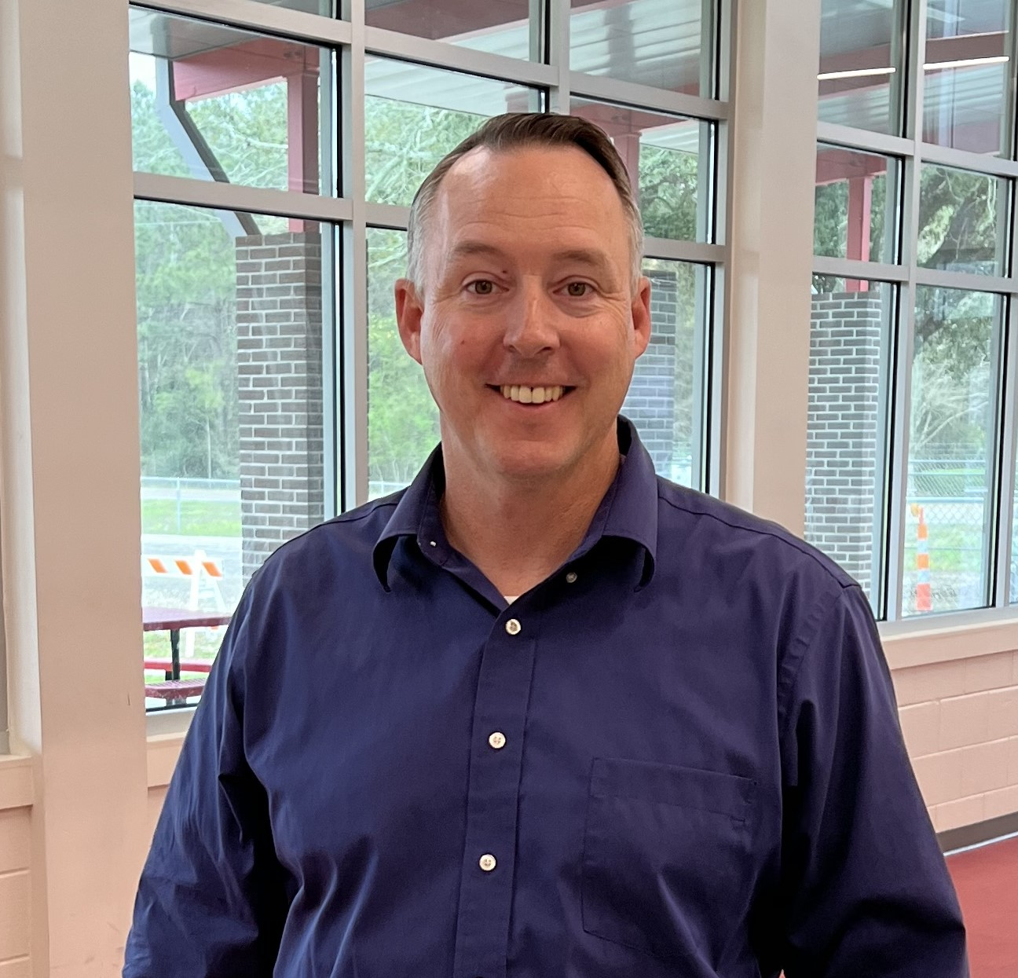
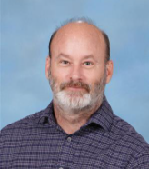
THANK YOU !
Dr. Hoffman, Assistant Principal
Champ Cooper School
Mrs. Womack,
Assistant Principal
Mr. Sciortino, Principal
Mr. Brian Freeman, Assistant Principal

