Slide 1

Diligence
9th - 12th

Slide 2

Objective
The Learner will be able to:
Understand the definition of Diligence
Discuss pertinent and relevant examples that demonstrate understanding
Increase awareness of being a diligent individual
Diligence

Slide 3
Warm-Up: Luck or Diligence?
01
02
Carl
Carl has had the same friend group since 1st grade; he has always been the popular friend and likes to hang out. He always makes straight A’s and has been on Honor Roll since 1st grade. His friends wonder how he does it. They don’t know that he always finds time to study no matter what.
Stacey
Stacey got home and realized she had 1,000 alerts on her computer. She opened it to see that her TikTok video she made was going viral. The number count was growing rapidly and she was amazed. A week later, she got a message from a makeup company stating that they wanted to feature her in a campaign.

Slide 4
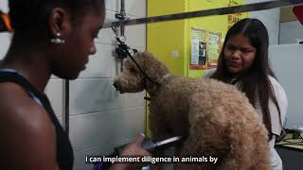
Diligence

Slide 5
Diligence
Definition:
Steady, earnest, and energetic effort

Slide 6
Activity: Are You Diligent?
True or False?
I always do my best; I strive for excellence.
I am willing to risk failure for a worthy goal.
I am self-disciplined.
I make sure to learn from my mistakes and failures.
I try to see the big picture and think long term.
I set goals and stay focused.
I don’t give up just because things seem difficult.
I don’t procrastinate.
Notes:
Students may complete this portion on the handout if used, or the teacher may decide to have students complete this on their own paper.

Slide 7
Activity Continued: Are You Diligent?
I think I am (or am not) a diligent person because: ______________________________________________________________
Notes:
Students may complete this portion on the handout if used, or the teacher may decide to have students complete this on their own paper.

Slide 8
Wrapping It Up
How could you benefit
by becoming a more
diligent person?

Slide 9

Diligence To-Go Activity
On your handout, answer this question:
How will you work to become a more diligent person?
Be specific!
Notes:
Students may complete this portion on the handout if used, or the teacher may decide to have students complete this on their own paper.

