Slide 1









Diligence
April Character Trait
6th -8th

Slide 2


Teachers,
In the presentation, students will learn what it means to be Diligent in different situations. Each slide will contain interactive activities and guided questions for “Bring Out The Best” Diligence Character Trait for grades 6-8.
Diligence

Slide 3







Objective
MECHANICS SECTION
Prepare a pen or
a pencil and
let’s have fun.
1
Define what it means to be Diligent
Explore what it means to have a steady, earnest, and energetic effort
2
3
Identify ways one can demonstrate Diligence
Diligence

Slide 4

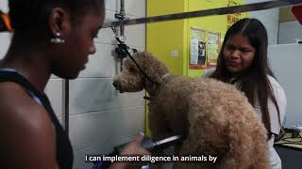
Diligence

Slide 5
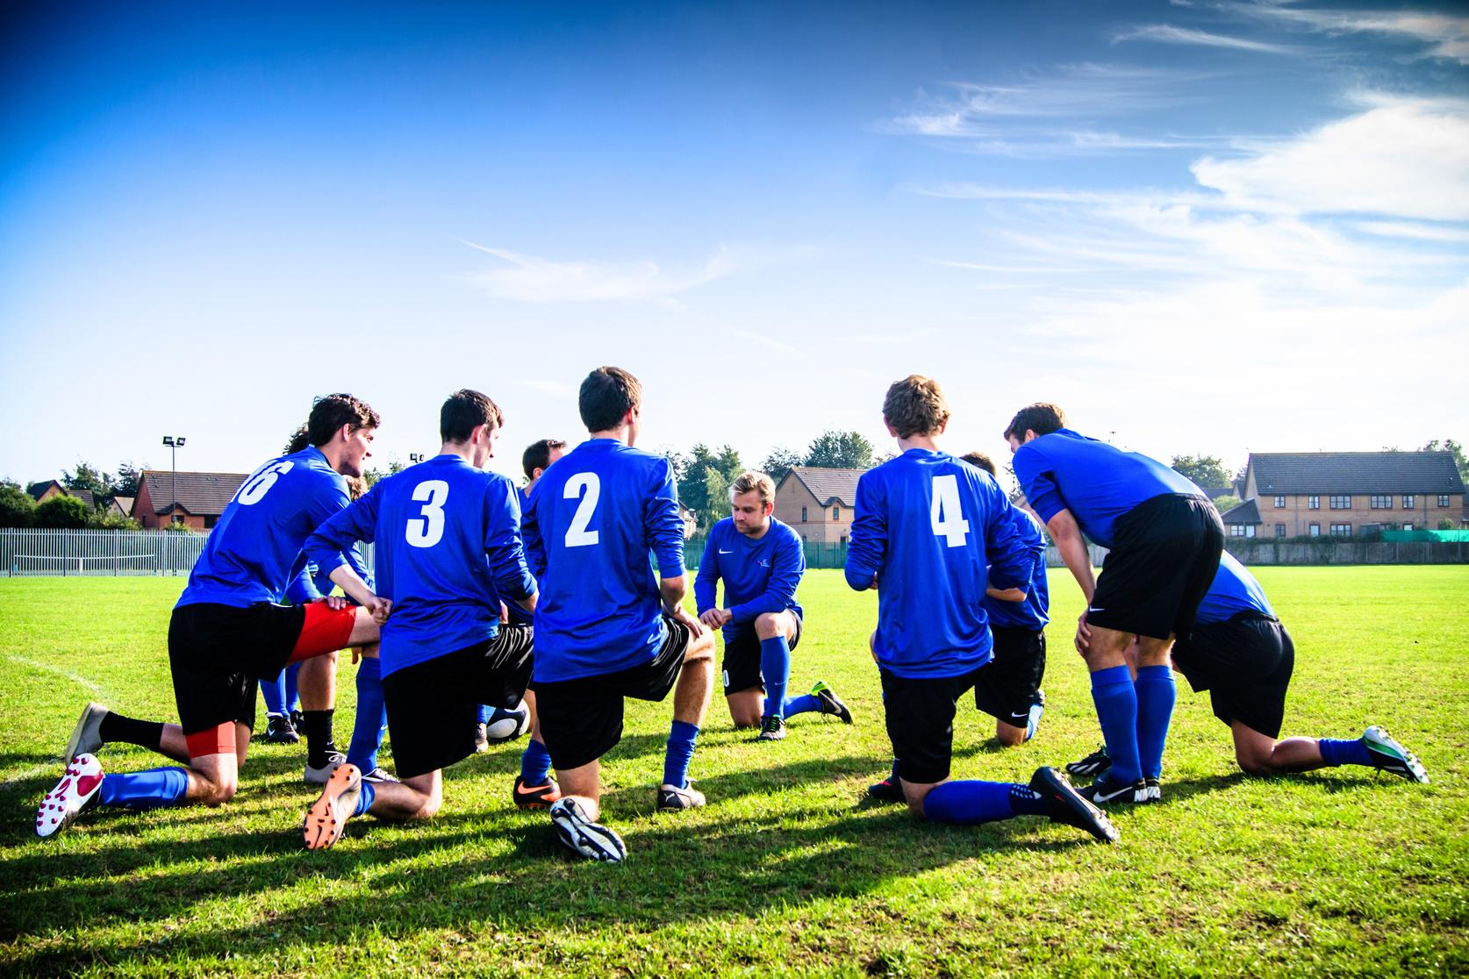
Diligence Quiz
Students, you will receive a worksheet from your teacher, which is double-sided, containing the tasks for today's lesson. Begin by taking the Diligence Quiz and answering all the questions.
Diligence

Slide 6



LET'S
DISCUSS
Diligence

Slide 7


Brainstorming Activity
  Make a chart of the things in your studies and/or extracurricular activities that are easy for you and those that seem difficult.
  Brainstorm ideas and actions that would help you be successful in the areas you are struggling in.
Diligence

Slide 8




Reflect
Create a detailed plan based on the information in your chart and brainstorming session that will help you overcome difficulties at school whether it be academic or extracurricular.
Diligence

Slide 9
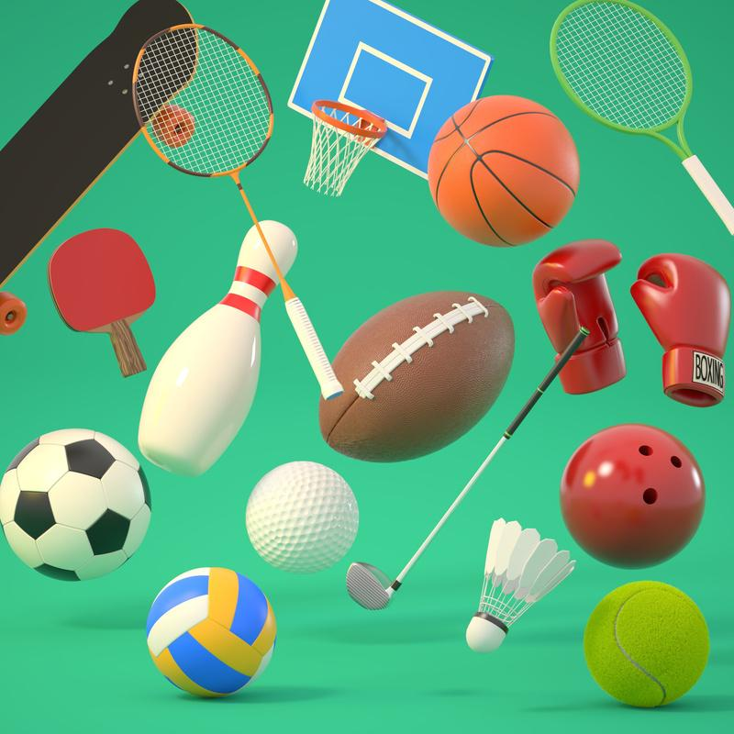
Home Connection
Share your plan of action with your parents/guardians. Ask them to assist you in needed areas and hold you accountable.
Diligence

