Slide 1

This is your presentation title
May 2024

Slide 2
DILIGENCE:
Definition: steady, earnest, and energetic effort
May 2024

Slide 3

Today, the learners will……….
Discuss the meaning of DILIGENCE.
Brainstorm ways to show DILIGENCE at school, at home, and within the community.
Conclude reasons why it is important to demonstrate DILIGENCE.

Slide 4
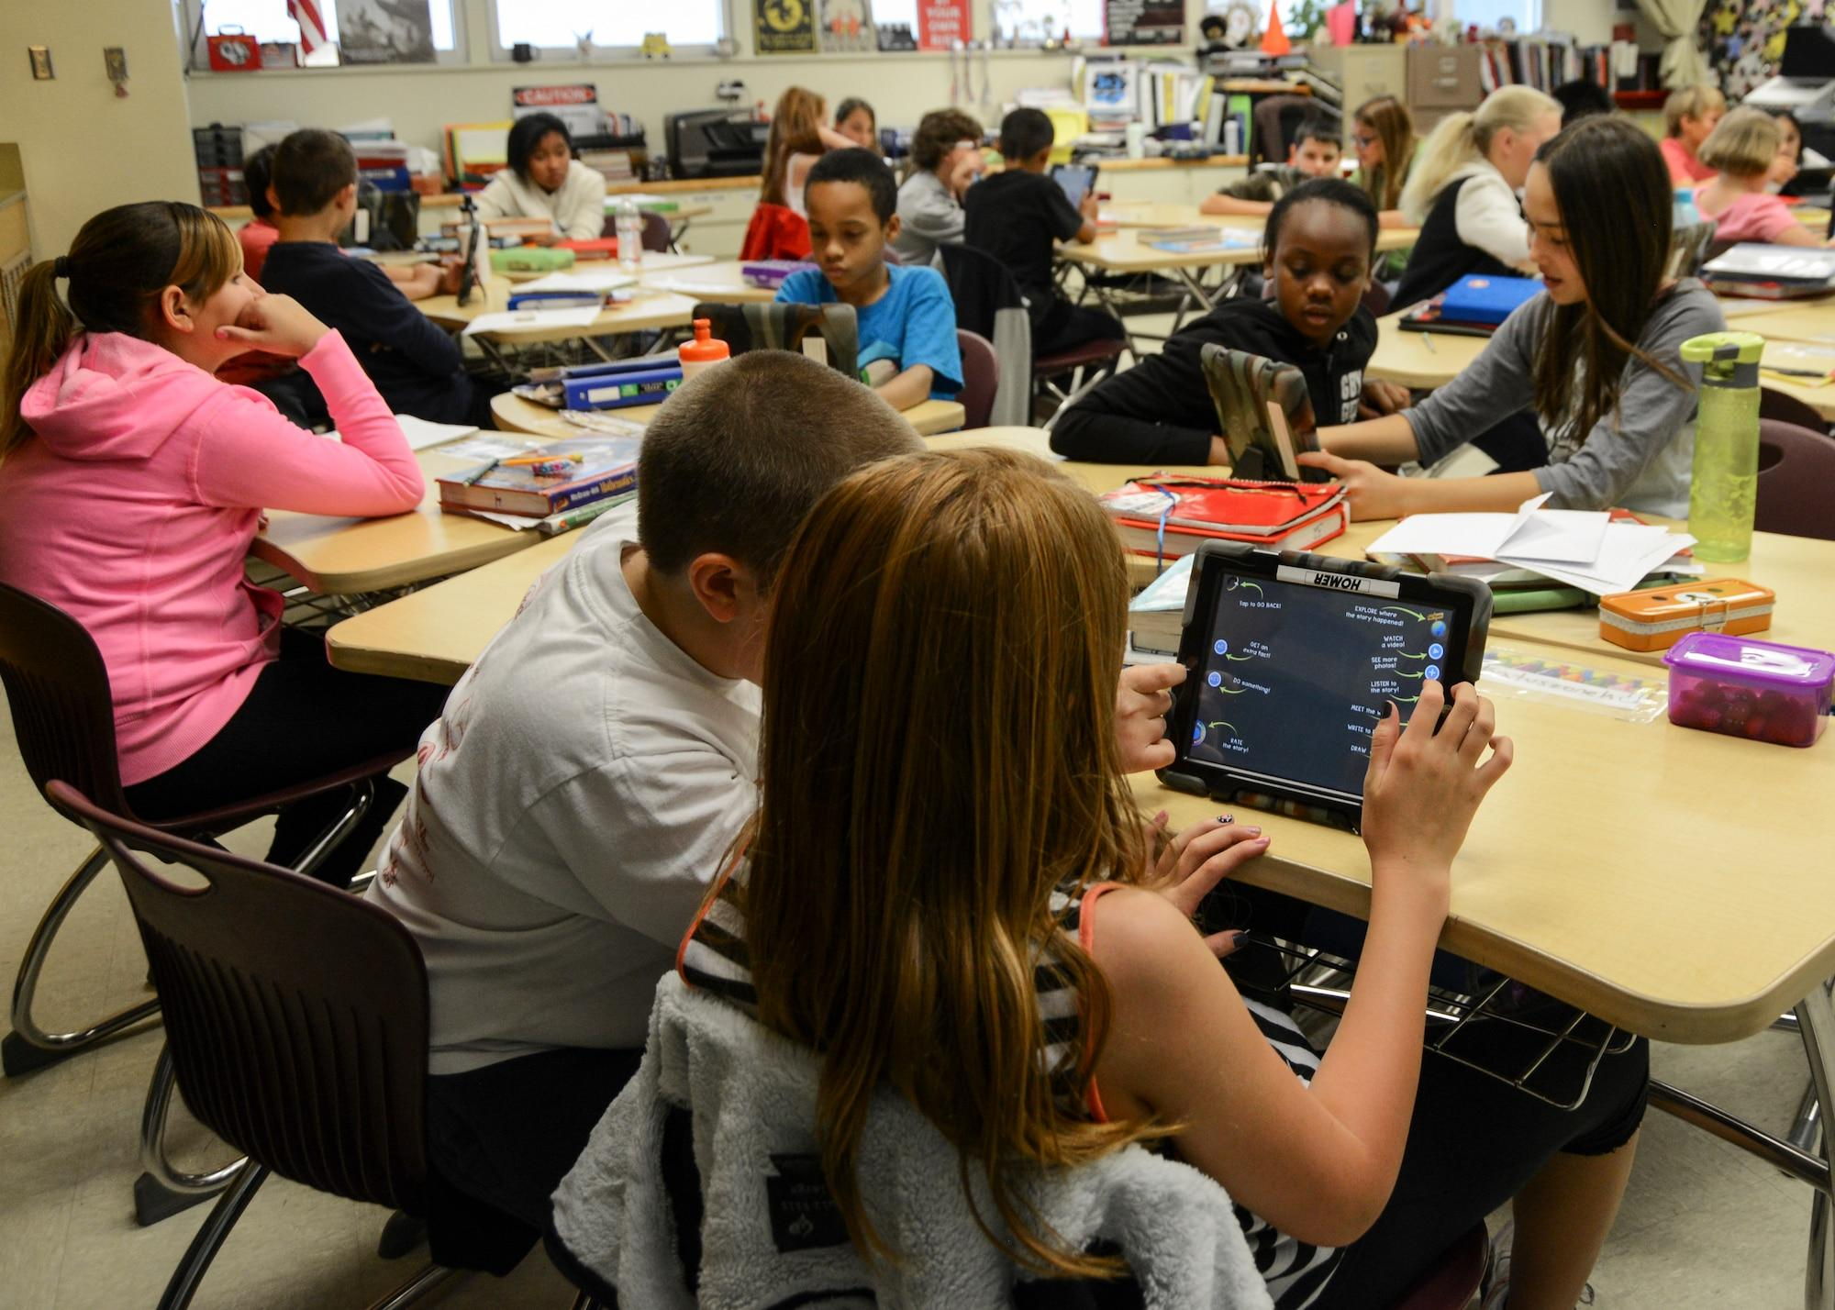
THINK ABOUT IT!
Think of a time you had to work hard at something.
Share what it was that you worked on and how long it took you.
Did it turn out the way you wanted?
TURN & TALK

Slide 5
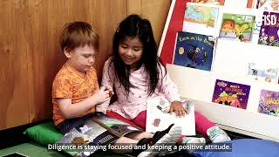
Insert Video Here…

Slide 6
THINK ABOUT IT
A DILIGENT PERSON…
gives his/her best effort!
pays attention to detail.
learns from mistakes.
Notes:
Teacher will discuss giving your best effort. It’s worth it to do my best work. I can learn from my mistakes. Teacher will discuss that the little steps of a project matter. Doing the little steps will make the end product great. Doing a little each day to reach a goal is better than waiting until the last minute to get something done. It can be tiring. It is important to stay focused and set goals. Encourage students to discuss feelings you have when you know you did your best, no matter how it turns out.

Slide 7

How Can I Practice DILIGENCE at School?
Concentrate on my work
Follow instructions
Do a job correctly
Finish my projects

Slide 8
DILIGENCE ACTIVITY: FOUR CORNERS
How do you measure up?
Always
Often
Rarely
Never
Notes:
The teacher will label the 4 corners of the room with the words: Always, Often, Rarely, and Never. The teacher will read the Diligence quiz statements from the next slide. The students will choose which word best describes themselves in relation to each statement. After each statement is read, students will move to the corner that represents them.

Slide 9
DILIGENCE ACTIVITY: FOUR CORNERS
How Diligent are You?
I always do my best; I strive for excellence.
I am willing to risk failure to accomplish a higher goal.
I am self-disciplined.
I learn from my mistakes and failures.
I look at the big picture; I think long-term.
I set goals and stay focused.
I don’t give up just because things seem difficult.
I don’t leave things unfinished.
I don’t procrastinate.
I learn from people who have made a habit of all these things.

Slide 10
Wrapping it Up……..
Why is DILIGENCE an important character trait?
What are some ways you can show DILIGENCE at school?
What are some ways you can show DILIGENCE at home?

Slide 11
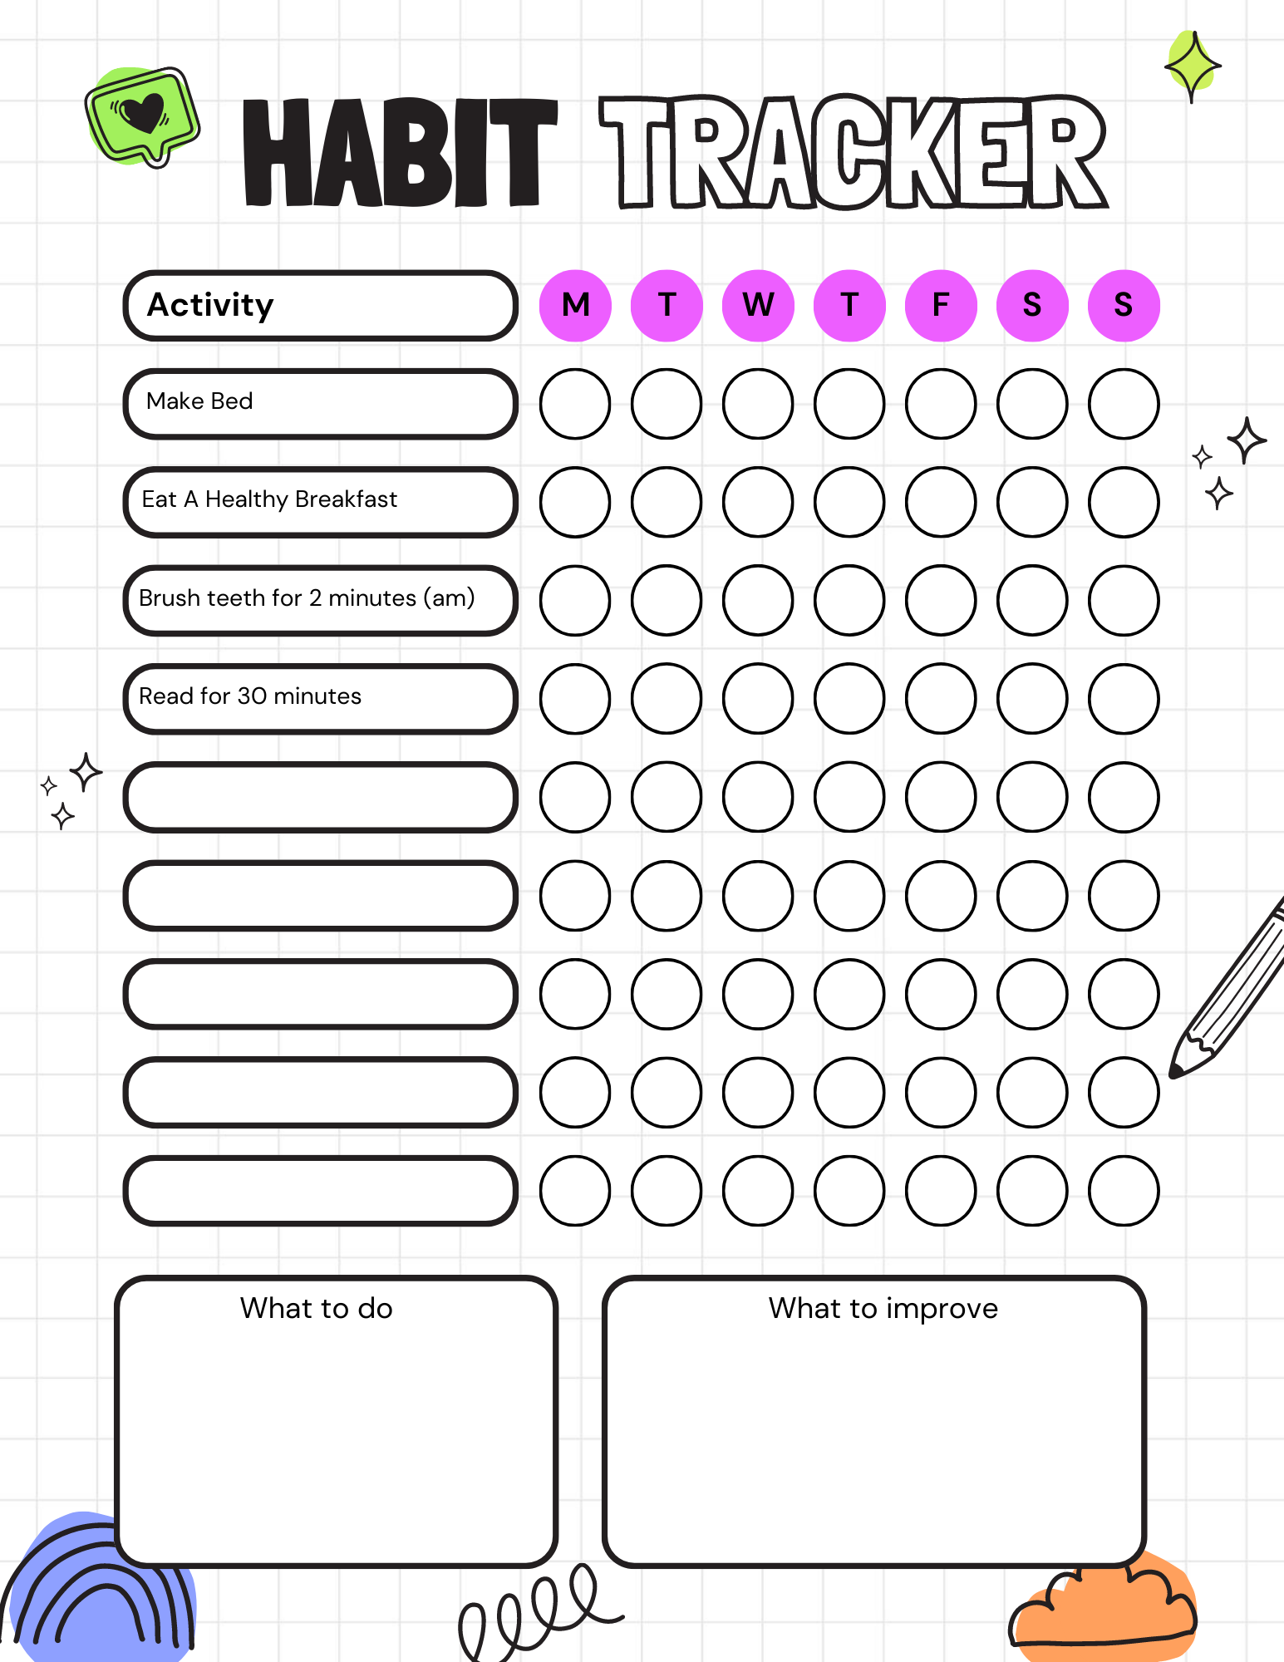
HOME CONNECTION
How do you hold yourself accountable for completing your tasks at home?.. at school?
Use the tracker to make sure you are being diligent both at home and at school.
What are you doing to be DILIGENT?
SAMPLE

