Slide 1

Diligence
PreK - 2nd

Slide 2
Diligence
Definition:
Steady, earnest, and energetic effort

Slide 3

Diligence

Slide 4
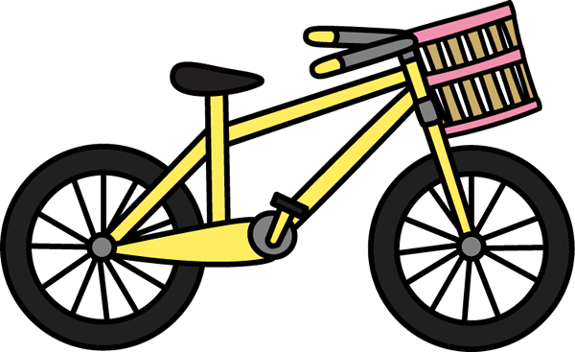

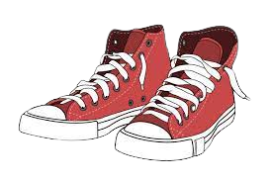
Practicing Diligence
There are many life skills that require diligence to learn.
Here are some examples:
How to ride a bicycle
How to learn to swim
How to tie your shoes

Slide 5
Practicing Diligence
As a class, can you come up with some additional examples of skills that take diligence to learn?

Slide 6
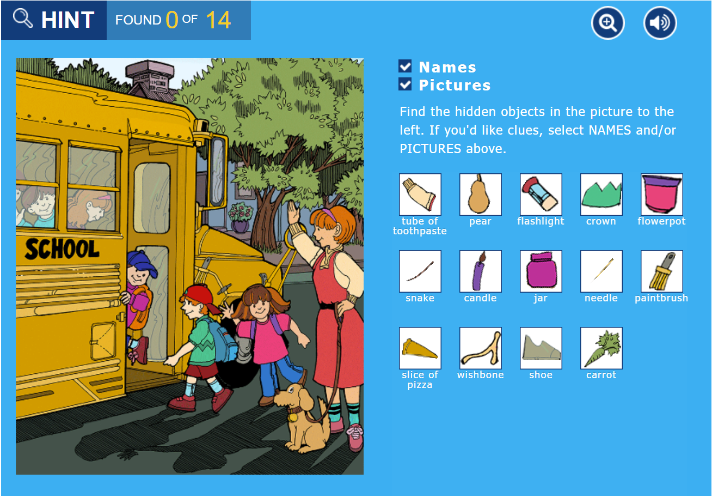
Diligence Activity
Completing a difficult task can take diligence!
Practice diligence as a class by finding all 14 items in the picture!
Click the link on the picture below to find all 14 items!

Slide 7
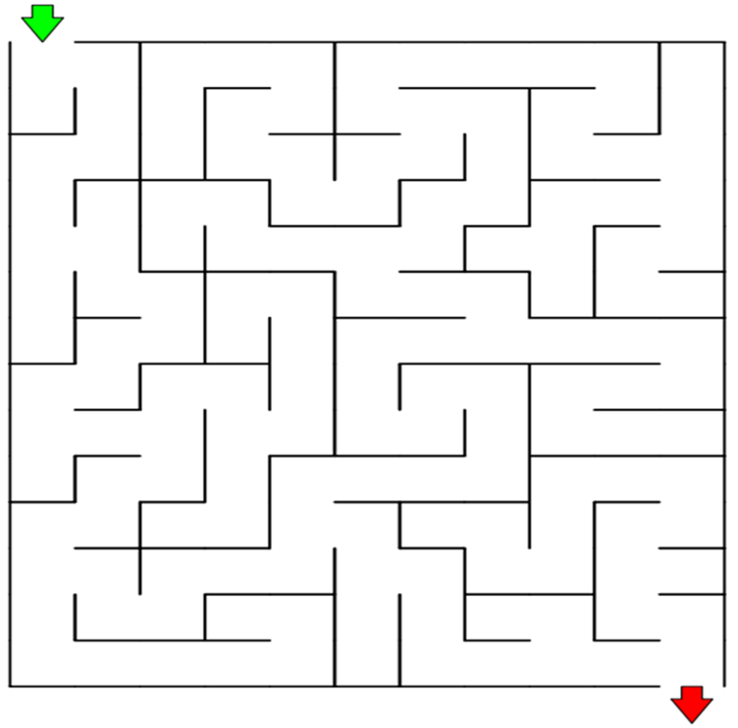

Diligence Home Activity
PK / K
1st / 2nd
A maze is a great way to practice diligence! You can practice diligence by giving your best effort and finishing the maze!

