Slide 1
Bringing Out The Best - CFISD
PATRIOTISM
9th - 12th
MAY 2024

Slide 2

PATRIOTISM

Slide 3
Patriotism:
Love for or devotion to one’s country.

Slide 4
What national holidays do we as a country use to display patriotism?
Independence Day - July 4th - Celebrates the passage of the Declaration of Independence.
Veterans Day - November 11th - Honors those who have served in the Armed Forces.
Memorial Day - Last Monday in May - Honors service personnel who have died in the line of duty.
Flag Day - June 14th - Formal observation of the origin of the US flag.
PATRIOTISM

Slide 5




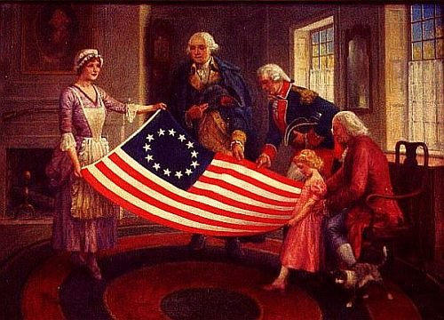
PATRIOTISM

Slide 6
Ways people can demonstrate patriotism:
Voting
Being respectful when a national anthem is played
Displaying a country's flag in a classroom, yard or community
Appropriate handling of the American Flag
Serving your country (ex. Military, Peace Corp, etc.)
Public Service
PATRIOTISM

Slide 7
Patriotism:
It is a personal experience
Allows for celebration for one’s country of origin
Where do we see countries display patriotism:
  Olympics
  World Cup
PATRIOTISM

Slide 8
DISCUSS:
How do you display patriotism?

Slide 9
“True patriotism springs from a belief in the dignity of the individual, freedom and equality not only for Americans but for all people on earth.”
-Eleanor Roosevelt

