Slide 1

May
Patriotism

Slide 2

The learner will:
Define and identify examples of patriotism.

Slide 3
Patriotism:
Love for or devotion to one’s country

Slide 4
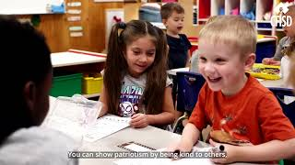

Slide 5
Turn and Talk:
What acts of Patriotism were shown in the video?
What are some other ways to show Patriotism?

Slide 6

Patriotism Trivia

Slide 7

Activity:
Turn and talk about what the pledge means to you.

Slide 8
Take Home Activity
Patriotism Trivia
How many stars are on the United States Flag?
What is the United States’ National Bird?
What is the United States’ National Flower?
Extension:
Research the National Symbols
of another country.

Slide 9

Go forth and show Patriotism!

