Slide 1

Patriotism
May 2024
PK- 2nd

Slide 2
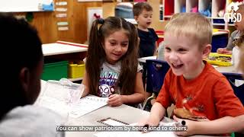

Slide 3
Define:
Identify:
Apply:
Students will define patriotism
Students will
learn the national symbols
Students will match country flags with names

Slide 4
Patriotism
Love for or devotion to one’s country

Slide 5

United States Flag

Slide 6
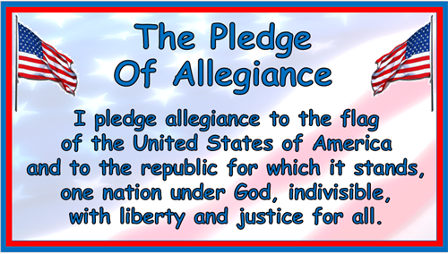
The Pledge

Slide 7
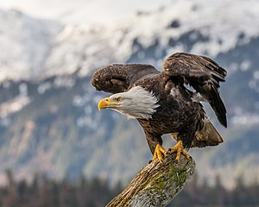
National Bird
Bald eagle

Slide 8
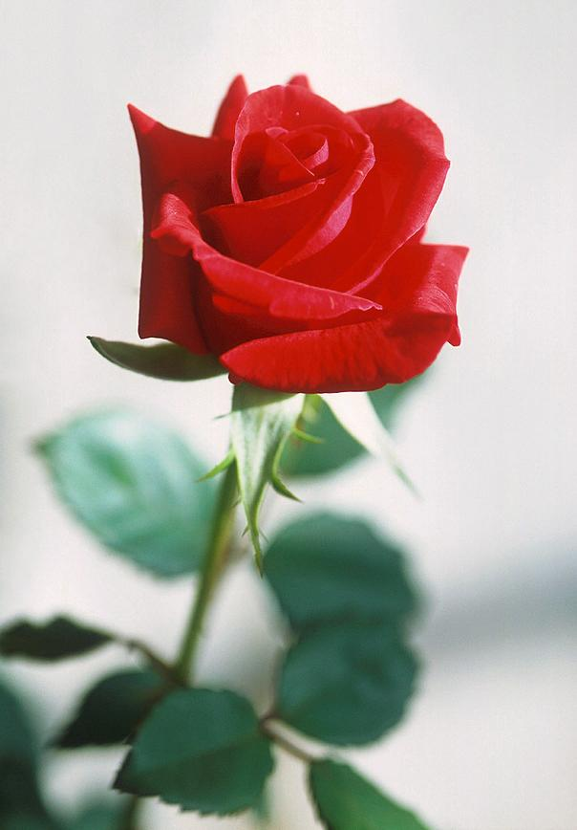
National Flower
Rose

Slide 9

National Seal

Slide 10
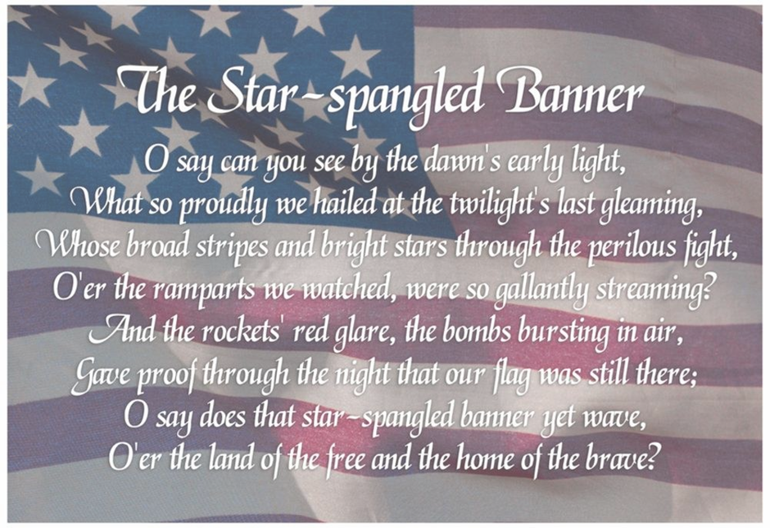
National Anthem

Slide 11


Let’s play Fun with Flags
Guess what country the flag represents. If you identify with the country, stand up.

Slide 12
Home Activity
Patriotism Trivia
How many stars are on the United States Flag?
What is the United States’ National Bird?
What is the United States’ National Flower?
Extension: Research the National Symbols of another country.

