Slide 1
Fabens Independent School District 2022-2023 Annual Performance Report
Notes:
This PowerPoint presentation has been designed for both campus and district use. The notes in italics are instructions for the user.
Insert your own campus/district name into the title.

Slide 2
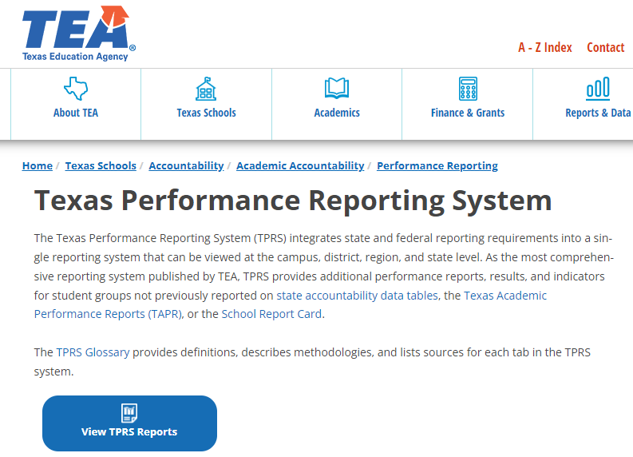
Accessing the TAPR Report
1
https://tea.texas.gov/texas-schools/accountability/academic-accountability/performance-reporting/texas-performance-reporting-system
www.fabensisd.net
Campus or District Offices
2
3
Notes:
Link to HTML TAPR System: https://rptsvr1.tea.texas.gov/perfreport/tapr/2019/index.html
Insert appropriate district/campus website links.

Slide 4
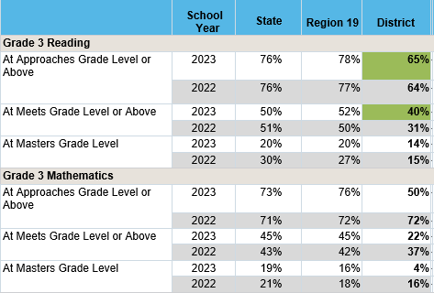

Slide 5
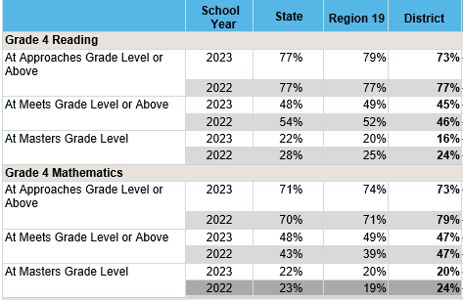

Slide 6
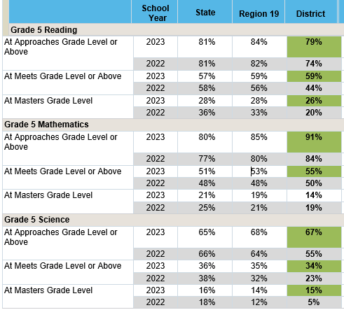

Slide 7
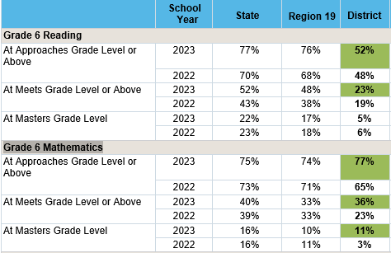

Slide 8
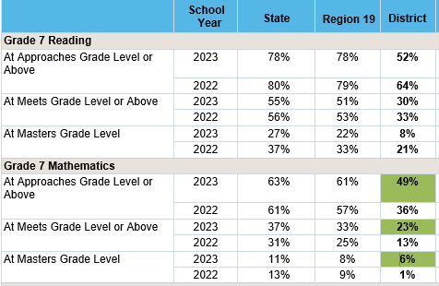

Slide 9
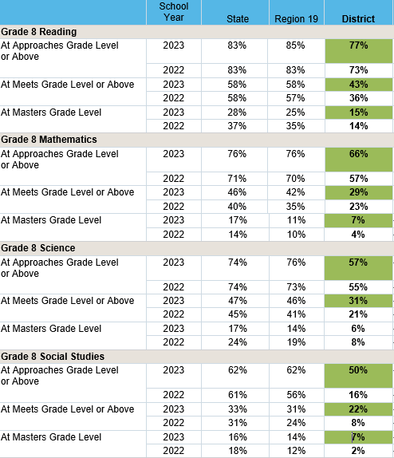

Slide 10
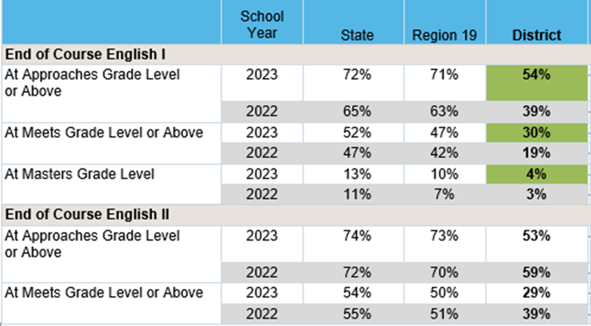

Slide 11
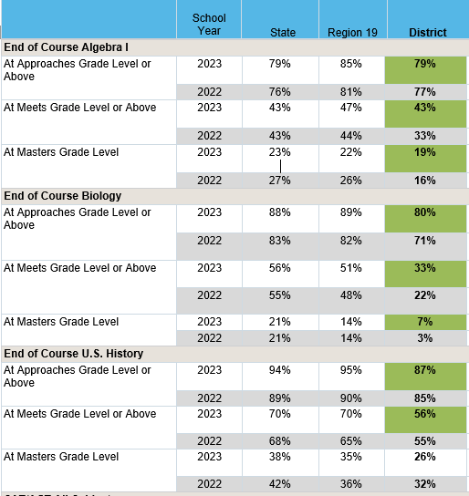

Slide 12
Class of 2022
College and Career Ready Graduates
Notes:
To insert your data into this chart, follow these steps:
Using your mouse, right click on the chart so that the whole chart is selected.
Choose the “Edit Data…” option from the menu that pops up.
An Excel spreadsheet will open.
Enter your Class of 2018 Career or Military Ready (Annual Graduates) for each group into the student group columns.
The chart will adjust automatically.

Slide 13
Advanced Course/Dual Enrollment Completion (Grades 9-12)
Subject 2021-2022 | STATE | REGION | FABENS ISD
ANY SUBJECT | 44.2% | 45.9% | 51.8%
ENGLISH LANGUAGE ARTS | 16.6% | 15.4% | 33.8%
MATHEMATICS | 19.9% | 17.4% | 15%
SCIENCE | 21.1% | 23% | 16.1%
SOCIAL STUDIES | 22.8% | 23% | 18.9%

Slide 14
Violent and Criminal Incidents
Student Disciplinary Action Incident Counts by Reason Code: 2022-2023
Reason Code | Description | FES | ODI | FMS | FHS
11 | Used, exhibited, possessed firearm | 0 | 0 | 0 | 0
12 | Used, exhibited possessed illegal knife | 0 | 0 | 0 | 0
13 | Used, exhibited, possessed illegal club | 0 | 0 | 0 | 0
14 | Used, exhibited, possessed prohibited weapon | 0 | 0 | 0 | 0
16 | Arson | 0 | 0 | 0 | 0
17 | Murder, capital murder, criminal attempt to commit murder/capital murder | 0 | 0 | 0 | 0
18 | Indecency with a child | 0 | 0 | 0 | 0
19 | Aggravated kidnapping | 0 | 0 | 0 | 0
29 | Aggravated assault against school district employee/volunteer | 0 | 0 | 0 | 0
30 | Aggravated assault against nonemployee/ volunteer | 0 | 0 | 0 | 0
31 | Sexual assault/aggravated sexual assault against school district employee/volunteer | 0 | 0 | 0 | 0
32 | Sexual assault/aggravated sexual assault against non-employee/volunteer | 0 | 0 | 0 | 0
36 | Felony controlled substance violation | 0 | 0 | 0 | 0
37 | Felony alcohol violation | 0 | 0 | 0 | 0
46 | Aggravated robbery | 0 | 0 | 0 | 0
47 | Manslaughter | 0 | 0 | 0 | 0
48 | Criminally negligent homicide | 0 | 0 | 0 | 0
Notes:
For more information about the report of violent or criminal incidents, please see the Safe
and Healthy Schools website at:
http://tea.texas.gov/Texas_Schools/Safe_and_Healthy_Schools/

Slide 15
Prevention Measures to Promote Safe Campuses
SRO and Security Expansion
Leader in Me
Curriculum and training
Staff, Students, Families
Bullying Prevention Training – Staff and Students
Code of conduct prohibiting unsafe conduct
Administrator Discipline Training on Discipline Updates
Counseling
At-risk Coordinator
Character Education
PBIS (Positive Behavior Interventions and Supports) All levels

Slide 16
Texas Higher Education Coordinating Board
Texas statute (TEC 51.403e) requires every district to include with its TAPR a report on student performance in postsecondary institutions during the first year enrolled after graduation from high school. The report includes:
Number of Total Graduates, disaggregated by attendance in Institutes of Higher Education
Number of Students within each GPA reporting band

Slide 17
High School Graduates from FY2021
Enrolled in Texas Public or Independent Higher Education in FY 2022
Fabens High School | Total Graduates | GPA for 1st Year in Public Higher Education in Texas
 |  | < 2.0 | 2.0 – 2.49 | 2.5 – 2.99 | 3.0 – 3.49 | > 3.5 | Unknown
Four-Year Public University | 22 | 3 | 3 | 3 | 3 | 10 | 0
Two-Year Public Colleges | 18 | 7 | 3 | 4 | 3 | 1 | 0
Independent Colleges & Universities | 0
Not Trackable | 2
Not Found | 108
Total High School Graduates | 150
Notes:
Each High School will need a separate slide. Right click on this slide and duplicate for the number of High Schools in your district.
Insert data from the following link for each high school:
http://www.txhighereddata.org/Interactive/HSCollLinkFilters/HSGradAcademicPerformance.cfm
The report is titled Report of 2016-2017 High School Graduates’ Enrollment and Academic Performance in Texas Public Higher Education in FY 2018. The first page explains the purpose of the report and data calculation methods.

Slide 18
PEIMS Financial Reporting 2021-2022 Actual Financial Data
 | Fabens ISD
 | All Funds | % | Per Student
Total Operating Expenditures | $29,544,149 | 100.00% | $14,899
Instruction(Function 11,95) | $16,293,577 | 55.15% | $8,217
Instructional Resources & Media Services (Function 12) | $1,198,722 | 4.06% | $604
Curriculum & Staff Development (Function 13) | $187,988 | 0.64% | $95
Instructional Leadership (Function 21) | $936,737 | 3.17% | $472
School Leadership (Function 23) | $1,368,594 | 4.63% | $690
Guidance Counseling Services (Function 31) | $1,143,026 | 3.87% | $576
Social Work Services (Function 32) | $91,857 | 0.31% | $46
Health Services (Function 33) | $429,060 | 1.45% | $216
Transportation (Function 34) | $506,927 | 1.72% | $256
Food Services (Function 35) | $1,475,515 | 4.99% | $744
Extracurricular (Function 36) | $795,892 | 2.69% | $401
General Administration (Function 41,92) | $1,213,059 | 4.11% | $612
Facilities Maintenance & Operations (Function 51) | $3,122,654 | 10.57% | $1,575
Security & Monitoring Services (Function 52) | $284,661 | 0.96% | $144
Data Processing Services (Function 53) | $388,391 | 1.31% | $196
Community Services (Function 61) | $107,489 | 0.36% | $54

Slide 19
District and Campus Goals
The district/ campus will provide a safe and orderly school climate, conducive to learning.
The district/ campus will increase student academic achievement while cultivating a growth mindset for all stakeholders.
The district/ campus will recruit, develop and retain highly qualified faculty, staff and support personnel to improve student academic excellence and ensure the postsecondary readiness of all students.
The district/ campus will build strong partnerships with parents, community and business members to promote a shared responsibility for student learning.
The district/ campus will operate in a fiscally sound manner through financial transparency.
Campus and District Improvement Plans: fabensisd.net About Fabens

Slide 20
2022-2023 Accreditation Status

Slide 21
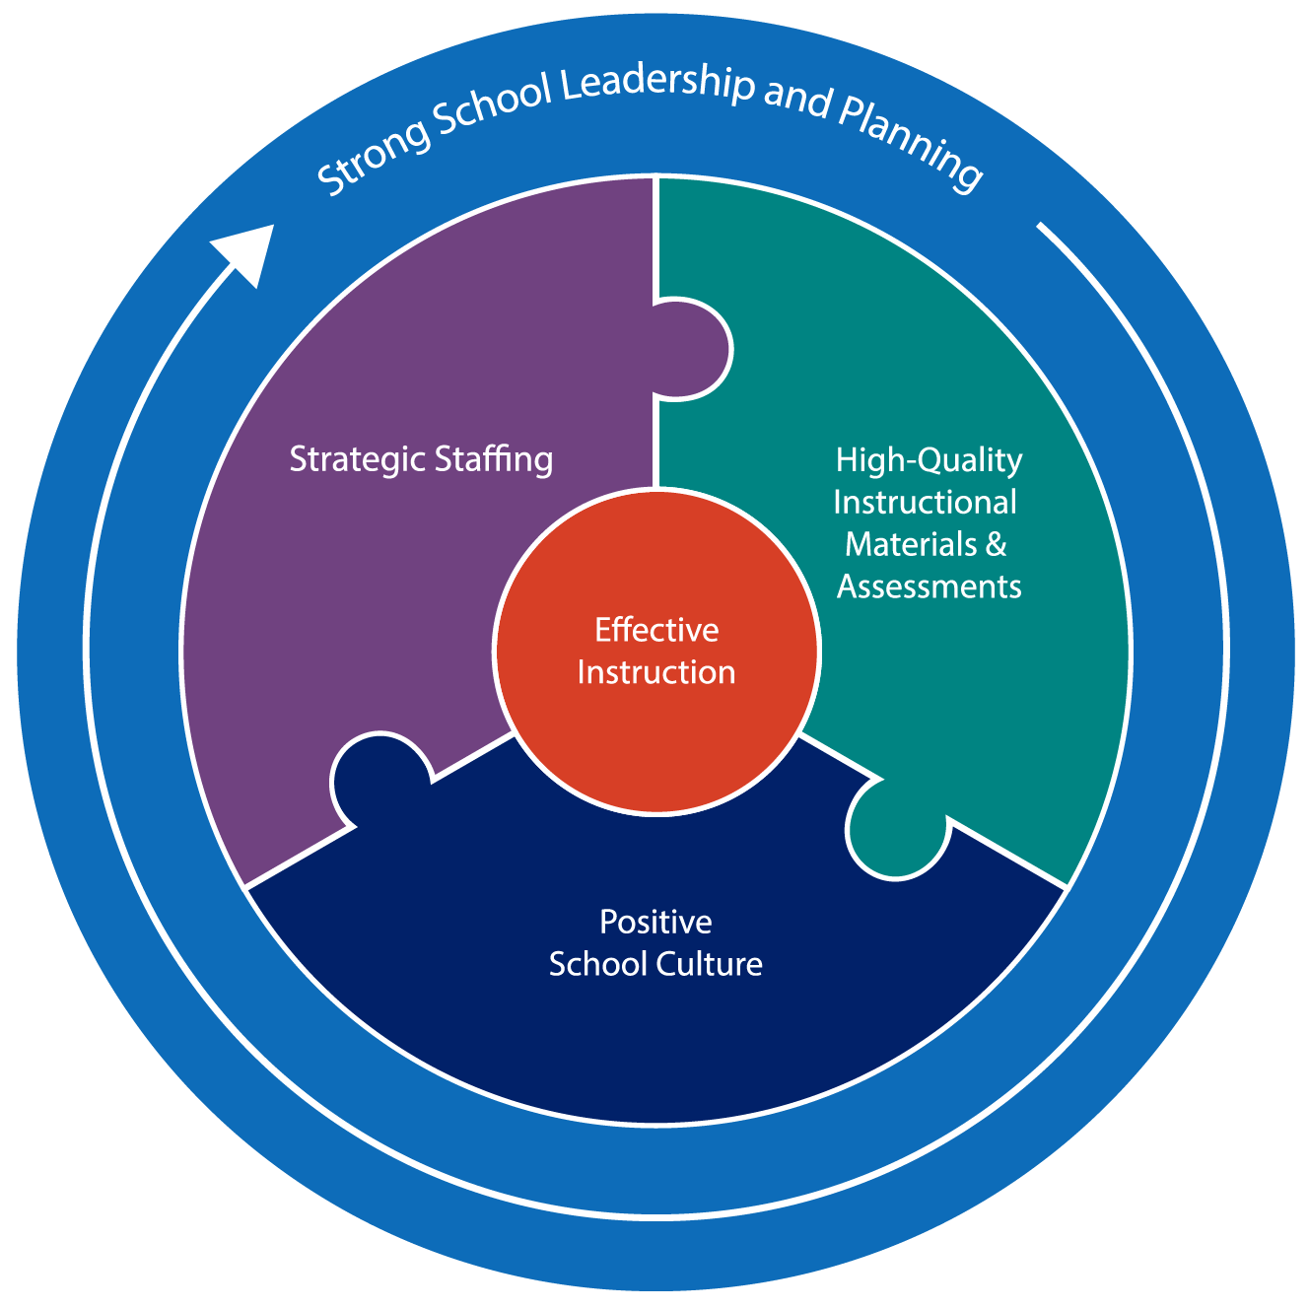

Slide 22
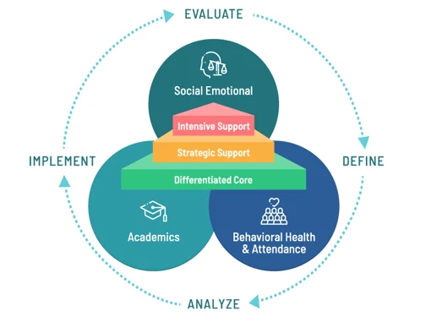

Slide 24
Notes:
Insert the main point of contact district/campus

