Slide 1
Growing Renton Educators to Accelerate Teaching (GREAT) Info Session
Spring 2024

Slide 2
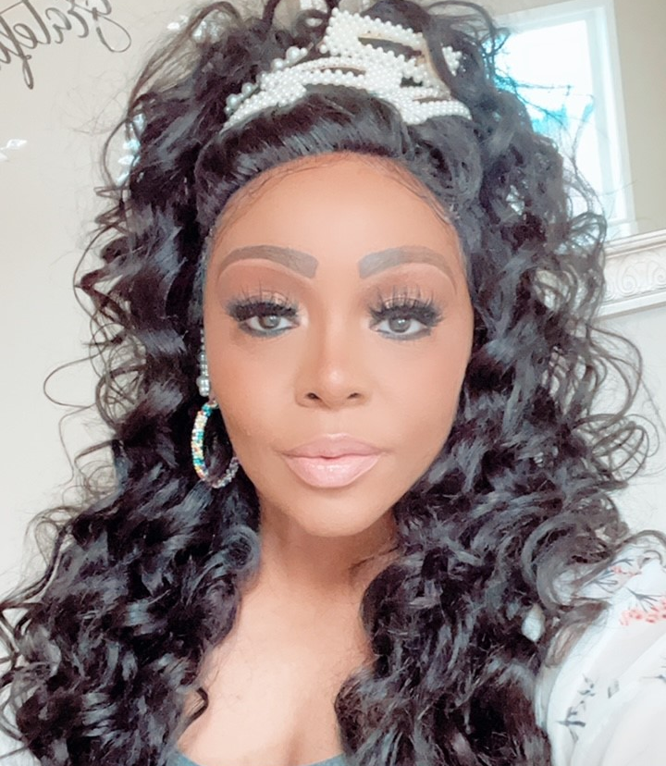
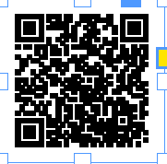
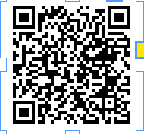
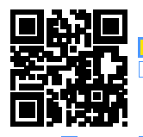
Who Am I?
Recruitment Coordinator for the Renton School District
MANAGE: GREAT PROGRAM (GYO)
COMMITTEE MEMBER: RSD/REA DIVERSITY EQUITY & INCLUSION TEAM
MANAGE: UNIVERSITY PARTNERSHIPS
CONTACT INFO – EMAIL ME RECRUITMENT@RENTONSCHOOLS.US

Slide 3
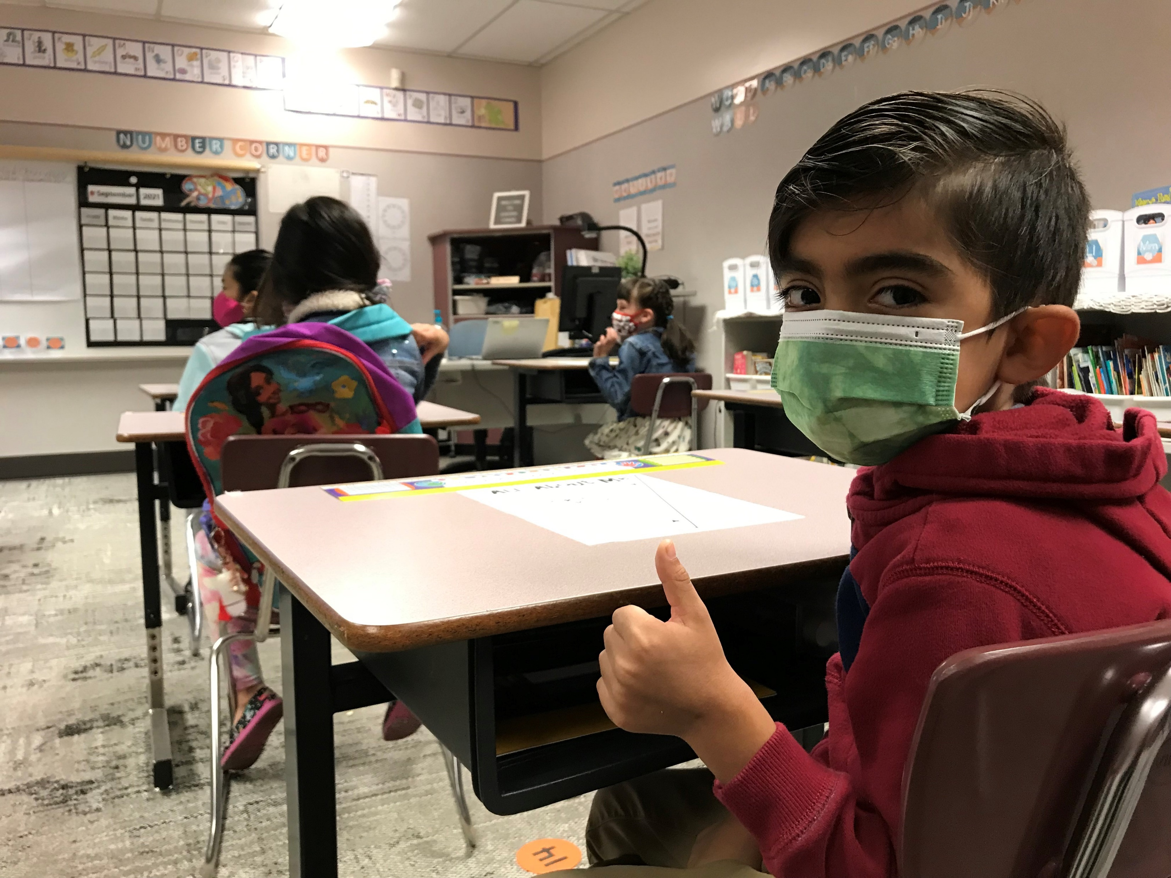
Welcome!
What brought you here tonight?
What do you hope to get out of tonight’s session?
Notes:
4:05-4:10 Put info into the chat!

Slide 4
Tonight’s Agenda
4:00-4:10
Welcome
The Why
GREAT program purpose/overview
4:10-4:30
Learn about our University Partners
Notes:
4:10

Slide 5
Before we talk about the program, let’s talk about the WHY...
Notes:
4:15

Slide 6
RSD Mission & Values
Each student graduating with options and prepared to participate fully in democracy

Slide 7
RSD Mission & Values
Notes:
You all know this very well, and I want to talk about how HR can be a key partner in helping the district realize this vision.

Slide 8
Why GREAT?
Our current teaching population is not reflective of our student community.
More than 70% of our students are students of color while only 24% of our teaching staff are teachers of color. Countless research shows that students deeply benefit when they see themselves reflected in school leadership and are able to connect with teachers over shared life experiences.
Our students have consistently communicated that they want to see themselves represented in the teaching staff and culture of our schools
In 2021, RSD’s Reimagining Student Experience (RISE) committee collected insight and feedback from students and families in our District about student’s experiences in our schools. A key recommendation made by that committee included more diverse representation in our teaching staff.
Notes:
You all know this very well, and I want to talk about how HR can be a key partner in helping the district realize this vision.

Slide 9
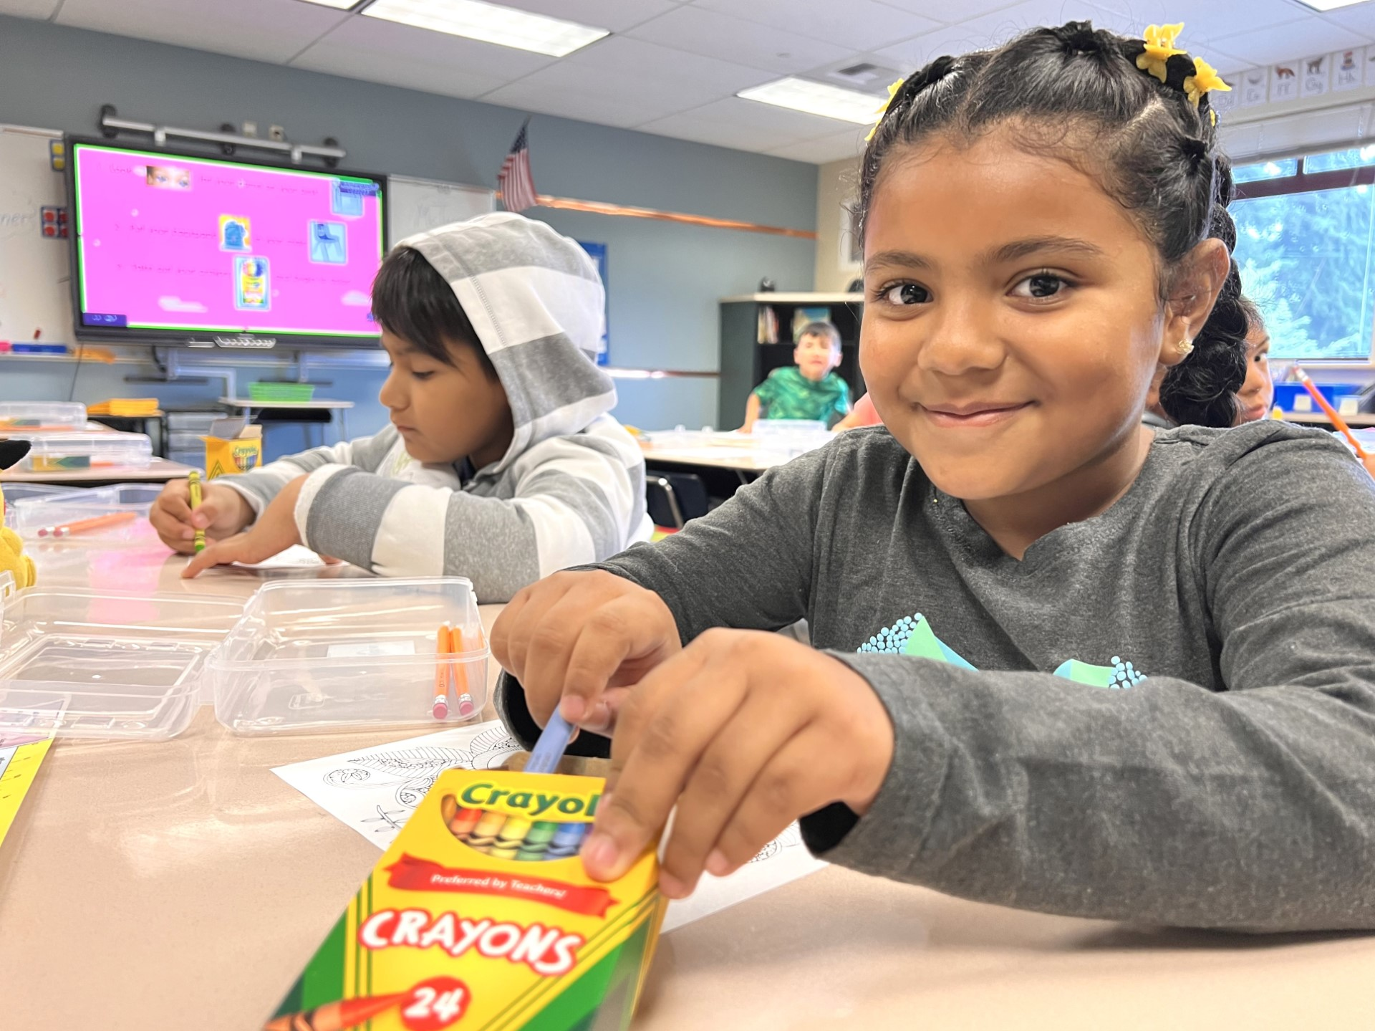
GREAT and our Strategic Framework
Family & Community Engagement
• Deepen family and community partnerships to promote student learning
Excellence in Learning & Teaching
• Develop and implement best practices consistent with our Vision of Instruction
• Strengthen planning, assessment, and data-based instructional cycles with a focus on:
o Elementary: K-2 Literacy, 3-5 Mathematics
o Middle School: Mathematics
o High School: 9th Grade Success
Removing Barriers & Supporting Students
• Expand practices to support the social-emotional needs of all learners
• Improve opportunities for students to provide feedback to improve our practices
• Continue to implement the recruitment, hiring, and retention plan that aligns with our Core Values and Diversity, Equity, and Inclusion (DEI) work
Notes:
It’s a bold statement and a big body of work. The HR team is incredibly excited to jump in, and we see this as our priority for the coming months and years.

Slide 10
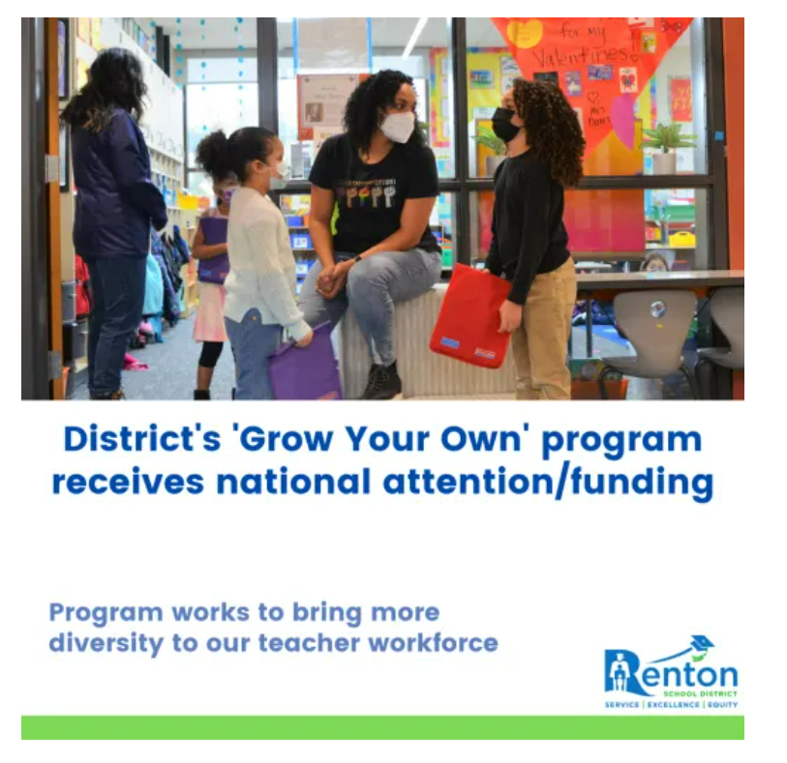
RSD Mission & Values
The Renton School District strives to remove and pursue outcomes that enable all students to realize their potential and maximize their future opportunities.
Notes:
Our goal is to strategically diversity the education workforce. Based on the statistics obtained from OSPI this identifies the strategic needs of the District to diversity the educator workforce has resulted in this grant being allocated to the District to support these goals of our strategic workforce.

Slide 11
Growing Renton Educators to Accelerate Teachers Program
(GREAT)
RSD’s “Grow Your Own” initiative and a central strategy for diversifying our teacher workforce so that students have more teachers that look like them.
A teacher pathway program for paraeducators of color that aims to get paraeducators on the road to a teaching certificate based on needs and level of educational attainment by eliminating financial barriers

Slide 12
Growth opportunities for current paraeducators who are already committed to and understand our students’ stories, strengths, and needs.
Classified employees more closely reflect the demographics of our students
GREAT is a pathway program for paraeducators of color
Why GREAT?
Notes:
You all know this very well, and I want to talk about how HR can be a key partner in helping the district realize this vision.

Slide 13
How does it work?
Paraprofessionals who are selected for the program continue in full-time positions, retain benefits and pay while attending classes.
Tuition assistance (last dollar aid) depending on program
Release time for internships and trainings as needed
Guaranteed employment with RSD in a certificated teaching position in high-need school or subject for 3 years following successful completion of the program
Starting teacher salary is approximately $65,000 - $86, 000 depending on teacher’s level of education
Notes:
Last Dollar Aid – after FAFSA is completed and university has applied all grants and other financial support

Slide 14
Process
March
GREAT application opens
March/April
Deadline to apply for alt-cert programs
Summer or Fall 2024
Programs begin
✔Apply and be accepted to an alternative certification program (at a college/university)
✔ After you are accepted in the college/university certification program, THEN complete the GREAT program application
✔ Sign Renton School District candidate agreement
This is a (2) step process – Step 1 YOU apply, and be accepted into an alternative route program
Step 2 YOU apply for GREAT program
Notes:
And start financial aid

Slide 15
Program Options
Associate’s Degree
You have a transferrable Associates Degree and need a Bachelor’s + teaching certificate
Bachelor’s Degree
You have a Bachelor’s Degree and only need your teaching certificate

Slide 16
RSD University Partners
City University of Seattle
Western Washington University (focus on Bilingual/ELL)
Central Washington University (3/15 session only)

Slide 17
FAQ
I am currently not a paraeducator, but in another classified position. Am I eligible?
NO – only current paraeducators working as paraeducators are eligible
I am a paraeducator already enrolled in an alt-cert program. Am I eligible?
Maybe. You must be currently enrolled in an alt-cert program with one of our partner universities and continuing that program into Fall, 2025.
How much leave time will I get for student teaching?
The district supports approximately 10 release days through GREAT for student teaching. The district does not offer paid leaves of absence through this program

Slide 18
Next Steps
If you have foreign transcripts, have them evaluated
Communicate your interest in the GREAT program to your supervisor
Contact university programs you are interest in applying to for admission and attend information sessions for those programs
Explore WEST-B and WEST-E/NES tests you may need to take (and check to see if you have already taken equivalencies)
Prepare your application materials for the program and district
Contact Aneeka Ferrell with any questions you have that are specific to the GREAT program

Slide 19
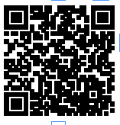
Thank you!
Please email me with questions at
recruitment@rentonschools.us
GREAT PROGRAM WEBSITE

