Slide 1
Open House
C.H. GULLATT ELEMENTARY SCHOOL

Slide 2
Meet the Teachers

Slide 3
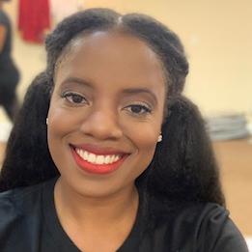
Meet Ms. Onuzo Lead Teacher- Department Chair
Hello Parents and Guardians! My name is Ms. Onuzo, and I am proud to serve as this years Department Chair for Kindergarten. I received my undergraduate degree in Speech Pathology from Georgia State University and my Masters degree in Early Childhood Education from Howard University! This will be my 4th year of teaching and I am truly excited to embark on this exciting adventure that is Kindergarten! I love to learn and l love to teach! I am looking forward to learning as much from your student as they will learn from me!

Slide 4
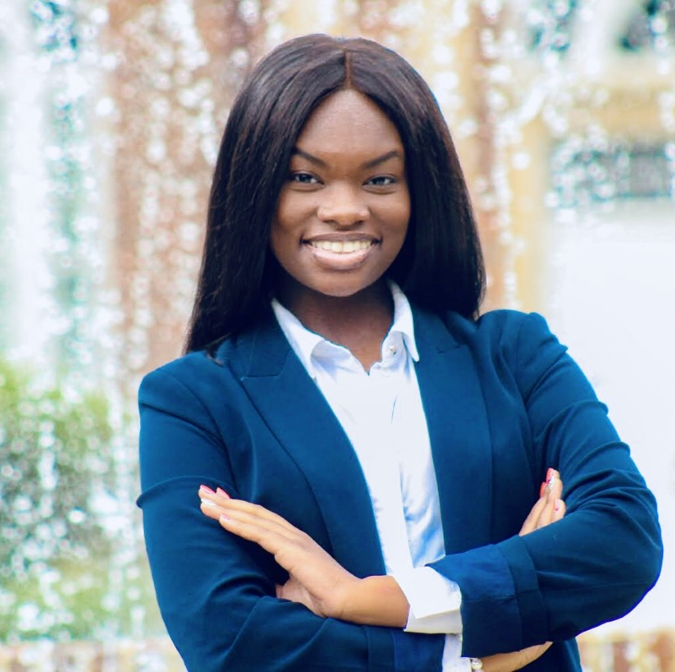
Meet Ms. Martin Paraprofessional
Hello parents,
My name is Ms. Regina Martin I graduated from Fort Valley State University in Fall 2019 with a degree in Communications. This is my first year as paraprofessional at C. H Gullatt, I am excited to work along Ms. Onuzo this year, as well as support and encourage each student through this year of kindergarten.

Slide 5
Kindergarten Supply List (2020-2021)
· (2) BOXES OF THICK PENCILS
· (4) GLUE STICKS
· (1) PAIR OF SCISSORS
· (1) BOX OF 8 ct. CRAYONS
· (1) 3 Ring 1inch Binder
· (2) PRIMARY WRITING JOURNALS
· (2) BOXES OF TISSUE
· (1) BOX OF WIPES
· BOOKBAG
· LYSOL AIR FRESHENER
· HAND SANITIZER/ SOAP
· CHANGE OF CLOTHES & UNDERGARMENTS
MASK

Slide 6
Attendance Policy

Slide 7
Attendance
Students should arrive to school every morning at 7:10 am.
Students are tardy after 7:40am.
Students should bring their communication folders to school everyday.

Slide 8
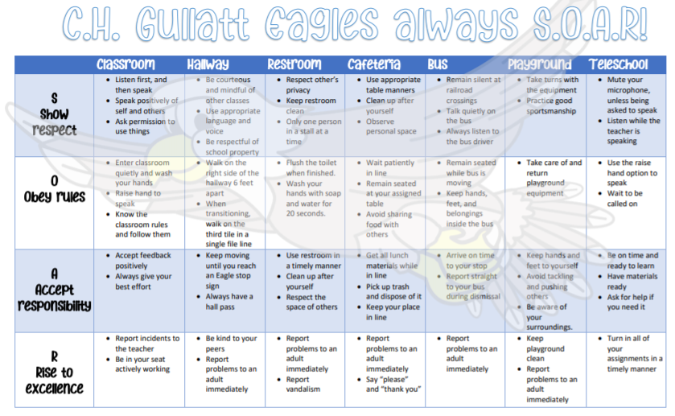
Behavior Plan: PBIS Points
PBIS Rewards:
Assignment passes
Virtual parties

Slide 9
MICROSOFT TEAMS

Slide 10
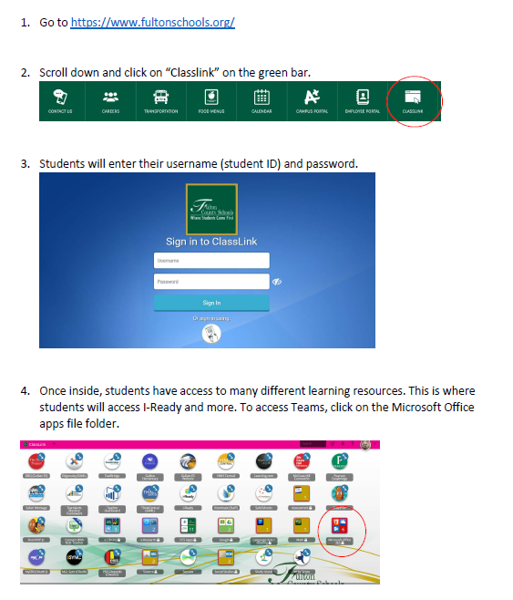
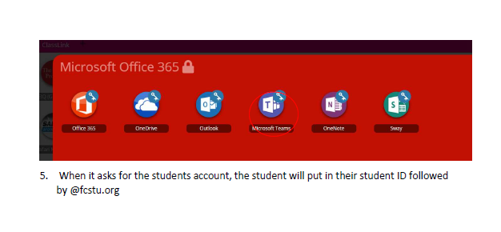
How to access Microsoft Teams
Monday-Friday
Open your computer and log into your Homeroom Team site ( It will have KINDERGARTEN in the name).

Slide 11
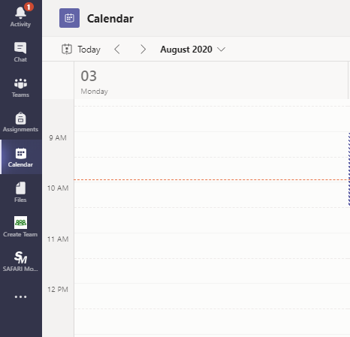
How to access my class.
You can access your classes 2 ways.
On the left side bar you can click on the calendar icon.
Look at the calendar day and click on the join button in order to join your class.
You can also go you your team and join directly from the team.

Slide 12
Grading Policy

Slide 13
Grades
ALL GRADES can be accessed on INFINITE CAMPUS
3 Types of Grades (Summative, Formative, and Progress Reporting)
7 grades per subject area per semester
Progress Reports will go home every 3 weeks
Grades will be updated weekly by Saturday evening at 11:59pm
Recovery options are available for tests and quizzes for grades falling below 70%

Slide 14
Infinite Campus Link
https://www.fultonschools.org/infinitecampus

Slide 15
Literacy Expectations

Slide 16
Literacy Standards and Expectations
Ask, answer, and identify
*Ask, answer, and identify Key Ideas and Details
Know
*Know the author, illustrator, and common types of texts
Be
*Be able to compare/contrast the adventures and experiences of characters in familiar stories
Engage in
*Actively engage in reading groups
Identify
*Identify main idea and retell stories
Describe
*Describe the connection between two individuals, events, ideas, or pieces of information in a text
Identify
*Identify the front cover, back cover, and title page of a book
Identify
*Identify the reasons an author gives to support points in a text

Slide 17
Literacy Expectations
*Phonological Awareness
*Print Concepts
*Phonics and Word Recognition
*Use a combination of drawing, dictating, and writing to compose opinion pieces, narratives, and informative pieces
*Comprehension and Collaboration
*Describe familiar people, places, and events
*Demonstrate command of the conventions of standard English grammar and usage when writing or speaking.
*Demonstrate command of the conventions of standard English capitalization, punctuation, and spelling when writing.
*Expand vocabulary knowledge and useage

Slide 18
Literacy Expectations
*By the time they leave Kindergarten, the students should be able to read approximately 400 sight words.
*Kindergarteners who end their school year on a BAS Level D/E are considered on level students.

Slide 19
Math Expectations

Slide 20
Students should be able too…
Count to 100 by ones and tens
Identify 2D and 3D Shapes and their attributes
Recognize 2D and 3D shapes in real world objects
Compose larger shapes from smaller shapes
Sort objects and count by categories
Count objects up to 20
Decompose teen numbers using pennies and dimes

Slide 21
Math Expectations
Count on from any number other than 1
Write and recognize numbers from 0-20
Answer “How Many” questions
Compare numbers and groups of objects (more than, less than, equal too)
Describe the attributes of an object (length, weight)
Order objects by length
Organize, represent, and interpret data
Identify dimes and understand that 10 pennies is equivalent to 1 dime

Slide 22
Math Expectations
Add and subtract fluently within 5
Decompose numbers less than or equal to 10
Addition facts of 10 (1+9, 2+8)
Represent addition or subtraction with objects, fingers, or mental images

Slide 23
How to Access Teacher Contact Info and Infinite Campus

Slide 24
THANK YOU FOR COMING!

